Slide 1
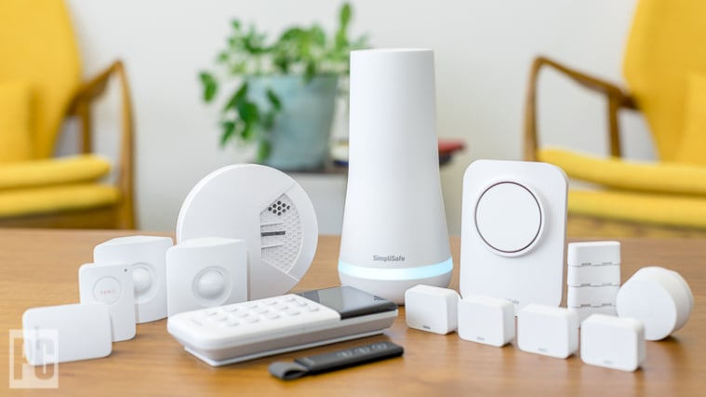
Workshop - Smart Home Devices
Raising awareness about transparency, privacy and data collection
User benefits & risks
1
Notes:
Daan
Welcome everyone to our workshop about smart home devices and concerns related to them.

Slide 2
Table of contents
01
02
03
04
EPS & Relink
Our group & Relink project
Introduction to SHD’s
What is a smart home device? Are there risks?
Interactive session
Activities
Feedback
Questions & Feedback
2
Notes:
Daan

Slide 3


EPS Group 5 Spring 2024 - RELINK project
Jasper Van Meel – Eve Bernhard – Melle Van Dijk – Daan Heetkamp – Janette Pakarinen
Supervisor: Henry Mainsah
3

Slide 4
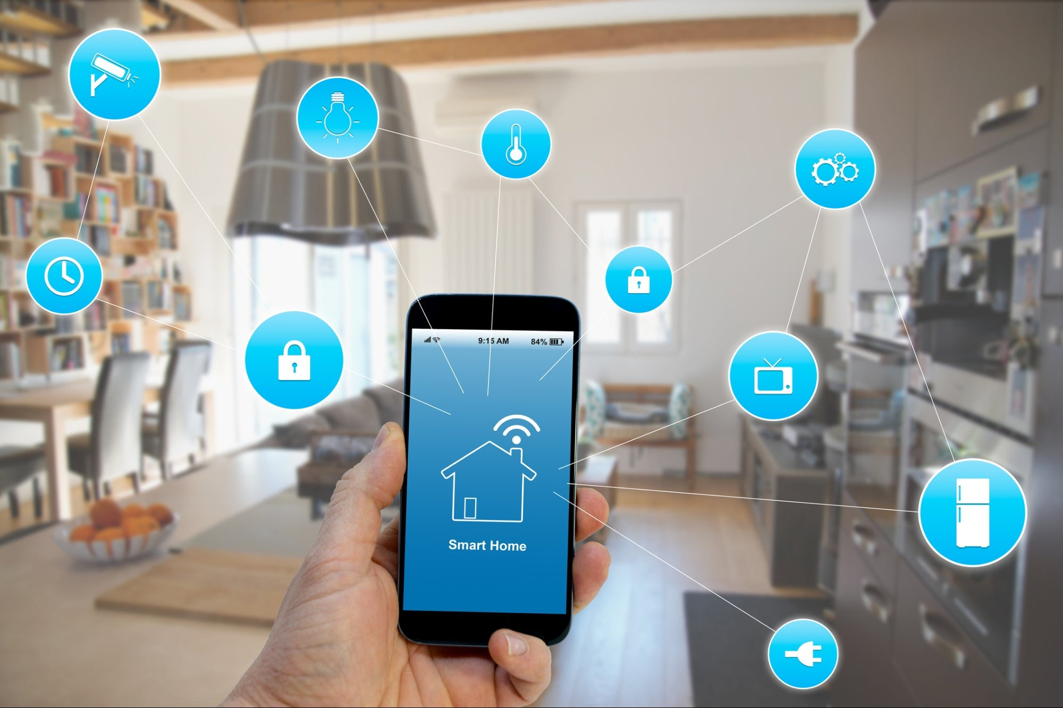
What is a smart home device?
Connected to internet
Provide automation and convenience
Collect information
4
Notes:
A smart home is a set up where applications or devices can be controlled from anywhere and are connected to the internet and other devices.
A device can perform functions independently as well as can be used even remotely when a person who owns it, is not home. Smart homes can provide homeowners security, comfort, convenience and energy efficiency by allowing them to control smart home devices by application on their smart phone or other device. These devices collect information constantly, so they have potential risks related to privacy and security. (Chawda et al. 2020.)
Picture:
(https://www.entrepreneur.com/science-technology/the-challenges-and-security-risks-of-smart-home-devices/362497)

Slide 5
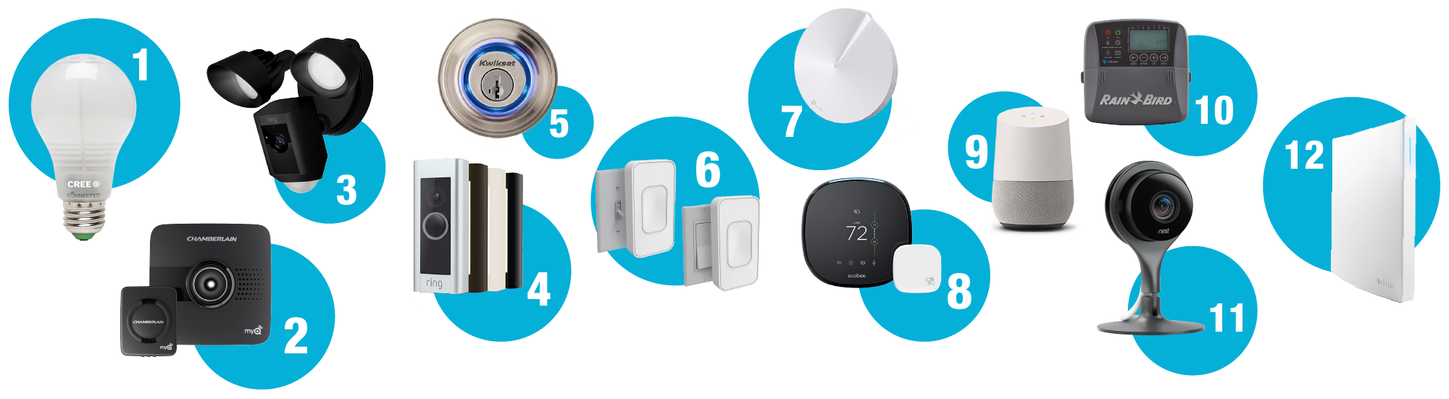
Examples of smart home devices
Smart lights, fridge, doorbell, camera & a car...
Amazon Alexa, Apple Siri, Google Assistant...
5
Notes:
Janette
There are many devices which can be classified as smart home devices, and it may be that there are some devices that people cannot even think of being a smart home device. Excellent examples of these devices are smart lights, fridge, doorbell, cameras and even a car which is something that many don't think of. Also, there are many smart home assistant devices, for example, Amazon Alexa, Apple Siri and Google Assistant.
An example of these devices:
- A car, Smart lights, Fridge, Smart speaker, Alarm systems, Doorbells, Smoke sensor, IR camera, Smart window, TV sets and stereos
There are also some smart home assistant devices, for example:
- Amazon Alexa, Samsung Smart Things Hub, Google Assistant, Apple Siri, LG Smart TV, Ecobee4
(Chawda et al. 2020.)
Picture:
(https://corporate.homedepot.com/news/products/12-simple-smart-home-upgrades)

Slide 6
Transparency
The Black box
The GDPR
Why this matters?
6

Slide 7
Transparency
What data is being processed?
User awareness
Lack of transparency
Lack of user education
User and manufacturer attitude
7

Slide 8
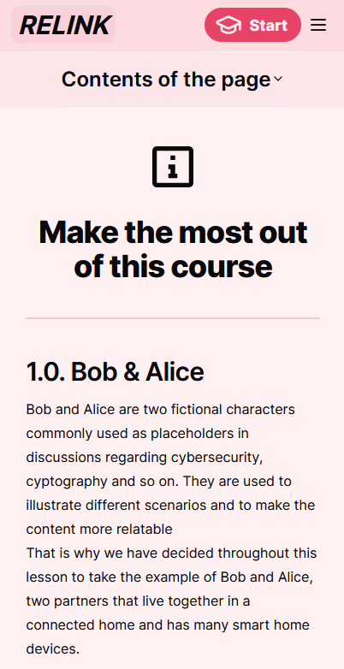
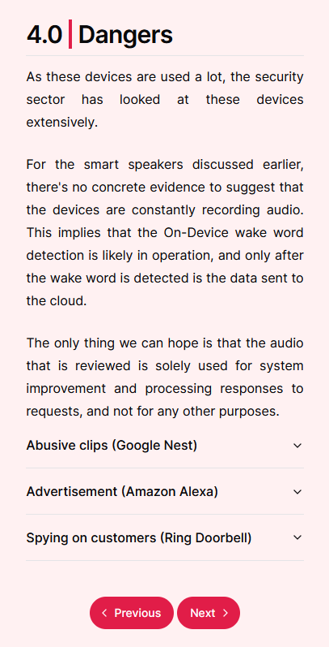
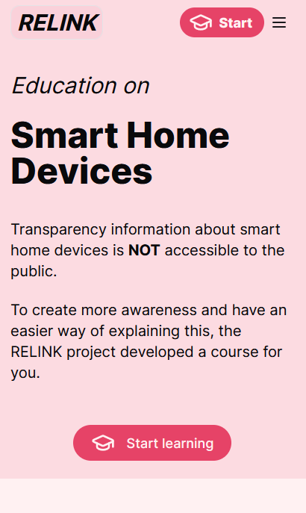
Preview of website
8

Slide 9

Scan to see our website!
9
Notes:
Here you can see our website – Scan the QR code!

Slide 10
Interactive session!
Two Activities
10

Slide 11
Activity 1: Cards
Concerning
True
False
11
Not concerning
Notes:
You are given a bunch of cards with events / scenarios. Some are real, some are made up, and it is up to you to figure that out. Rank all the cards on the chart: worrying/not worrying & true/false. When you have ranked them all, you can turn them around & learn the truth, there is also source in the back of the card (QR code if you want to take a look). If you know the answer to one of the cards, you may also decide to stay silent & let the others discuss it.

Slide 12
Activity 2
Consumer vs. Hacker
12
Notes:
In this activity, we want you to look at smart home devices from two different viewpoints. Start off by discussing how the device is useful for you in your daily life (or for someone you know), what benefits does it have & would you want to live without it? Next, imagine yourself a hacker: how can you exploit the device to make someone’s life as miserable as possible? How can you deal damage to the company? Or how can you spy on someone? What are the dangers you can think of? Now reflect on how you initially thought of the device, has your opinion changed? What insights have you gained?
Discussion questions:
Could this happen to you? Or someone you know? Why (not)?
Does some of the truth parts sound scary that they are real?

Slide 13
+/- 45 min
13

Slide 14
Feedback time
14
Notes:
What did you like? What not?
Are there things to improve?
What would motivate you to go to the website?
What did you learn? Anything you expected but didn't get?
How many things know beforehand? Are you shocked or surprised?

Slide 15
Thanks!
Thank you for your participation and feedback.
Any questions?
15

