Slide 1

Data Science in Python
Evan Edelstein

Slide 2

Why code?
Computational software allows us to:
Manipulate Data
Apply Functions
Build Algorithms

Slide 3
What do we do?
Manipulate Data:
We read protein data from PDB files, store scores in CSV files, and use computational data types like data frames , arrays, and dictionaries to manipulate data. This is how we get real world data into our code and move it between code
Apply Functions:
We mainly apply 3 types of functions:
(1) Assess : sorting, manipulating, or filtering values in a data structure. (2) Math: apply mathematical/statistical functions
(3) Visualization: see our output in a readable way
Build Algorithms:
By combining data manipulation with functions we have a working algorithm that can perform some task for us
We are combining these three “jobs” of software to predict protein interface residues.

Slide 4
Python on one slide:
Python is an interpreted language (no compiler) which trades off performance for accessibility.
Why python?
R sucks
There is nothing it can't do
Tons of libraries of helpful data science packages
robust curated community and documentation (stackoverflow, PEP , annoying YouTube videos)
Complex things are easy ( but some easy things are “hard”)
you can still do complex memory management like in C but can also be abstract as you like.
What you’ll need in python?
Data types
Comprehension
Recursion
“Infinite cleverness”

Slide 5
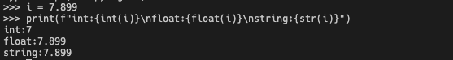

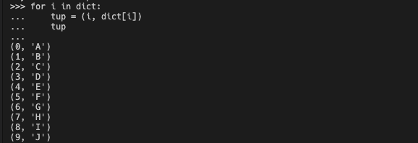
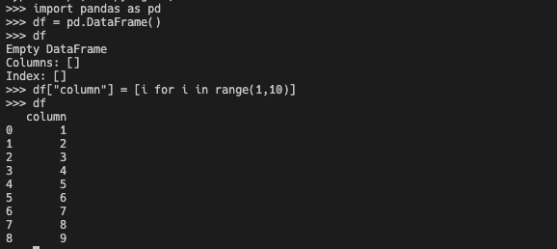
Okay 2 slides:
Data types:
Int, float, string:
List :[]
Dictionary : {}
Tuple : ()
DataFrame: pd.DataFrame

Slide 6
How to use simple code to do cool things:
ROC curve :
Manipulate data: get the protein, residue, predication score and annotated value in one nice place
Apply Functions:
Assess: sort by score, take top n residues based on threshold
Math: find TPR and FPR
Visualize: Plot TPR vs FPR per predictor and show AUC
Build Algorithm: put it all together.

