Slide 1
Protein interface prediction:
A look at predus2.0 and implementation methods

Slide 2
Protein-Protein Interface:
Proteins are defined by a set of residue sites of the protein
The specific interface site is defined as a subset of specific residues
Interface prediction software ranks each residue and chooses the top raked residue to be a apart of the interface subset.

Slide 3
Predus2.0 uses 2 main scores to predict protein interfaces
Template based score- query proteins are compared to homologs with known interface residue geometry to predict similar interface geometry on query protein.
01
Patch based score- uses different parameters like conservation, and relative accessible surface areas to give propensity score to each residue.
02

Slide 4

The 2 prediction scores are combined using a Bayesian network:
This scoring system increases the accuracy of predus1.0
It combined orthogonal data points to enhance the orginal method
Precision was calculated as TP/(TP1FP) and recall was calculated as TP/(TP1FN) where TP means “true positive,” FP means “false positive,” and FN means “false negative.

Slide 5
Predus 2.0 dynamic cutoff
The cutoff for the query protein was defined as n=6.1N^{0.3} where n is the cutoff point and N is the number of residues in the protein.

Slide 6
Method:
Predus 2.0 score was taken from the online server. The proteins were then ranked by score and using cutoff of N, defined by the number of residues in the annotated file, was compared to the annotated file.
The F-score both globally and average was determined.
Pymol software was used, for antigen test set, to visualize the prediction residues, both accurate and not.

Slide 7
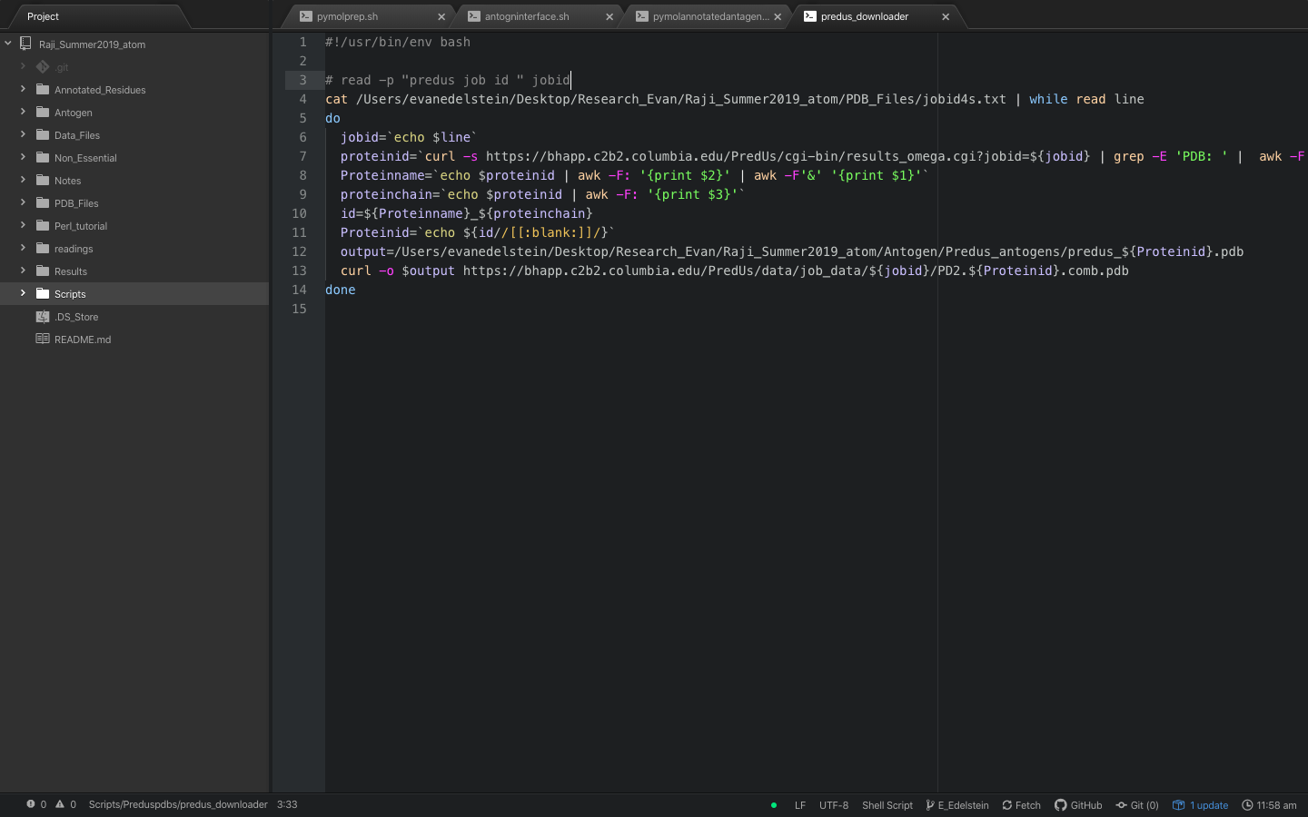
Code sample: Predus2.0 prediction PDB download script

Slide 8
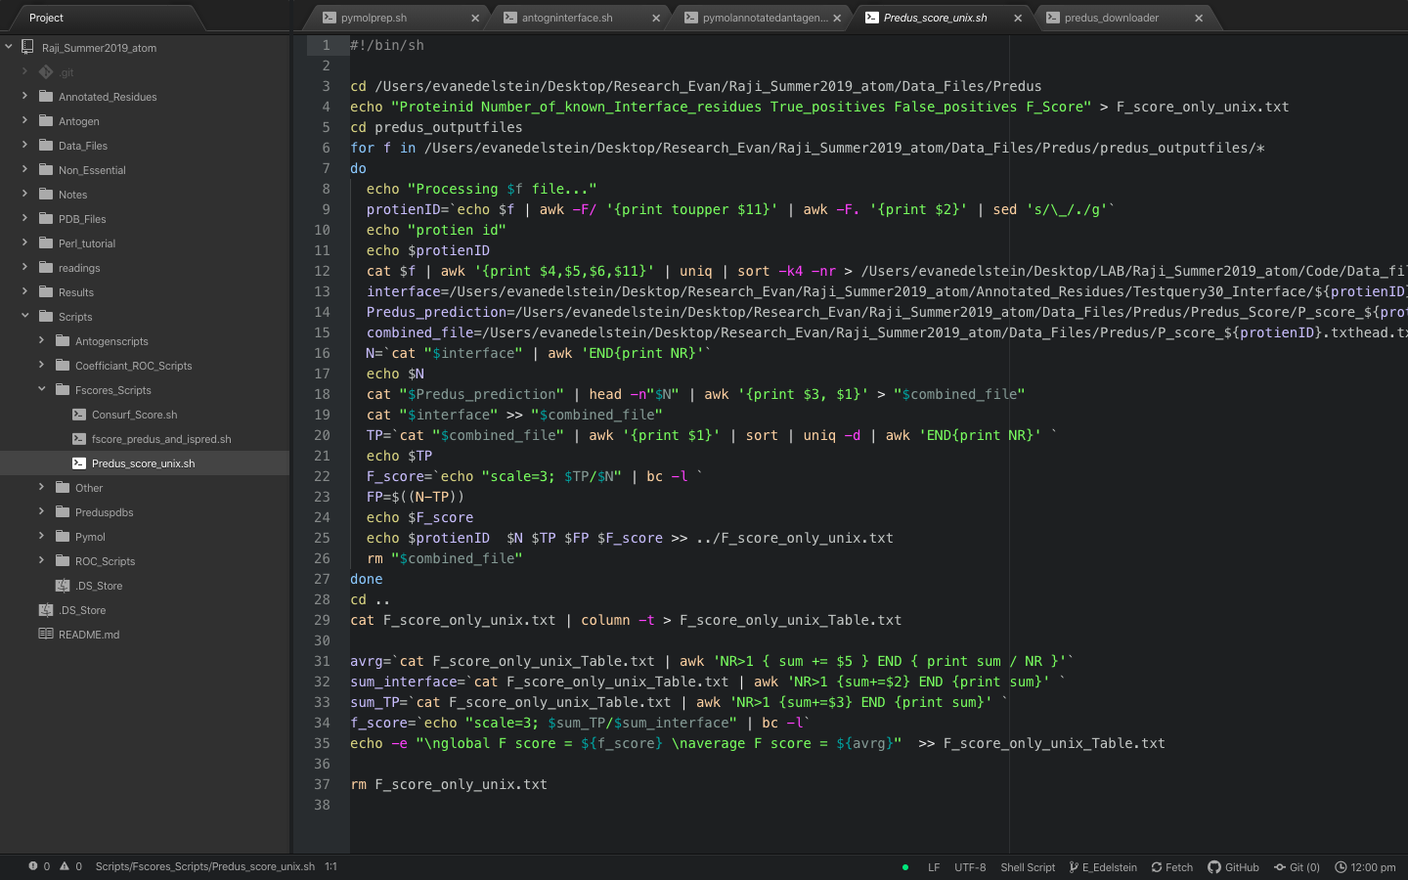
Code Sample: F-score

Slide 9
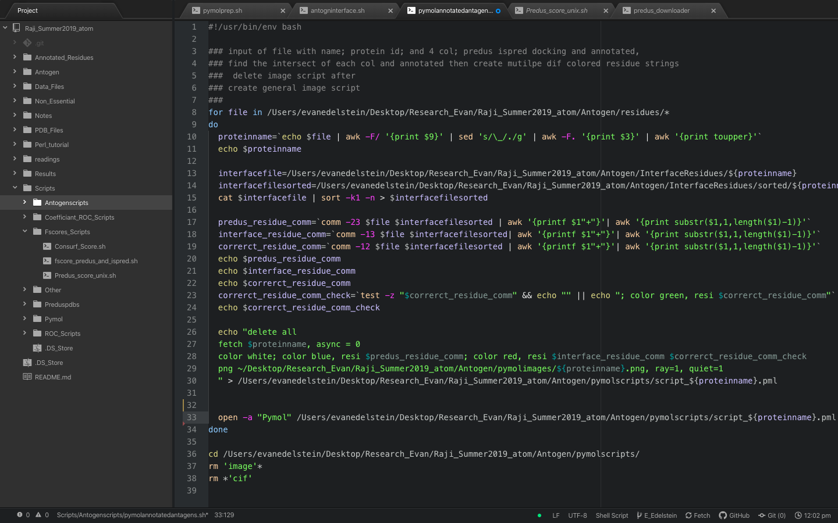
Code Sample: Pymol image

Slide 10
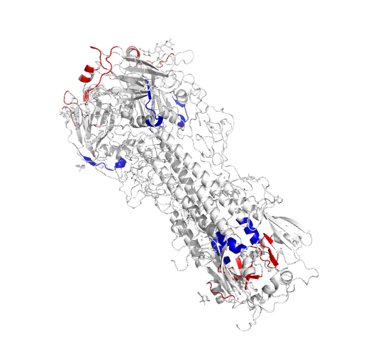




Pymol image example: antigen
Red = annotated
Blue = predus prediction

Slide 11
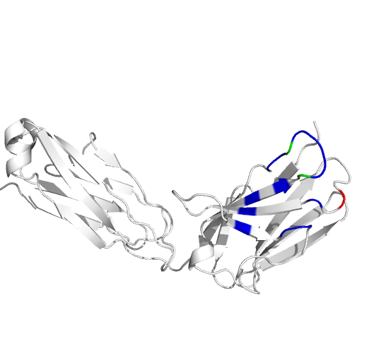
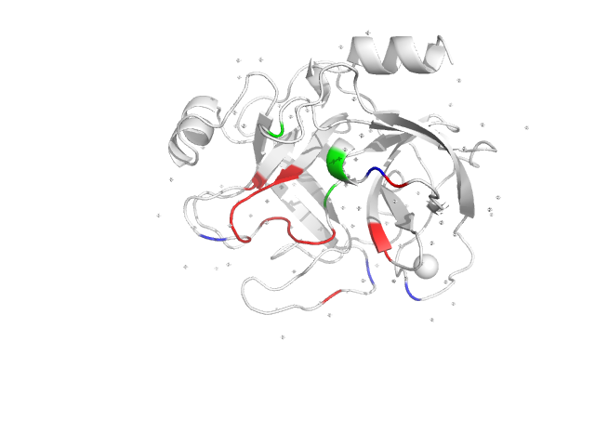
Pymol image of 1ahw_A and 1AVX_A
Blue -predus prediction
Red –annotated
Green – correctly predicted residues

Slide 12
Looking forward:
Imaging of sets of non-antigen proteins
Linear combination and analysis of predus2.0, Ispred and docking
Enhance imaging script to include van der walls spheres and “bring –front” program

