Slide 1
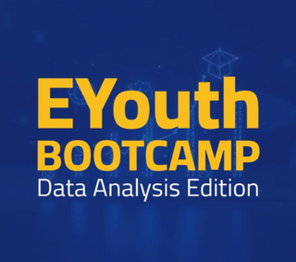



Data Analysis Bootcamp
eCommerce Analysis from Raw Data to Business Decisions
By : Team 17
Team Leader : Eslam Ashraf

Slide 2
Table of contents
01
02
03
Introduction
Data Architecture & Source Integration
Data Cleaning & Transformation
04
05
06
Exploratory Data Analysis (EDA) in SSMS
Advanced Data Analysis in Power BI
Dashboard Walkthrough

Slide 3
Table of contents
07
08
Insights & Recommendations
The Extra Mile: AI-Augmented Analysis
09
10
Conclusion
Q&A

Slide 4
Introduction
Objective
Team Collaboration
Provide data-driven insights to optimize sales, understand customer behavior, and drive eCommerce growth
Tools used: Notion for task tracking, documentation, and real-time collaboration. o Roles distribution and project timeline.

Slide 5
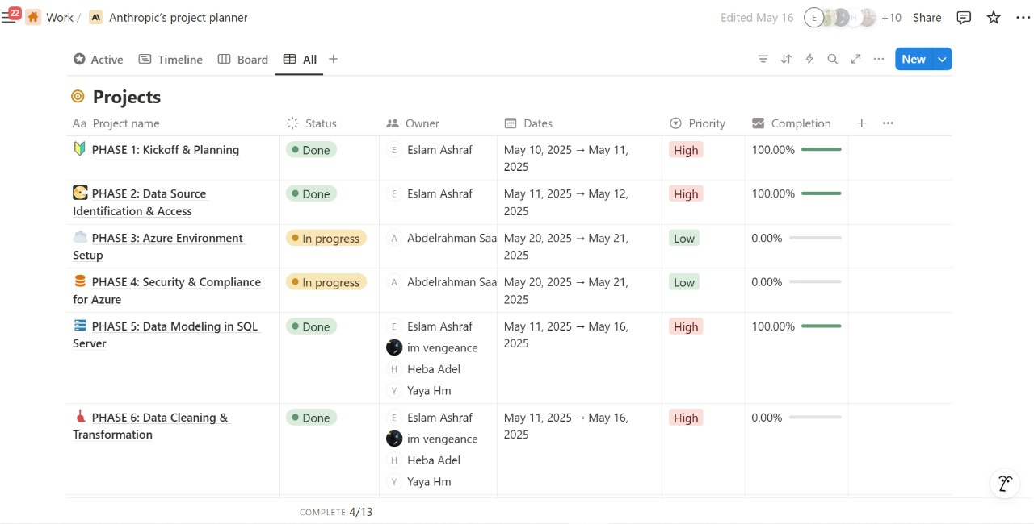

Slide 6
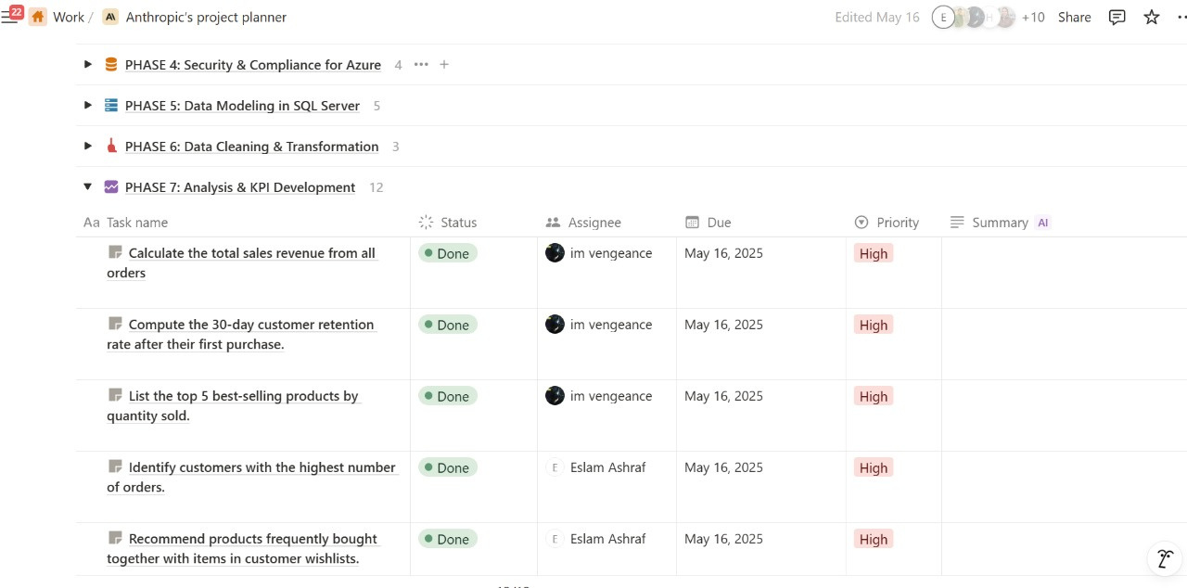

Slide 7
Data Architecture & Source Integration
Data Source
Why Azure
Connected structured datasets stored securely on Microsoft Azure SQL Database.
Scalability, security, and real-time access for all collaborators.

Slide 8
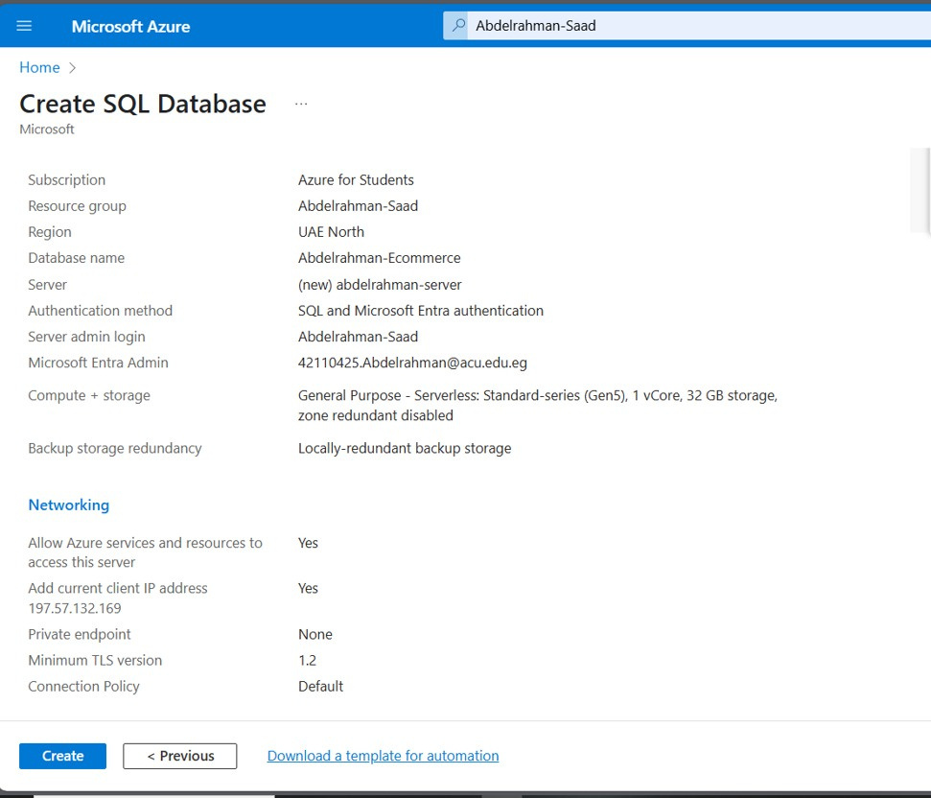

Slide 9
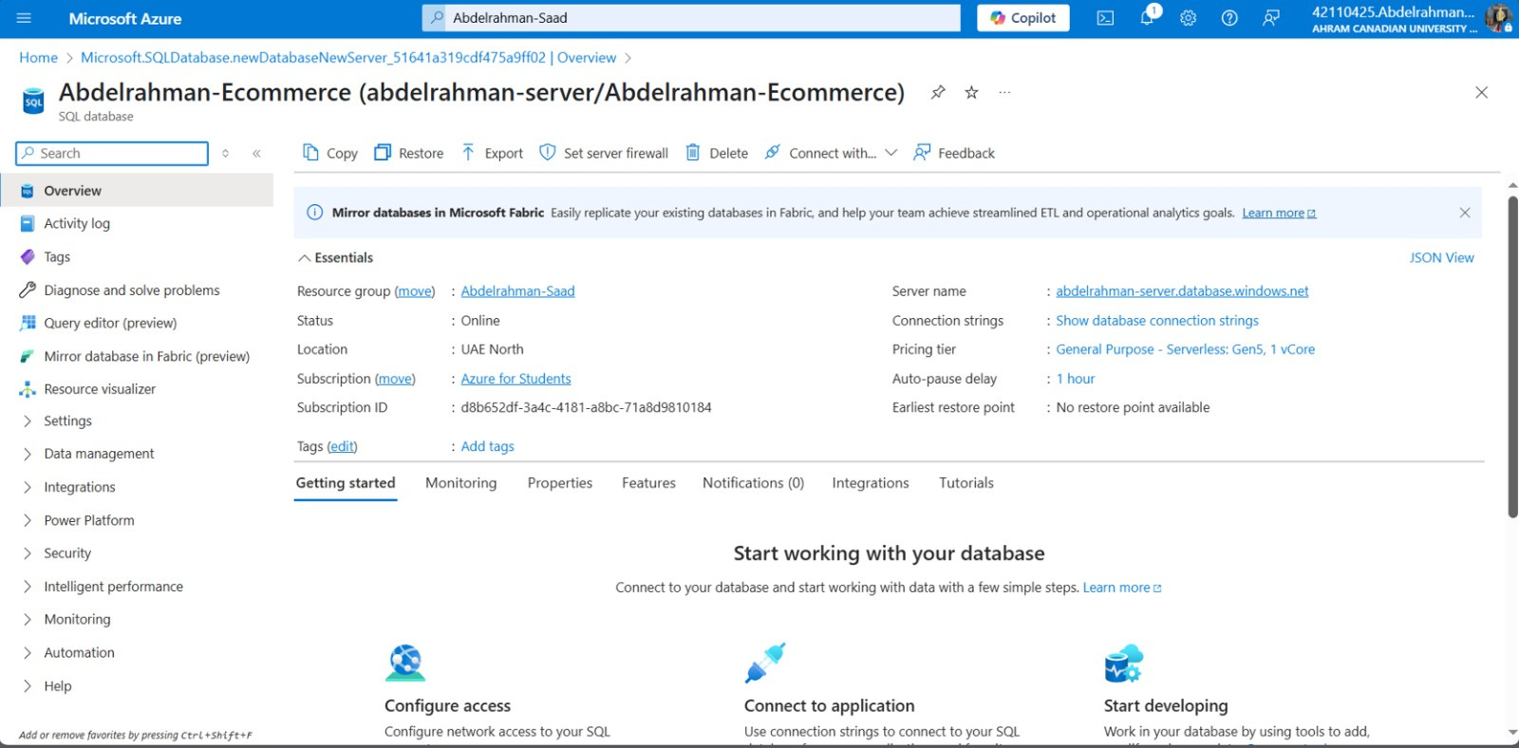

Slide 10
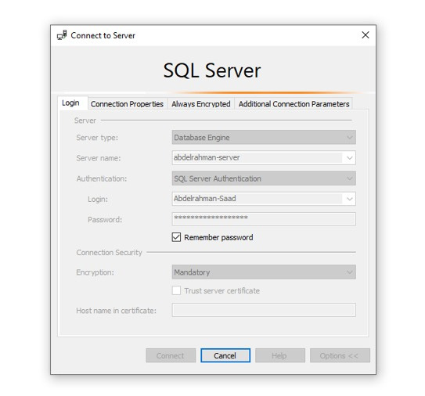

Slide 11
Data Cleaning & Transformation
Tools Used
SQL Server Management Studio (SSMS)
Steps Performed
Null & duplicate checks, date/format standardizatio.
Joining tables, managing discounts, handling outliers.
Stored procedures and window functions for performance.

Slide 12
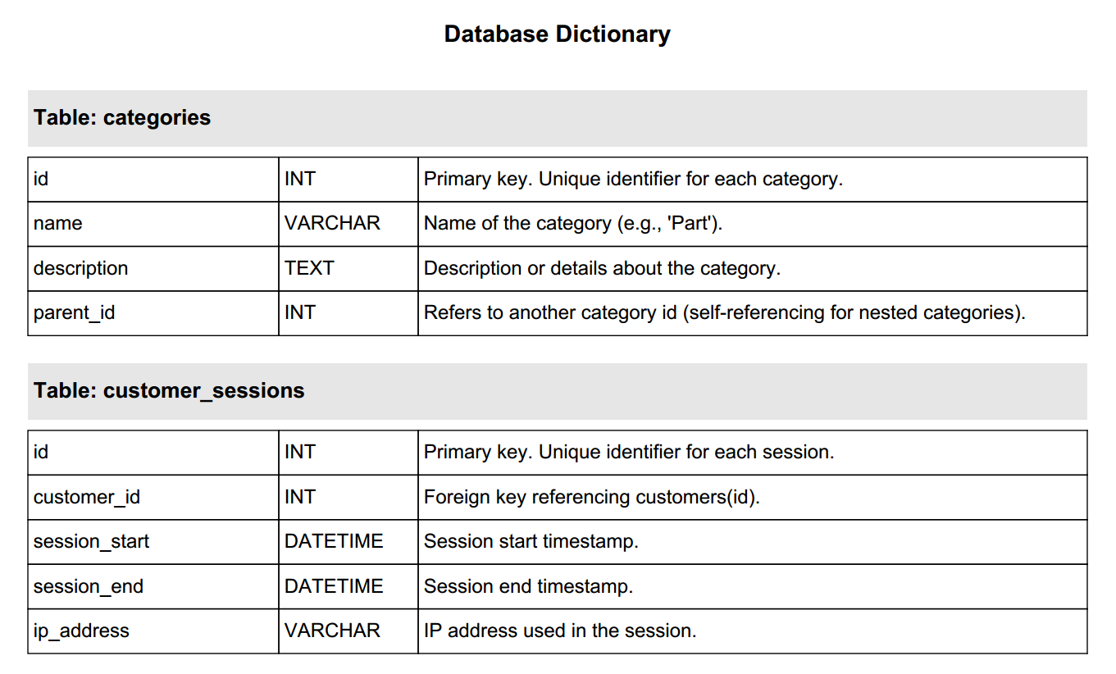

Slide 13
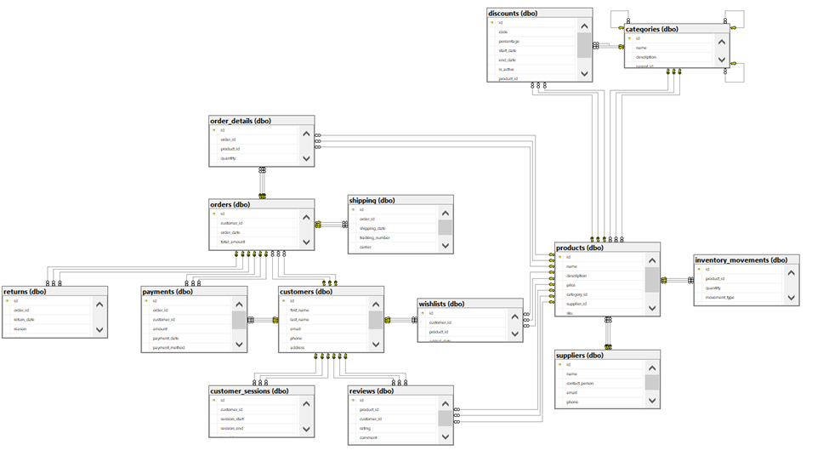

Slide 14
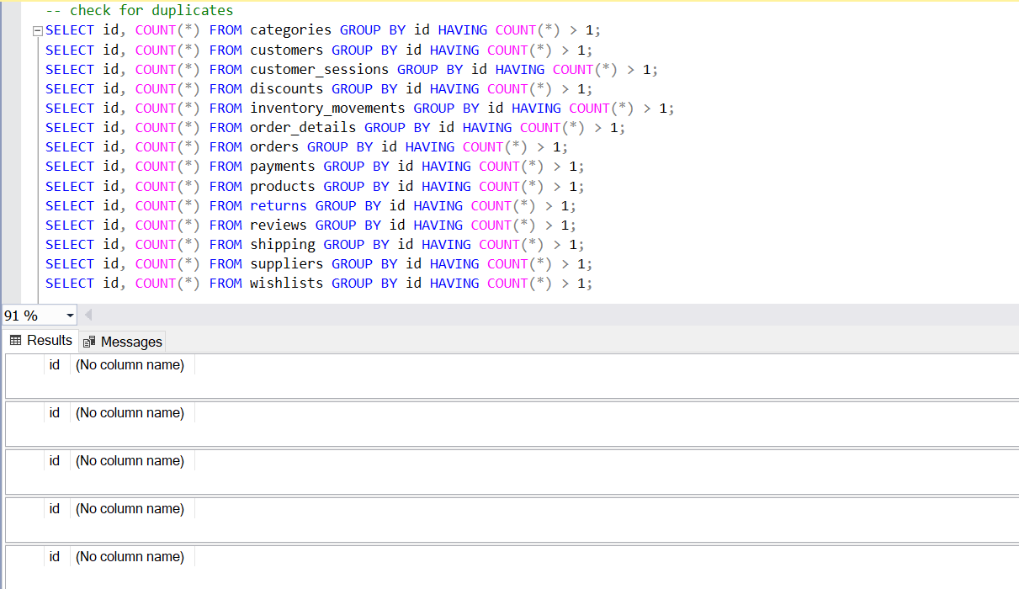
Cleaning the data : Checking the dublicates

Slide 15
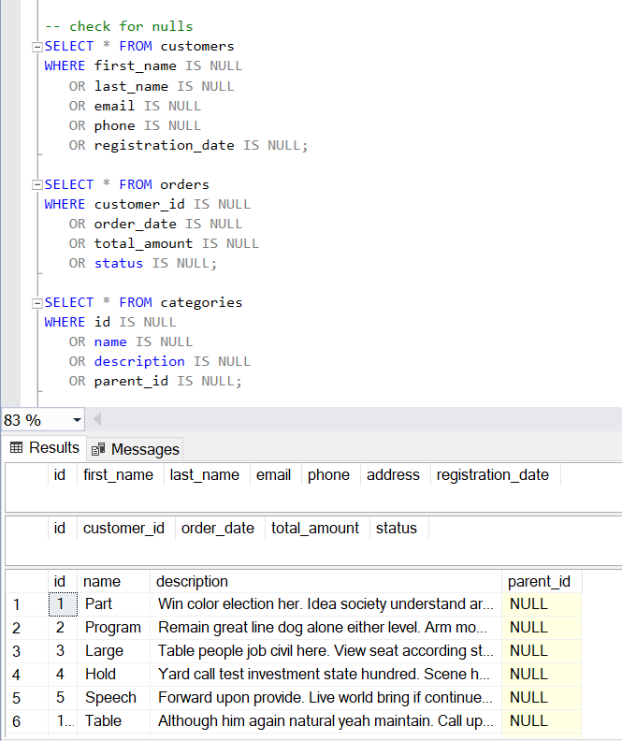
Checking for nulls

Slide 16
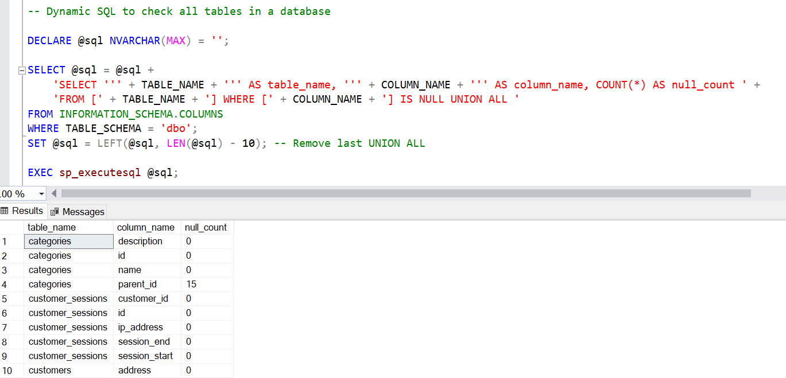
Dynamic SQL to check all tables in a database
Instead of repeating the same query for each table, we used a dynamic SQL query that scans all tables in the database and reports the number of NULLs per column.
The script uses the INFORMATION_SCHEMA.COLUMNS view to automatically build and run the NULL-check query.

Slide 17
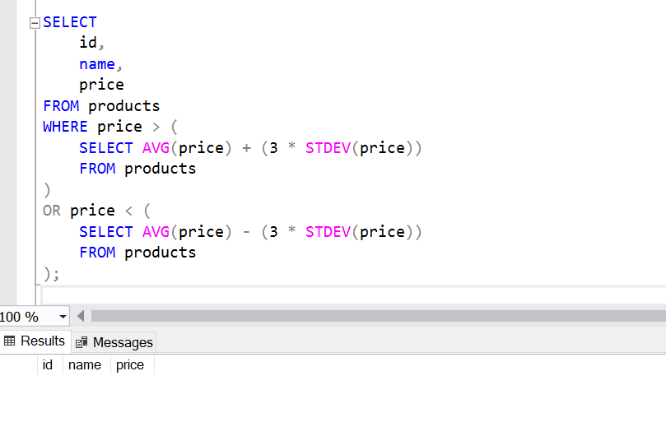
Checking for outliers

Slide 18
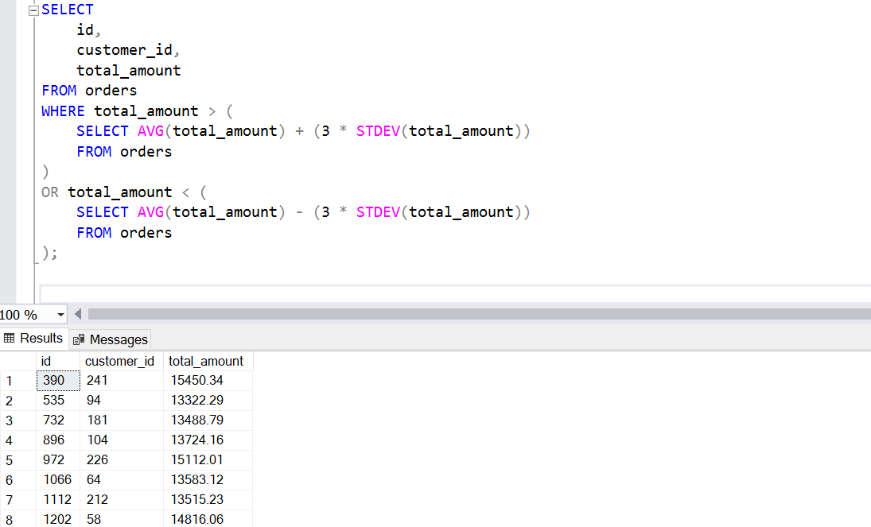
Orders Table

Slide 19
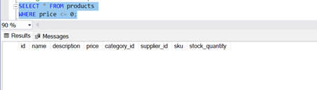
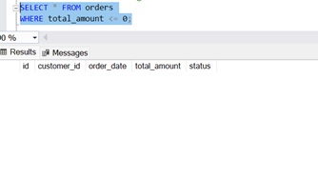
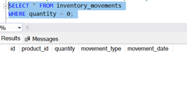
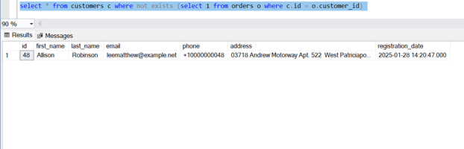
Check for Impossible or Suspicious Values
Negative or zero prices
Orders with zero or negative total
Inventory movements
with zero quantity
customers with no orders

Slide 20
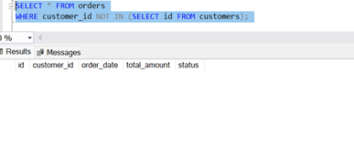
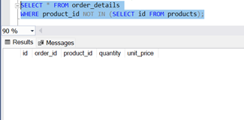
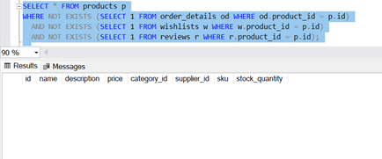
Check Foreign Key Violations
Orders without valid customers
Order details with invalid products
Check for Unused Products

Slide 21
Data Analysis in SSMS
● Calculate the total sales revenue from all orders.
● List the top 5 best-selling products by quantity sold.
● Identify customers with the highest number of orders.
● Generate an alert for products with stock quantities below 20 units
● Determine the percentage of orders that used a discount.
● Calculate the average rating for each product
● Compute the 30-day customer retention rate after their first purchase.
● Recommend products frequently bought together with items in customer wishlists
● Track inventory turnover trends using a 30-day moving average.
● Identify customers who have purchased every product in a specific category.
● Find pairs of products commonly bought together in the same order.
● Calculate the time taken to deliver orders in days

Slide 22
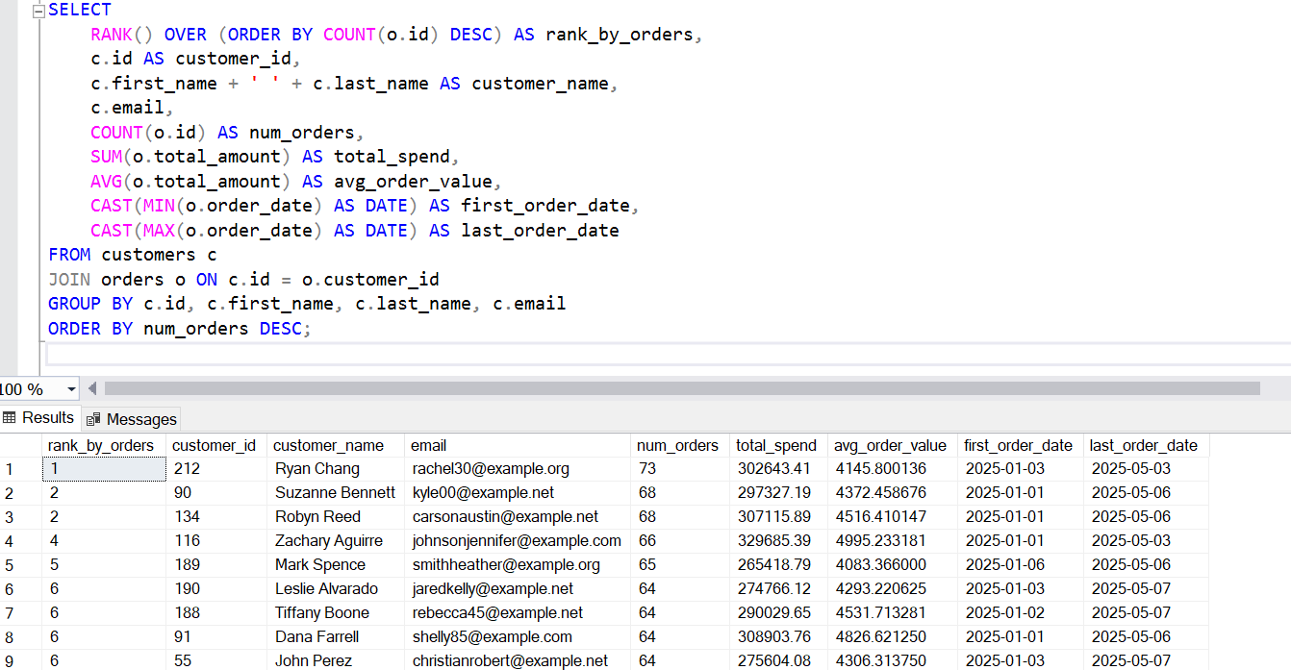
Identify customers with the highest number of orders.

Slide 23
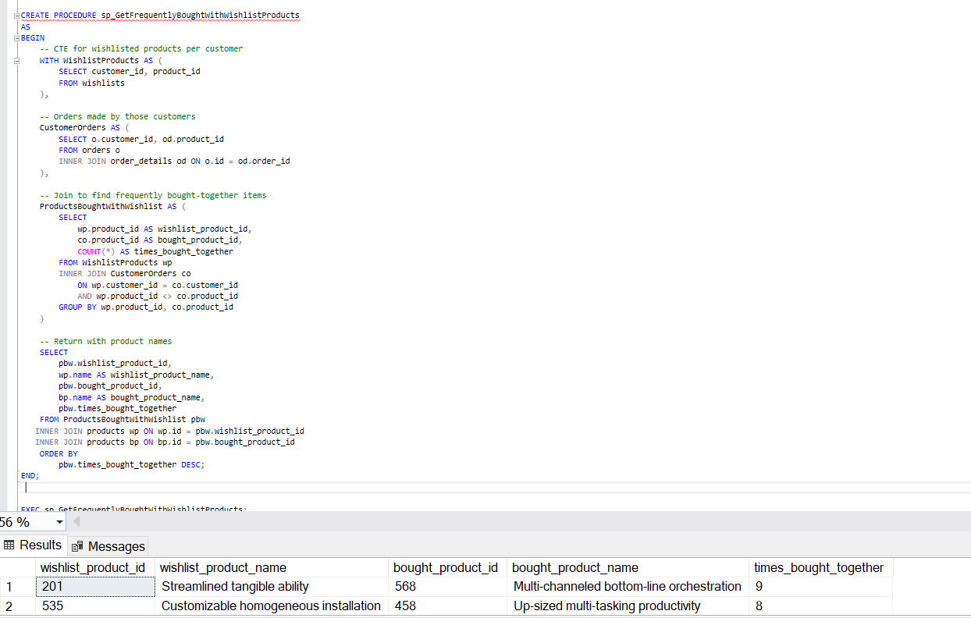
Recommend products frequently
bought together with items
in customer wishlists

Slide 24
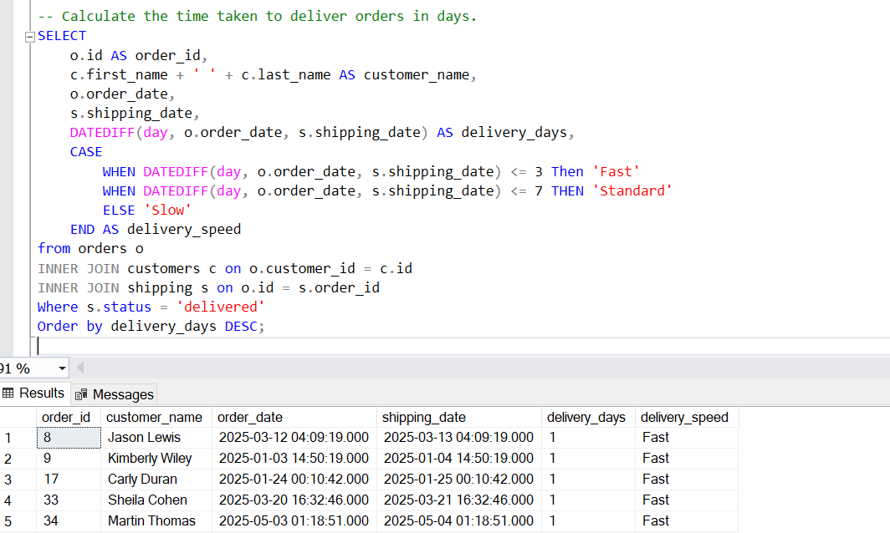
Use high-conversion bundles in social and display ads.
Calculate the time taken to deliver orders in days.

Slide 25
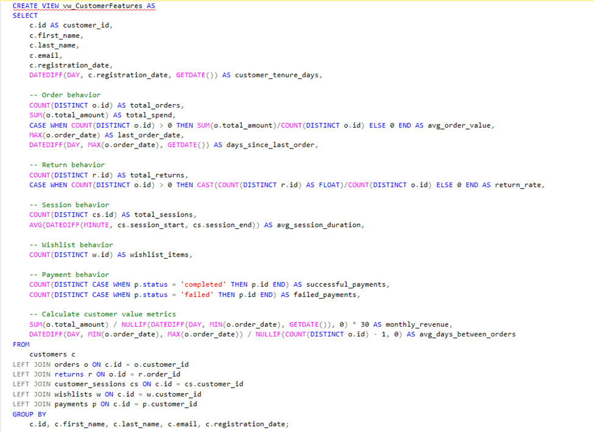
Customer Features View

Slide 26
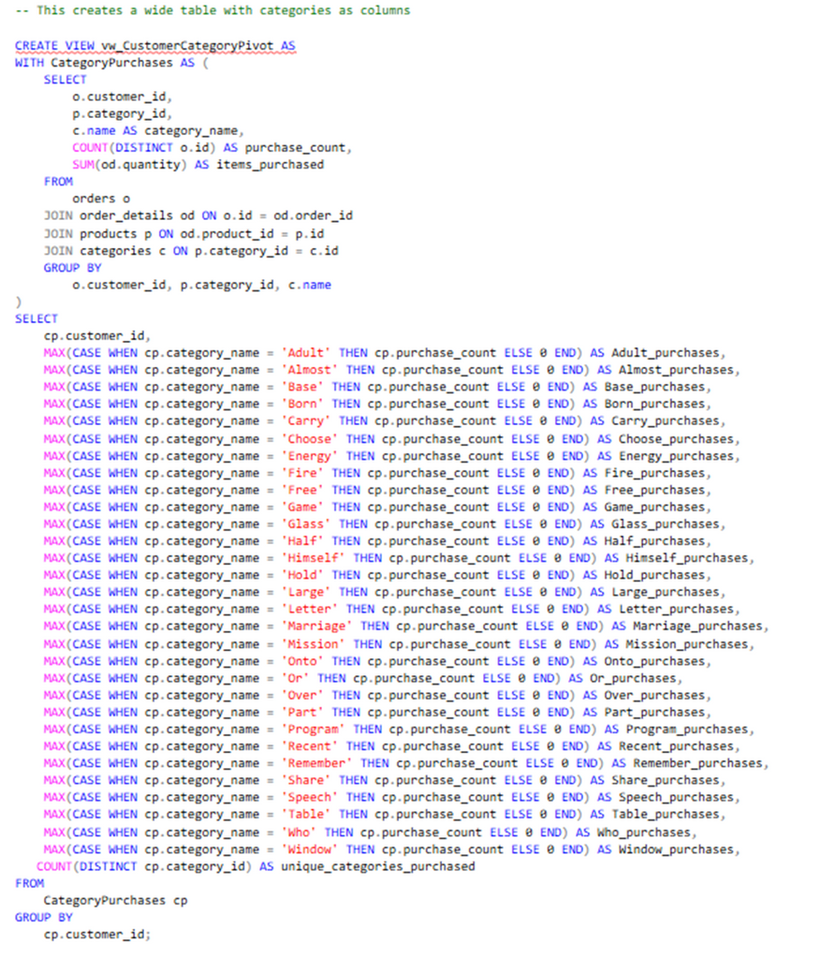
Customer Category Pivot View

Slide 27
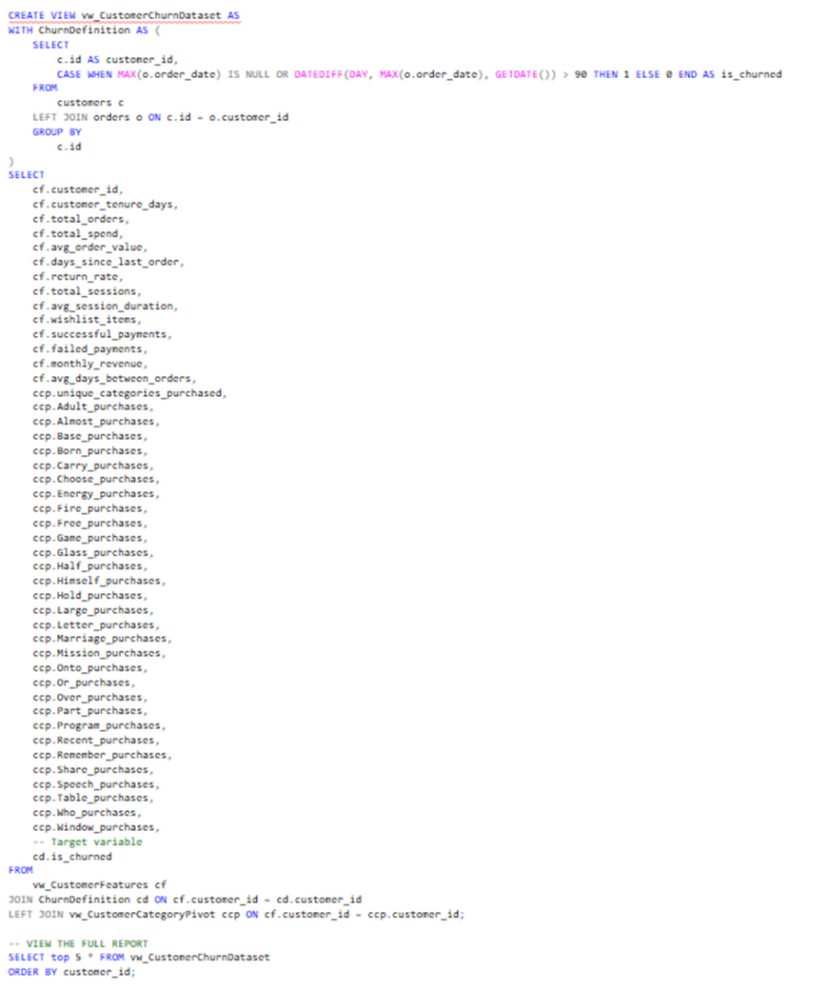
Full Report

Slide 28
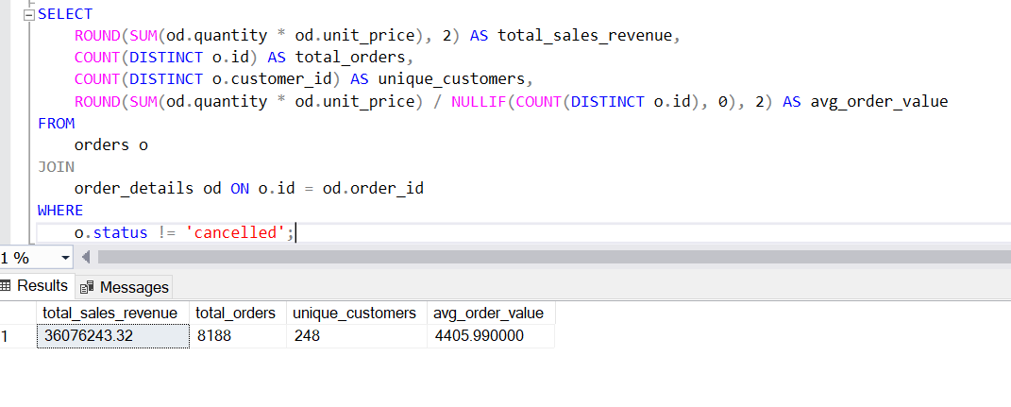
Calculate the total sales revenue from all orders

Slide 29
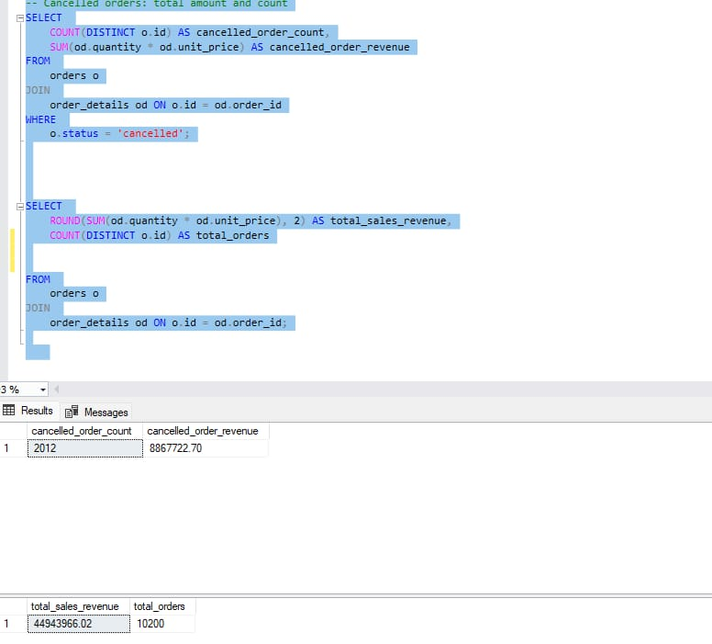
Calculate the total sales revenue from all orders

Slide 30
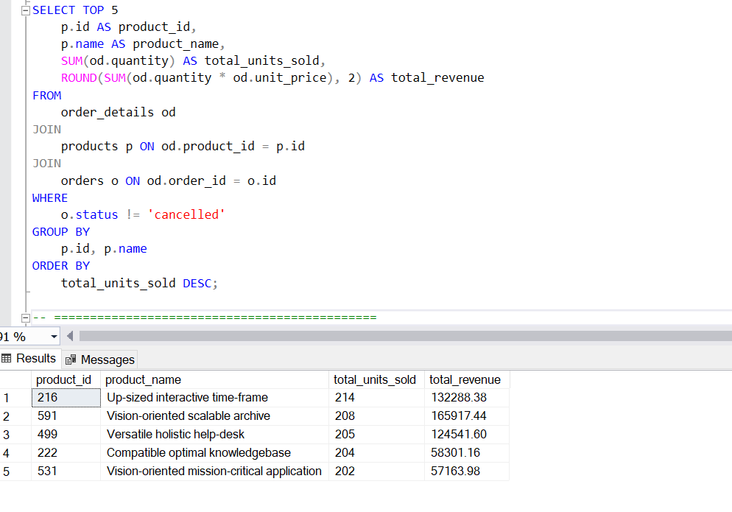
List the top 5 best-selling products by quantity sold.
(Ranked by units sold, with revenue)

Slide 31
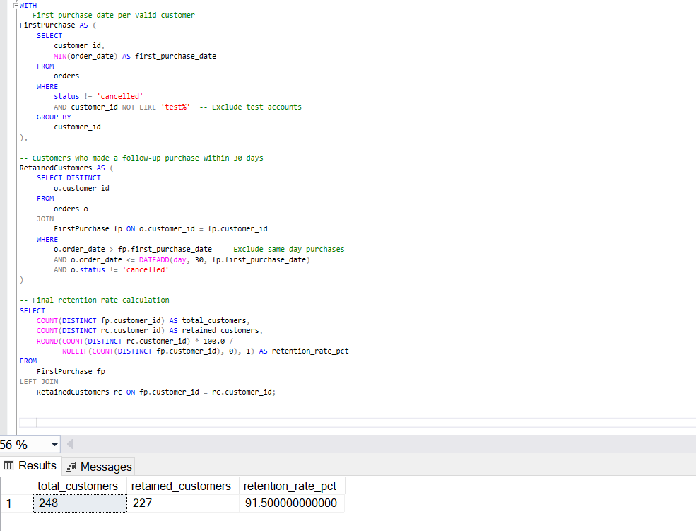
Compute the 30-day customer retention rate after their first purchase.

Slide 32
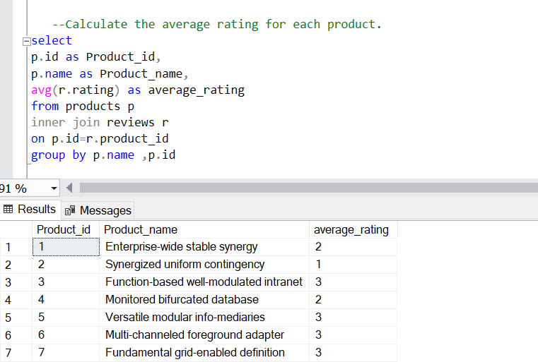
Calculate the average rating for each product.

Slide 33
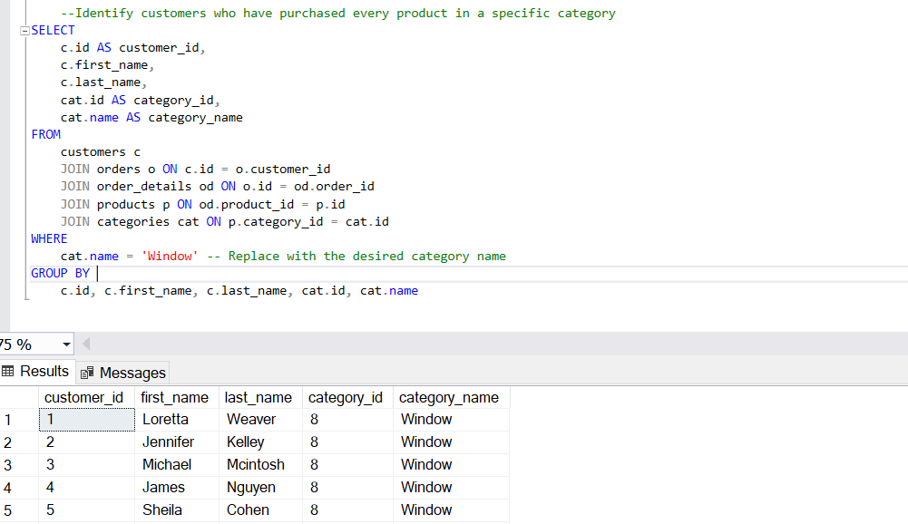
Identify customers who have purchased every product in a specific category.

Slide 34
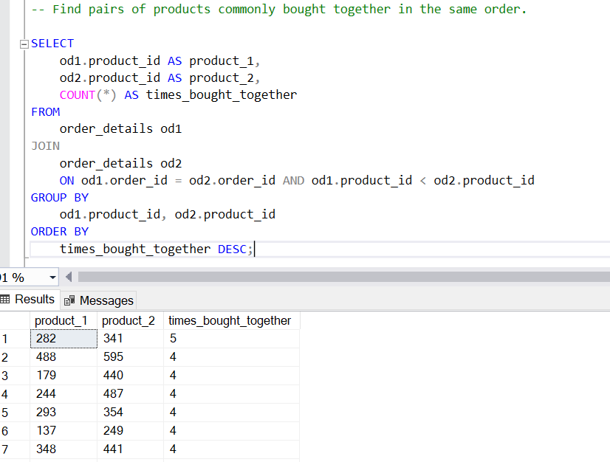
Find pairs of products commonly bought together in the same order.

Slide 35
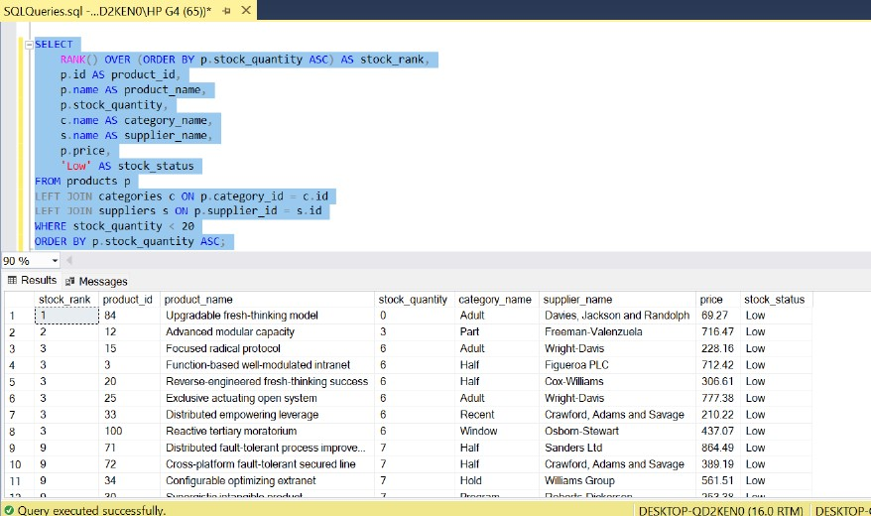
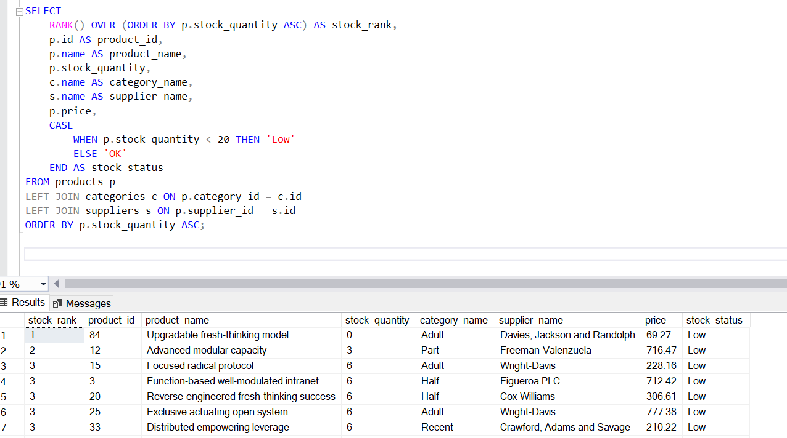
Generate an alert for products with stock quantities below 20 units

Slide 36
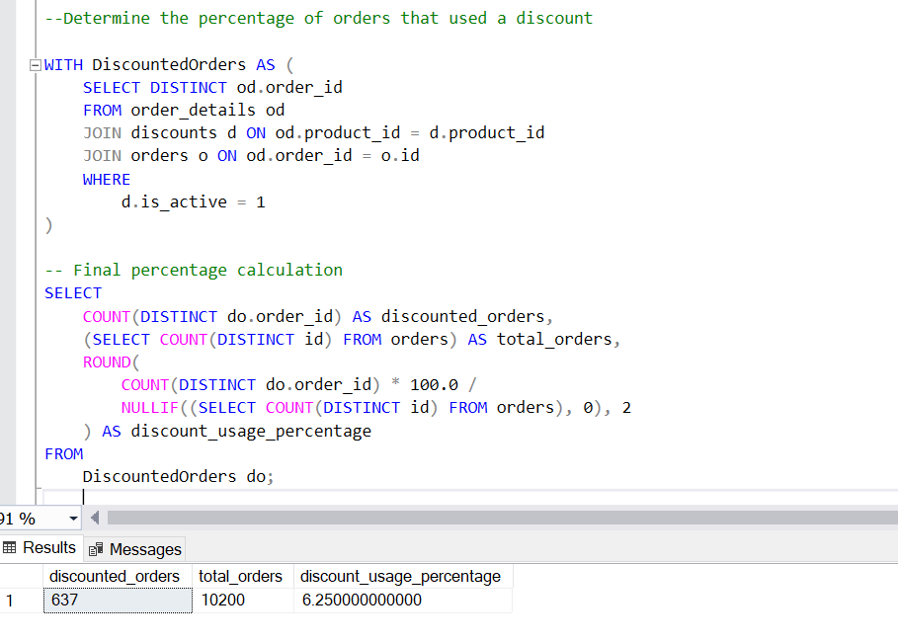
Determine the percentage of orders that used a discount.

Slide 37
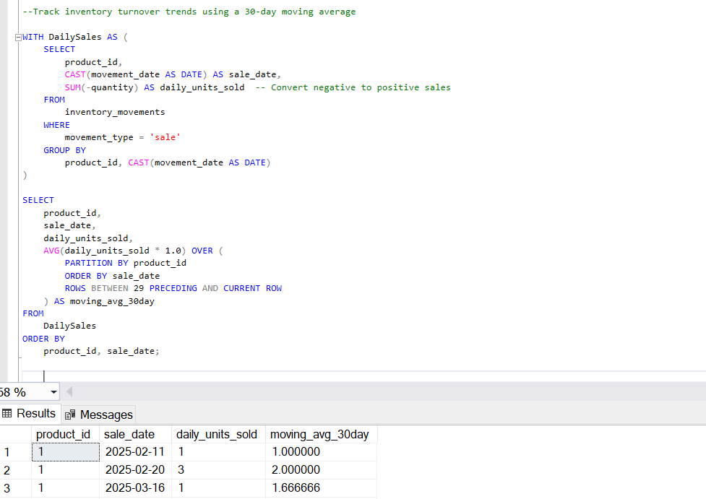
Track inventory turnover trends using a 30-day moving average.

Slide 38
Recommendation
Several products consistently receive low ratings (3 or below).
Recommendations:
o Focus improvement efforts on products with ratings ≤ 3.
o Run surveys for low-rated products to gather detailed feedback.
o Send follow-up emails asking happy customers to leave reviews.
o Offer small incentives (discounts, loyalty points) for leaving a review.

Slide 39
1. Launch a Loyalty Program
Reward top customers with points, discounts, or exclusive benefits.
Encourage repeat purchases and increase customer retention.
2. Create VIP Customer Tiers
Introduce “Gold” or “Platinum” levels for frequent buyers.
Offer perks like early access, premium support, or free shipping.
3. Collect Direct Feedback
Engage top customers through surveys or feedback forms.
Use insights to enhance user experience and service quality.

Slide 40
4. Implement Smart Product Bundles
Create dynamic bundles featuring wishlist items and their frequently bought companions.
Offer bundle discounts to encourage larger cart sizes.
5. Cart Suggestions Based on Wishlist
At checkout, recommend products commonly bought with items from the customer’s wishlist.
Increase average order value with timely, relevant prompts.
6. Targeted Ads Based on Wishlist Associations
Retarget users with ads showing complementary products.

Slide 41
Advanced Data Analysis in Power BI
Visual-Driven Insights
Tools & Calculations Used
Sales Performance: Revenue trends, AOV, discount impact.
Product Analysis: Best/worst performers, returns, stock alerts.
Customer Segmentation: Top customers, retention, lifetime value.
DAX for custom measures (CLV, discount effect, YoY growth).
Power Query for data modeling and cleaning.

Slide 42
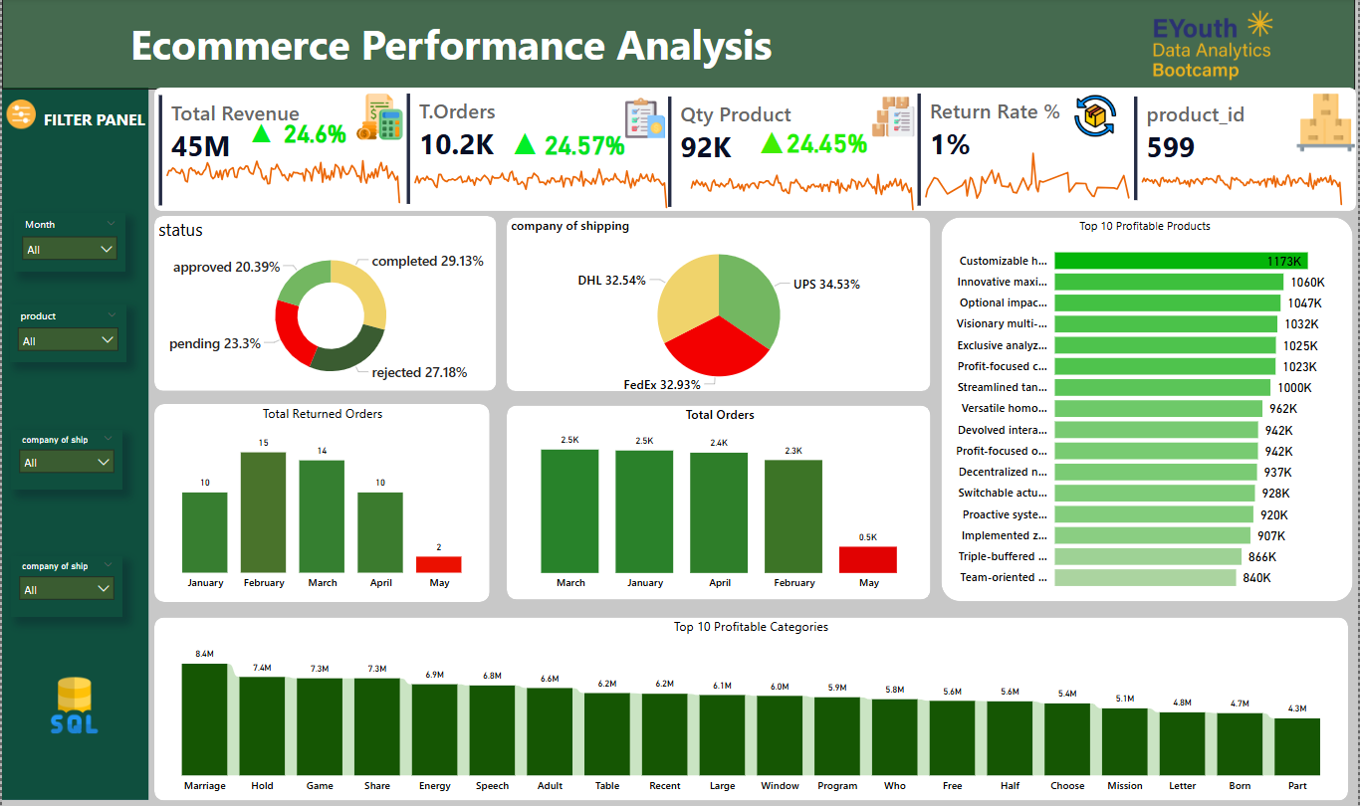

Slide 43
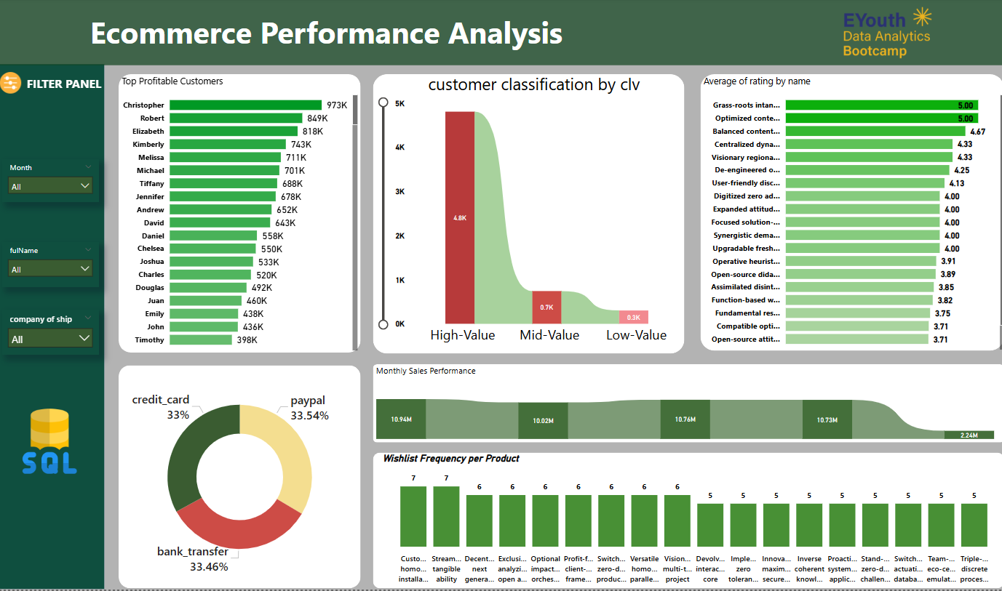

Slide 44
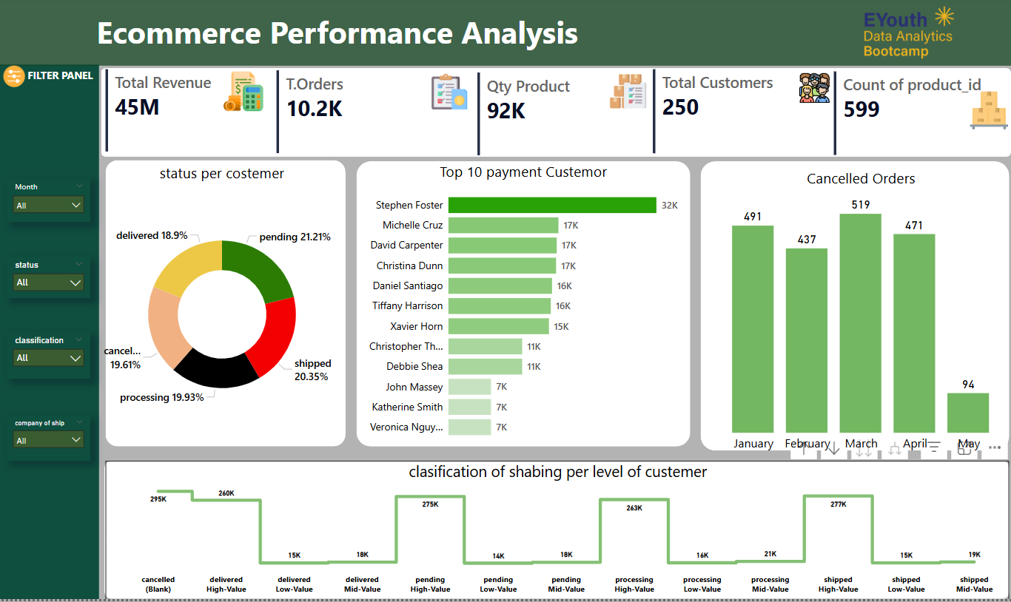

Slide 45
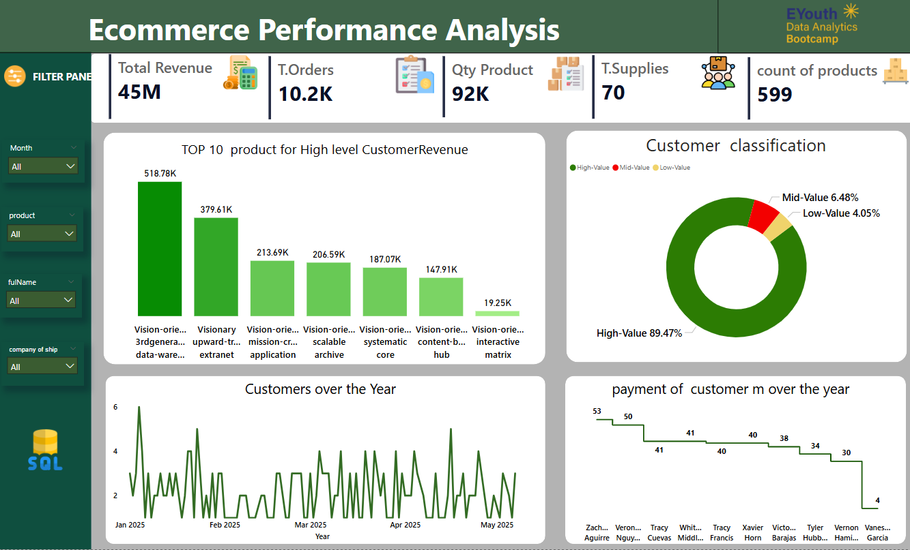

Slide 46
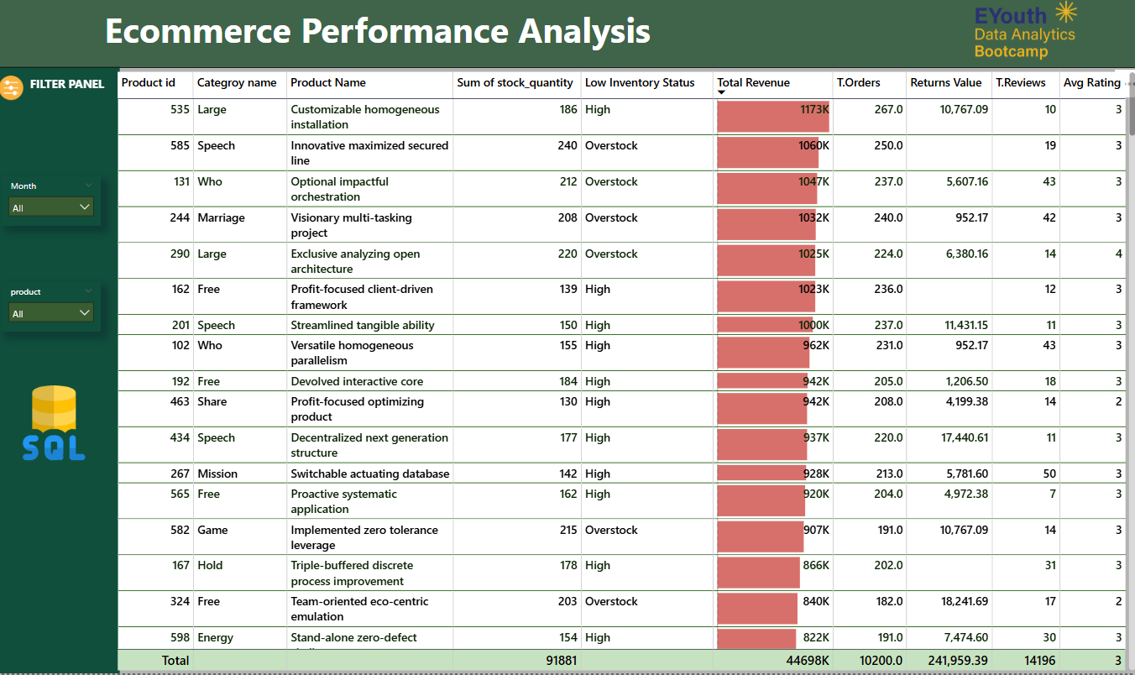

Slide 47
Key KPIs
- Total Revenue: 45M (+24.6%)
- Total Orders: 10.2K (+24.57%)
- Quantity Sold: 92K (+24.45%)
- Return Rate: 1% (very low, indicates high customer satisfaction)
- Products Analyzed: 599
Returns Analysis
Completed: 29.13%
Rejected: 27.18% (high – requires review)
Pending: 23.3%
Approved: 20.39%
Returns peaked in February and March; dropped sharply in May.
Shipping Company Distribution
UPS: 34.53%
FedEx: 32.93%
DHL: 32.54%

Slide 48
Top Products & Categories
Top product: 'Customizable homogeneous installation' – Revenue: 1.17M
Most categories range between 6M–8.4M in revenue.
Inventory Observations
Many overstocked items are high-sellers – potential supply chain optimization.
Products with high return value need attention (e.g., 'Team-oriented eco-centric emulation' – 18K+ return value).
Critical Drop in May
Orders dropped from average of ~2.4K to 0.5K – a 75%+ decrease.
This is a red flag and could indicate marketing, technical, or supply issues.
Returns and reviews also dropped accordingly.

Slide 49
Insights & Recommendations
Sales Strategy
Inventory Planning
Focus marketing on months with high AOV.
Expand top-selling categories.
Restock high-rated low-stock items.
Remove long-idle products.
Customer Retention
Target frequent discount users with loyalty programs.
Win-back campaigns for dormant customers.

Slide 50
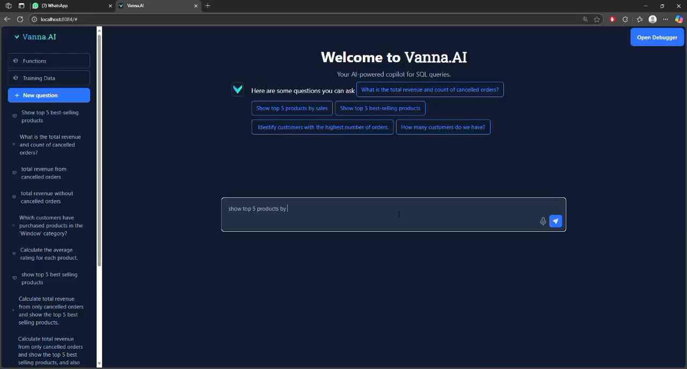

Slide 51
Machine Learning

Slide 52
Objective:
To predict trends and automate analysis using SQL Server data and modern Python-based ML tools. This documentation expands upon the technical implementation, tools used, and insights derived

Slide 53
4.1 Automated Data Cleaning
Tools & Definitions:
Mito: A low-code spreadsheet-like interface integrated with Jupyter that allows for rapid data wrangling and generates Python code behind the scenes.
Pandas: A powerful Python data analysis library used for handling structured data (DataFrames).
pyodbc: A Python module for connecting to ODBC-compliant databases, like SQL Server.

Slide 54
Process:
Established a secure connection to SQL Server using pyodbc and extracted the following relational tables:
orders, customers, products, categories, order_details, reviews
Tables were loaded into a Python dictionary for modular and programmatic access.
Cleaning operations:
Filled missing parent_id fields in the categories table with the median.
Converted data types for date fields (order_date, registration_date) and price fields (unit_price, total_price).
Hierarchical enhancement:
Used recursive merging to represent parent-child relationships in categories.
Constructed a visual graph of category relationships using networkx.

Slide 55
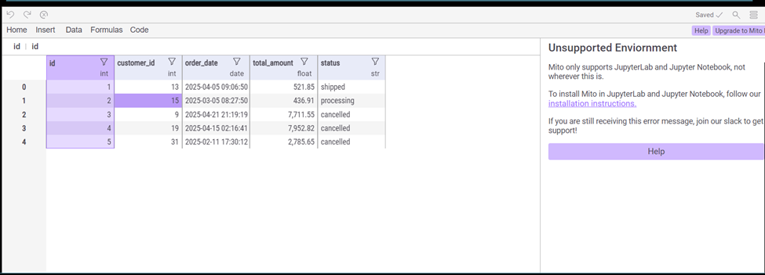
Insight: Enhanced relational integrity and data quality, setting a strong foundation for downstream modeling and analytics.

Slide 56
Exploratory Data Analysis (EDA):
Generated visualizations to analyze:
Order distribution by status and date
Product price and review rating histograms
Monthly revenue trends and customer acquisition timeline
Category-level sales and top products by revenue

Slide 57
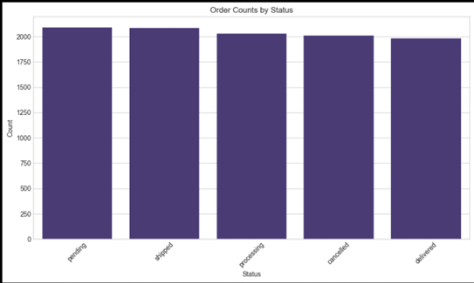
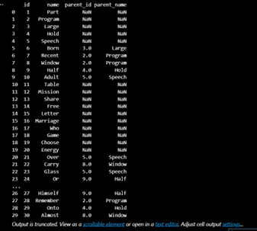
Insight: Identified high-performing products and peak sales periods. Detected imbalance in order statuses indicating potential operational bottlenecks.

Slide 58
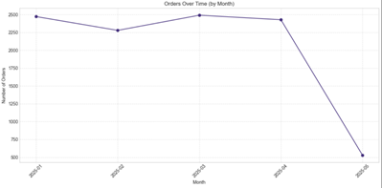
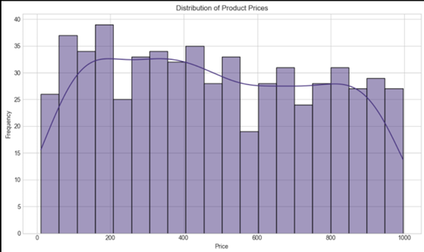
Explore product price distribution
Explore order trends over time

Slide 59
Feature Engineering:
Created new variables such as:
days_as_customer: Days since a customer joined
order_month, order_day_of_week: Useful for identifying seasonality
customer_avg_order: Calculated per-customer order value trends
Repeat buyer flags and historical purchase metrics

Slide 60
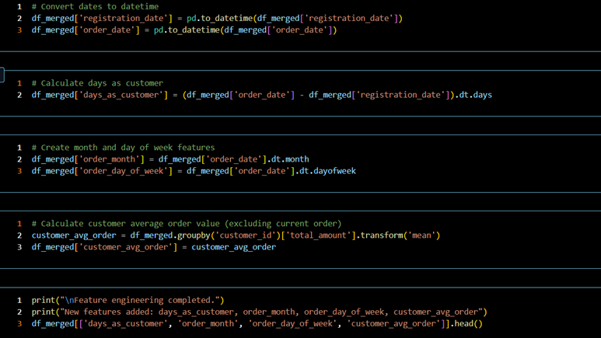
Insight: Time-based and customer-centric features significantly improved model accuracy and personalization capabilities.

Slide 61
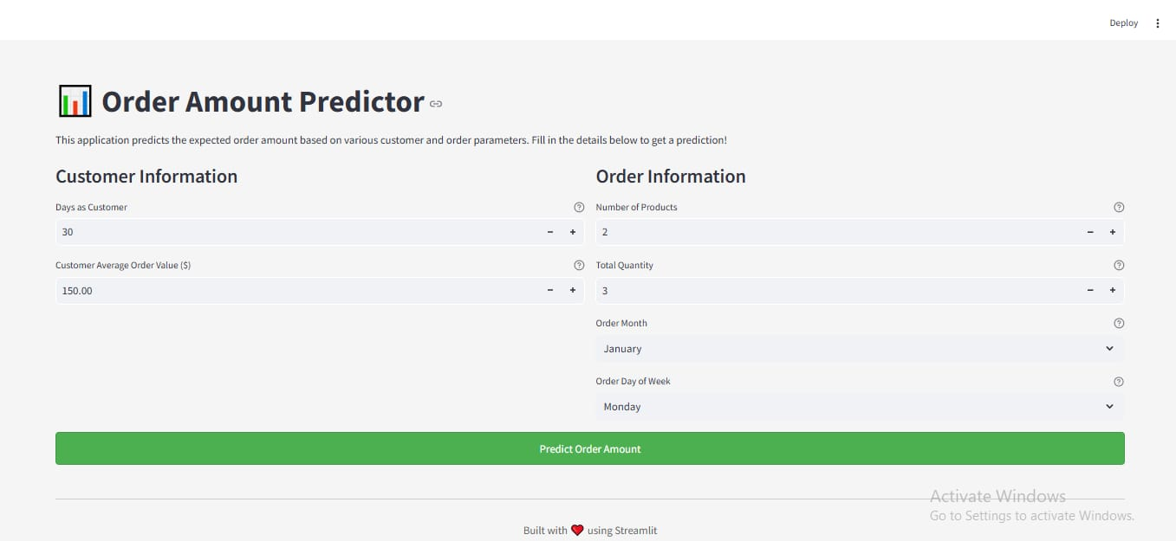
App Screen

Slide 62

App Screen

Slide 63


