Slide 1
Data science with F#: Analysing social networks
Evelina Gabasova

Slide 2
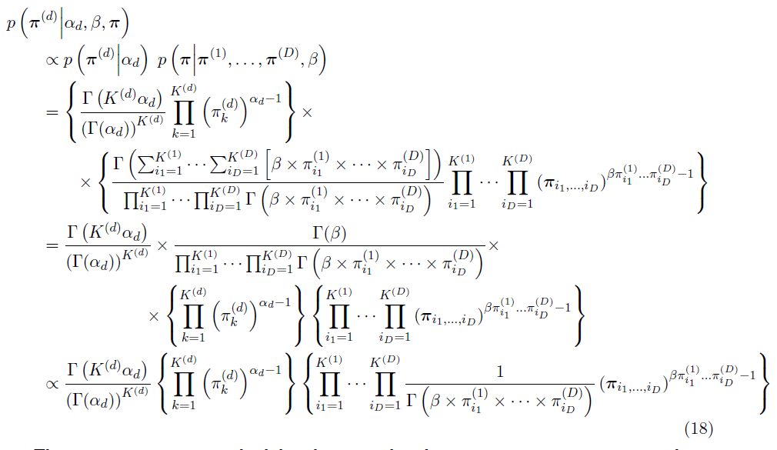
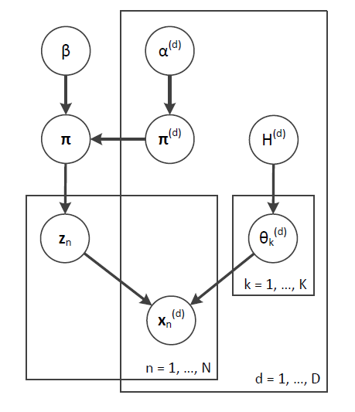
Twitter @evelgab
Blog evelinag.com

Slide 3
Why network science
gene interaction networks
disease spreading
cascading failures in power grids
brain connections
social networks

Slide 4
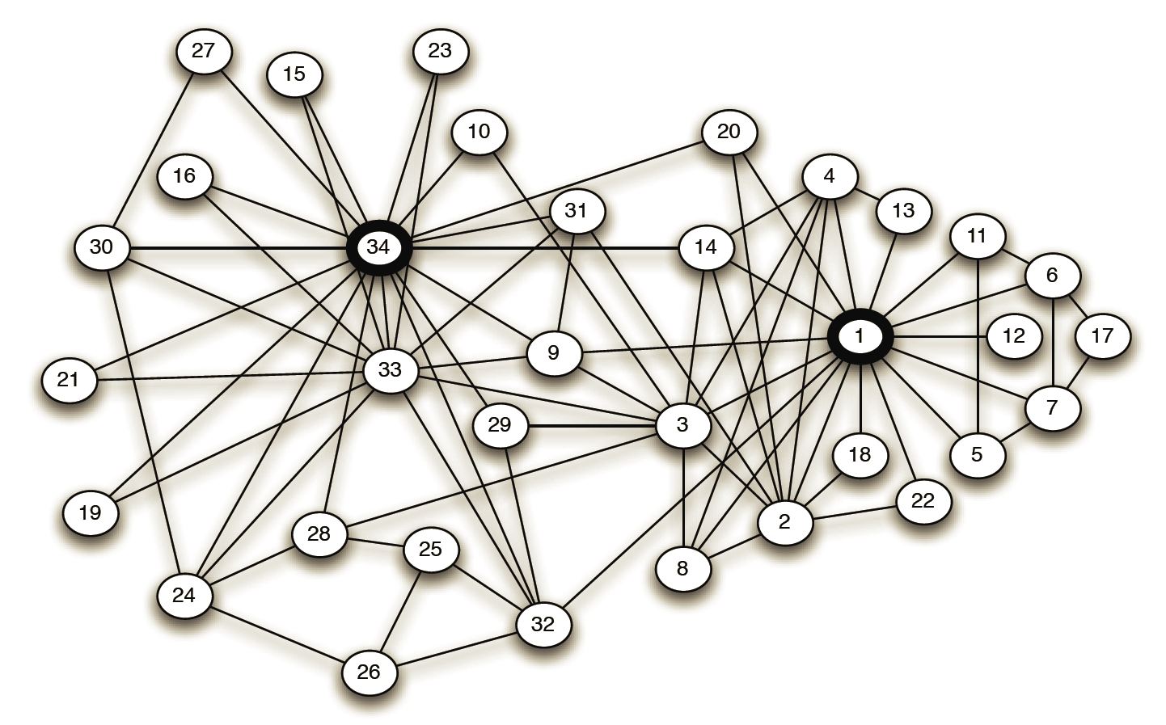
Social network analysis
Karate club network

Slide 5
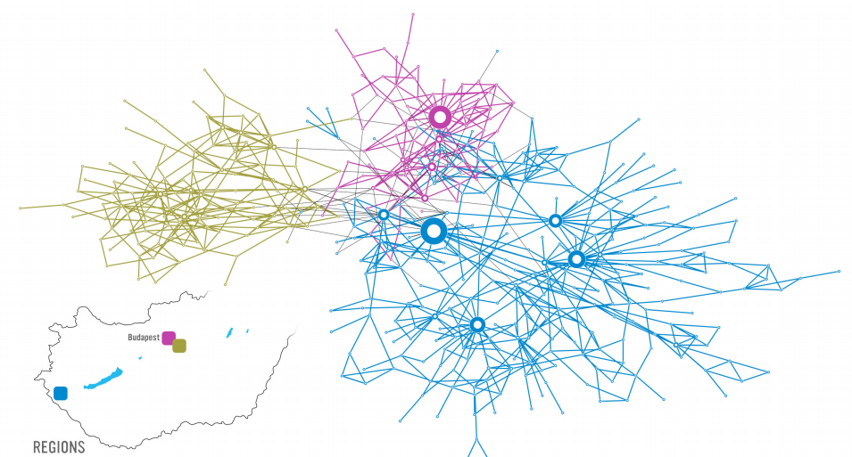
Social network analysis

Slide 6
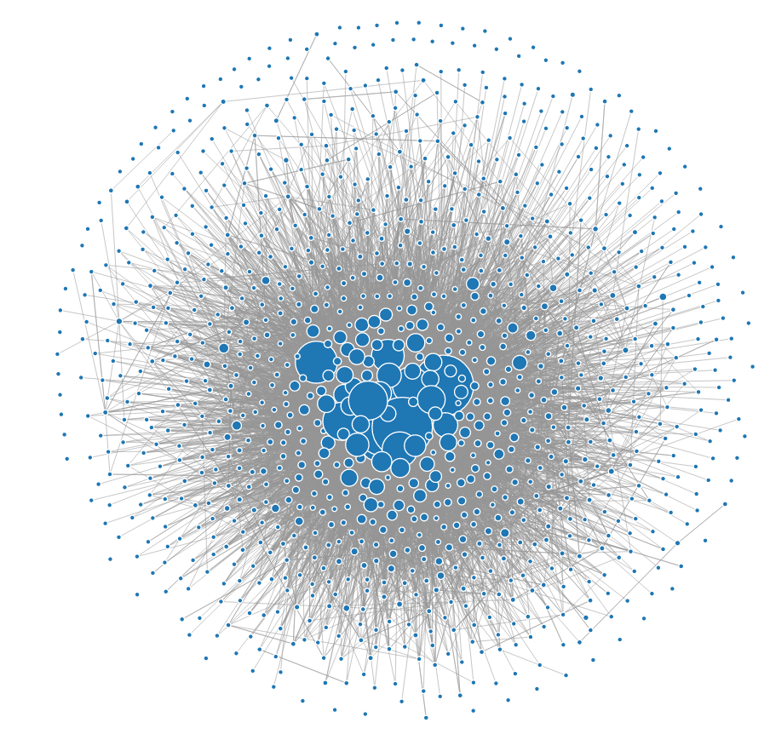
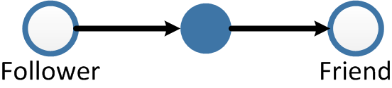
Twitter networks

Slide 7
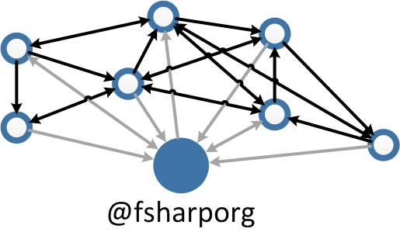
Ego network

Slide 8

Downloading data from Twitter
List of nodes
Connections between nodes
Twitter API allows only 15 requests every 15 minutes
to list connections.

Slide 9
Downloading data from Twitter

Slide 10

Downloading data from Twitter
Twitter is not consistent
and networks are dynamic

Slide 11
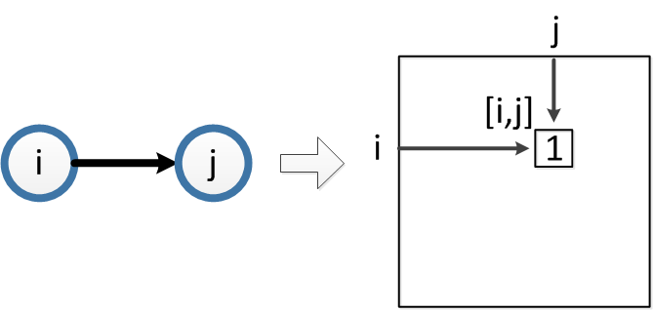
Adjacency matrix

Slide 12
Adjacency matrix

Slide 13
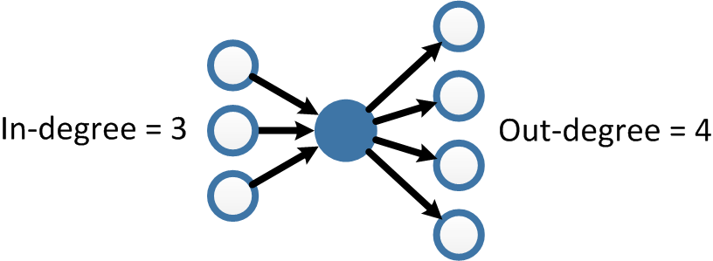
Degrees

Slide 14
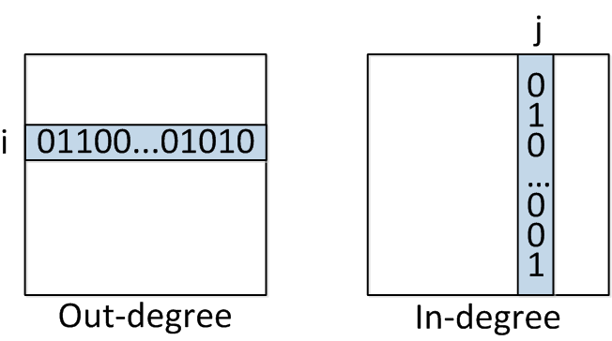
Degrees

Slide 15
Degrees

Slide 16
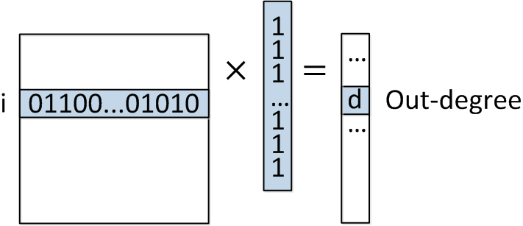
Degrees

Slide 17
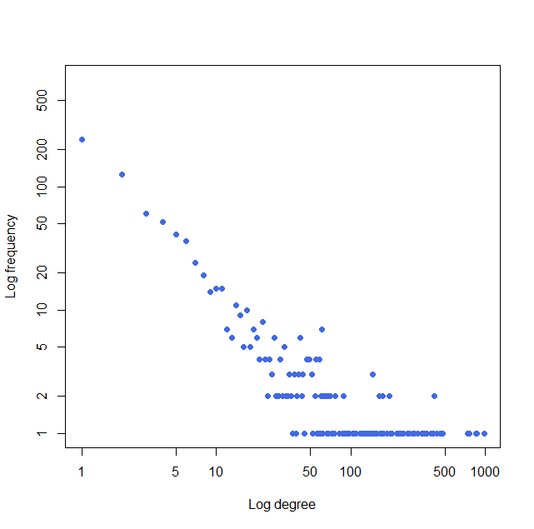
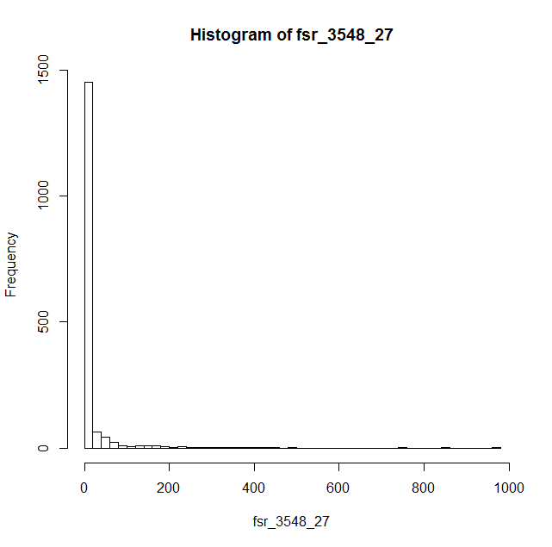
Degree distribution

Slide 18
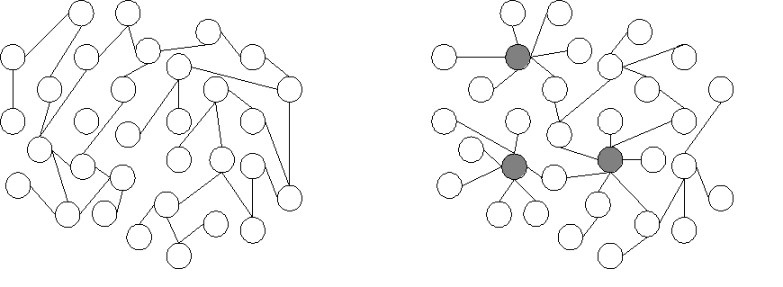
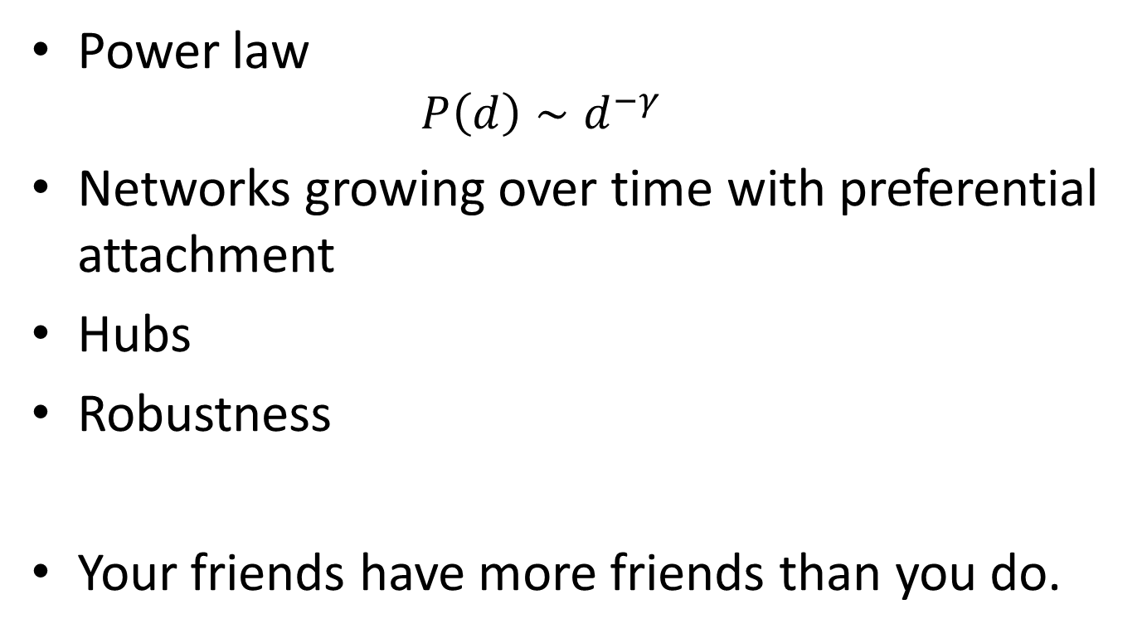
Scale-free networks
Power law
$$P\left(d\right)∼d^{−γ}$$
Networks growing over time with preferential attachment
Hubs
Robustness
Your friends have more friends than you do.

Slide 19
Top ranking users

Slide 20
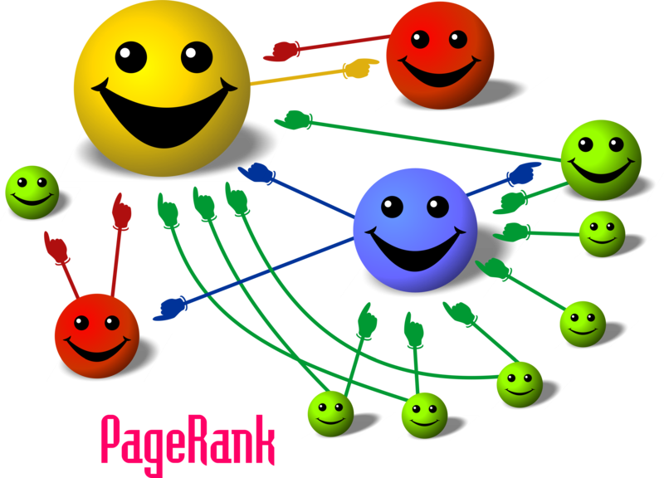
Centrality with PageRank
Your followers are not created equal.

Slide 21

Random surfer model

Slide 22
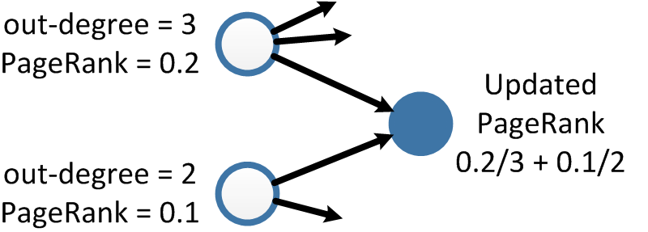
Centrality with PageRank
+ random jumps

Slide 23
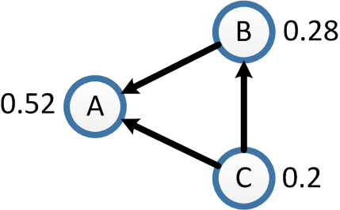
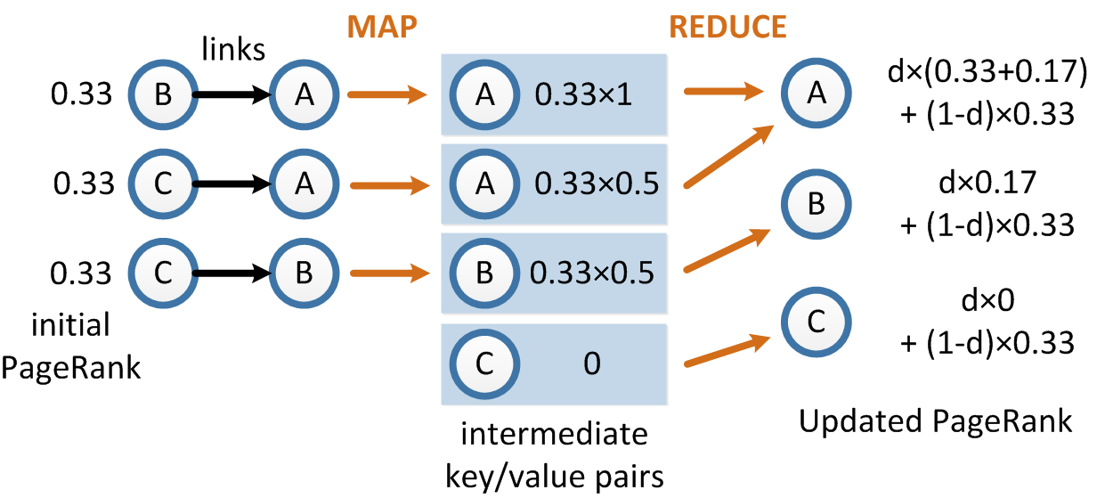

Slide 24
centrality with Pagerank

Slide 25
PageRank changes
February
September
1. migueldeicaza (0.033130)
2. dsyme (0.032783)
3. tomaspetricek (0.027756)
4. LincolnAtkinson (0.021993)
5. VisualFSharp (0.020233)
6. c4fsharp (0.019720)
7. rickasaurus (0.019189)
8. ptrelford (0.018099)
9. 1tgr (0.016525)
10. sforkmann (0.014970)
1. dsyme (0.028640)
2. migueldeicaza (0.024808)
3. VisualFSharp (0.024479)
4. tomaspetricek (0.021066)
5. c4fsharp (0.019612)
6. rickasaurus (0.014272)
7. sforkmann (0.013471)
8. 1tgr (0.012768)
9. ptrelford (0.012669)
10. FSPowerTools (0.012113)

Slide 26
Visualisation with d3.js

Slide 27
So who’s my most central follower?
1) dsyme
2) tomaspetricek
3) rickasaurus
4) ptrelford
5) sforkmann
6) brandewinder
7) sergey_tihon
8) rachelreese
9) ScottWlaschin
10) 7fsharp9

Slide 28
So who’s my most central follower?
1) dsyme
2) tomaspetricek
3) rickasaurus
4) ptrelford
5) sforkmann
6) brandewinder
7) sergey_tihon
8) rachelreese
9) ScottWlaschin
10) 7fsharp9
Thank you!

