Slide 1
Multi-market Deal Size prediction
Evelin C. F. de Amorim
Departamento de Ciência da Computação
Universidade Federal do Espírito Santo
Sistemas de Recomendação 2014/02
Evelin Carvalho Freire de Amorim

Slide 2
Introduction
Daily Deals Sites (DDSs) are web portals that offer discount coupons for services and products
Merchants want to disclose a new service or the business itself
The more coupon DDSs sell, the more profit DDSs gets

Slide 3
Introduction
If DDSs know before hand, it is possible to take business decisions
Related work
(Byers, Mitzenmacher, & Zervas,2012): Description of deal size by a linear model
(Lappas & Terzi, 2012): Solution that take in account deals diversity and user limit budget
Notes:
Considera tbm o impacto de redes sociais no problema
Oferece solução que considera a diversidade de ofertas e o orçamento limitado do consumidor, mas que não considera a competição no mercaod

Slide 4
Methodology
Three main phases
Identification of markets in catalog;
SVR training/testing
Expectation-maximization method in order to find the market weight

Slide 5
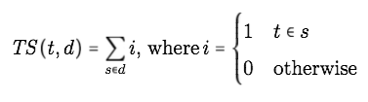
Methodology
Identification of markets catalog
Text Features: Title, description, merchant’s name, highlight of the deal, bag-of-words, concatenation
Types of weights: Term Spread (TS), Inverse Feature Frequency (IFF), Term Frequency (TF), TS x IFF, TF x IFF
Latent Dirichlet Allocation (LDA): find topics
Notes:
Term spread formula

Slide 6

Methodology
2. SVR training/testing
City of the deal, the absolute value of discount, whether the deal sold out, #days available, day of week the deal starts, category of the deal;

Slide 7

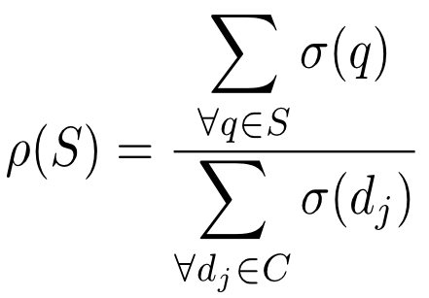

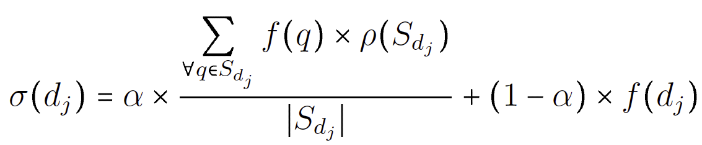
Methodology
3. Expectation-maximization (RMSE)
Expectation
Max.
Notes:
Rho é o peso dos mercados
(impact of market in deal size)
Weighted mean also

Slide 8
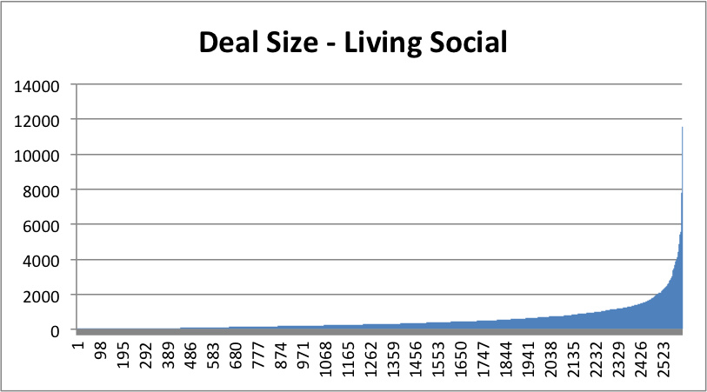
Dataset
Living Social (Byers et. al)
March 21st and July 3rd, 2011
19 documents removed from the original: 2590
Notes:
Como podemos ver é uma distribuição quase exponencial e os valore da deal size pode variar muito. Essa variação também justificará o porquê da nossa me’trica

Slide 9
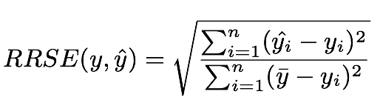
Experiments and Results
EM method is not evaluated
Strategy | RRSE
Best-Market | 1.03
All-Market | 1.13
Thresh-Market (0.3) | 1.06
Notes:
- Full task: seven classes

Slide 10
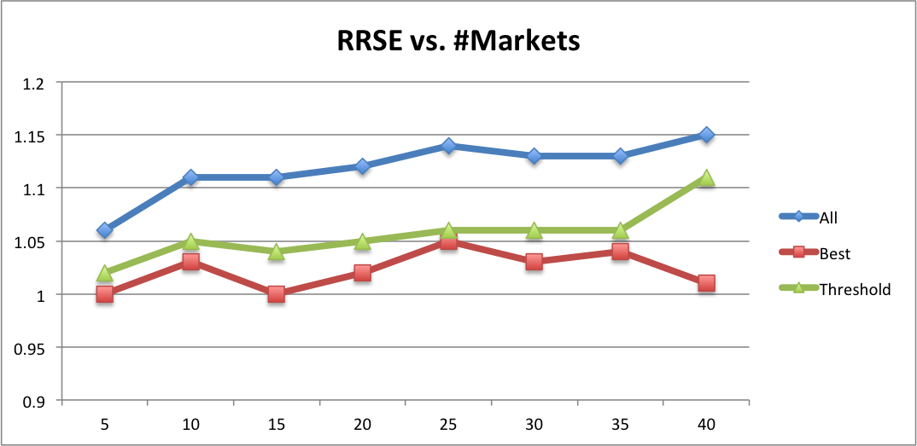
Experiments and Results

Slide 11
Conclusion and Discussion
Likely, the other markets add error to the final classification
More tests…
Groupon dataset
Confidence interval
Will EM strategy improve when considering other markets?
Another thresholds values

Slide 12
References
Byers, J. W., Mitzenmacher, M., & Zervas, G. (2012,February). Daily deals: Prediction, social diffusion, and reputational ramifications. In Proceedings of the fifth ACM international conference on Web search and data mining (oo. 543-552). ACM.
Lacerda, A.M. (2013). Revenue Optimization and Customer Targeting in Daily-Deals Sites.
Lappas, T., & Terzi, E. (2012, October). Daily-deal selection for revenue maximization. In Proceeding of the 21st ACM international conference on Information and knowledge management (pp. 565-574). ACM.

