Slide 1
Context-aware Deal Size Prediction
Anisio Lacerda (CEFET-MG)
Adriano Veloso (UFMG)
Rodrygo Santos (UFMG)
Nivio Ziviani (UFMG/Zunnit)

Slide 2



Daily-Deals Sites (DDSs)
Daily-Deals Site
(mediator)
Merchant
Customer
(seller)
(buyer)
Notes:
DINAMICA FUNCIONAMENTO DDS
- Para que todo o sistema funcione diversos problemas precisam ser resolvidos, nesta tese focamos em dois aspectos: Revenue maximization e Customer satisfaction

Slide 3
Daily-Deals Sites (DDSs)
Daily-Deals Site
(mediator)
Deal
Selection
Revenue
Maximization
Available
Deals
Deal
Size?
Catalog
Notes:
DINAMICA FUNCIONAMENTO DDS
- Para que todo o sistema funcione diversos problemas precisam ser resolvidos, nesta tese focamos em dois aspectos: Revenue maximization e Customer satisfaction

Slide 4
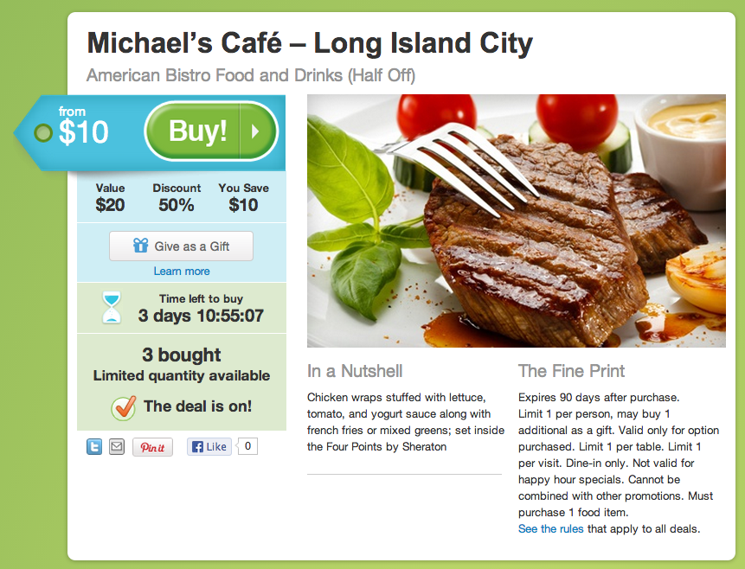
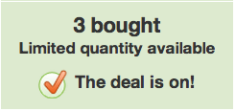
Deal size prediction
Predict how many coupons will be sold

Slide 5
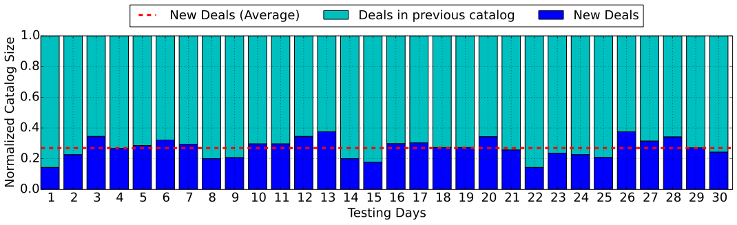
Challenge #1: catalog volatility
Lack of historical purchase data
30% of new deals each day on average
Maximum deal lifetime of 4-5 days
Notes:
- ofertas possuem um tempo de vida limitado, ou seja, sao validas durante curtos periodos de tempo
- alem disso, o catalogo, isto e, o conjunto de ofertas, renova-se diariamente
- com isso temos pouco dados historico sobre as ofertas

Slide 6
Related work
Global Predictor (GLPR) [Byers et al. 2012]
Deals Catalog
Deals Vectors
Global Predictor
Predictions
P
Feature Extraction
Predictor Learning
Notes:
- nosso metodo para predicao do numero de coupons vendidos
- QUATRO fases
- a seguir apresentamos as diferencas do nosso trabalho em relacao aos dois baselines

Slide 7
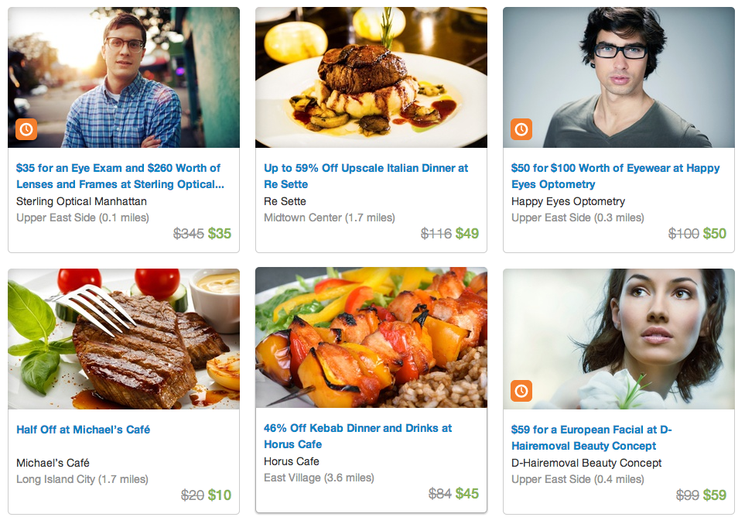
Challenge #2: deals specificity
Different deals
Different content
Different prediction
Deals belong to MARKETS
Health
Food
Notes:
- ofertas podem competir entre si
- ofertas podem ajudar outras ofertas
-TODO: ver se troco os exemplos???

Slide 8
Related work
One Predictor per Business Market (OPBM) [Lappas and Terzi 2012]
Markets
Per-market Predictors
P₁
Prediction Switcher
Deals Catalog
Deals Vectors
P₂
Predictions
…
…
P_{k}
Feature Extraction
Market Clustering
Predictor Learning
Notes:
- nosso metodo para predicao do numero de coupons vendidos
- QUATRO fases
- a seguir apresentamos as diferencas do nosso trabalho em relacao aos dois baselines

Slide 9
Challenge #3: deals interference
Deals may compete with one another
Deals may complement one another
Markets provide CONTEXT
Eye exam
Restaurants
Eyewear
Notes:
- ofertas podem competir entre si
- ofertas podem ajudar outras ofertas
-TODO: ver se troco os exemplos???

Slide 10
Our contributions
A novel context-aware, content-based approach for deal size prediction
Features derived from multiple fields
Market interactions as context
A large-scale empirical validation
Real usage data from 3 commercial DDSs

Slide 11
Context-aware deal size prediction
The size of a deal depends on the interference of the other deals from the same market
Markets
Per-market Predictors
P₁
Contextual Prediction
Deals Catalog
Deals Vectors
P₂
Predictions
…
…
P_{k}
Feature Extraction
Market Clustering
Predictor Learning
Notes:
- nosso metodo para predicao do numero de coupons vendidos
- QUATRO fases
- a seguir apresentamos as diferencas do nosso trabalho em relacao aos dois baselines

Slide 12
Context-aware deal size prediction
Feature extraction
Market clustering
Per-market prediction learning
Contextual prediction learning
Notes:
- nosso metodo para predicao do numero de coupons vendidos
- QUATRO fases
- a seguir apresentamos as diferencas do nosso trabalho em relacao aos dois baselines

Slide 13
Feature extraction
Field-based term features
Markets
Per-market Predictors
P₁
Contextual Prediction
Deals Catalog
Deals Vectors
P₂
Predictions
…
…
P_{k}
Feature Extraction
Market Clustering
Predictor Learning
Notes:
- RQ1: COMO PODEMOS REPRESENTAR AS OFERTAS?
- focamos agora na primeira parte do metodo: TERMS EXTRACTION

Slide 14

Tackling catalog volatility
Name
Manhattan Kayak
Title
Up to 51% Off ...
Highlight
Kayakers and standup paddleboarders tour the Hudson River ...
Description
Kayakers, unlike pancakes or depressed turtles, muster the will to get themselves upright when flipped upside down. Float through life with this Groupon.
…
Notes:
- exploramos a ESTRUTURA TEXTUAL as ofertas

Slide 15
Deal representation
Fields
Term weights
Name
Title
Description
Concatenation
TF, TF*IFF, TS, TS*IFF
Term Frequenty (TF)
Term Spread (TS)
Inverse Feature Frequency (IFF)
4 fields x 4 weighting schemes
= 16 feature spaces
Notes:
- utilizamos apenas o CONTEUDO TEXTUAL para representar as ofertas nesta fase
- SUPOSICAO: diferentes mercados sao descritos por diferentes vocabularios
- FEATURES (6)
- WEIGHTING SCHEMES (4)
- TODO: eu somo as frequencias dos termos?

Slide 16
Market clustering
Latent Dirichlet allocation (LDA)
Market = latent topic
Markets
Per-market Predictors
P₁
Contextual Prediction
Deals Catalog
Deals Vectors
P₂
Predictions
…
…
P_{k}
Feature Extraction
Market Clustering
Predictor Learning
Notes:
- RQ1: COMO PODEMOS REPRESENTAR AS OFERTAS?
- focamos agora na primeira parte do metodo: TERMS EXTRACTION

Slide 17
Market clustering
“Gym” | “Hair Salon” | “Sports”
class | salon | camping
fit | hair | week
body | look | sport
train | services | day
Notes:
- utilizamos o LDA
- metodo probabilistico que retorna topicos latentes
- TOPICOS LATENTES sao distribuicoes de probabilidade sobre o vocabulario
- no caso do LDA o numero de topicos e um PARAMETRO do metodo
- interpretamos TOPICOS == MERCADOS
- apresentamos 5 topicos de exemplo:
- Groupon
- Highlight
- TS*IFF
- titulo de cada topico e uma INTERPRETACAO feita por nos

Slide 18
Predictor learning
Support vector regression (SVR)
Extra features (face value, discount, days active)
Markets
Per-market Predictors
P₁
Contextual Prediction
Deals Catalog
Deals Vectors
P₂
Predictions
…
…
P_{k}
Feature Extraction
Market Clustering
Predictor Learning
Notes:
TODO: how is SVR trained?

Slide 19
Contextual prediction
Expectation maximization (EM)
Markets
Per-market Predictors
P₁
Contextual Prediction
Deals Catalog
Deals Vectors
P₂
Predictions
…
…
P_{k}
Feature Extraction
Market Clustering
Predictor Learning
Notes:
- RQ1: COMO PODEMOS REPRESENTAR AS OFERTAS?
- focamos agora na primeira parte do metodo: TERMS EXTRACTION

Slide 20

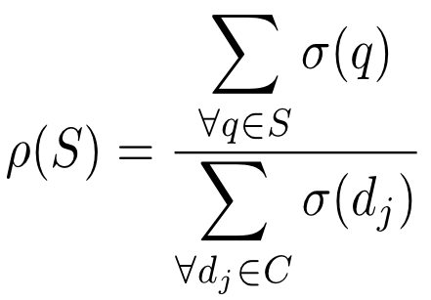

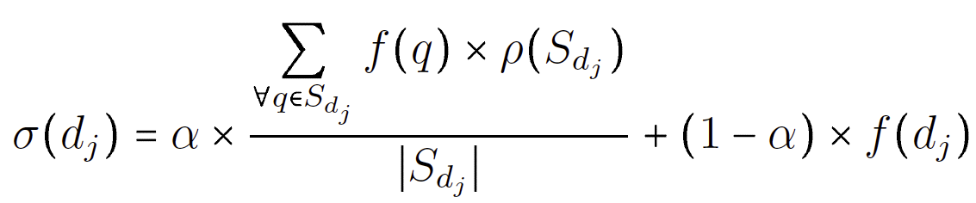
Deal size EM predictor
Expectation
ρ(S): score of market S
σ(d_{j}): size of deal d_{j}
RMSE as loss function
Maximization
Notes:
- ALPHA: o parametro alpha permite balancearmos a previsao local e a previsao que leva em conta todo o catalogo
- RHO: o parametro rho e desconhecido e representa o peso das ofertas de um mercado (INTERPLAY)
- TAMANHO DO MERCADO: quando dividimos a soma das previsoes pelo tamanho do mercado, estamos tratando a COMPETICAO entre os mercados
- inicializamos o valor de RHO com as medias historicas dos mercados
- o objetivo é minimizar o RMSE
- iteramos ate: (i) CINCO iteracoes ou (ii) a diferenca de RMSE seja menor que 0.005

Slide 21
Experimental setup
Interleaved test-then-train [Bifet et al. 2010]
Train up to day t, test at day t+1
Datasets
Groupon (English)
16,409 deals, from Jan 3rd, 2011 to Jul 3rd, 2011
LivingSocial (English)
2,610 deals, from Mar 21st, 2011 to Jul 3rd, 2011
Peixe Urbano (Portuguese)
4,309 deals, from Jan 1st, 2012 to Dec 31st, 2012

Slide 22
Experimental setup
Baselines
GPBM (global predictor) [Byers et al. 2012]
OPBM (one predictor per business market) [Lappas and Terzi 2012]
Evaluation
RMSE averaged over the test days

Slide 23
Research questions
Q1: How effective is our approach? (ours vs. GPBM and OPBM)
Q2: What is the impact of context? (contextual vs. global predictors)
Q3: What is the impact of feature spaces (textual field + weighting scheme)
(a few highlights: more on the paper)

Slide 24
Overall effectiveness
RQ1: How effective is our approach?
 | RMSE
 | Ours
Groupon (50) | 1.13
LivingSocial (30) | 1.02
Peixe Urbano (30) | 1.14
GLPR | Gain
1.37 | +17.6%
1.12 | +9.6%
1.29 | +11.7%
OPBM | Gain
1.35 | +16.3%
1.11 | +8.1%
1.25 | +9.1%
Notes:
Using trained number of topics
-> our context-aware approach beats global predictor
-> our context-aware approach beats per-market predictor

Slide 25
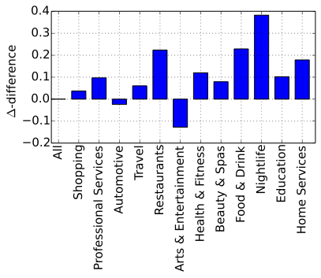
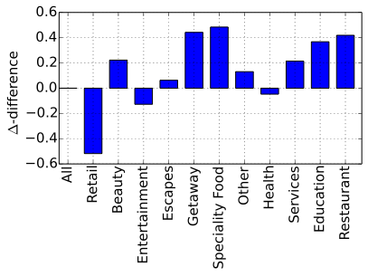
Context-aware predictors
RQ2: What is the impact of context?
contextual (+diff) vs. global (-diff) predictors
Groupon
Living Social
Notes:
Real categories to isolate the effect of misclustered deals
-> per-market predictors better for almost all deals
-> global predictors better for arguably less cohesive topics
Latent topics beat real categories (in the paper)
-> manual separation into categories does not reflect

Slide 26
Number of markets
 | RMSE
# markets | Groupon | LivingSocial | P. Urbano
5 | 1.366 | 1.128 | 1.317
10 | 1.295 | 1.119 | 1.244
20 | 1.255 | 1.094 | 1.151
30 | 1.192 | 1.020 | 1.143
40 | 1.196 | 1.086 | 1.167
50 | 1.133 | 1.137 | 1.149
100 | 1.182 | 1.093 | 1.184
Notes:
RQ7: QUAL O IMPACTO DO NUMERO DE MERCADOS NA EFICACIA DO METODO?
- estamos na QUARTA fase do metodo
- estamos usando TF e concatenacao
- apresentamos os resultados para os tres datasets
- independente da lingua, nosso metodo e capaz de prever o numero de coupons vendidos
- Groupon: CINQUENTA mercados
- Living Social e Peixe Urbano: TRINTA MERCADOS
- CEM mercados tendem a ser muito especificos e, talvez, por isso tenhamos resultados piores

Slide 27
Feature extraction
RQ3: What is the impact of features spaces?
textual field + weighting scheme
 | RMSE (Groupon)
 | Name | Title | Desc. | Concat.
TS | 1.173 | 1.152 | 1.167 | 1.422
TSxIFF | 1.211 | 1.227 | 1.295 | 1.214
TF | 1.190 | 1.146 | 1.157 | 1.133
TFxIFF | 1.198 | 1.216 | 1.458 | 1.213

Slide 28
Feature extraction
RQ3: What is the impact of features spaces?
textual field + weighting scheme
 | RMSE (Groupon)
 | Name | Title | Desc. | Concat.
TS | 1.173 | 1.152 | 1.167 | 1.422
TSxIFF | 1.211 | 1.227 | 1.295 | 1.214
TF | 1.190 | 1.146 | 1.157 | 1.133
TFxIFF | 1.198 | 1.216 | 1.458 | 1.213
Notes:
Sparse spaces (e.g., name, title)
-> use TS

Slide 29
Feature extraction
RQ3: What is the impact of features spaces?
textual field + weighting scheme
 | RMSE (Groupon)
 | Name | Title | Desc. | Concat.
TS | 1.173 | 1.152 | 1.167 | 1.422
TSxIFF | 1.211 | 1.227 | 1.295 | 1.214
TF | 1.190 | 1.146 | 1.157 | 1.133
TFxIFF | 1.198 | 1.216 | 1.458 | 1.213
Notes:
Dense spaces (e.g., desc, concat)
-> use TF

Slide 30
Feature extraction
RQ3: What is the impact of features spaces?
textual field + weighting scheme
 | RMSE (Groupon)
 | Name | Title | Desc. | Concat.
TS | 1.173 | 1.152 | 1.167 | 1.422
TSxIFF | 1.211 | 1.227 | 1.295 | 1.214
TF | 1.190 | 1.146 | 1.157 | 1.133
TFxIFF | 1.198 | 1.216 | 1.458 | 1.213
Notes:
IFF almost always harms performance
-> exception is TSxIFF (Concat)

Slide 31
Wrap-up
Introduced a novel context-aware, content-based approach for deal size prediction
Overcomes deals volatility
Exploits within-market interference
Taking into account deals interaction and structure improves deal size prediction
Gains range from 8% to 17%

Slide 32
Future work
Market identification
Non-textual features
Hierarchical, soft clustering
Context-aware prediction
Predict competition / complementarity
Incorporate anchoring (position bias)
Notes:
Hierarchical markets
Pairwise competition vs complementarity prediction

Slide 33
Context-aware Deal Size Prediction
Anisio Lacerda (CEFET-MG)
Adriano Veloso (UFMG)
Rodrygo Santos (UFMG)
Nivio Ziviani (UFMG/Zunnit)

