Slide 1
WOBBLE
MECHANISMS
From restoring torque to a measured motion loop
ESP32 / BNO055 / TMC2209 / stepper actuation / USB dashboard
A bottom-heavy body turns an internal torque command into visible motion.
The dashboard closes the loop with orientation, inertial, and motor state.

Slide 2
02
The motion loop
The technical question is how input becomes measurable wobble
Command becomes useful when the physical response is observable.
FORWARD PATH
COMMAND
CURRENT
TORQUE
REACTION
WOBBLE
JSON over USB
115200 bit/s
TMC2209 coil drive
I [A]
Stepper shaft
τ [N·m]
Offset mass
τreaction [N·m]
Egg tilt
θ [deg]
FEEDBACK / SAFETY
BNO055: orientation θ [deg] | gyro ω [deg/s] | acceleration a [m/s²] | temperature T [°C]
Dashboard observes orientation, inertial, and motor state. Stable-rock safety + peer filtering use it; ordinary run/rock remains open-loop.

Slide 3
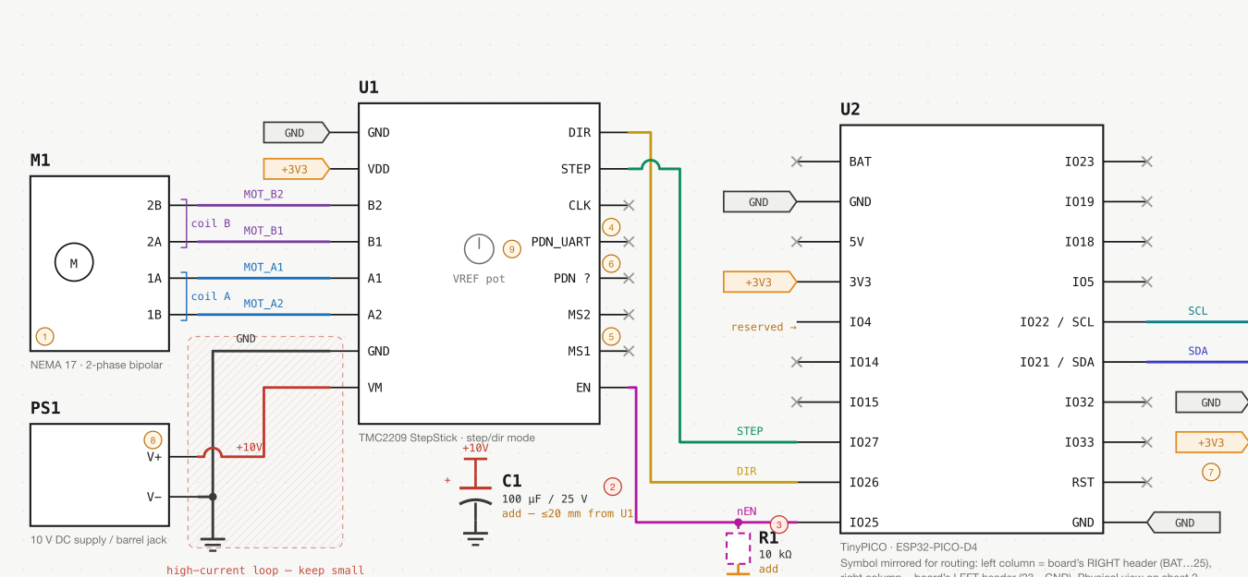
03
Electronics integration
The schematic is a wiring reference; the firmware test map is the current authority
SIGNALS
• I²C: SDA GPIO 21, SCL GPIO 22
• I²C clock: 100 [kHz]
• Firmware test map: STEP GPIO 25, DIR GPIO 26
• ENN GPIO 27, active low
POWER
• 12 [V] motor reference; verify installed supply; asset labels 10 [V]
• Logic 3.3 [V] + common ground
• Bulk cap 100 [µF] / ≥25 [V]; EN pull-up 10 [kΩ]
• SM-17HS4023 motor reference: 0.7 [A/phase]
• TMC2209 current limit: not recorded; verify setting
AS-BUILT NOTE
Schematic pin map unreconciled; test map: STEP 25 / ENN 27.

Slide 4
04
Components inside one egg
Each part owns one stage of the sensing-to-motion chain
01
BNO055
IMU
orientation [deg], acceleration [m/s²], gyro [deg/s]
02
ESP32
controller
parses JSON, schedules motion, emits telemetry
03
TMC2209
driver
regulates phase current [A] at a hardware-configured limit; STEP / DIR / ENN provide pulse, direction, enable
04
STEPPER
actuator
SM-17HS4023 ref: 0.7 [A/phase] → shaft torque [N·m]
05
MECHANISM
body + offset mass
converts internal reaction torque into tilt [deg]
BNO055 → ESP32 → TMC2209 → stepper → mechanism → BNO055

Slide 5
05
Mechanical design: load path + center of mass
Mass properties, bearing support, and contact geometry determine how torque becomes visible wobble
MECHANICAL LOAD PATH
MODEL INPUTS / REPOSITORY
mass m = 500 [g] = 0.500 [kg]
semi-axes ≈ 35 × 35 × 40 [mm]
CoM = (0, 0, −25) [mm] from geometric center
contact radius = 35 [mm] · roughness = 0.1 [mm]
shell thickness = 2 [mm]
MOTOR / SHAFT
BEARING SUPPORT
OFFSET MASS
τmotor [N·m]
radial + axial load [N]
r [m]
internal mechanism
geom.
center
TORQUE CALCULATION
dCoM = 25 [mm]
τg = −m g ℓCoM sin(θ)
θrad = θdeg × π / 180
kg ≈ m g ℓCoM [N·m/rad]
Proxy: m g dCoM = 0.123 [N·m/rad].
Use dCoM for the model; ℓCoM is contact-to-CoM. Measure contact geometry before treating the proxy as physical torque.
CoM
contact
load returns through shell → contact → table
BEARING / LOAD CHECK NEXT: load [N] · support spacing [mm] · backlash [deg] · drag [N·m]

Slide 6
06
Why the egg self-rights
Gravity creates a restoring torque when the center of mass is offset
τg = −m g ℓCoM sin(θ)
gravity
F = m g [N]
τg [N·m]
• m [kg] is total body mass
• g = 9.81 [m/s²] is gravitational acceleration
• ℓCoM [m] is the contact-to-CoM lever arm used in the torque equation
• dCoM [m] is the modeled offset below geometric center; contact geometry remains to be measured
• θ [rad] is tilt from upright; θrad = θdeg × π/180 converts IMU output
θ [deg]
measured by IMU
CoM
contact
Near upright: sin(θ) ≈ θ, so k_g = m g ℓCoM [N·m/rad].
Model example: m = 0.500 [kg], dCoM = 0.025 [m].

Slide 7
07
The rotational physics
Torque, angular speed, work, and power describe the actuator side
TORQUE AND WORK
SPEED, POWER, AND GEARS
τ = r × F
ω = 2π · RPM / 60
τ [N·m] r [m] F [N]
ω [rad/s] RPM [rev/min]
W = ∫ τ dθ
Pmech = τ ω
W [J] θ [rad]
Pmech [W]
Ideal reduction N [-]: ωout = ωmotor / N
τout ≈ ηg N τmotor [N·m]
A longer lever arm gives more rotational push for the same force.
Gears trade speed for torque; ηg [-] captures loss.
Causal flow: F [N] → τ [N·m] → W [J] → ω [rad/s] → P [W] → geared output [N·m]

Slide 8
08
Where the energy goes
A command changes electrical energy into motion, storage, and dissipation
Energy transitions make the technical story testable: each arrow names a quantity we can measure or estimate.
ELECTRICAL INPUT
MECHANICAL OUTPUT
MECHANICAL STATE
DISSIPATION
Eelec = ∫ V I dt
V [V], I [A], t [s] → E [J]
Pmech = τω
τ [N·m], ω [rad/s] → P [W]
K = ½ Jω² [J]
ΔU = m g d(1 − cos θ) [J]
J [kg·m²], d [m], θ [rad]
friction + damping
coil heat + sound [J]
EFFICIENCY QUESTION
ηsystem [-] = Pmech [W] / Pelec [W]
Electrical power, output torque, and loaded energy efficiency are not yet measured.
The next experiment instruments Vsupply [V], Isupply [A], torque [N·m], and body response θ [deg].

Slide 9
09
Individual board communication
First establish one complete board contract; then relay a motion intent to its peer
INDIVIDUAL BOARD CONTRACT
BNO055
ESP32
TMC2209
STEPPER
I²C SDA 21 / SCL 22
100 [kHz]
parses commands
reads sensor
STEP 25 / DIR 26 / ENN 27
VMOT 12 [V]
phase current 0.7 [A]
shaft output
BOARD-TO-BOARD INTENT PATH
EGG A
LAPTOP
DELAY
EGG B
telemetry
features [deg/s, m/s²]
filter + sequence
JSON packet
250 [ms]
scale 0.50 [-]
rock intent
rpm [rev/min]
STATUS: USB peer path is laptop-mediated; direct board-to-board Wi-Fi is next.

Slide 10
10
Peer coordination
A filtered, delayed, scaled motion intent travels between the two boards
IMU SAMPLE
FEATURES
SCORE
FILTER
FOLLOWER
gyro [deg/s]
accel [m/s²]
‖gyro‖ [deg/s]
adyn [m/s²]
0.70 gyro +
0.30 accel [-]
EMA τ = 0.18 [s]
hysteresis [-]
250 [ms] delay
0.50 scale [-]
gyro_score = clamp(|gyro| / 90 [deg/s], 0, 1)
accel_score = clamp(adyn / 2.5 [m/s²], 0, 1)
I_source = 0.70 × gyro_score + 0.30 × accel_score [-]
I_eff = clamp(3.0 × I_source, 0, 1) × target_fraction [-]
rpm = 60 × I_eff [rev/min]
amplitude = 0.25 × I_eff [shaft rev]
accel = min(30, 30 × I_eff) [rev/min/s]
SAFETY GATES
start ≥ 0.18 [-] stop ≤ 0.10 [-]
stale timeout = 800 [ms]
Peer stale/stop detection exists; motor stop delivery is not yet validated.
Output: I_eff [-] maps to rock command with rpm [rev/min], amplitude [shaft rev], accel [rev/min/s], cycles [-].

Slide 11
11
Codespace setup and rationale
Parallel layers are joined by explicit interfaces, not a serial software pipeline
SHARED CONTRACT: newline-delimited JSON commands and telemetry
simulator/src/
simulator/firmware/
simulator/dashboard/
simulator/dual_board/
physics model
metrics
IMU + PWM
state machine
USB bridge
plots + controls
filter + delay
peer intent
WHY THIS SPLIT
Test physics without hardware.
Isolate transport from motion.
Trace each run to one command and one log.
Interfaces: physics ↔ experiments; firmware ↔ dashboard; dashboard → peer filter; tests → evidence.

Slide 12
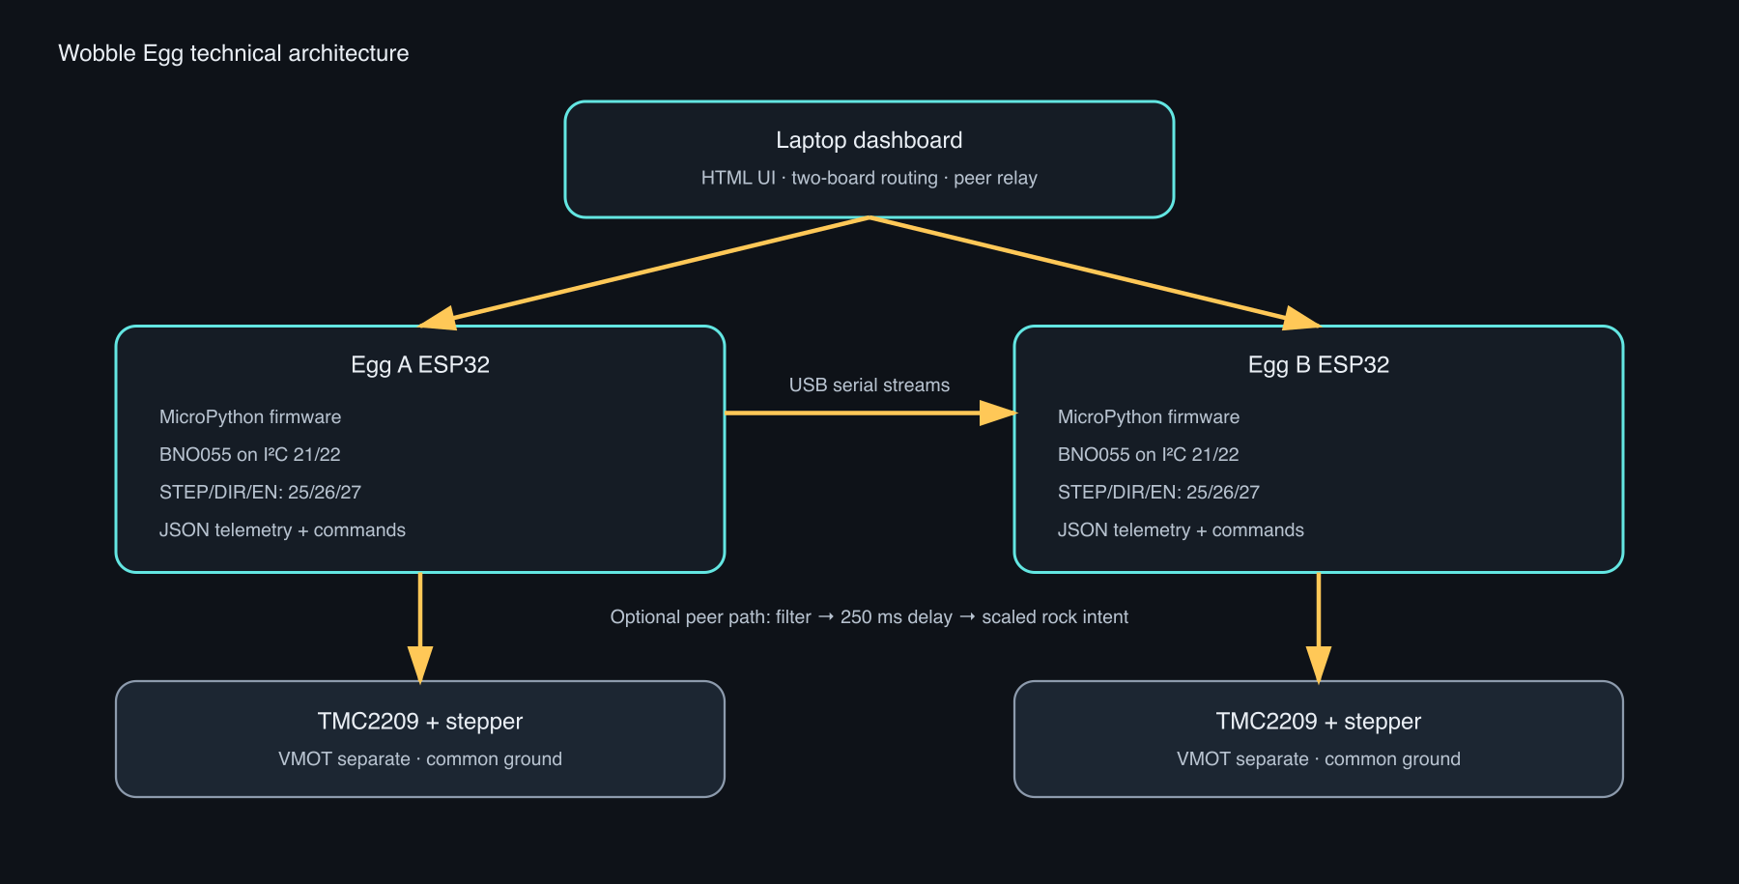
12
Runtime architecture
Two independent USB channels share the same control contract
WORKING PATH
• Laptop dashboard routes commands by board ID
• Each board emits telemetry at about 30 [samples/s]
• Serial link: 115200 [bit/s] JSON
• USB is the deterministic commissioning transport
OPTIONAL PEER PATH
Laptop-mediated: features → filter → 250 [ms] delay → rock intent.
Both eggs remain independently addressable.
Board commands remain independently addressable.

Slide 13
13
Wireless next steps
USB works today; Wi-Fi is an experimental HTTP API with unfinished command parity and heartbeat servicing
CURRENT SETUP
USB SERIAL
JSON
DASHBOARD
laptop ↔ ESP32
115200 [bit/s]
commands + telemetry
newline delimited
controls + plots
about 30 [samples/s]
WIRELESS PATH
ACCESS POINT
ESP32 HTTP
HEARTBEAT
PEER RELAY
2.4 [GHz] Wi-Fi
GET /api/state
POST /api/command
750 [ms] watchdog
motion packet
250 [ms] delay
STATUS: USB working · Wi-Fi experimental · command parity + heartbeat pending

Slide 14
14
Command surface
Every numeric input maps to a physical or timing quantity
INPUT | UNIT | EFFECT
mode | enum | run, smooth run, rock, smooth rock, stable rock (tilt limit)
distance_rev | shaft rev | one-way travel target
amplitude_rev | shaft rev | one-way rock amplitude
rpm | rev/min | peak shaft speed
accel | rev/min/s | speed ramp slope
direction | sign [-] | +1 clockwise, −1 counter-clockwise
cycles | cycles [-] | rock repetitions; 0 means continuous
max_tilt_deg | deg | stable-rock tilt ceiling
intensity | fraction [-] | rock command scale from 0 to 1
target_fraction | fraction [-] | peer follower scale; default 0.50
Actions without numeric inputs: tare IMU, stop, stop immediately, record origin, return to origin.

Slide 15
15
Dashboard measurements
The UI exposes orientation, inertial, thermal, and motor state
IMU MEASUREMENTS
MOTOR AND TIMING STATE
heading / yaw
orientation about vertical
[deg]
rpm / target_rpm
shaft speed / target
[rev/min]
roll, pitch
body orientation relative to tare
[deg]
accel_rpm_s
speed ramp
[rev/min/s]
position_steps
commanded position
[steps]
accel x / y / z
specific force, includes gravity
[m/s²]
distance_rev
commanded travel
[shaft rev]
gyro x / y / z
angular velocity
[deg/s]
target_steps
finite travel target
[steps]
temperature
sensor / board thermal reading
[°C]
step_rate_hz
STEP pulse rate
[steps/s]
calibration
BNO055 status per subsystem
[0–3]
t_ms
sample timestamp
[ms]
telemetry_hz
stream rate
[samples/s]
Position is generated-step state; IMU angles are body orientation.

Slide 16
16
Physics vocabulary in the dashboard
Raw sensor fields become interpretable motion features
GYROSCOPE
ω [deg/s]
ACCELEROMETER
a [m/s²]
Angular velocity.
Large magnitude means rapid rotation.
Specific force.
A still sensor is near g = 9.81 [m/s²].
DYNAMIC ACCEL
adyn [m/s²]
EULER ANGLES
yaw / roll / pitch [deg]
Motion beyond gravity.
adyn = |‖a‖ − g|.
Orientation coordinates.
Tare makes them relative to a pose.
Peer detection uses gyro magnitude first, then dynamic acceleration to reject a stationary tilt.

Slide 17
17
Motion primitives and conversion
The firmware commands shaft travel; the mechanism determines the resulting tilt
RUN
SMOOTH RUN
ROCK
TILT-LIMITED ROCK
one-way travel
to distance_rev
one-way travel
with braking
alternate direction
for cycles
continuous motion
with over-tilt safety
200 [full steps/rev] × 16 [microsteps/full step] = 3200 [commanded steps/rev]
step_rate = RPM × 3200 / 60
step_rate [steps/s] RPM [rev/min]
DISTANCE (SHAFT)
COMMANDED TRAVEL
COMMANDED SHAFT ANGLE
0.05
rev
160
steps
18
deg

Slide 18
18
Smooth distance control
Braking begins before the endpoint so the command does not cut off at cruise speed
REMAINING STEPS [steps] ↓
NORMAL RUN
braking_rpm = sqrt(
remaining_steps × 120 × accel / steps_per_rev)
target_rpm = min(cruise_rpm, braking_rpm)
step_rate [steps/s] =
target_rpm × steps_per_rev / 60
RAMP
CRUISE
CUT
SMOOTH RUN
RAMP
CRUISE
BRAKE
SETTLE
CONTROL LAW
120 = 2 × 60 [s/min] remaining_steps [steps] accel [rev/min/s] steps_per_rev [steps/rev]
The input is a speed ramp; the output is lower endpoint impulse.

Slide 19
19
Firmware realization
A small state machine turns JSON fields into bounded pulse timing
JSON PARSER
command + numeric fields [units]
if mode == "smooth_run":
remaining = target_steps - abs(position_steps)
target_rpm = min(cruise_rpm, braking_rpm(remaining))
step_pwm.freq(round(target_rpm * 3200 / 60))
STEPPER STATE
mode + position [steps]
PWM OUTPUT
STEP [steps/s] + DIR + ENN
TELEMETRY
IMU + motor state / 33 [ms]
Configured ceilings
1–240 [rev/min] 1–120 [rev/min/s] 15,000 [steps/s]

Slide 20
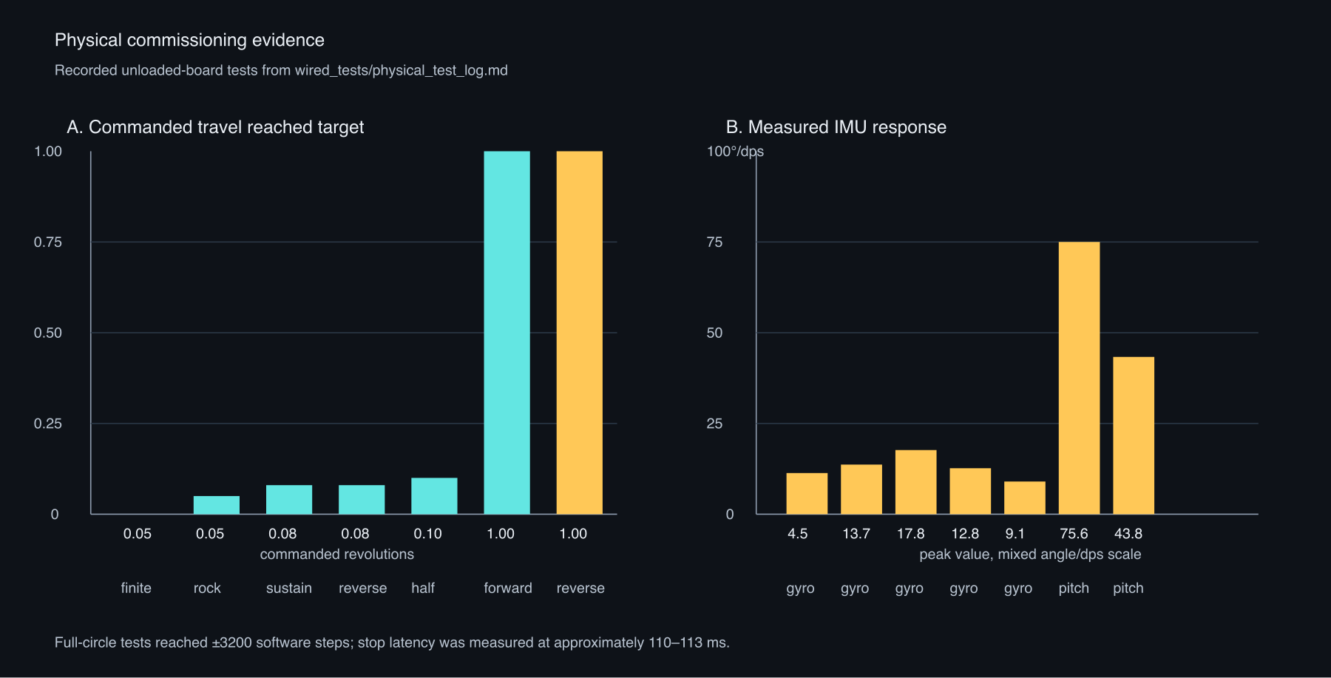
20
Measured command-path evidence
Physical log from unloaded-board USB commissioning
GENERATED TARGET
USB CMD→IDLE
160
steps
110–113
ms
GENERATED CIRCLE
SENSOR TEMP
±3200
steps
31–32
°C
KEY READOUT
4 [rev/min] · 0.05 [shaft rev] → software auto-stop at 160 [steps] → pitch peak 3.06 [deg] · gyro peak 13.73 [deg/s]
Command path observed: parse → auto-stop → reversal → telemetry → 0.110 [s] stop response.

Slide 21
21
What the current evidence measures
Separate generated motion, sensed body motion, and physical load
OBSERVED NOW
INSTRUMENT NEXT
PRODUCT QUESTION
• Generated position [steps] and travel [shaft rev]
• BNO055 orientation [deg], gyro [deg/s], accel [m/s²]
• USB stop response [ms]
• Unloaded-board temperature [°C]
• Physical shaft angle [deg] with marker or encoder
• Motor phase current [A] and VMOT [V]
• Loaded tilt amplitude [deg] and natural frequency [Hz]
• Repeatability [%] and missed-step count [steps]
• Can the body hold a target tilt [deg]?
• What load [g] and torque [N·m] remain stable?
• What temperature rise [°C] occurs over duty time [s]?
• Does peer delay [ms] feel intentional?
Key gap: commanded shaft motion [steps] versus verified physical shaft motion [deg].
Validated: unloaded USB command path. Not yet validated: loaded tilt, physical shaft angle, torque, power, final gear ratio, or wireless reliability.

Slide 22
22
Next experiment
Close the command-to-motion gap with an instrumented loaded run
01
POWER
02
SHAFT
03
LOAD
04
CORRELATE
VMOT [V]
logic [V]
marker / encoder
angle [deg]
mass [g]
CoM offset [mm]
tilt [deg]
current [A]
temperature [°C]
Acceptance output
commanded steps [steps] ↔ measured shaft angle [deg] ↔ body response [deg/s, m/s²]
• Repeat at conservative speed: 3–10 [rev/min]
• Sweep acceleration: 5–30 [rev/min/s]
• Record current [A], temperature [°C], tilt [deg], missed steps [steps] over time [s]

Slide 23
23
Making the wobble feel cute
Precise control turns mechanical parameters into a motion language
CUTE IS A CONTROLLED GESTURE
AUTHORING FLOW
parameter → command → measured response → perceived quality
amplitude
size [shaft rev]
small = contained
ANTICIPATE
WOBBLE
SETTLE
rpm
tempo [rev/min]
low = gentle
low speed
small ramp
bounded tilt
measured [deg]
smooth brake
short dwell [s]
accel
softness [rev/min/s]
slow ramp = soft
cycles
persistence [count]
brief = expressive
delay
social timing [ms]
late reply = character
ART / USER EXPERIENCE
The dashboard authors the gesture.
The egg is the visible character.
A second egg makes it social.
Hypothesis until measured.
intensity
command scale [-]
reduced = tender
θbody(t) = A · E(t) · sin(2π fw t + φ)
A [deg] fw [Hz] E [-] t [s] φ [rad]
rpm [rev/min] sets motor tempo; fw [Hz] is measured body response.
Design direction: use variation and delay to make control feel alive.

Slide 24
24
What I learned
A first serious hardware build grew out of a software and installation practice
STARTING POINT
THE HARDWARE LESSON
Most of my background is in software, digital and user-experience design, and art installations.
This was the first time I soldered since my first year of college.
I found the work incredibly rewarding and meditative, and I feel very blessed to have had the best mentors.
This project moved that practice into sensing, wiring, motion, and physical feedback.
Thank you to the lab for providing tools so generously. I definitely consumed a lot of 3D-printing resources.
The technical result is a working prototype. The personal result is a wider practice.

Slide 25
25
Photos and meals
Space for process documentation and the shared studio life around the build
FIRST SOLDERING / PROCESS
WIRING + DEBUGGING
3D PRINT ITERATIONS / RESOURCES
MEALS / MENTORSHIP

Slide 26
26
Reproducibility
Source map for the deck, video, and prototype
BUILD
python3 simulator/docs/build_google_slides_deck.py
# output: simulator/docs/WOBBLE_MECHANISMS_TECHNICAL_DECK_post_critique.pptx
PRIMARY REFERENCES
RASTER ASSETS
simulator/docs/TECHNICAL_PRESENTATION.md
simulator/docs/PHYSICS_TALKING_OUTLINE.md
simulator/docs/CAD_IMPORT_GUIDE.md
simulator/src/egg_model.py
simulator/wired_tests/physical_test_log.md
simulator/firmware/main.py
simulator/dashboard/index.html
simulator/dual_board/ripple_logic.py
simulator/docs/assets/png/
system-architecture.png
physical-validation.png
egg-unit-sheet1-schematic-focus.png
COMPANION VIDEO
simulator/ripple_3d/output/
ripple_4x4.mp4
Explanatory only: not calibrated rigid-body dynamics.
Technical flow: model → command → pulse → motion → measurement.

