Slide 1
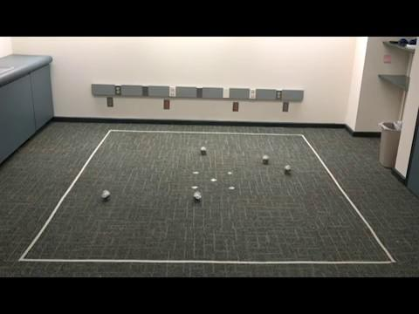
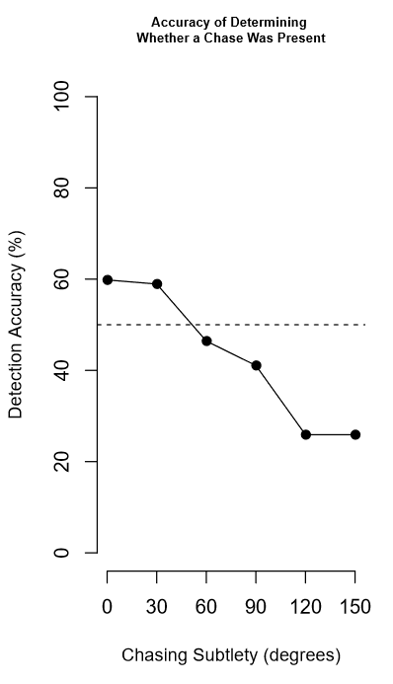
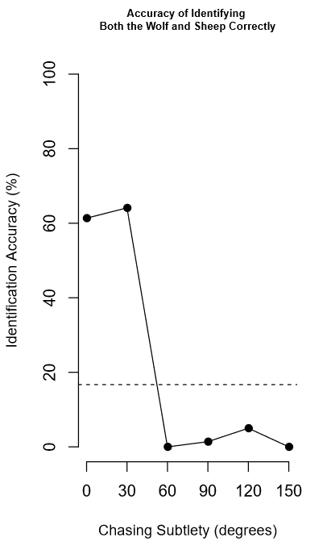
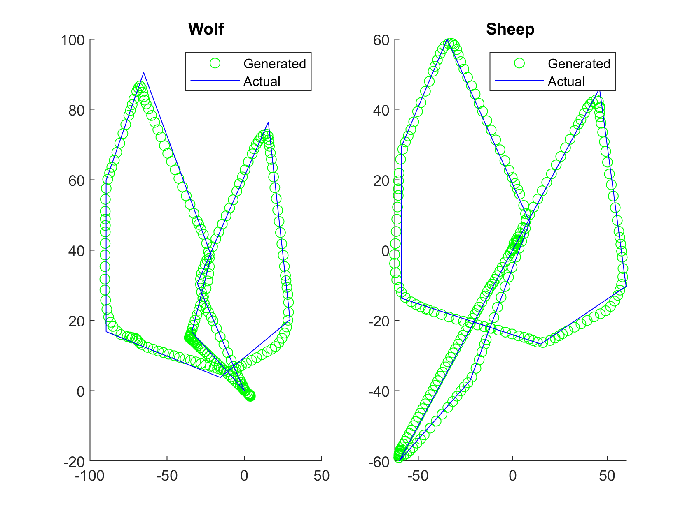
Human Perception of Chasing in Real Life
(Isabelle Carson, Sanya Nijhawan, and Evelyn Huang, 2018)
How does human perception of chasing change when the chasing occurs in real life as opposed to in a 2D animation?

