Slide 1
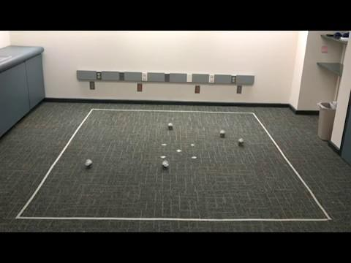
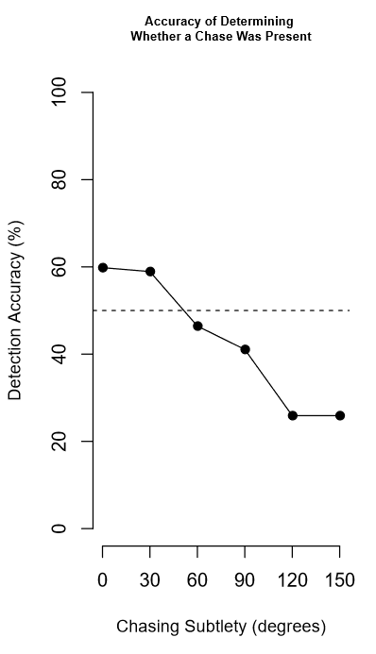
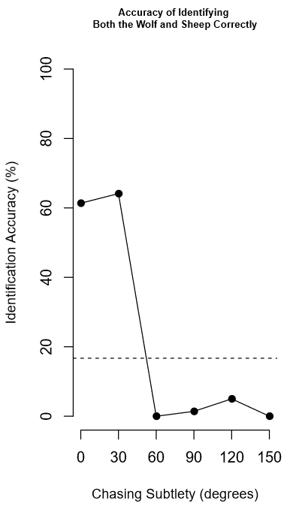
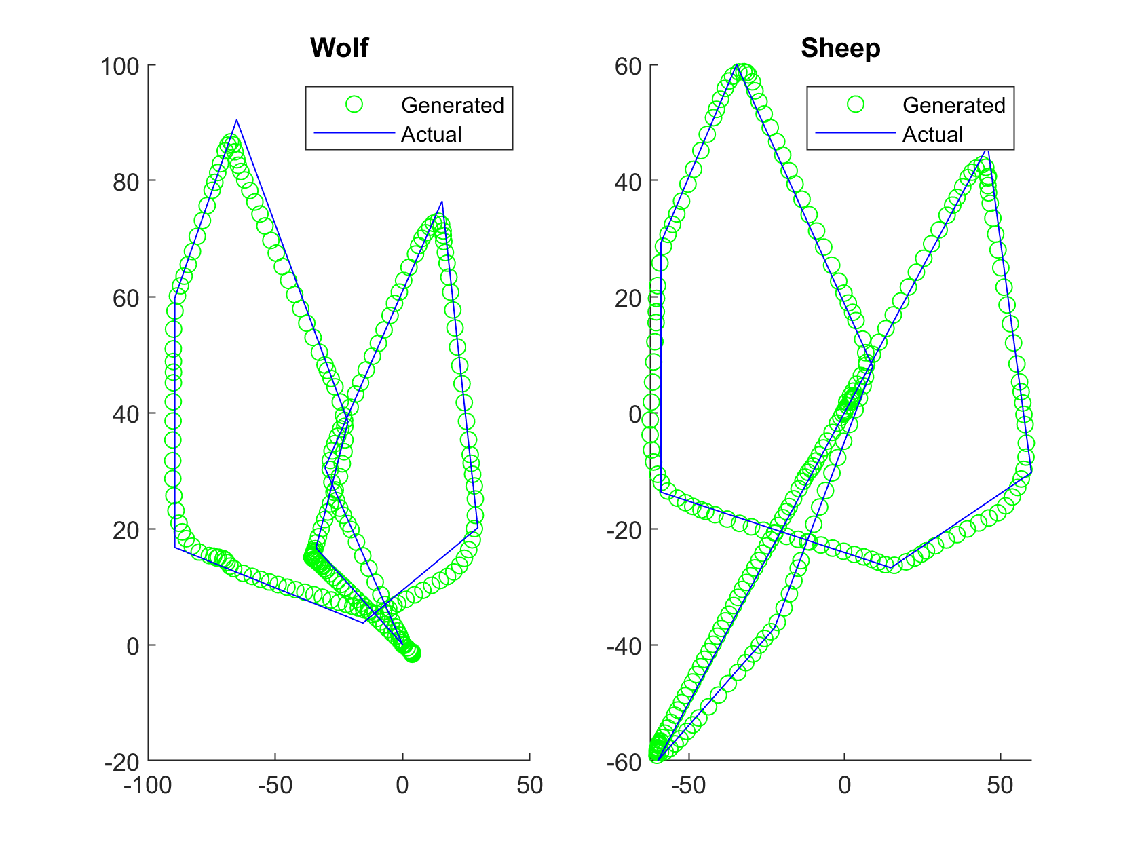
Human Perception of Chasing in Real Life
Isabelle Carson, Evelyn Huang, and Sanya Nijhawan (2018)
How does human perception of chasing change when the chasing occurs in real life as opposed to in a 2D animation?

