Slide 1






Group 4
Hidden Stories in Bird Watching
Insights Uncovered
From the eBird Data Pipeline
Evelyn Huang, Dorrie Ge, Keyu Yan, Xingye (Athena) Chen

Slide 2


02
INTRO
DUCTION
What is eBird?
eBird is a global, crowdsourced bird-monitoring platform created by the Cornell Lab of Ornithology. It allows anyone—from beginners to expert birders—to record the birds they see at any time. Currently, eBird includes over 1 billion global observations contributed by citizen scientists
eBird provides rich, real-time, geospatial species data that is deal for exploring biodiversity patterns
Why This Project Matters
Raw observations are scattered across API endpoints
Insights require a reliable, scalable data pipeline
Turning raw data into stories reveals:
Rare species movements
State-level biodiversity differences
Hotspot concentration patterns
Seasonal shifts in bird presence
Goal: Build an end-to-end data pipeline that transforms raw eBird API data into meaningful ecological insights for both practical exploration and scientific analysis.
Notes:
Every day, thousands of people step outside with nothing more than a pair of binoculars and curiosity.
They upload millions of bird sightings—tiny moments in nature—onto the internet.
Individually, each sighting is just a point on a map. But together, they form stories:
Where rare birds suddenly appear
How species shift as seasons change
Which states attract the richest biodiversity
What patterns scientists could never see from the ground alone
The problem is: those stories are buried in raw APIs and scattered observations.
Without a system to collect, structure, and analyze this information, the insights remain hidden.

Slide 3
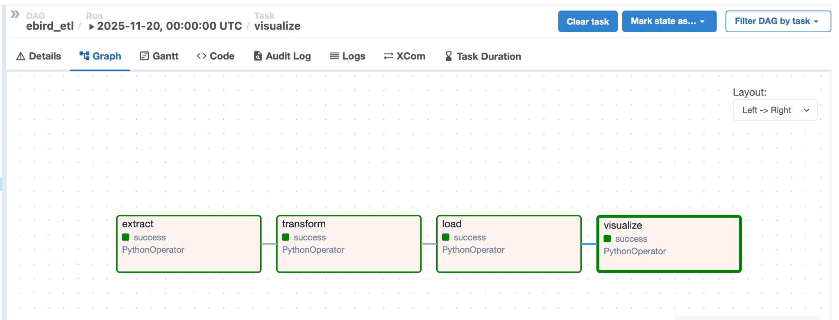

03
Solution: Our End-to-End Pipeline
Notes:
Our pipeline is implemented with airflow and Docker for easy deployment. This workflow runs automatically on a schedule to reflect the most recent bird observations.

Slide 4
03
Solution: Our End-to-End Pipeline
01. Extract
02. Transform
03. Load
04. Visualize
Get species that are uncommon in specified state
Get observation data for those species across the United States within the last 30 days
Get hotspot location across the United States
Feature Selection
Map state with longitude and latitude using geopanda
Calculate species richness and hot spot density for each state
Linked bird names to URLs for additional information
Normalizing the data for relational database
Load the normalized data into SQLite
Querying the processed tables using sql to get relevant data
Use HTML and Folium to map bird location with layer for interactive maps
Notes:
There are four stages in our pipeline, in the extracting state, we first get …then get…and get….
The transforming process involve feature selection, mapping, calculating, for more information, we linked, and lastly
In the loading state, we loaded
For visualization, we first, then

Slide 5
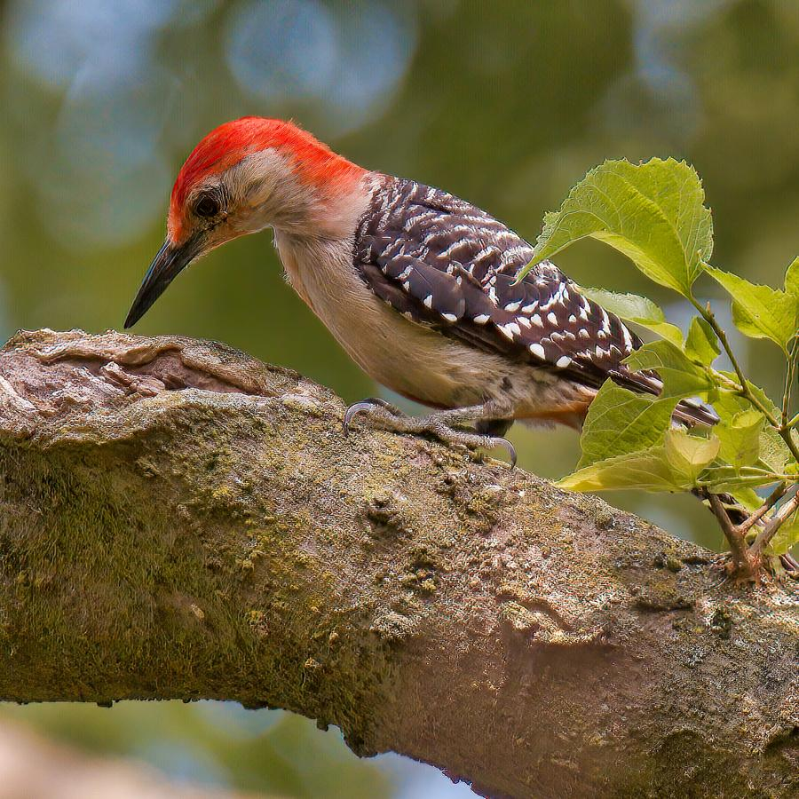

Search
04
Delivering Value: How Our Pipeline Serves Different Birdwatchers
01. Casual Birdwatcher
Goal: User-oriented, easy to use, straightforward, interactive
Quickly check local birds by state or species
View scatterplots of sightings across the U.S.
View predict key hotspots for bird sights in 7 days
02. Professional Ornithologist
Goal: Scientific insights, tracking trends, complex analytical products, comparison
Identify rare or uncommon species in a region
Compare state-level density vs. national hotspots
Generate analytical maps and reports for research
Notes:
Our pipeline is designed to serve different bird watcher, the first one is the casual birdwatcher, the interface is designed in a more user friendly way and carries straightforward insight. The user can quickly check local birds by state or species and we provide them with scatterplots of sightings across the U.S and predict key hotspot for bird sight in 7 days for them. For the professionals, they can use our interactive map to conduct complex analysis. The maps allow them to identify rare or uncommon species in a region, compare state-level density vs national hotspots to for research analysis.
Our pipeline supports two main types of users:
Casual birdwatchers who want a quick, intuitive way to explore local birds, and scientists or professional trackers who need complex analytical products for ecological research.
The same underlying data powers both use cases—just tailored for different needs.
Casual Birdwatcher
The main goal for casual birdwatchers is to provide a user-friendly and straightforward experience that allows them to explore birds without needing technical expertise.
They can quickly check which bird species are present in their state or specific area of interest, making birdwatching more engaging and informative.
Interactive scatterplots allow them to visualize recent bird sightings across the U.S., giving a clear sense of where birds are most active.
The interface is designed to be intuitive, enabling users to filter, explore, and understand the data without prior experience.
Professional Ornithologist (means Scientific Birdwatcher)
Professional or scientific users require detailed analytical products that can generate actionable ecological insights for research purposes.
They can identify rare or uncommon species in a region and track their appearance patterns over time to support conservation or scientific studies.
The pipeline allows comparison of state-level species density against national hotspots, highlighting unusual trends or shifts in bird populations.
Users can generate complex visualizations, such as density maps and analytical reports, to support in-depth ecological research and decision-making.

Slide 6

05
Type I:
Casual Birdwatcher

Slide 7
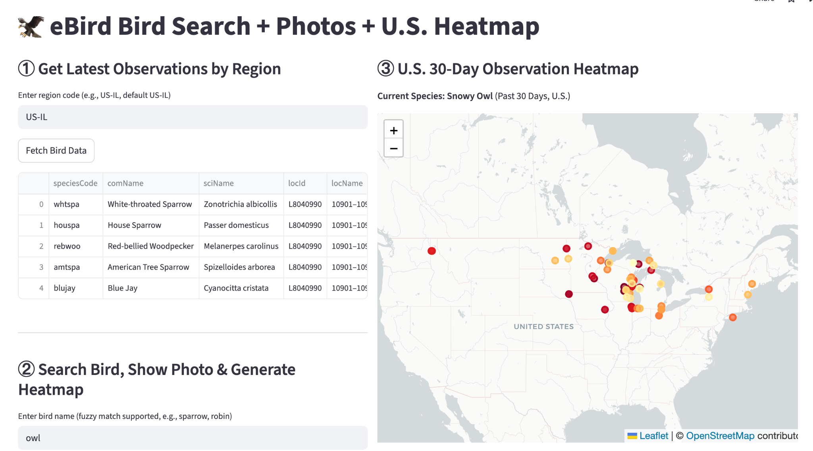
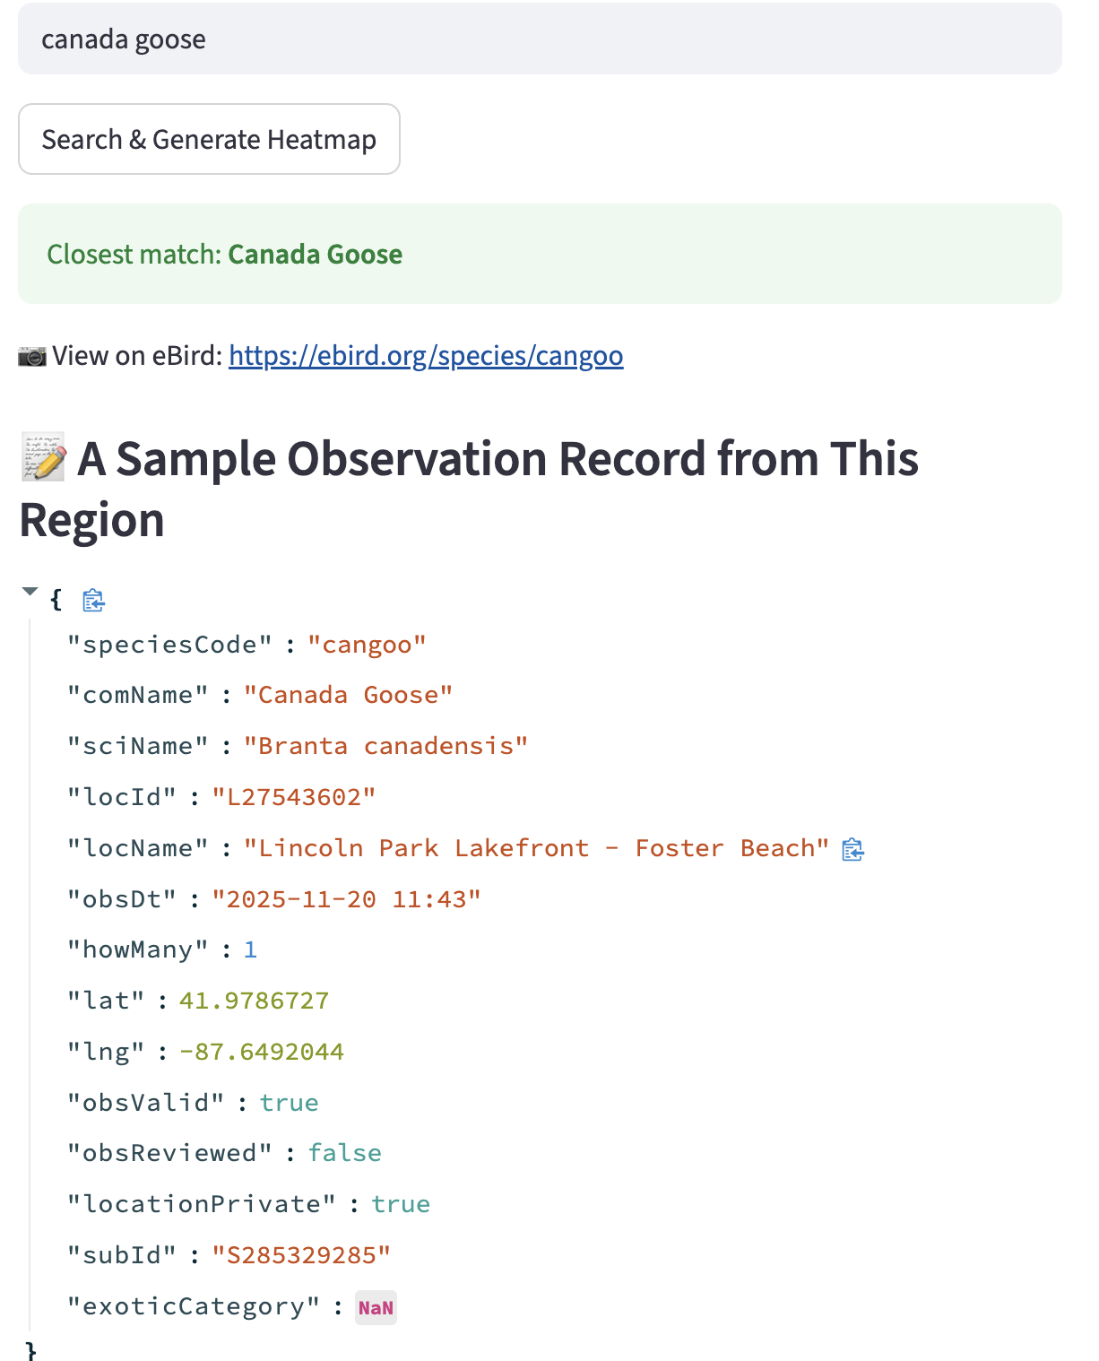

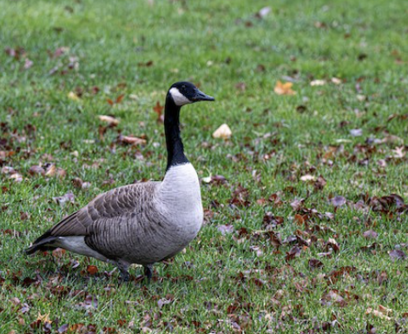

Slide 8
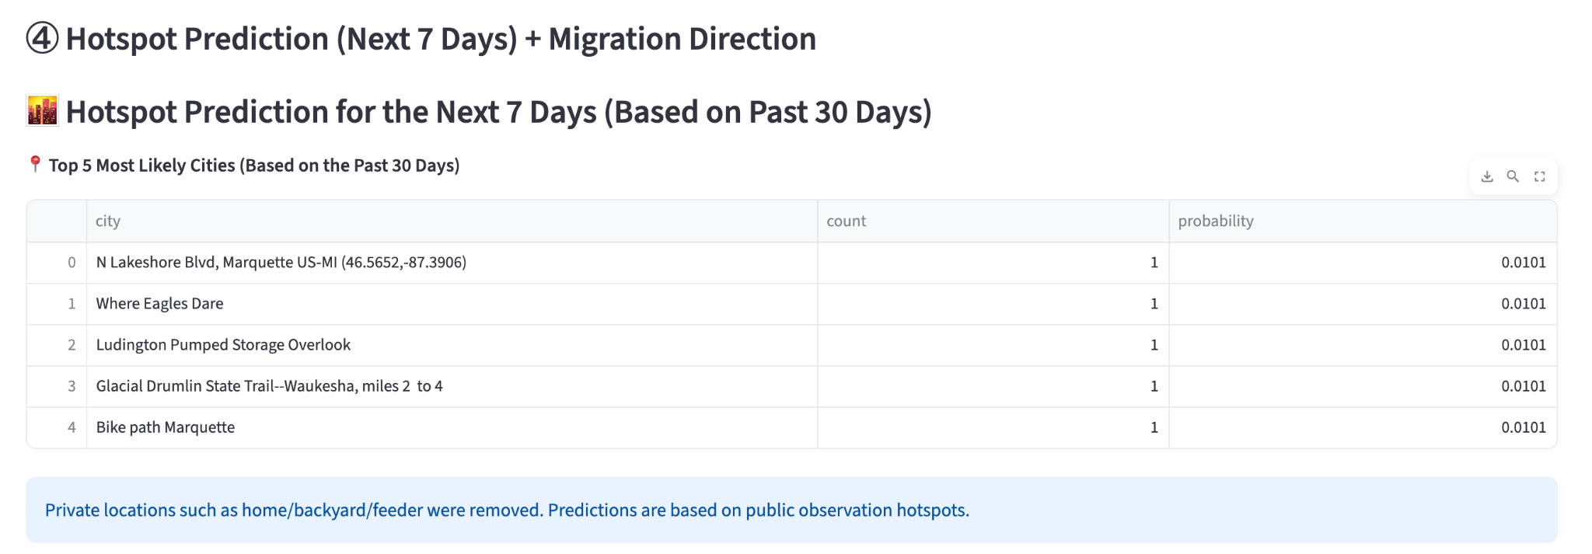
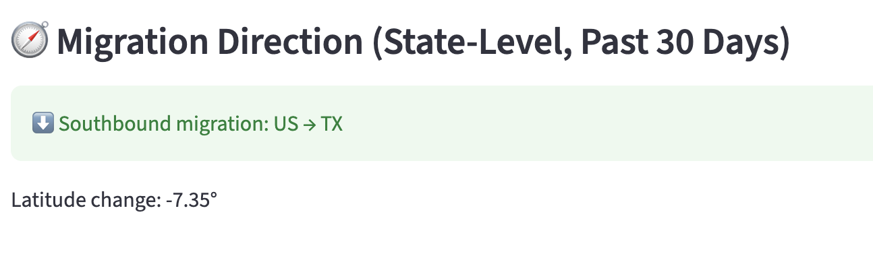

Slide 9


TYPE II:
Professional Ornithologist
Key Needs:
Scientists and experts need data-driven insights to support both research and conservation efforts for birds. They tend to focus more on patterns and signals in the data.
Observations of rare or uncommon species often serve as important indicators of ecological changes, highlighting shifts in habitat health or environmental conditions.
Furthermore, understanding spatial and categorical patterns in bird populations is essential for conducting migration studies, planning effective conservation strategies, and assessing biodiversity across different regions.
06
Notes:
For user group: professional orthologist, which means scientific birdwatchers

Slide 10
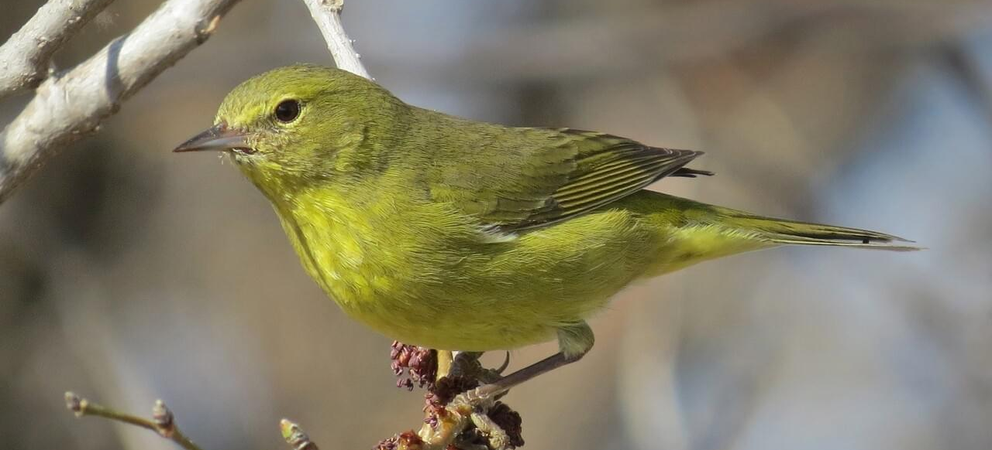
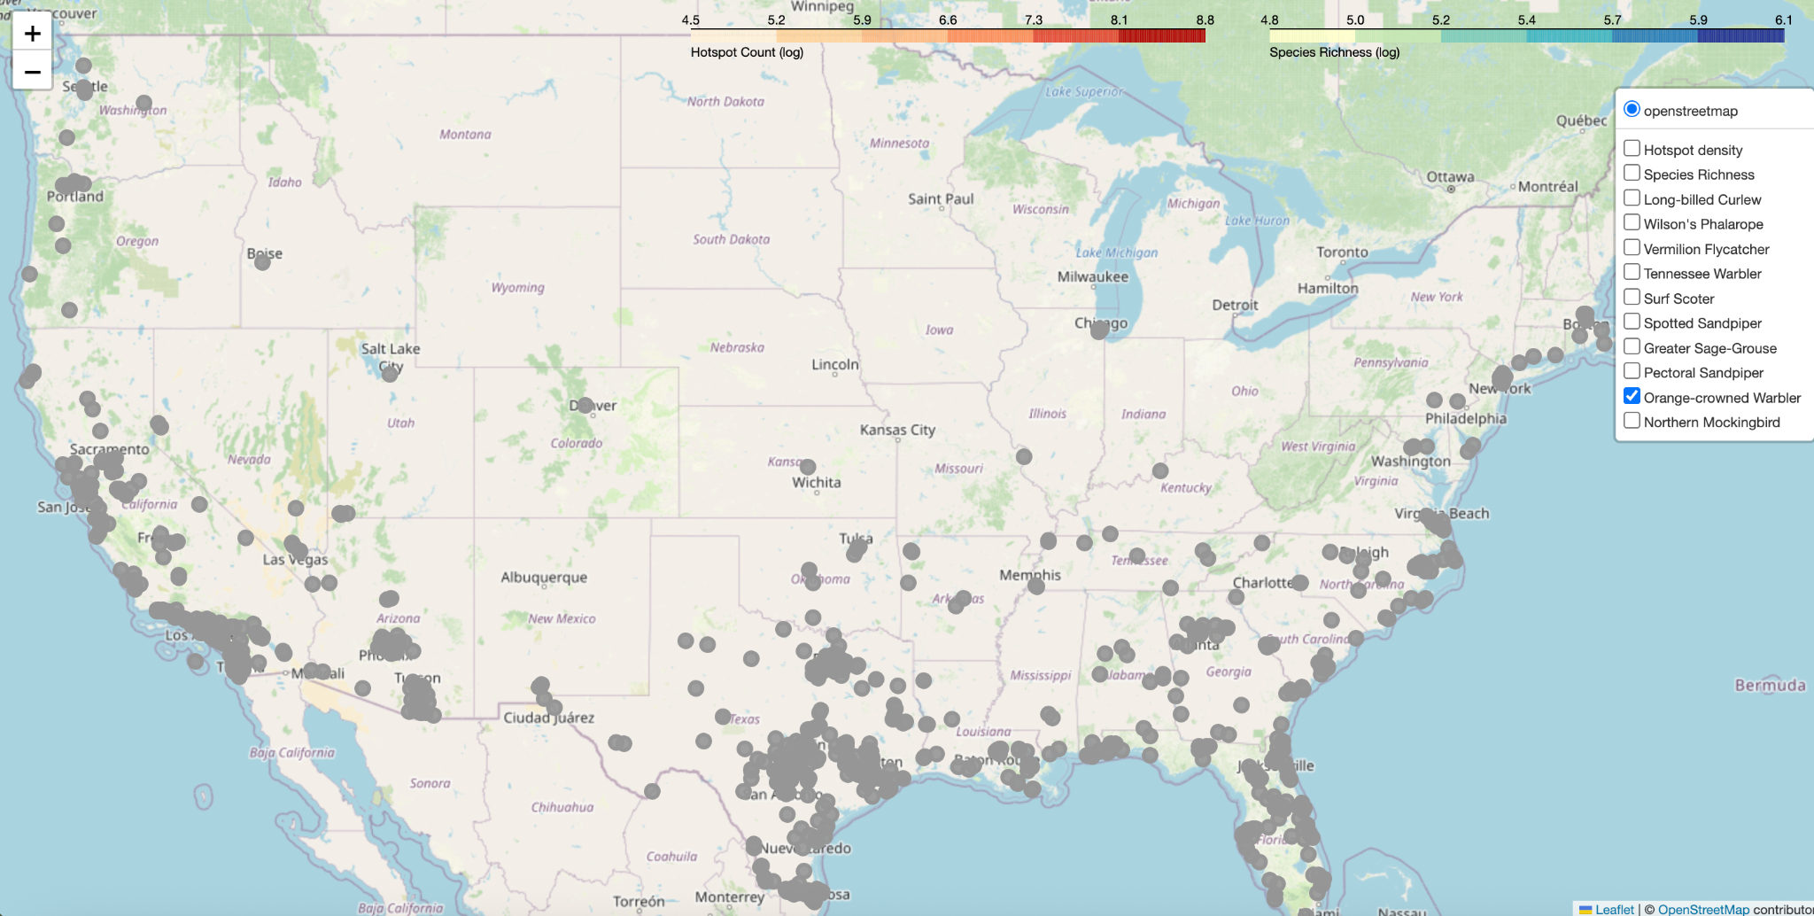
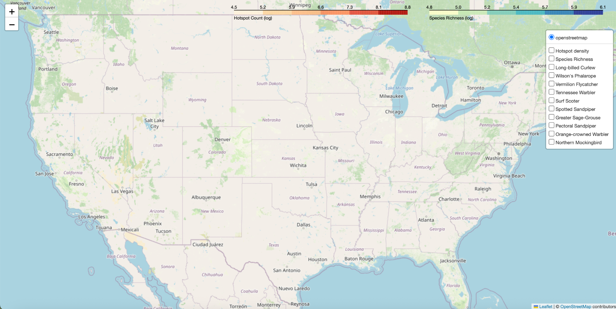
How a Scientific User Uses Our Pipeline - Case Scenario
Suppose I am a professional ornithologist who visited Yellowstone National Park this summer. I noticed some notable observations—species that are rare, unusual, or simply should not appear that region. I am curious to learn more about those species.
Steps:
Connect to our pipeline and fetch the top 10 notable bird species in Utah from the eBird API. The pipeline automatically stores the results in our database.
01
Retrieve their last 30 days of sightings in the USA from the eBird recent observations API, and the pipeline stores this data in the database as well.
02
The pipeline then cleans and analyzes the data, and the processed results are displayed on the visualization map.
03
Among the notable species, I find the one I observed: Orange-crowned Warbler.
Notes:
Among the notable species, I find the one I observed—Orange-crowned Warbler.
Using this, I generate a scatterplot map of all its recent observation points, helping me understand its current distribution and potential ecological signals.

Slide 11
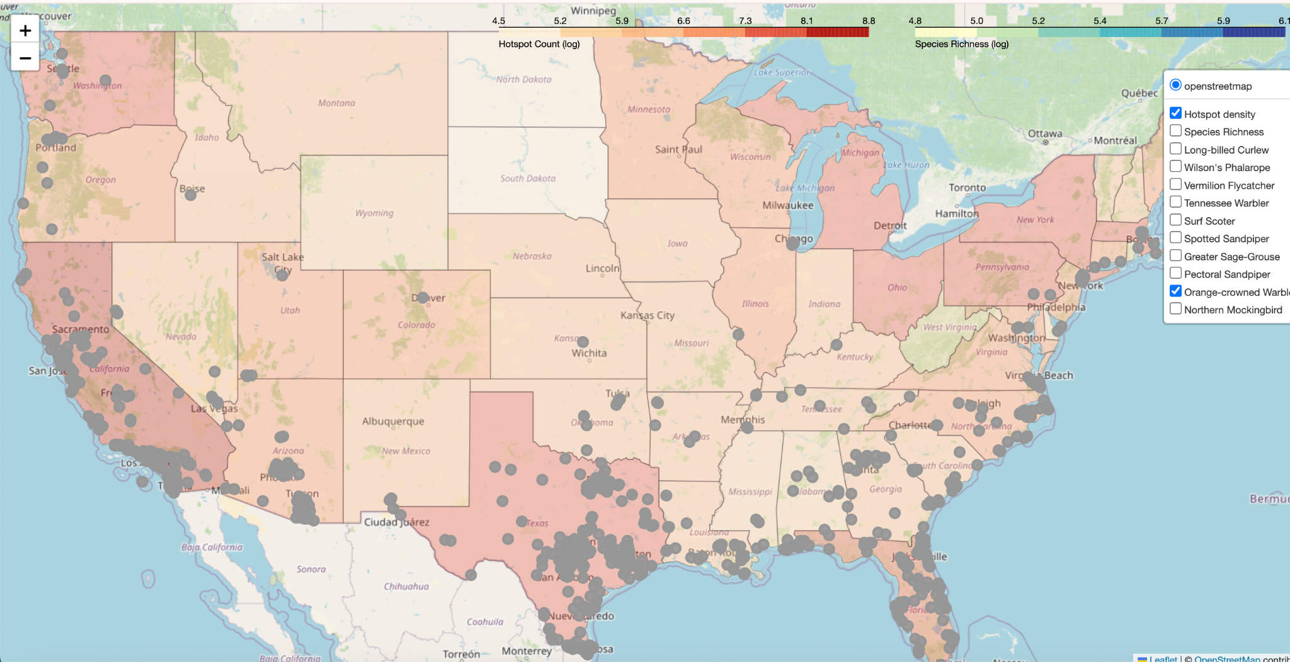
Analysis I: Where Birds Appear vs. Where We Expect Them
Conclusion: Here, the Orange-crowned Warbler’s recent observations largely align with the high-density hotspots on the map (California, Florida, Texas, Washington…). This suggests that the areas where this species appears coincide with regions frequently visited by birdwatchers. This corroborates that those hotspots are reasonable selections that experienced birdwatchers makes based on their knowledge on actual species presence.
Hotspot Def: A geographic area where a high number of bird observations have been reported.
Implication: Hotspots is based on observer effort or expectations. It is a reflection on human selection.

Slide 12
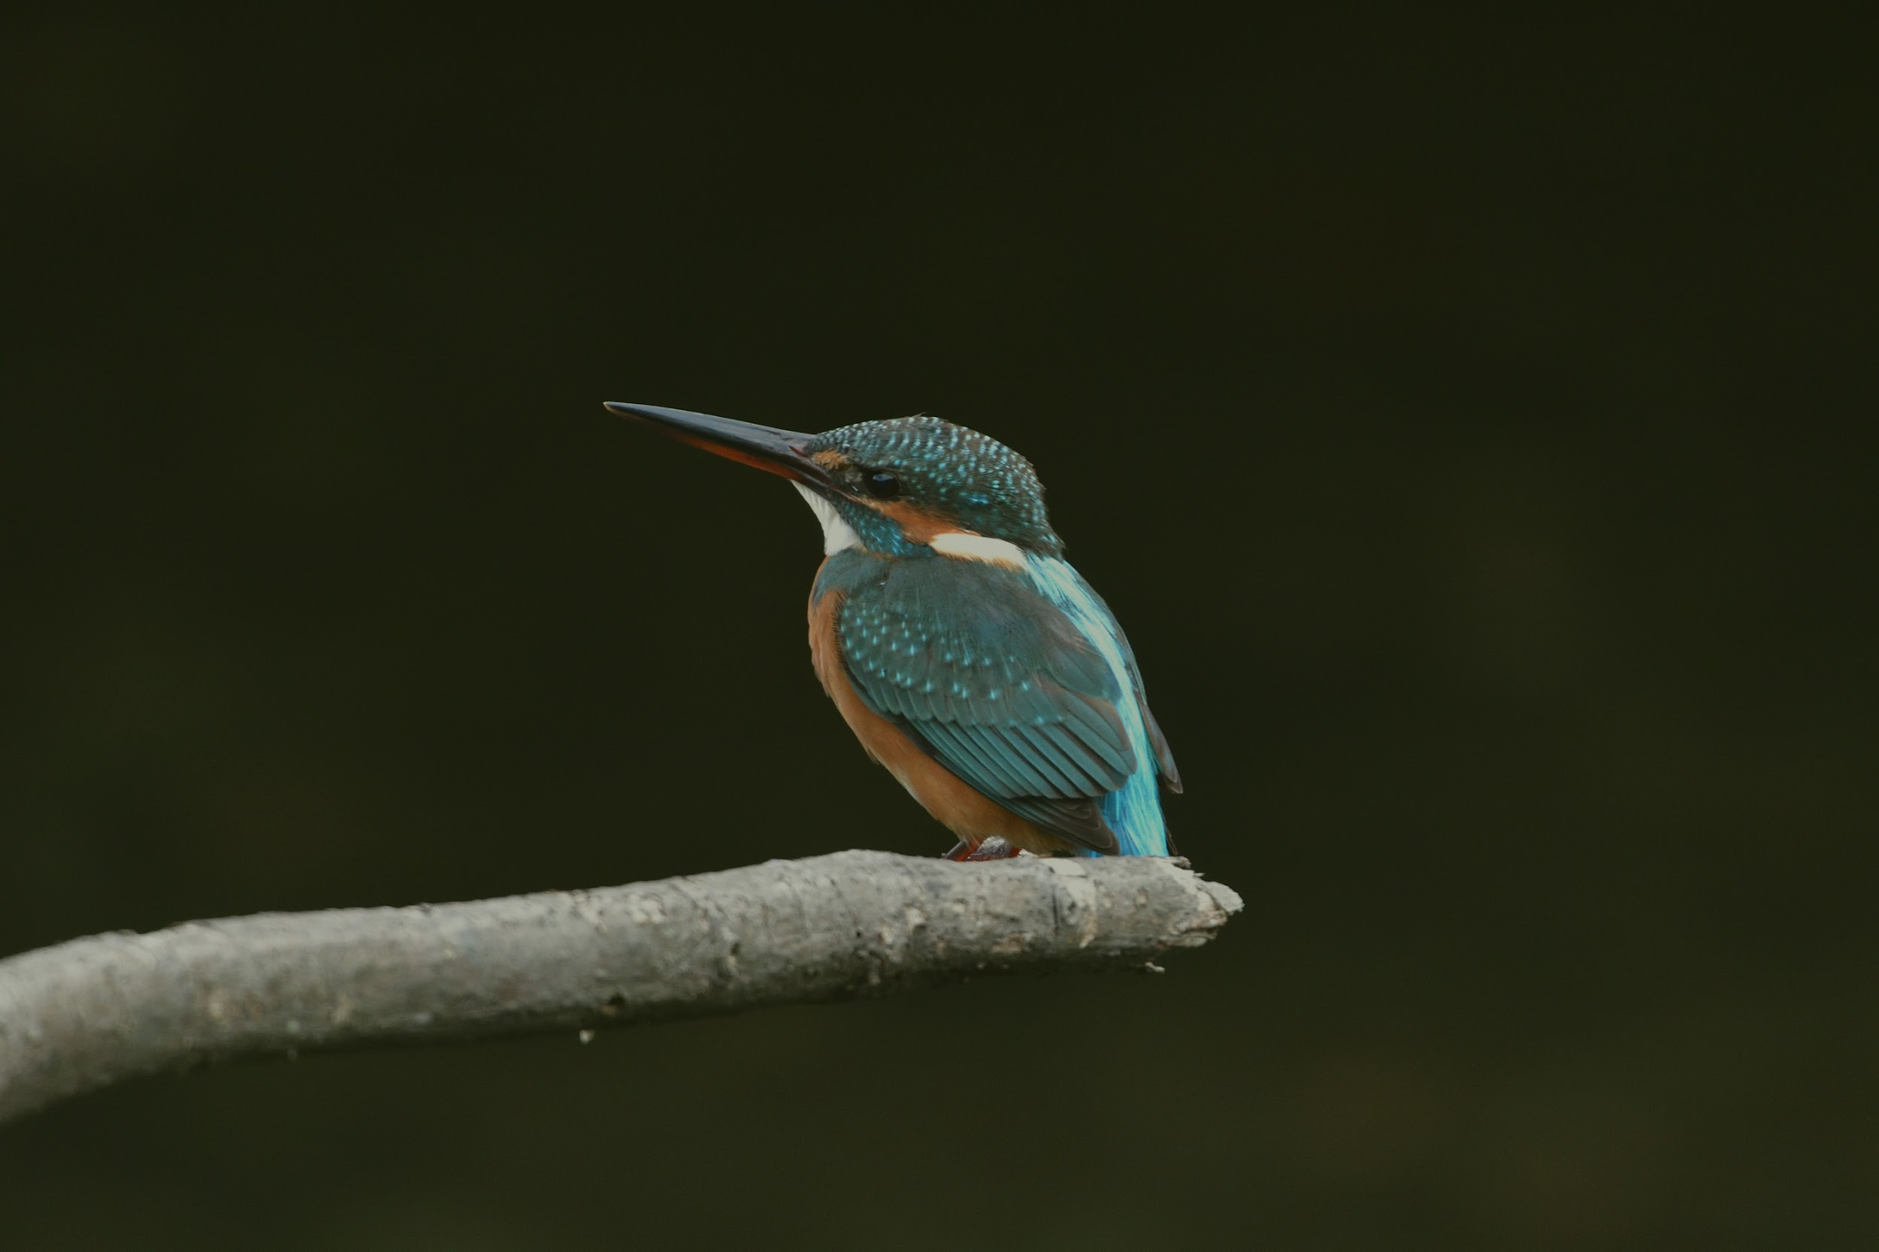
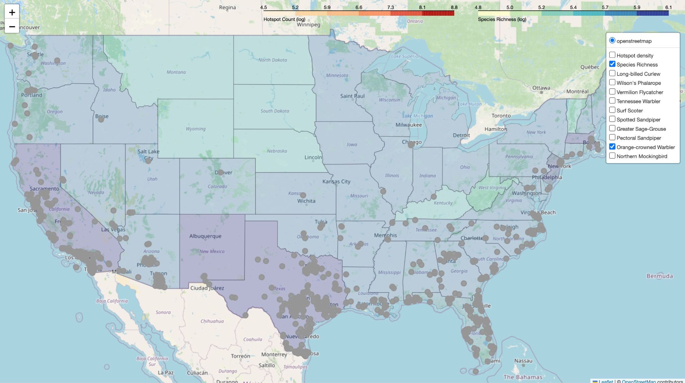
Analysis II: Species Distribution vs. Biodiversity
Analysis II: Species Distribution vs. Biodiversity
Conclusion: The Orange-crowned Warbler’s highest concentrations are in California, Texas, and the East Coast, only partially matching areas of high species density. This suggests that not all individuals of this species prefer highly biodiverse habitats, indicating that protection or observation efforts may be more effective in more diverse regions and under different weather conditions. It also suggests the need for more diverse conservation methods.
Species Richness Def: A measure of how many species of birds are observed in a specific area.
Implication: High species density indicates areas where number of species are abundant, helping identify core habitats and biodiversified region.

Slide 13


Roadmap Ahead
Phase 1: Enhancing prediction accuracy by incorporating weather and seasonal factors
Phase 2: Building a mobile-friendly interface for greater convenience
Phase 3: Supporting conservation groups

Slide 14

THANK YOU!
Feel free to check out our GitHub and try out the demo!
https://github.com/evelynh037/ebird-data-analysis

