Slide 1
Relational Database

Slide 2
Content
Overview
Data Model
Entity Relationship Diagram (ERD)
Associative entity set
Further learning topic
Summary

Slide 3
Relational Database Overview
Database is a structured collection of information that recognizes relations between stored items of information.
Data are stored in tables (entities) with columns (attributes).
Most software applications require a database.
Example: Video table that we are using for phase 2
VideoID | VideoTitle | VideoLength | WebURL | ThumbnailURL | isFavourite
1 | CS50 2018 - Lecture 0 - Computational Thinking, Scratch | 4235 | https://www.youtube.com/watch?v=5azaK2cBKGw | https://i.ytimg.com/vi/5azaK2cBKGw/mqdefault.jpg | false
10 | On board Virgin Orbit’s flying launchpad | 479 | https://www.youtube.com/watch?v=cBP4sXT-TO0 | https://i.ytimg.com/vi/cBP4sXT-TO0/mqdefault.jpg | false
12 | Winter of Xamarin | 101 | https://www.youtube.com/watch?v=jZ3JJ0hIJTE | https://i.ytimg.com/vi/jZ3JJ0hIJTE/mqdefault.jpg | true
Notes:
The demand for database would only go up as complexity of information increases.

Slide 4
Entity Relationship Diagram (ERD)
The Entity Relationship Diagram (ERD) is an abstraction for the data model.
An ERD is crucial to creating a good database design. Once an ERD is carefully constructed, it can readily be converted into a database structure.
Entity Sets
Attributes
Relationships
The tables in your database
Information such as property, facts you need to describe each table
How tables are linked together: one-to-one, one-to-many, many-to-many

Slide 5
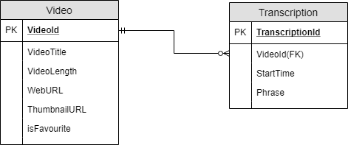
Database Schema for phase 2
Notes:
Each entity has a unique ID/primary key and followed by attributes.
Explain one mandatory to optional many relationship: one video can have none to many transcriptions and 1 transcription must belong to one and only one video
Foreign key: For a typical one-to many, the foreign key stays with the child entity set on the many side, where it references the primary key of the parent entity set on the one side
If the foreign key becomes part of the primary key in the child entity set, that makes the entity set weak. Which means, you can also create the Transcription table with the FK VideoID and StartTime both being the Primary Key, but it will make your Transcription entity set weak.

Slide 6
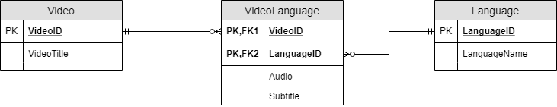
Associative entity set
Associative entity set is to resolve many-to-many relationship in the conceptual data model
Each many-to-many relationship would be resolved into two one-to-many relationships with an associative entity set

Slide 7
You’re encouraged to learn more about:
Crow's foot notation
Strong and Weak Entity Set
Superset and subset in ER model
Specialisation and generalisation
Completeness and disjointness

Slide 8
Summary
Have an overview about relational database.
Know the vocabulary of the ER model: entity, entity set, attribute, relationship, foreign key, etc.
Design ERD to be ready to convert into building a database
How to resolve many-to-many relationship with an associative entity set

