Slide 1


Introduction to Specialization Fields and Industrial Study Cases Decorative paper Laminates MUNKSJÖ
Yu-Jung Chen
Alireza Rezaei
Nadile Nunes de Lima
Evelyn Paiz

Slide 2
Outline
Introduction
Project Objective
Background and Methods
Tools
Results
Future Work
Conclusions

Slide 3
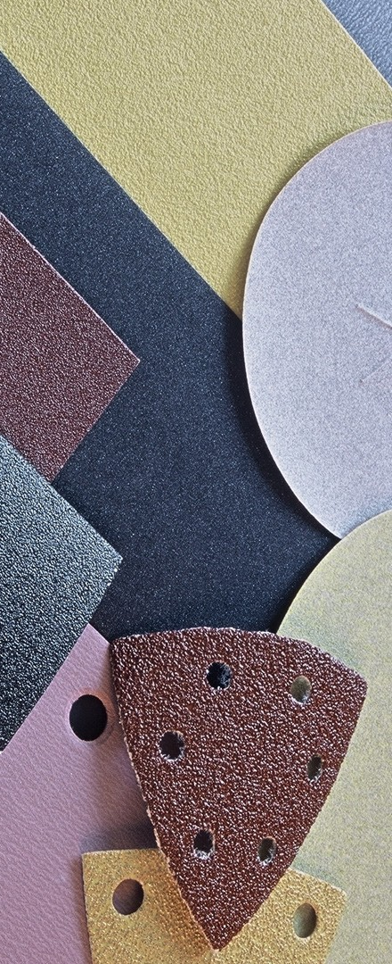
Introduction
Our focus will be on decorative laminates which means paper or plastic composites.
Munksjö depends on human eyes to do color management nowadays.
Create an user interface which helps them to handle the color management easier.

Slide 4
Introduction (2)
Around 11 000 samples from Munkjö this year.
The data show seach laminate coming from each roll that includes the following details:
L*a*b* White Underlay for sample and master
L*a*b* Kraft Underlay for sample and master
Opacity for sample and master
Roll status regarding color : accepted, Yes or No

Slide 5
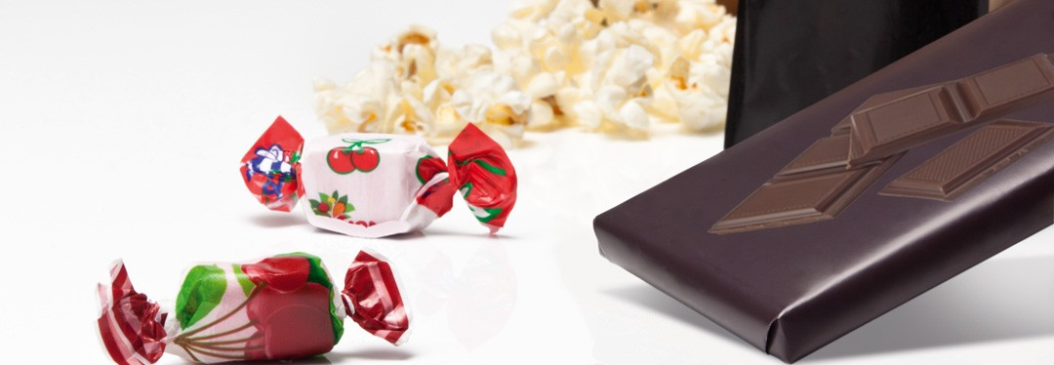
Project Objective
Based on the work done last year, the objectives were:
Build a model that is able to predict the acceptance or rejection of agiven sample.
To develop an application which would be usable directly for the tests.

Slide 6
Background and Methods
From the last year codes and reports, we knew that they used Naïve Bayes on R.
We found out two other methods, based on ensamble: AdaboostM1 and Bagging.
Therefore, here we implemented and compared the methods:
Naïve Bayes
AdaboostM1
Bagging
Bayes theorem
Ensemble methods

Slide 7
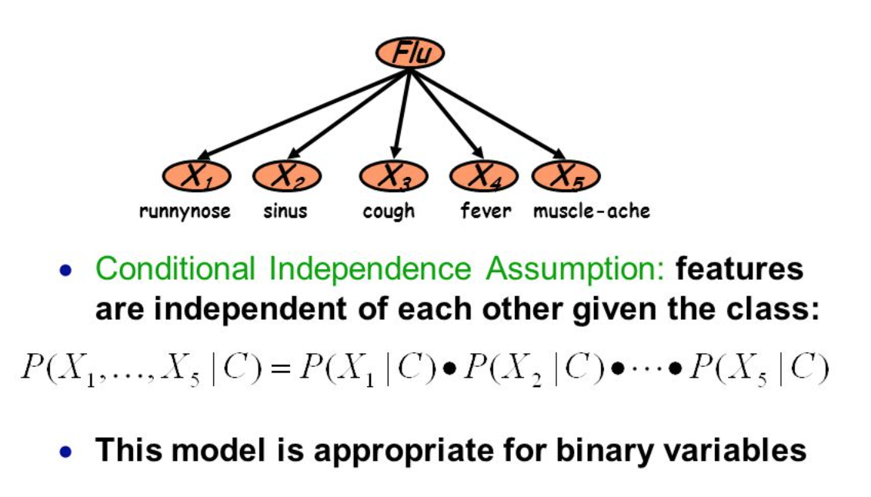
Naïve Bayes
In machine learning, naive Bayes classifiers are a family of simple probabilistic classifiers based on applying Bayes' theorem with strong independence assumptions (naive) between the features.

Slide 8
Ensemble methods
Ensemble methods use multiple learning algorithms to obtainbetter predictive performance than could be obtained from any ofthe constituent learning algorithms alone.

Slide 9
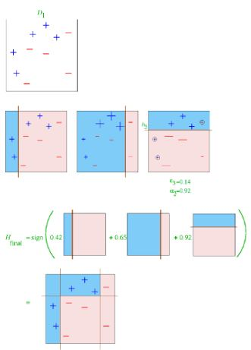
Ensemble methods - Adaboost
Adaboost (adapting boosting) is a general method for generating a strong classifier out of a set of weak classifiers.

Slide 10
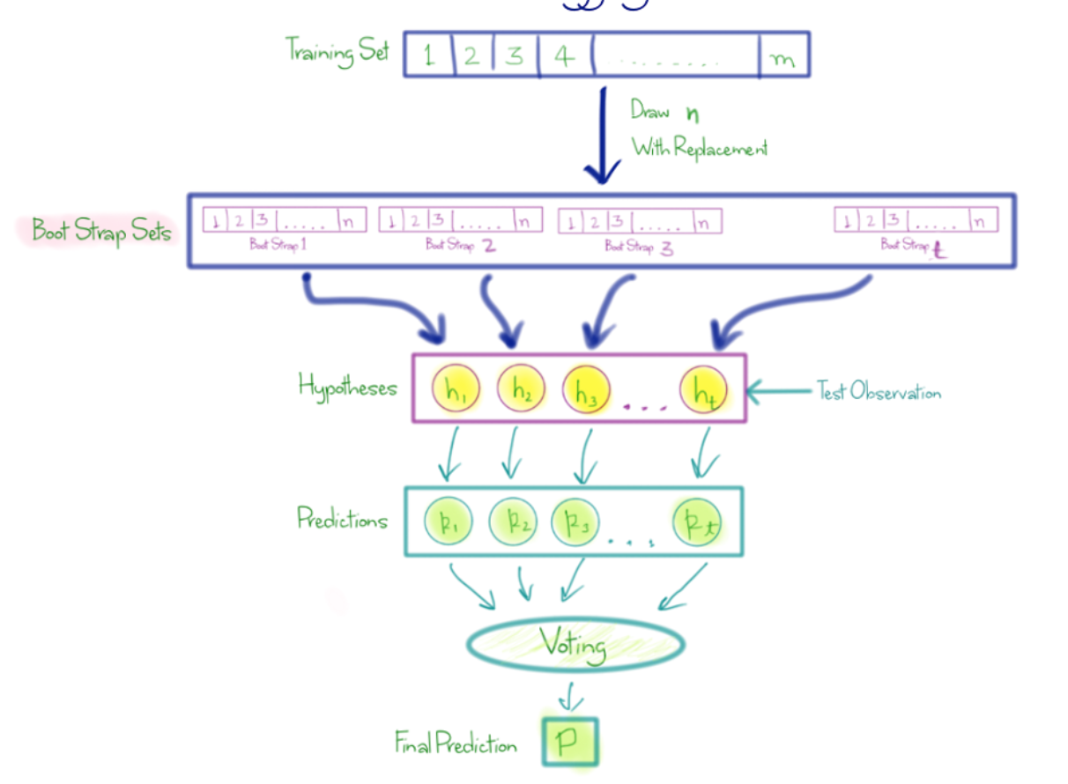
Ensemble methods - BAGGING
Bagging instead of using the same training set to fit the individual classifiers in the ensemble, it draw bootstrap samples (random samples with replacement) from the initial training set.

Slide 11

Tools
Matlab as our backend to implement ouralgorithms.
Webstorm (for coding) and Simbla (for website designing) for the frontend to create user interface.

Slide 12
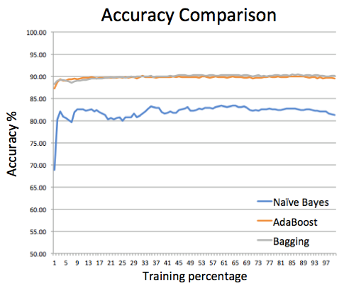
Results - Methods
Implementation of the past code to a new platform -> matlab.

Slide 13
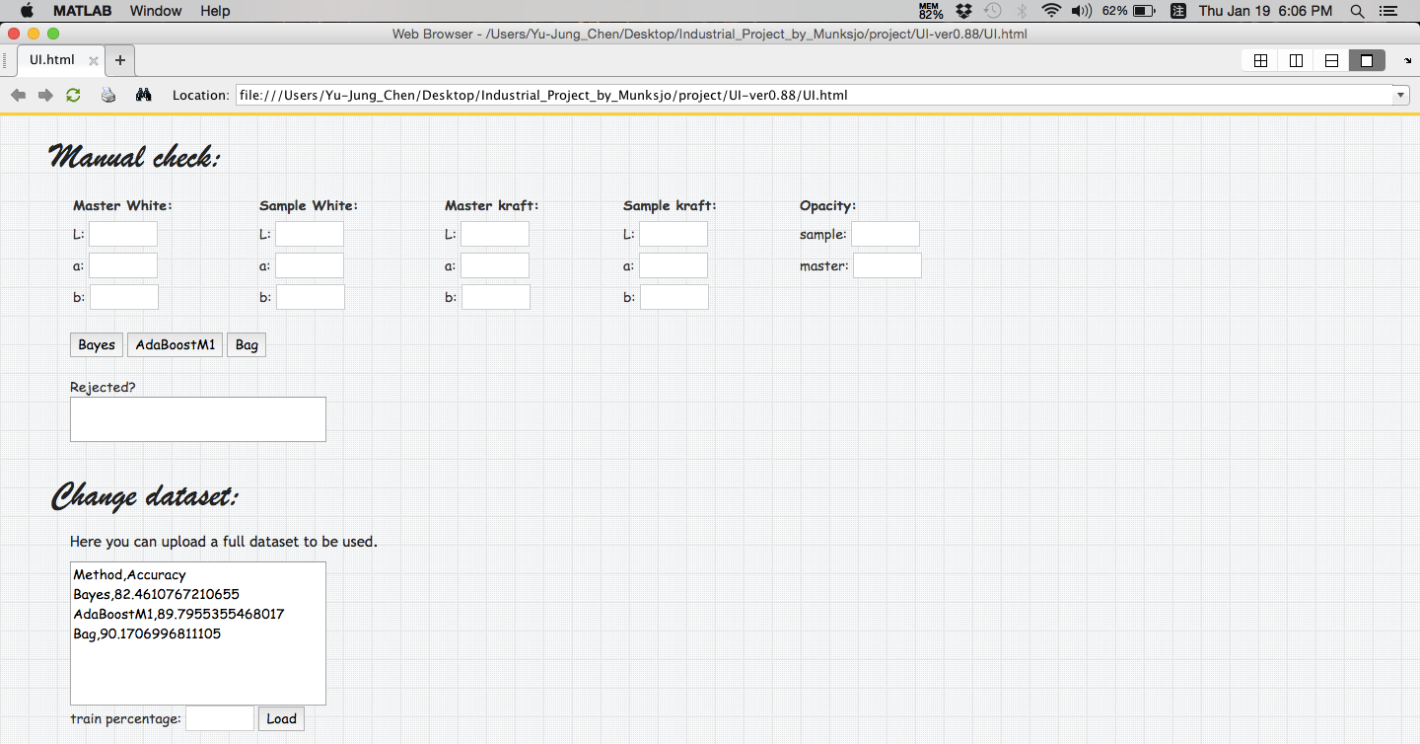
Results - User Interface

Slide 14
Future Work
Try more algorithms.
Acceptability should be judged by more people, maybe customers.
Build a model to remove noisy data.

Slide 15
Conclusions
Successful implementation of an interface for last year's work.
Suggesting and implementing two other algorithms with better accuracy.
Providing a platform for changing the training data in the future.
Providing a way for manually check matching or not matching of the samples.

Slide 16
Any Questions? Thank You For your AtTention! ☺

