Slide 1

Us Air Pollution
DSC-530 Exploratory Data ANalysis
By: Evelyn Torrellas Cates

Slide 2
Introduction
When it comes to climate changes, air pollution is a topic that is mentioned but not really focused on because it isn't as tangible as other topics.
Originally when I found this dataset from Kaggle: https://www.kaggle.com/sogun3/uspollution
The hypothesis I originally formed was: Is US air pollution increasing every year? .However, throughout the project I started focusing on how much each air pollutant: NO2, O3, SO2 and CO is in our air. I changed my hypothesis to: Is there an air pollutant that was generated the most?
Important variables in the dataset were the AQI for the air pollutants, Date, and state it occurred.

Slide 3
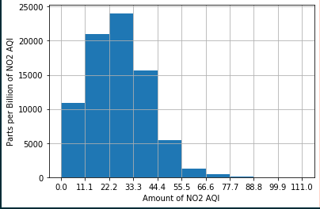
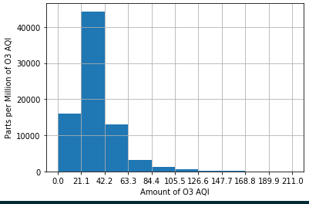
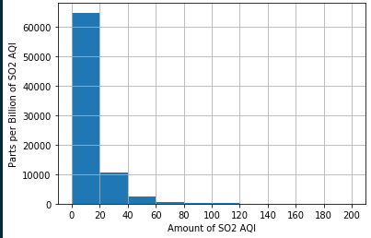
Histogram variables
My analysis focused on 4 air pollutants: NO2, O3, SO2 and CO

Slide 4
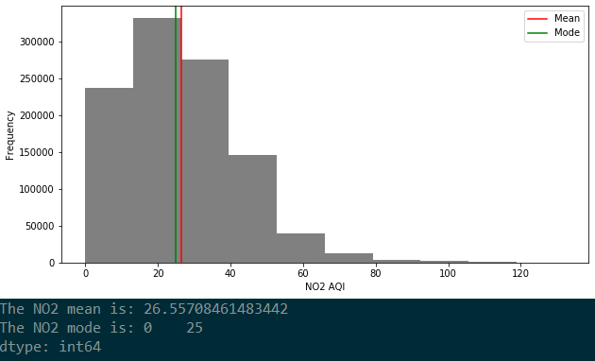
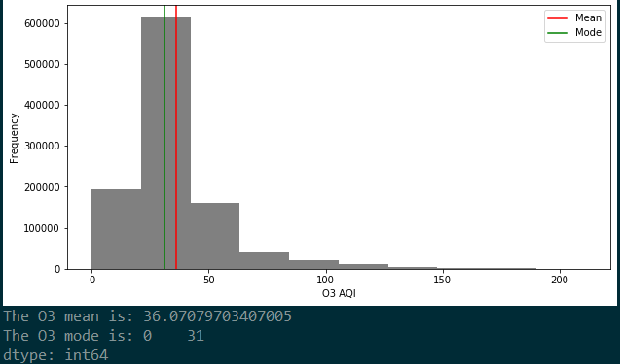
Descriptive Statistics
NO2 has a distribution is asymmetric, and the Tail and Spread is also higher towards the left. While O3 has a normal distribution and it’s a variable I look into later on to explore it more.
There are a few outliers towards the higher end of the graph for both NO2 and O3. The data points were too small to matter in the data and shift it more towards the right.

Slide 5
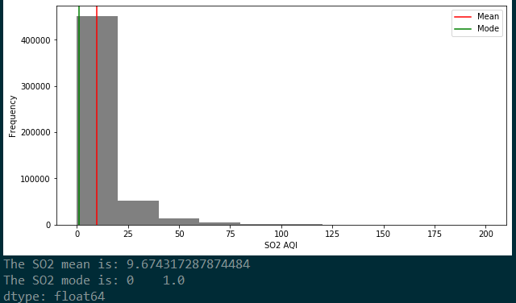
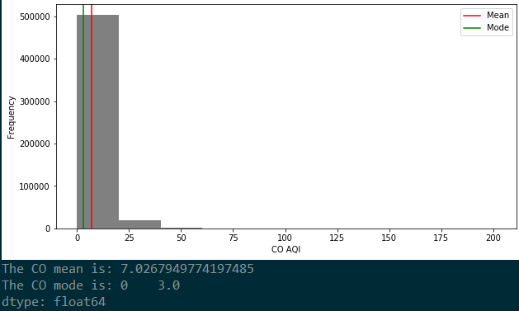
Descriptive Statistics
For the SO2 and CO the numbers are significantly smaller with a similar asymmetric distribution with the Tail and Spread higher at the left.
SO2 also had more outliers than CO but it wasn’t enough to where it would change the spread of the data.

Slide 6
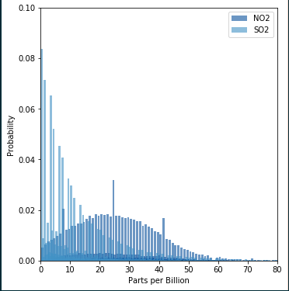
PMF- Comparing two Scenarios
I choose to compare NO2 and SO2 because their measurements were in billions verses the other pollutants were measured in millions.
NO2 shows a consistent distribution in probability with few outliers and probability less than 0.02, while probability for SO2 is higher reaching 0.08

Slide 7
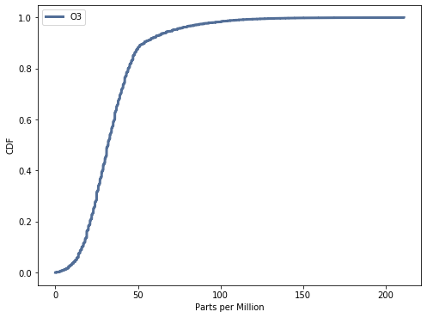
CDF- O3
The variable O3 has a normal CDF distribution.
By visualizing O3 in this format it helps answer my hypothesis question by demonstrating the increase in O3 is higher towards 100-200 parts per million

Slide 8
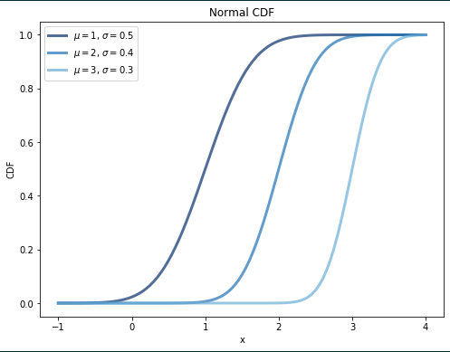
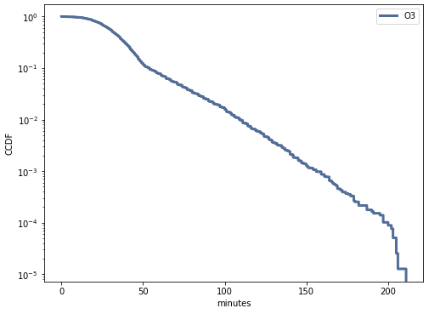
Analytical distribution
This graph demonstrates how O3 has a normal distribution with a range of parameters in it.

Slide 9
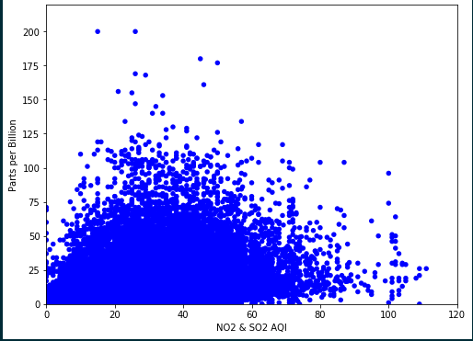
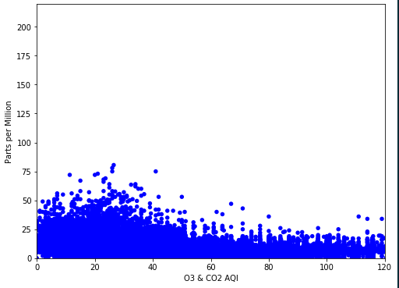
Scatterplots
The following scatterplot demonstrates how NO2/SO2 and O3/CO2 have similar relationship in the amount it generates.

Slide 10
Conclusion
By performing this analysis I was able to understand how each pollutant contributes differently to our air quality.

