Slide 1
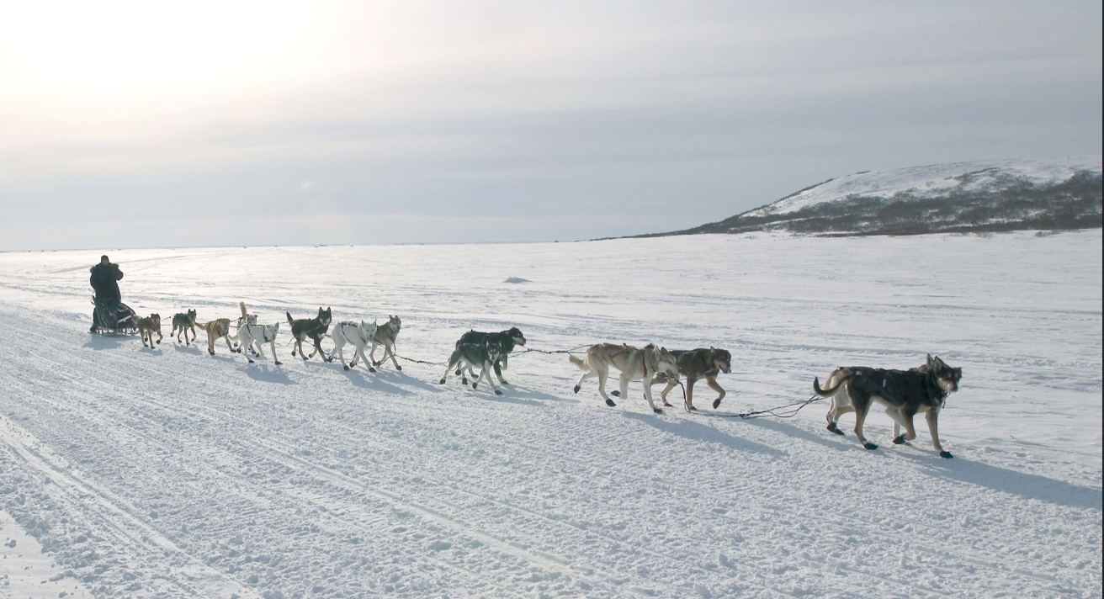
Interesting Info about the Iditarod 2017

Slide 2
The Last Great Race on Earth®
For this project, some interesting facts and figures about the 2017 Iditarod Race will be analyzed and visualized to answer questions such as:
Did veteran teams outpace rookie teams?
Did the number of dogs in the team impact the end of the race?
What were the basic statistics for the teams?
What eating venues are in Nome, the endpoint of the Iditarod Trail?
Answers to these questions are important to the mushers who spend an entire year getting ready and raising the money needed to get to Nome. Some prepare while holding down a full-time job. In addition to planning the equipment and feeding needs for themselves and their 16-dog teams for up to three weeks on the trail, hundreds of hours and hundreds of miles of training have to be put on each dog team.

Slide 3
Data
The dataset for this analysis was retrieved from Kaggle at: https://www.kaggle.com/iditarod/iditarod-race It includes the musher's name, number and country, checkpoint name and location, distance in miles from the last checkpoint, time from departure at the last checkpoint, date and time of arrival and departure, layover time at the checkpoint, and the number of dogs at arrival and departure at each checkpoint.
Foursquare location data was used to discover points of interest in Nome, the endpoint of the race.

Slide 4
Methodology
Preprocess the dataset to obtain inferential statistics
Obtain latitude and longitude coordinates using Google Geocode
Create Folium geopsatial maps and display race checkpoints by their geocodes
Use K-means clustering to look at speed/time
Use the FourSquare API to obtain venue info for Nome

Slide 5
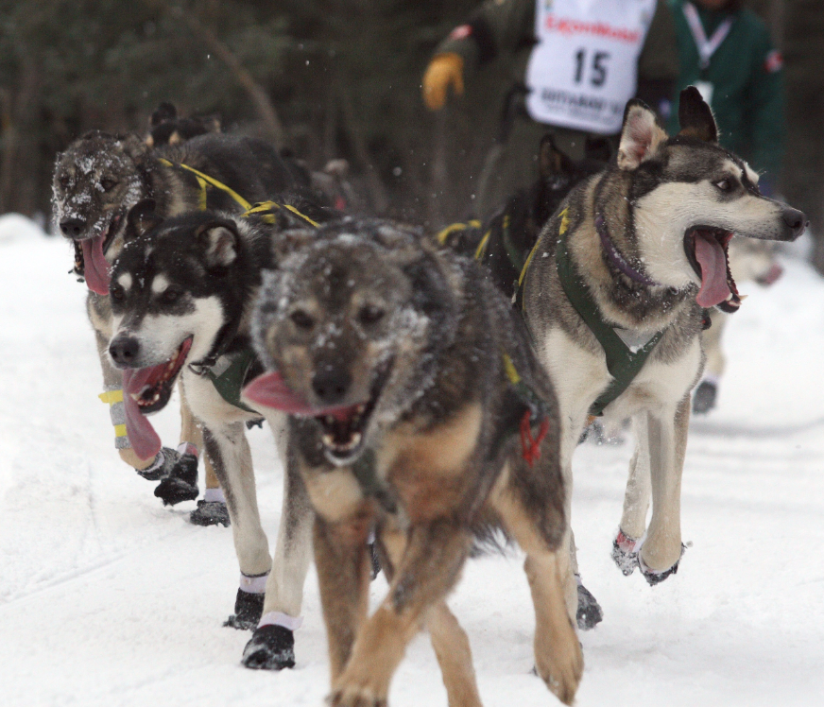
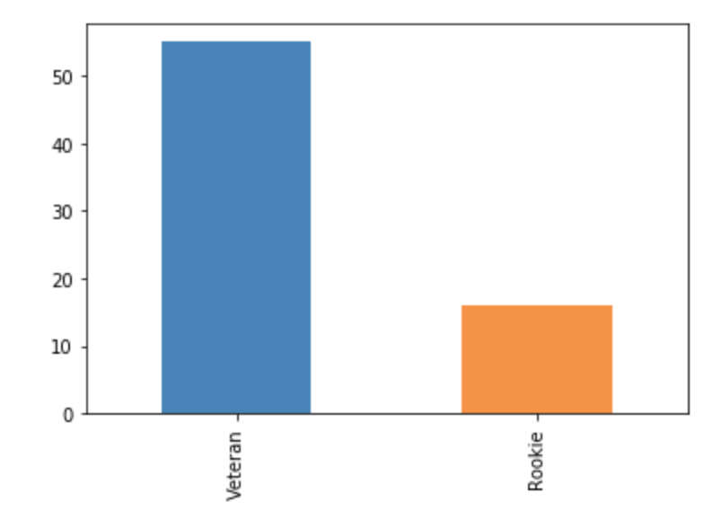
Results
Average Speed: 7.2 mph
Average number of dogs per team at the end of the race (16-dog teams): 10
Min number of dogs for a team at the end: 7
Number of registered dog teams: 72
55 veteran teams
16 rookie teams
Number of teams that made it to Nome: 64

Slide 6
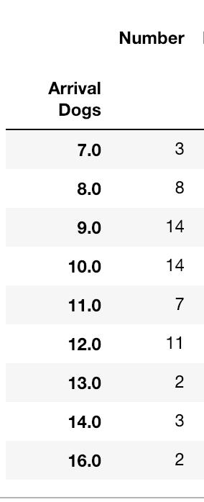
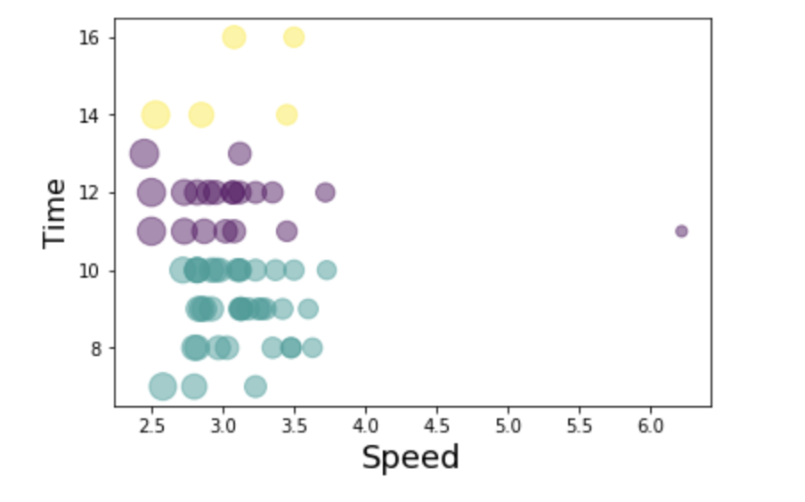
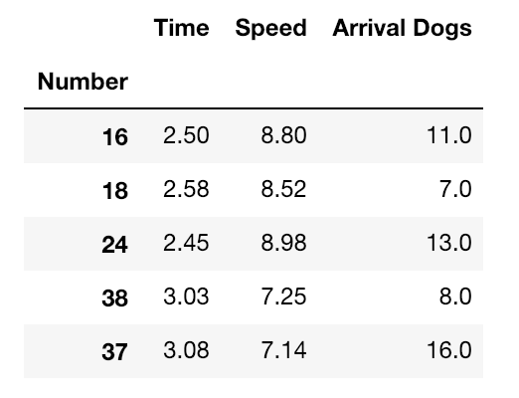
Discussion
As seen above, the top five finishers ended with very differing dog teams.
There were just as many teams that finished the race with less than half the dogs they started out with than those who finished the race with more than half.

Slide 7
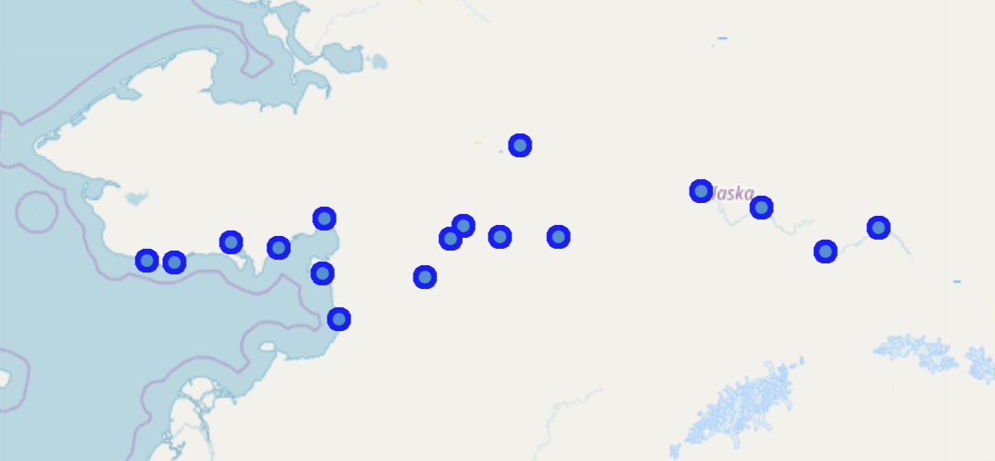
Conclusion
The number of dogs in a team that finished the race was not a significant factor
Map shows the 17 checkpoints ranging over 979 miles between Fairbanks & Nome

