Slide 1
Human vs Artificial intelligence
Patryk Gałczyński, Konrad Najder

Slide 2
Agenda
Historical view on consciousness
Modern perspective

Slide 3
Consciousness
Notes:
The question of whether or not an inanimate object could hold any type of conscious state has always been (or still is) a question in today’s modern culture.

Slide 4
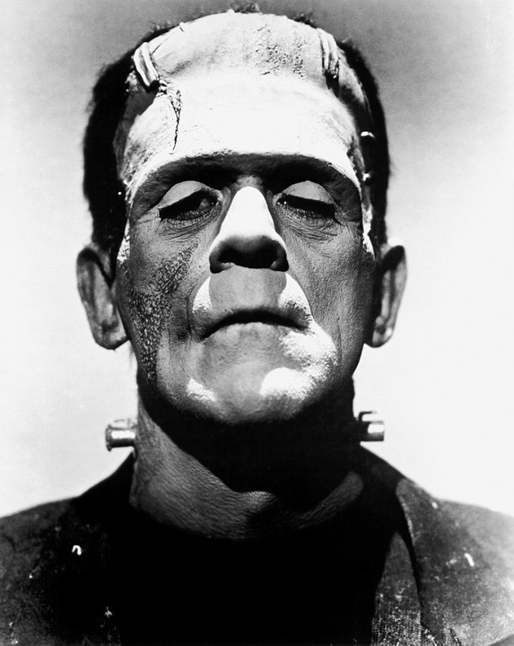
Notes:
I bet you know who this guy is?
First examples in modern literature of bringing back consciousness to an object that is no longer capable of thought can be found in Mary Shelley’s Frankenstein

Slide 5
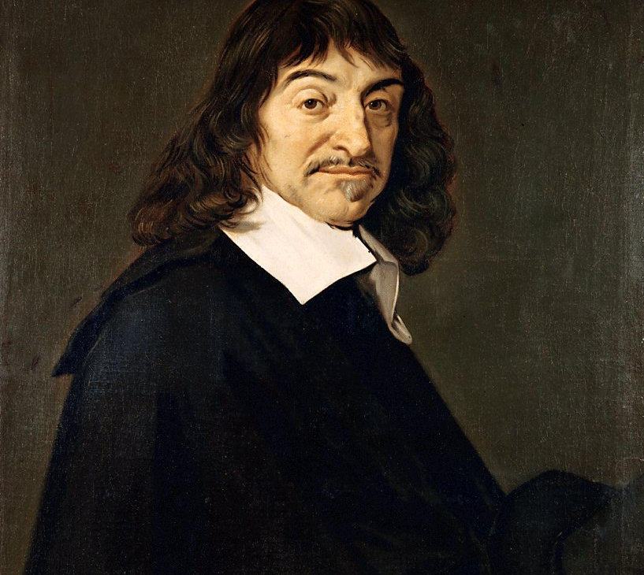
René Descartes
(Kartezjusz)
Notes:
However, even before such question was communicated into peoples consciousness in the form of FrankenStein science fiction, there already was a variation of this question that has been debated over 300 years by René Descartes.
Father of modern Philosophy
Cognito Ergo Sum
Mathematics, Physics, Philosophy, Carteesian coordinate system

Slide 6
“Discourse on the Method for Conducting One’s Reason Well and for Seeking the Truth in the Sciences”
Notes:
1637 - Discourse on the Method
Descartes questioned whether or not machines (animals) hold the same reasoning faculties as men, and this can be traced to his book Discourse on the Method for Conducting One’s Reason Well and for Seeking the Truth in the Sciences
From this Cartesian perspective of knowing that I, myself am a conscious and thinking being raises the question of if it is possible for me to know whether or not my fellow man or the animals are also conscious, thinking, and rational beings.
He established model of testing consciousness in machines to understand whether or not such they are self-aware

Slide 7
“First is that they could never use words or other signs, or put them together as we do in order to declare our thoughts to others”
Notes:
He created a method to distinguish between machine (animals) and human consciousness. In his method, he creates two categorical rules that divide humans and animals into two categories, those that are considered conscious – humans, and those that are simply composed of mechanical parts that constitute a living entity without a soul.

Slide 8
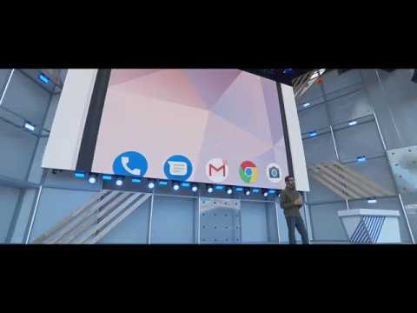

Slide 9
“The second means is that, although they might perform many task very well or perhaps better than any of us, such machines would fail in other tasks by this means one would discover that they were acting, not through knowledge, but only through the disposition of their organs”

Slide 10
Cartesian dualism
Descartes believed that mind and body is completely separate from one another,
it’s possible to doubt the body, but not the mind: “Cogito ergo sum”.
Notes:
Descartes believed in something we now call the Cartesian dualism. It means that the mind and the body are completely separate from one another.
“I think, therefore I am”
If consciousness doesn’t emerge from our physical brains, but “the soul” or “the mind”, then it would be impossible to simulate it via AI

Slide 11
Turing test
envisioned by Alan Turing, first introduced in his paper: "Computing Machinery and Intelligence",
can’t actually check consciousness of the machine, only the appearance of it.
Notes:
invented in 1950, it’s about checking if an observer can determine if he’s talking with a machine or a human,
based on written responses to given questions,
related to the first criterion, checking if the machine can put words together to convey meaning.
Unclear about the thoughts tho

Slide 12
Current state of technology
exponential growth of processing power
Notes:
Descartes formulated his thoughts when the most advanced machines were mechanical clocks and printing press,

Slide 13
What can we do with artificial neural networks today
speech recognition,
natural language processing,
recognizing people, animals, objects in images,
learning games by playing with itself - AlphaGo, AlphaZero.
Notes:
We can do a lot of the tasks that were considered to only be possible by humans:
Speech, NLP, synthesizing,
Even emotions, from body language, can be classified by NN (used in CCTV),
AlphaZero played against itself, and beat the best algorithm by just that, also beating best human players in Go, Chess

Slide 14
Where the current AI is lacking
it’s still very specialized,
usually needs a lot of data to learn,
processing power,
needs human supervision in determining goals, inputs.
Notes:
Because of this specialization, it doesn’t match Descartes 2nd criteria.
Processing power is much lower than the processing power of the human brain.
Doesn’t act on its own

Slide 15
The future - General AI
doesn’t actually have to work like a human brain,
able to take action in the physical world,
able to solve general problems,
more processing power than all human brains.
Notes:
potentially copying human consciousness to a computer? (very frequent in popular media)

Slide 16
Thanks for the attention

