Slide 1
COMPUTATIONAL INTELLIGENCE - labs & project
Patryk Gałczyński

Slide 2
Labs
Iris, MLP, SOM, AGDS..

Slide 3
Summary no.1
Personal neural net:
Written in Python3
Follows OO concept
Loads data from csv
Exports net to yaml and cypher
Pluginable bias nodes
Any activation function

Slide 4
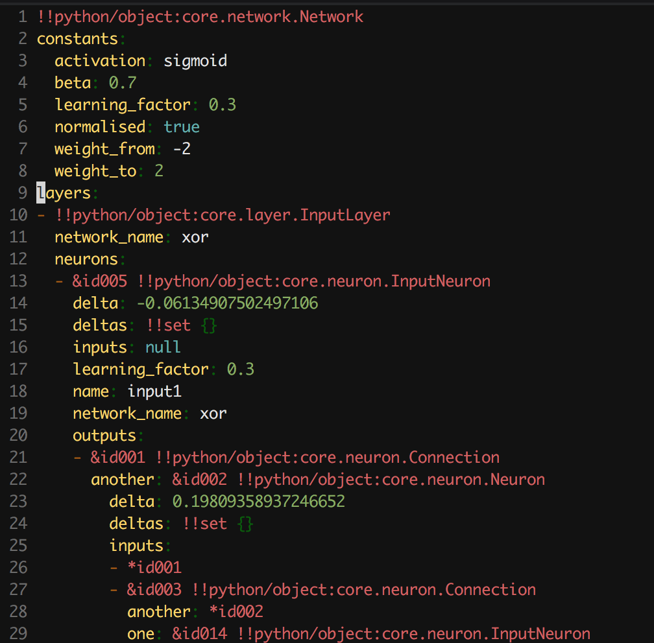
The right way to do that

Slide 5
Protip #0
Use YAML, its awesome

Slide 6
Basic iris
1
We all love iris dataset

Slide 7
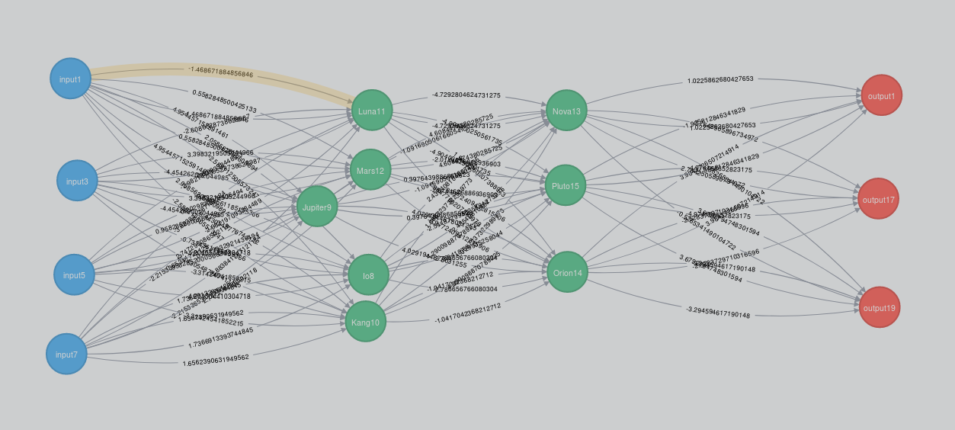
Iris dataset
1000 iterations in 4 folds
folds results: [99.6, 99.96842105263158, 94.68947368421053, 91.9361111111111]
+-------+-------+-------+-------+----------------+---------------+-------------+
| In0 | In1 | In2 | In3 | Iris-virginica | Iris- | Iris-setosa |
| | | | | | versicolor | |
+-------+-------+-------+-------+----------------+---------------+-------------+
| 6.900 | 3.100 | 5.100 | 2.300 | 1.000 | 0.001 | 0.000 |
+-------+-------+-------+-------+----------------+---------------+-------------+
| 5 | 2 | 3.500 | 1 | 0.000 | 0.966 | 0.007 |
+-------+-------+-------+-------+----------------+---------------+-------------+
| 5.400 | 3.700 | 1.500 | 0.200 | 0.000 | 0.008 | 0.994 |
+-------+-------+-------+-------+----------------+---------------+-------------+
Took obout 40s
Learning rate: 0.3
Beta: 0.7
Random weights: from -2 to 2
Activation function: sigmoid
For Tensor Flow it was 0.3s..

Slide 8
Notice #1
Python is slow.
or I can’t write fast code

Slide 9
xor
1
xor?

Slide 10
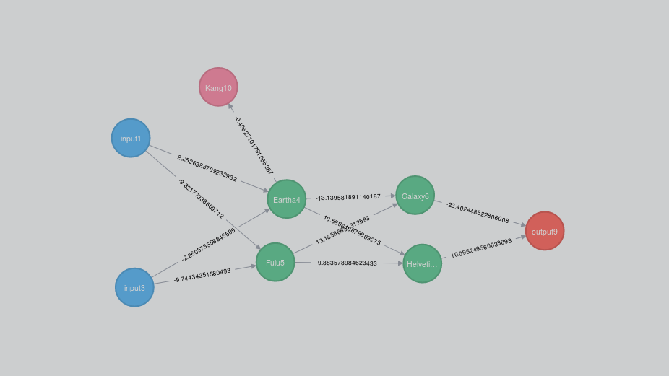
Another dataset
------- test -------
+-----+-----+-------+
| In0 | In1 | Out0 |
+-----+-----+-------+
| 0 | 0 | 0.022 |
+-----+-----+-------+
| 0 | 1 | 0.934 |
+-----+-----+-------+
| 1 | 1 | 0.081 |
+-----+-----+-------+
| 1 | 0 | 0.937 |
+-----+-----+-------+
Learning rate: 0.1
Beta: 0.98
Weights: from -5 do 5
10k iterations
Took about 2s
Random bias added
Activation: ReLu

Slide 11
Pro tip #2
Try different activation function!

Slide 12
Deep MLP
1
Multi layer perceptron

Slide 13
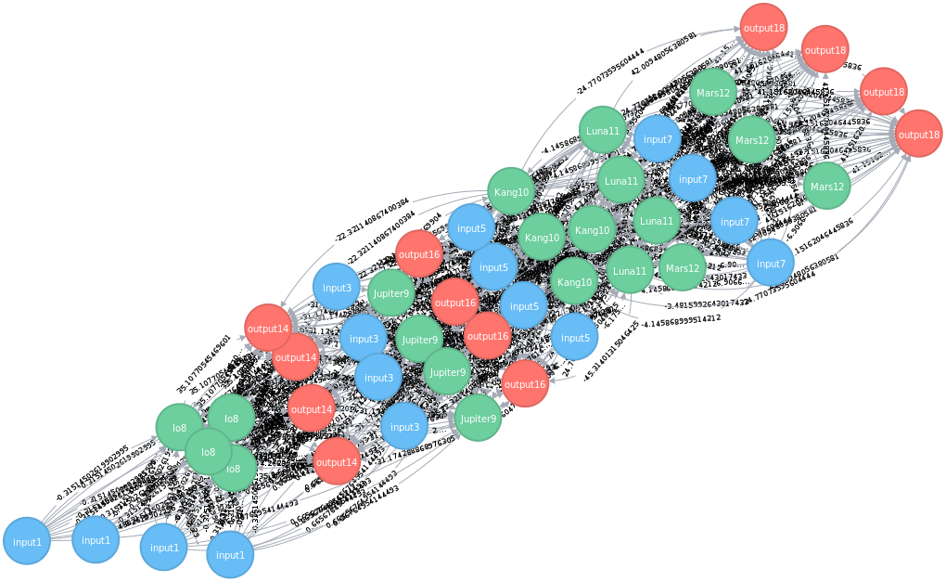
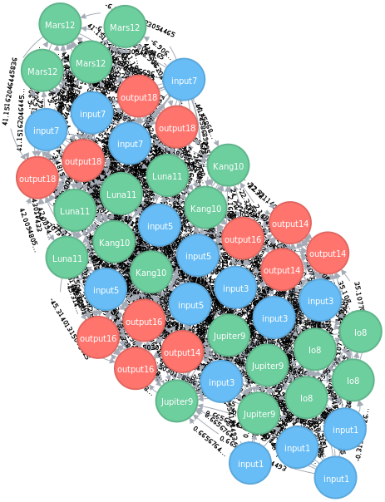
How it looks like?
Results:
I could not train it well
For 4 folds I obtained 68% of success at most

Slide 14
Som
2
Self organizing maps

Slide 15
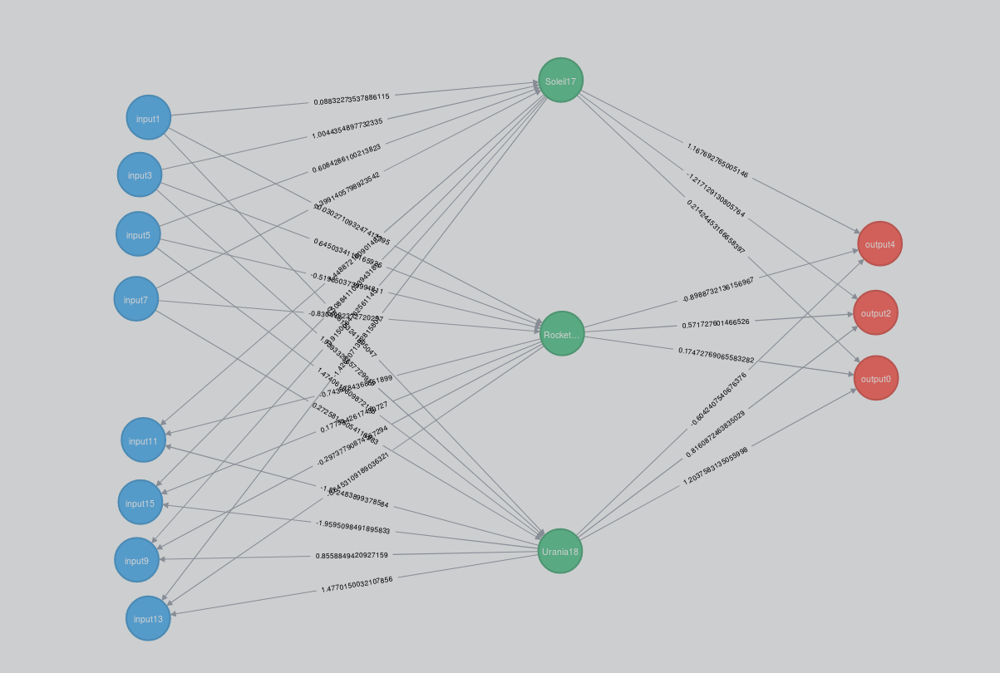
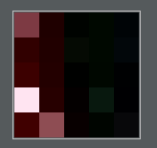
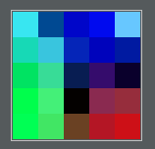
Som
Implemented with 5x5 matrix (numpy),
Trained unsupervised
Plugged as second input to mlp

Slide 16
Gains:
95.75 % without SOM
96.50 % with SOM

Slide 17
AGDS
3

Slide 18
Similarity percentage:
[((id: 140403750792328, class: Iris-versicolor, 4.0-1.2-5.8-2.6), 100.0)
((id: 140403750816568, class: Iris-virginica, 5.6-1.4-6.1-2.6), 81.24),
((id: 140403750808208, class: Iris-virginica, 5.0-1.5-6.0-2.2), 79.67),
((id: 140403750818872, class: Iris-virginica, 5.1-1.9-5.8-2.7), 79.6),
((id: 140403750799008, class: Iris-virginica, 5.1-1.9-5.8-2.7), 79.6),
((id: 140403750816288, class: Iris-virginica, 5.1-1.5-6.3-2.8), 79.33),
((id: 140403750789528, class: Iris-versicolor, 3.9-1.2-5.8-2.7), 78.83),
((id: 140403750806528, class: Iris-virginica, 5.0-2.0-5.7-2.5), 78.55),
((id: 140403750814328, class: Iris-virginica, 4.8-1.8-6.2-2.8), 78.4),
((id: 140403750809328, class: Iris-virginica, 4.9-1.8-6.3-2.7), 78.34),
((id: 140403750800408, class: Iris-virginica, 4.5-1.7-4.9-2.5), 78.31),
((id: 140403750817688, class: Iris-virginica, 4.8-1.8-6.0-3.0), 77.84),
((id: 140403750808768, class: Iris-virginica, 4.9-2.0-5.6-2.8), 77.5),
((id: 140403750820832, class: Iris-virginica, 5.1-1.8-5.9-3.0), 77.38),
((id: 140403750819992, class: Iris-virginica, 5.0-1.9-6.3-2.5), 77.17),
((id: 140403750785264, class: Iris-versicolor, 4.1-1.0-5.8-2.7), 77.16),
((id: 140403750791768, class: Iris-versicolor, 4.4-1.2-5.5-2.6), 76.98),
((id: 140403750814608, class: Iris-virginica, 4.9-1.8-6.1-3.0), 76.95),
((id: 140403750785824, class: Iris-versicolor, 3.9-1.1-5.6-2.5), 76.88),
...

Slide 19
Notice #3
Precalculated AGDS is blazing-fast

Slide 20
Final project
Artificial player (neural net) for Snake

Slide 21
Design Features
1
Which parameters could be useful?

Slide 22
Features
Obstacles?
In front
Left side
Right side
Distance to apple?
Angle to apple?

Slide 23
Gather data
2
Lots of it

Slide 24
How to gather data?
Generate your own
Since snake is fairly simple, we can generate random moves and evaluate them
Get some friends
Track moves from real games

Slide 25
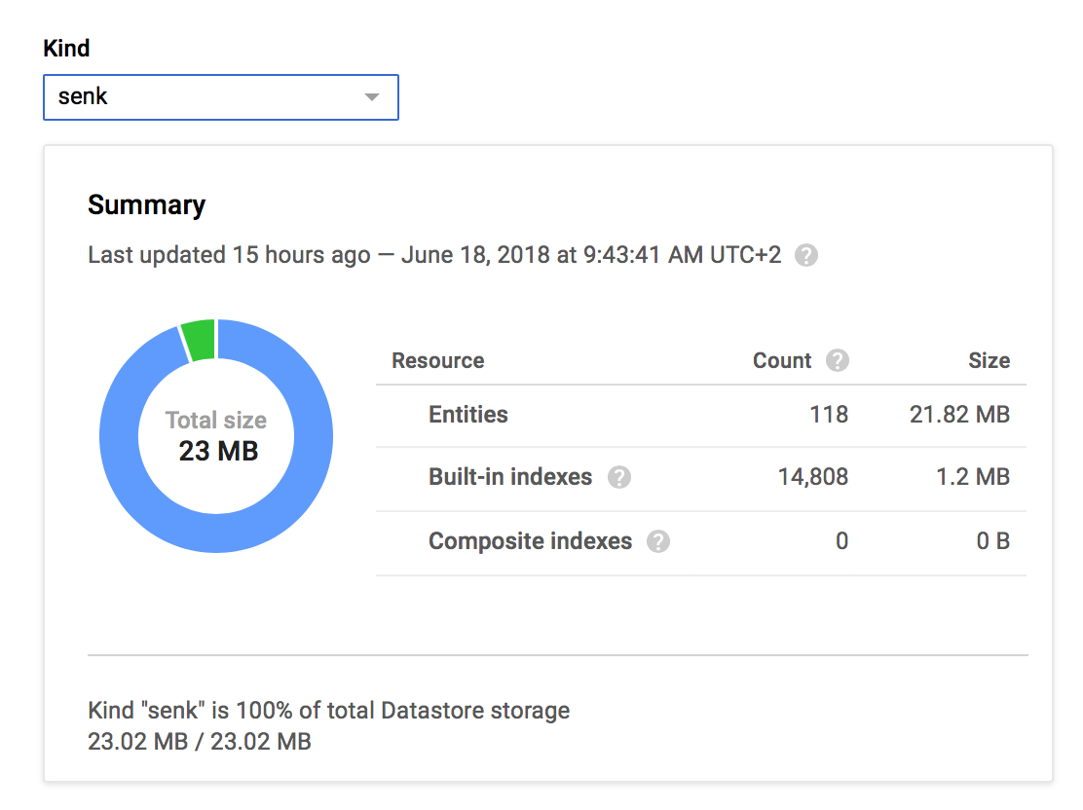
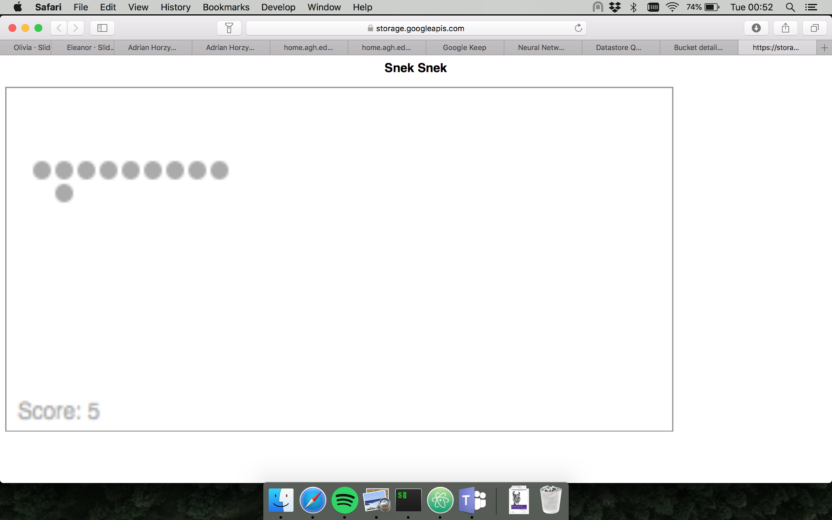
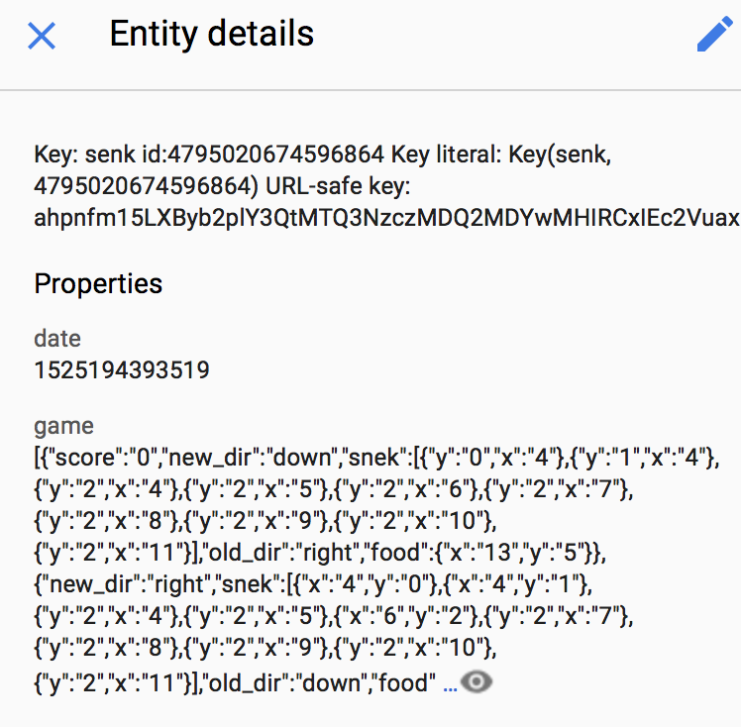
Learning data gathering
https://storage.googleapis.com/snek-front/main.html

Slide 26
Pro tip #4
Gather more, filter later

Slide 27
Learning time
2
This thing is so lazy..

Slide 28
Baby steps

Slide 29
We can do better
3
Uh oh.

Slide 30
After tinkering for a while
Things done to improve:
Change number of layers/neurons/connections
Add some bias
Change activation function to ReLu
Tinker around parameters (learning rate and so on..)

Slide 31
Well..
meh.

Slide 32
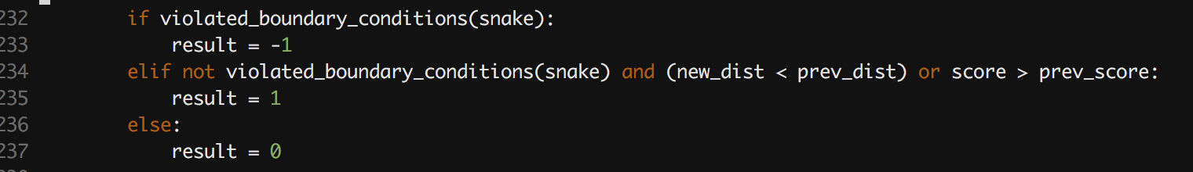
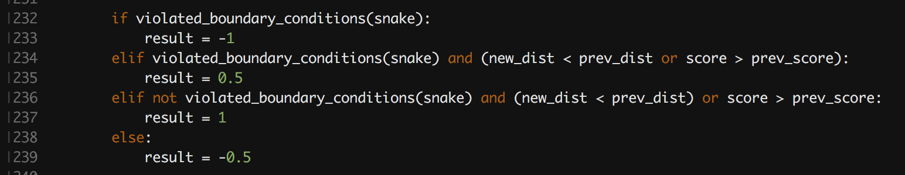
And then something clicked

Slide 33
Its first points gathered

Slide 34
Pro tip #5
Be patient

Slide 35
Obtained results:
With:
Over 100 real games
About 2000 data points extracted
Over 10k points generated
After:
20 minutes of learning
Got:
~ 86% from 4 folds

Slide 36
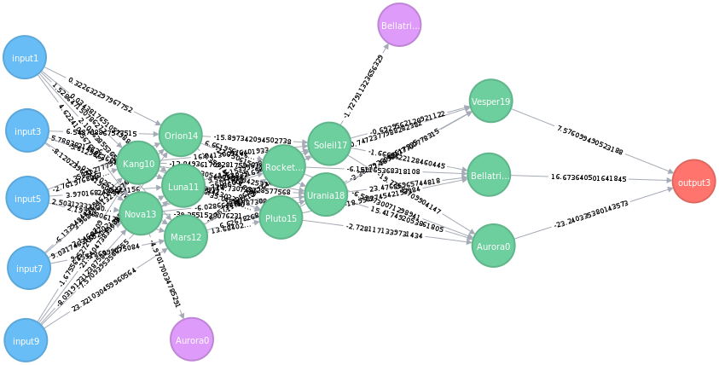
Summary
1 network
5 layers
18 neurons

Slide 37
Thanks!
ANY QUESTIONS?

