Slide 1
Hva er Servlets

Slide 2
https://www.ntu.edu.sg/home/ehchua/programming/howto/Tomcat_HowTo.html

Slide 3
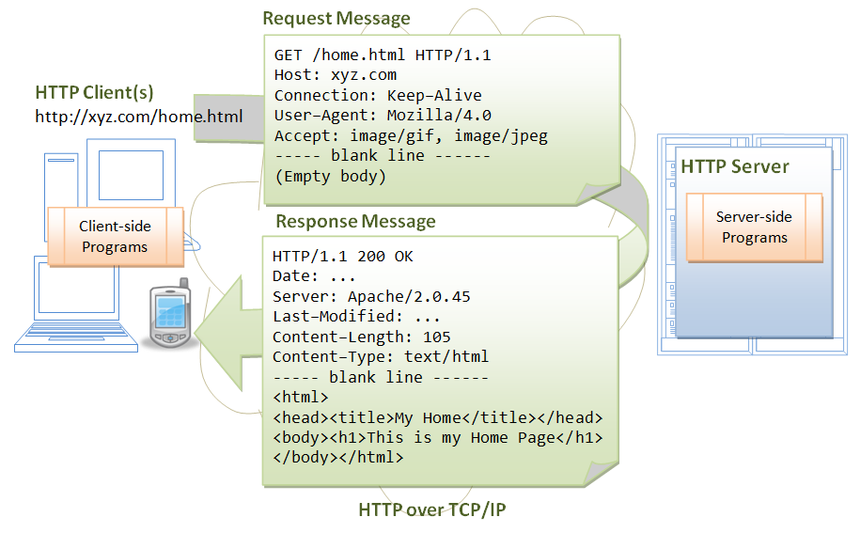

Slide 4
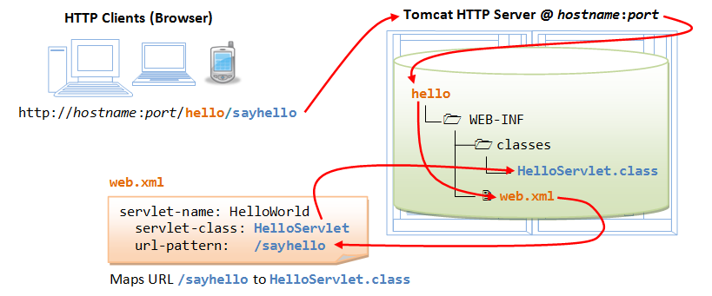

Slide 5
