Slide 1













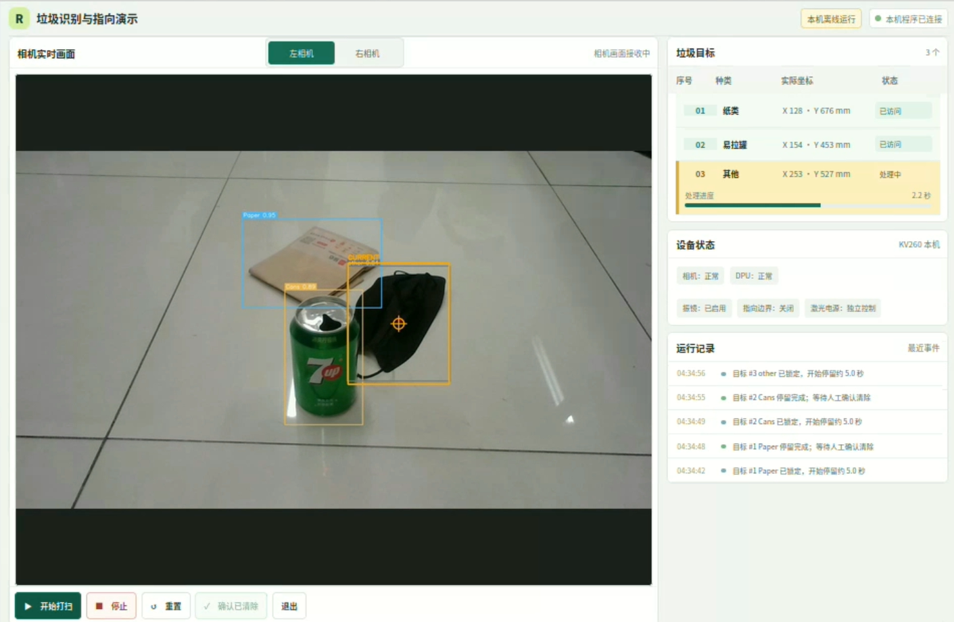



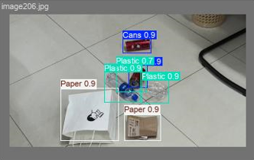
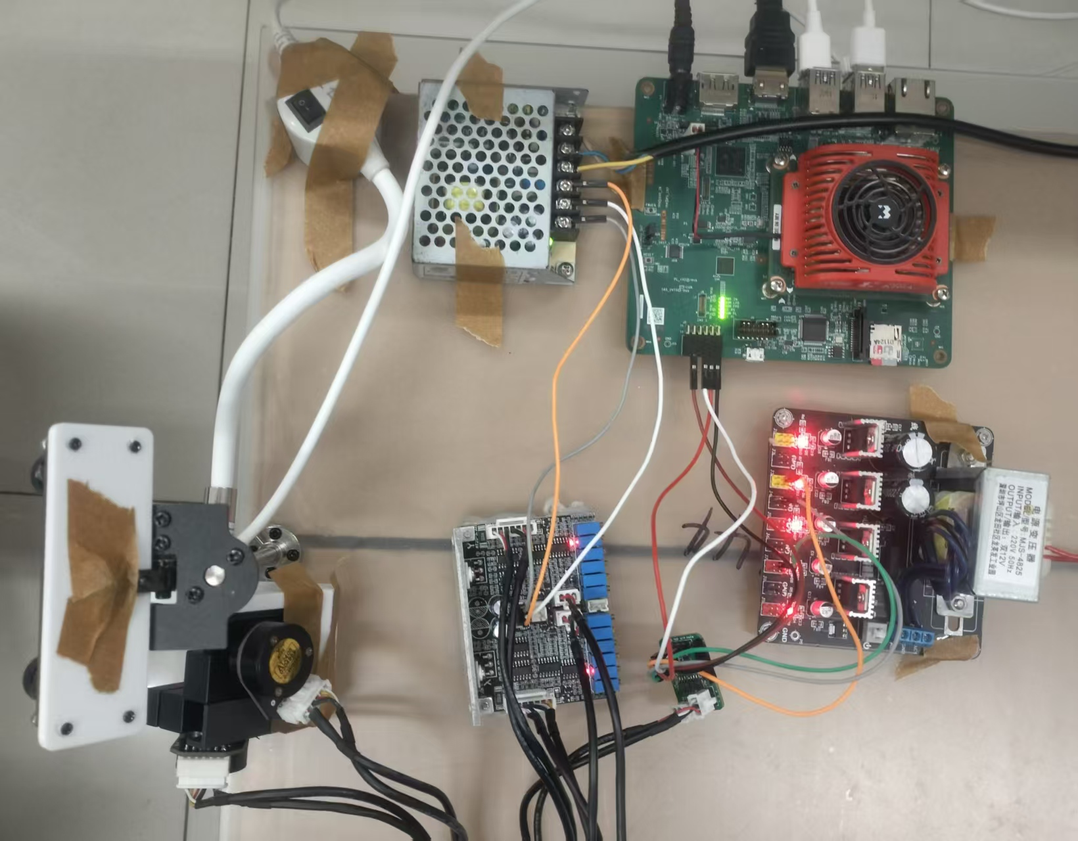
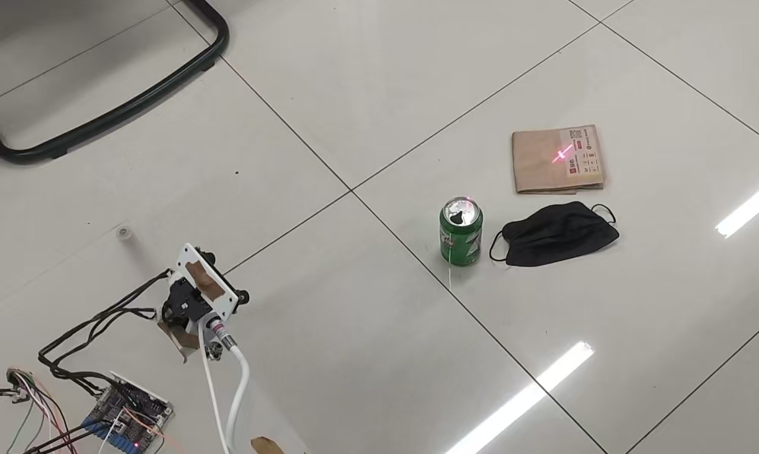
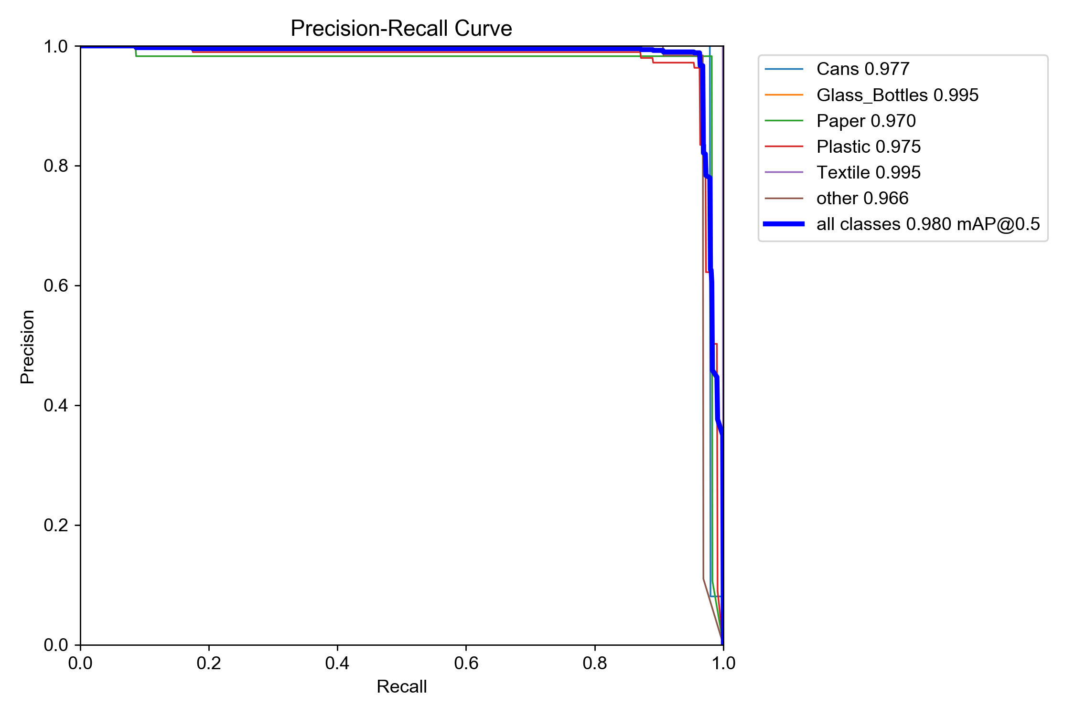
KV260-Based Road Litter Visual Recognition
and Classification System
A stereo-vision system on AMD Kria KV260 that detects, ranges and laser-marks road litter, entirely on-device.
SYSTEM PIPELINE
Stereo Camera
KV260 PS + PL
DPU Detection
Stereo Disparity
DAC + Galvo
Laser Marking
Left + right
images
PS: Linux control
PL: custom IP
YOLOv5s INT8
detect + classify
Distance +
3-D position
SPI-DAC drives
galvanometer
Spot lands on
the target
DETECT · LOCATE · MARK
1
Detect
2
Locate
3
Mark
L
R
ANALOG
Cans
Glass Bottles
Paper
Z
DAC
GALVO
Plastic
Textile
Other
TARGET
YOLOv5s · INT8 on DPU · 320×320
~8,100 training images
Disparity gives distance and
3-D position of each target
SPI-controlled DAC drives the galvo
Laser spot marks the litter target
MODEL DEPLOYMENT FLOW
SYSTEM INTERFACE
KEY TECHNOLOGIES
1
Model Training
Vitis AI
INT8 quantization and DPU compilation, producing the KV260 .xmodel
YOLOv5s · ReLU · best.pt
2
Model Adaptation
DPU-friendly structure
3
Vitis AI Quantizer
INT8 quantization
4
DPU Compilation
PyTorch
YOLOv5s training and weight export
SPI Communication
PS drives the DAC that steers the galvo
KV260 arch.json → .xmodel
VALIDATION RESULTS
HARDWARE TOP VIEW
IN OPERATION
DETECTION ACCURACY
KEY METRICS
98.0%
~165 FPS
mAP@0.5 (six classes)
DPU inference only (≈ 6 ms)
~22 FPS
0.96
Validation set · IoU 0.5 · six classes
End-to-end detection (≈ 45 ms)
Average F1 at confidence 0.794
Speed measured on KV260 · INT8 · 320×320 · batch 1. Excludes camera capture, display, stereo matching and galvo control.
CONCLUSION
A complete detect–range–mark loop runs on a single KV260: low power and reconfigurable.
Future work: tracking · path planning · robotic collection.

