Slide 1
Intro to Linear Algebra
ISTA 331

Slide 2
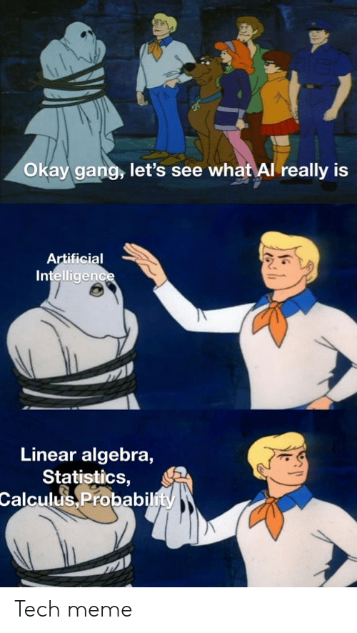
Linear Algebra is a foundation of Data Science
Linear algebra is the math behind vectors and matrices
Data Science, Machine Learning, and AI all rely on linear algebra to work
Simplifies many of the problems in ML, often giving the only reasonable solution
OLS, Support Vector Machines, Neural Networks, K-Means, and many other techniques are only possible with linear algebra

Slide 3
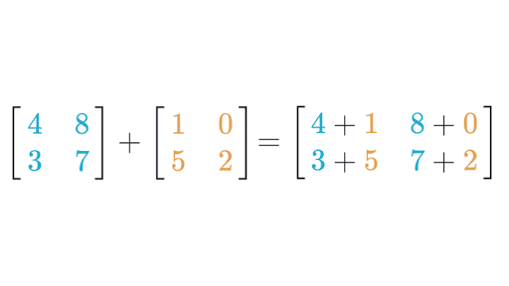
Matrix Math: Adding Matrices
Matrices are added element-wise, meaning that for two matrices A and B:
(A + B)_{i, j} = A_{i, j} + B_{i, j}
Example:

Slide 4
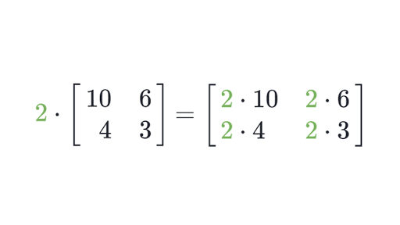
Matrix Math: Scaling Matrices
Matrices can be scaled by constants, meaning that for a matrix A and constant c:
(c*A)_{i, j} = c*A_{i, j}
Example:

Slide 5
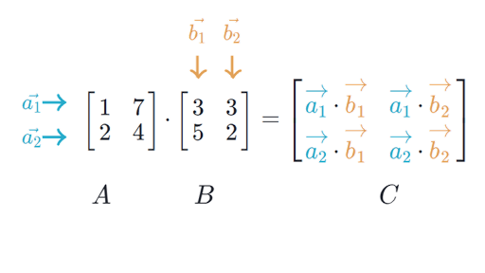
Matrix Math: Multiplying Matrices
Matrix multiplication takes the dot product of the rows of the first matrix and the columns the second matrix to form a new matrix:

Slide 6
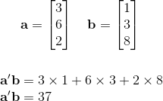
Matrix Math: The Dot Product
The dot product of two vectors u and v is the sum of their element-wise product :
u ⦁ v = u₀v₀ + u₁v₁ + . . . + u_{n-1}v_{n-1} + u_{n}v_{n}
Example:
*This is the same as multiplying a (1 x n) matrix and an (n x 1) matrix!

Slide 7
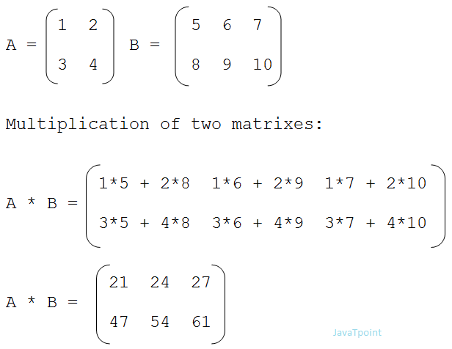
Multiplying Matrices: Example

Slide 8
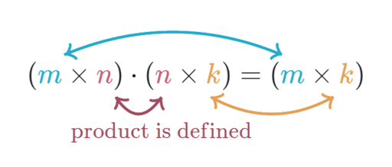
Matrix Math: Dimensions
To multiply two matrices, the number of columns of the first matrix MUST match the number of rows in the second. Multiplying a (m x n) and a (n x k) matrix will result in a (m x k) matrix.
Note that A B is NOT the same as B A! Keep this in mind when solving matrix equations: you may have to multiply on the LEFT or the RIGHT.

Slide 9
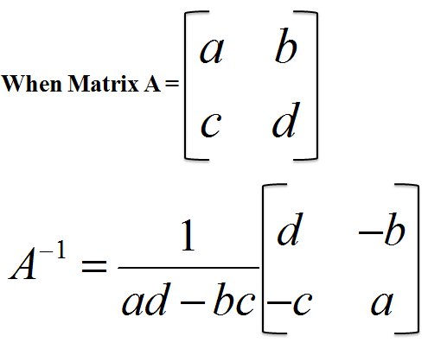
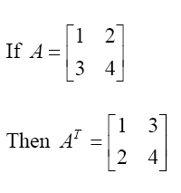
Matrix Math: Inverse and Transpose
Inverse:
Transpose:

Slide 10
Matrix Math: Solving for X
Just like in regular algebra, we can solve for X! Except now, X is a matrix…
Solve for X: 2 A X - B = A^{T} (A, B, and X are square matrices)
Steps:
2 A X = A^{T} + B
A X = 0.5 (A^{T} + B)
A⁻¹ A X = 0.5 A⁻¹ (A^{T} + B)
X = 0.5 A⁻¹ (A^{T} + B)
Add the B matrix to both sides
Multiply by the scalar 0.5
LEFT MULTIPLY by A⁻¹
Inverses cancel, leaving the solution

Slide 11

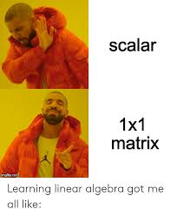
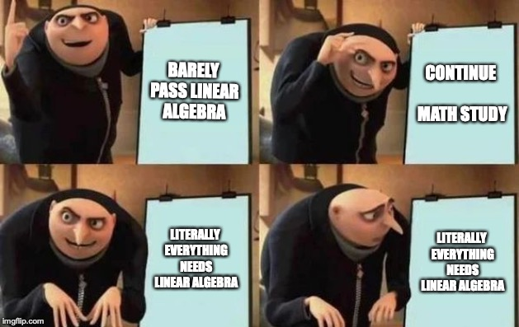
Linear Algebra Memes to Help You Learn

Slide 12
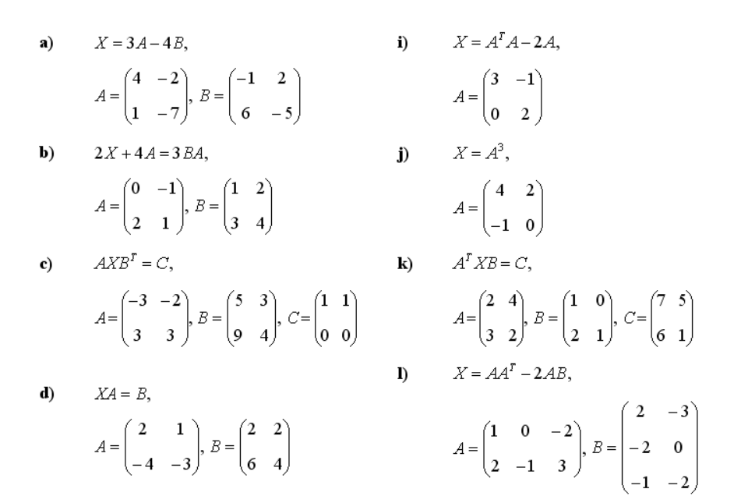
Assignment: Solve for X.
Do {A, B, D, I, L} and one of {C, K}
What happens in b) if the matrix B is
[1 2]
changed to [3 4] ?
[5 6]
What if A is changed?
*You may use numpy for THREE of these. The rest must be done by hand.

