Slide 1
Lab 8
ISTA 331

Slide 2
Pandas Review: Series
Pandas series are used to represent feature vectors in this assignment
Feature vectors: sequence of feature values representing an instance. A row in a database of a data frame or a series
A series is used to literally represent a column or row in a data frame
Pandas documentation: https://pandas.pydata.org/pandas-docs/stable/dsintro.html

Slide 3
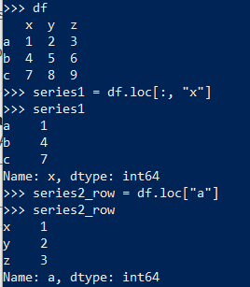
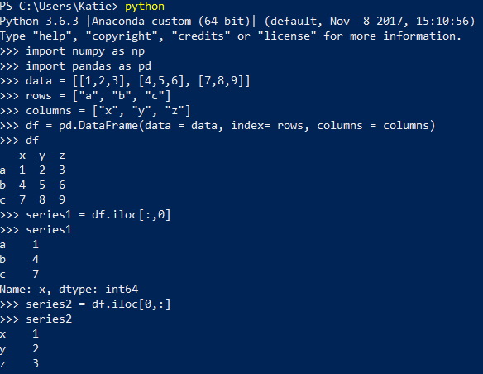
How to Make Series from Data frames
Use loc and iloc to index into a data frame in pandas to extract the series that you need
Do not use ix
loc example
iloc example

Slide 4
Brief Explanation of K-Means
Clustering is unsupervised learning
Clustering is particularly good for finding hidden patterns in data
Unsupervised learning is used when the data does not have labeled responses
Works by splitting the data into clusters (k is the amount of clusters)
Centroid is a data point in the middle of a cluster
Each centroid is an existing data point picked at random so all the clusters are unique

Slide 5
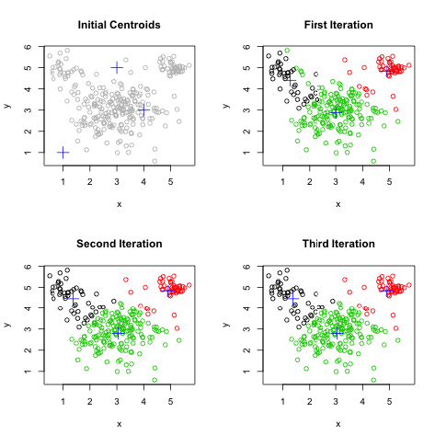
K-means Homework Overview
You first go through the data points and assign each point to a randomly generated centroid based on the proximity to it
The proximity to a centroid is calculated in the function euclidean_distance
Once the data points have been assigned, K-Means moves the centroids to the average of the points in the cluster

Slide 6
Euclidean Distance
In the homework, each column correlates with a feature (i.e. column 1 could be marital status, column 2 could be income)
For example, each row could represent a person and the values in the row can represent characteristics they possess
If we wanted to calculate the Euclidean distance between Rob and Burt, we would need to determine if both feature vectors possess the same feature
Sets are a great way to get rid of the features that the feature vectors don’t have in common (we can’t compare the features if the data is not there)
 | Income | Age | Debt
Rob | 70000 | 33 | 10000
 | Gender | Age | Debt
Burt | 0 | 7 | 100000

Slide 7
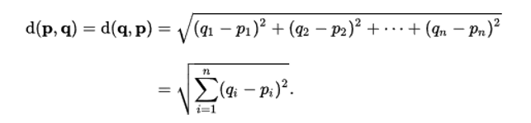
Euclidean Distance
Then, the features that the feature vectors do have in common can have the formula for Euclidean distance applied to them
Which columns should be used to calculate the Euclidean distance?
 | Gender | Age | Debt
Burt | 0 | 7 | 100000
 | Income | Age | Debt
Rob | 70000 | 33 | 10000

Slide 8
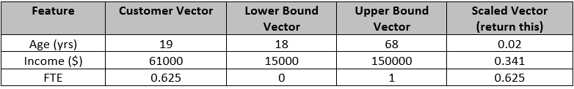
Scaled_feature_vector
There is a flaw in our calculator of Euclidean distance. For instance, what if one feature is a customer's age in years and another is his/her income in dollars? The units are different, as is the scale of the numbers, making income much more important than age in calculating distance.
One way to compensate for this is to scale all values so that they fall in the range [0, 1].
This function takes three feature vectors. The first is our vector for the object of interest. The second contains the lower bounds for all of the features. The third contains the upper bounds. For example:

Slide 9
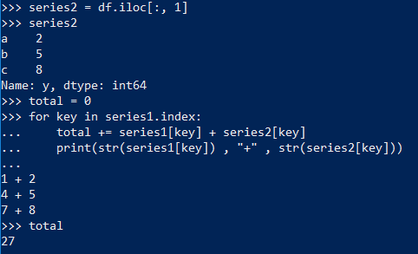
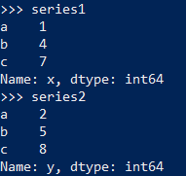
How to grab corresponding features in Series

Slide 10
Complete lab8.py

Slide 11
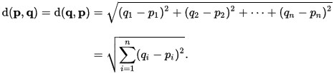
1st function in lab4: euclidean_distance
Euclidean distance, d, is a measure commonly used by data scientists. It is also called the L² norm. It is calculated just the way you would calculate the distance between two ndimensional points. Given feature vectors p = [p₁, p₂, …, p_{n}] and q = [q₁, q₂, …, q_{n}], d is calculated (image from Wikipedia):
This function takes two Series objects and returns the Euclidean distance between them. The twist is that the feature vectors may not contain the same features (sometimes a real-life issue). The twist is also that our problem context has changed. In lab 2, two vectors had a feature in common if both of them had a 1 in the same position, and each position could only be either 0 or 1. But when we use Euclidean distance, we are dealing with features that can typically take on many values, possibly ranging from -∞ to +∞. Now we consider two vectors to have a given feature in common if they both have that feature's name in their index. In the example at the top of the next page, the two vectors have the features 'age' and 'income' in common.

Slide 12
euclidean_distance
Use only common features to calculate the distance between the two arguments. If the two vectors contain no features in common, return numpy.nan. You can get the common features by traversing the index of one of the vectors (for label in fv1.index:) and building a list of labels that are common to both vectors. Or, you can use this code: features = set(fv1.index) &
set(fv2.index). After execution of this statement, features contains an object that you can traverse by element containing all of the labels common to both vectors (Series objects). For instance, if you have two feature vectors, fv1 ==
And fv2 ==
then your feature name/label set would be {'income', 'age'}. Now you can traverse this set, using each label to access the feature values for the common features in each vector.
age | income | gender
19 | 23000 | 1
income | fav_color | age
97000 | 3 | 57

Slide 13
2nd function in lab8: scaled_feature_vector
You may have noticed a flaw in our calculation of Euclidean distance.
For instance, what if one feature is a customer's age in years and another is his/her income in dollars?
The units are different, as is the scale of the numbers, making income much more important than age in calculating distance. This is reflected in the assertions in the test file for euclidean_distance.
However, age may be just as predictive as income, depending on the problem we are trying to solve. One way to compensate for this is to scale all values so that they fall in the range [0, 1].

Slide 14
scaled_feature_vector
Suppose we have a (very small) dataset of 5 customers with ages 18, 36, 24, 68, and 50. We need to convert these per the following table (note that this is NOT a feature vector – these are values for 5 instances of a single feature):
Try to design an algorithm that transforms the unscaled values to the scaled values yourself before looking at the formula below. Now imagine a feature vector – each feature value will have to be scaled using different upper and lower bounds.
Unscaled Age | Scaled Value
18 | 0
23 | 0.1
36 | 0.36
50 | 0.64
68 | 1

Slide 15
scaled_feature_vector
This function takes three feature vectors. The first is our vector for the object of interest. The second contains the lower bounds for all of the features. The third contains the upper bounds. For example:
Use the copy method to make a copy of the first vector. Scale all of its values using the limits contained in the lower and upper bounds vectors and return it. Here is the formula:
scaled feature = (feature value – lower bound) / (upper bound – lower bound)
 | Age (yrs) | Income ($) | FTE
feature vector | 19 | 61000 | 0.625
lower bound vector | 18 | 15000 | 0
upper bound vector | 68 | 150000 | 1
scaled feature vector | 0.02 | 0.341 | 0.625

Slide 16
3rd function: scaled_euclidean_distance
This function takes two instance feature vectors, a lower bounds feature vector, and an upper bounds feature vector. Use the previous function to return the distance between scaled versions of the feature vector. Here's the catch (there's always a catch) – you must also return the number of features used to calculate the distance (hint: the length of the common feature set). To return two values, just separate them with commas. E.g. return vector, n. This code can then store the result of a function call into variables:
dist, n = scaled_euclidean_distance(object1, object2, lower, upper)

Slide 17
4th function: similarity
Given feature vectors for two objects and lower and upper bounds vectors, this function will calculate and return the similarity between the two objects. We want our measure of similarity to fall in the range [0, 1], with 0 representing two completely different objects and 1 representing objects with all equal features. Using the previous function, we get a Euclidean distance that was calculated giving equal weight to each feature, which we called scaled Euclidean distance. Let's calculate the maximum distance that we can get between two vectors with n features in common – this will be the distance between a vector with n zeros as values and a vector with n ones as values, e.g. dist([0, 0, 0], [1, 1, 1]), because 0 and 1 are now lower and upper limits for each feature value.

Slide 18
similarity
Applying the formula for Euclidean distance, we find this distance to be √n. So the range of the distances returned by the previous function is [0, √n], so we need to scale the distance again. To transform the upper limit of this range to 1, we need to divide the distance by √n to get the scaled distance. Use the number of features used to calculate the scaled Euclidean distance (n in the code above) to scale the distance again so that it falls in the range [0, 1]. Then similarity = 1 – scaled distance.

Slide 19

Complete lab8.py

