Slide 1

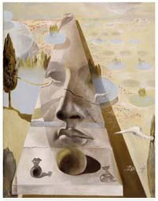
Lecture 3
Camera Models 2 & Camera Calibration
Professor Silvio Savarese
Computational Vision and Geometry Lab
Silvio Savarese
Lecture 3 -
Jan 17th, 2018

Slide 2
Lecture 3
Camera Models 2 & Camera Calibration
Recap of camera models
Camera calibration problem
Camera calibration with radial distortion
Example
Reading:
[FP] Chapter 1 “Geometric Camera Calibration” [HZ] Chapter 7 “Computation of Camera Matrix P”
Some slides in this lecture are courtesy to Profs. J. Ponce, F-F Li
Silvio Savarese
Lecture 3 -
Jan 17th, 2018

Slide 3
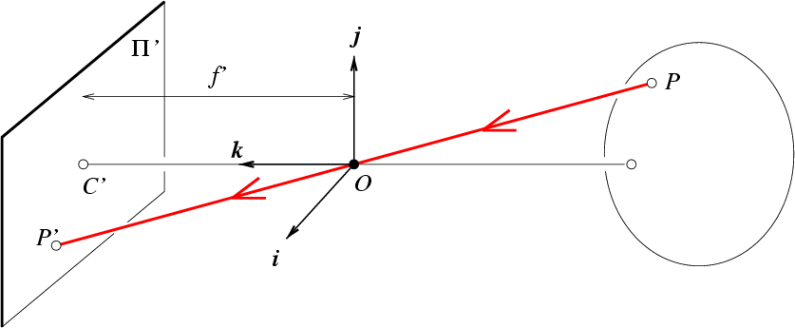


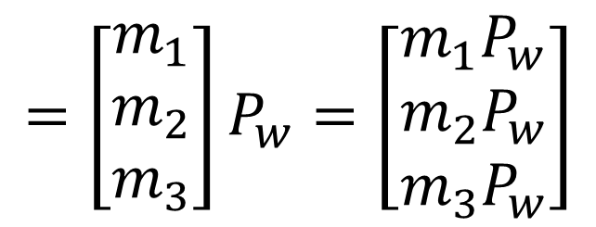
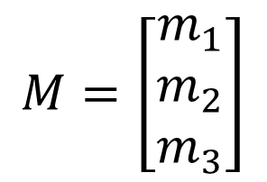
Projective camera
j_{w}
R,T
k_{w}
O_{w}
f
$$M=\left[\begin{matrix}m_{1} \\ m_{2} \\ m_{3}\end{matrix}\right]$$
$${P′}_{3×1}=MP_{w}=K_{3×3}{\left[\begin{matrix}R & T\end{matrix}\right]}_{3×4}P_{w4×1}$$
$$=\left[\begin{matrix}m_{1} \\ m_{2} \\ m_{3}\end{matrix}\right]P_{w}=\left[\begin{matrix}m_{1}P_{w} \\ m_{2}P_{w} \\ m_{3}P_{w}\end{matrix}\right]$$
$$→(\frac{m_{1}P_{w}}{m_{3}P_{w}},\frac{m_{2}P_{w}}{m_{3}P_{w}})$$
$$E$$
[Eq.12]

Slide 4

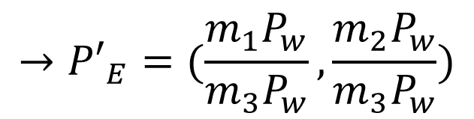
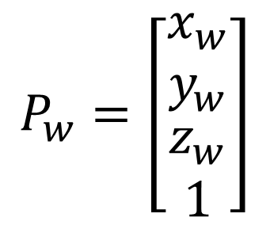
Exercise!
R,T
j_{w}
f
P
k_{w}
O_{w}
P’
i_{w}
$$M=K\left[\begin{matrix}R & T\end{matrix}\right]$$
Suppose we have no rotation or translation
Zero skew, square pixels, no distortion, no off-set
$$P_{w}=\left[\begin{matrix}x_{w} \\ y_{w} \\ \begin{aligned}z_{w} \\ 1\end{aligned}\end{matrix}\right]$$
$$→{P′}_{E}=(\frac{m_{1}P_{w}}{m_{3}P_{w}},\frac{m_{2}P_{w}}{m_{3}P_{w}})$$

Slide 5
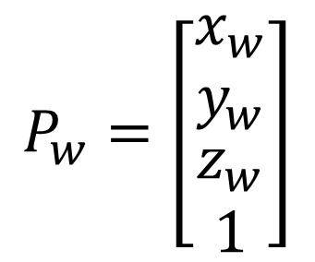
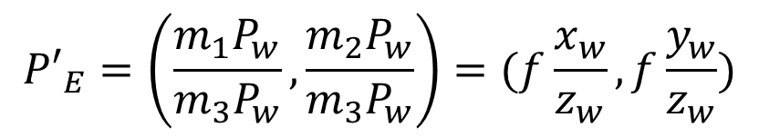
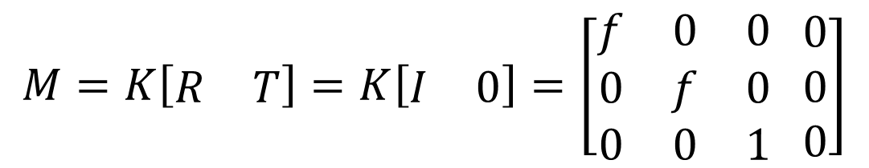
Exercise!
R,T
j_{w}
f
P
k_{w}
O_{w}
P’
i_{w}
$$M=K\left[\begin{matrix}R & T\end{matrix}\right]=K\left[\begin{matrix}I & 0\end{matrix}\right]=\left[\begin{matrix}f & 0 & 0 \\ 0 & f & 0 \\ 0 & 0 & 1\end{matrix} \begin{matrix}0 \\ 0 \\ 0\end{matrix}\right]$$
$$P_{w}=\left[\begin{matrix}x_{w} \\ y_{w} \\ \begin{aligned}z_{w} \\ 1\end{aligned}\end{matrix}\right]$$
$${P′}_{E}=\left(\frac{m_{1}P_{w}}{m_{3}P_{w}},\frac{m_{2}P_{w}}{m_{3}P_{w}}\right)=(f\frac{x_{w}}{z_{w}},f\frac{y_{w}}{z_{w}})$$

Slide 6
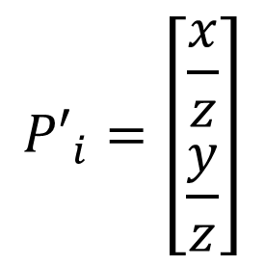
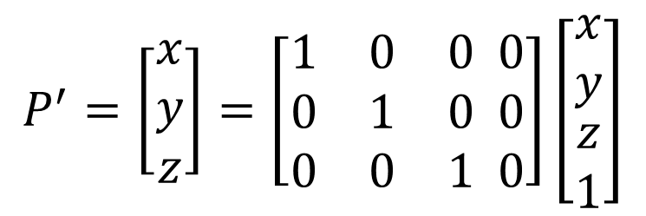
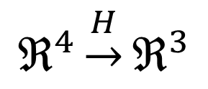

Canonical Projective Transformation
$$P^{′}=\left[\begin{matrix}x \\ y \\ z\end{matrix}\right]=\left[\begin{matrix}1 & 0 & 0 \\ 0 & 1 & 0 \\ 0 & 0 & 1\end{matrix} \begin{matrix}0 \\ 0 \\ 0\end{matrix}\right]\left[\begin{matrix}x \\ y \\ \begin{aligned}z \\ 1\end{aligned}\end{matrix}\right]$$
$$P^{′}=MP$$
$$ℜ^{4}\underset{→}{H}ℜ^{3}$$
M
$${P′}_{i}=\left[\begin{matrix}\frac{x}{z} \\ \frac{y}{z}\end{matrix}\right]$$

Slide 7

Projective camera
f’
R
Q
p’
q’
r’
O
P

Slide 8
Weak perspective projection
When the relative scene depth is small compared to its distance from the camera
f’
zo
R
R_
p’
q’
r’
Q
O
Q_
P_
π
P

Slide 9



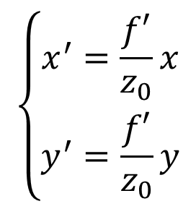
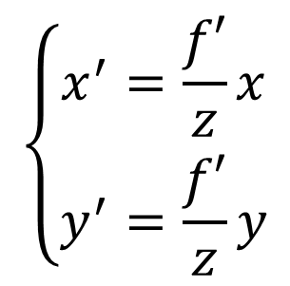
Weak perspective projection
f’
zo
R
R_
p’
q’
r’
Q
O
Q_
P_
π
P
$$\left\{\begin{matrix}x^{′}=\frac{f′}{z}x \\ y^{′}=\frac{f′}{z}y\end{matrix}\right.$$
$$\left\{\begin{matrix}x^{′}=\frac{f′}{z_{0}}x \\ y^{′}=\frac{f′}{z_{0}}y\end{matrix}\right.$$
→
Magnification m

Slide 10

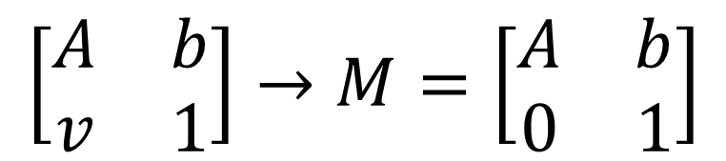
Weak perspective projection
π
f’
zo
R
R_
p’
q’
r’
Q
O
Q_
P_
P
Projective (perspective)
Weak perspective
$$\left[\begin{matrix}A & b \\ v & 1\end{matrix}\right]→M=\left[\begin{matrix}A & b \\ 0 & 1\end{matrix}\right]$$
$$M=K\left[R T\right]=$$

Slide 11
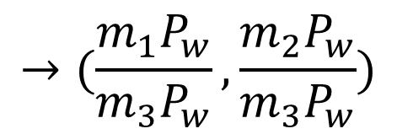
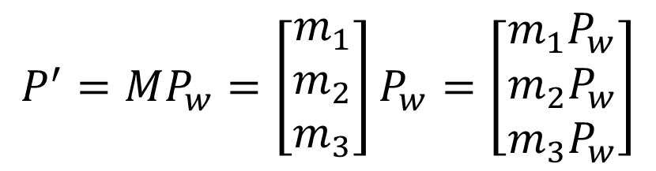
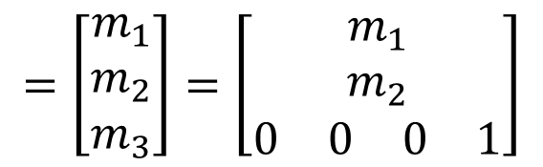
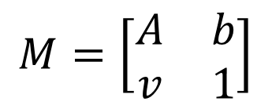
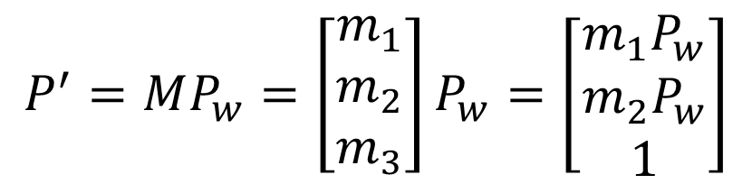
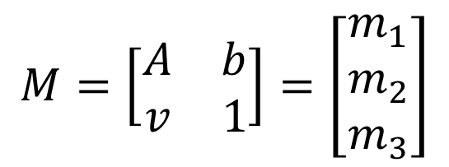

$$P^{′}=MP_{w}=\left[\begin{matrix}m_{1} \\ m_{2} \\ m_{3}\end{matrix}\right]P_{w}=\left[\begin{matrix}m_{1}P_{w} \\ m_{2}P_{w} \\ m_{3}P_{w}\end{matrix}\right]$$
$$M=\left[\begin{matrix}A & b \\ v & 1\end{matrix}\right]=\left[\begin{matrix}m_{1} \\ m_{2} \\ m_{3}\end{matrix}\right]$$
$$→(\frac{m_{1}P_{w}}{m_{3}P_{w}},\frac{m_{2}P_{w}}{m_{3}P_{w}})$$
E
Perspective
$$P^{′}=MP_{w}=\left[\begin{matrix}m_{1} \\ m_{2} \\ m_{3}\end{matrix}\right]P_{w}=\left[\begin{matrix}m_{1}P_{w} \\ m_{2}P_{w} \\ 1\end{matrix}\right]$$
$$M=\left[\begin{matrix}A & b \\ v & 1\end{matrix}\right]$$
$$=\left[\begin{matrix}m_{1} \\ m_{2} \\ m_{3}\end{matrix}\right]=\left[\begin{matrix}m_{1} \\ m_{2} \\ \begin{matrix}\begin{matrix}0 & 0\end{matrix} & \begin{matrix}0 & 1\end{matrix}\end{matrix}\end{matrix}\right]$$
E
$$→(m_{1}P_{w},m_{2}P_{w})$$
magnification
Weak perspective

Slide 12
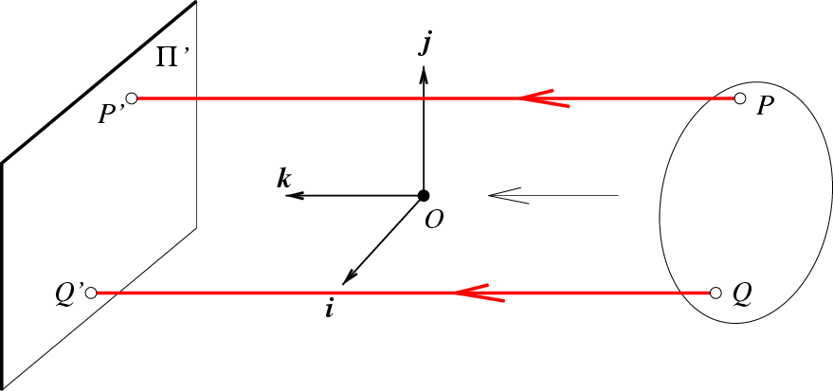
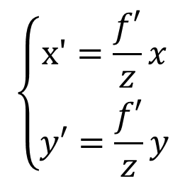
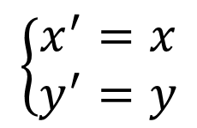
Orthographic (affine) projection
Distance from center of projection to image plane is infinite
$$\left\{\begin{matrix}x'=\frac{f′}{z}x \\ y′=\frac{f′}{z}y\end{matrix}\right.$$
$$\left\{\begin{matrix}x^{′}=x \\ y^{′}=y\end{matrix}\right.$$
→

Slide 13
Pros and Cons of These Models
Weak perspective results in much simpler math.
Accurate when object is small and distant.
Most useful for recognition.
Pinhole perspective is much more accurate for modeling the 3D-to-2D mapping.
Used in structure from motion or SLAM.

Slide 14
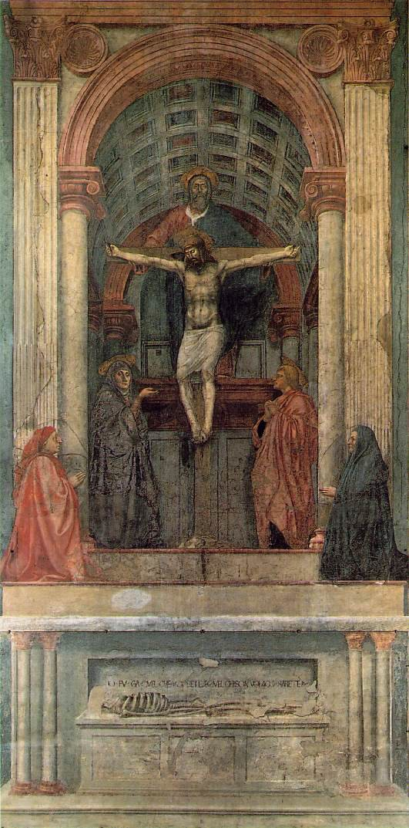
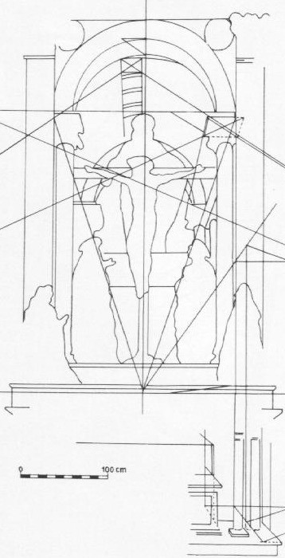
One-point perspective
Masaccio, Trinity, Santa Maria Novella, Florence, 1425-28
Credit slide S. Lazebnik

Slide 15
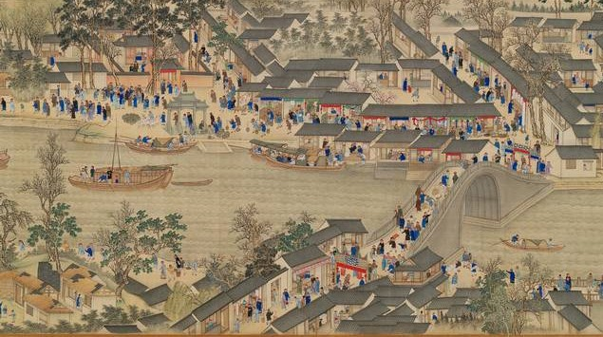
Weak perspective projection
The Kangxi Emperor's Southern Inspection Tour (1691-1698)By Wang Hui

Slide 16
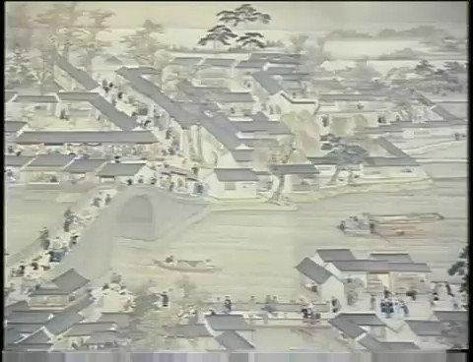
Weak perspective projection
The Kangxi Emperor's Southern Inspection Tour (1691-1698)By Wang Hui

Slide 17
Lecture 3
Camera Calibration
Recap of camera models
Camera calibration problem
Camera calibration with radial distortion
Example
Reading:
[FP] Chapter 1 “Geometric Camera Calibration” [HZ] Chapter 7 “Computation of Camera Matrix P”
Some slides in this lecture are courtesy to Profs. J. Ponce, F-F Li
Silvio Savarese
Lecture 3 -
18-Jan-18

Slide 18
Why is this important?
Estimate camera parameters such pose or focal length from images!
?

Slide 19
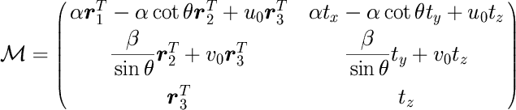
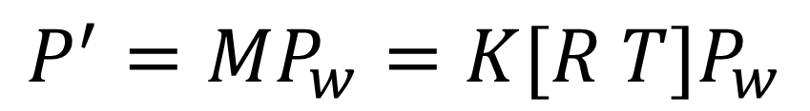
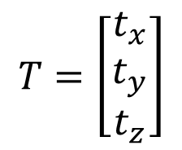
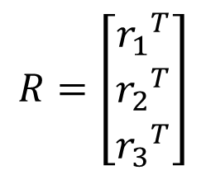
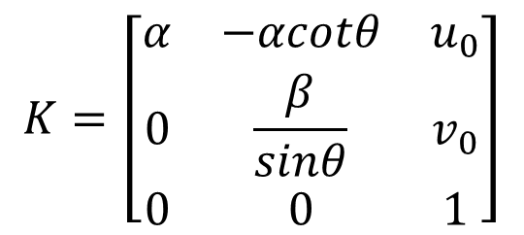
Projective camera
Internal parameters
External parameters
$$P^{′}=MP_{w}=K[R T]P_{w}$$
3× 4
$$K=\left[\begin{matrix}α & −αcotθ & u_{0} \\ 0 & \frac{β}{sinθ} & v_{0} \\ 0 & 0 & 1\end{matrix}\right]$$
$$R=\left[\begin{matrix}{r_{1}}^{T} \\ {r_{2}}^{T} \\ {r_{3}}^{T}\end{matrix}\right]$$
$$T=\left[\begin{matrix}t_{x} \\ t_{y} \\ t_{z}\end{matrix}\right]$$

Slide 20
Goal of calibration
Internal parameters
External parameters
$$P^{′}=MP_{w}=K[R T]P_{w}$$
Estimate intrinsic and extrinsic parameters from 1 or multiple images
Change notation:
P = P_{w}
p = P’

Slide 21
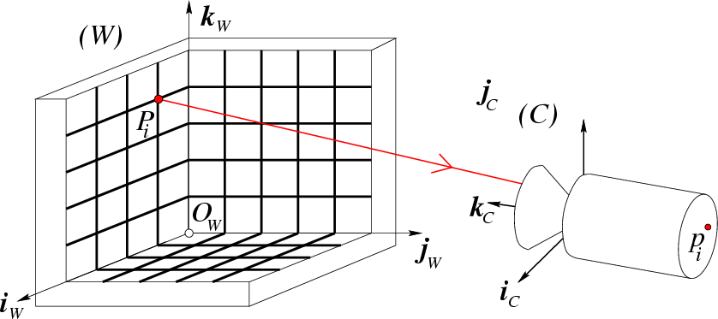
Calibration Problem
Calibration rig
j_{C}
P₁… P_{n} with known positions in [O_{w},i_{w},j_{w},k_{w}]

Slide 22
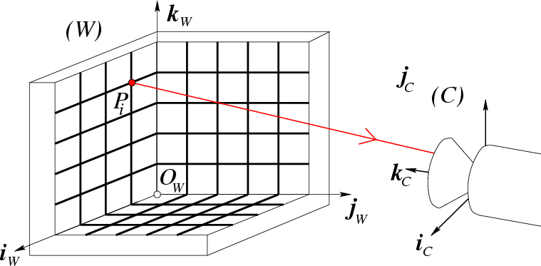

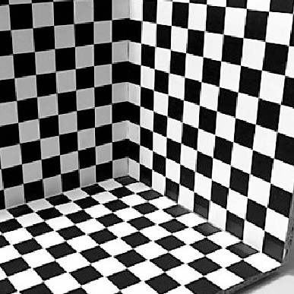
Calibration Problem
Calibration rig
image
p_{i}
j_{C}
P₁… P_{n} with known positions in [O_{w},i_{w},j_{w},k_{w}]
p₁, … p_{n} known positions in the image
Goal: compute intrinsic and extrinsic parameters

Slide 23
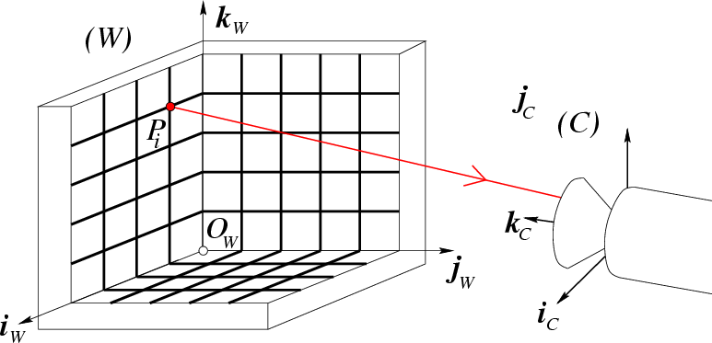
Calibration Problem
Calibration rig
image
im
age
jj_{CC}
pp_{ii}
p_{i}
How many correspondences do we need?
M has 11 unknowns • We need 11 equations • 6 correspondences would do it

Slide 24
Calibration Problem
Calibration rig
image
p_{i}
jj_{CC}
In practice, using more than 6 correspondences enables more robust results

Slide 25
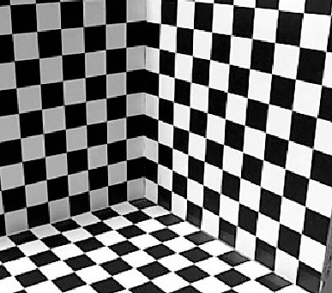
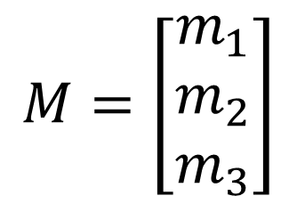
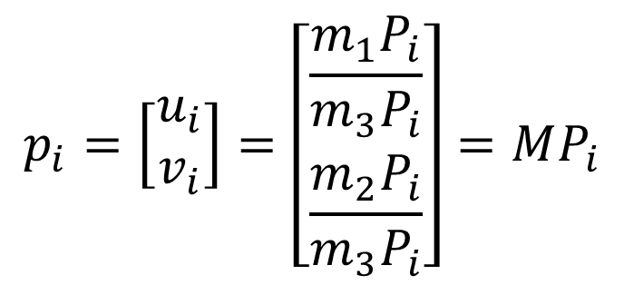
Calibration Problem
Calibration rig
image
p_{i}
jj_{CC}
$$p_{i}=\left[\begin{matrix}u_{i} \\ v_{i}\end{matrix}\right]=\left[\begin{matrix}\frac{m_{1}P_{i}}{m_{3}P_{i}} \\ \frac{m_{2}P_{i}}{m_{3}P_{i}}\end{matrix}\right]=MP_{i}$$
$$M=\left[\begin{matrix}m_{1} \\ m_{2} \\ m_{3}\end{matrix}\right]$$
[Eq. 1]
in pixels

Slide 26
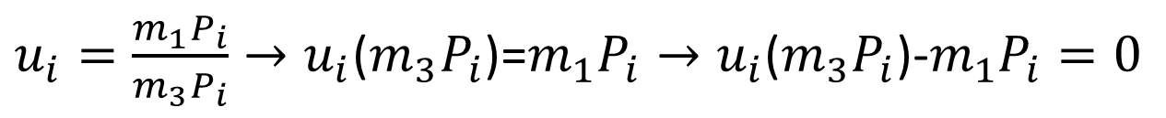
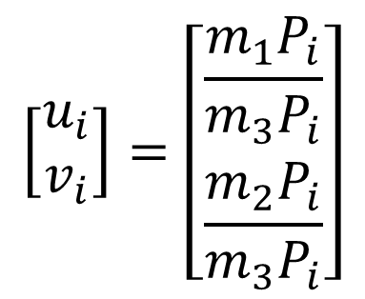
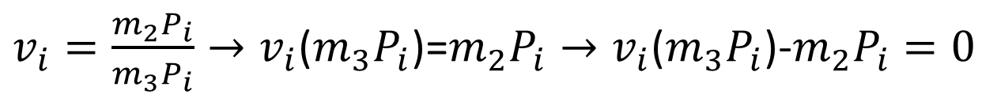
Calibration Problem
$$\left[\begin{matrix}u_{i} \\ v_{i}\end{matrix}\right]=\left[\begin{matrix}\frac{m_{1}P_{i}}{m_{3}P_{i}} \\ \frac{m_{2}P_{i}}{m_{3}P_{i}}\end{matrix}\right]$$
[Eq. 1]
$u_{i}=\frac{m_{1}P_{i}}{m_{3}P_{i}}→u_{i}$($m_{3}P_{i}$)=$m_{1}P_{i}→u_{i}\text{(}m_{3}P_{i}\text{)}\text{−}m_{1}P_{i}=0$
$v_{i}=\frac{m_{2}P_{i}}{m_{3}P_{i}}→v_{i}$($m_{3}P_{i}$)=$m_{2}P_{i}→v_{i}\text{(}m_{3}P_{i}\text{)}\text{−}m_{2}P_{i}=0$
[Eqs. 2]

Slide 27
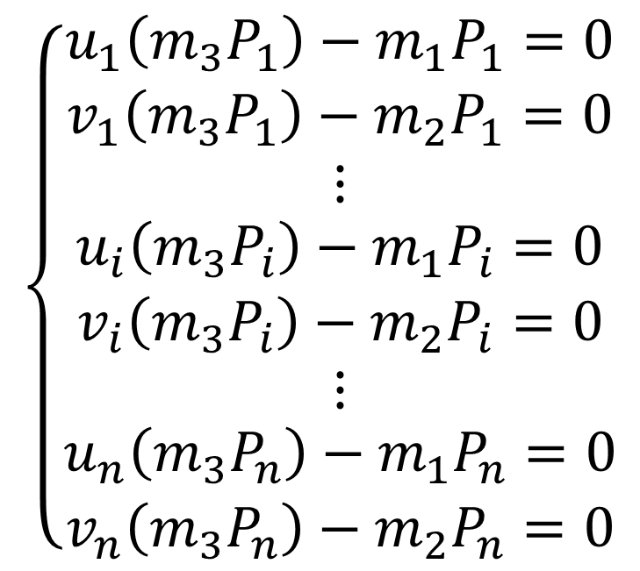
Calibration Problem
$$\left\{\begin{matrix}\begin{matrix}u_{1}\left(m_{3}P_{1}\right)−m_{1}P_{1}=0 \\ v_{1}\left(m_{3}P_{1}\right)−m_{2}P_{1}=0 \\ ⋮\end{matrix} \\ \begin{matrix}u_{i}\left(m_{3}P_{i}\right)−m_{1}P_{i}=0 \\ v_{i}\left(m_{3}P_{i}\right)−m_{2}P_{i}=0 \\ ⋮\end{matrix} \\ \begin{matrix}u_{n}\left(m_{3}P_{n}\right)−m_{1}P_{n}=0 \\ v_{n}\left(m_{3}P_{n}\right)−m_{2}P_{n}=0\end{matrix}\end{matrix}\right.$$
[Eqs. 3]

Slide 28
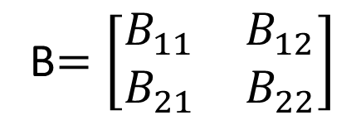
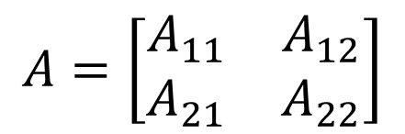
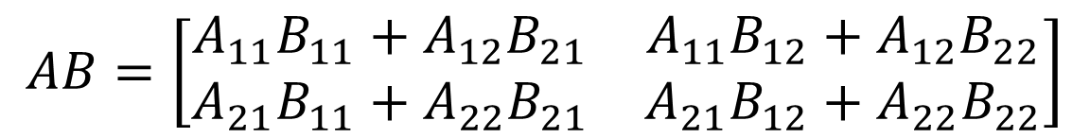
Block Matrix Multiplication
$$A=\left[\begin{matrix}A_{11} & A_{12} \\ A_{21} & A_{22}\end{matrix}\right]$$
B$=\left[\begin{matrix}B_{11} & B_{12} \\ B_{21} & B_{22}\end{matrix}\right]$
What is AB ?
$$AB=\left[\begin{matrix}A_{11}B_{11}+A_{12}B_{21} & A_{11}B_{12}+A_{12}B_{22} \\ A_{21}B_{11}+A_{22}B_{21} & A_{21}B_{12}+A_{22}B_{22}\end{matrix}\right]$$

Slide 29
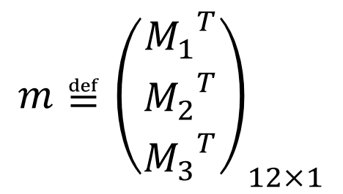
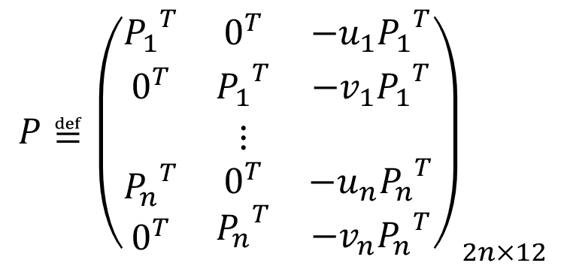

Calibration Problem
known
unknown
$$\left\{\begin{matrix}{−u}_{1}\left(m_{3}P_{1}\right)+m_{1}P_{1}=0 \\ {−v}_{1}\left(m_{3}P_{1}\right)+m_{2}P_{1}=0 \\ −\begin{matrix}⋮ \\ u_{n}\left(m_{3}P_{n}\right)+m_{1}P_{n}=0 \\ {−v}_{n}\left(m_{3}P_{n}\right)+m_{2}P_{n}=0\end{matrix}\end{matrix}\right.$$
P
m = 0
[Eq. 4]
Homogenous linear system
1x4
$$P≝{\left(\begin{matrix}{P_{1}}^{T} & 0^{T} & −u_{1}{P_{1}}^{T} \\ 0^{T} & {P_{1}}^{T} & {{−v_{1}P}_{1}}^{T} \\ \begin{aligned} \\ {P_{n}}^{T} \\ 0^{T}\end{aligned} & \begin{aligned}⋮ \\ 0^{T} \\ {P_{n}}^{T}\end{aligned} & \begin{aligned} \\ {{−u_{n}P}_{n}}^{T} \\ {{−v_{n}P}_{n}}^{T}\end{aligned}\end{matrix}\right)}_{2n×12}$$
4x1
$$m≝{\left(\begin{matrix}{M_{1}}^{T} \\ {M_{2}}^{T} \\ {M_{3}}^{T}\end{matrix}\right)}_{12×1}$$

Slide 30
Homogeneous M x N Linear Systems
M=number of equations = 2n N=number of unknown = 11
Rectangular system (M>N)
0 is always a solution
To find non-zero solution
Minimize |P m|²
under the constraint |m|² =1
N
P
m = 0
M

Slide 31
Calibration Problem
P m = 0
How do we solve this homogenous linear system?
Via SVD decomposition!

Slide 32

Calibration Problem
P
m = 0
SVD decomposition of P
T
^{U}2n×12 ^{D} 12×12^{V}
12×12
Last column of V gives
m
Why? See pag 592 of HZ
$$m≝\left(\begin{matrix}{m_{1}}^{T} \\ {m_{2}}^{T} \\ {m_{3}}^{T}\end{matrix}\right)$$
M

Slide 33
Extracting camera parameters
ρ

Slide 34








Extracting camera parameters
See [FP],
Sec. 1.3.1
$$\frac{M}{ρ}=\left(\begin{matrix}α{r_{1}}^{T}−αcotθ{r_{2}}^{T}+u_{0}{r_{3}}^{T} & αt_{x}−αcotθt_{y}+u_{0}t_{z} \\ \frac{β}{sinθ}{r_{2}}^{T}+v_{0}{r_{3}}^{T} & \frac{β}{sinθ}t_{y}+v_{0}t_{z} \\ {r_{3}}^{T} & t_{z}\end{matrix}\right)=K[R T]$$
b
$$K=\left[\begin{matrix}α & −αcotθ & u_{0} \\ 0 & \frac{β}{sinθ} & v_{0} \\ 0 & 0 & 1\end{matrix}\right]$$
A
Box 1
Intrinsic
$$A=\left[\begin{matrix}{a_{1}}^{T} \\ {a_{2}}^{T} \\ {a_{3}}^{T}\end{matrix}\right]$$
b$=\left[\begin{matrix}b_{1} \\ b_{2} \\ b_{3}\end{matrix}\right]$
$$u_{0}=ρ^{2}(a_{1}∙a_{3})$$
$$ρ=\frac{±1}{|a_{3}|}$$
$$v_{0}=ρ^{2}(a_{2}∙a_{3})$$
$$cosθ=\frac{(a_{1}×a_{3})∙(a_{2}×a_{3})}{|a_{1}×a_{3}|∙|a_{2}×a_{3}|}$$
Estimated values

Slide 35


Extracting camera parameters
See [FP],
Sec. 1.3.1
$$\frac{M}{ρ}=\left(\begin{matrix}α{r_{1}}^{T}−αcotθ{r_{2}}^{T}+u_{0}{r_{3}}^{T} & αt_{x}−αcotθt_{y}+u_{0}t_{z} \\ \frac{β}{sinθ}{r_{2}}^{T}+v_{0}{r_{3}}^{T} & \frac{β}{sinθ}t_{y}+v_{0}t_{z} \\ {r_{3}}^{T} & t_{z}\end{matrix}\right)=K[R T]$$
b
$$K=\left[\begin{matrix}α & −αcotθ & u_{0} \\ 0 & \frac{β}{sinθ} & v_{0} \\ 0 & 0 & 1\end{matrix}\right]$$
A
Box 1
Intrinsic
$$A=\left[\begin{matrix}{a_{1}}^{T} \\ {a_{2}}^{T} \\ {a_{3}}^{T}\end{matrix}\right]$$
b$=\left[\begin{matrix}b_{1} \\ b_{2} \\ b_{3}\end{matrix}\right]$
$$α=ρ^{2}|a_{1}×a_{3}|sinθ$$
β$=ρ^{2}|a_{2}×a_{3}|sinθ$
Estimated values

Slide 36

Theorem (Faugeras, 1993)

Slide 37




Extracting camera parameters
See [FP],
Sec. 1.3.1
$$\frac{M}{ρ}=\left(\begin{matrix}α{r_{1}}^{T}−αcotθ{r_{2}}^{T}+u_{0}{r_{3}}^{T} & αt_{x}−αcotθt_{y}+u_{0}t_{z} \\ \frac{β}{sinθ}{r_{2}}^{T}+v_{0}{r_{3}}^{T} & \frac{β}{sinθ}t_{y}+v_{0}t_{z} \\ {r_{3}}^{T} & t_{z}\end{matrix}\right)=K[R T]$$
b
$$K=\left[\begin{matrix}α & −αcotθ & u_{0} \\ 0 & \frac{β}{sinθ} & v_{0} \\ 0 & 0 & 1\end{matrix}\right]$$
A
Box 1
Intrinsic
$$A=\left[\begin{matrix}{a_{1}}^{T} \\ {a_{2}}^{T} \\ {a_{3}}^{T}\end{matrix}\right]$$
b$=\left[\begin{matrix}b_{1} \\ b_{2} \\ b_{3}\end{matrix}\right]$
$$r_{1}=\frac{(a_{2}×a_{3})}{|a_{2}×a_{3}|}$$
$$r_{3}=\frac{±a_{3}}{|a_{3}|}$$
$$r_{2}=r_{3}×r_{1}$$
$$T=ρK^{−1}b$$
Estimated values

Slide 38

Degenerate cases
P_{i}’s cannot lie on the same plane!
Points cannot lie on the intersection curve of two
quadric surfaces
[FP] section 1.3

Slide 39
Lecture 3
Camera Calibration
Recap of projective cameras
Camera calibration problem
Camera calibration with radial distortion
Example
Reading:
[FP] Chapter 1 “Geometric Camera Calibration” [HZ] Chapter 7 “Computation of Camera Matrix P”
Some slides in this lecture are courtesy to Profs. J. Ponce, F-F Li
Silvio Savarese
Lecture 3 -
18-Jan-18

Slide 40


Radial Distortion
Image magnification (in)decreases with distance from the optical axis
Caused by imperfect lenses
Deviations are most noticeable for rays that pass through the edge of the lens
No distortion
Pin cushion
Barrel

Slide 41





Radial Distortion
Image magnification decreases with distance from the optical center
How do we model that?
v
S
$$\left[\begin{matrix}\frac{1}{λ} & 0 & 0 \\ 0 & \frac{1}{λ} & 0 \\ 0 & 0 & 1\end{matrix}\right]MP_{i}→\left[\begin{matrix}u_{i} \\ v_{i}\end{matrix}\right]=p_{i}$$
λ
d
$$λ=1±\sum_{p=1}^{3}{K_{p}d^{2p}}$$
Distortion coefficient
[Eq. 6]
$$d^{2}=au^{2}+{bv}^{2}+cuv$$
[Eq. 5]
To model radial behavior
Polynomial function

Slide 42




Radial Distortion
$$\left[\begin{matrix}\frac{1}{λ} & 0 & 0 \\ 0 & \frac{1}{λ} & 0 \\ 0 & 0 & 1\end{matrix}\right]MP_{i}→\left[\begin{matrix}u_{i} \\ v_{i}\end{matrix}\right]=p_{i}$$
$$Q=\left[\begin{matrix}q_{1} \\ q_{2} \\ q_{3}\end{matrix}\right]$$
Q
Is this a linear system of equations?
$$p_{i}=\left[\begin{matrix}u_{i} \\ v_{i}\end{matrix}\right]=\left[\begin{matrix}\frac{q_{1}p_{i}}{q_{3}p_{i}} \\ \frac{q_{2}p_{i}}{q_{3}p_{i}}\end{matrix}\right]$$
$$\left\{\begin{matrix}u_{i}q_{3}P_{i}=q_{1}P_{i} \\ v_{i}q_{3}P_{i}=q_{2}P_{i}\end{matrix}\right.$$
[Eqs.7]
No! why?

Slide 43

General Calibration Problem
$$\left[\begin{matrix}u_{i} \\ v_{i}\end{matrix}\right]=\left[\begin{matrix}\frac{q_{1}p_{i}}{q_{3}p_{i}} \\ \frac{q_{2}p_{i}}{q_{3}p_{i}}\end{matrix}\right]$$
X = f (Q)
[Eq .8]
parameters
measurements
i=1…n
f( ) is the nonlinear mapping
-Newton Method
-Levenberg-Marquardt Algorithm
Iterative, starts from initial solution
May be slow if initial solution far from real solution
Estimated solution may be function of the initial solution (because of local minima)
Newton requires the computation of J, H
Levenberg-Marquardt doesn’t require the computation of H

Slide 44

General Calibration Problem
$$\left[\begin{matrix}u_{i} \\ v_{i}\end{matrix}\right]=\left[\begin{matrix}\frac{q_{1}p_{i}}{q_{3}p_{i}} \\ \frac{q_{2}p_{i}}{q_{3}p_{i}}\end{matrix}\right]$$
X = f (Q)
[Eq .8]
parameters
measurements
A possible algorithm
f( ) is the nonlinear mapping
i=1…n
Solve linear part of the system to find approximated solution
Use this solution as initial condition for the full system
Solve full system using Newton or L.M.

Slide 45
General Calibration Problem
$$\left[\begin{matrix}u_{i} \\ v_{i}\end{matrix}\right]=\left[\begin{matrix}\frac{q_{1}p_{i}}{q_{3}p_{i}} \\ \frac{q_{2}p_{i}}{q_{3}p_{i}}\end{matrix}\right]$$
X = f (Q)
[Eq .8]
parameters
measurements
i=1…n
f( ) is the nonlinear mapping
Typical assumptions:
zero-skew, square pixel
u_{o}, v_{o} = known center of the image

Slide 46

Radial Distortion
$$p_{i}=\left[\begin{matrix}u_{i} \\ v_{i}\end{matrix}\right]=\left[\begin{matrix}\frac{q_{1}p_{i}}{q_{3}p_{i}} \\ \frac{q_{2}p_{i}}{q_{3}p_{i}}\end{matrix}\right]=\frac{1}{λ}\left[\begin{matrix}\frac{m_{1}p_{i}}{m_{3}p_{i}} \\ \frac{m_{2}p_{i}}{m_{3}p_{i}}\end{matrix}\right]$$
Can we estimate m₁ and m₂ and ignore the radial distortion?
v
d
u_{i}
Hint:
u
= slope
v_{i}

Slide 47





Radial Distortion
Tsai [87]
Estimating m₁ and m₂…
$$p_{i}=\left[\begin{matrix}u_{i} \\ v_{i}\end{matrix}\right]=\frac{1}{λ}\left[\begin{matrix}\frac{m_{1}p_{i}}{m_{3}p_{i}} \\ \frac{m_{2}p_{i}}{m_{3}p_{i}}\end{matrix}\right]$$
[Eq .9]
$$\frac{u_{i}}{v_{i}}=\frac{\frac{(m_{1} P_{i})}{(m_{3}p_{i})}}{\frac{(m_{2}p_{i})}{{(m}_{3}p_{i})}}=\frac{m_{1}p_{i}}{m_{2}p_{i}}$$
[Eq .10]
[Eq .11]
L n = 0
$$L≝\left(\begin{matrix}v_{1}{p_{1}}^{T} & −u_{1}{p_{1}}^{T} \\ v_{2}{p_{2}}^{T} & −u_{2}{p_{2}}^{T} \\ \begin{aligned}⋮ \\ v_{n}{p_{n}}^{T}\end{aligned} & \begin{aligned}⋮ \\ −u_{n}{p_{n}}^{T}\end{aligned}\end{matrix}\right)$$
$$\left\{\begin{matrix}\begin{matrix}v_{1}\left(m_{1}P_{1}\right)−{u_{1}(m}_{2}P_{1})=0 \\ v_{i}\left(m_{1}P_{i}\right)−{u_{i}(m}_{2}P_{i})=0\end{matrix} \\ ⋮ \\ v_{n}\left(m_{1}P_{n}\right)−{u_{n}(m}_{2}P_{n})=0\end{matrix}\right.$$
$$n=\left[\begin{matrix}{m_{1}}^{T} \\ {m_{2}}^{T}\end{matrix}\right]$$
Get m₁ and
m by SVD
2

Slide 48
Radial Distortion
Once that m₁ and m₂ are estimated…
$$p_{i}=\left[\begin{matrix}u_{i} \\ v_{i}\end{matrix}\right]=\frac{1}{λ}\left[\begin{matrix}\frac{m_{1}p_{i}}{m_{3}p_{i}} \\ \frac{m_{2}p_{i}}{m_{3}p_{i}}\end{matrix}\right]$$
m₃ is non linear function of m₁,
m₂ ,
λ
There are some degenerate configurations for which m₁ and m₂ cannot be computed

Slide 49
Lecture 3
Camera Calibration
Recap of projective cameras
Camera calibration problem
Camera calibration with radial distortion
Example
Reading:
[FP] Chapter 1 “Geometric Camera Calibration” [HZ] Chapter 7 “Computation of Camera Matrix P”
Some slides in this lecture are courtesy to Profs. J. Ponce, F-F Li
Silvio Savarese
Lecture 3 -
18-Jan-18

Slide 50

Calibration Procedure
Camera Calibration Toolbox for Matlab J. Bouguet – [1998-2000]
http://www.vision.caltech.edu/bouguetj/calib_doc/index.html#examples

Slide 51

Calibration Procedure

Slide 52

Calibration Procedure

Slide 53

Calibration Procedure

Slide 54

Calibration Procedure

Slide 55

Calibration Procedure

Slide 56

Calibration Procedure

Slide 57

Calibration Procedure

Slide 58
Next lecture
Single view reconstruction

Slide 59

Eigenvalues and Eigenvectors
Eigendecomposition
$$A=SΛS^{−1}=S\left[\begin{matrix}λ_{1} & & \\ & λ_{2} & \\ \begin{aligned} \\ \end{aligned} & \begin{aligned} \\ \end{aligned} & \begin{aligned}∙ \\ \end{aligned}\end{matrix} \begin{matrix} \\ \\ \begin{aligned} \\ λ_{N}\end{aligned}\end{matrix}\right]S^{−1}$$
S = [v₁ v_{N} ]
Eigenvectors of A are columns of S

Slide 60


Singular Value decomposition
$$\sum{=\left[\begin{matrix}σ_{1} & & \\ & σ_{2} & \\ \begin{aligned} \\ \end{aligned} & \begin{aligned} \\ \end{aligned} & \begin{aligned}∙ \\ \end{aligned}\end{matrix} \begin{matrix} \\ \\ \begin{aligned} \\ σ_{N}\end{aligned}\end{matrix}\right]}$$
$$A=UΣV^{−1}$$
U, V = orthogonal matrix
σ _{i} = λ_{i}
σ = singular value
λ = eigenvalue of A A
t

