Slide 1

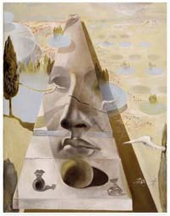
Lecture 6
Stereo Systems Multi-view geometry
Professor Silvio Savarese
Computational Vision and Geometry Lab
Silvio Savarese
Lecture 6 -
2-Feb-18

Slide 2
Lecture 6
Stereo Systems Multi-view geometry
Stereo systems
Rectification
Correspondence problem
Multi-view geometry
The SFM problem
Affine SFM
Reading:
[AZ] Chapter: 9 “Epip. Geom. and the Fundam. Matrix Transf.” [AZ] Chapter: 18 “N view computational methods”
[FP] Chapters: 7 “Stereopsis”
[FP] Chapters: 8 “Structure from Motion”
Silvio Savarese
Lecture 6 -
2-Feb-18

Slide 3





Epipolar geometry
P
p
p’
e
e’
O₁
Epipolar Plane
Baseline
Epipolar Lines
O₂
Epipoles e, e’
= intersections of baseline with image planes
= projections of the other camera center

Slide 4



Epipolar Constraint
P
p’
p
O₁
O₂
$$p^{T}Ep^{′}=0$$
$$E=[T_{x}]×R$$
E = Essential Matrix
(Longuet-Higgins, 1981)

Slide 5
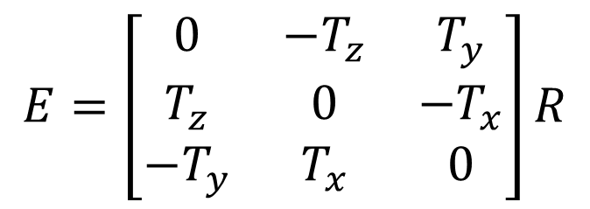

Essential matrix
$$E=\left[T_{x}\right]∙R$$
$$E=\left[\begin{matrix}0 & −T_{z} & T_{y} \\ T_{z} & 0 & −T_{x} \\ −T_{y} & T_{x} & 0\end{matrix}\right]R$$

Slide 6

Epipolar Constraint
P
p’
p
O₁
O₂
p^{T} F p′ = 0
$$F=K^{−T}∙\left[T_{x}\right]∙R{K′}^{−1}$$
F = Fundamental Matrix
(Faugeras and Luong, 1992)

Slide 7
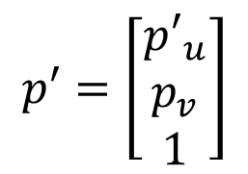
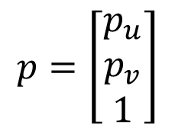
Parallel image planes
P
v
e
p
p’
e’
y
u
z
O₁
x
O₂
Epipolar lines are horizontal
Epipoles go to infinity
v-coordinates are equal
$$p=\left[\begin{matrix}p_{u} \\ p_{v} \\ 1\end{matrix}\right]$$
$$p′=\left[\begin{matrix}{p′}_{u} \\ p_{v} \\ 1\end{matrix}\right]$$

Slide 8
Parallel image planes
P
v
e
p
p’
e’
y
u
z
O₁
x
O₂
E=?
Hint :
R = I
K₁=K₂ = known
x parallel to O₁O₂
T = (T, 0, 0)

Slide 9
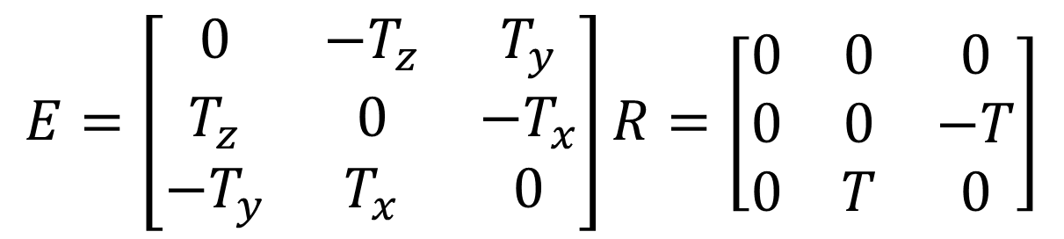
Essential matrix for parallel images
E = [T× ]× R
$$E=\left[\begin{matrix}0 & −T_{z} & T_{y} \\ T_{z} & 0 & −T_{x} \\ −T_{y} & T_{x} & 0\end{matrix}\right]R=\left[\begin{matrix}0 & 0 & 0 \\ 0 & 0 & −T \\ 0 & T & 0\end{matrix}\right]$$
T = [ T 0 0 ]
R = I

Slide 10
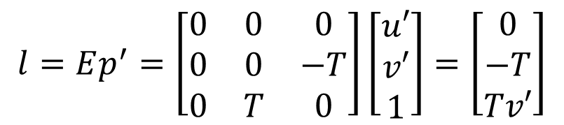
Parallel image planes
P
v
v’
e
l
p
p’
l’
e’
y
u
u’
z
O₁
What are the directions of epipolar lines?
x
$$l=Ep^{′}=\left[\begin{matrix}0 & 0 & 0 \\ 0 & 0 & −T \\ 0 & T & 0\end{matrix}\right]\left[\begin{matrix}u′ \\ v′ \\ 1\end{matrix}\right]=\left[\begin{matrix}0 \\ −T \\ Tv′\end{matrix}\right]$$
horizontal!

Slide 11
Parallel image planes
P
v
v’
e
p
p’
e’
y
u
u’
z
O₁
How are p and p’ related?
x
T
p ⋅ E p' = 0

Slide 12
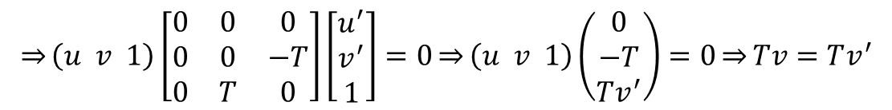
Parallel image planes
P
v
v’
e
p
p’
e’
y
u
u’
z
O₁
x
How are p
$$\overset{⇒}{}\left(u v 1\right)\left[\begin{matrix}0 & 0 & 0 \\ 0 & 0 & −T \\ 0 & T & 0\end{matrix}\right]\left[\begin{matrix}u^{′} \\ v^{′} \\ 1\end{matrix}\right]=0\overset{⇒}{}\left(u v 1\right)\left(\begin{matrix}0 \\ −T \\ Tv^{′}\end{matrix}\right)=0\overset{⇒}{}Tv=Tv^{′}$$
and p’ related?
p^{T}E p′ = 0

Slide 13
Parallel image planes
P
v
v’
e
p
p’
e’
y
u
u’
z
O₁
x
Rectification: making two images “parallel”
Why it is useful?
Epipolar constraint → v = v’
New views can be synthesized by linear interpolation

Slide 14
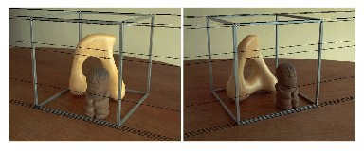
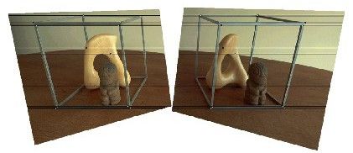
Rectification: making two images “parallel”
H
Courtesy figure S. Lazebnik

Slide 15
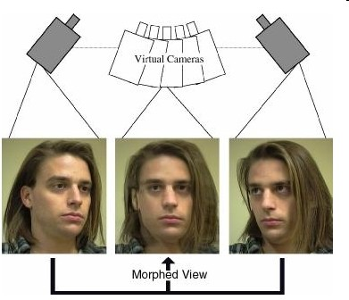
Application: view morphing
S. M. Seitz and C. R. Dyer, Proc. SIGGRAPH 96, 1996, 21-30

Slide 16
Rectification
P
H₁
I₁
I_{s}
î₁
u
I₂
v
î_{S}
u
v
C₁
H₂
u
v
î₂
C_{s}
C₂

Slide 17
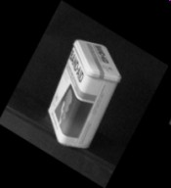



Slide 18
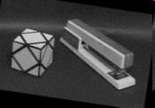
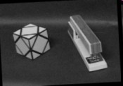
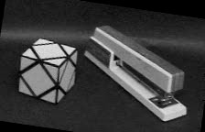

Slide 19




Slide 20
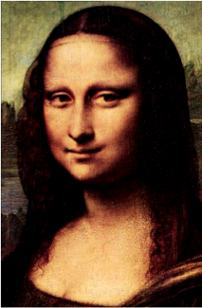
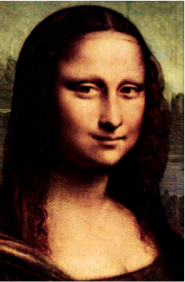
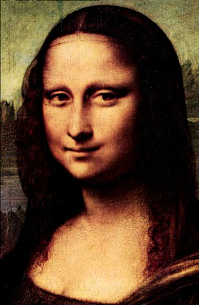
From its reflection!

Slide 21
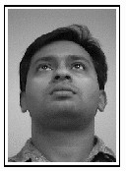
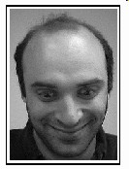


Slide 22
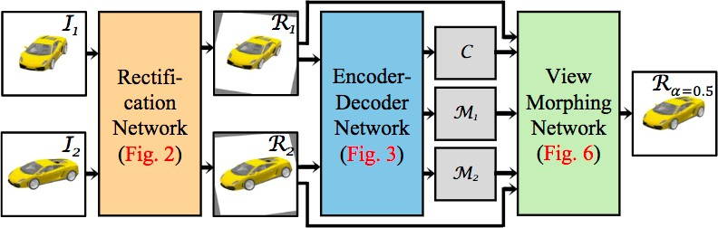
Deep view morphing
D. Ji, J. Kwon, M. McFarland, S. Savarese, CVPR 2017

Slide 23
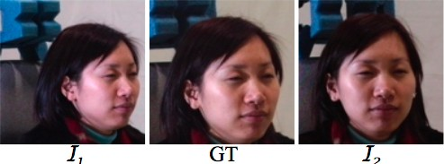

Deep view morphing
D. Ji, J. Kwon, M. McFarland, S. Savarese, CVPR 2017

Slide 24
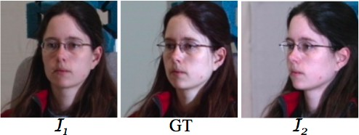
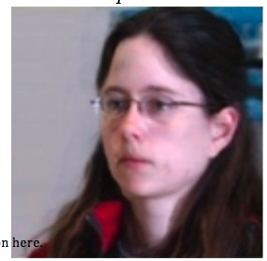
Deep view morphing
D. Ji, J. Kwon, M. McFarland, S. Savarese, CVPR 2017

Slide 25
Why are parallel images useful?
Makes triangulation easy
Makes the correspondence problem easier

Slide 26

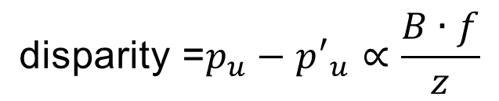
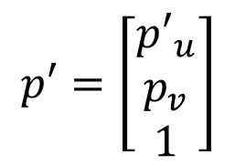
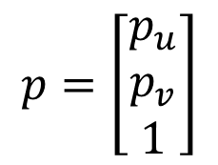
Point triangulation
P
v
v
e
p
p’
z
e’
y
u
u
z
O
x
B
O’
$$\text{disparity} \text{=}p_{u}−{p′}_{u}∝\frac{B∙f}{z}$$
$$p=\left[\begin{matrix}p_{u} \\ p_{v} \\ 1\end{matrix}\right]$$
$$p′=\left[\begin{matrix}{p′}_{u} \\ p_{v} \\ 1\end{matrix}\right]$$
[Eq. 1]
Disparity is inversely proportional to depth z!

Slide 27
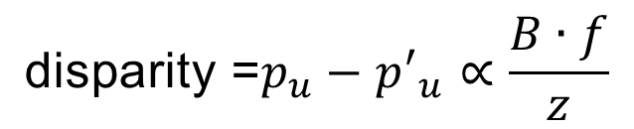
Computing depth
P
(0, p_{v}, 1)
z
p_{u}
u
p'_{u}
u
f
O
B
O’
$$\text{disparity} \text{=}p_{u}−{p′}_{u}∝\frac{B∙f}{z}$$
[Eq. 1]
Disparity is inversely proportional to depth z!

Slide 28
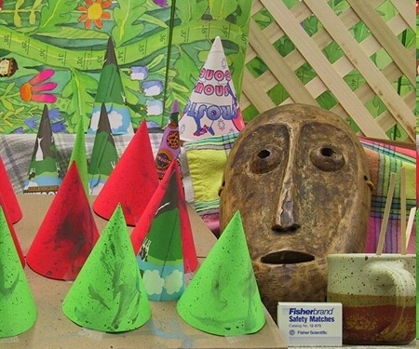
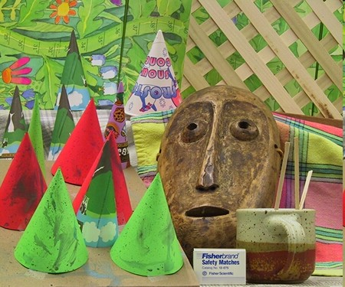
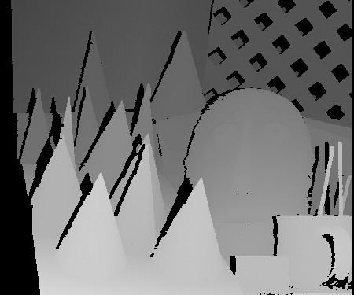
Disparity maps
http://vision.middlebury.edu/stereo/
p − p' ∝ ^{B ⋅ f}
p_{u}
p’_{u}
u u
z
[Eq. 1]
Stereo pair
Disparity map / depth map

Slide 29
Why are parallel images useful?
Makes triangulation easy
Makes the correspondence problem easier

Slide 30
Correspondence problem
P
p belongs to l = F p’
p’ belongs to l’ = F^{T} p
p
p’
O
O’
Given a point in 3D, discover corresponding observations
in left and right images [also called binocular fusion problem]

Slide 31
Correspondence problem
P
p
p’
O
O’
When images are rectified, this problem is much easier!

Slide 32
Correspondence problem
A Cooperative Model (Marr and Poggio, 1976)
Correlation Methods (1970--)
Multi-Scale Edge Matching (Marr, Poggio and Grimson, 1979-81)
[FP] Chapters: 7

Slide 33


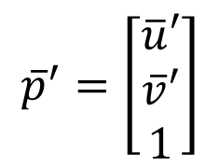
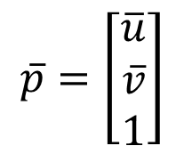
Correlation Methods (1970--)
Where is p ' ?
p
is
image 1
Image 2
$$\overline{p}=\left[\begin{matrix}\overline{u} \\ \overline{v} \\ 1\end{matrix}\right]$$
$${\overline{p}}^{′}=\left[\begin{matrix}\overline{u}′ \\ \overline{v}′ \\ 1\end{matrix}\right]$$

Slide 34

Correlation Methods (1970--)
p
Where is p ' ?
is
u
u
image 1
Image 2
100
$$\overline{p}=\left[\begin{matrix}\overline{u} \\ \overline{v} \\ 1\end{matrix}\right]$$
$${\overline{p}}^{′}=\left[\begin{matrix}\overline{u}′ \\ \overline{v}′ \\ 1\end{matrix}\right]$$

Slide 35
Correlation Methods (1970--)
p
Where is p ' ?
is
u
u
image 1
Image 2
130
100
170
100
30
What’s the problem with this?

Slide 36


Window-based correlation
W
p
v
u
u
image 1
u
image 2
Pick up a window W around p = (u, v )
Build vector w

Slide 37
Window-based correlation
W
100
100
100
v
90 100 20
150
150
145
u
u
image 1
u
image 2
u ' = u + d = u −1
Example: W is a 3x3 window in red
w is a 9x1 vector
w = [100, 100, 100, 90, 100, 20, 150, 150, 145]^{T}
Pick up a window W around p = (u, v )
Build vector w
Slide the window W along v = v in image 2 and compute w’ (u) for each u
Compute the dot product w^{T} w’(u) for each u and retain the max value

Slide 38
Window-based correlation
W
100
100
100
v
90 100 20
150
150
145
u
u
image 1
u
image 2
u ' = u + d = u −1
Example: W is a 3x3 window in red
w is a 9x1 vector
w = [100, 100, 100, 90, 100, 20, 150, 150, 145]^{T}
What’s the problem with this?

Slide 39
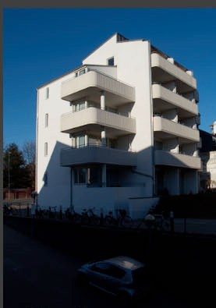
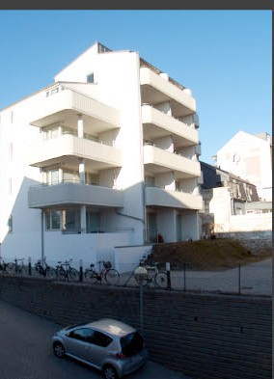


Changes of brightness/exposure
Changes in the mean and the variance of intensity values in corresponding windows!

Slide 40
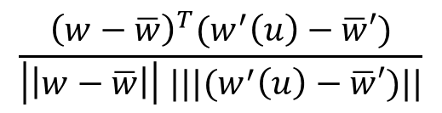
Normalized cross-correlation
W
100
100
100
v
90 100 20
150
150
145
u
u
image 1
u
image 2
u ' = u + d = u +1
$$\frac{{\left(w−\overline{w}\right)}^{T}(w^{′}\left(u\right)−\overline{w}′)}{\left|\left|w−\overline{w}\right|\right| |||(w^{′}\left(u\right)−\overline{w}′)||}$$
Find u that maximizes:
[Eq. 2]
w = mean value within W
w '(u) = mean value within W
located at u in image 2
located at u^{bar} in image 1

Slide 41
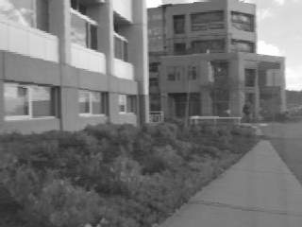
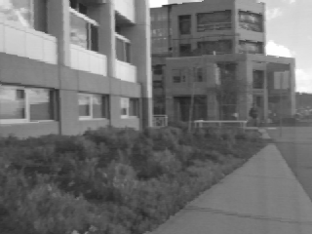
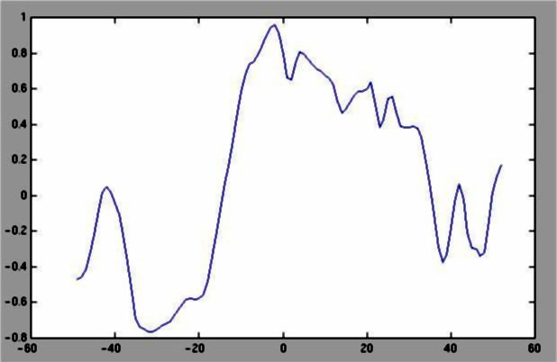
Example
Image 1
Image 2
v
scanline
NCC
u
Credit slide S. Lazebnik

Slide 42
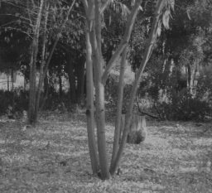
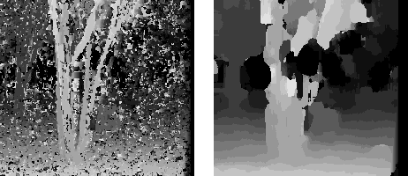
Effect of the window’s size
Window size = 3
Window size = 20
Smaller window
More detail
More noise
Larger window
Smoother disparity maps
Less prone to noise
Credit slide S. Lazebnik

Slide 43

Issues
Fore shortening effect
O
O’
Occlusions
O
O’

Slide 44



Issues
To reduce the effect of foreshortening and occlusions, it is desirable to have small B / z ratio!
However, when B/z is small, small errors in measurements imply large error in estimating depth
Small
B / z ratio
Large B / z ratio
O
O’
O
O’
u
u’ u_{e}’
u
u’ u_{e}’

Slide 45
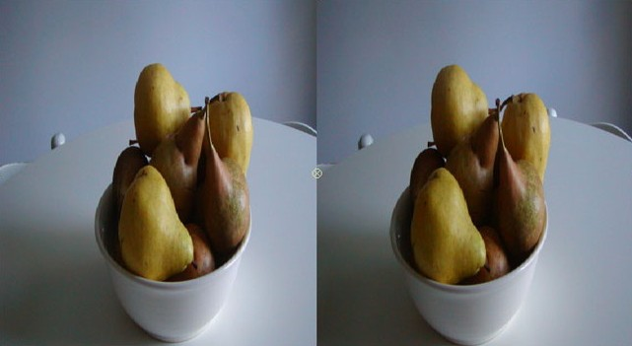
Issues
Homogeneous regions
mismatch

Slide 46
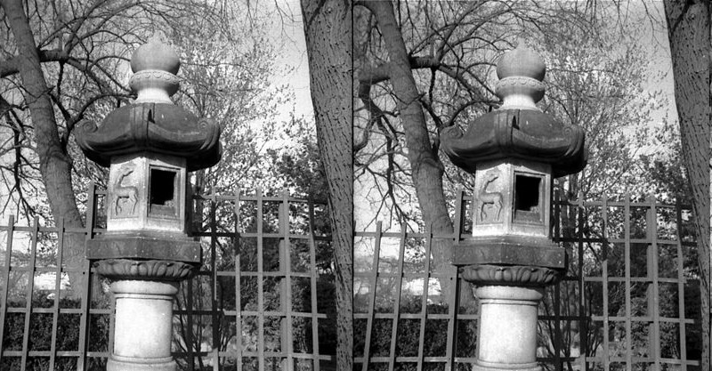
Issues
Repetitive patterns

Slide 47
Correspondence problem is difficult!
Occlusions
Fore shortening
Baseline trade-off
Homogeneous regions
Repetitive patterns
Apply non-local constraints to help enforce the correspondences

Slide 48
Non-local constraints
Uniqueness
For any point in one image, there should be at most one matching point in the other image
Ordering
Corresponding points should be in the same order in both views
Smoothness
Disparity is typically a smooth function of x (except in occluding boundaries)

Slide 49
Lecture 6
Stereo Systems Multi-view geometry
Stereo systems
Rectification
Correspondence problem
Multi-view geometry
The SFM problem
Affine SFM
Silvio Savarese
Lecture 5 -
2-Feb-18

Slide 50
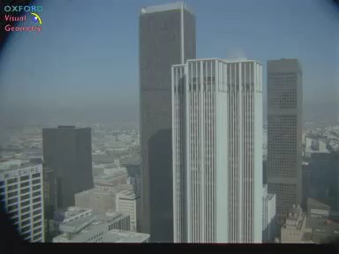
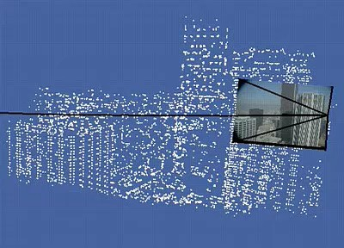
Structure from motion problem
Courtesy of Oxford Visual Geometry Group

Slide 51

Structure from motion problem
X_{j}
M_{m} ^{x}mj
^{x}1j
M₁
^{x}2j
M₂
Given m images of n fixed 3D points
$$x_{ij}=M_{i}X_{j},i=1,…m,j=1…,n$$

Slide 52
Structure from motion problem
X_{j}
M_{m} ^{x}mj
^{x}1j
M₁
^{x}2j
M₂
From the mxn observations x_{ij}, estimate:
m projection matrices M_{i}
motion structure
n 3D points X_{j}

Slide 53

Affine structure from motion
(simpler problem)
World point X_{j}
Image 1
^{x}ij
Image i
From the mxn observations x_{ij}, estimate:
m projection matrices M_{i} (affine cameras)
n 3D points X_{j}

Slide 54
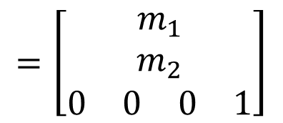
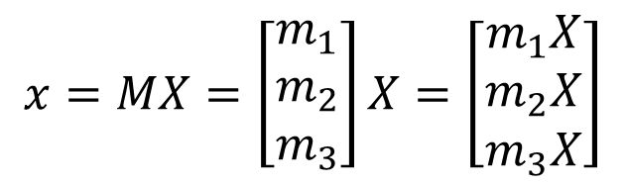
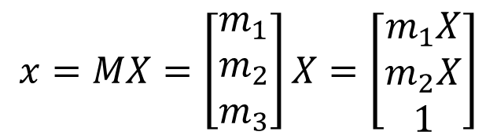
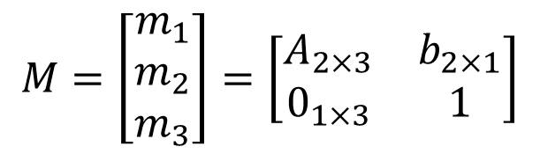
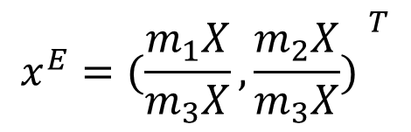
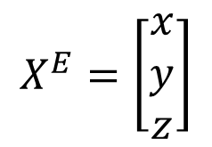


Perspective
$$x=MX=\left[\begin{matrix}m_{1} \\ m_{2} \\ m_{3}\end{matrix}\right]X=\left[\begin{matrix}m_{1}X \\ m_{2}X \\ m_{3}X\end{matrix}\right]$$
$$M=\left[\begin{matrix}A & b \\ v & 1\end{matrix}\right]=\left[\begin{matrix}m_{1} \\ m_{2} \\ m_{3}\end{matrix}\right]$$
$$x^{E}={(\frac{m_{1}X}{m_{3}X},\frac{m_{2}X}{m_{3}X}) }^{T}$$
Affine
$$x=MX=\left[\begin{matrix}m_{1} \\ m_{2} \\ m_{3}\end{matrix}\right]X=\left[\begin{matrix}m_{1}X \\ m_{2}X \\ 1\end{matrix}\right]$$
$$M=\left[\begin{matrix}m_{1} \\ m_{2} \\ m_{3}\end{matrix}\right]=\left[\begin{matrix}A_{2×3} & b_{2×1} \\ 0_{1×3} & 1\end{matrix}\right]$$
$$=\left[\begin{matrix}m_{1} \\ m_{2} \\ \begin{matrix}\begin{matrix}0 & 0\end{matrix} & \begin{matrix}0 & 1\end{matrix}\end{matrix}\end{matrix}\right]$$
$$x^{E}={(m_{1}X,m_{2}X)}^{T}=\left[A b\right]X=\left[ A b \right]\left[\begin{matrix}x \\ y \\ \begin{aligned}z \\ 1\end{aligned}\end{matrix}\right]=AX^{E}+b$$
[Eq. 3]
$$X^{E}=\left[\begin{matrix}x \\ y \\ z\end{matrix}\right]$$
magnification

Slide 55
Affine cameras
X_{j}
^{x}1j
Image 1
^{x}i j
Image i
For the affine case (in Euclidean space)
x_{ij} = A_{i}X _{j} + b_{i}
[Eq. 4]
2x1
2x3
3x1
2x1

Slide 56
The Affine Structure-from-Motion Problem
Given m images of n fixed points X_{j} we can write
x_{ij} = A_{i}X _{j} + b_{i}
for i = 1, …,m and j = 1, … ,n
N. of cameras N. of points
Problem: estimate m matrices A_{i}, m matrices b_{i}
and the n positions X_{j} from the m×n observations x_{ij} .
How many equations and how many unknown?
2m × n equations in 8m + 3n - 8 unknowns

Slide 57
The Affine Structure-from-Motion Problem
Two approaches:
Algebraic approach (affine epipolar geometry; estimate F; cameras; points)
Factorization method

Slide 58
Next lecture
Multiple view geometry:
Affine and Perspective structure
from Motion

