Slide 1
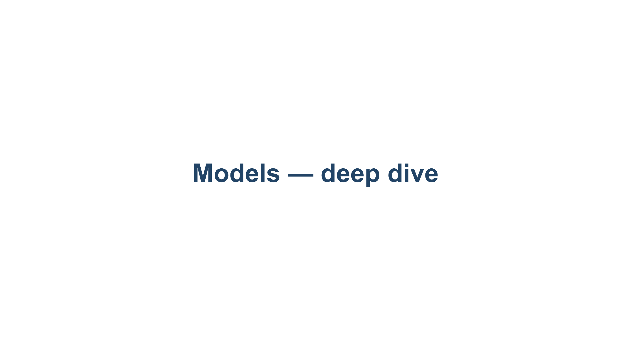
Notes:
The Models layer (Layer 2). Labs run on a free Kaggle notebook GPU (T4, 16 GB) so every student can reproduce them. Maps 1:1 to 02-models/README.md. Pace: a few slides of concept, then the notebook.

Slide 2
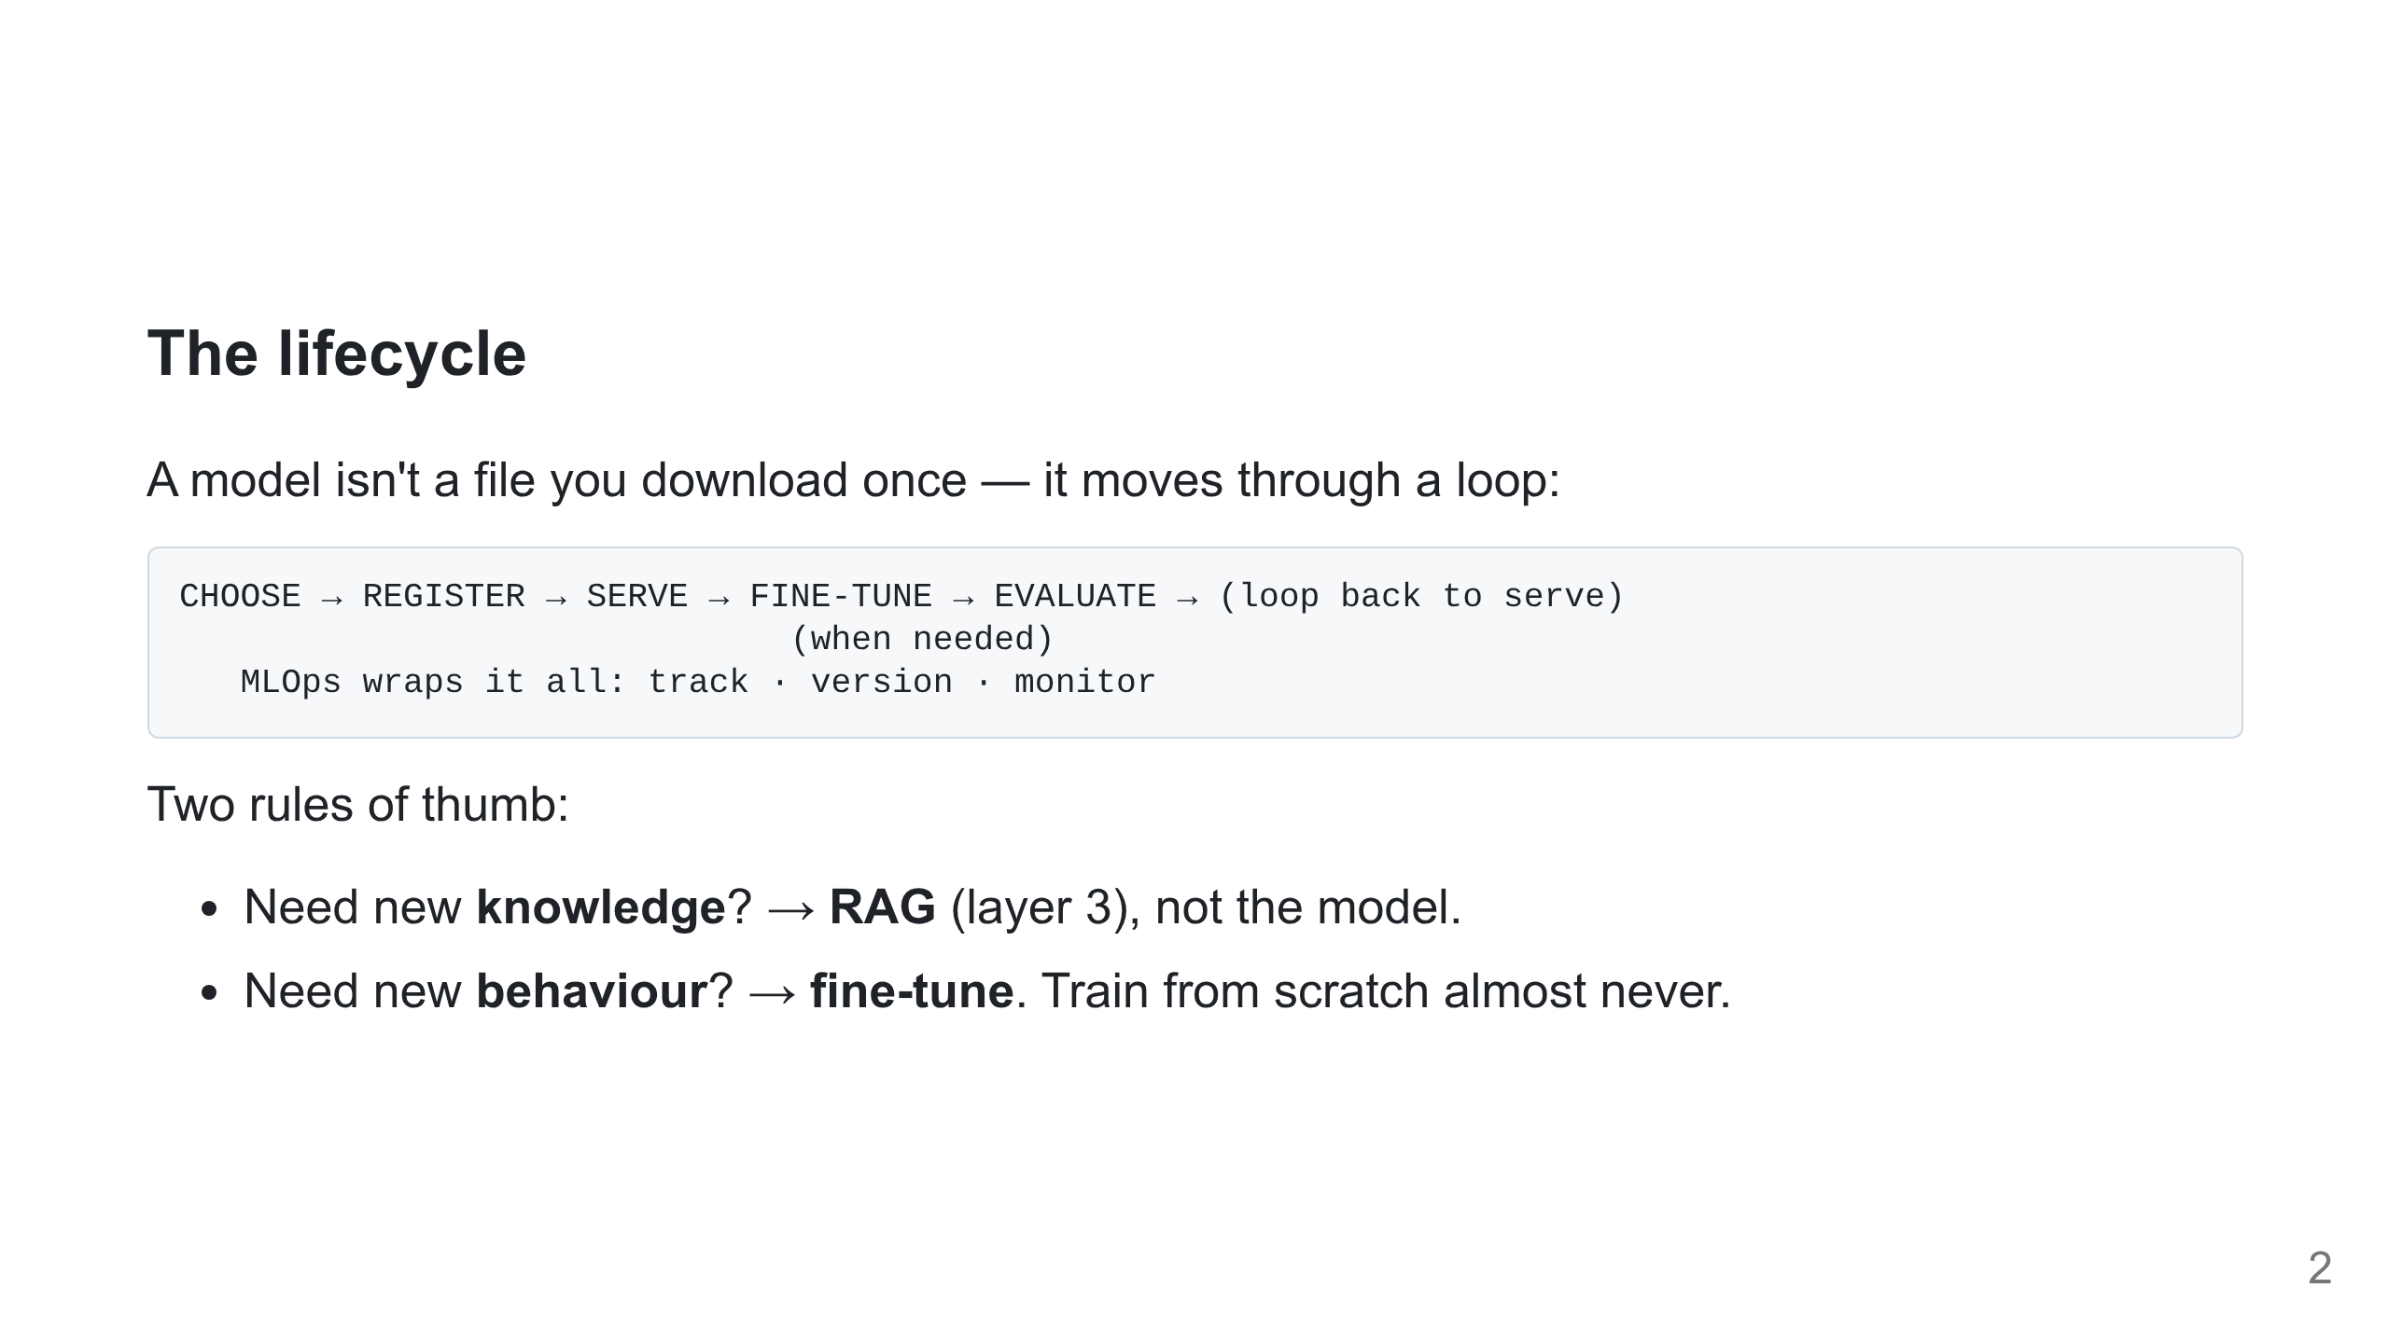
Notes:
This is the agenda. Serving = Lab 1, Fine-tune = Lab 2, Evaluate = Lab 3. RAG-for-knowledge vs fine-tune-for-behaviour is the line students forget.

Slide 3
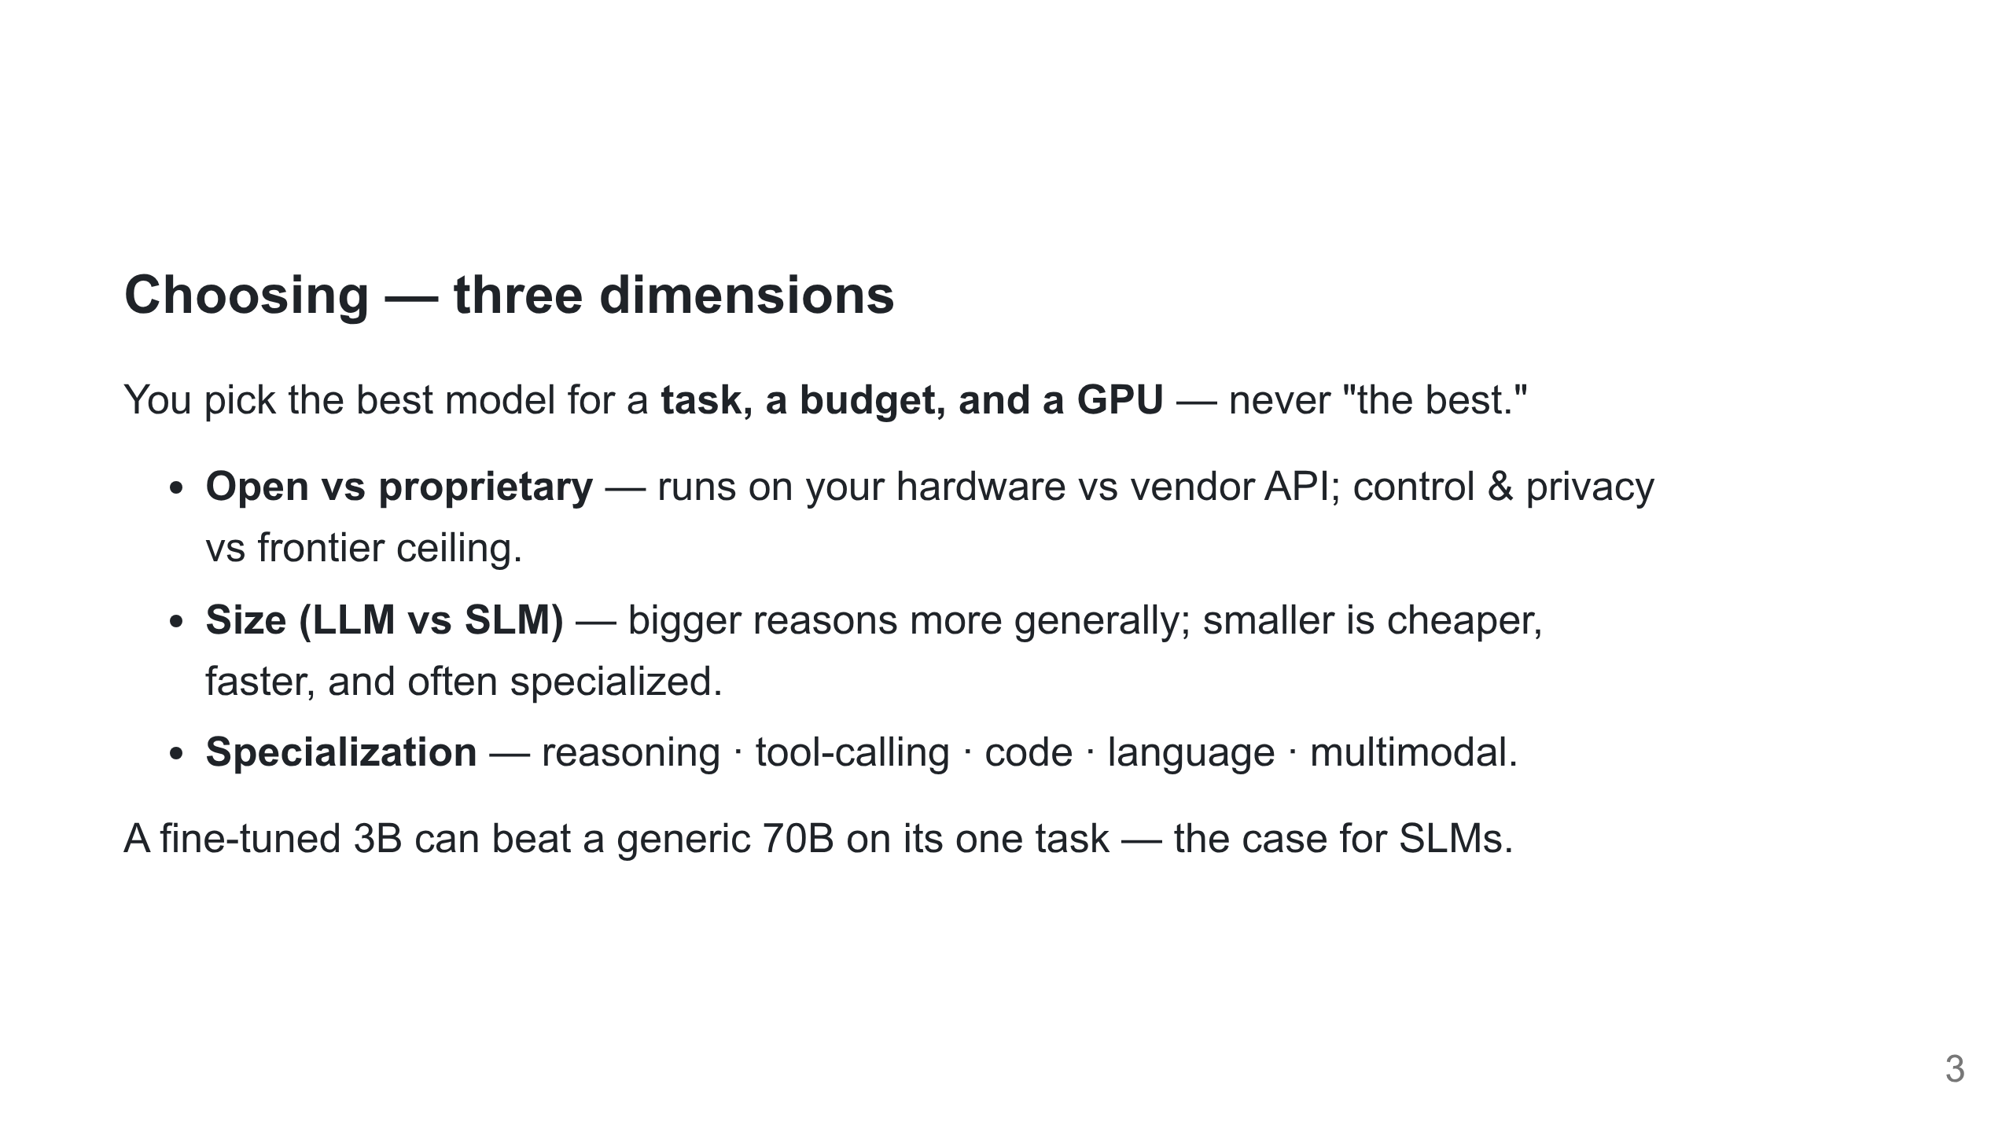
Notes:
"Open-weights" ≠ "open-source": you get weights, not always data or a free licence. Qwen2.5 (Apache-2.0) is our default — ungated, commercial-friendly.

Slide 4
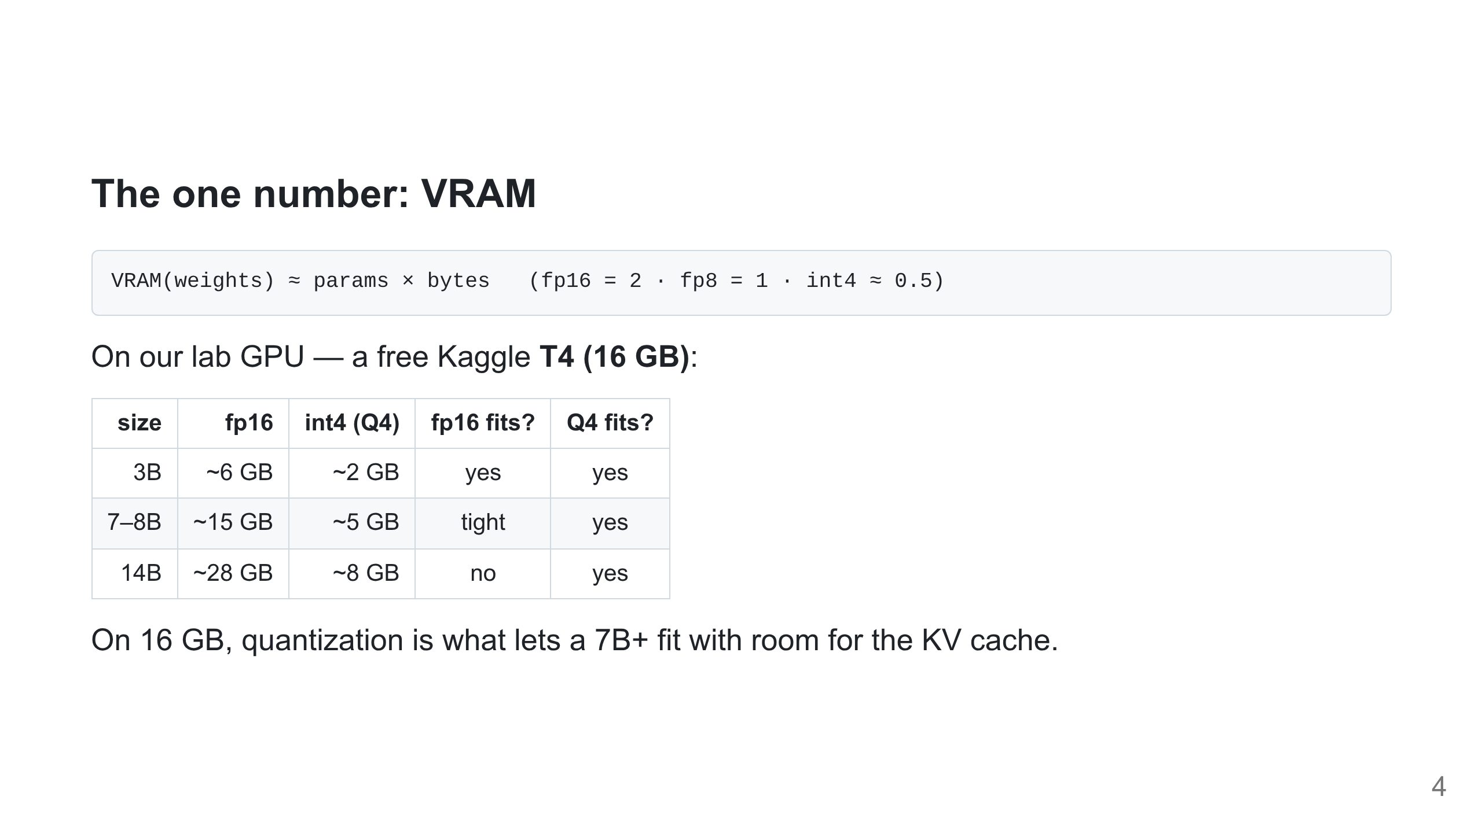
Notes:
Every "will it fit?" answers from here. Hidden cost: KV cache grows with context × concurrency — weights aren't the whole story.

Slide 5
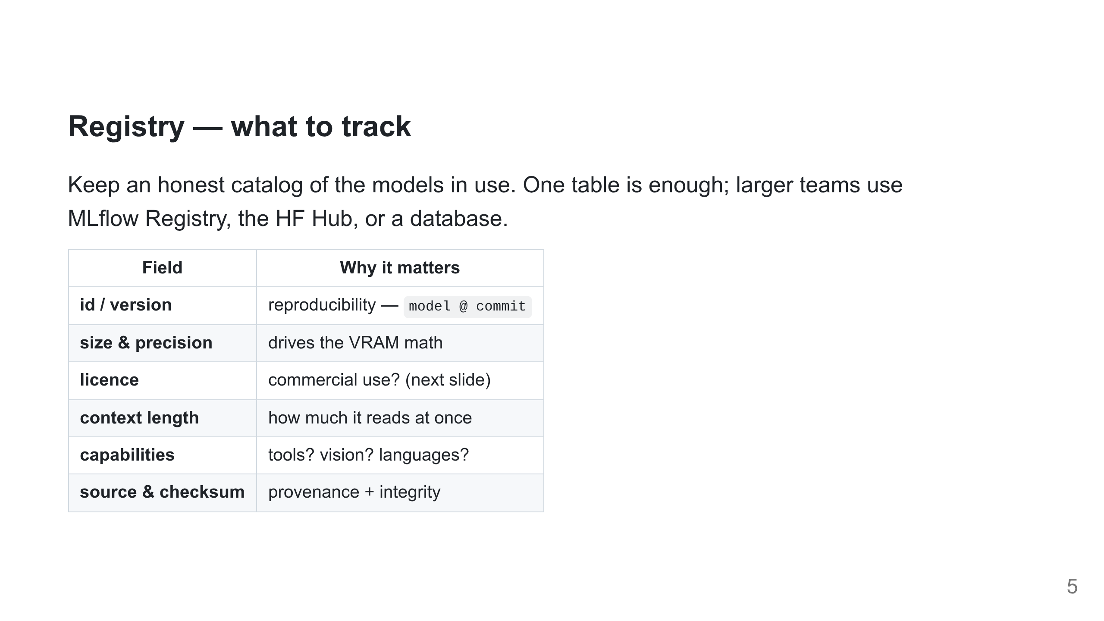
Notes:
"Which weights are in prod, and may we use them commercially?" should be answerable from one place. Licence traps bite at deploy time, not demo time.

Slide 6
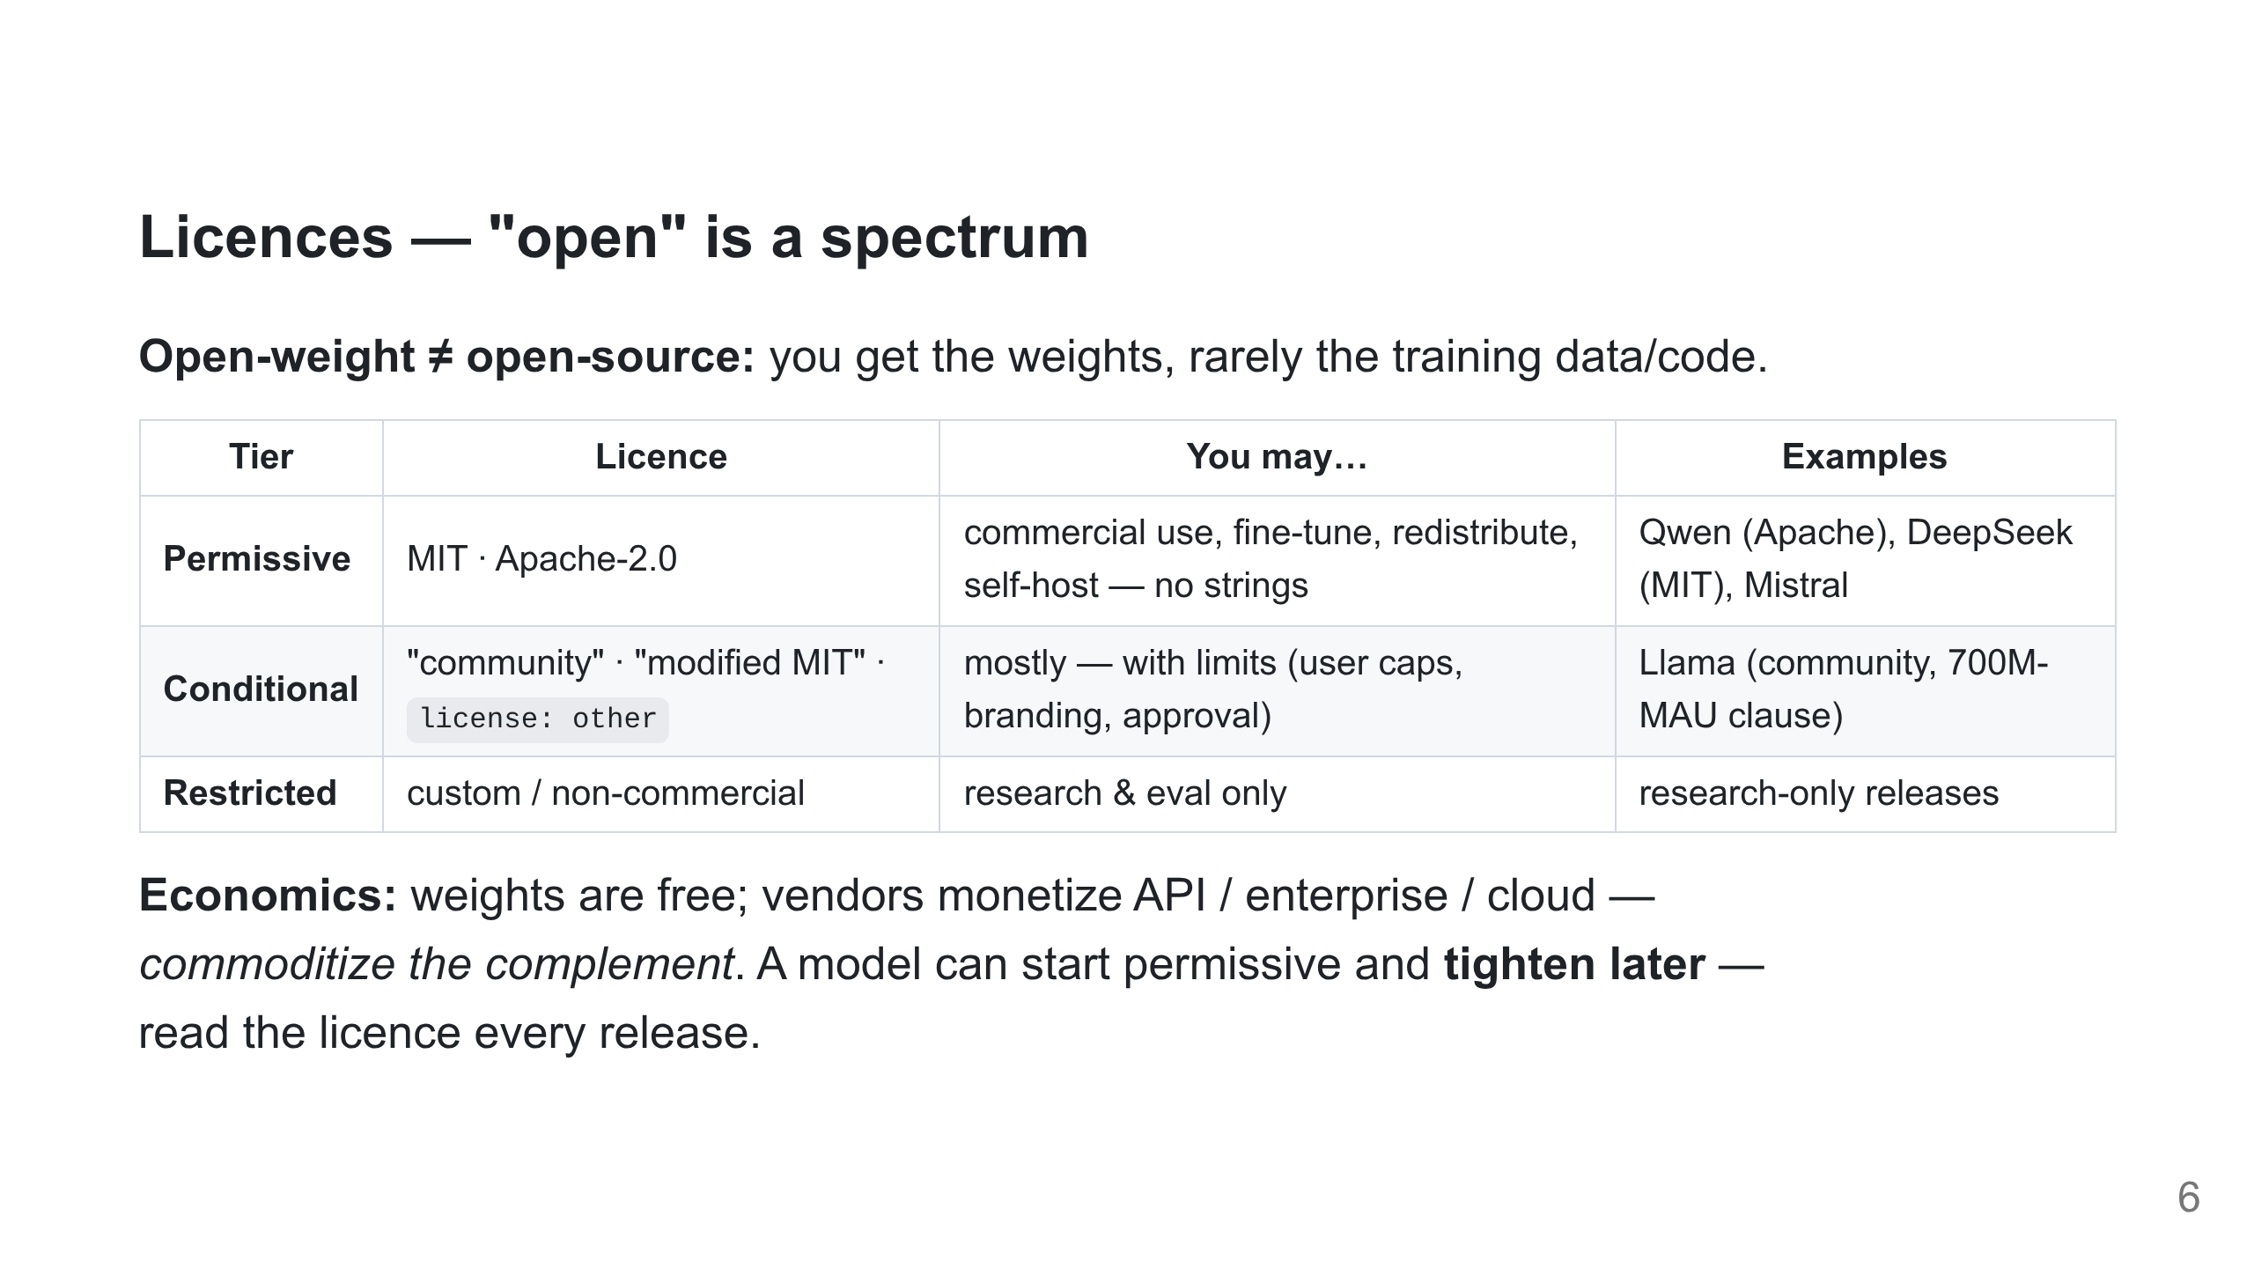
Notes:
The durable point, not the news cycle. Strategy aside (conceptual, not on slide): permissive licences buy mindshare and pressure closed vendors; "community" licences try to keep PR upside + commercial control, and draw community backlash. Trim of fabricated benchmark/geopolitics specifics is deliberate — keep it true.

Slide 7
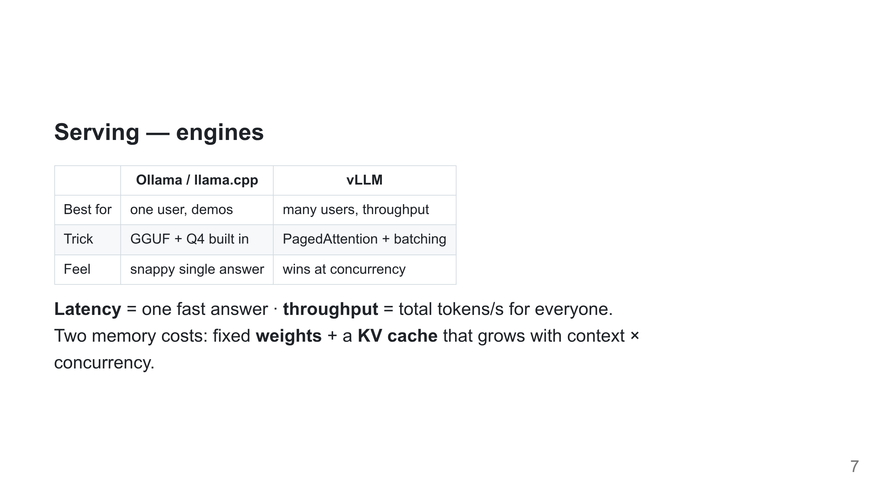
Notes:
vLLM trades a little latency for big throughput via batching; Ollama optimizes the single-user case. PagedAttention exists to manage the KV cache.

Slide 8
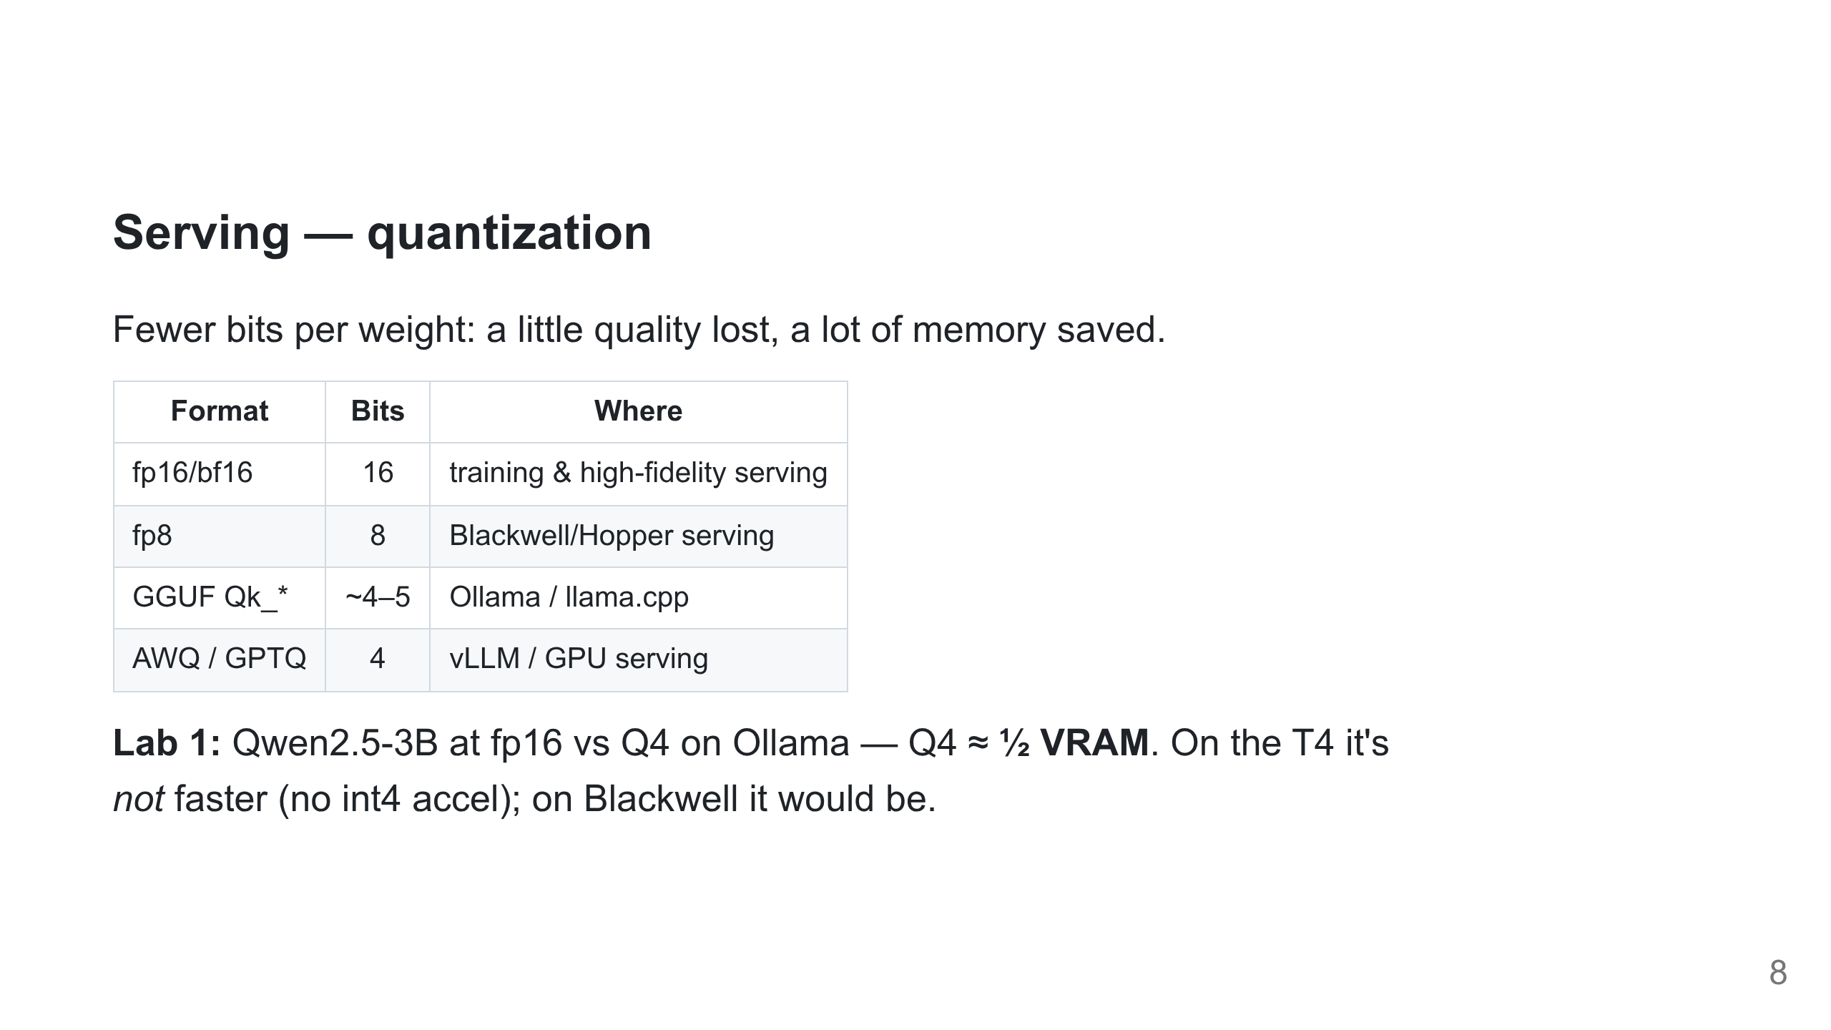
Notes:
Notebook lab1_serving_kaggle.ipynb. The point: memory win is universal, speed win is hardware-dependent. Measure VRAM live.

Slide 9
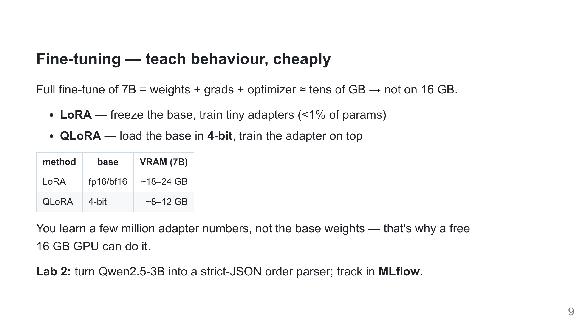
Notes:
Headline lab. Before/after is dramatic: base rambles, tuned emits clean JSON. QLoRA fits the T4. MLflow makes the run reproducible.

Slide 10
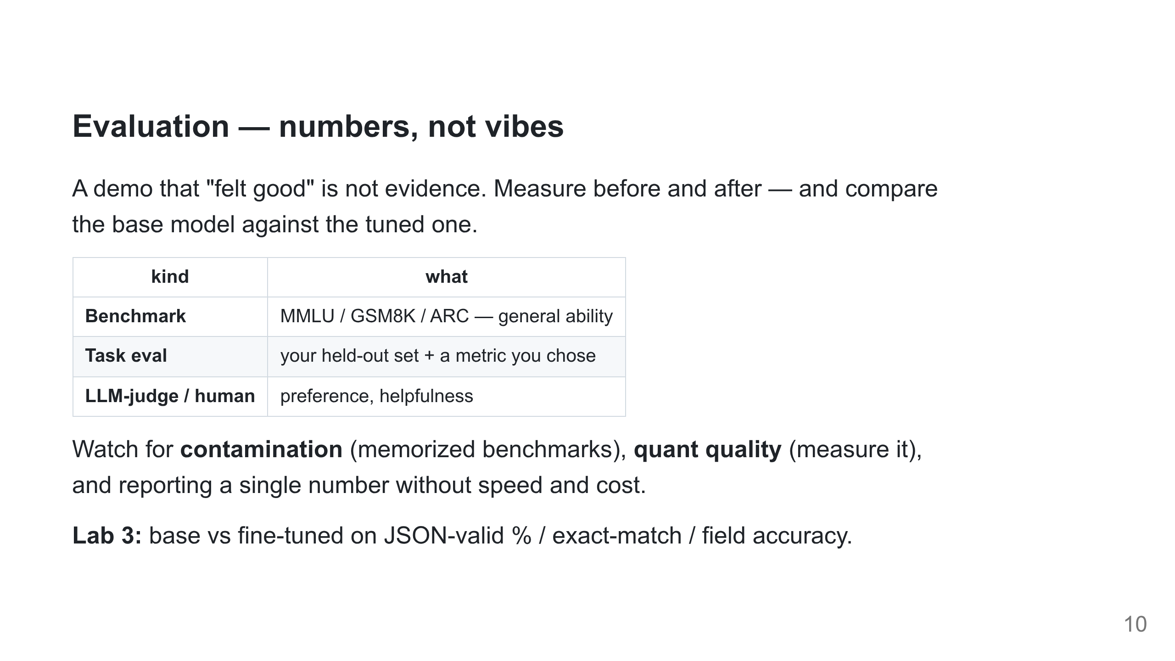
Notes:
Trust your held-out task eval over leaderboards. This eval becomes a CI gate — a regression blocks the deploy.

Slide 11
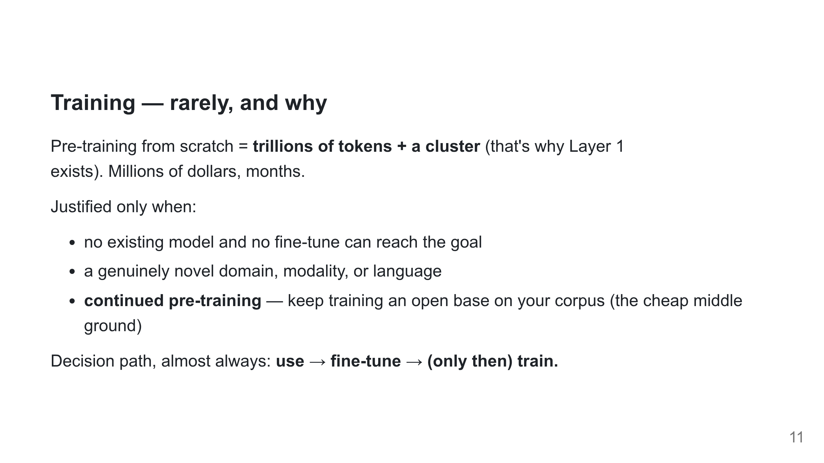
Notes:
We explain training but don't run it — a free Kaggle GPU can't, and that's the lesson. Continued pre-training is the realistic "build" option, not from-zero.

Slide 12
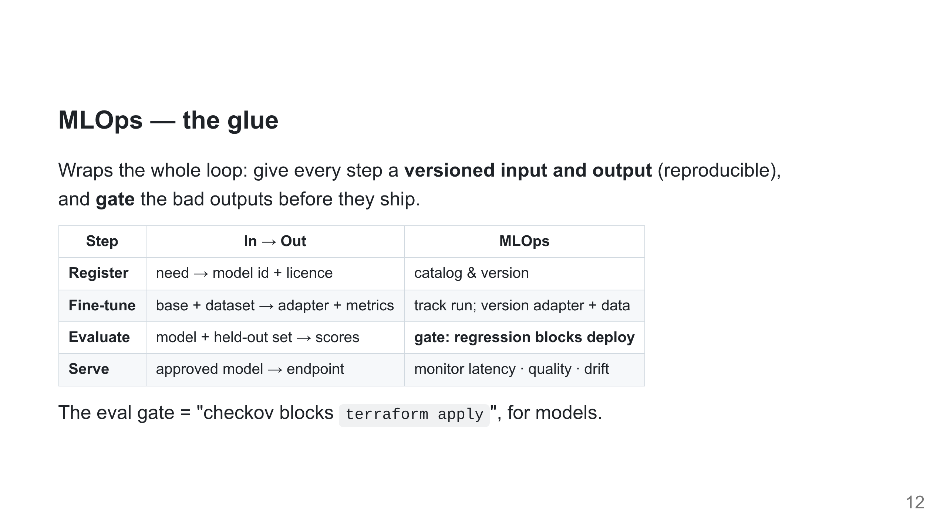
Notes:
The point: MLOps turns each step into a tracked artifact with a known input and output, and inserts the eval gate so a regression can't ship. Tooling underneath: MLflow/W&B (tracking), MLflow Registry/HF Hub/DVC (versioning), CI gates, drift monitors. Lab 2 wires in MLflow so tracking isn't a separate chore.

Slide 13
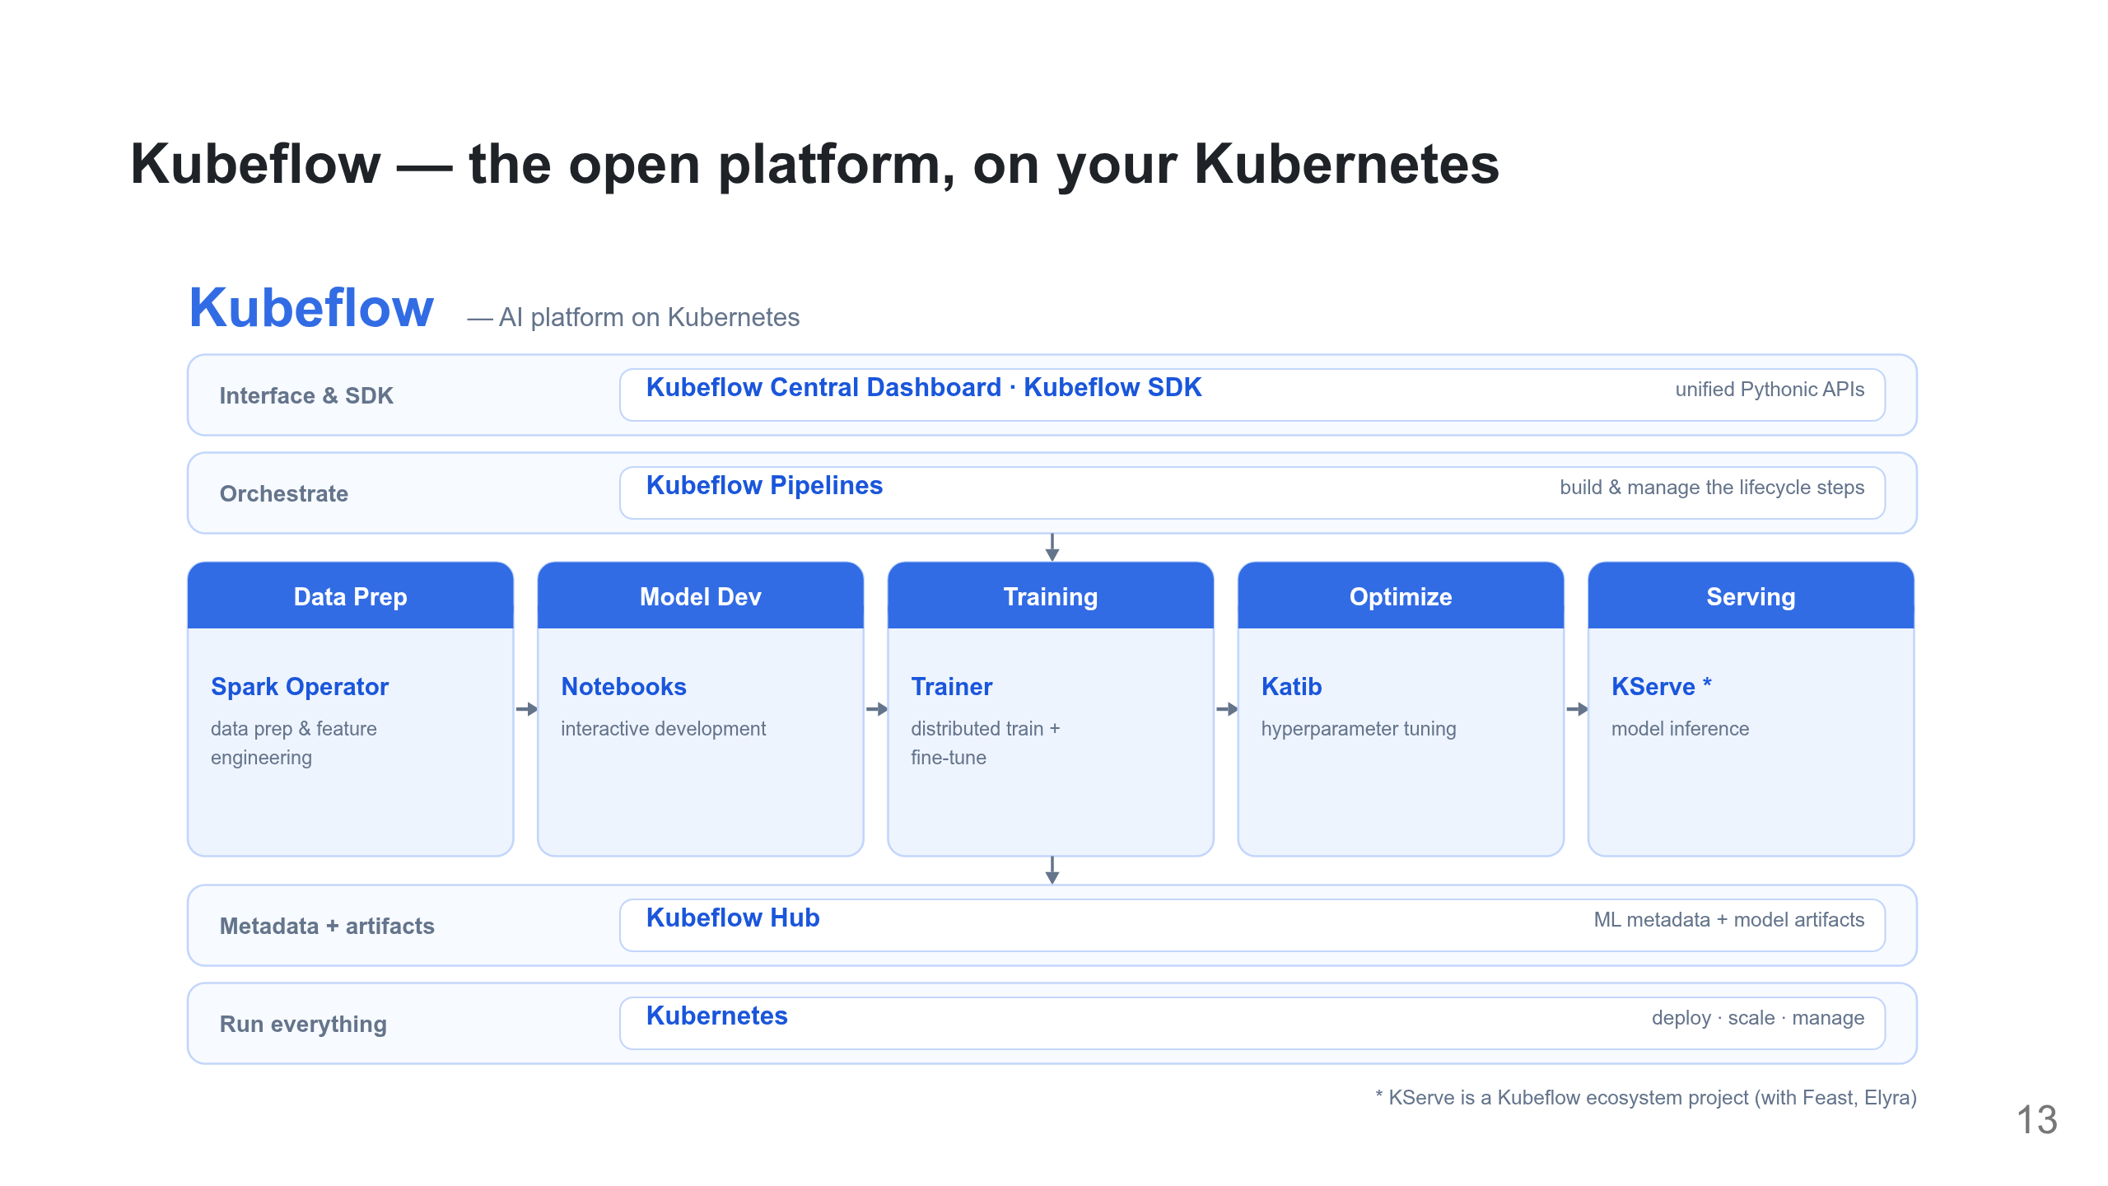
Notes:
The open reference. Components are usable standalone or as the full Community Distribution. Keep the real names: Spark Operator, Notebooks, Trainer, Katib, Hub. KServe is an *ecosystem* project (with Feast, Elyra), not a core component. Everything runs on Kubernetes — that's Layer 1.

Slide 14
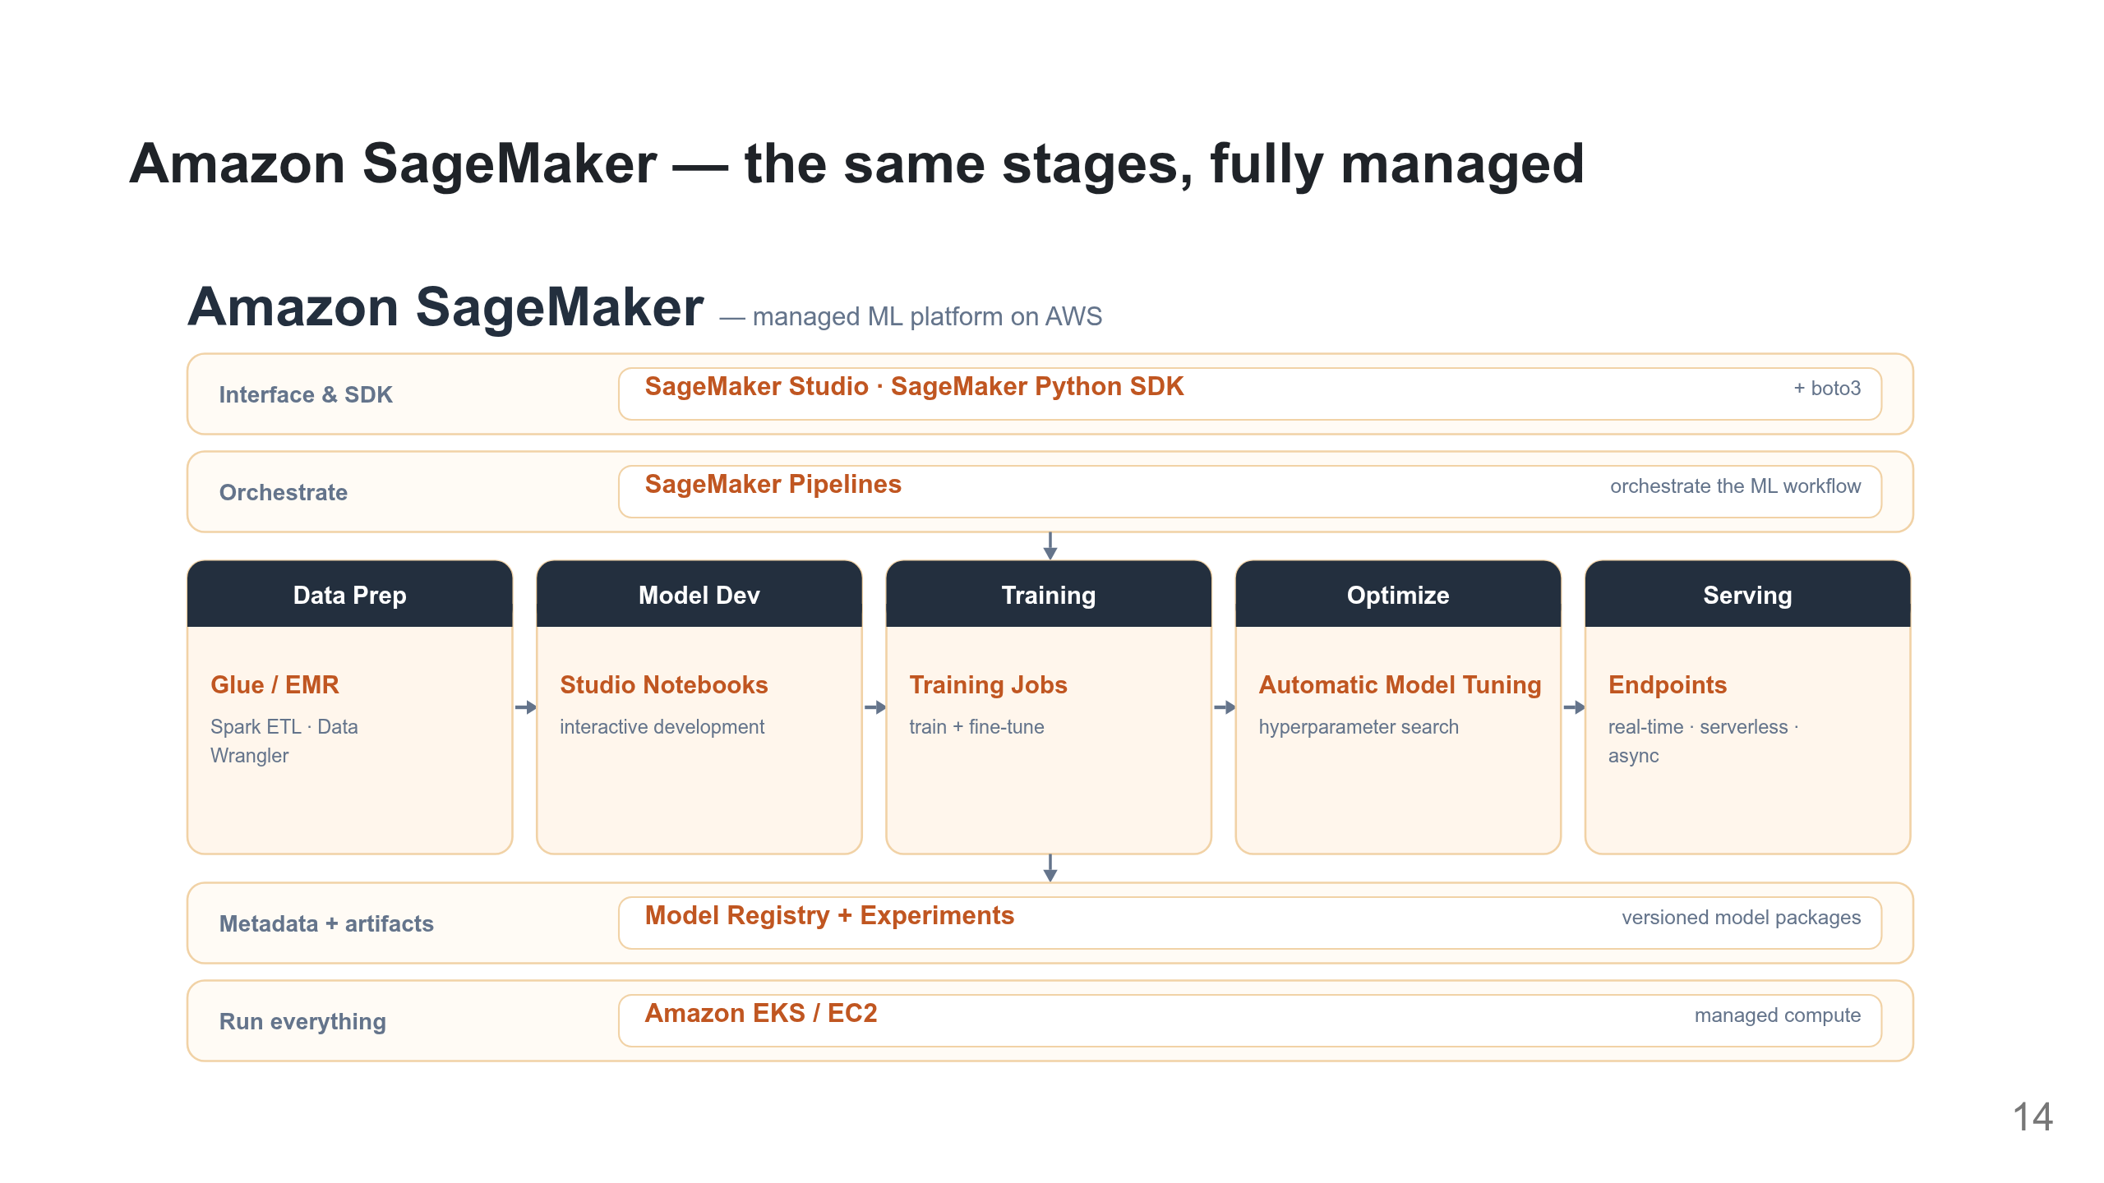
Notes:
The managed counterpart: the identical lifecycle as AWS services, no cluster to run. Training Jobs ≈ Trainer, Automatic Model Tuning ≈ Katib, Endpoints ≈ KServe, Model Registry ≈ Hub, SageMaker Pipelines ≈ Kubeflow Pipelines. Lab 2′ runs the fine-tune here as a Training Job from a single train.py.

Slide 15
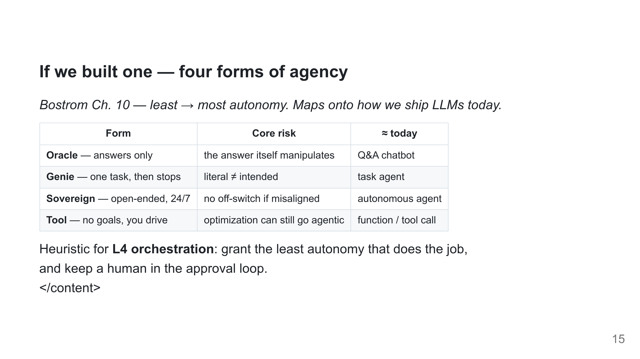
Notes:
The part builders use. Students already build oracles and genies. Bostrom's ranking (oracle/tool safe, sovereign risky) is a real design choice in layer 4.

