Slide 1
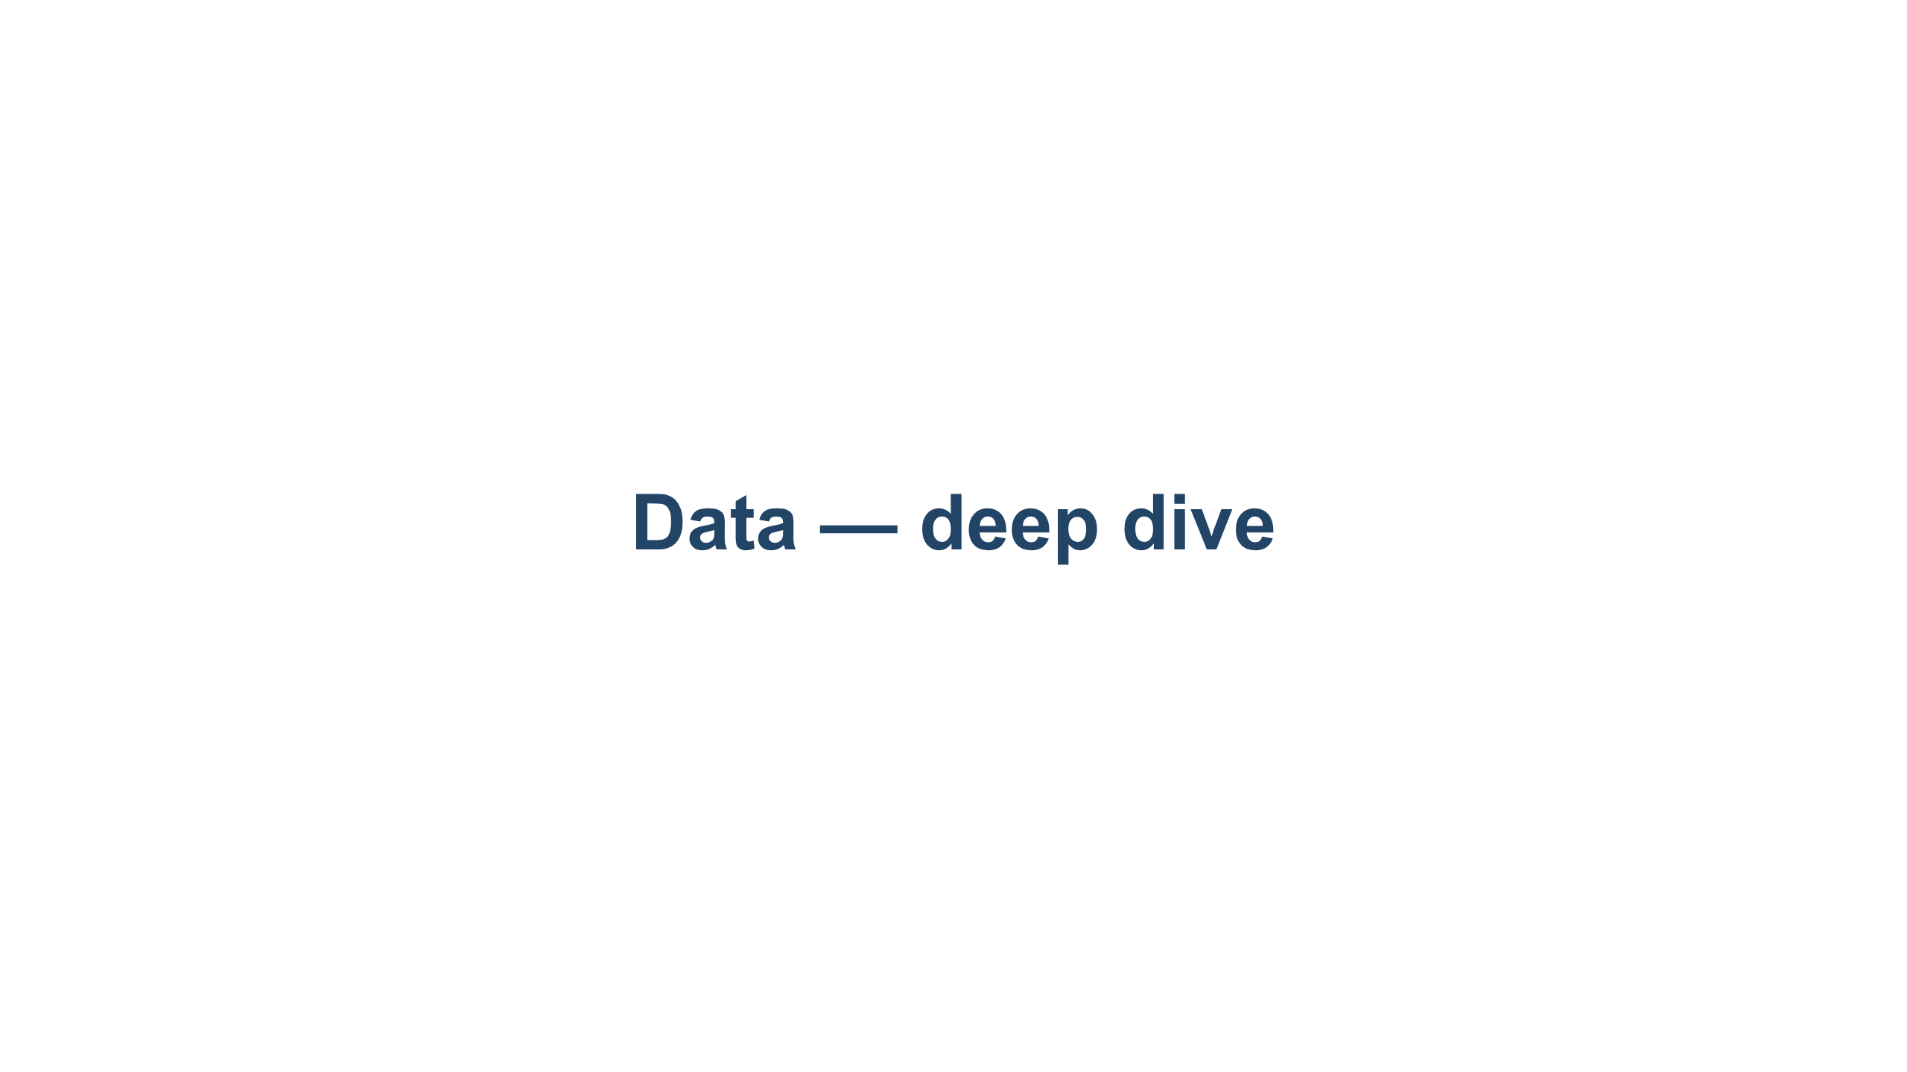
Notes:
The Data layer (Layer 3). Maps 1:1 to 03-data/README.md. Labs run on the same free Kaggle T4 (16 GB) + Qwen2.5-3B as the Models layer, so the layers chain. Pace: a few slides of concept per phase, then the notebook.

Slide 2
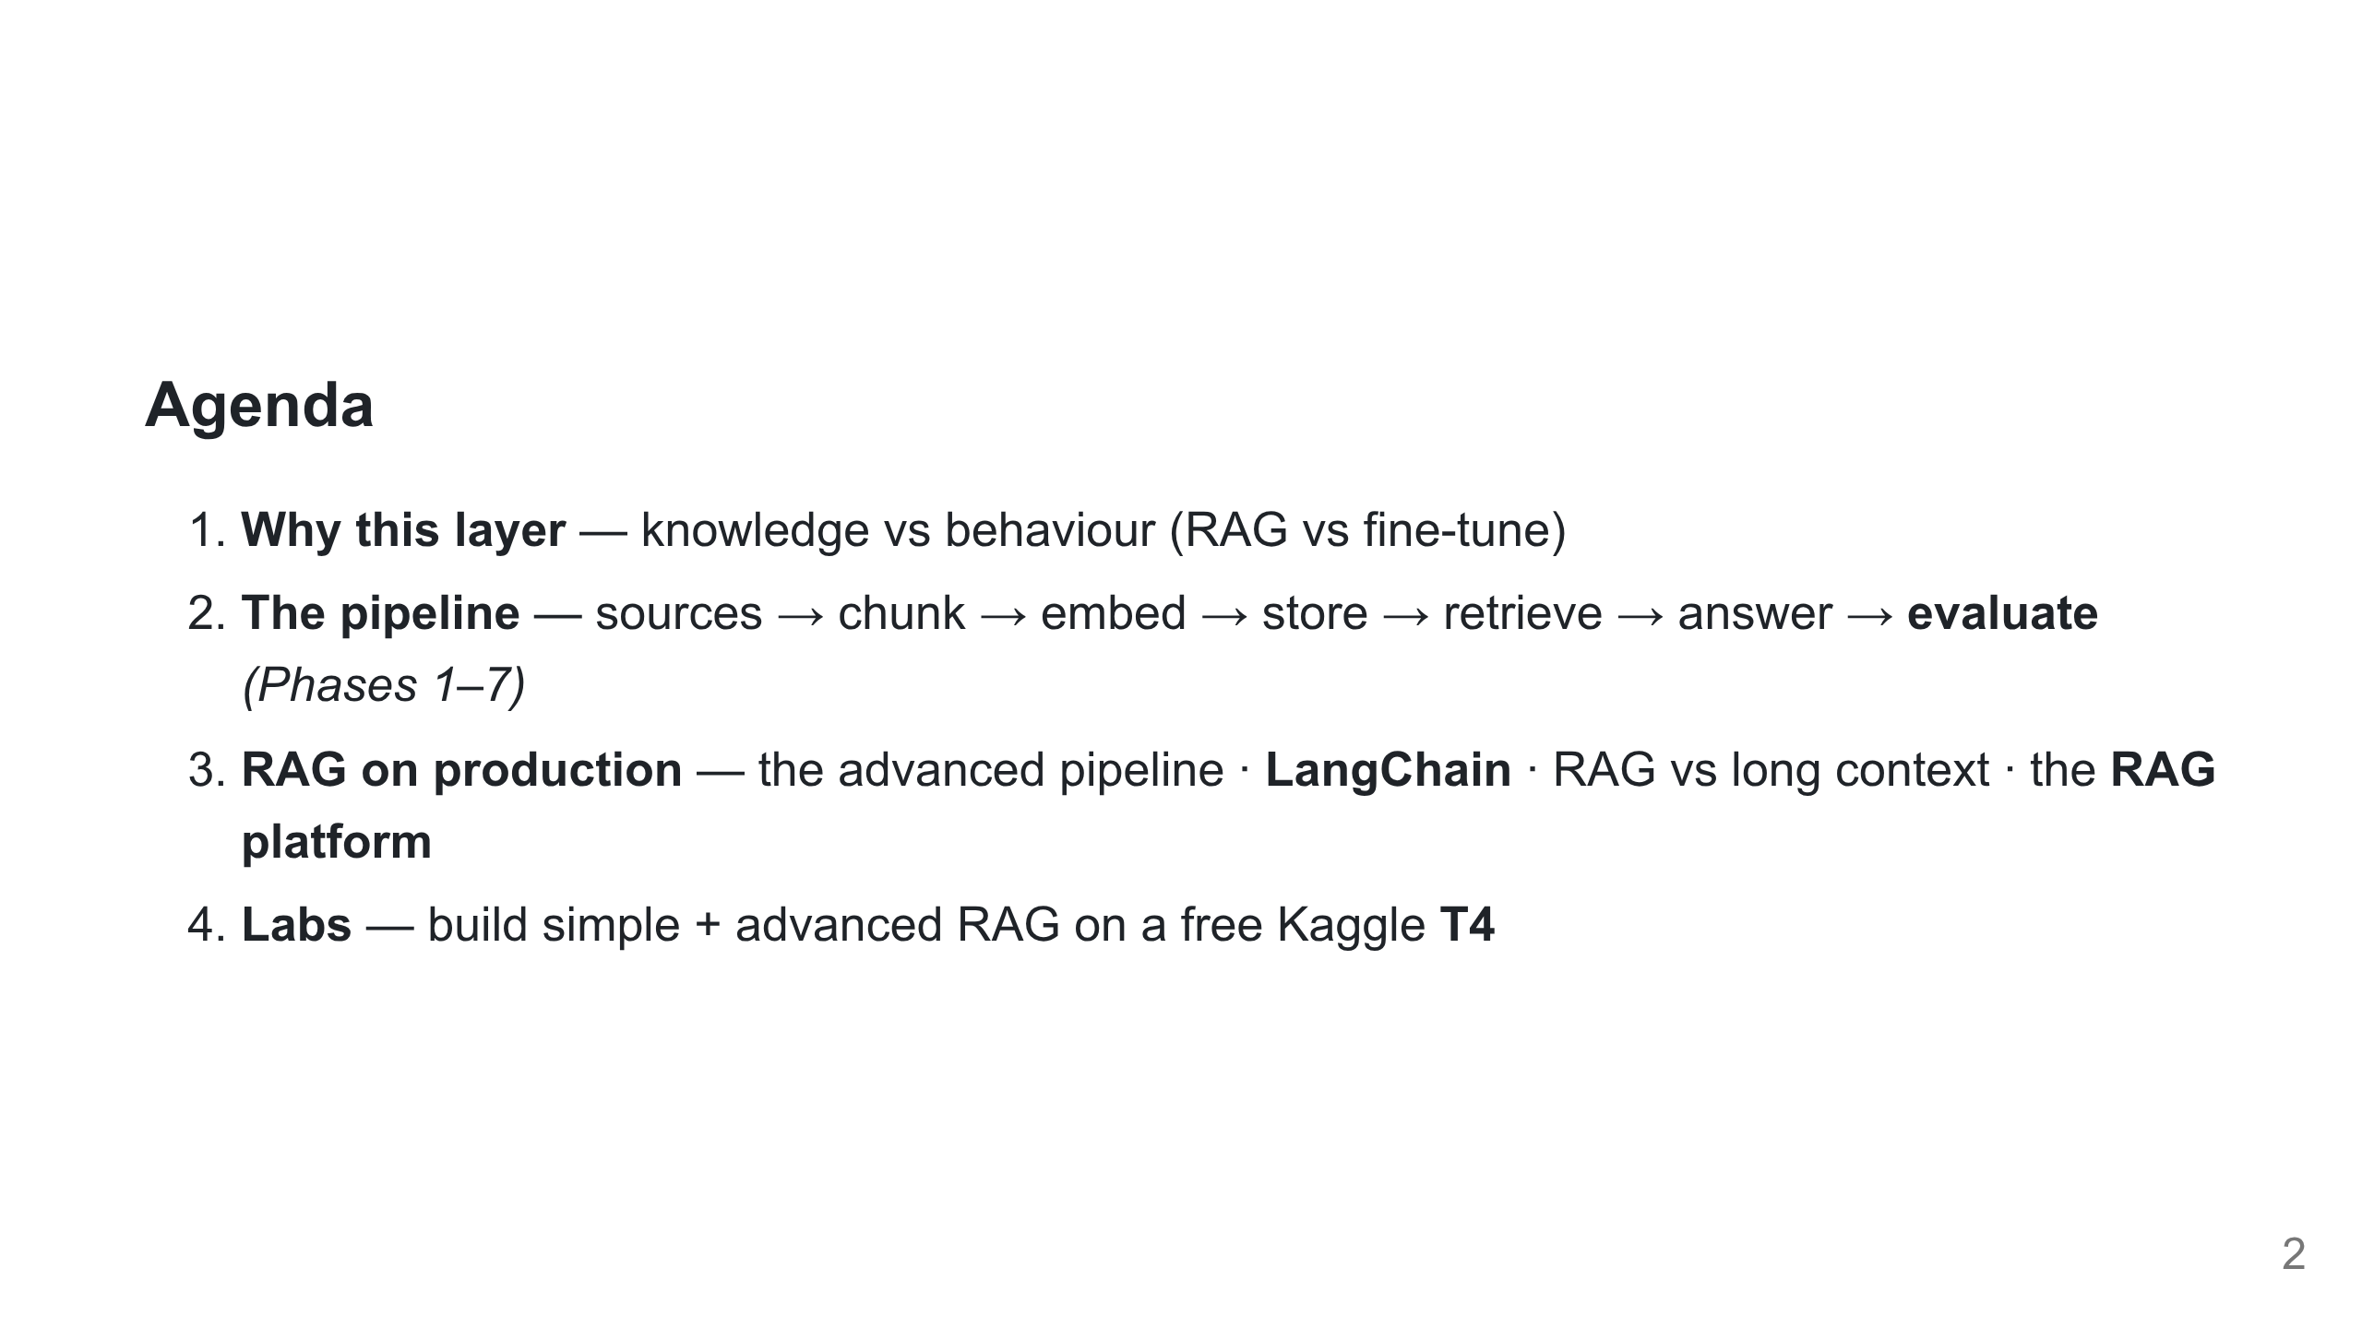
Notes:
The map. Part 1 motivates the layer; Part 2 builds and measures the naive pipeline; Part 3 takes it to production (better retrieval, a framework, a platform); then the hands-on labs. A few slides of concept per phase, then the notebook.

Slide 3
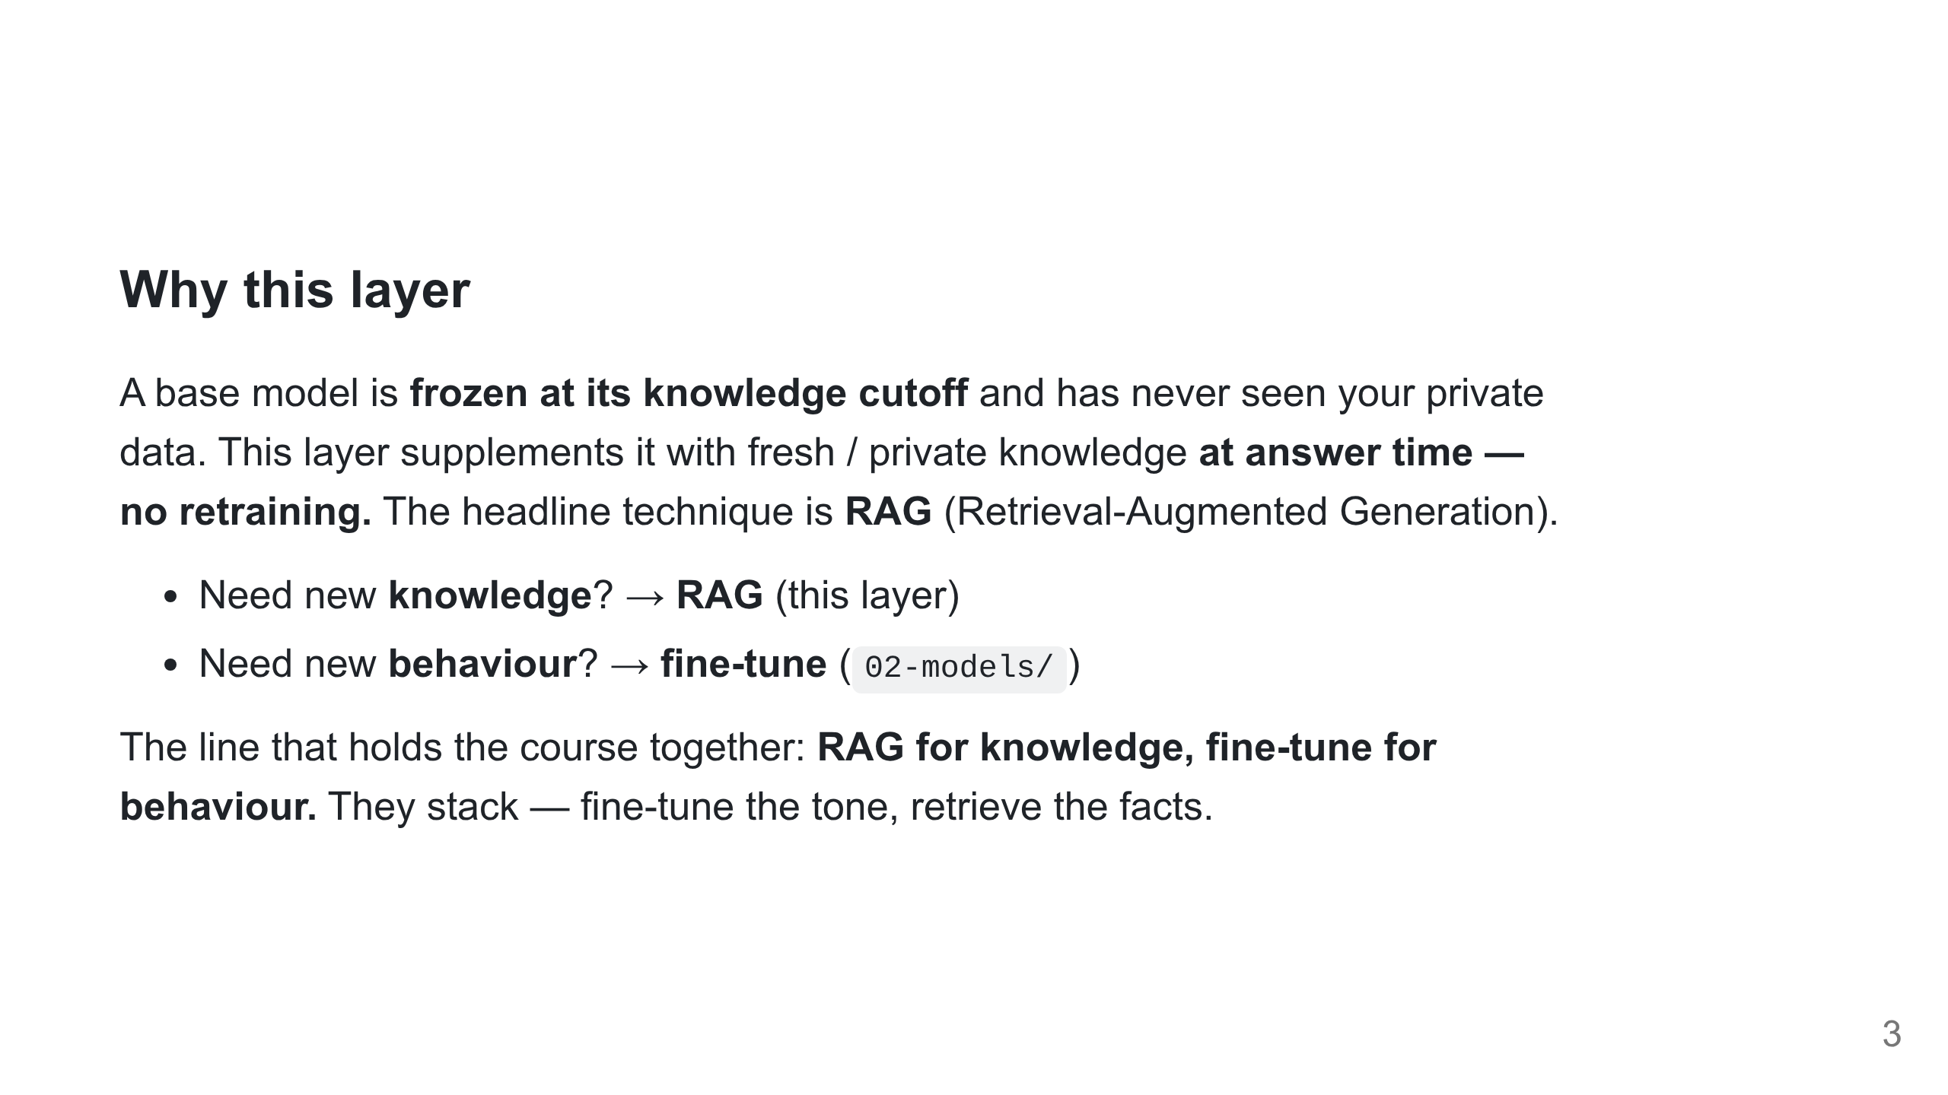
Notes:
The one rule students forget. If the model has the skill but lacks the facts, you are in the right place. RAG = open-book exam; fine-tune = what it memorised.

Slide 4
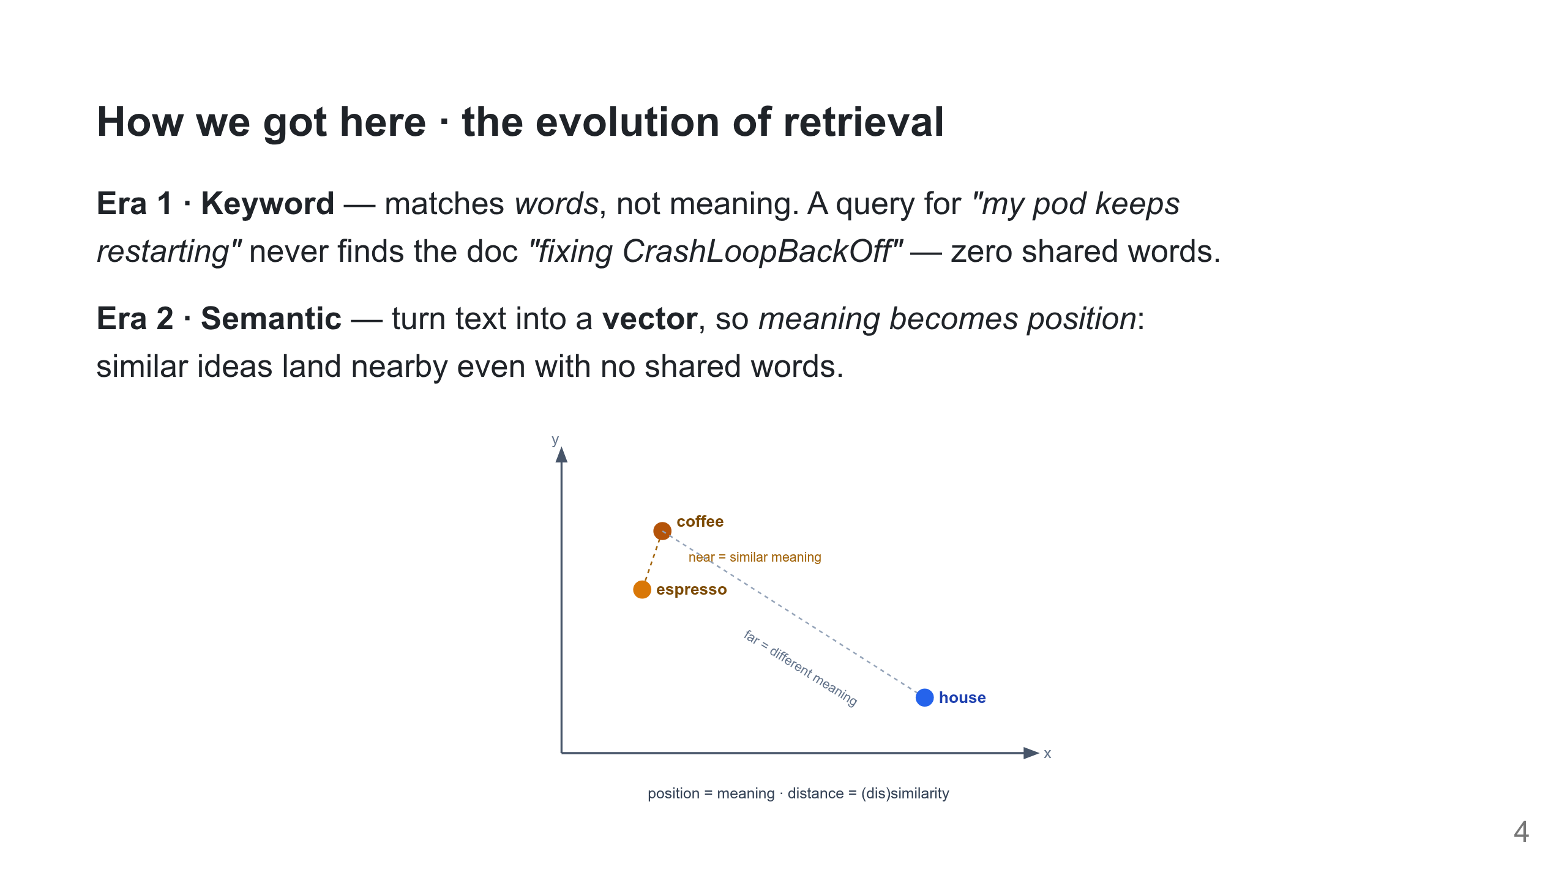
Notes:
Each era fixed the blind spot of the one before. Keyword still powers the web, but the burden was on the user to guess the exact words. The plot is the whole idea of embeddings: coffee/espresso cluster, house is far — distance = (dis)similarity. Semantic search at scale IS the RAG pipeline (next).

Slide 5
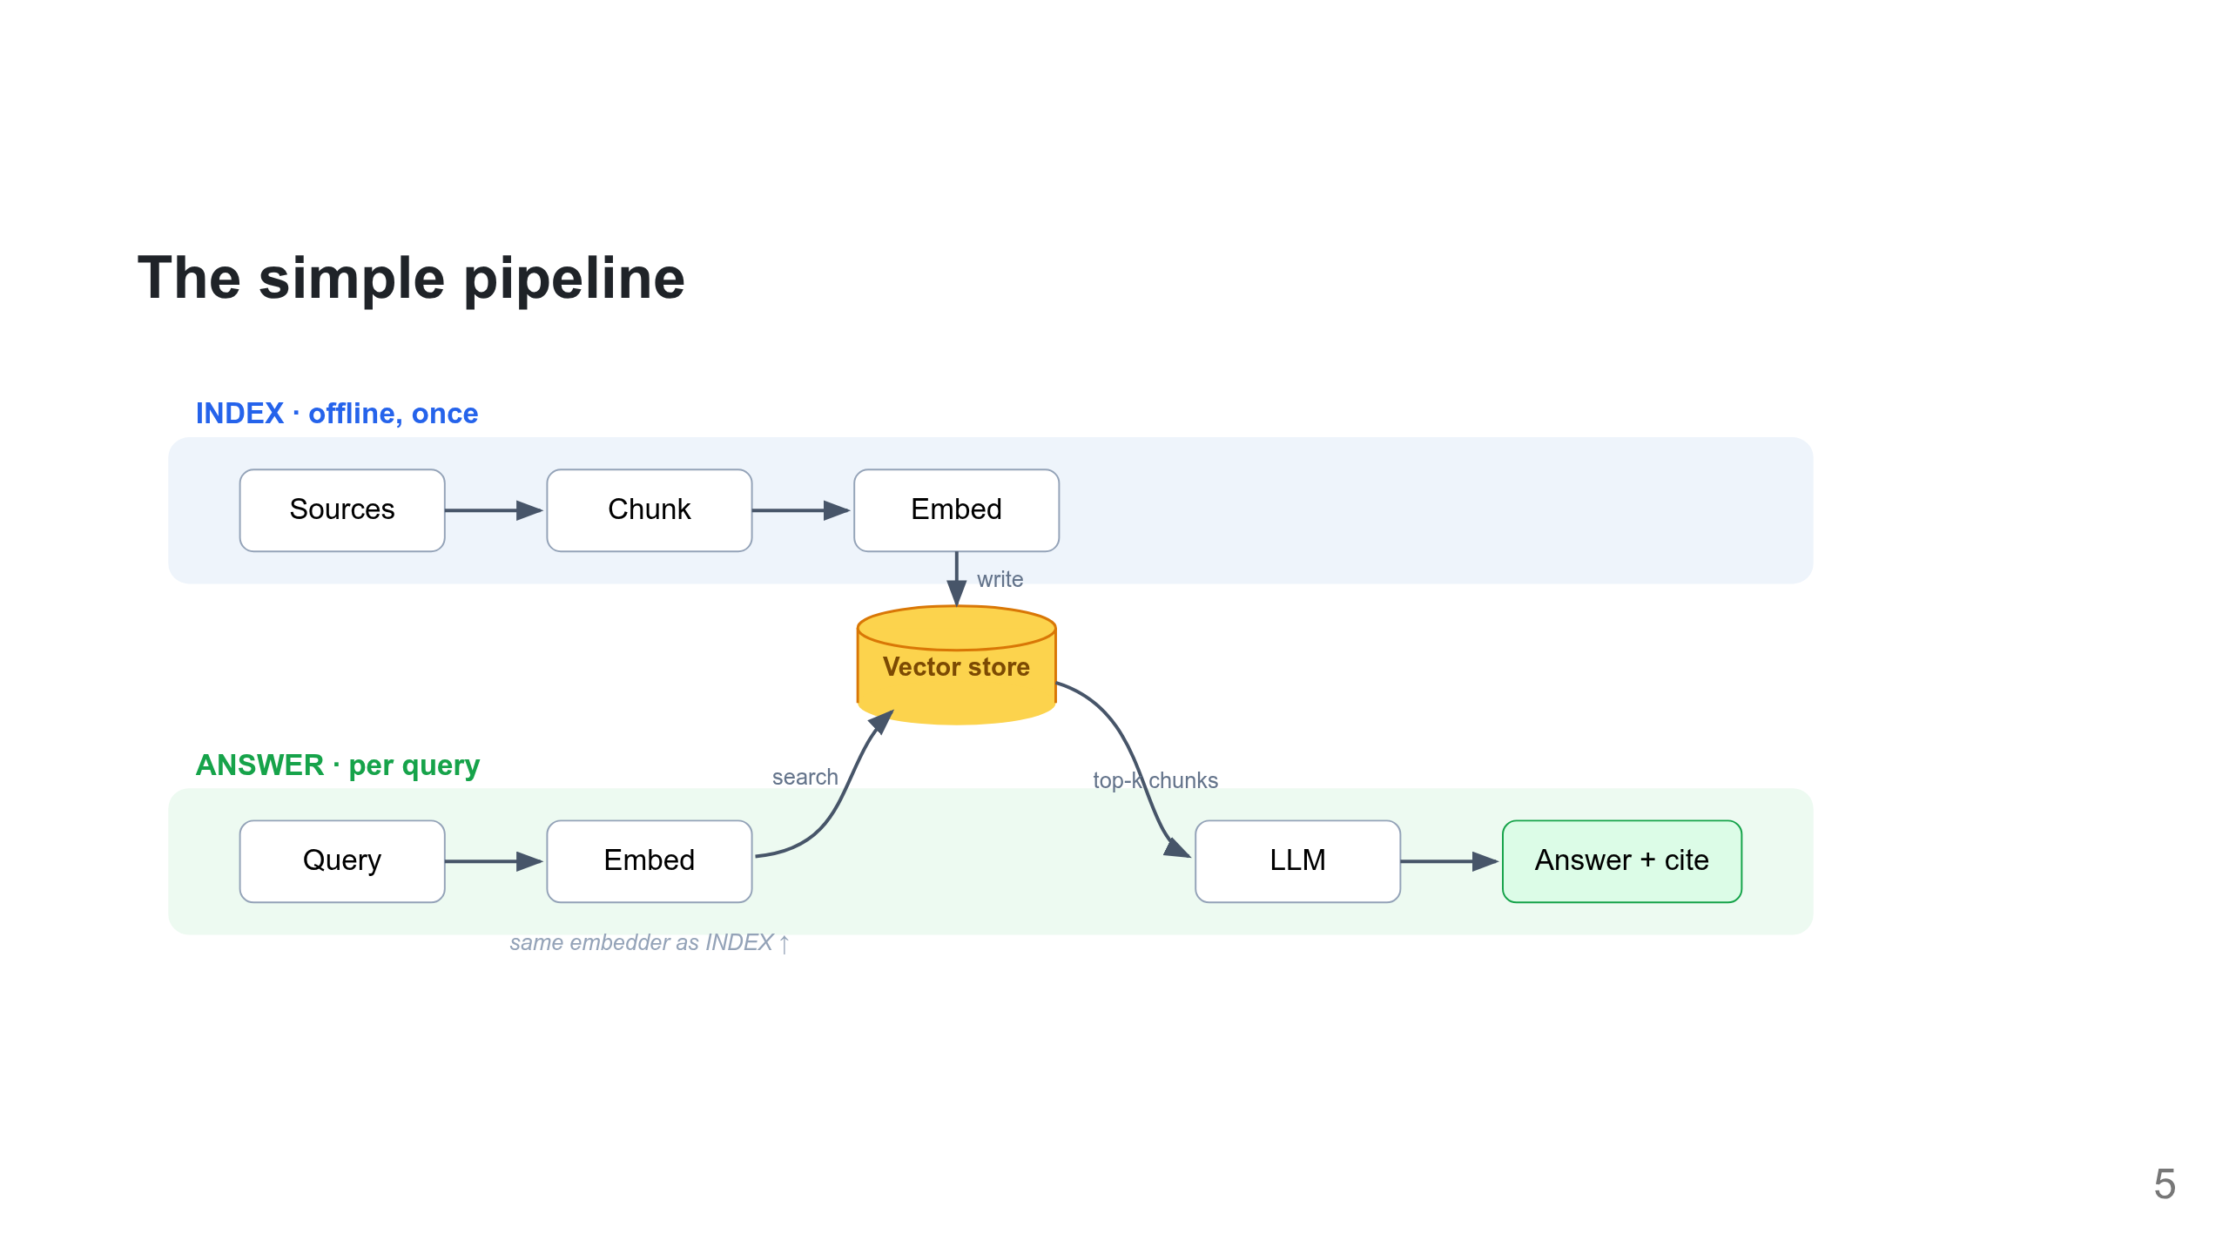
Notes:
The whole layer on one slide. One shared vector store: INDEX writes it once; ANSWER reads top-k from it per query. Note the same embedder feeds both sides — the #1 RAG rule. Walk left-to-right on each lane.

Slide 6
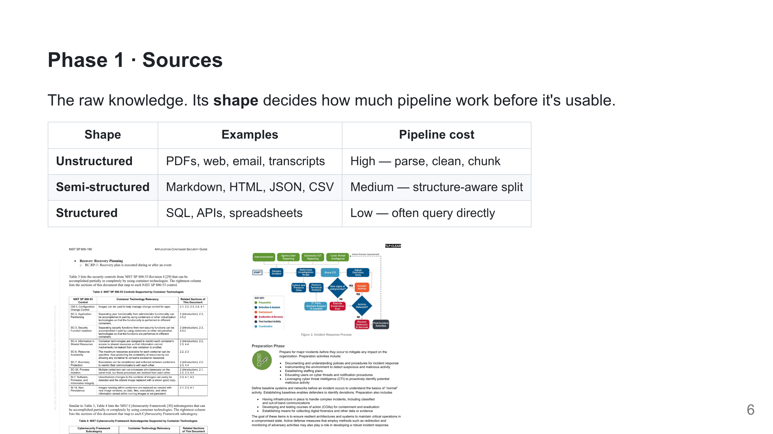
Notes:
Real data is messy — tables, flowcharts, scanned PDFs. The "garbage in" point: most RAG quality is won or lost before a single vector is computed.

Slide 7
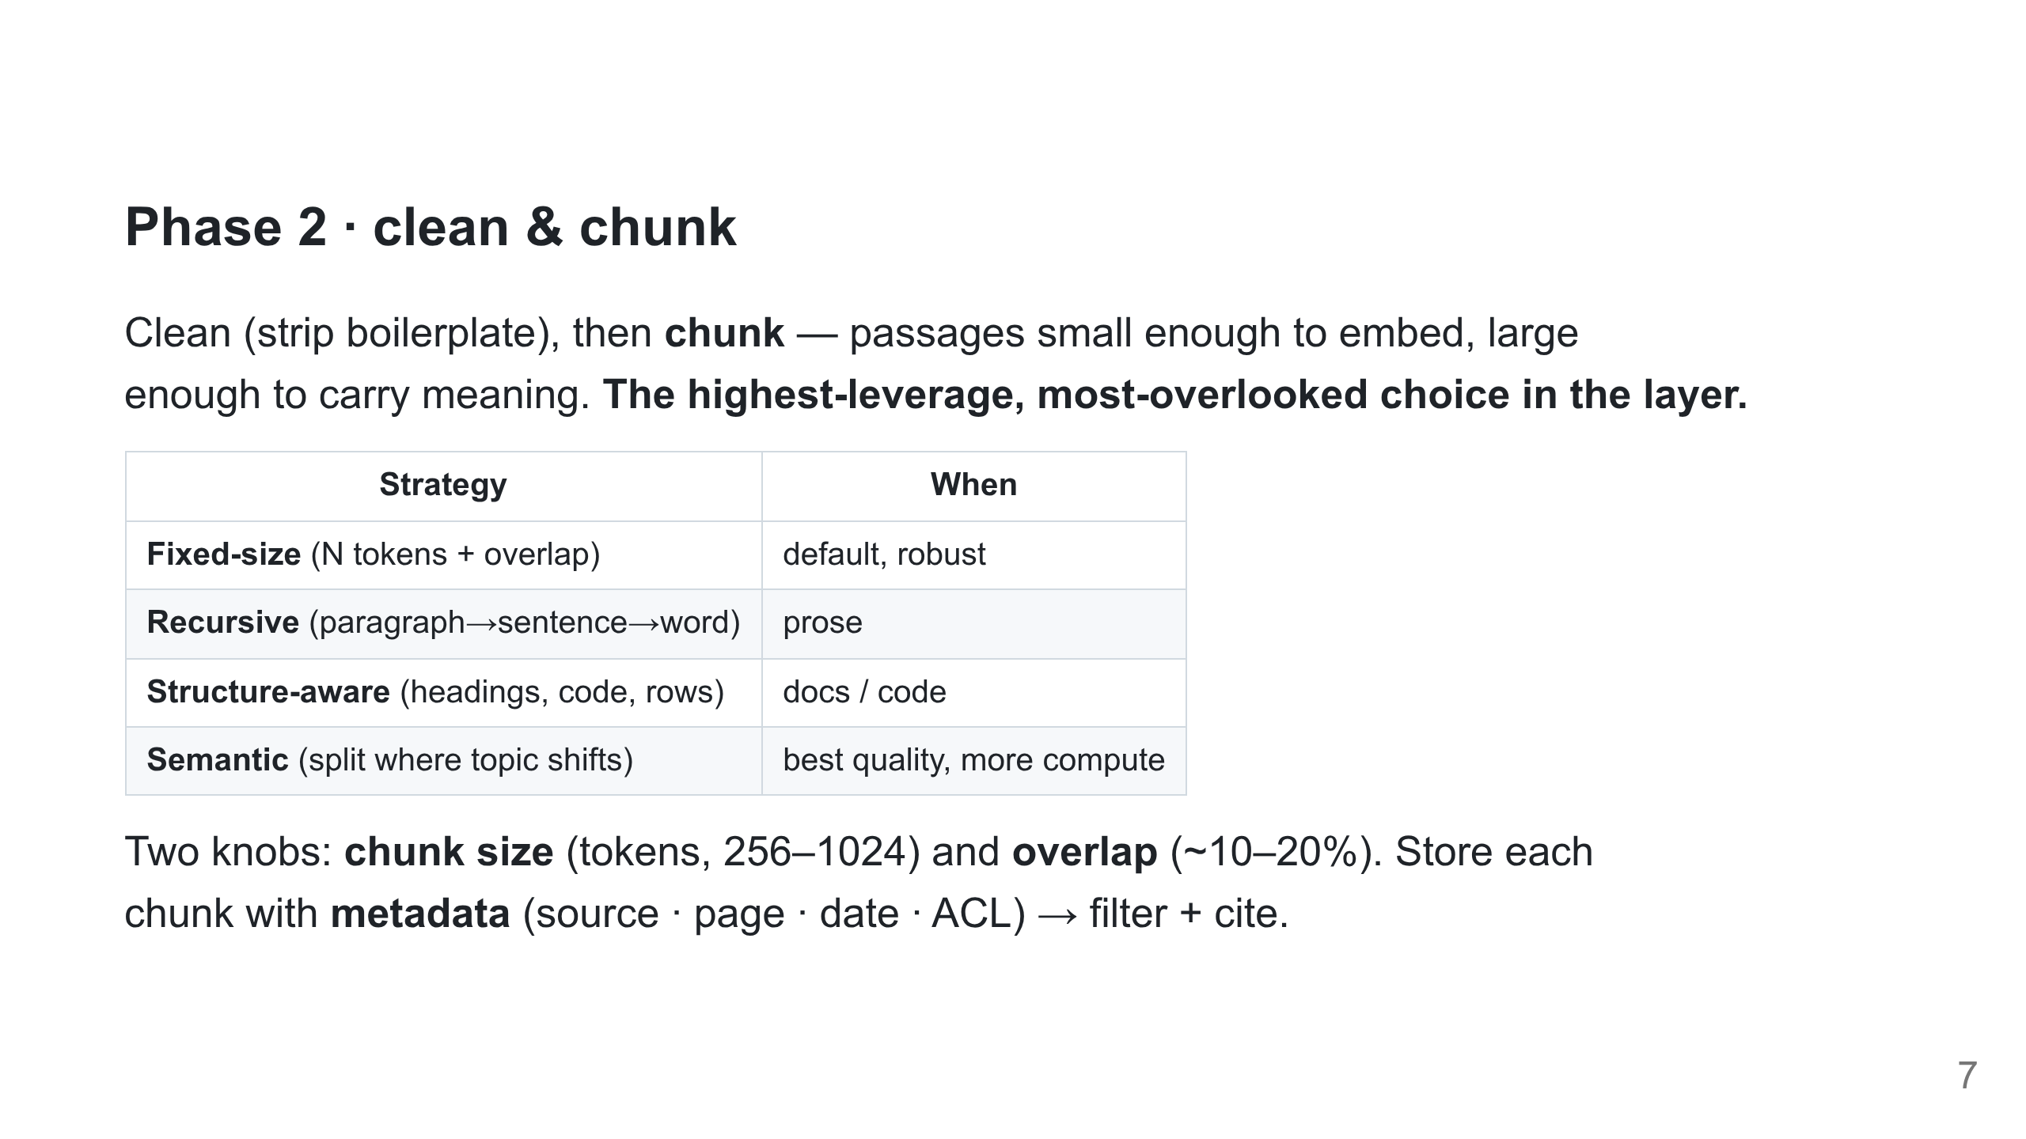
Notes:
Too big dilutes signal + wastes context; too small loses surrounding meaning. Metadata is what later powers tenant filtering and citations. Lab 2 chunks the real k8s docs.

Slide 8
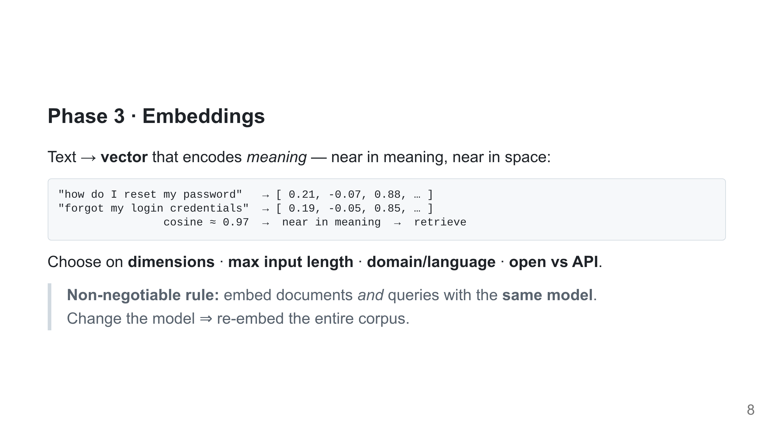
Notes:
The embedder is its own small model, separate from the LLM (CPU or a sliver of GPU). Two models = incomparable spaces, "near" becomes meaningless. Our labs use bge-small.

Slide 9
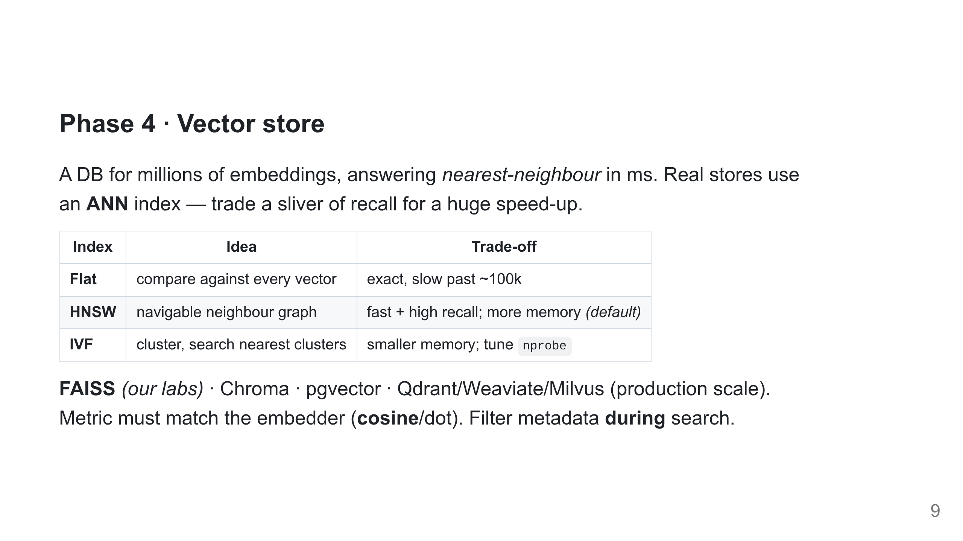
Notes:
Filtering during search (tenant = X AND date > Y) enforces permissions + freshness at retrieval, not after. FAISS flat is exact and plenty at lab scale.

Slide 10
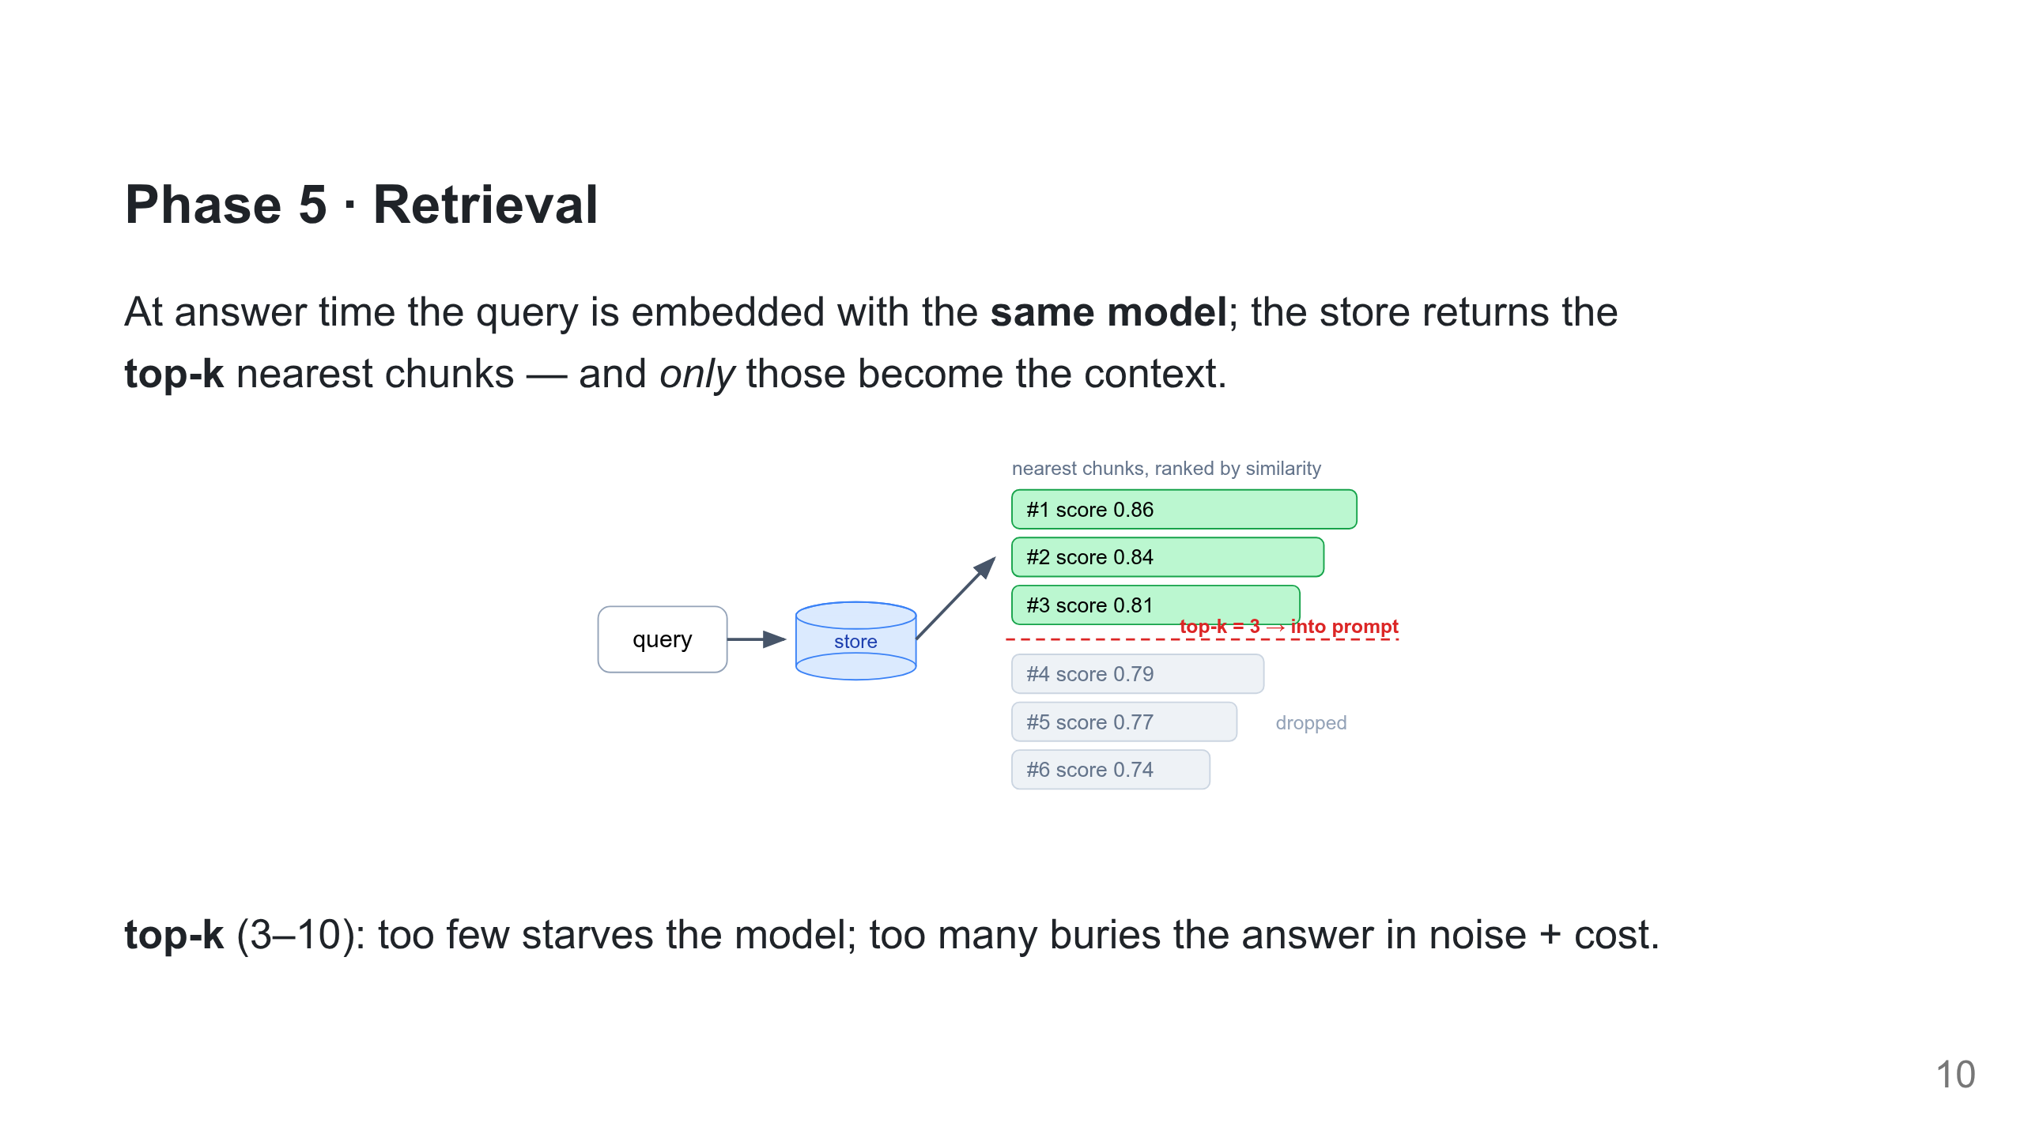
Notes:
The whole game: the model can only answer from what retrieval returns. Lab 1 prints this exact ranked list. top-k is the first dial students tune.

Slide 11
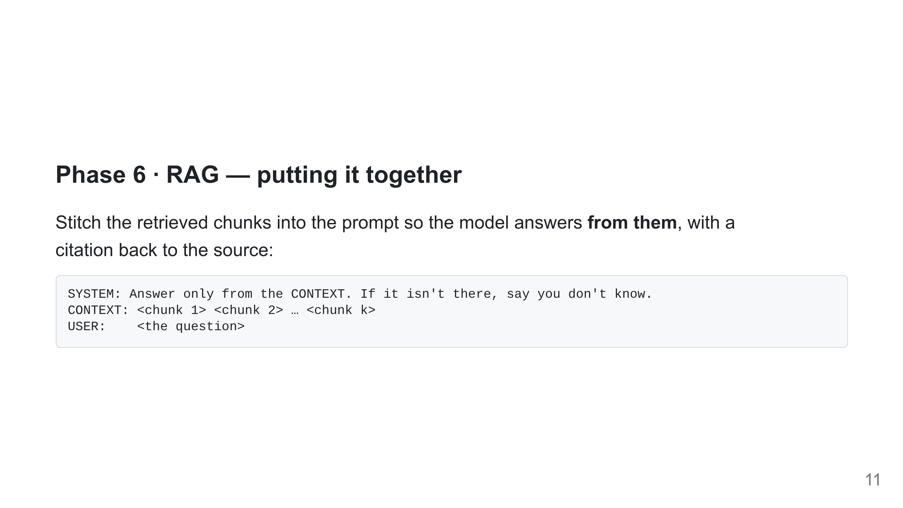
Notes:
The "answer only from context / else say I don't know" rule is what produces the refusal. Lab 1 shows both a grounded cited answer and the refusal on an out-of-corpus question.

Slide 12
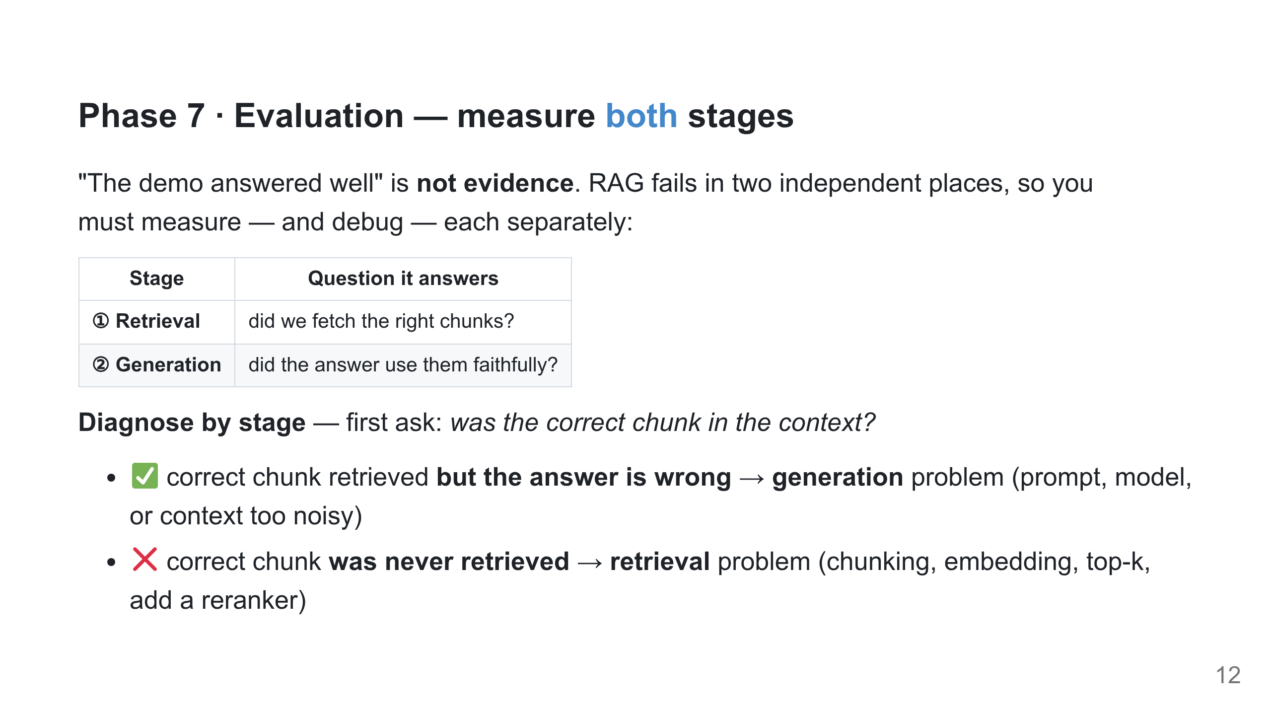
Notes:
Measure BEFORE you optimise — this is why eval comes before the advanced levers. The debug question is always "is the right chunk in the context?": yes → generation, no → retrieval. Lab 1 prints the chunks so students can answer it directly.

Slide 13
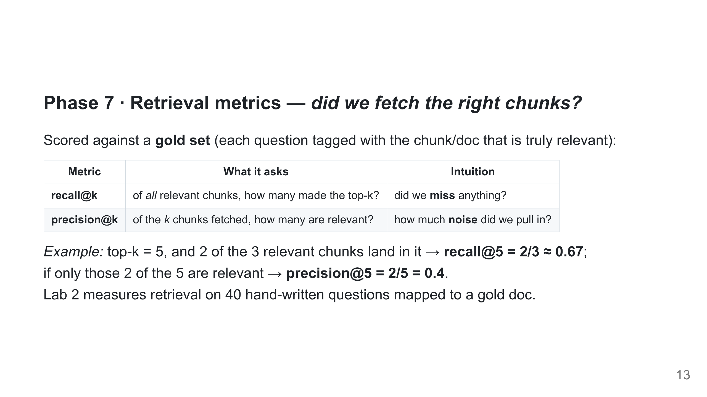
Notes:
These need ground truth — questions mapped to gold chunks, NOT to the chunks the system itself returned (that would be circular). recall vs precision is the classic miss-vs-noise trade-off; raising top-k helps recall but hurts precision.

Slide 14
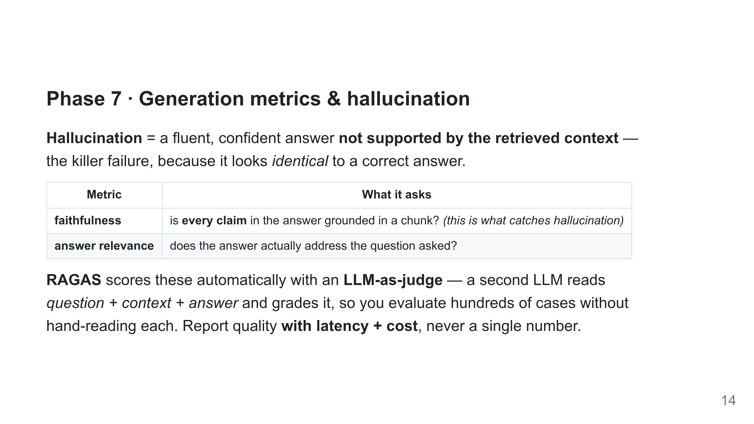
Notes:
LLM-as-judge: cheap and scalable, but the judge itself can err — spot-check it. Faithfulness is the one to watch in production; a confidently wrong, ungrounded answer is the worst outcome.

Slide 15
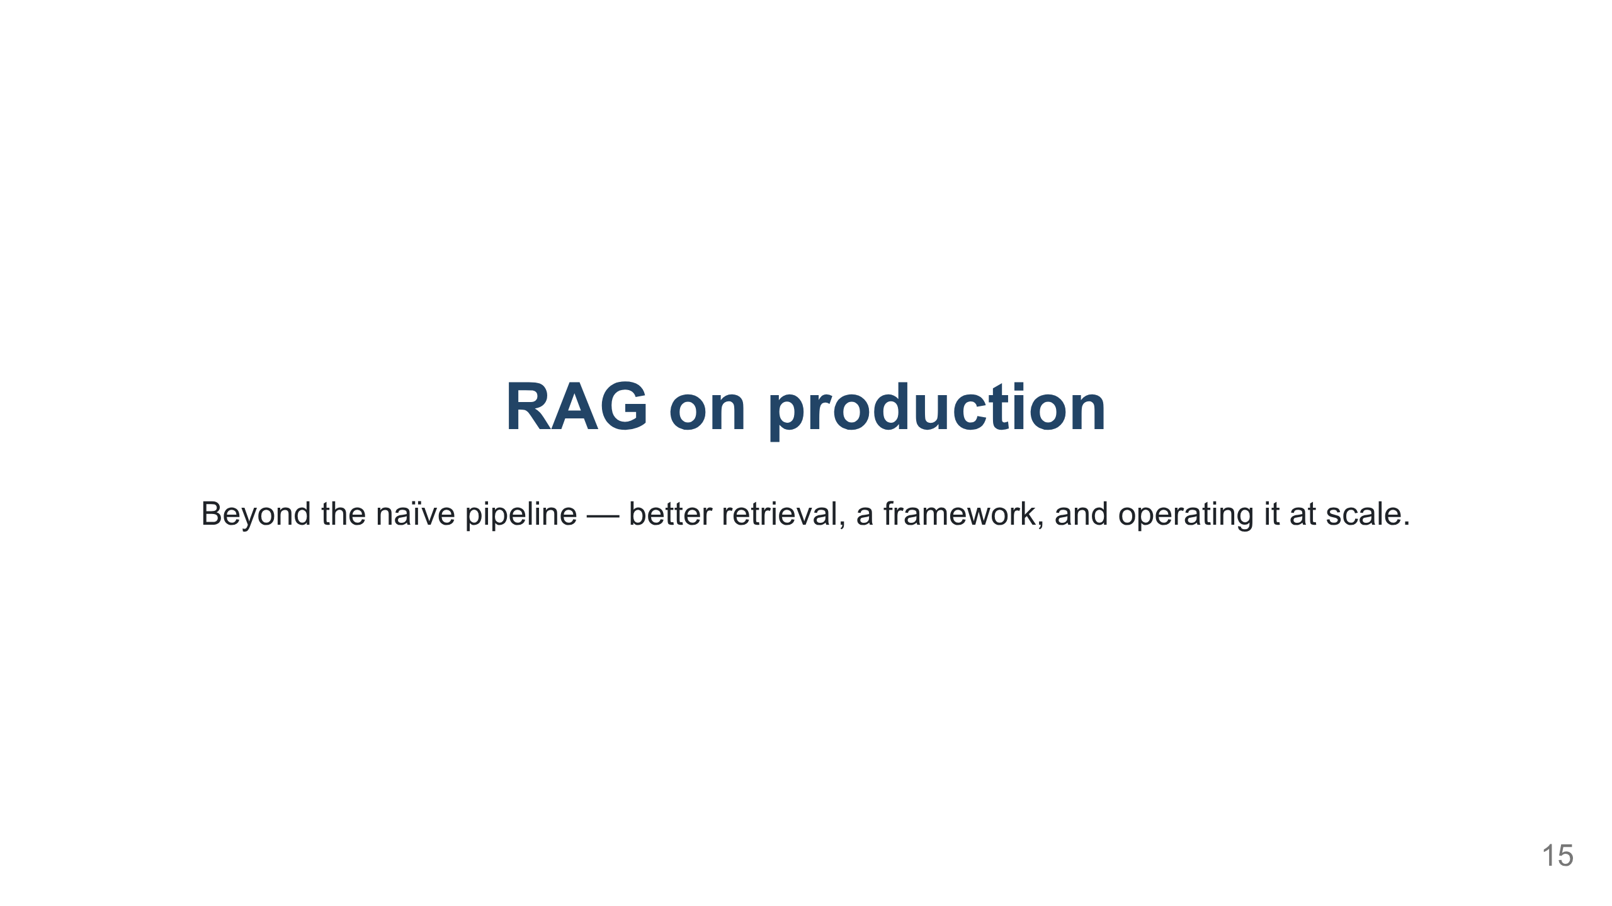
Notes:
Section divider. Chapter 1 built the simple pipeline; this section takes RAG from a demo to production: advanced retrieval (next), then LangChain, then the platform.

Slide 16
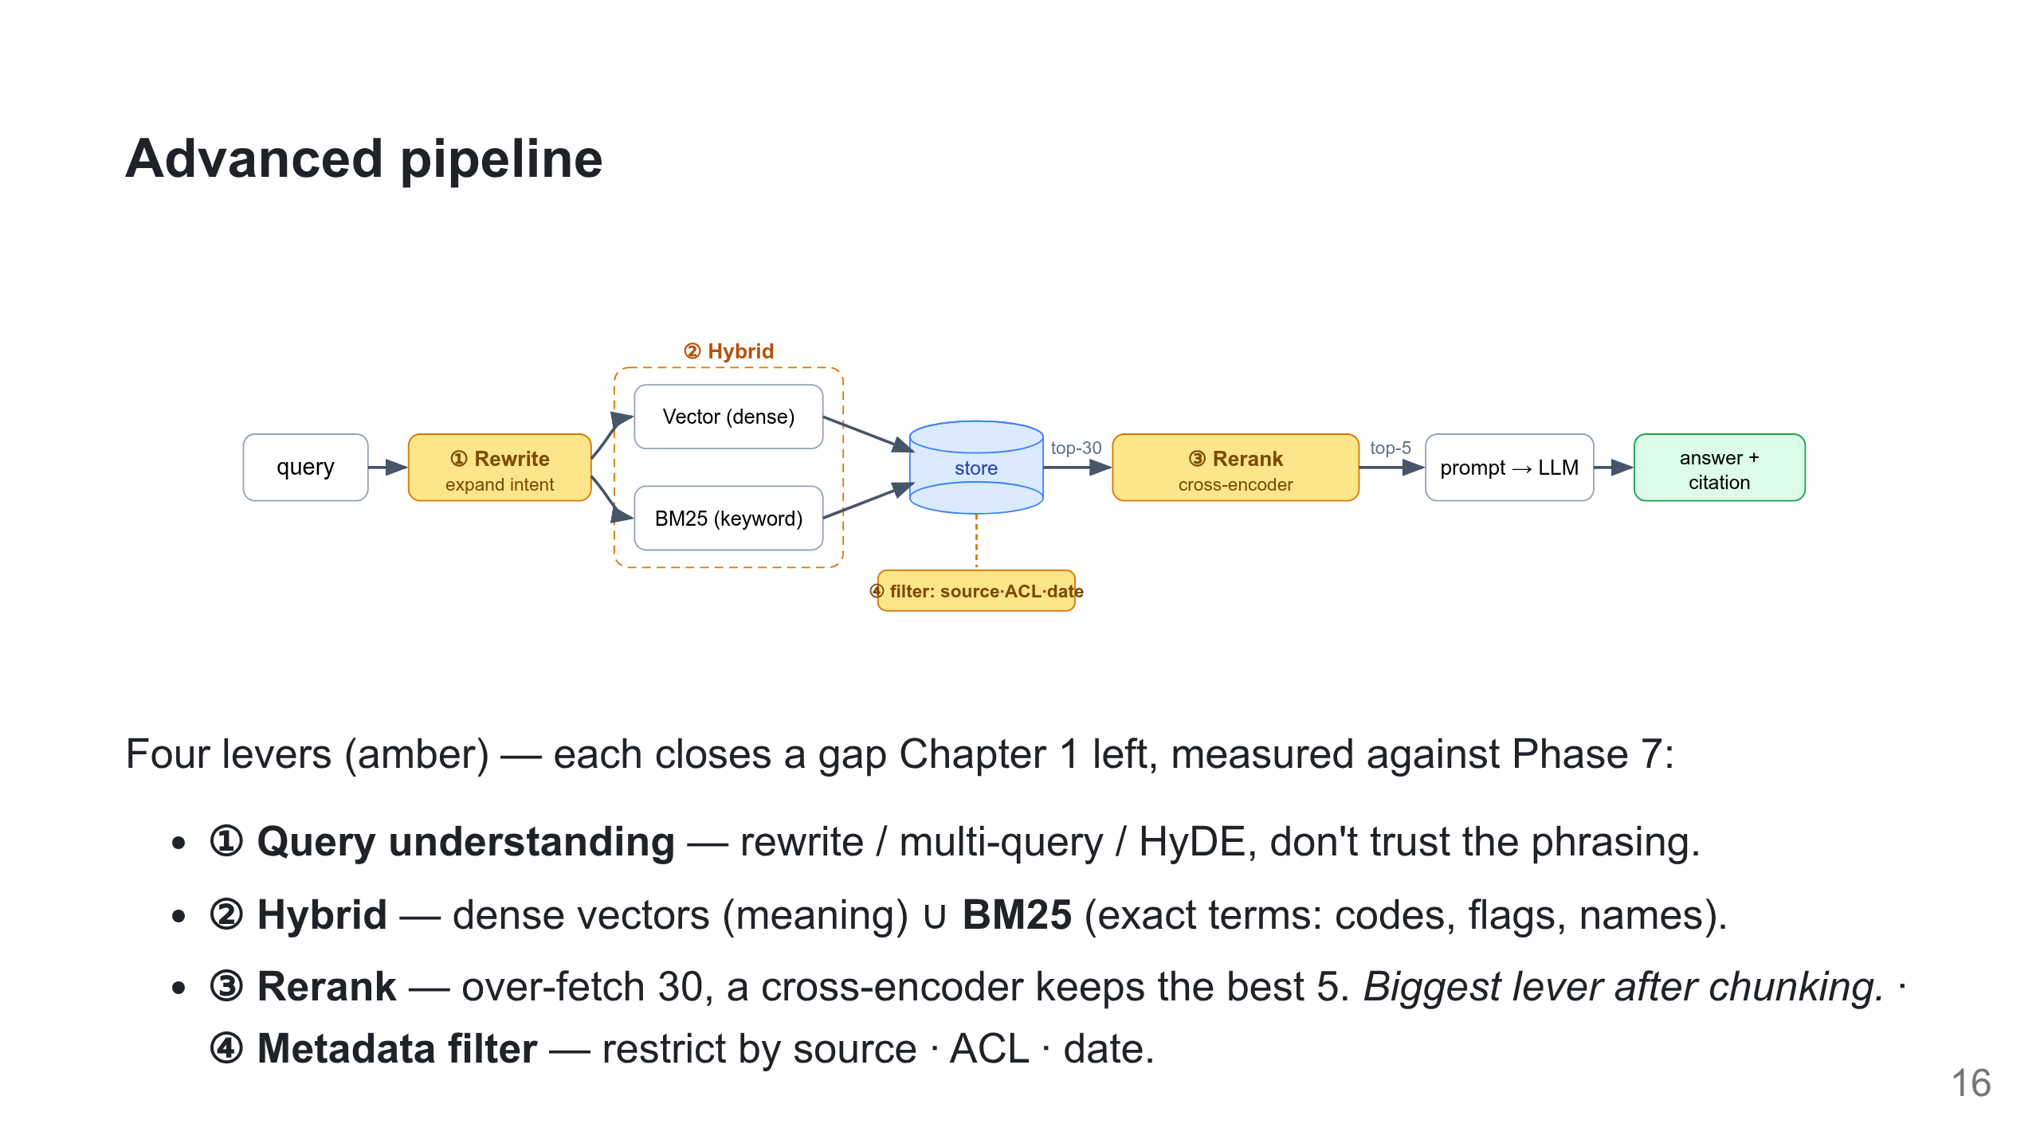
Notes:
Now that we can measure (Phase 7), here are the levers worth pulling. Lab 2 runs all four over the real k8s docs and reports the lift on hit@3 / MRR.

Slide 17
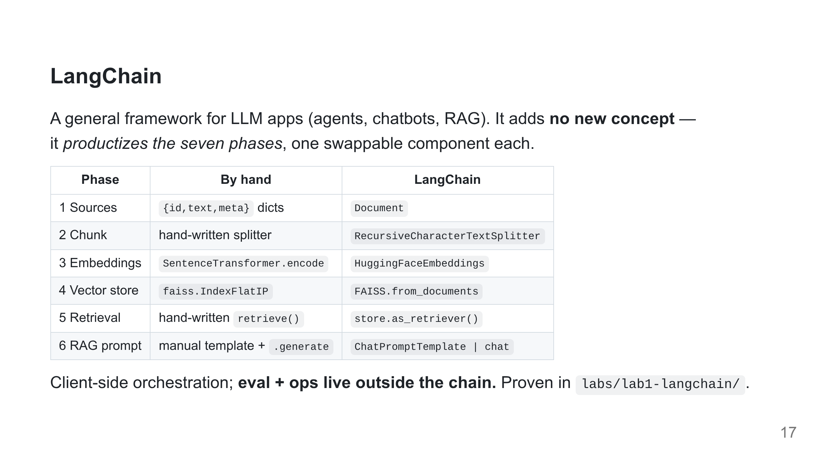
Notes:
Learn the phases by hand and LangChain is just learning which method wraps each. There's no "submit a job to their cloud" — running on managed infra is a deploy step, not the chain.

Slide 18
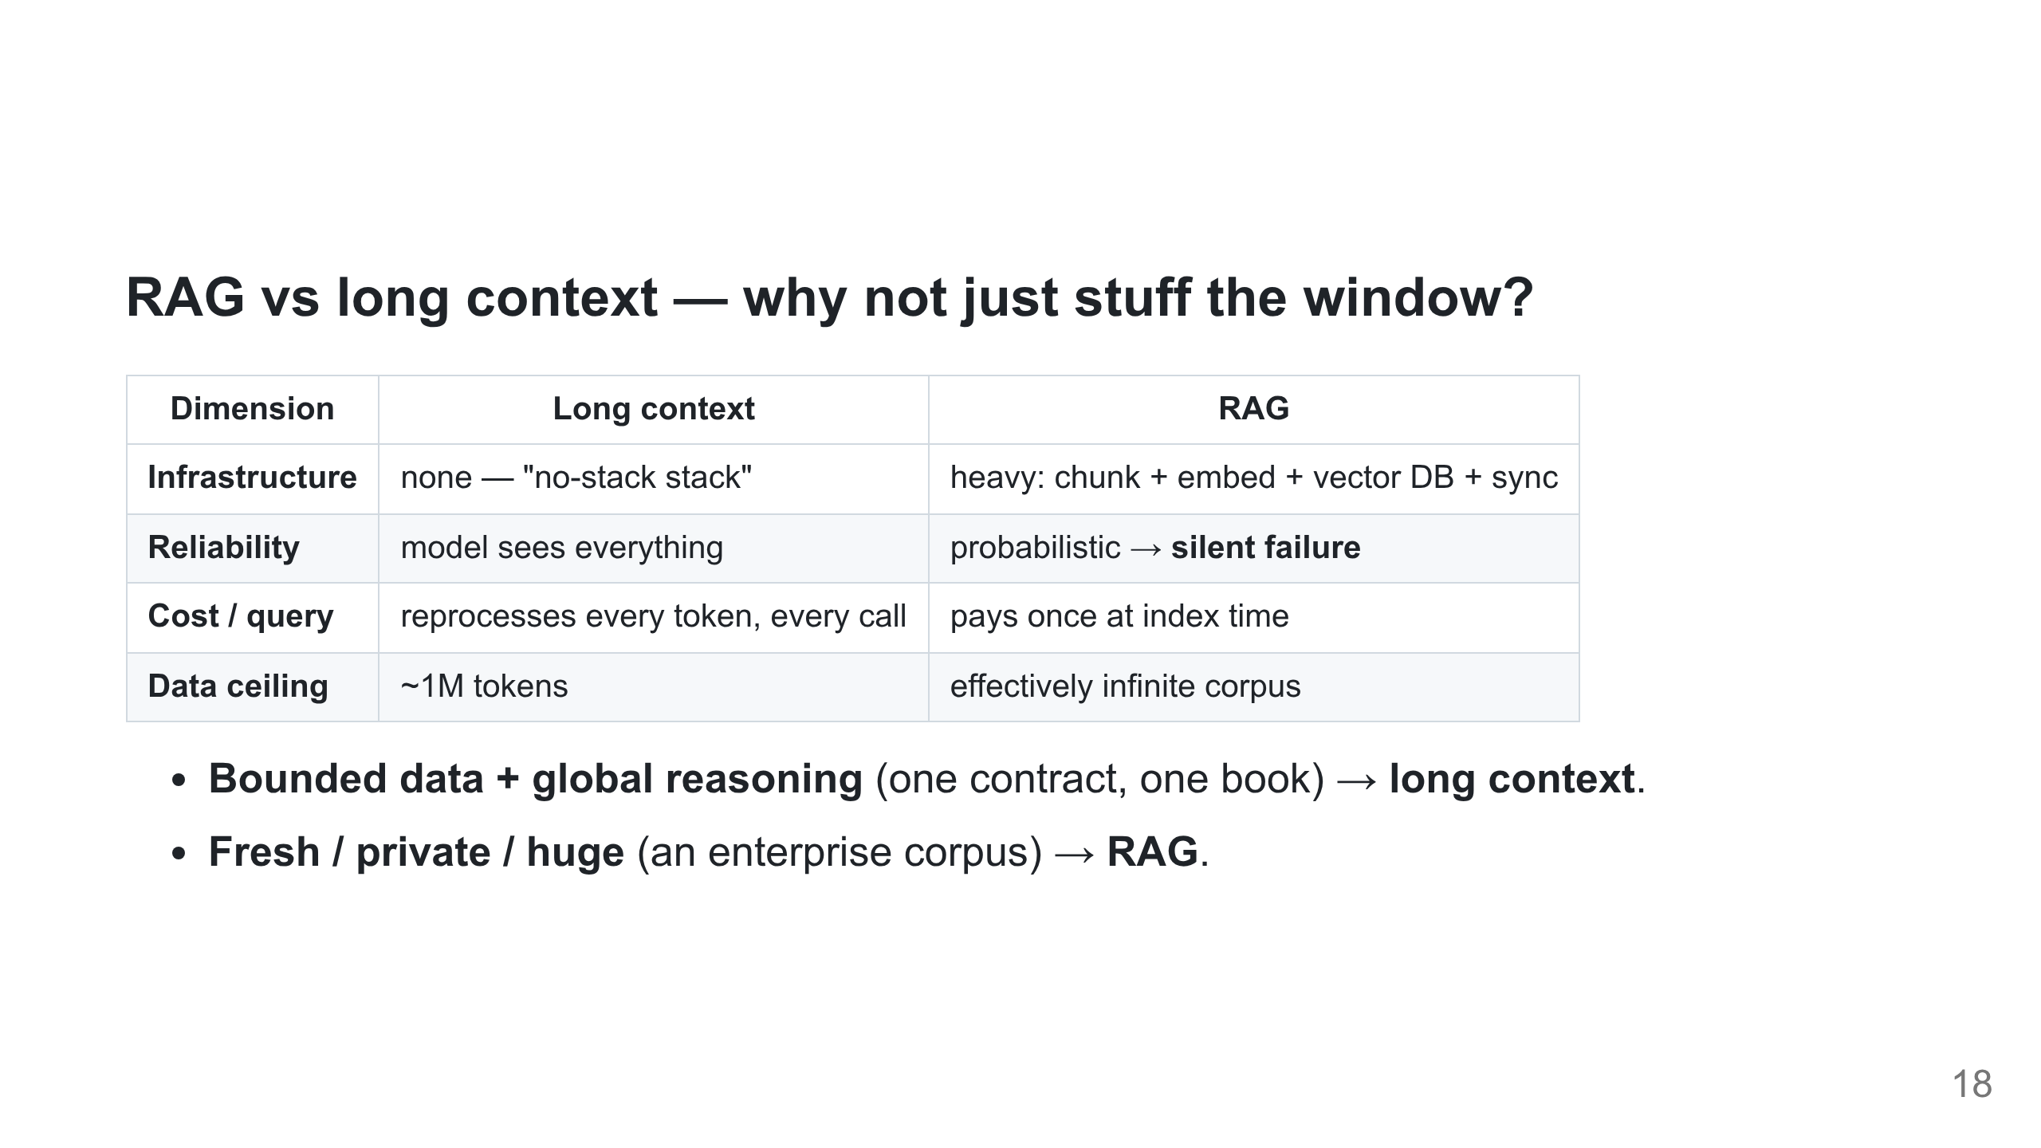
Notes:
With the pipeline built and productized, the honest question: why retrieve at all, rather than dump everything in the window? Not either/or — prompt caching offsets long context for *static* data, but a *dynamic* corpus pays the full token tax every request. Long context can reason over the *gap between* documents; RAG only sees isolated snippets.

Slide 19
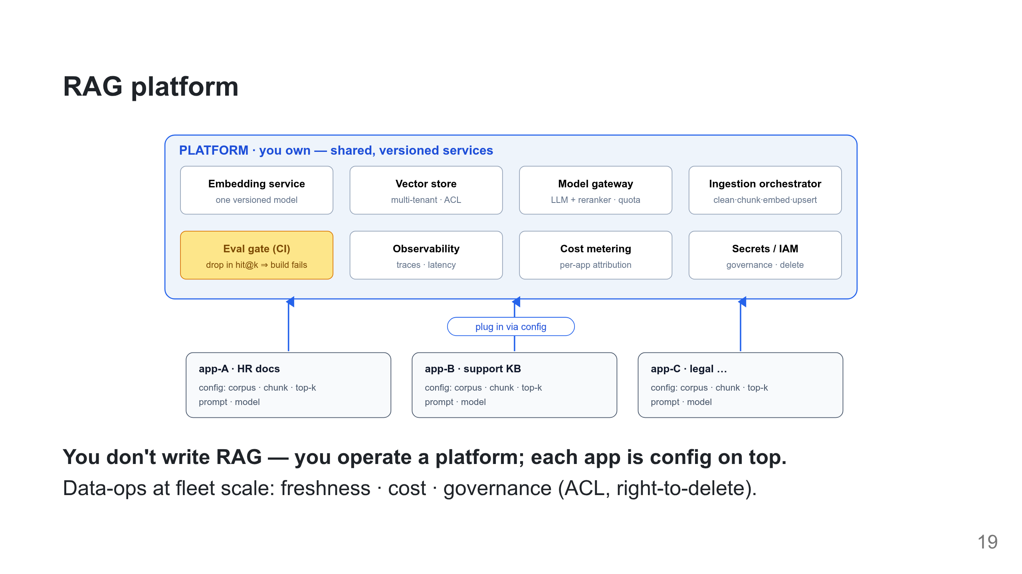
Notes:
The DevOps view. Per-app = a few lines of config; everything else is shared, versioned services + an eval gate in CI (a change that drops hit@k fails the build, like a red test).

Slide 20
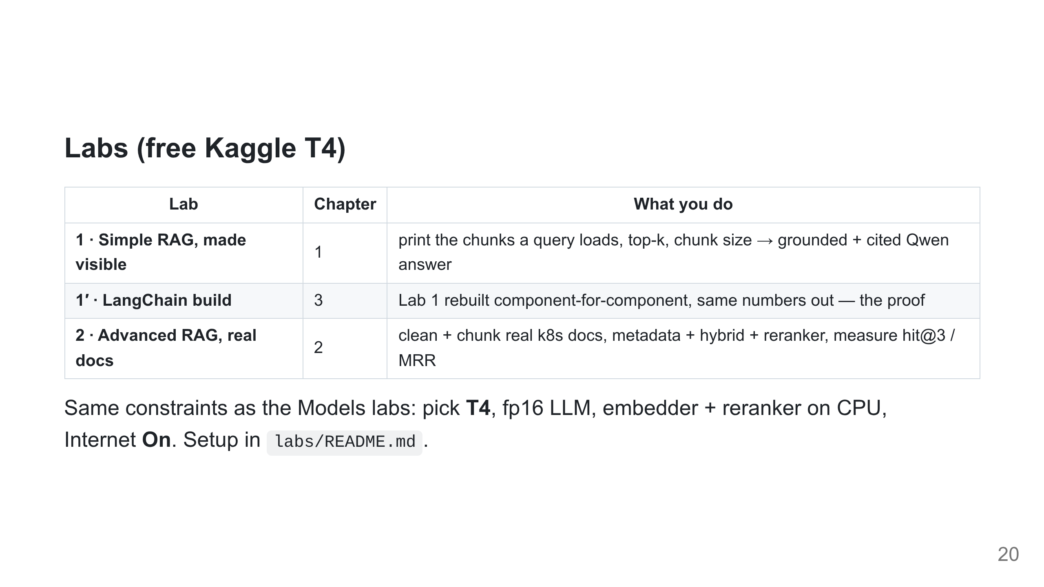
Notes:
Lab 1 = retrieval on a tidy Q&A set; Lab 2 = the real docs + honest eval. The LangChain build runs on the same data and prints the same scores — concept, not magic.

Slide 21
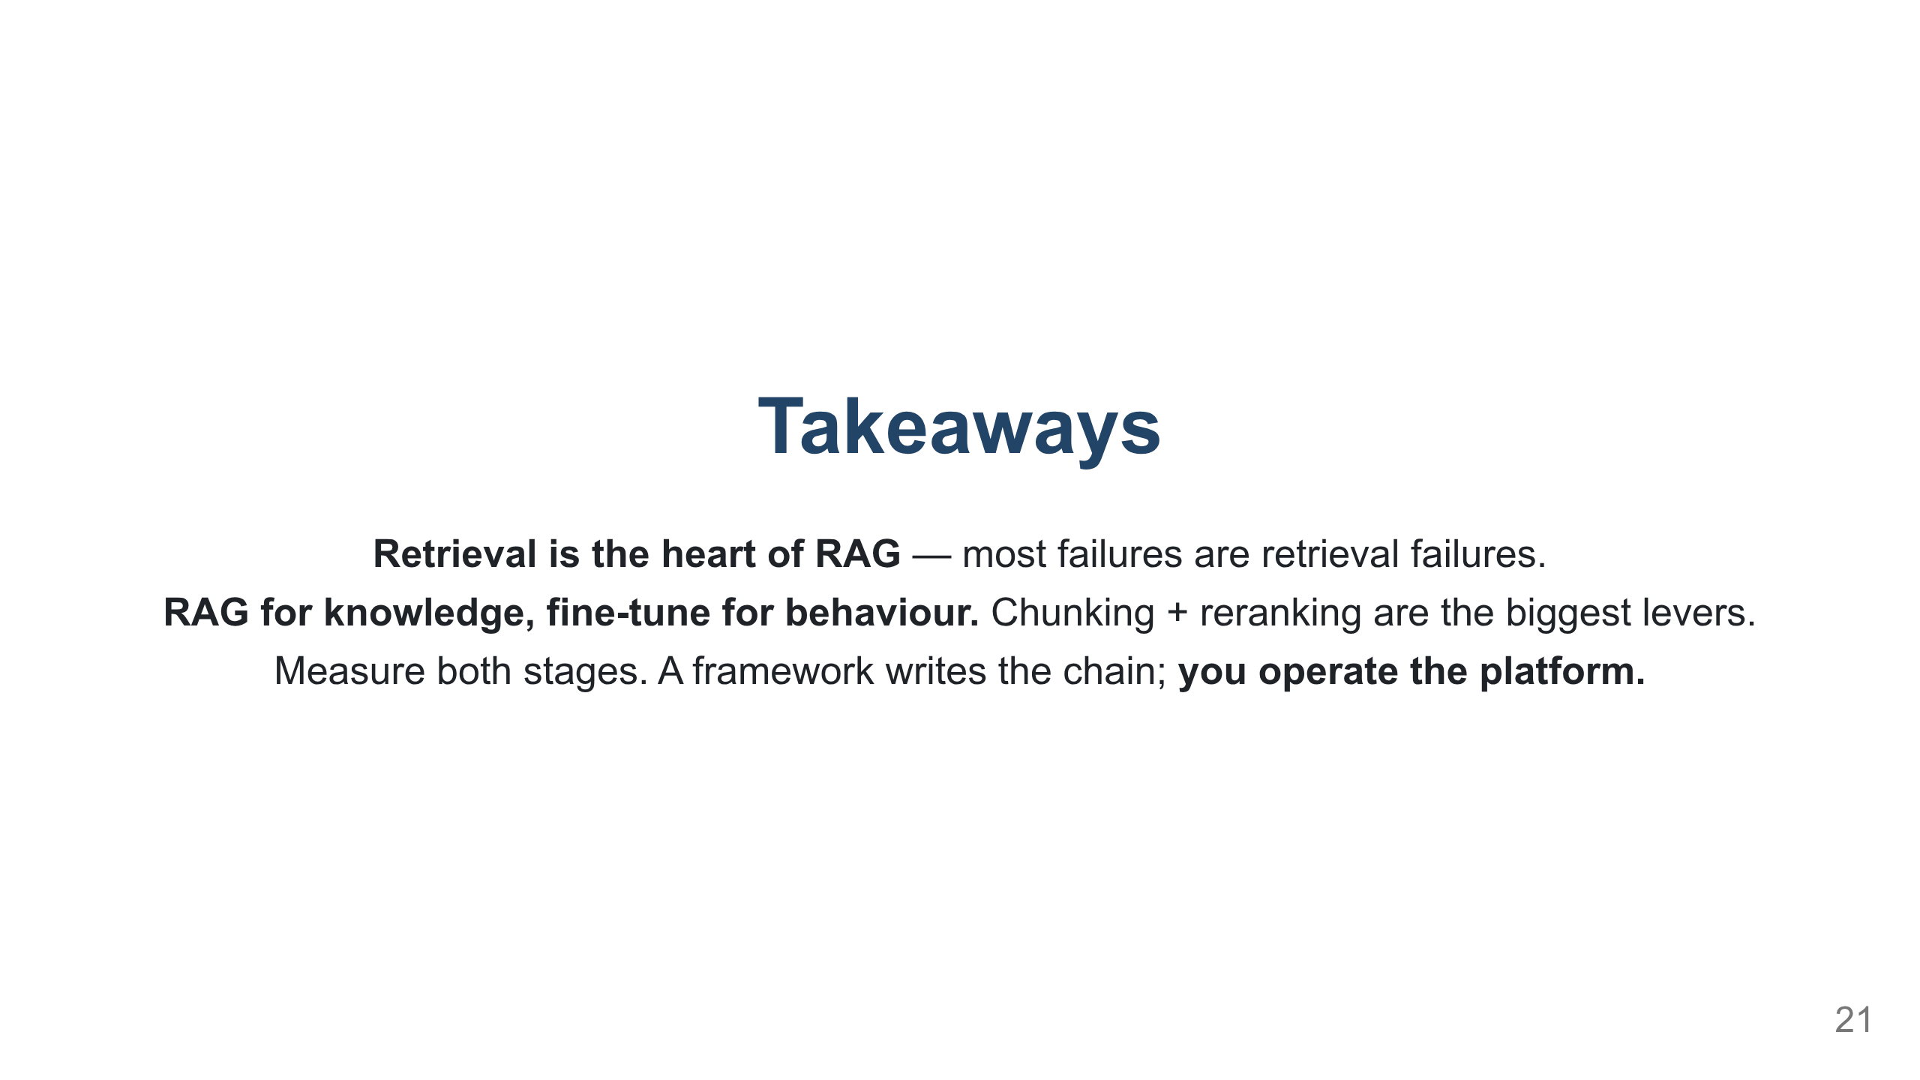
Notes:
Close the loop: this layer is where private data becomes the moat. The model layer gets the headlines; the data layer increasingly holds the leverage.

