Slide 1
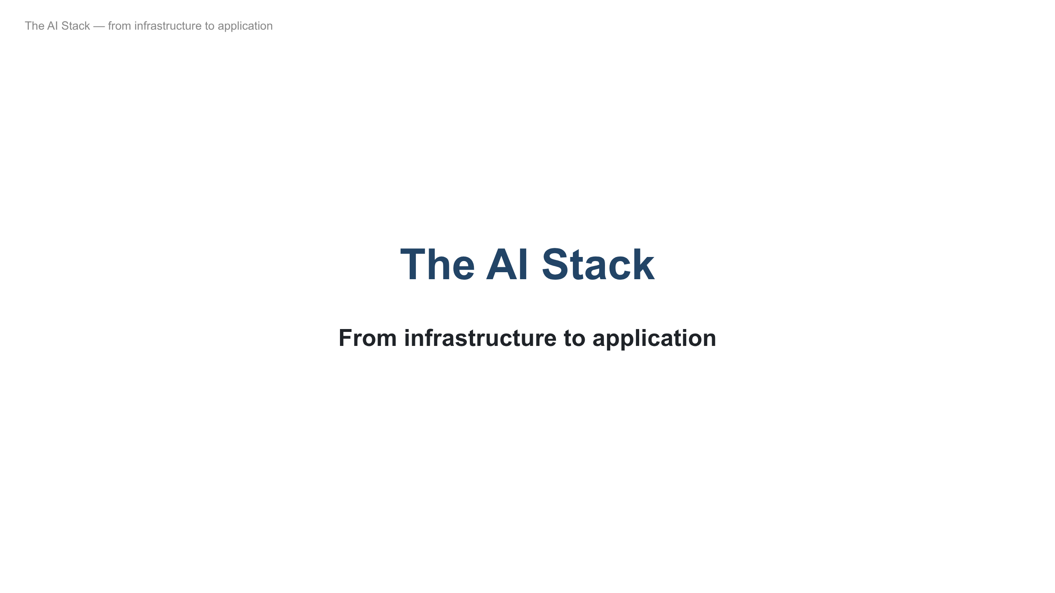
Notes:
Open: a model is just one piece. Today we map the whole stack, then look at the money and what it means for DevOps. Figures are as of mid-2026; the CEO-math numbers are illustrative — the method matters, not the exact dollars.

Slide 2
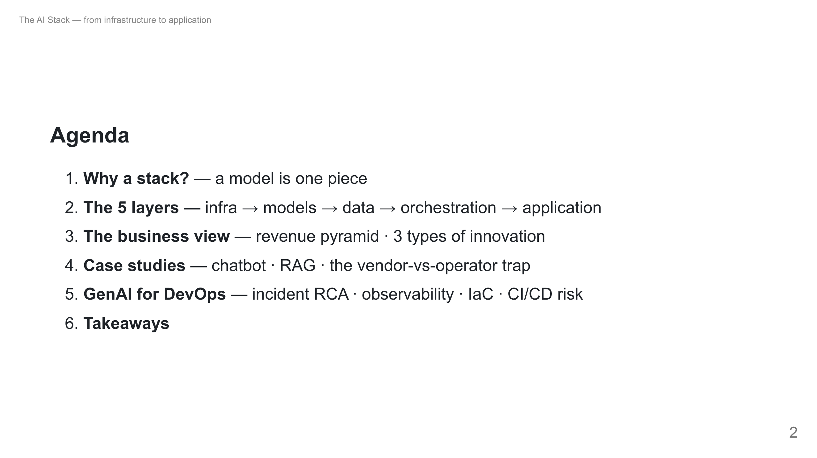
Notes:
~35-45 min. Stop me with questions during the layers; hold strategy questions for the business section where they'll be answered.

Slide 3
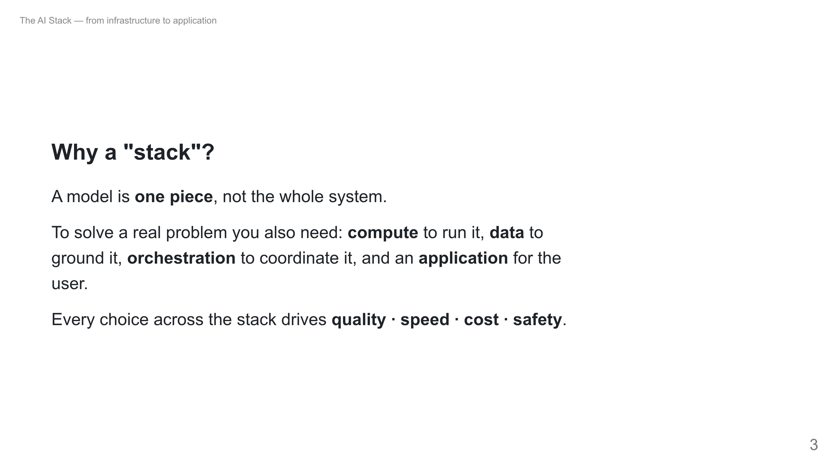
Notes:
Concrete example: a research assistant for new scientific papers. The model alone can't help — it has a knowledge cutoff, needs GPUs, needs the papers as data, needs steps to plan/summarize, and a UI. That's the whole stack.

Slide 4
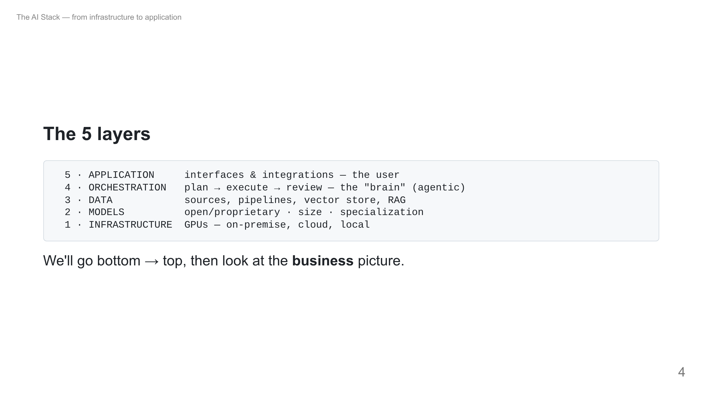
Notes:
You can buy a managed service that hides several layers, or build each yourself. Either way you should know all five exist — that's how you debug cost/quality.

Slide 5
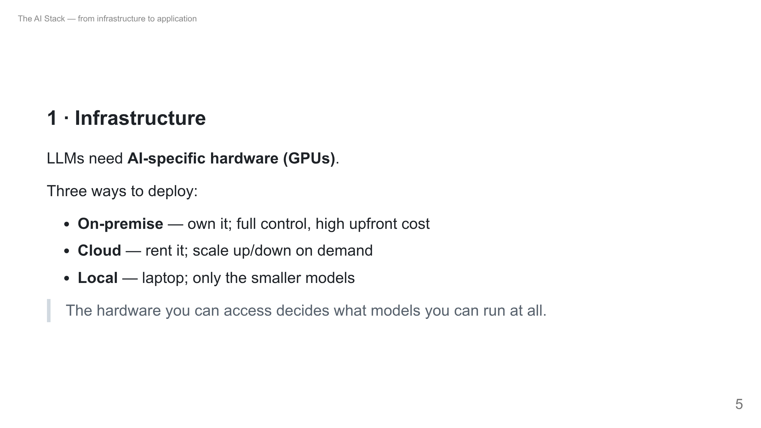
Notes:
DevOps tie-in: this is the layer your audience provisions — GPU nodes on k8s, autoscaling, cost control. The capex here is what feeds the revenue pyramid later.

Slide 6
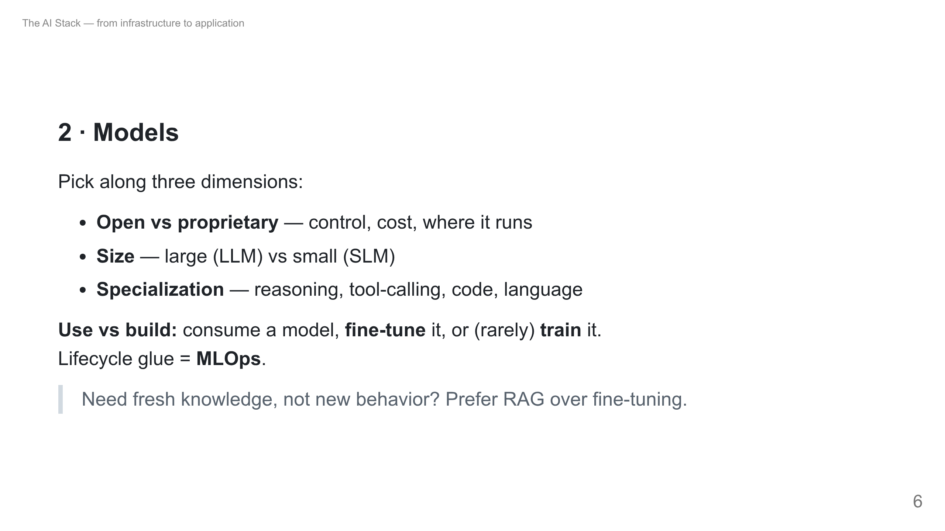
Notes:
Common student misconception: "we must train our own model." Almost never. Use an existing one; fine-tune for behavior/format; RAG for knowledge. MLOps is the DevOps of this layer.

Slide 7
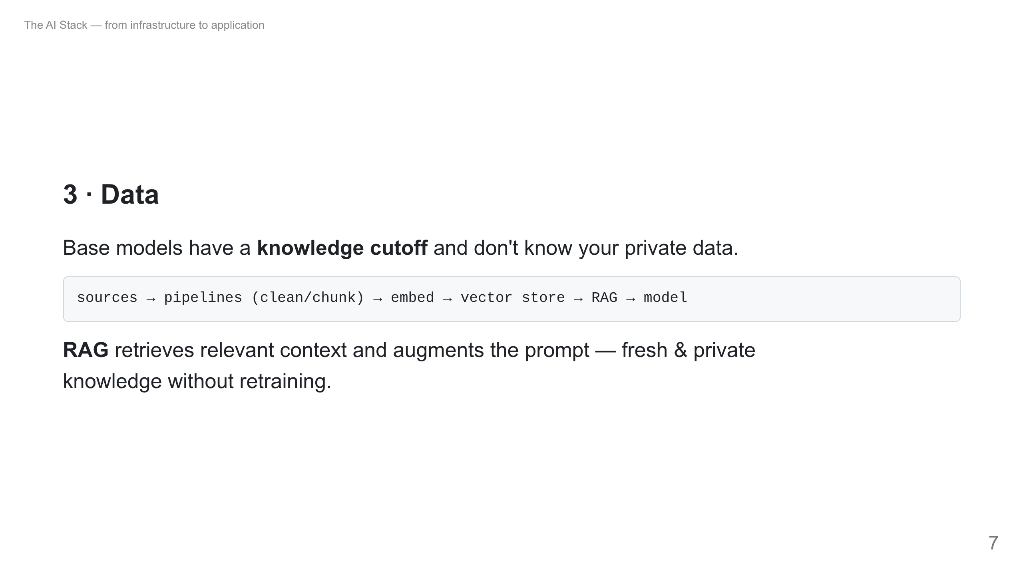
Notes:
RAG = open-book exam vs memorizing. The model looks things up at answer time. This is what powers the Morgan Stanley case later.

Slide 8
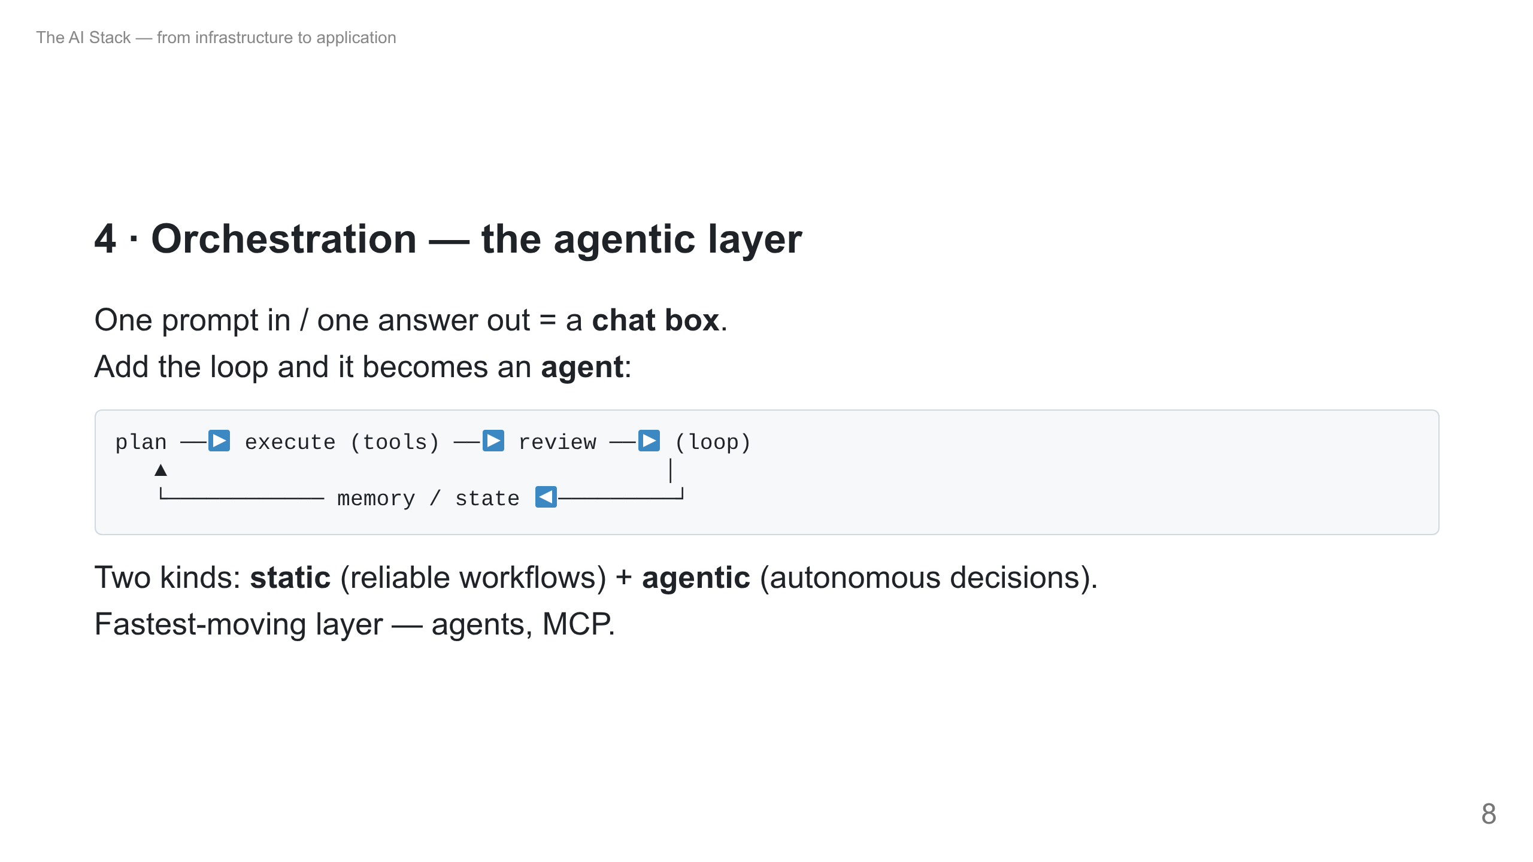
Notes:
Key line: orchestration is the mechanism, "agentic" is the behavior. This is the most hyped layer — remember that when we hit the revenue pyramid (it earns the least).

Slide 9
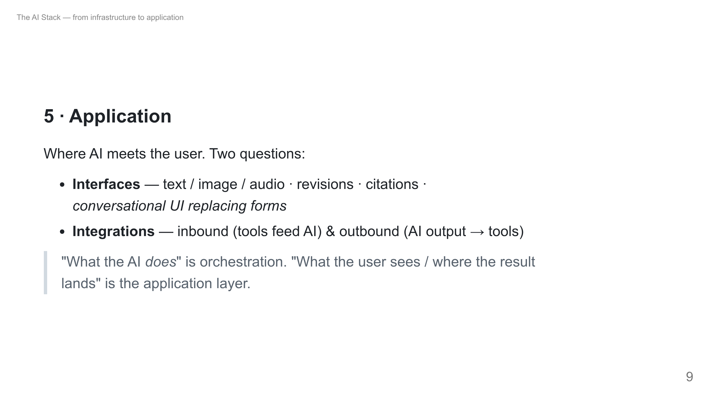
Notes:
Examples: summarize email, text→report, chat replacing a shopping/fintech form. The brain is layer 4; fitting it into screens + business flow is layer 5.

Slide 10
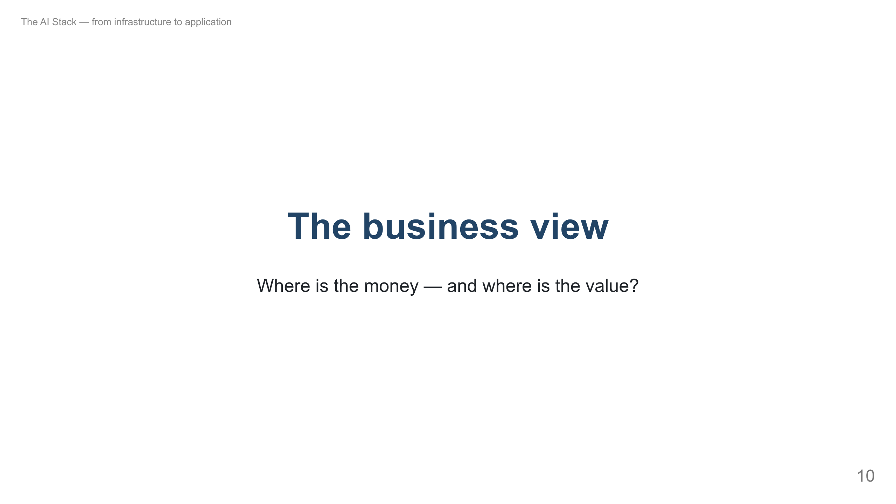
Notes:
Shift gears. Students entering AI need orientation: where dollars flow today vs where value is created. These are two different questions.

Slide 11
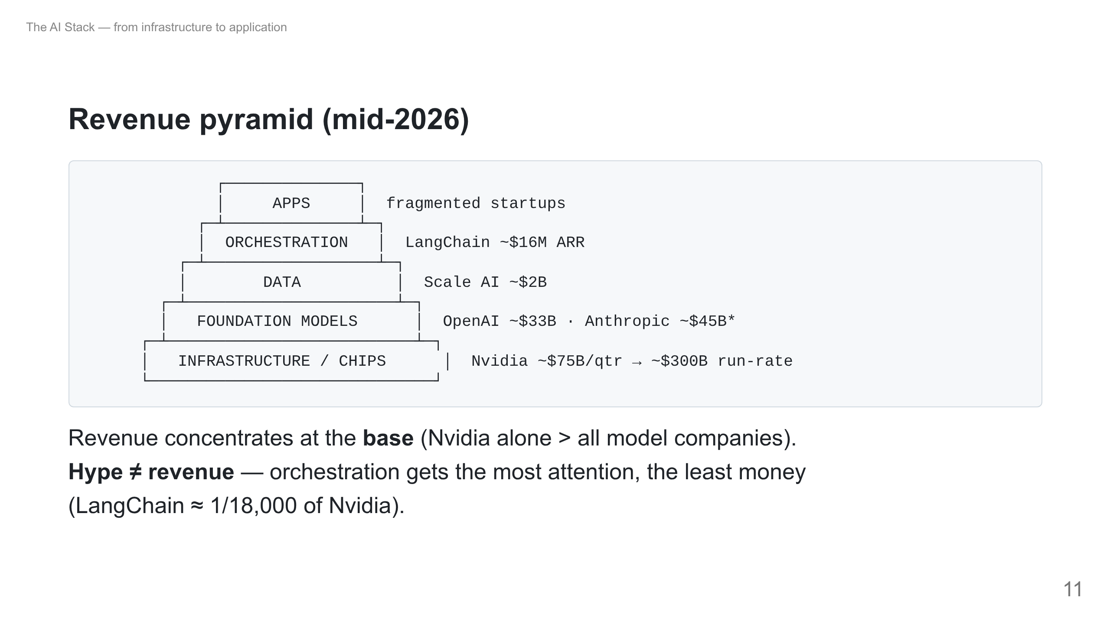
Notes:
Figures mid-2026. *Anthropic ~$45B is gross (books cloud-reseller spend); ~$22B net — always ask gross or net. Anthropic just passed OpenAI. Punchline: the most-talked-about layer earns the least.

Slide 12
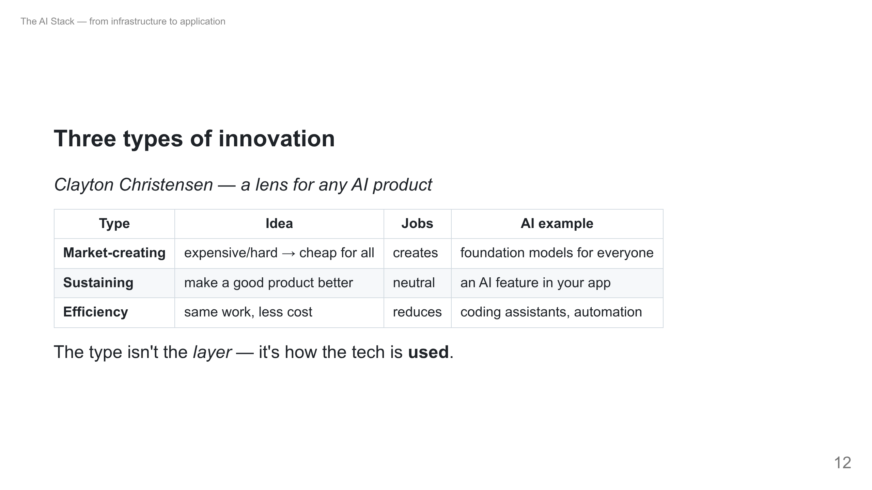
Notes:
Ask the room: "Copilot — which type?" Efficiency. "ChatGPT launch?" Market-creating. Same LLM, different use → different type. AI coding = efficiency = cost-cutting, which sets up the math.

Slide 13
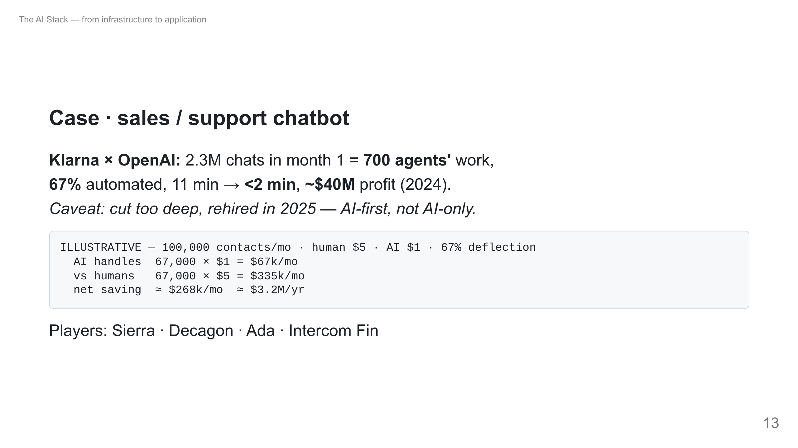
Notes:
Say out loud: these dollar numbers are illustrative, not Klarna's books. The $0.99/resolution is Intercom Fin's real public price. The Klarna rehire is the honest part — don't sell AI as headcount-zero.

Slide 14
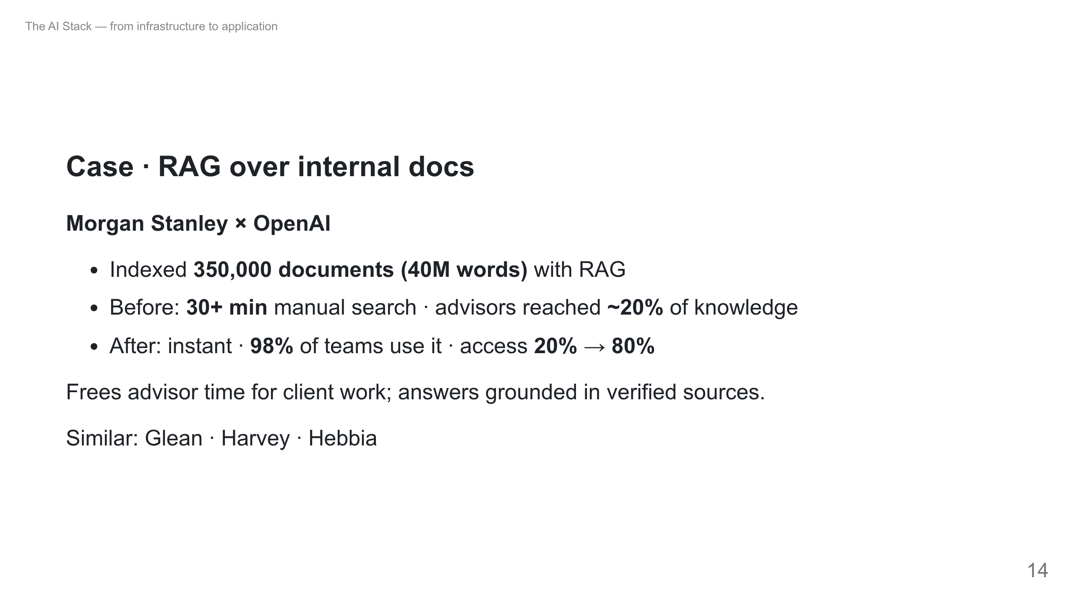
Notes:
This is layer 3 (data/RAG) in production. Value here is time saved + better answers, not a flashy chatbot. Real, measured adoption (98%).

Slide 15
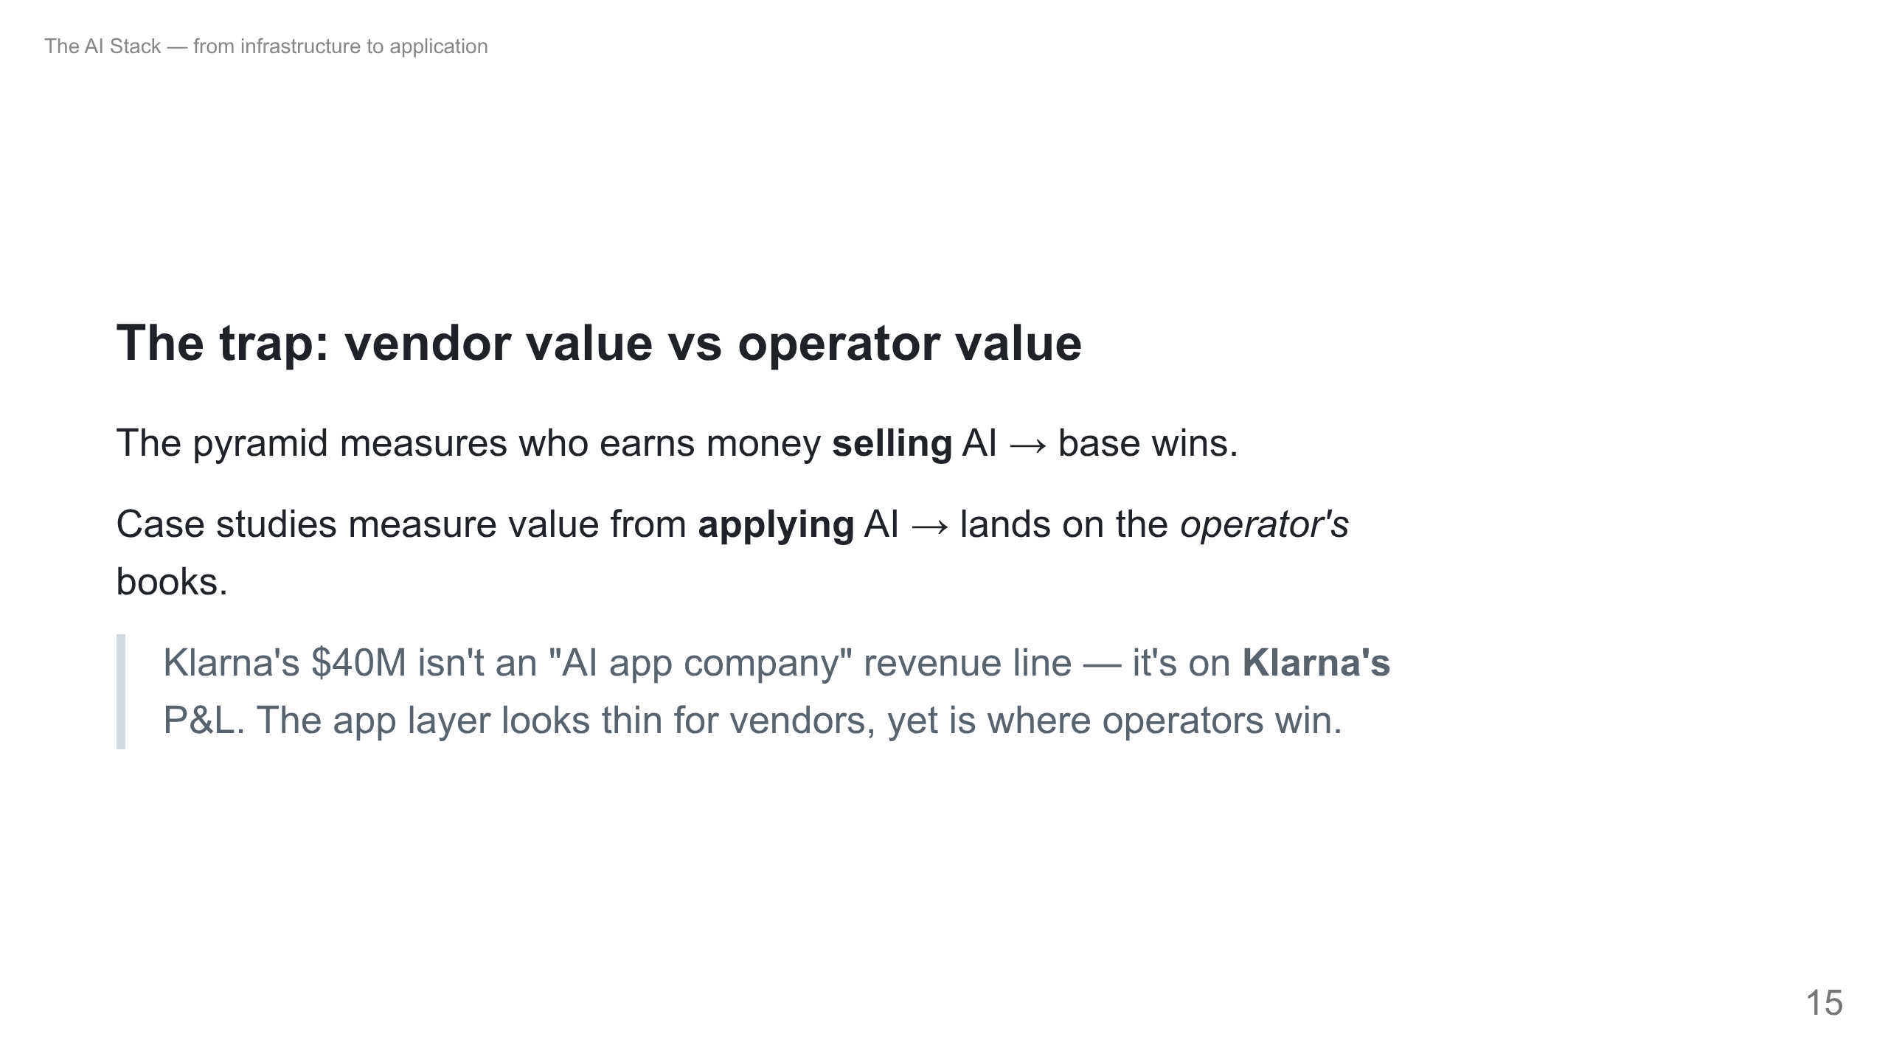
Notes:
This resolves the apparent contradiction: pyramid says app layer is thin, but case studies show huge value. Two different questions. Most students in this room will be operators, not AI vendors — the value is on their side.

Slide 16
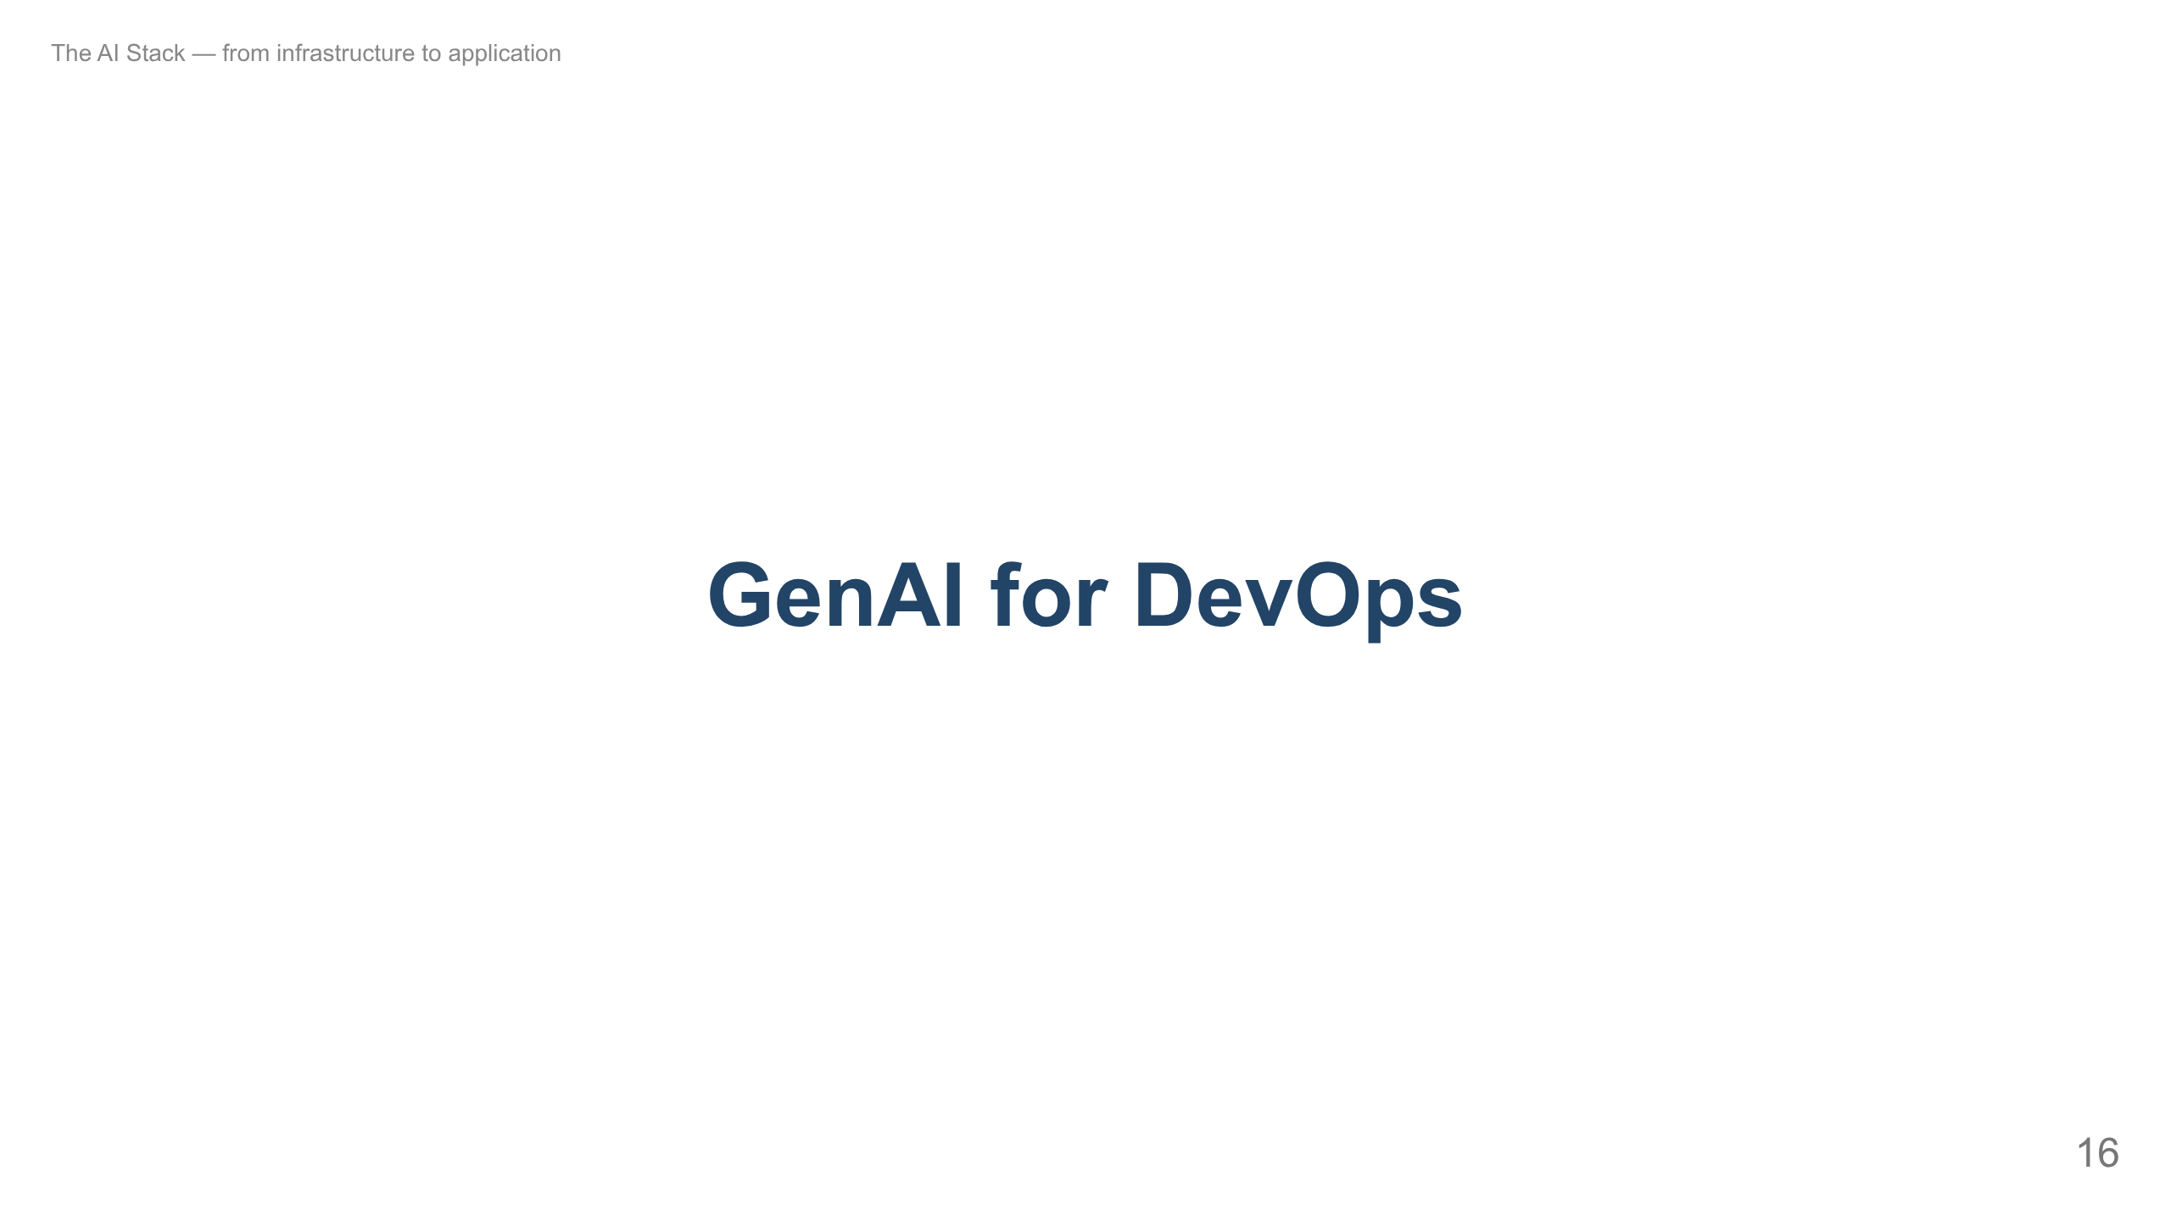
Notes:
The platform/DevOps job: incident triage, RCA, runbooks, observability, IaC, and CI/CD risk. It's the capstone — it uses every layer we just covered. (Coding assistants are dev productivity — a different thing.)

Slide 17
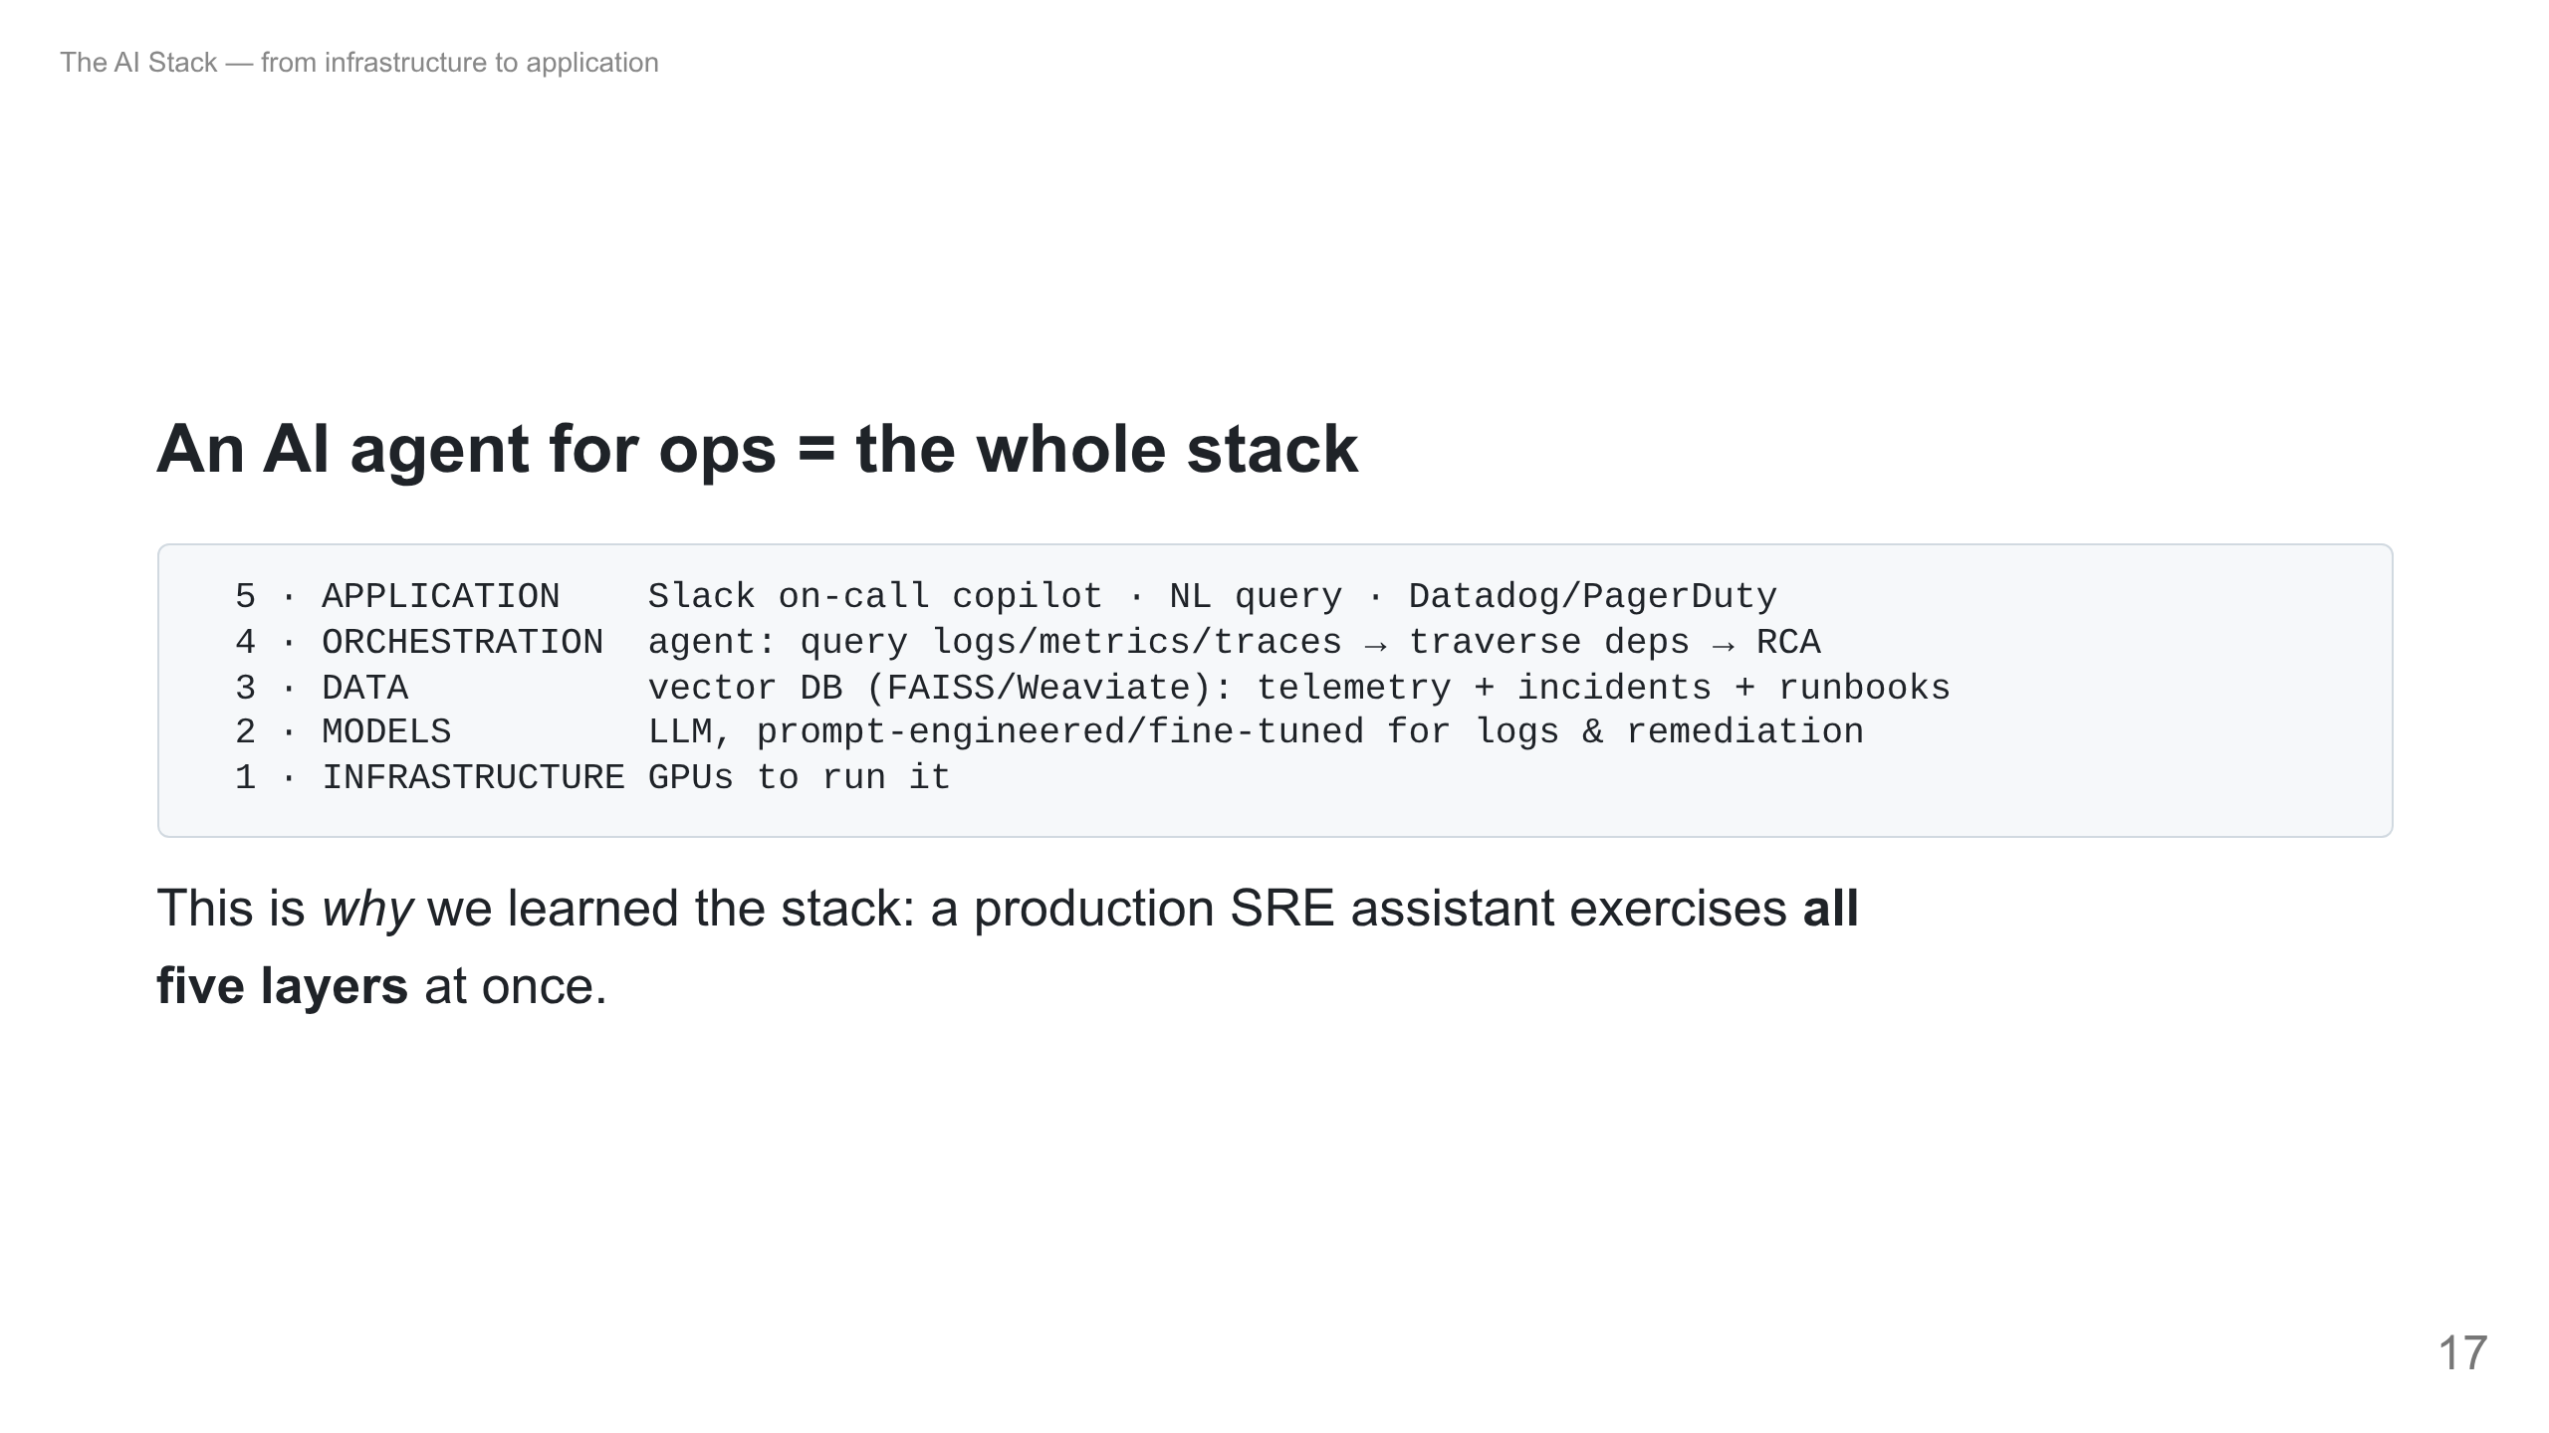
Notes:
Payoff slide. Tie the whole lecture together. Walk bottom-up: the agent runs on GPUs, uses an LLM, grounds on a vector DB of your telemetry + past incidents + runbooks (RAG), orchestrates multi-step investigation, and meets the on-call engineer in Slack. Map each to the JD they'll be hiring against.

Slide 18
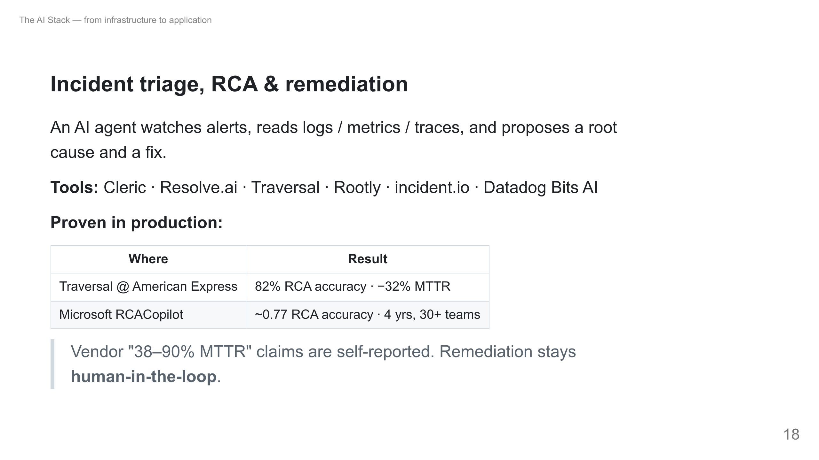
Notes:
Area 1+2 of the JD. Stress: the credible numbers come with a named customer or a published study; treat vendor ranges skeptically. Self-healing exists but humans approve production actions.

Slide 19
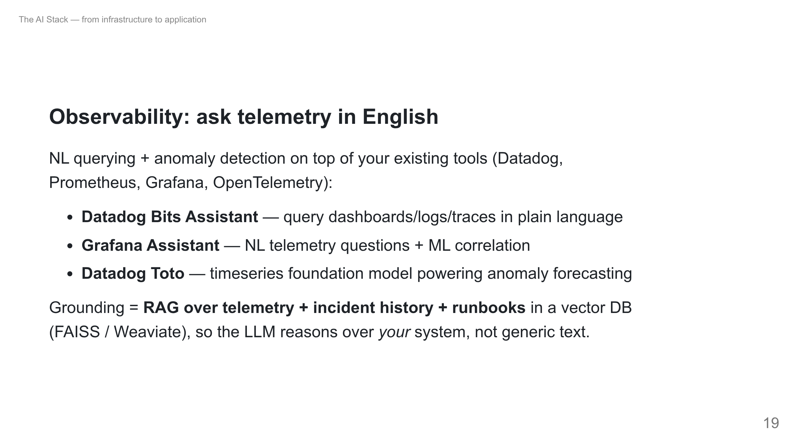
Notes:
Areas 2+3 of the JD. The big shift: SLI/SLO and platform health become queryable in natural language. The vector DB of incident history is the "institutional memory" — this is layer 3 doing real work in SRE.

Slide 20
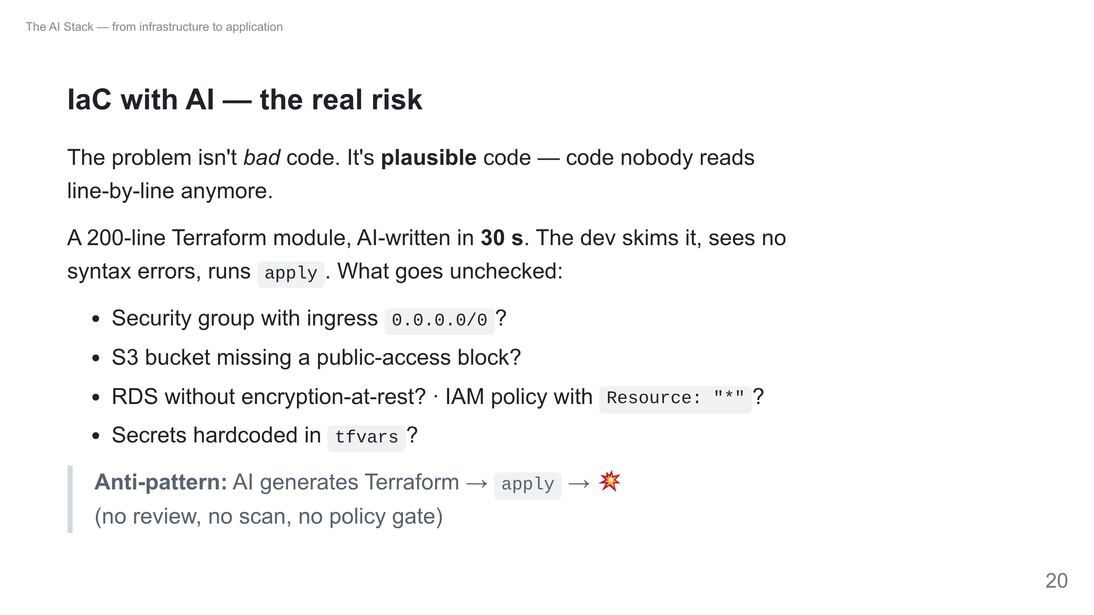
Notes:
Core message of this part. Generate ~30s, review <60s — speed becomes a security hole when review turns into "tick the box." Second risk: mental-model loss. If a team stops writing HCL by hand, ask someone to explain an AI module line-by-line with no docs — if >20% can't, that's a dangerous gap.

Slide 21
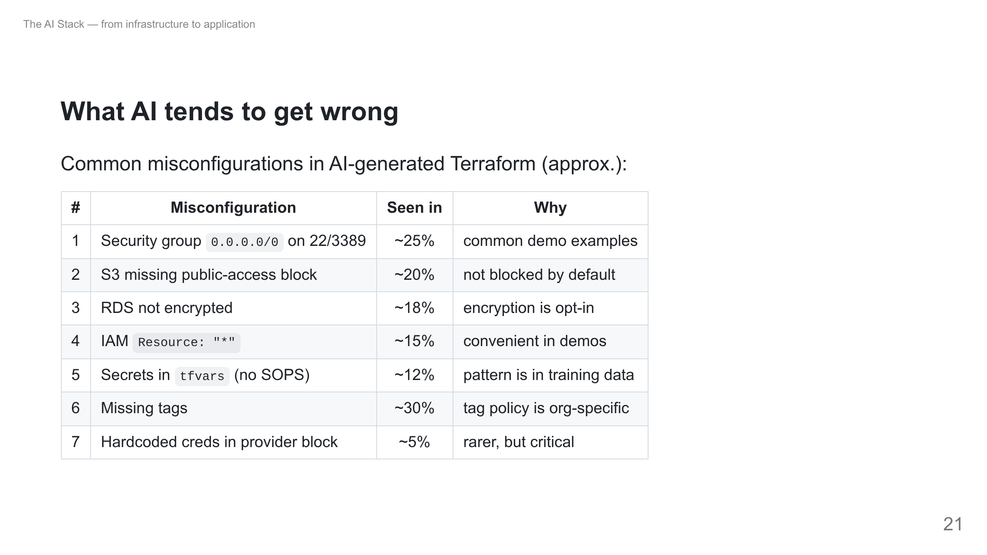
Notes:
Frequencies are illustrative teaching figures, not a benchmark. The pattern is real: the model reproduces demo-grade defaults, which are exactly wrong for prod.

Slide 22
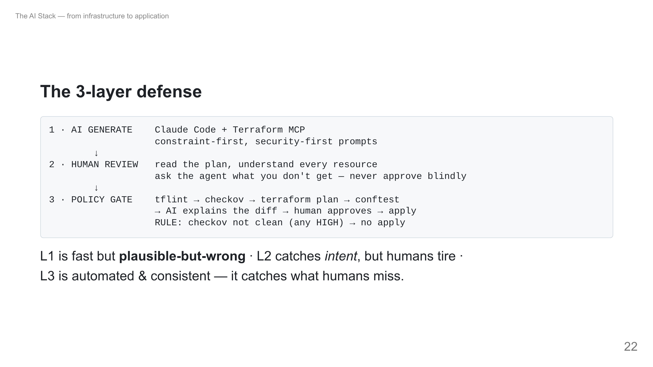
Notes:
This is the payoff pattern. No single layer is enough: speed (L1) needs judgment (L2) needs an automated gate (L3). The hard rule lives in L3 — a failing checkov HIGH blocks apply, no exceptions. That's how you keep AI's speed without its risk.

Slide 23
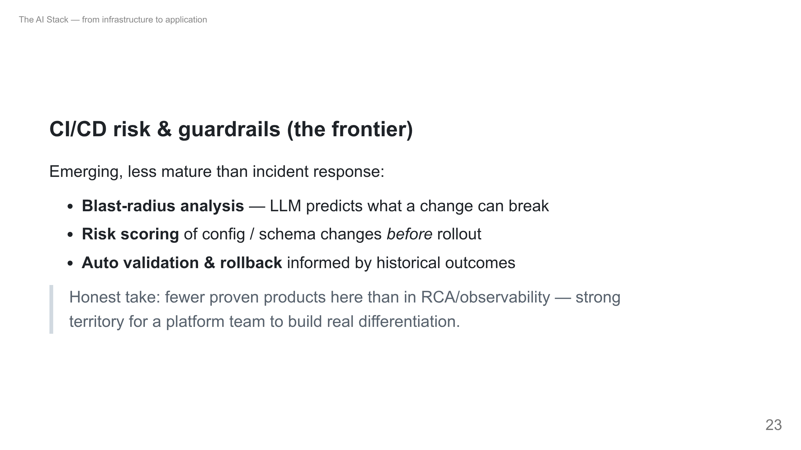
Notes:
Area 4 of the JD. Be candid: this is greenfield. Great project territory for students — risk scoring and auto-rollback from historical outcomes.

Slide 24
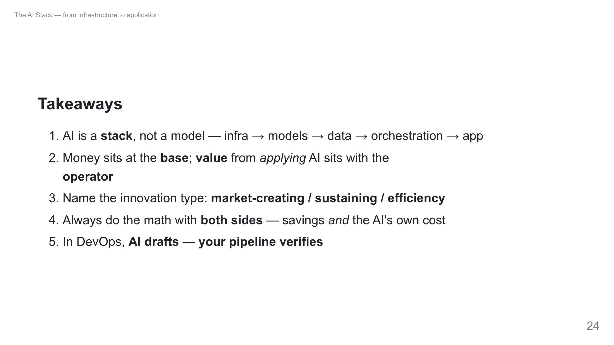
Notes:
Recap in 30 seconds, then open Q&A. If short on time, slides 5 (layers), the pyramid, and the AI-agent-as-whole-stack are the must-keeps.

Slide 25
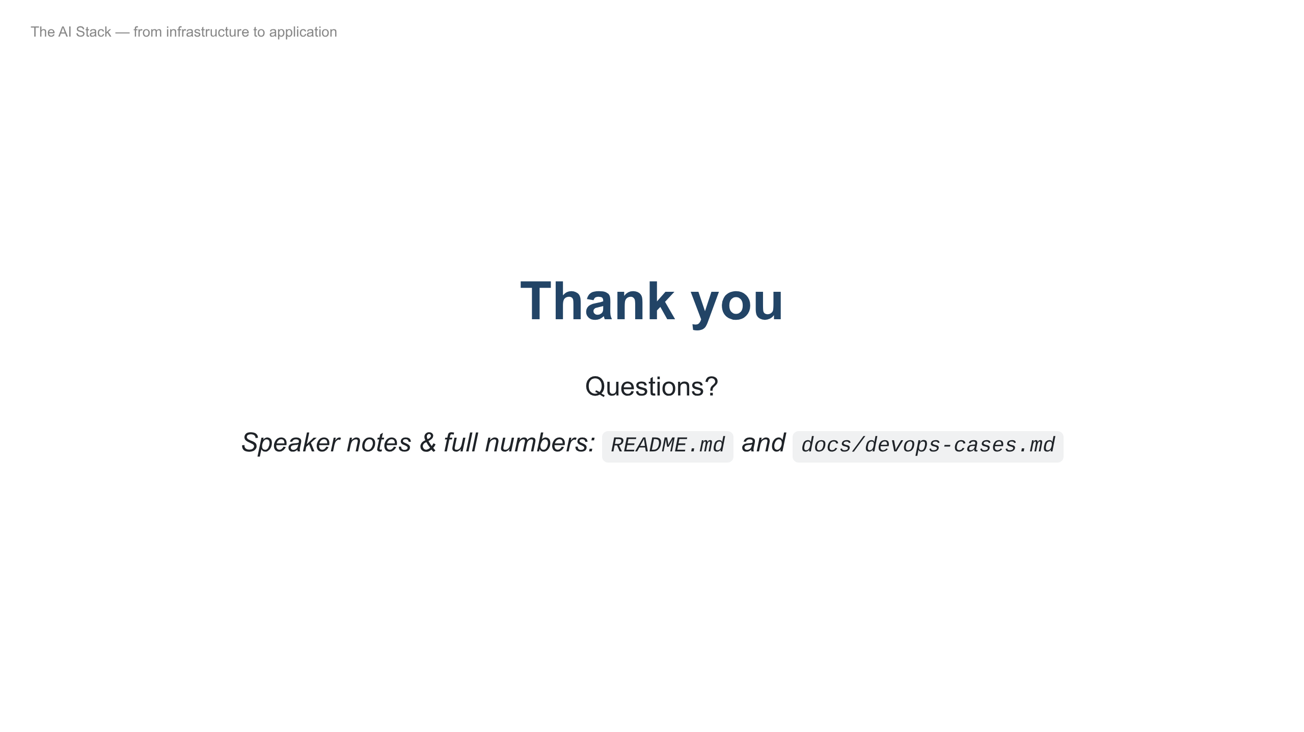
Notes:
Likely questions: "should we train our own model?" (no — use/fine-tune/RAG); "will AI replace devs?" (Klarna rehired; remediation stays human-in-the-loop); "gross vs net revenue?" (Anthropic example).

