Slide 1

Line Graph Visual Clutter
Last update: 2015 / 08 / 03

Slide 2
Outline
● Introduction
● Visual Design
● Related Work
● Expected Results
● Remaining Tasks

Slide 3
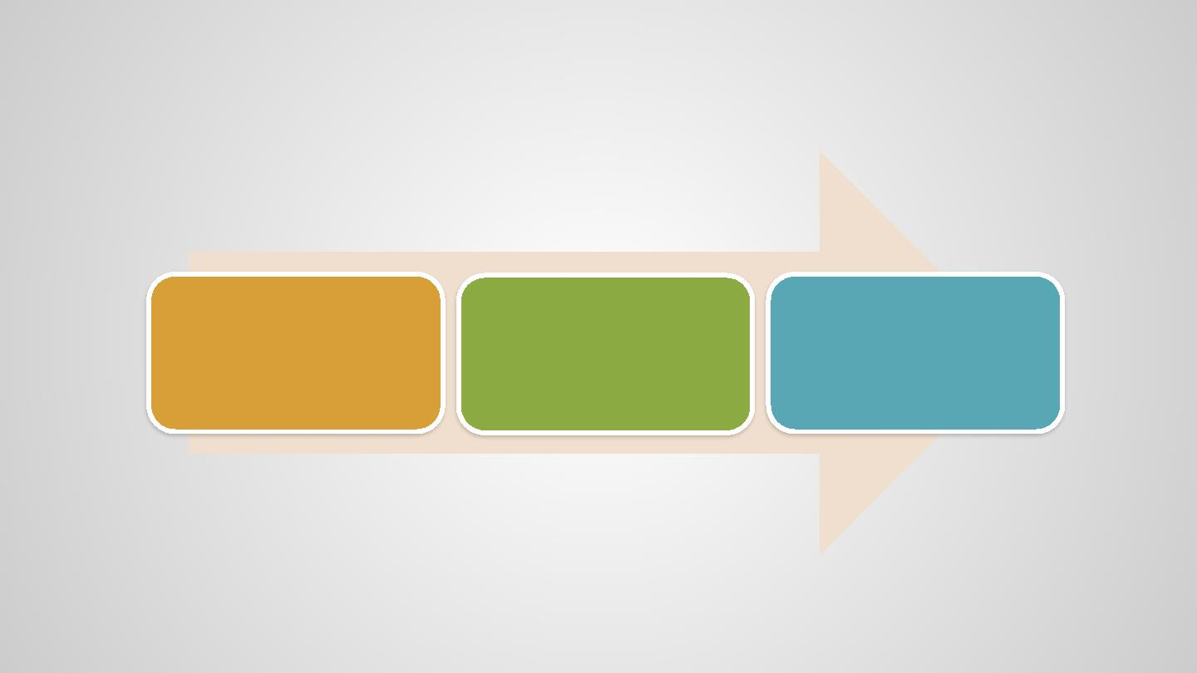
Introduction – Logic Flow
Explain the main
problems and
objectives
Summarize and
briefly justify our
Approach
Contribution
.

Slide 4
Introduction
Explain the main objective:
• Line graph importance: the most fundamental visualization for time series data and scientific measurement
• Time series data (the fluctuation of stocks, climatic changes, etc. )
• High dimensional data (temperature, humidity, microarray data, etc.)
• What we use line graph for:
• Observe trends / directions
• Observe absolute values
• Relationship of some dependent variables and an in-reorderable independent variable
• Comparison between lines
• Line graphs' insufficiency when dealing with multiple line:
• (“The main disadvantage is that it only works well with very few time series at the same time if multiple line graphs are
compared with each other”) (Ziegler, 2010)
• Importance of solving line graph's visual clutter:
• The number of line graphs in a given study (i.e. the subject of analysis) can be quite large, with hundreds to thousands
of samples.(Kincaid, 2006)
->> Summarize the objective.
To alleviate the over-plotting problem in line graphs when having multiple lines simultaneously drawn, and make their
expressiveness more comparable to those with small number of lines.

Slide 5
Introduction
Summaries of Approach
Explain considerations for hierarchical partial clustering:
• Clustering’s necessity
•
Techniques other than clustering could overlook line graph’s features
• e.g., Small multiples – not good at comparison, query – lack of overview for existing trends
• Partial clustering’s importance
• Two lines are unlikely to follow the exact same x-y relationship throughout the whole x domain.
• Stock price raise together in a short period only due to certain events
• Users with various watching behaviors response similarly to a specific short video frame only
• Partial trends in only a period might be important.
• (Hochheiser, 2004) Find genes with similar expression patterns during key period in programmed cell death
• Hierarchical clustering’s importance
• Some less distinguishable feature could be visually unrecognizable due to clutter reduction, and will require more
detailed observation.
->> Hierarchical partial clustering is needed to emphasize all these kinds of relations.
Visual exploration based on clustering results:
• For observing and comparing the otherwise cluttered lines based on the partial similarities discovered.
->> Visual design is closely connected with clustering and works effectively for clutter reduction

Slide 6
Contributions
The major contributions of this paper are
(1) Study the line graph visual clutter problem
(2) Develop a hierarchical visual clustering algorithm specifically for line graphs
(3) A new design that deals with line graph visual clutter issue, and allows hierarchical
exploration.

Slide 7
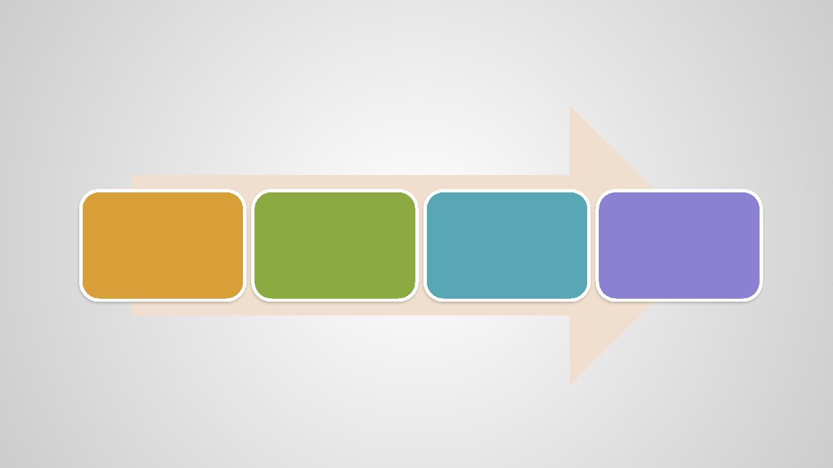
Requirement Analysis – Logic Flow
Necessity for allowing
Summarize the
objective
Necessity for
understanding x-y
relationship
common
functionalities of line
graphs based on the
x-y relationship
Required encodings

Slide 8
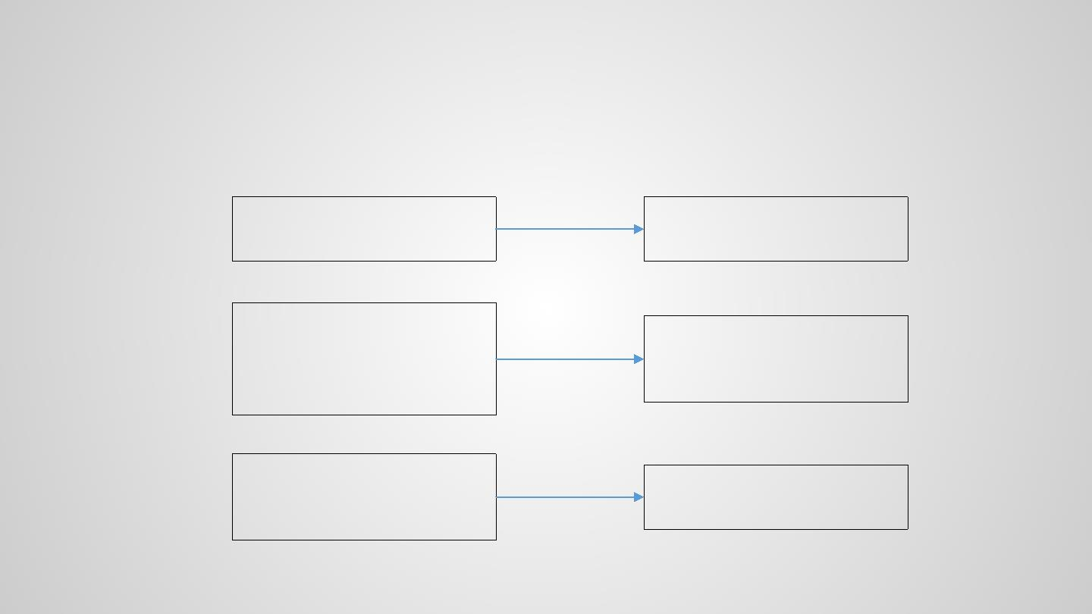
Requirement Analysis – Overview
Motivation re-visited
Line graphs is designed to show x-y
relationship (Shah, 2011)
Understand the x-y relationship
revealed in the line graphs
Users make more sophisticated
observations with x-y relationship
(e.g., similarities and differences in
weather, microarray, etc.)
Understand what users would be
interested to observe based on the
x-y relationship they discover.
Line graphs clearly display features
when they only contain a small
number of lines
Make the line graphs less cluttered
and intuitive in massive line cases

Slide 9
Requirement Analysis – x-y relationship
x-y relationship regards of: This is the primal observation from the line graphs and the basis for users' more
complicated usage of line graphs. Should eventually lead to the design consideration of Algorithm.
• Absolute positions: differences on y (Kelley, 1997)
• Relative changes: gradients or directions of a line in a certain interval (Kelley, 1997)
• Un-reorderable independent value / independent value correspondence: Both the afore mentioned two are with respect of
x (independent variable)'s specific range. (Kincaid, 2006)
->> need to
• Find the leading x-y relationships that:
• preserve the aforementioned three features
• Emphasis on partial similarities (as mentioned in INTRODUCTION)
• Observe How do the obtained x-y relationship distribute

Slide 10
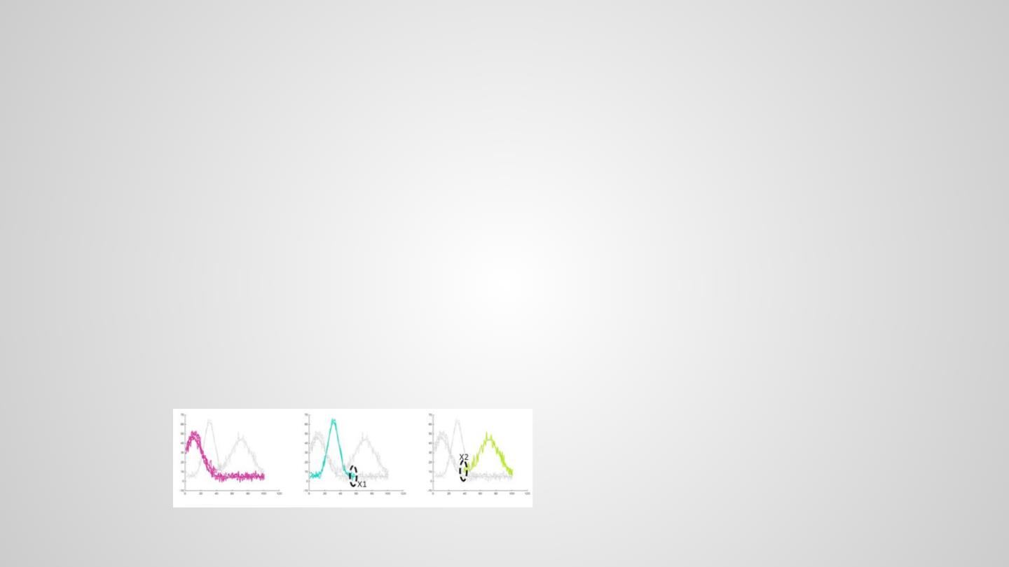
Requirement Analysis – Line graph functionalities
Users use line graph to: To demonstrate that with the x-y relationship being obtained, how we would enable other functionalities
of line graphs in our design. Should be closely connected to visual designs.
Assess trends:
• [FIND DIRECTION] For a specific range of x, how would y vary with it? What are the direction they go?
• [Direction alignment] If the trend is commonly shared / frequently occurred?
Compare between multiple lines:
“We expect that some line graphs will show similar features and others will not. This similarity or dissimilarity is what we seek in the analysis.
(Kincaid, 2006). ”
• Similarities:
• [Representativeness of a cluster] Do several lines grow similarly / stay close in a certain period?
• [Centrality of a cluster] How similar are them in the period?
• [Target exploration]Track the similarity of lines : If several lines have practical correlation in real world, are they clustered together?
• Dissimilarities:
• [Outliers] Are there any lines that develop significantly differently from others? , either on the whole time period or during a interval?
• [Turning points] Are there any lines that certainly start to develop uniquely? When do these differences start?
A clustering result generated by the
current algorithm. X1 and x2 might be
the turning points that worth more
investigation.
• [Hierarchy] Explore details of some specific lines in a certain period based on their interests

Slide 11

Your Methods
Basic workflow:
Visual
overview
Clustering
Interaction

Slide 12
Algorithm – partial clustering
Requirements:
• LoD: Allow hierarchical exploration
• Emphasis on global features:
• Eliminate local details: Piecewise linear representation (Douglas Peucker)
• Priority for consecutive segments from one line
• Meaningful comparison - independent value correspondence
• Settings in distance functions: Do not accept similarity of two lines that are horizontally
too far away.
• Emphasis on x-y relationship features
• Absolute value: no normalization
• Relative change: consider Perpendicular, parallel, angle distance

Slide 13
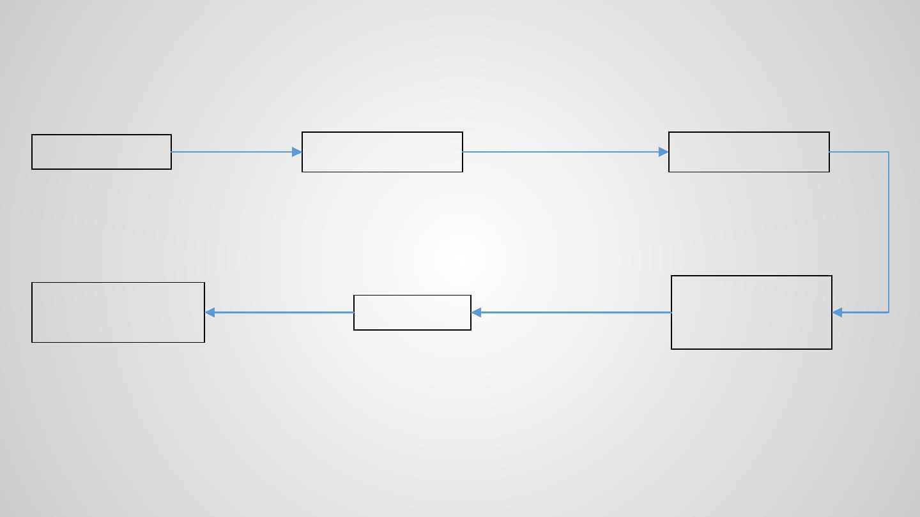
Algorithm – partial clustering
Piecewise linear
representation
Compute distance between line
segments based on some criteria
n input lines
m segments for line l
i i
M × M distance matrix
Eliminate local noise
M line s egments in total
Basis for clustering. Consider :
Perpendicular, parallel, angle distance
Priority for consecutive segments from one
line: avoid over-emphasis on local detail
Segments withno overlap x interval AND is
not consecutive segment of a line: distance
should be NaN – independent variable are
meaningful in line graphs, and similarity of
two lines being horizontally too far away is
useless.
•
•
Build the Optics
reachability plot
•
Consecutively orde re d
line segments are
potentially members of
the same cluster
Centroid of each cluster
(i.e., main x-y relationships
in every level)
The order of M
Centroid extraction
Clustering result
Extract hierarchical clustering results
segments in the
reachability plot, and its
distance
Used for representing a set of
lines in visualization
Group similar lines together
w.r.t different level of details

Slide 14
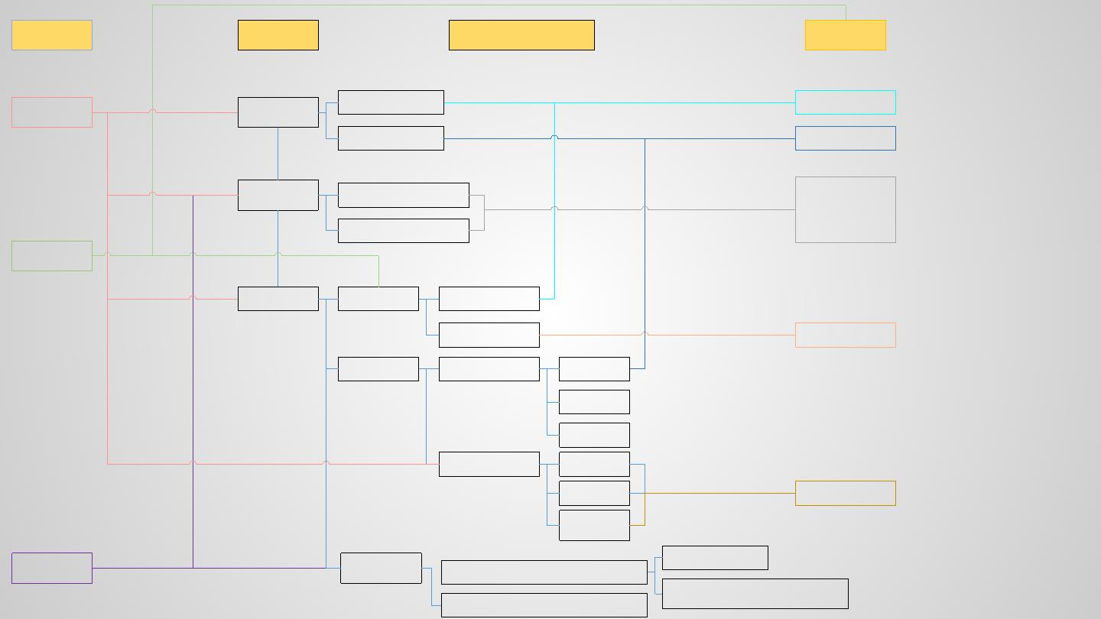
Interactions
Brush
Line graph
features
Information to be encoded
(clustering as a premise)
OVERVIEW
X-Y relationship
Cluster centroid
Outlier
Cluster centroid
Thin grey lines
Trend /
direction
Exact leading direction
Direction glyphs
(only display on-
demand / with a
threshold)
Line alignment in a region
Select
Comparison
Similarity
Dissimilar
Representativeness
Centrality
Outlier
Heatmap
Placement
Uniqueness
Visual
Design
Encoding
Belonging
Where
Turning point
NO.of line
Glyph
Between
cluster
Query
Targeted
observation
Display it as a whole
Exploration of one line s x-y relationship
Target other lines with a specific
pattern / universality of the pattern
Query several lines for comparison

Slide 15
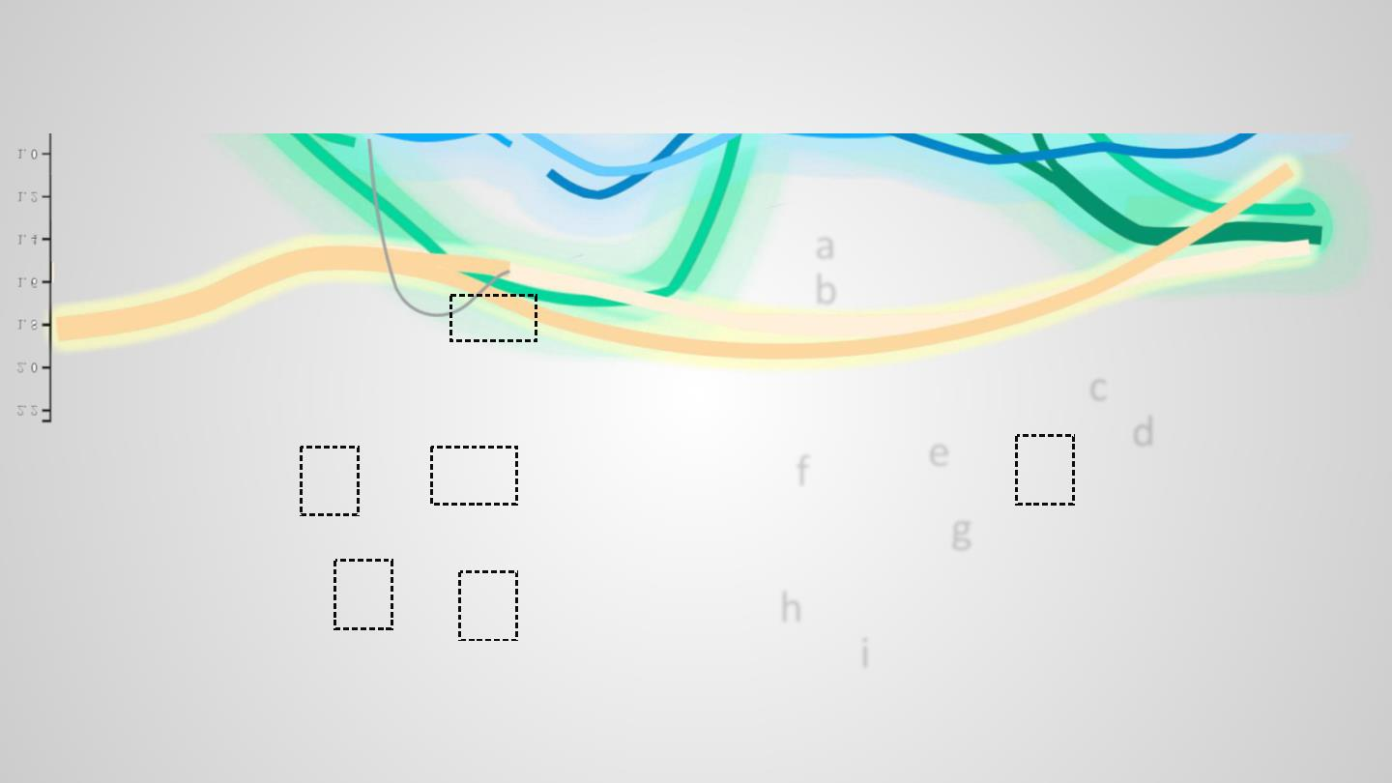
Visual design – Overview
a
b
c
d
e
f
g
h
i

Slide 16
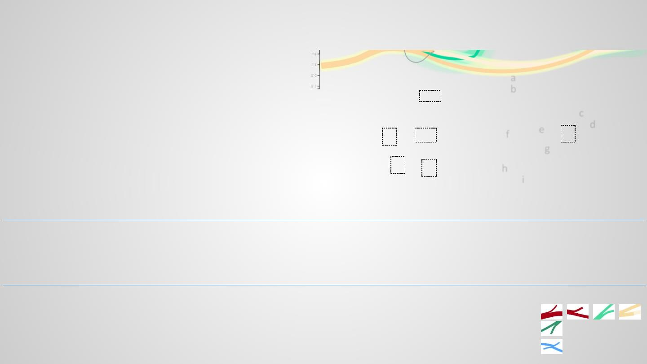
Visual design – Overview
a – i: cluster centroid
• Width: No. of line in the cluster at the specific time point
• Color : The cluster.
a
b
• Similar color: will be clustered together in the next lower level.
(e.g., a,b; c,d; e,f,g; h,i)
• REAL MEANING: there are several lines distributing
similarly,(e.g., all in blue), they have several leading x-y
relationship (e, f, g).
c
e
d
f
g
• X-y R as indication for LoD: they are close if a region has been
well-clustered (a, b), and would be very dissimilar (offset or
very different angle) if a region worth more detailed
exploration.
h
i
Heatmap - the distribution of lines follow some x-y relationship
• Color: the cluster (cluster with similarly colored centroids will
share a heatmap)
Glyph packing - detailed direction, which is not available in heatmap
• See the algorithm later
• Only display the most extreme cases / or only display on demand
(see in the interaction)
• Density of the color: No. of lines distributed in a specific region
Turning points (lines entering or exiting a cluster)
• Width: No. of lines turning in / out
• Placement: where the entering / exiting happen (only draw the
leading placements, approximated based on the turning points
of every line in a cluster)
Examples of turning points
Lines exiting the original x-y relationship
Lines entering a x-y relationship
A place that both have line entering and exiting

Slide 17
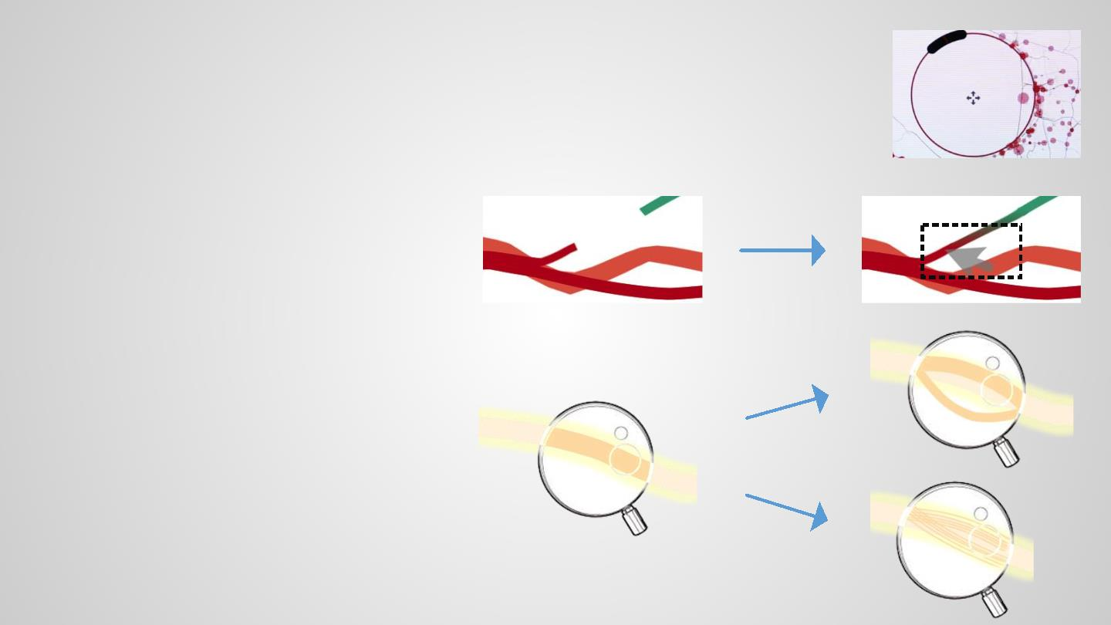
Visual design – Possible interactions - Brush
With the encodings in the overview, brushing helps to explore more specific information. It works as a
guideline for selecting regions / clusters for further exploration.
• Basic idea: take the brushing as lens / fisheye to enlarge or shrink the target region, only that some
distortion would be based on hierarchical clustering results.
An in / out turning point:
Connect the cluster before and after transfer
A cluster:
Lens view for previewing clusters’ splitting
behavior at other levels
OR
Its involved lines’ real placement (could
further select the shown line)

Slide 18
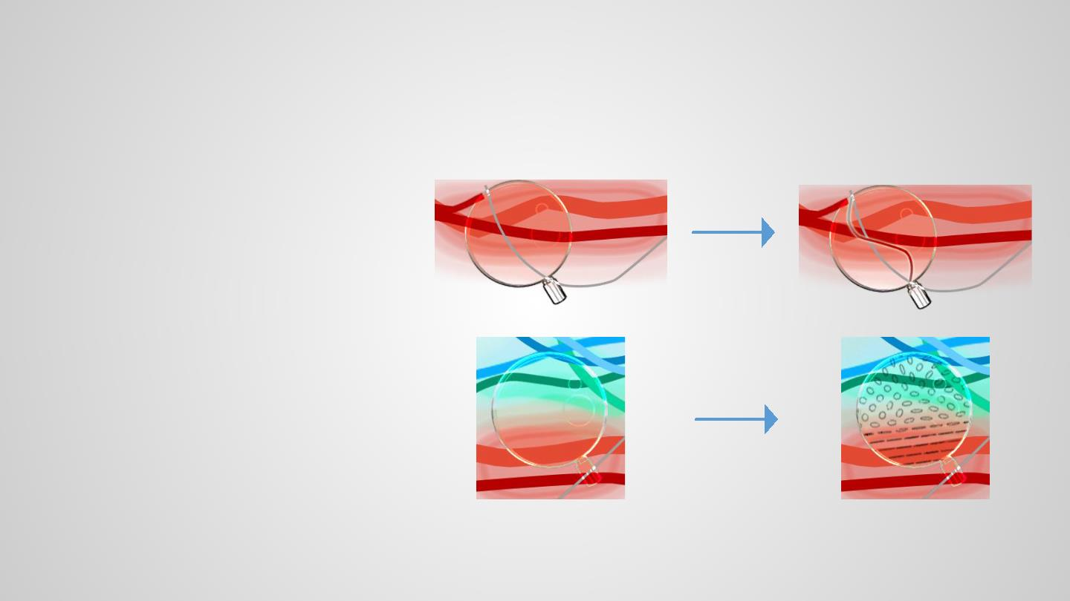
Visual design – Possible interactions – Brush (Cont’)
An outlier:
• Distort the outlier to make it closer to the cluster it
will later join
• degree of distortion encode number of levels
later that it will be clustered
• and re-color part of it as the to-be-clustered color.
A random region:
Display the glyphs showing the direction of
each sub-region (see possible algorithm)

Slide 19

Visual design – Possible interactions – Select & Query
Select:
• Select a cluster
• More precise heatmap showing the line distribution
• Show the glyphs for the directions at all the regions where the lines belonging to the cluster exist
• Select a region
• Zoom-in the overview to explore some region
Query (to link the individual features with the overview)
• Query a line
• What to query:
• By its name
• By the line observed in brushing
• Display it as a whole (connect its segments in different clusters)
• Target other lines with a specific pattern
• Query a trend pattern
• What to query:
• The degree of alignment of the lines
• The lines’ main directions
• Visual cue
• Directions observed in brushing
• Distributions of the main directions (slope: -90 to 90 degree)and the alignment of the lines (a score)

Slide 20
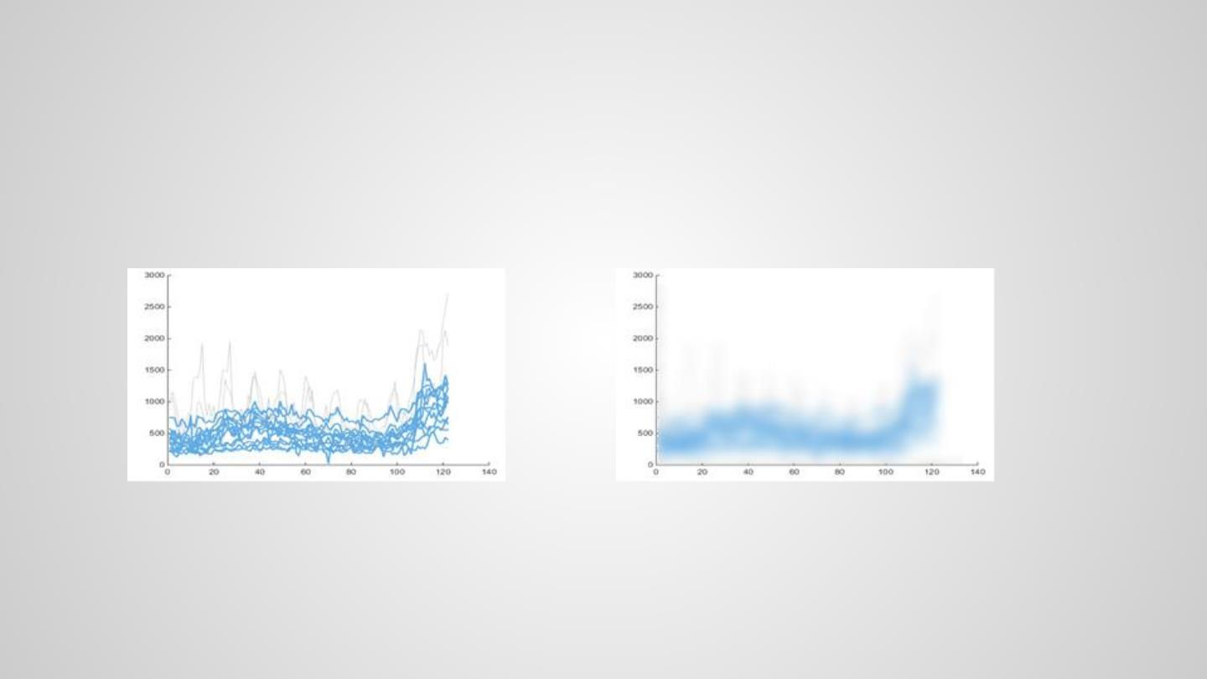
Algorithm – Heatmap for density (TBD)
Encode: spatial distribution of lines with similar x-y Relationships (i.e., the centroid for them should be in similar color)
Possible algorithm
1. Scale Space
2. Contour map: No. of line in a specified range around the centroids

Slide 21
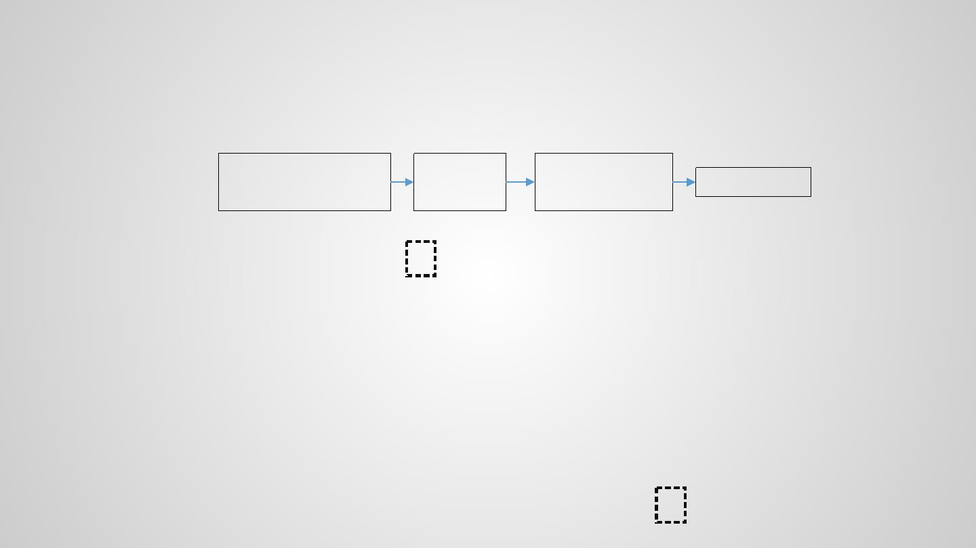
Algorithm – Glyph packing for directions (TBD)
Encode: The main direction and the lines’ alignments in a small region
Possible algorithm
This could allow different LoD
Split the line graph into several
regions (square / Voroni based
on the clusters)
Compute the
main direction
for each region
Compute the line
alignment by computing
the angle distance
Visualize it
No apparent alignment,
roughly -20 degree
Glyphs (ellipse)
Thinness represent the alignment:
thinner -> more aligned
Direction of the major axis: direction of
the region
•
•
All lines follow an approximately
45 degree direction

Slide 22
Related Work – Line Graph
Time Series Visualization Comparion
Javed W, McDonnel B, Elmqvist N. Graphical perception of multiple time series[J]. Visualization and Computer Graphics, IEEE
Transactions on, 2010, 16(6): 927-934.
https://engineering.purdue.edu/~elm/projects/multilinevis/multilinevis.pdf
- Comparison between line graph, Braided graph, small multiples, horizon graphs with Maximum, Slope, Discrimination tasks.
- Synthetic data.
Heer J, Kong N, Agrawala M. Sizing the horizon: the effects of graph size and layering on the graphical perception of time series
visualizations[C]//Proceedings of the SIGCHI Conference on Human Factors in Computing Systems. ACM, 2009: 1303-1312.
http://vis.berkeley.edu/papers/horizon/2009-TimeSeries-CHI.pdf
- Use position encodings for both time and value
- Synthetic data.

Slide 23
Related Work – Line Graph
Characteristics of line graph (trend, metric information about absolute scales)
Playfair W. The commercial and political atlas: representing, by means of stained copper-plate graphs, the progress of the commerce, revenues,
expenditure and debts of england during the whole of the eighteenth century[M]. T. Burton, 1801.
-
The invention of line graph
Shah, Priti, and Eric G. Freedman. "Bar and Line Graph Comprehension: An interaction of top‐down and bottom‐up processes." Topics in
Cognitive Science 3.3 (2011): 560-578.
http://onlinelibrary.wiley.com/doi/10.1111/j.1756-8765.2009.01066.x/epdf
-
-
Line graphs reflects trends because lines connect discrete entities and directly represent slope.
Line graphs reflect x-y relationship
Shah P, Hoeffner J. Review of graph comprehension research: Implications for instruction[J]. Educational Psychology Review, 2002, 14(1): 47-69.
http://deepblue.lib.umich.edu/bitstream/handle/2027.42/44452/10648_2004_Article_363437.pdf?sequence=1
-
-
Num of data points – influence interpretation
Number of trend reversals is the main determinant of comprehension difficulty as measured by study times.
Kelley D L. Graphing Statistics and Data: Creating Better Graphs[J]. Technometrics, 1997, 39(4): 429-430.
-
-
Line graph is suitable for observing the development, judge the gradients, find significant changes and turning points
Variations: index graph, sparkline

Slide 24
Related Work – Line Graph
Line graph scalability
Kincaid R, Lam H. Line graph explorer: scalable display of line graphs using Focus+ Context[C]//Proceedings of the working conference on
Advanced visual interfaces. ACM, 2006: 404-411.
http://www.heidilam.com/doc/KincaidLam_LGE_AVI06.pdf
-
-
-
-
Line graph use for scientific measurements
Visualization system with a gel-like overview.
Data: (1) time series climate data (2) Wheat Strains (3) Cancer data (All available online)
Showed similar view: Lam, Heidi, Tamara Munzner, and Robert Kincaid. "Overview use in multiple visual information resolution
interfaces." Visualization and Computer Graphics, IEEE Transactions on 13.6 (2007): 1278-1285.
Hochheiser H, Shneiderman B. Visual queries for finding patterns in time series data[J]. University of Maryland, Computer Science Dept. Tech
Report, CS-TR-4365, 2002.
http://hcil2.cs.umd.edu/trs/2002-06/2002-06.pdf
-
-
Interactive system for querying time series among multiple time lines.
Data: microarray data
Berry L, Munzner T. Binx: Dynamic exploration of time series datasets across aggregation levels[C]//Information Visualization, 2004. INFOVIS
2004. IEEE Symposium on. IEEE, 2004: p2-p2.
https://www.cs.ubc.ca/~tmm/papers/binx/BinXPoster2004.pdf
-
Display a single line graph that focuses scalability on the x-dimension

Slide 25
Related Work – Line Graph
Line graph scalability – Cont’
Ziegler, Hartmut, et al. "Visual market sector analysis for financial time series data." Visual Analytics Science and Technology (VAST), 2010 IEEE
Symposium on. IEEE, 2010.
http://www.cs.ubc.ca/~tmm/courses/cpsc533c-06-fall/readings/vanwijk99cluster.pdf
-
Small multiple for financial data: clusters a selection of large amounts of financial time series data according to their similarity, and analyzes
the distribution of the assets among market sectors
Bernard, Jürgen, et al. "A visual digital library approach for time-oriented scientific primary data."International Journal on Digital Libraries 11.2
(2010): 111-123.
https://kops.uni-konstanz.de/bitstream/handle/123456789/28470/Bernard_284706.pdf?sequence=1&isAllowed=y
-
Small multiple for scientific primary data (time-oriented research data). Cluster with SOM map, and then show the centrality of the clusters
with opacity-based overlaying view.

Slide 26
Related Work – Line Graph
Line graph visual improvements
Heer J, Agrawala M. Multi-Scale Banking to 45º[J]. IEEE TRANSACTIONS ON VISUALIZATION AND COMPUTER GRAPHICS, 2006, 12(5): 2.
http://vis.pku.edu.cn/course/Visualization_2011F/materials/2006-Banking-InfoVis.pdf
-
-
The orientations of the line segments in the graph
Data: Monthly atmospheric CO , daily download counts of the prefuse visualization toolkit, EEG reading
2
Kong N, Agrawala M. Perceptual interpretation of ink annotations on line graphs[C]//Proceedings of the 22nd annual ACM symposium on User interface
software and technology. ACM, 2009: 233-236.
http://citeseerx.ist.psu.edu/viewdoc/download?doi=10.1.1.185.2602&rep=rep1&type=pdf
-
-
Identify and highlight perceptual parts in line graphs
Data: Annual number of sunspots, Annual number of goals scored by leading scorer in the National Hockey League
Van Wijk, Jarke J., and Edward R. Van Selow. "Cluster and calendar based visualization of time series data." Information Visualization, 1999.(Info Vis' 99)
Proceedings. 1999 IEEE Symposium on. IEEE, 1999.
http://www.cs.ubc.ca/~tmm/courses/cpsc533c-06-fall/readings/vanwijk99cluster.pdf
-
Cluster similar daily data patterns, and to visualize the average patternsas graphs and the corresponding days on a calendar, to identify patterns and
trends on multiple time scales.
-
Data: power demand by ECN (electronic communications network)
Zhao, Jian, et al. "Exploratory analysis of time-series with chronolenses." Visualization and Computer Graphics, IEEE Transactions on 17.12 (2011): 2422-2431.
-
-
http://www.cs.toronto.edu/~jianzhao/papers/chronolens.pdf
Perform transformation of the data points in their focus area, visualizing derived values, identifying correlations, or discovering anomalies Data: visiting
Data: population of two P2P video-on-demand channels, ALMA Line Length Correction Stretcher Voltage plots for four antennas

Slide 27
Related Work – Visual Clutter
Summary
Ellis G, Dix A. A taxonomy of clutter reduction for information visualisation[J]. Visualization and Computer Graphics, IEEE
Transactions on, 2007, 13(6): 1216-1223.
http://eprints.lancs.ac.uk/12942/1/Ellis_%26_Dix_clutter_reduction_taxonomy_5.3.pdf
More related paper: clustering-based, hierarchical / aggregated / filtering, visual enhancement.
Mostly pure technical improvements. Some real-world problem motivated paper:
Clustering:
Zhang L, Tang C, Song Y, et al. VizCluster and its application on classifying gene expression data[J]. Distributed and Parallel
Databases, 2003, 13(1): 73-97.
http://citeseerx.ist.psu.edu/viewdoc/download?doi=10.1.1.18.4866&rep=rep1&type=pdf
Filtering:
Brodbeck D, Chalmers M, Lunzer A, et al. Domesticating bead: adapting an information visualization system to a financial
institution[C]//Information Visualization, 1997. Proceedings., IEEE Symposium on. IEEE, 1997: 73-80.
http://citeseerx.ist.psu.edu/viewdoc/download?doi=10.1.1.33.4938&rep=rep1&type=pdf

Slide 28
Related Work
Discuss the feasibility of visual clutter reduction techniques: To assess if a certain common
techniques could be used in our case for line graphs. (and MOST IMPORTANTLY prove clustering is a must).
• Current clutter reduction techniques for lines graphs
• Small multiples (SOM clustering (Bernard, 2010), serial density map (Kincaid, 2006), etc.)
• This separation would require users to move back and forth to understand lines in different sub-graphs, which
greatly sacrifices the comparability of line graphs, and make it difficult to observe the overall trend of all lines.
• Queries (Timebox (Hochheiser, 2004), query with scratch / example (Wattenberg, 2001), etc.)
• Lack an overview for guiding the users for further interaction
->> Draw with a common baseline

Slide 29
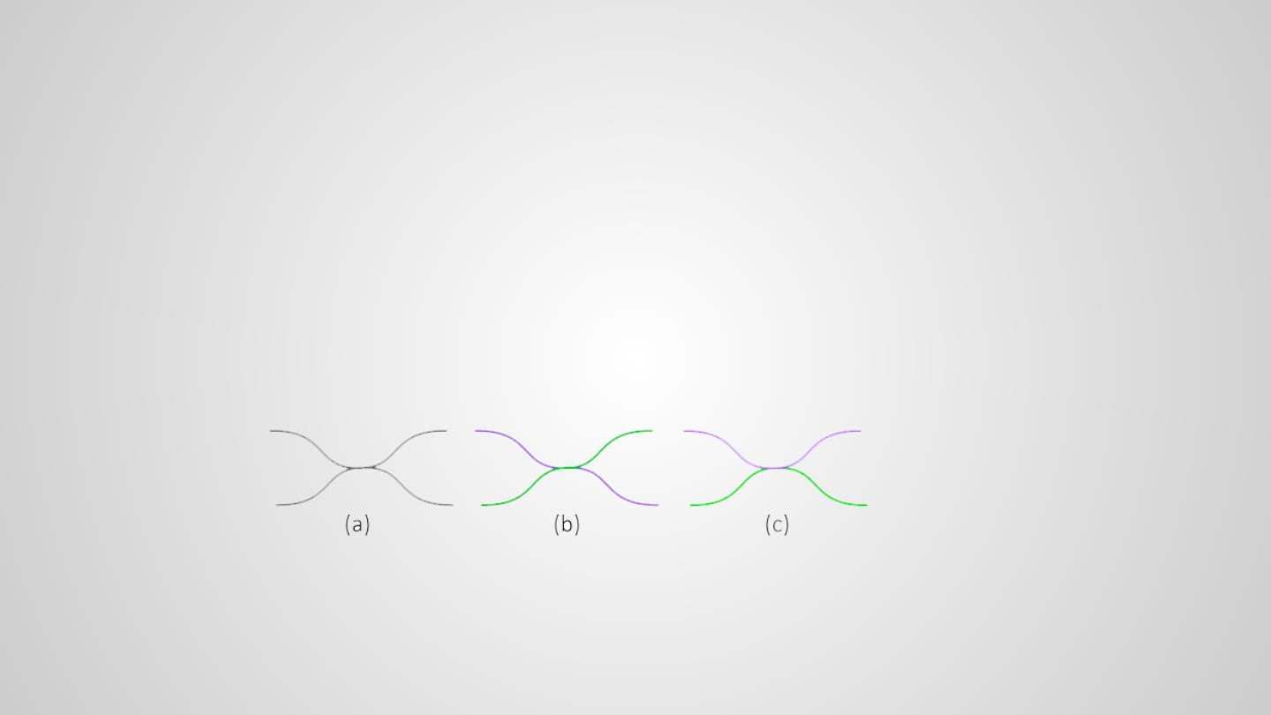
Related Work
• Other related techniques
• Edge bundling, e.g., Kernel Density Estimation (KDE) (Hurter, 2012)
• The main pattern extracted by KDE is undirected, and the trend in line graph could not be revealed. (see the figure
below. )
• Reordering for parallel coordinates
• Line graph's independent variable are not re-orderable.
• etc.
->> Clustering is the one that could reduce clutter problems without much loss on the emphasis of line graphs' primal features.
Whereas KDE may summarize the patterns as (a), given that
line graphs have the development direction, the real case
could be (b) or (c).

Slide 30
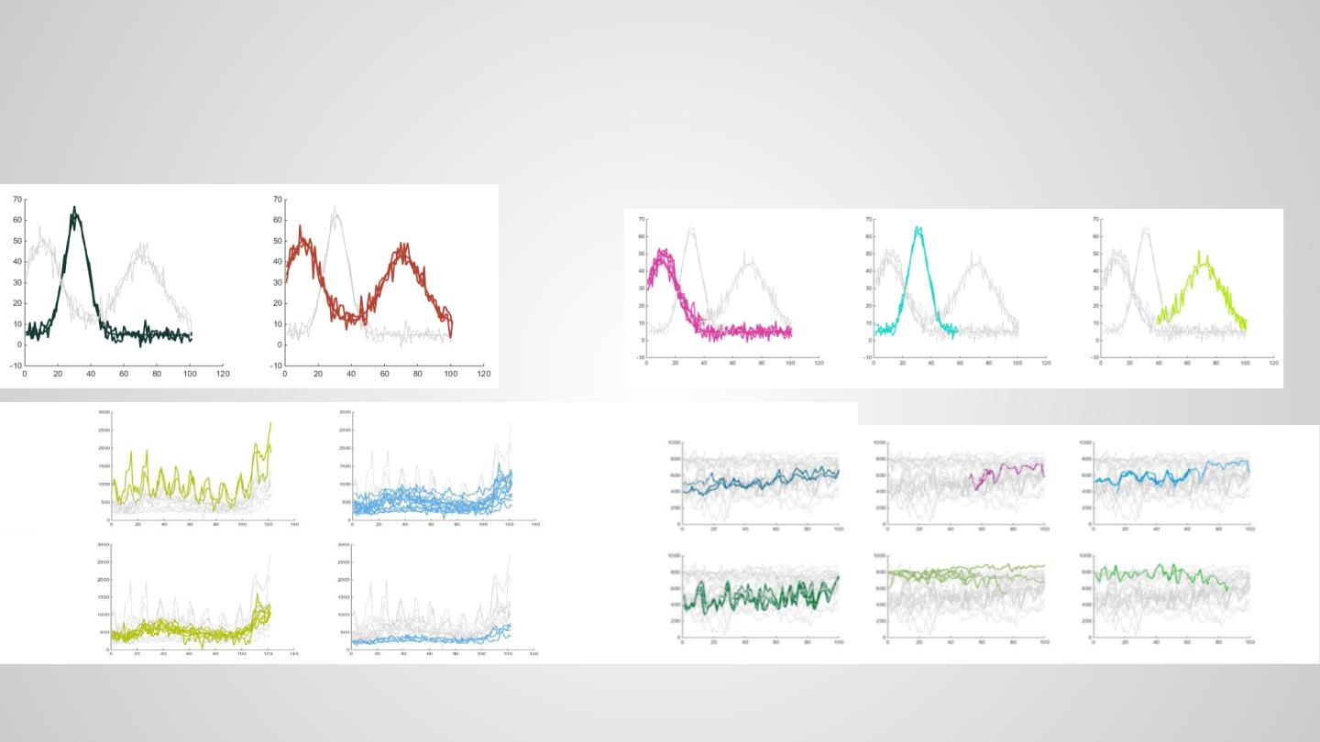
Initial Results from the clustering

Slide 31
Expected Results
- Implementation: javascript + d3.js + WebGL
- Evaluation: two case study + a user study
- Emphasis on user study

Slide 32
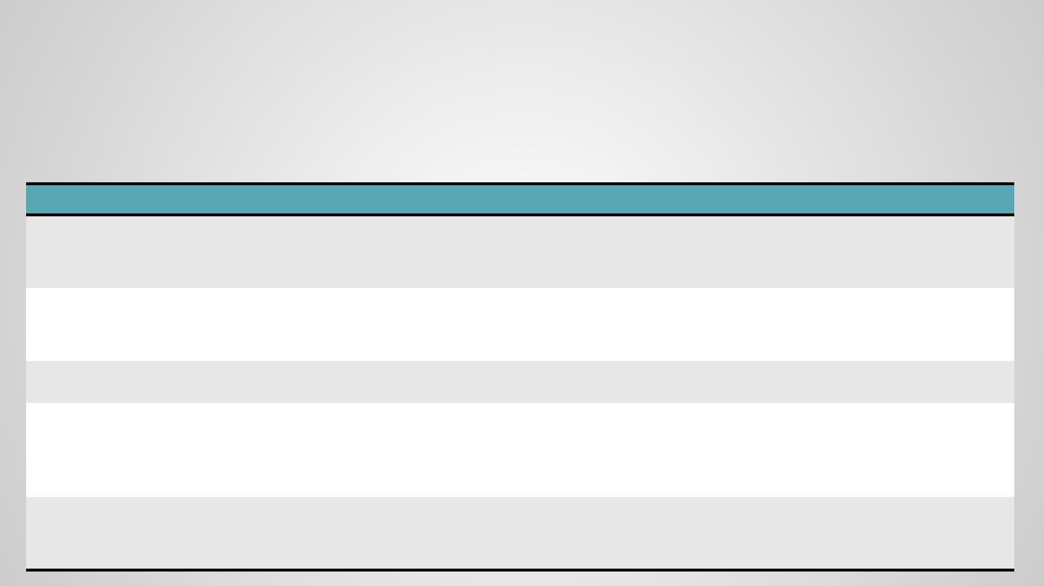
Evaluation - Case Study
Ideal cases
• General and understandable data
• Use data that partial similarities are very meaningful
Otherwise only summarize the phenomenon without specific explanation. (e.g., micro-array data)
Data
Synthetic
Control Graph
Time Series
Pro
Con
Source
Classical data; partial
similarity is meaningful;
Not easy to explain triggers behind the https://archive.ics.uci.edu/ml/datasets/Synt
patterns
hetic+Control+Graph+Time+Series
(BESDOK, 2000)
Weather
Easy to understand; time
series data; data range is
reasonable
The change is annual-based and may
not discover a lot of partial similarity
patterns
Kincaid, 2006
DNA sequence
Stock
Widely used in studies
Not explanable
Kincaid, 2006
Widely used in studies;
partial similarity is
meaningful
Relative changes are much more
important than absolute values in
reality; most studies would perform
normalization
Hochheiser, 2004
http://www.cs.umd.edu/hcil/timesearcher/
Search log data
Easy to understand, partial
similarity is meaningful
Data may vary in a too wide range and
difficult to observe very meaningful
result without normalization

Slide 33
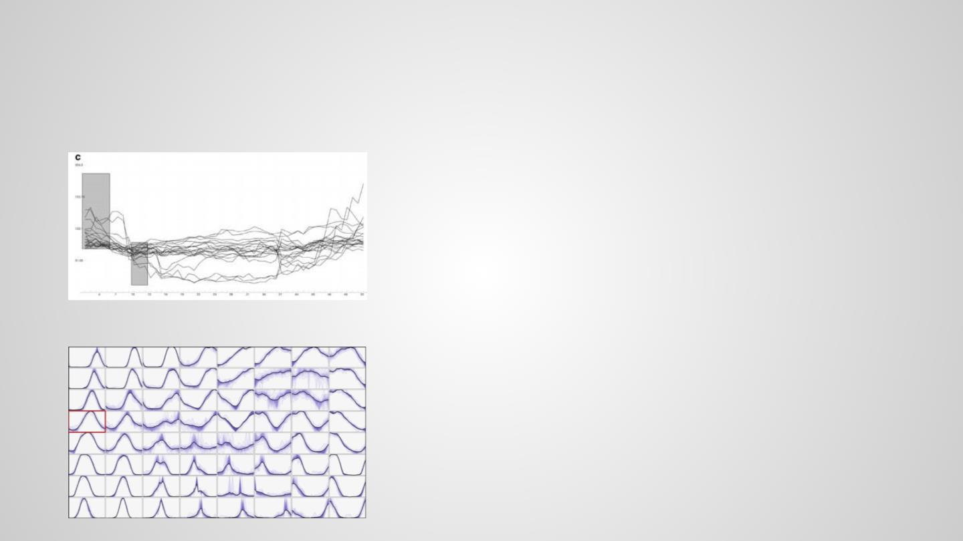
Evaluation - User Study
Baselines
• Query
Potential tasks
• Point out main x-y relationships;
• Point out outliers;
Hochheiser, 2004
• Which x-y relationship tend to be stable throughout the whole
time period? Which ones do lines easily break away from?
• Lines in which regions are most similar?
• Find lines that follow several specified x-y relationship;
• Etc.
(Mainly follow the tasks analysis. TBD when the system is done, and
when we understand what it is most suitable for)
• Small multiples
Bernard, 2010
Appendix:
User study task or TimeSearcher (Hochheiser, 2004) with Stock data:
• During days 22–23, are there more stocks between 69–119, 59–
109, or 49–99
• Find stocks that traded in a 20 range for at least three
consecutive time periods.

Slide 34
Discussions

Slide 35
A List of Expected Figures

Slide 36
Remaining Tasks
-
Coding
Clustering
Visual system
(Mostly done. Compute the centroid)
Working on
-
Evaluation
Data collection
Case study
User study
-
Writing
W1 abstraction
W2 introduction
W3 related work Collecting related paper
W4 problem characterization
W5 system design
W6 case studies
W7 user study
W8 discussion
W9 conclusion and future work

