Slide 1
Structured Products
Manos Venardos manos.venardos@gmail.com

Slide 2
Agenda
Introduction
Single Asset Derivatives
Multi Asset Derivatives
Algorithmic Underlyings

Slide 3
Introduction
Introduction
  Options on Returns
  Currency Treatment
  Capital Protection

Slide 4

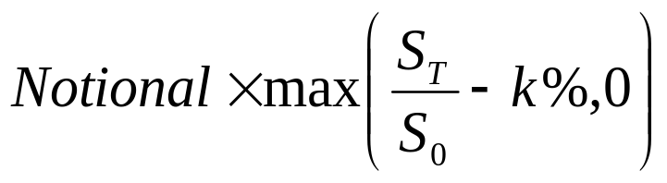
Options on Returns
Textbook vanilla option payoff
Option on return payoff is
  Most investors invest a given notional i.e. option on return is more meaningful
  Strike / moneyness in % i.e. ATM k = 100%
  S₀ is referred to as the reference level
  Textbook option is option on return with Notional = S₀

Slide 5
Currency Treatment
Investors want payoff in a particular currency but underlying assets are denominated in various currencies
Example: USD investor wants a USD payoff of an option on BP (share denominated in GBP)
  S_{t} is the GBP price of BP
  X_{t} is the USD/GBP FX rate
Two main currency conversion conventions
  Currency Struck returns
  Currency Protected returns a.k.a. quanto

Slide 6
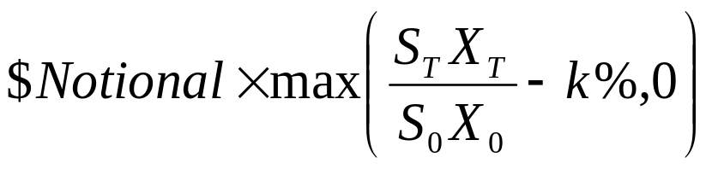
Currency Struck Returns
Option on CCY struck return payoff is
Share price is converted into USD using FX rate
It is an option on CCY struck asset $Y_{t} = X_{t} S_{t}
Investor is exposed to both share price and FX rate fluctuations
  Volatility of CCY struck asset is a composite volatility i.e. made up of equity volatility, FX volatility and equity-FX correlation
  CCY struck is tradable for USD investor, hence expected value determined by Risk-Neutral mean

Slide 7
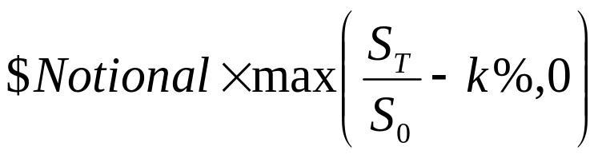
Currency Protected Returns
Option on currency protected return payoff is
GBP return is measured as if it were in USD
It is an option on CCY protected asset $Z_{t} = S_{t}
Investor is not exposed to FX rate fluctuations
  Volatility of CCY protected asset is the equity volatility
  CCY protected asset is not tradable for USD investor, hence expected value needs to be adjusted
CCY protected payoffs are incredibly more popular than CCY struck payoffs

Slide 8

Capital Protection
Payoff example
  t: invest $1 in structured product
  T: payoff
Assume interest rates are 3%
The mechanics of capital protection are as follows
  t: invest $0.97 in a T ZCB and $0.03 in options
  T: return $1 from ZCB + option payoff
Capital protection achieved by investing in bond
  Capital is protected but does not necessarily grow as in a ZCB investment

Slide 9
Investing in Derivatives
Investors are after one of the following themes
  Protection: hedge against risk
  Income: to generate income / coupon stream
  Leverage: higher exposure than a cash instrument
  Relative Value: look for cheap Vs expensive products
Derivatives are packaged in various forms
  OTC derivative contract, funded or unfunded
  Listed warrants or options
  Securitized derivative
  Structured fund
  Special Purpose Entity

Slide 10
Categories of Equity Derivatives
Single Asset, No Path Dependence
Vanillas e.g. call, put, combinations
Sensitive to asset’s distribution at maturity
Priced with Closed Form as combinations of vanillas
Single Asset, Path Dependent
Average options, lookbacks, knock-outs, cliquet
Sensitive to asset’s path distribution
Priced with ClosedForm, Tree, MonteCarlo
Multi Asset, No Path Dependence
Basket, rainbow
Sensitive to correlation and distribution at maturity
Priced with MonteCarlo or ClosedForm approximations
Multi Asset, Path Dependence
Rainbow knock-outs
Sensitive to correlation and all asset’s joint
distribution of returns
Priced with MonteCarlo

Slide 11
Single Asset Derivatives
Average
Barrier
Variance Swap

Slide 12
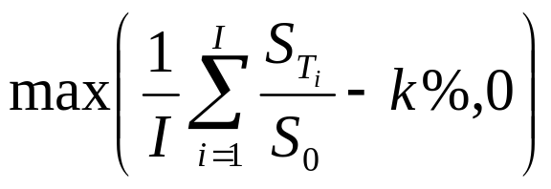
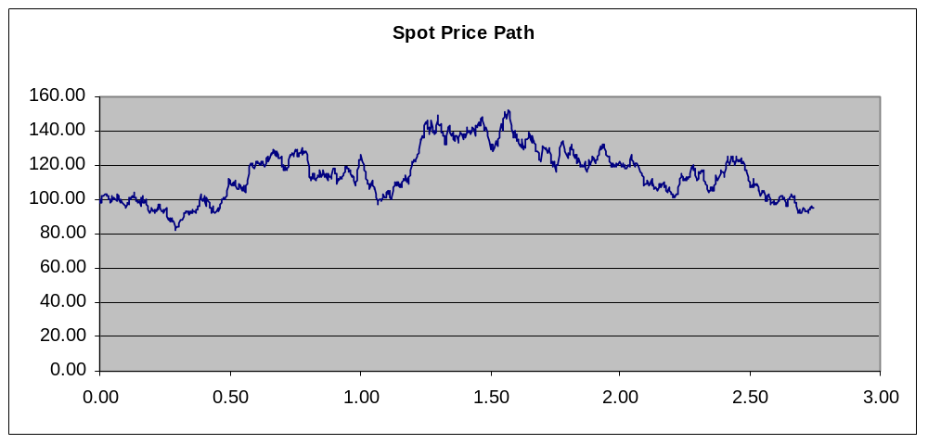
Average Option
Option on arithmetic average of equity returns
Returns measured relative to same reference level i.e. not a Moving Average

Slide 13
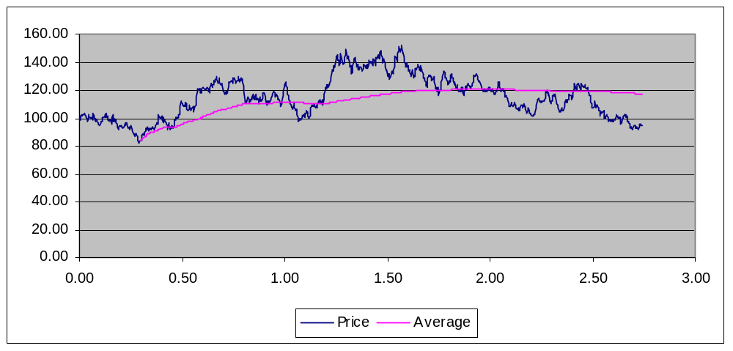
Average Option
Why buy it
  Average dampens stock price fluctuations and spikes
  Clients may have exposure to stock price over time rather than at a particular date so hedge with Avg
Average smoothes out rallies and crashes
Vol of Average is lower than Vol of Spot

Slide 14
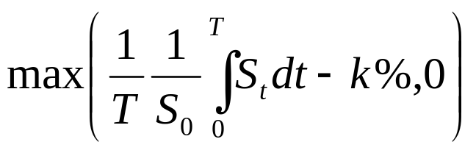
Average Option
Fixings may be taken weekly, monthly etc. In the limit, i.e. continuous averaging, the payoff is
Averaging usually concentrates near maturity
  The desired effect is to smooth out the vanilla payoff
Towards the end of the option, the average has almost no volatility left as it has been fixed by historic samples
What about exposure to the reference level?

Slide 15
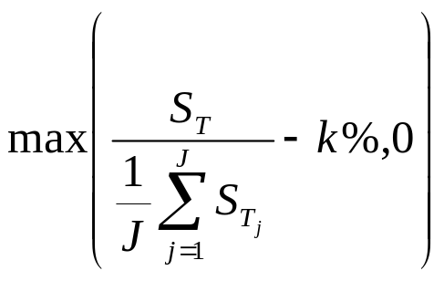
Average Reference
The exposure to the reference level in a vanilla can be smoothed out by averaging
Immunizes payoff against an unlucky reference level
Non-linearity of payoff more complex compared to simple Avg
  Avg Payout: Sum of returns
  Avg Ref: 1 / Sum of returns

Slide 16
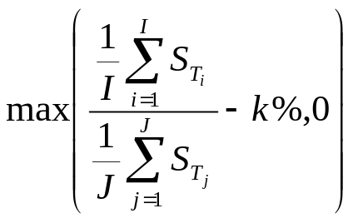
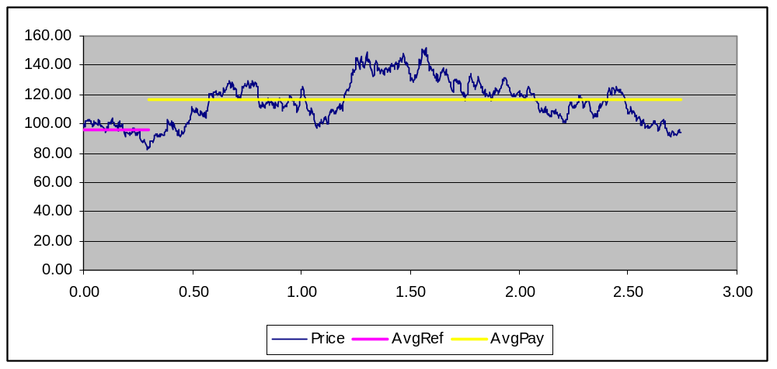
Average Combinations
Both types of averaging combined
Avg features are used in numerous other products

Slide 17
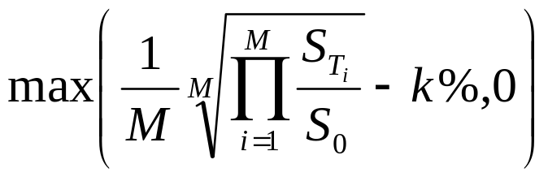
Geometric Average Option
Option on geometric average of equity returns
Never traded but found in all textbooks…
Interesting from theoretical point of view
  Product and powers of log-normal variables remain log-normal
  Can use a Black-Scholes formula to price them

Slide 18
Lookback
Average options smooth exposure to outliers but do not ensure optimal samples
Lookback options are used to ensure highest ex-post returns
  The Reference level can be set to the minimum over the reference period
  The payout can be set to the maximum over the payout period
Features can be combined

Slide 19
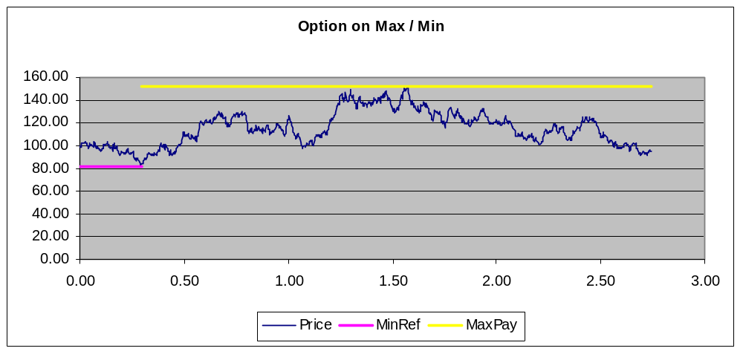
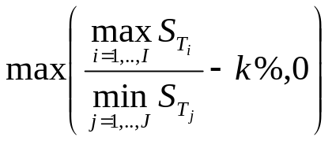
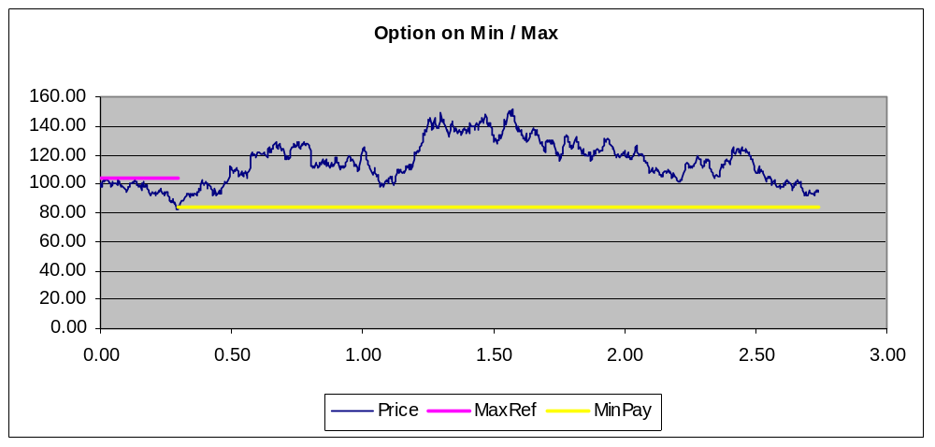
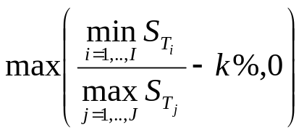
Lookback
Most expensive
Cheapest

Slide 20
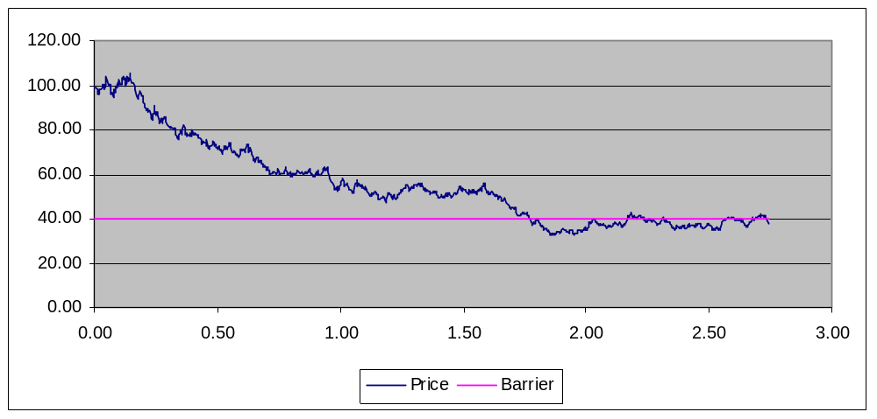
Binary Option
Pays rebate R triggered by spot price crossing a barrier level B and 0 otherwise
Example Down & Out
  Pay 1 if S_{t} falls below 40% of initial price before T
  Pay 0 otherwise
Mimics a CDS payoff
Price is discounted probability of crossing B during the life of the trade

Slide 21




Barrier Option
Option on a stock triggered by spot price crossing a specified barrier level
  Direction: Up Vs Down Barrier
  Optionality: Knock-In Vs Knock-Out, Call Vs Put
A rebate may be paid in case of KO or not KI
Up and In
Assume S₀ < B
Up and Out
Assume S₀ < B
Down and In
Assume S₀ > B
Down and Out
Assume S₀ > B

Slide 22
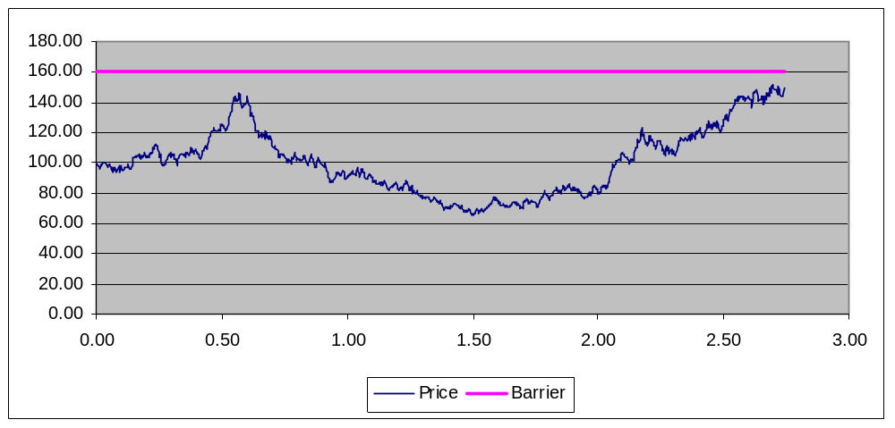
Up & Out Call
U&O call option with strike K and barrier B
  Meaningful if K < B otherwise value is zero
Cheaper than a vanilla call @K as it
  Caps upside at maturity
  Imposes upper limit during life of the option
Allows leverage given view on local risk

Slide 23
Up & Out Call
Payoff at maturity assuming no KO
Payoff is discontinuous - hedging is difficult
Suppose a tick before maturity the spot is just below barrier level i.e. the call is in-the money
  If stock ends up below B deliver S-K
  If stock ends up above B deliver nothing
K
B
S_{T}

Slide 24
Up & Out Call
Price as a function of spot before maturity
  Zero at low spot prices
  Increasing as spot approaches strike
  Falls to zero as spot approaches barrier level
Similar to vanilla for moderate stock prices
K
B
S_{T}

Slide 25
Up & Out Call
Delta of option is
  Positive and increasing up to price peak i.e. build up stock position as option becomes more In-The-money
  Negative from price peak to barrier level i.e. unwind stock position as price approaches barrier even though option becomes more In-The-Money
Gamma is
  Positive for low spot prices since delta position increases
  Negative for spot prices near barrier
Hedging difficult

Slide 26
Barrier Options
Relationship between In & Out options
IN + OUT = VANILLA
Monitoring usually specified on a daily basis
  Textbook example of continuous monitoring rarely traded
Valuation of Barrier Options
  Call / Put options are priced using the Implied Volatility at the option’s strike – recall no-arbitrage interval
  Barrier option depends on numerous implied volatilities
  A proper model is required - not just implied volatilities

Slide 27
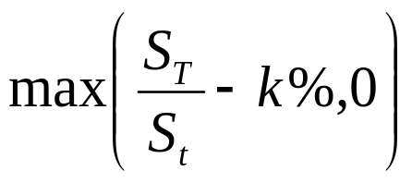
Forward Starting Option
An option on a future return i.e. reference level is set in the future
Two important features
  At any time before t, it remains a k% option i.e. movements in spot do not affect moneyness
  At time t, it becomes a vanilla option with a fixed reference level
Market Jargon
  “2Y in 1Y” is an option on the ( T+1, T+3 ) return

Slide 28
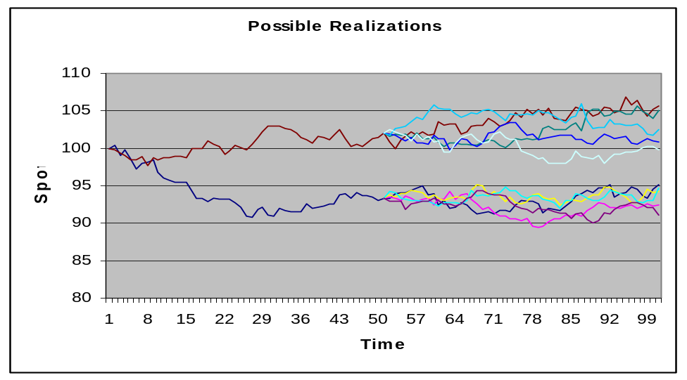
Forward Starting Option
Consider an ATM 2Y in 1Y option
  t: the price will depend on the 2Y ATM implied volatility at time t
  s < t: the price will depend on how volatile the 2Y ATM implied vol is in (t-s) years
Low Vol scenario
High Vol scenario

Slide 29
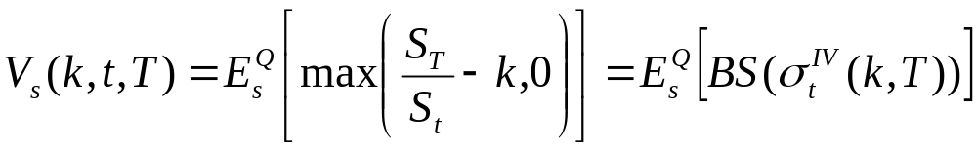
Forward Starting Option
At time s < t, option price depends on randomness of implied volatility i.e. “Vol-Of-Vol”
Option is traded to lock future random implied vol
Usually traded as call-spreads rather than calls
  Exposed to randomness of volatility skew
Future random Implied Vol

Slide 30
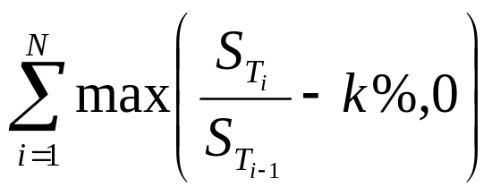
Cliquet
A cliquet is a strip of forward starting options with different start dates
Reference level is reset on each cliquet date

Slide 31
Cliquet
Usually traded in call spreads e.g. annual 80%-120% call spread
Annual returns are
  Capped at +20%
  Floored at –20%
S_{T} / S_{T-1}
80%
120%
Standard feature in structured products

Slide 32
Variance Swap
Some investors want to take a view on volatility rather than spot
Some vanilla payoffs partly offer this exposure
  Delta hedged vanilla option
  ATM straddle
But investors should continuously delta hedge payoffs to isolate volatility exposure
In contrast, Variance Swaps have been designed to give exposure to volatility only

Slide 33
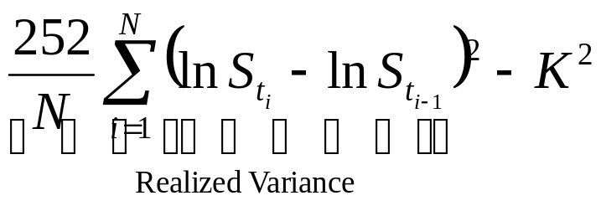
Variance Swap
Counterparties exchange
  Annualized sum of squared returns against
  A fixed amount
K is chosen to make swap have zero value at inception
K is the Variance Swap Volatility
Started as exotic derivative, now standardized flow product – 2way quotes on liquid indices

Slide 34
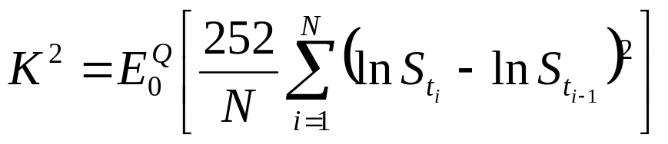
Variance Swap
Zero value at inception means
K ² is the Risk Neutral expectation of the asset’s variance
It is not the market’s statistical expectation of the asset’s variance
Similar setup to any forward contract

Slide 35
Multi Asset Derivatives
Basket
Rainbow
Barrier

Slide 36
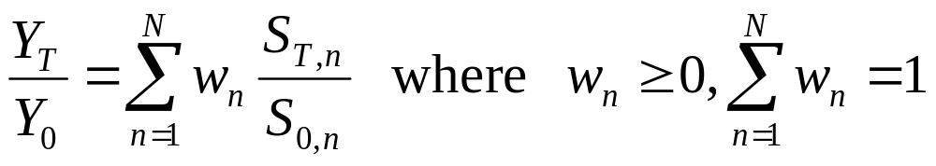
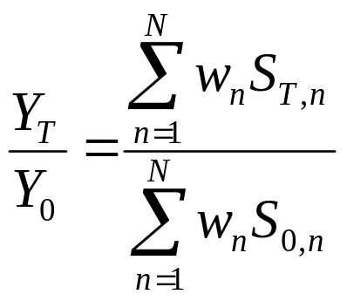
Basket
A basket is a portfolio of individual stocks
Basket returns are measured as a weighted sum of individual returns
  Proportional weights
  Unit Weights

Slide 37
Basket
A basket has more diversified risk compared to a position on a single stock
Components in basket need not be in the same currency i.e. any component return can be
  Vanilla i.e. payoff CCY or
  CCY protected or
  CCY struck
Most baskets are specified in terms of proportional weights

Slide 38
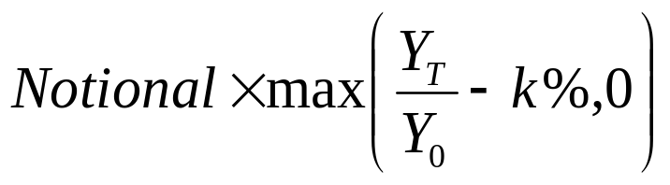
Basket
Basket options are defined as
The payoff is N-dimensional i.e. it depends on all assets’ returns
Valuation of options on basket depends on joint distribution of assets i.e.
  Marginal distribution of each individual asset
  Codependence (e.g. correlation) of assets

Slide 39
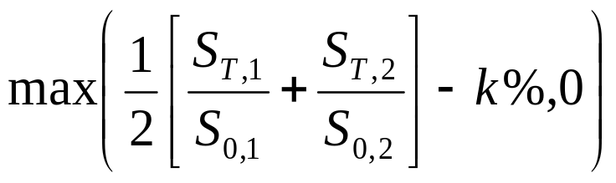
2 Asset Basket Call
Call option on basket on equally weighted returns
1+ Return2
2k
Exercise Region
1+ Return1
2k
(1 + Return1) + (1 + Return2) = 2k

Slide 40
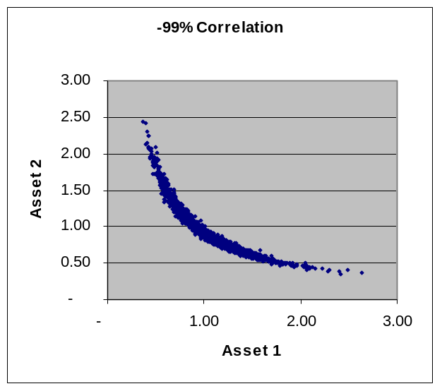
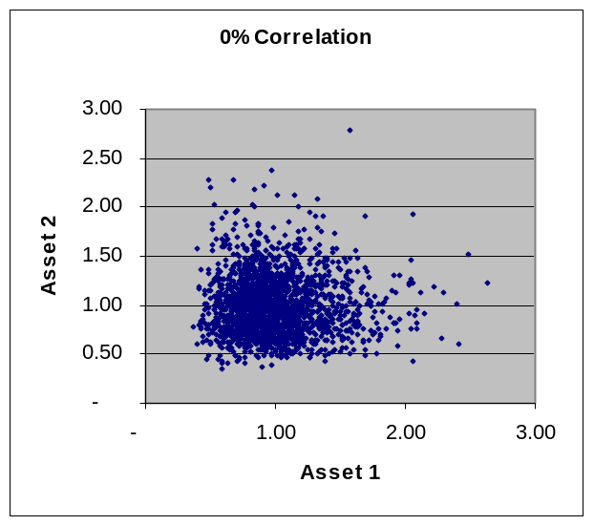
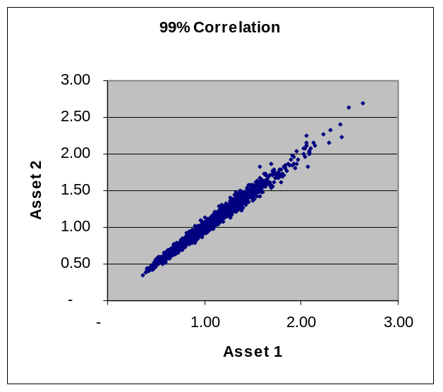
2 Asset Basket Call
Call option on basket is long correlation
  Negative correlation ➔ low option payoffs
  Positive correlation ➔ high option payoffs

Slide 41
Rainbow
A rainbow is a basket where the weights are applied to returns ordered by performance i.e.
  w₁: weight of best return
  w₂: weight of 2nd best return
  …
  w_{N} : weight of worst return
Order of returns is only known at maturity
  Hedging can be difficult

Slide 42


Rainbow
A Best-Of rainbow has weights
  The most valuable rainbow
    Highest call payoff
    Lowest put payoff
A Worst-Of rainbow has weights
  The least valuable rainbow
    Lowest call payoff
    Highest put payoff

Slide 43

Call on Best-Of 2
Call on Best-Of payoff
1+ Return2
Return1 = Return2
k
Exercise Region
1 + Return1
k
Return2 > Return1
Return1 > Return2

Slide 44
Call on Best-Of 2
Call on Best-Of is short correlation
  Negative correlation ➔ a lot of samples pay
    If Asset 1 goes down ➔ Asset 2 goes up and vice versa hence there is always a good performing asset ➔ high payoff
  Positive correlation ➔ a lot of samples don’t pay
    All assets move together so there is a good chance that they will not finish in the money ➔ lower payoff

Slide 45

Call on Worst-Of 2
Worst-Of payoff
1+ Return2
Return1 = Return2
Exercise Region
k
1 + Return1
k
Return2 > Return1
Return1 > Return2

Slide 46
Call on Worst-Of 2
Call on Worst-Of is long correlation
  Negative correlation ➔ very few samples pay
    If Asset 1 goes down ➔ Asset 2 goes up and vice versa hence there is always a bad performing asset ➔ Low payoff
  Positive correlation ➔ a lot of samples pay
    All assets move together so there is a good chance that they will finish in the money ➔ higher payoff

Slide 47
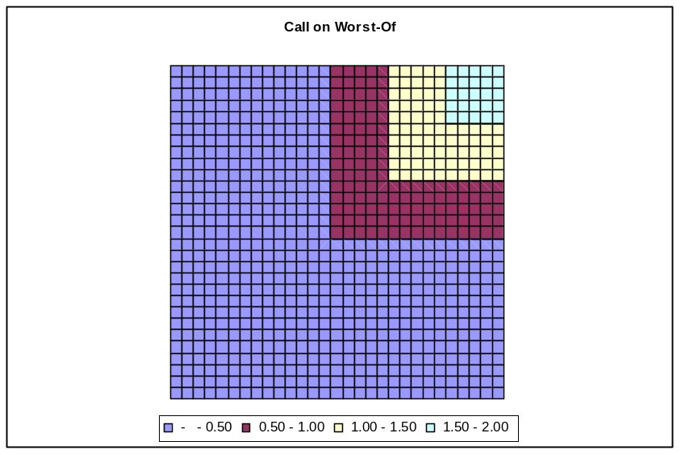
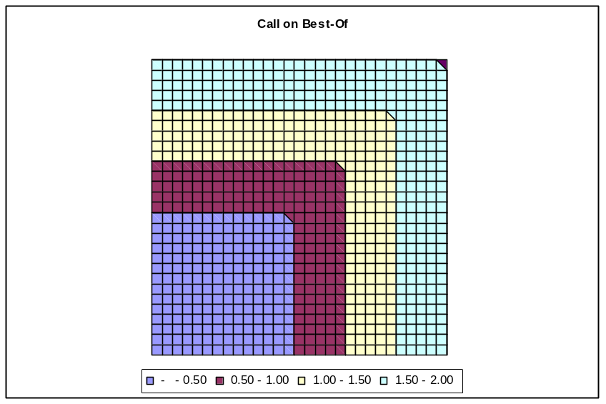
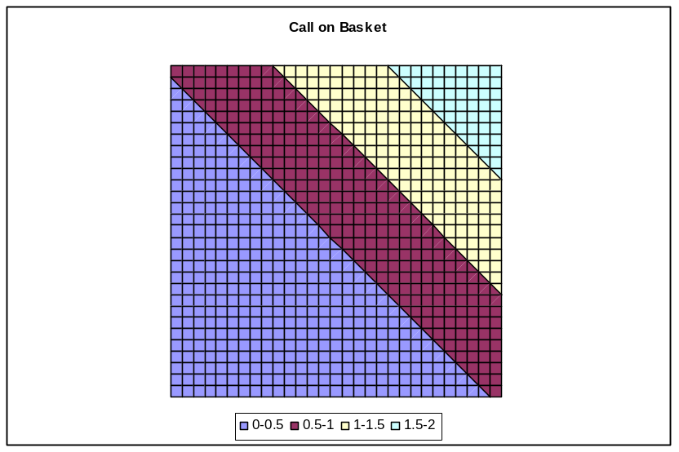
Worst-Of ➔ Basket ➔ Best-Of

Slide 48
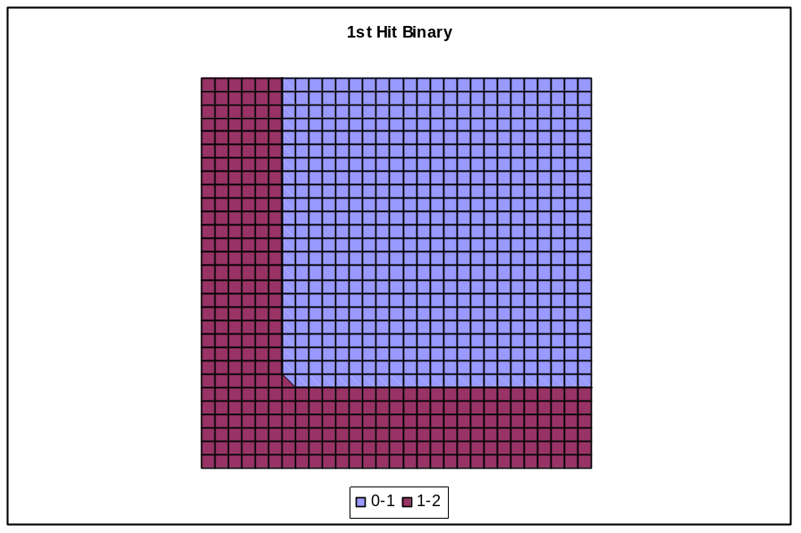
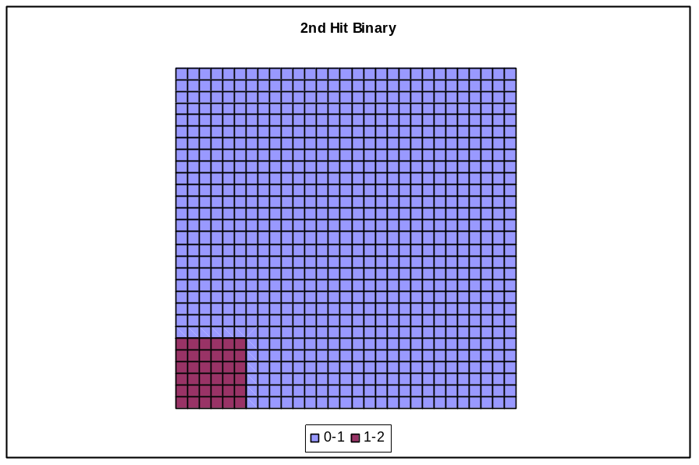
Multi Asset Binaries
Pays rebate R triggered by n-th spot price crossing a barrier level B and 0 otherwise
2-Asset
1st Hit Binary
2-Asset
2nd Hit Binary

Slide 49
Relation to Credit Derivatives
A Down and Out single factor binary is similar to a CDS
  They both pay when the asset crosses a low barrier / defaults
A Down and Out n-th to hit Binary option is similar to an n-th to Default Basket
  They both pay when the n-th asset crosses a low barrier / defaults

Slide 50
Algorithmic Underlyings
CPPI
Volatility Target
Leveraged ETF

Slide 51
Algorithmic Underlyings
Structured Payoff Innovation
  Complicated payoffs and features e.g. Asian, barrier, American exercise
  On usual universe of underlyings e.g. stocks, indices, fx rates
Structured Underlying Innovation
  Simple payoffs and features e.g. forward, vanilla option
  On complicated synthetic / dynamic / algorithmic underlyings

Slide 52




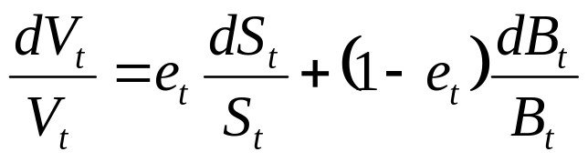

Algorithmic Underlyings
Invest $100 in a basket of 2 tradable assets
  Exposure in risky asset e.g. stock, index
  Exposure in riskless asset e.g. bank account, bond etc.
Any basket is rebalancing is self-financing
The basket evolution is governed by
Financial innovation focuses on

Slide 53
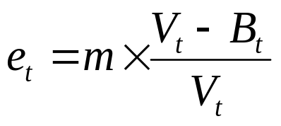
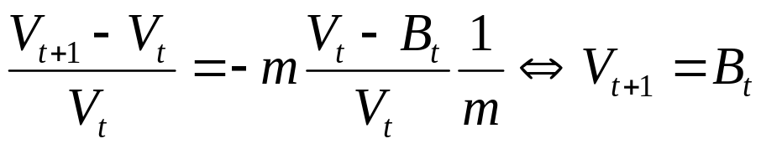
CPPI
Constant Proportion Portfolio Insurance
Risky asset exposure
  Defined via
  Given a contractually agreed multiplier m
  Designed to guarantee capital protection for losses in the risky asset up to -1/m since
  Excess losses are known as “gap risk” and can be quantified using jump-diffusion models

Slide 54
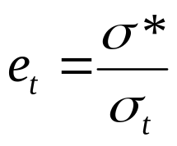

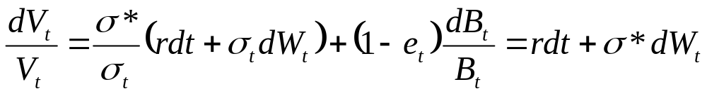
Volatility Target
To minimise volatility risk
Risky asset exposure
  Defined via
  Given a contractually agreed volatility target
  Designed to create a constant volatility underlying
  Employed in the absence of liquid option markets for the risky asset

Slide 55

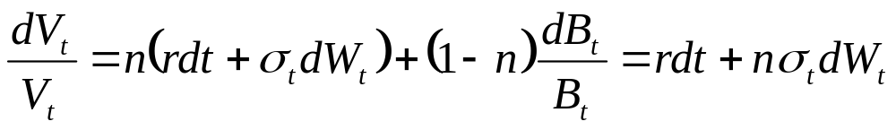

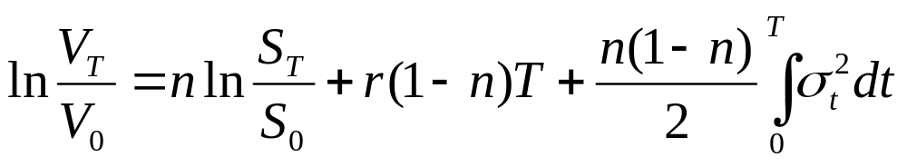
Leveraged ETFs
To leverage the exposure in the risky asset
Risky asset exposure
  Defined via
  Given a contractually agreed leverage n
Basket decays due to volatility for

