Slide 1
Chapter 4
Introduction to Probability
Experiments, Counting Rules,
and Assigning Probabilities
Events and Their Probability
Some Basic Relationships
of Probability
Conditional Probability
Bayes’ Theorem

Slide 2
Probability as a Numerical Measure of the Likelihood of Occurrence
Increasing Likelihood of Occurrence
0
.5
1
Probability:
The event
is very
unlikely
to occur.
The occurrence
of the event is
just as likely as
it is unlikely.
The event
is almost
certain
to occur.

Slide 3
An Experiment and Its Sample Space
An experiment is any process that generates
well-defined outcomes.
The sample space for an experiment is the set of
all experimental outcomes.
An experimental outcome is also called a sample
point.

Slide 4


Example: Bradley Investments
Bradley has invested in two stocks, Markley Oil and
Collins Mining. Bradley has determined that the
possible outcomes of these investments three months
from now are as follows.
Investment Gain or Loss
in 3 Months (in $000)
Markley Oil
Collins Mining
10
5
0
−20
8
−2

Slide 5
A Counting Rule for
Multiple-Step Experiments
If an experiment consists of a sequence of k steps
in which there are n₁ possible results for the first step,
n₂ possible results for the second step, and so on,
then the total number of experimental outcomes is
given by (n₁)(n₂) . . . (n_{k}).
A helpful graphical representation of a multiple-step
experiment is a tree diagram.

Slide 6
A Counting Rule for
Multiple-Step Experiments
Bradley Investments can be viewed as a
two-step experiment. It involves two stocks, each
with a set of experimental outcomes.
Markley Oil: n₁ = 4
Collins Mining: n₂ = 2
Total Number of
Experimental Outcomes: n₁n₂ = (4)(2) = 8

Slide 7
Tree Diagram
Markley Oil
(Stage 1)
Collins Mining
(Stage 2)
Experimental
Outcomes
Gain 8
(10, 8) Gain $18,000
(10, -2) Gain $8,000
Gain 10
Lose 2
Gain 8
(5, 8) Gain $13,000
Lose 2
(5, -2) Gain $3,000
Gain 5
Gain 8
(0, 8) Gain $8,000
Even
(0, -2) Lose $2,000
Lose 20
Lose 2
Gain 8
(-20, 8) Lose $12,000
Lose 2
(-20, -2) Lose $22,000

Slide 8
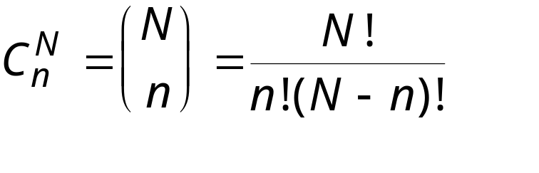
Counting Rule for Combinations
A second useful counting rule enables us to count the
number of experimental outcomes when n objects are to
be selected from a set of N objects.
Number of Combinations of N Objects Taken n at a Time
where: N! = N(N − 1)(N − 2) . . . (2)(1)
n! = n(n − 1)(n − 2) . . . (2)(1)
0! = 1

Slide 9
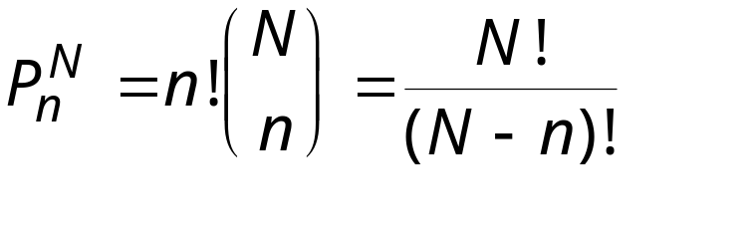
Counting Rule for Permutations
A third useful counting rule enables us to count the
number of experimental outcomes when n objects are to
be selected from a set of N objects, where the order of
selection is important.
Number of Permutations of N Objects Taken n at a Time
where: N! = N(N − 1)(N − 2) . . . (2)(1)
n! = n(n − 1)(n − 2) . . . (2)(1)
0! = 1

Slide 10
Assigning Probabilities
Classical Method
Assigning probabilities based on the assumption
of equally likely outcomes
Relative Frequency Method
Assigning probabilities based on experimentation
or historical data
Subjective Method
Assigning probabilities based on judgment

Slide 11
Classical Method
If an experiment has n possible outcomes, this method
would assign a probability of 1/n to each outcome.
Example
Experiment: Rolling a die
Sample Space: S = {1, 2, 3, 4, 5, 6}
Probabilities: Each sample point has a
1/6 chance of occurring

Slide 12
Relative Frequency Method
Example: Lucas Tool Rental
Lucas Tool Rental would like to assign
probabilities to the number of car polishers
it rents each day. Office records show the following
frequencies of daily rentals for the last 40 days.
Number of
Polishers Rented
Number
of Days
0
1
2
3
4
4
6
18
10
2

Slide 13
Relative Frequency Method
Each probability assignment is given by
dividing the frequency (number of days) by
the total frequency (total number of days).
Number of
Polishers Rented
Number
of Days
Probability
0
1
2
3
4
4
6
18
10
2
40
.10
.15
.45
.25
.05
1.00
4/40

Slide 14
Subjective Method
When economic conditions and a company’s
circumstances change rapidly it might be
inappropriate to assign probabilities based solely on
historical data.
We can use any data available as well as our
experience and intuition, but ultimately a probability
value should express our degree of belief that the
experimental outcome will occur.
The best probability estimates often are obtained by
combining the estimates from the classical or relative
frequency approach with the subjective estimate.

Slide 15
Subjective Method
Applying the subjective method, an analyst
made the following probability assignments.
Exper. Outcome
Net Gain or Loss
Probability
(10, 8)
(10, −2)
(5, 8)
(5, −2)
(0, 8)
(0, −2)
(−20, 8)
(−20, −2)
$18,000 Gain
$8,000 Gain
$13,000 Gain
$3,000 Gain
$8,000 Gain
$2,000 Loss
$12,000 Loss
$22,000 Loss
.20
.08
.16
.26
.10
.12
.02
.06

Slide 16
Events and Their Probabilities
An event is a collection of sample points.
The probability of any event is equal to the sum of
the probabilities of the sample points in the event.
If we can identify all the sample points of an
experiment and assign a probability to each, we
can compute the probability of an event.

Slide 17
Events and Their Probabilities
Event M = Markley Oil Profitable
M = {(10, 8), (10, −2), (5, 8), (5, −2)}
P(M) = P(10, 8) + P(10, −2) + P(5, 8) + P(5, −2)
= .20 + .08 + .16 + .26
= .70

Slide 18
Events and Their Probabilities
Event C = Collins Mining Profitable
C = {(10, 8), (5, 8), (0, 8), (−20, 8)}
P(C) = P(10, 8) + P(5, 8) + P(0, 8) + P(−20, 8)
= .20 + .16 + .10 + .02
= .48

Slide 19
Some Basic Relationships of Probability
There are some basic probability relationships that
can be used to compute the probability of an event
without knowledge of all the sample point probabilities.
Complement of an Event
Union of Two Events
Intersection of Two Events
Mutually Exclusive Events

Slide 20
Complement of an Event
The complement of event A is defined to be the event
consisting of all sample points that are not in A.
The complement of A is denoted by A^{c}.
Sample
Space S
Event A
A^{c}
Venn
Diagram

Slide 21
Union of Two Events
The union of events A and B is the event containing
all sample points that are in A or B or both.
The union of events A and B is denoted by A ∪ B.
Sample
Space S
Event A
Event B

Slide 22
Union of Two Events
Event M = Markley Oil Profitable
Event C = Collins Mining Profitable
M ∪ C = Markley Oil Profitable
or Collins Mining Profitable
M ∪ C = {(10, 8), (10, −2), (5, 8), (5, −2), (0, 8), (−20, 8)}
P(M ∪ C) = P(10, 8) + P(10, −2) + P(5, 8) + P(5, −2)
+ P(0, 8) + P(−20, 8)
= .20 + .08 + .16 + .26 + .10 + .02
= .82

Slide 23
Intersection of Two Events
The intersection of events A and B is the set of all
sample points that are in both A and B.
The intersection of events A and B is denoted by A ∩ Β.
Sample
Space S
Event A
Event B
Intersection of A and B

Slide 24
Intersection of Two Events
Event M = Markley Oil Profitable
Event C = Collins Mining Profitable
M ∩ C = Markley Oil Profitable
and Collins Mining Profitable
M ∩ C = {(10, 8), (5, 8)}
P(M ∩ C) = P(10, 8) + P(5, 8)
= .20 + .16
= .36

Slide 25
Addition Law
The addition law provides a way to compute the
probability of event A, or B, or both A and B occurring.
The law is written as:
P(A ∪ B) = P(A) + P(B) − P(A ∩ B)

Slide 26
Addition Law
Event M = Markley Oil Profitable
Event C = Collins Mining Profitable
M ∪ C = Markley Oil Profitable
or Collins Mining Profitable
We know: P(M) = .70, P(C) = .48, P(M ∩ C) = .36
Thus: P(M ∪ C) = P(M) + P(C) − P(M ∩ C)
= .70 + .48 − .36
= .82
(This result is the same as that obtained earlier
using the definition of the probability of an event.)

Slide 27
Mutually Exclusive Events
Two events are said to be mutually exclusive if the
events have no sample points in common.
Two events are mutually exclusive if, when one event
occurs, the other cannot occur.
Sample
Space S
Event A
Event B

Slide 28
Mutually Exclusive Events
If events A and B are mutually exclusive, P(A ∩ B) = 0.
The addition law for mutually exclusive events is:
P(A ∪ B) = P(A) + P(B)
there’s no need to
include “− P(A ∩ B)”

Slide 29
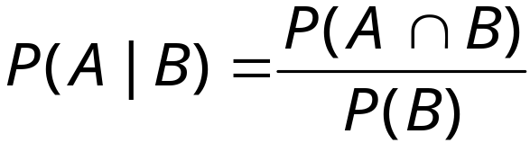
Conditional Probability
The probability of an event given that another event
has occurred is called a conditional probability.
The conditional probability of A given B is denoted
by P(A|B).
A conditional probability is computed as follows :

Slide 30

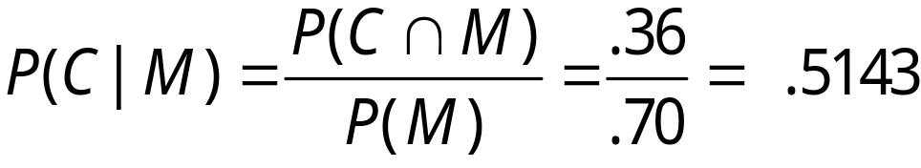
Conditional Probability
Event M = Markley Oil Profitable
Event C = Collins Mining Profitable
= Collins Mining Profitable
given Markley Oil Profitable
We know: P(M ∩ C) = .36, P(M) = .70
Thus:

Slide 31
Multiplication Law
The multiplication law provides a way to compute the
probability of the intersection of two events.
The law is written as:
P(A ∩ B) = P(B)P(A|B)

Slide 32
Multiplication Law
Event M = Markley Oil Profitable
Event C = Collins Mining Profitable
M ∩ C = Markley Oil Profitable
and Collins Mining Profitable
We know: P(M) = .70, P(C|M) = .5143
Thus: P(M ∩ C) = P(M)P(M|C)
= (.70)(.5143)
= .36
(This result is the same as that obtained earlier
using the definition of the probability of an event.)

Slide 33
Independent Events
If the probability of event A is not changed by the
existence of event B, we would say that events A
and B are independent.
Two events A and B are independent if:
P(A|B) = P(A)
P(B|A) = P(B)
or

Slide 34
Multiplication Law
for Independent Events
The multiplication law also can be used as a test to see
if two events are independent.
The law is written as:
P(A ∩ B) = P(A)P(B)

Slide 35
Multiplication Law
for Independent Events
Event M = Markley Oil Profitable
Event C = Collins Mining Profitable
Are events M and C independent?
Does P(M ∩ C) = P(M)P(C) ?
We know: P(M ∩ C) = .36, P(M) = .70, P(C) = .48
But: P(M)P(C) = (.70)(.48) = .34, not .36
Hence: M and C are not independent.

Slide 36
Bayes’ Theorem
Often we begin probability analysis with initial or
prior probabilities.
Then, from a sample, special report, or a product
test we obtain some additional information.
Given this information, we calculate revised or
posterior probabilities.
Bayes’ theorem provides the means for revising the
prior probabilities.
Prior
Probabilities
New
Information
Application
of Bayes’
Theorem
Posterior
Probabilities

Slide 37
Bayes’ Theorem
Example: L. S. Clothiers
A proposed shopping center
will provide strong competition
for downtown businesses like
L. S. Clothiers. If the shopping
center is built, the owner of
L. S. Clothiers feels it would be best to
relocate to the center.
The shopping center cannot be built unless a
zoning change is approved by the town council. The
planning board must first make a recommendation, for
or against the zoning change, to the council.

Slide 38
Bayes’ Theorem
Prior Probabilities
Let:
A₁ = town council approves the zoning change
A₂ = town council disapproves the change
Using subjective judgment:
P(A₁) = .7, P(A₂) = .3

Slide 39
Bayes’ Theorem
New Information
The planning board has recommended against the zoning change. Let B denote the event of a negative recommendation by the planning board.
Given that B has occurred, should L. S. Clothiers revise the probabilities that the town council will approve or disapprove the zoning change?

Slide 40
Bayes’ Theorem
Conditional Probabilities
Past history with the planning board and the town council indicates the following:
P(B|A₁) = .2
P(B|A₂) = .9
Hence:
P(B^{C}|A₁) = .8
P(B^{C}|A₂) = .1

Slide 41
Bayes’ Theorem
Tree Diagram
Town Council
Planning Board
Experimental
Outcomes
P(B|A₁) = .2
P(A₁ ∩ B) = .14
P(A₁) = .7
P(A₁ ∩ B^{c}) = .56
P(B^{c}|A₁) = .8
P(B|A₂) = .9
P(A₂ ∩ B) = .27
P(A₂) = .3
P(A₂ ∩ B^{c}) = .03
P(B^{c}|A₂) = .1

Slide 42
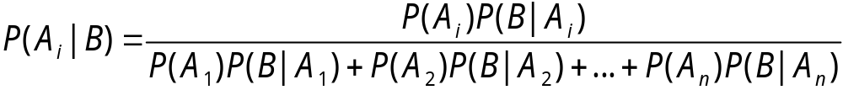
Bayes’ Theorem
To find the posterior probability that event A_{i} will
occur given that event B has occurred, we apply
Bayes’ theorem.
Bayes’ theorem is applicable when the events for
which we want to compute posterior probabilities
are mutually exclusive and their union is the entire
sample space.

Slide 43
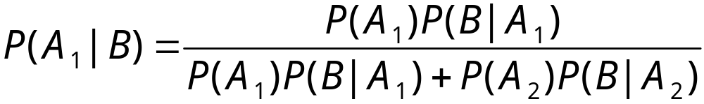
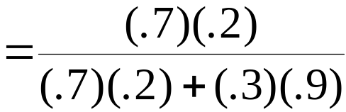
Bayes’ Theorem
Posterior Probabilities
Given the planning board’s recommendation not to approve the zoning change, we revise the prior probabilities as follows:
= .34

Slide 44
Bayes’ Theorem
Conclusion
The planning board’s recommendation is good news for L. S. Clothiers. The posterior probability of the town council approving the zoning change is .34 compared to a prior probability of .70.

Slide 45
Tabular Approach
Step 1
Prepare the following three columns:
Column 1 − The mutually exclusive events for which
posterior probabilities are desired.
Column 2 − The prior probabilities for the events.
Column 3 − The conditional probabilities of the new
information given each event.

Slide 46
Tabular Approach
(1)
(2)
(3)
(4)
(5)
Prior
Probabilities
P(A_{i})
Conditional
Probabilities
P(B|A_{i})
Events
A_{i}
A₁
A₂
.2
.9
.7
.3
1.0

Slide 47
Tabular Approach
Step 2
Column 4
Compute the joint probabilities for each event and the new information B by using the multiplication law.
Multiply the prior probabilities in column 2 by the corresponding conditional probabilities in column 3. That is, P(A_{i} B) = P(A_{i}) P(B|A_{i}).

Slide 48
Tabular Approach
(1)
(2)
(3)
(4)
(5)
Prior
Probabilities
P(A_{i})
Conditional
Probabilities
P(B|A_{i})
Joint
Probabilities
P(A_{i}  B)
Events
A_{i}
A₁
A₂
.2
.9
.14
.27
.7
.3
1.0
.7 x .2

Slide 49
Tabular Approach
Step 2 (continued)
We see that there is a .14 probability of the town
council approving the zoning change and a negative
recommendation by the planning board.
There is a .27 probability of the town council
disapproving the zoning change and a negative
recommendation by the planning board.

Slide 50
Tabular Approach
Step 3
Column 4
Sum the joint probabilities. The sum is the
probability of the new information, P(B). The sum
.14 + .27 shows an overall probability of .41 of a
negative recommendation by the planning board.

Slide 51
Tabular Approach
(1)
(2)
(3)
(4)
(5)
Prior
Probabilities
P(A_{i})
Conditional
Probabilities
P(B|A_{i})
Joint
Probabilities
P(A_{i}  B)
Events
A_{i}
A₁
A₂
.2
.9
.14
.27
.7
.3
1.0
P(B) = .41

Slide 52
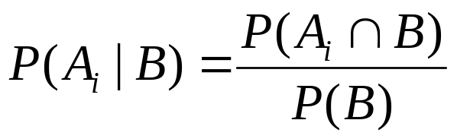
Tabular Approach
Step 4
Column 5
Compute the posterior probabilities using the basic relationship of conditional probability.
The joint probabilities P(A_{i}  B) are in column 4 and the probability P(B) is the sum of column 4.

Slide 53
Tabular Approach
(1)
(2)
(3)
(4)
(5)
Prior
Probabilities
P(A_{i})
Conditional
Probabilities
P(B|A_{i})
Joint
Probabilities
P(A_{i}  B)
Posterior
Probabilities
P(A_{i} |B)
Events
A_{i}
A₁
A₂
.2
.9
.14
.27
.7
.3
1.0
.3415
.6585
1.0000
P(B) = .41
.14/.41

Slide 54
End of Chapter 4

