Slide 1
Security Bot 4000
Securing the Nation
from Threats to our Secure-ness

Slide 2
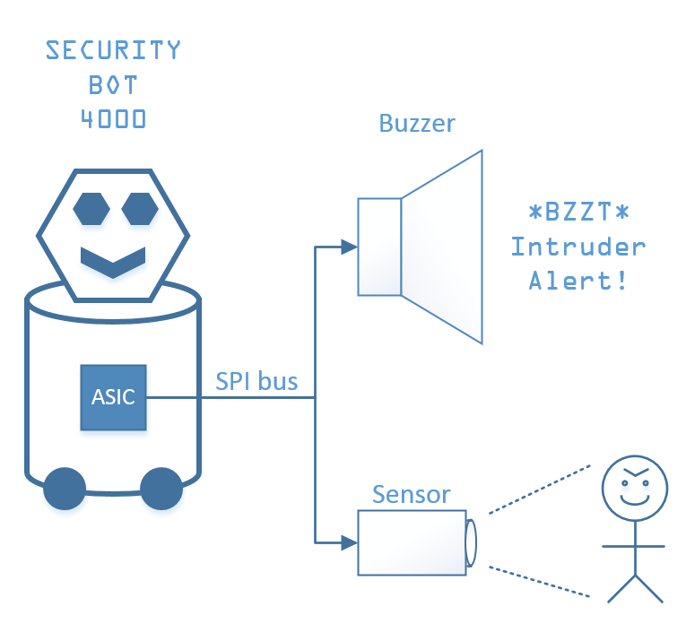
Problem Statement
Consider an intruder detection system.
There is an ASIC which connects to a buzzer and a sensor over a SPI* bus.
The ASIC is the master on the SPI bus.
Upon power-up, the ASIC sends commands over the SPI bus to initialize the sensor and the buzzer.
Then, the ASIC waits 50 milliseconds.
Then, the ASIC enters its main routine, which makes the buzzer respond to the sensor.
We want to model this in a statechart.
The statechart will model only the ASIC.
The statechart will capture the initialization of the peripherals and the 50 ms wait. For this illustration we don’t need to worry about the details of the main routine.
* Note: SPI is a common serial protocol used in embedded systems. In SPI, one of the devices on the bus is designated the “master” device, and it controls when all communications occur, though data can still flow in both directions. In this case, the master device is the ASIC.

Slide 3
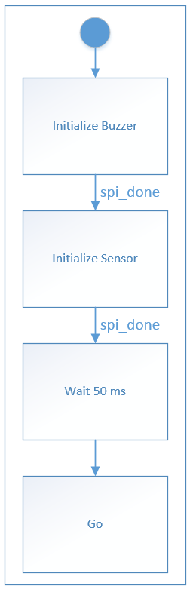
Highest Level Statechart
Meaning of the Statechart
The ASIC first initializes the buzzer. This will involve sending a message over the SPI bus, but that detail isn’t captured yet.
Once the message is sent (which will be indicated by some event saying that the SPI system is done), the ASIC moves on to initializing the sensor.
Then, the ASIC moves into a waiting state for 50 ms.
Then, the ASIC moves into the state which represents normal operation.

Slide 4
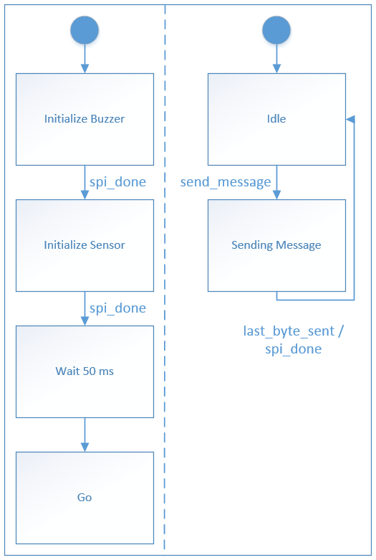
First Refinement
Meaning of the Statechart
This level of refinement adds a parallel state representing the SPI subsystem.
The SPI subsystem usually does nothing (Idle state).
When the send_message event occurs, the SPI subsystem enters a state in which represents sending the message, byte by byte.
When the last byte of the message is sent, it raises the spi_done event, allowing the other parallel state to continue, and goes back to idle.

Slide 5
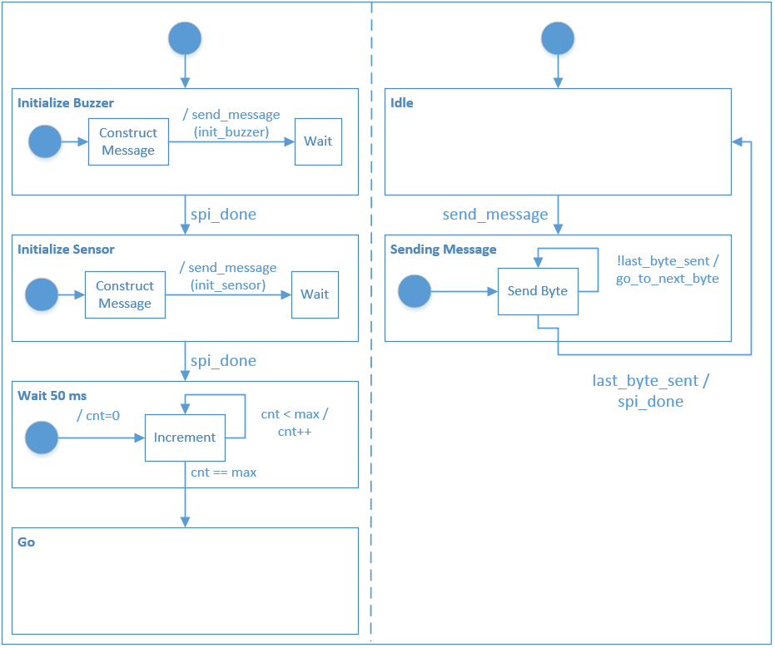
Second Refinement
We add more details on how the initialization states, the wait state, and the SPI subsystem operate, including how they interact with each other.
Note that the exclamation mark means “not”.
(Continued on next slide)

Slide 6
Second Refinement (continued)
Meaning of the Statechart
The Initialize Buzzer state constructs the SPI message to send, then it raises the send_message event, parameterized with the specific message (as indicated by the parentheses; this might actually be implemented as setting some variables). Then it waits.
After send_message is raised, the SPI subsystem kicks into action. It spins for a while in the send_byte, looping as many times as it takes to get to the last byte in the message. When the last byte in the message is sent, it goes back to idle and raises an event which allows the state machine on the left to proceed.
The sensor is initialized in a very similar manner to the buzzer.
After both peripherals are initialized, the state machine goes into the Wait 50 ms state, where it simply increments a counter until it reaches some maximum, then exits.

Slide 7
Questions (Stream-of-Consciousness)
Highest Level
At this level of abstraction, spi_done looks like an external event. It won’t be; it comes from elsewhere in the ASIC. However, leaving the transition unguarded makes it look like it should exit the state as soon as it enters it, which is also quite false. What is the appropriate way to represent this?
Similarly, how can we indicate that the transition from the Wait 50 ms state to the Go state isn’t dependent on an external event, but nonetheless doesn’t happen right away?
Perhaps we leave all the transitions unguarded. Then is there any way at this level of detail to express some of those details to be filled in later? (I.e. you know that it’s going to move on when some event indicates it’s ready, you just haven’t captured that behavior yet)
First Refinement
Adding a parallel state is not a vertical refinement. However, this type of design process, wherein the designer starts with the high level flow and then adds details of the communication protocol later, is quite natural. It would not make sense to represent the SPI subsystem as a substate of any of the states on the left-hand side, because it would then have to be duplicated multiple times – once for each state that sends a SPI message.
Similar to last slide, there are events whose source is unclear. In this case, send_message will be raised by some of the states on the left, and last_byte_sent will be something that happens inside the Sending Message state. If we leave both of those events out altogether, that will allow the SPI subsystem to churn out messages at arbitrary times. Is that a necessary evil at this level? How should this statechart be represented?
Second Refinement
In some parts of the state machine, a transition must happen and must happen immediately. For example, when send_message is raised, the SPI subsystem must start transmitting the message, or else the whole statechart will freeze up. It also is necessary that one of the two parallel state machines be able to stay in a single state indefinitely while the other takes various actions. Are these inconsistent? Do they, together, compromise stuttering-invariance and, in turn, refinement?
Is there a scoping problem because send_message is generated at a different level of refinement than it is responded to?
There is an intuitive notion that the message is composed of some integer number of bytes, and each byte should be sent sequentially until the last one. The way it is notated right now though is in terms of an event called last_byte_sent, which doesn’t indicate that. If we leave off the events altogether, the looping arrow around Send Byte becomes unnecessary, and it looks like it’s only sending one byte. Or an arbitrary number of bytes. How to notate this?
Because of stuttering, the counter isn’t obligated to count. That makes it pretty useless as a delay element. That’s ok for refinement (after all, the thing will eventually be hardware clocked), but it might be a stumbling point for a designer trying to understand it.

