Slide 1
SCXML scenarios

Slide 2
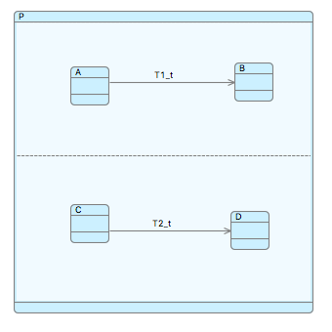
Parallel triggered transitions
T1 and T2 are both triggered by trigger t.
They are in parallel state-machines so could be triggered together,
Or one at a time depending on other guards such as source state.
Or the trigger could be consumed when neither transition is available
We could represent these options as 4 events:
E0: [~A & ~C & t]/skip
E1: [A & ~C & t]/ T1
E2: [~A & C & t]/ T2
E3: [A & C & t]/ (T1 || T2)
(The reason for explicitly modelling T1 || T2 rather than allowing them to fire in non-deterministic order, has to do with the difficulty of refining SCXML semantics and is discussed elsewhere).

Slide 3
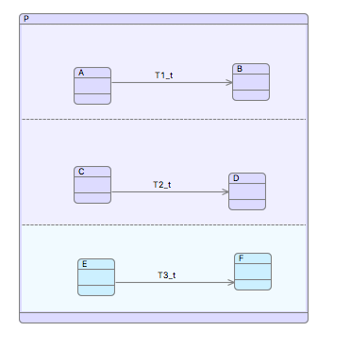
Parallel triggered transitions
In a refinement, another parallel transition T3, also triggered by t, is added. It may also fire independently or in combination with the other parallel triggered transitions.
We need to add all of these options as a further 4 events:
E0: [~A & ~C & ~E & t]/skip
E1: [A & ~C & ~E & t]/ T1
E2: [~A & C & ~E & t]/ T2
E3: [A & C & ~E & t]/ (T1 || T2)
E4: [~A & ~C & E & t]/ T3
E5: [A & ~C & E & t]/ (T1 || T3) (refines E1)
E6: [~A & C & E & t]/ (T2 || T3 ) (refines E2)
E7: [A & C & E & t]/ (T1 || T2 || T3) (refines E3)
In all cases additional clauses are added to guards hence strengthening them.

Slide 4
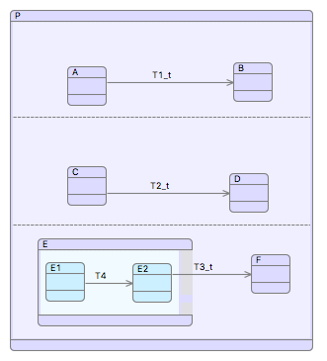
Parallel triggered transitions
In this refinement a preliminary step T4 is added to T3 which strengths the guard of T3. Note that T4 cannot fire with any of T1-3 because it is not triggered by t.
We need to strengthen the guard of all the events involving T3 to ensure that it is not enabled until after T4. Unfortunately this means that T1 and T2 have more scenarios where they can fire without T3. I.e. we should also weaken the guards of events that don’t involve T3:
E0: [~A & ~C & ~E2 & t]/skip
E1: [A & ~C & ~E2 & t]/ T1
E2: [~A & C & ~E2 & t]/ T2
E3: [A & C & ~E2 & t]/ (T1 || T2)
E4: [~A & ~C & E2 & t]/ T3
E5: [A & ~C & E2 & t]/ (T1 || T3)
E6: [~A & C & E2 & t]/ (T2 || T3 )
E7: [A & C & E2 & t]/ (T1 || T2 || T3)
E8: [E1]/ T4
N.b. E2 => E, but ~E2 /=> ~E Hence E0-3 are not correct refinements

Slide 5
Parallel triggered transitions
To avoid this problem, we allow more non-determinism in the abstract levels
We need to add all of these options as a further 4 events:
E0: [~A & ~C & ~E & t]/skip
E1: [A & ~C & ~E & t]/ T1
E2: [~A & C & ~E & t]/ T2
E3: [A & C & ~E & t]/ (T1 || T2)
E4: [~A & ~C & E & t]/ T3
E5: [A & ~C & E & t]/ (T1 || T3) (refines E1)
E6: [~A & C & E & t]/ (T2 || T3 ) (refines E2)
E7: [A & C & E & t]/ (T1 || T2 || T3) (refines E3)
In all cases additional clauses are added to guards hence strengthening them.

