Slide 1
Translating SCXML Statecharts to iUML-B State-machines
Karla Morris
Sandia National Laboratories, CA, USA
Colin Snook
University of Southampton, UK

Slide 2
Motivation
Event-B gives verification by formal proof…
… but restricted notation to simplify verification.
Engineers are used to richer semantics..
.. may find these restrictions difficult to accept.
iUML-B State-machines help but still close to Event-B.
Can Harel style state-chart semantics be reconciled with iUML-B?
We investigate a translation from SCXML state-charts to iUML-B state-machins.

Slide 3
SCXML
<state id="on">
<initial>
<transition target="idle"/>
</initial>
<!-- on/pause state -->
<transition event="turn.off" target="off"/>
<transition cond="timer &gt;= cook_time" target="off"/>
<state id="idle">
<!-- default immediate transition if door is shut -->
<transition cond="door_closed" target="cooking"/>
<transition event="door.close" target="cooking">
<assign location="door_closed" expr="true"/>
<!-- start cooking -->
</transition>
</state>
<state id="cooking">
<transition event="door.open" target="idle">
<assign location="door_closed" expr="false"/>
</transition>
<!-- a 'time' event is seen once a second -->
<transition event="time">
<assign location="timer" expr="timer + 1"/>
</transition>
</state>
</state>
</scxml>
<?xml version="1.0"?>
<scxml xmlns="http://www.w3.org/2005/07/scxml"
version="1.0"
datamodel="ecmascript"
initial="off">
<!-- trivial 5 second microwave oven example -->
<datamodel>
<data id="cook_time" expr="5"/>
<data id="door_closed" expr="true"/>
<data id="timer" expr="0"/>
</datamodel>
<state id="off">
<!-- off state -->
<transition event="turn.on" target="on"/>
</state>

Slide 4
iUML-B Statemachines

Slide 5
Similarities
Hierarchical nested state-charts
Transitions have Guards and Actions
States can have Entry and Exit Actions
(use with care in iUML-B)

Slide 6
Differences
Refinement in Event-B
Invariants in Event-B
Run to Completion – Big step/little step

Slide 7
Initial translation

Slide 8
SCXML Extensions
XML tools allow new meta-model ‘namespaces’ to be introduced.
Existing SCXML tools will ignore them
Needed in order to support:
Refinement levels (new attribute <iumlb:refinement …>)
Invariants (new element <iumlb:invariant …>)
Guards (new element <iumlb:guard …>)

Slide 9
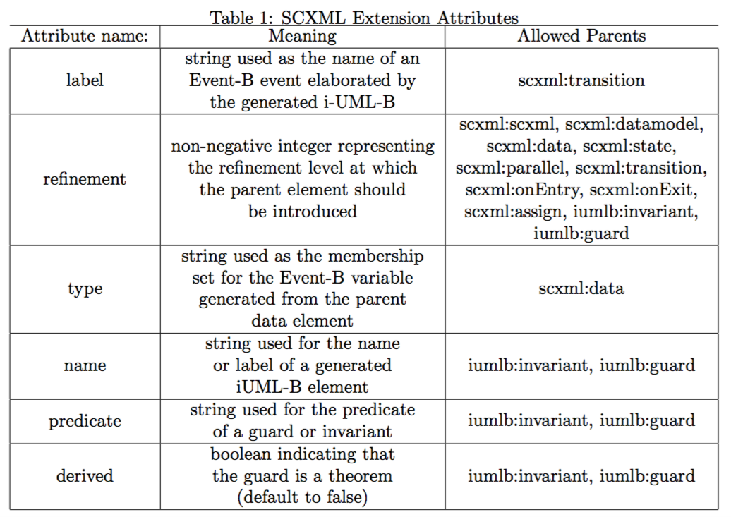
SCXML Extension Attributes

Slide 10
Example extended SCXML (extensions are the bits in red)
<datamodel iumlb:refinement="2">
<data expr="false" id="Gate_In.Block" iumlb:type="BOOL"/>
</datamodel>
<!-- Other model details -->
<state id="BLOCKED">
<transition cond="[On_In.CardAccept==true]" target="UNBLOCKED">
<iumlb:guard name="gd1" predicate="On_In.CardAccept==true" refinement="2"/>
<assign expr="true" location="Gate_In.Block" iumlb:refinement="3"/>
</transition>
<onentry>
<assign expr="true" location="Gate_In.Block"/>
<assign expr="false" location="On_In.Reset"/>
</onentry>
<onexit>
<assign expr="false" location="Gate_In.Block"/>
</onexit>
<iumlb:invariant predicate="Gate_In.Block == TRUE" name="GateCondition"/>
</state>

Slide 11
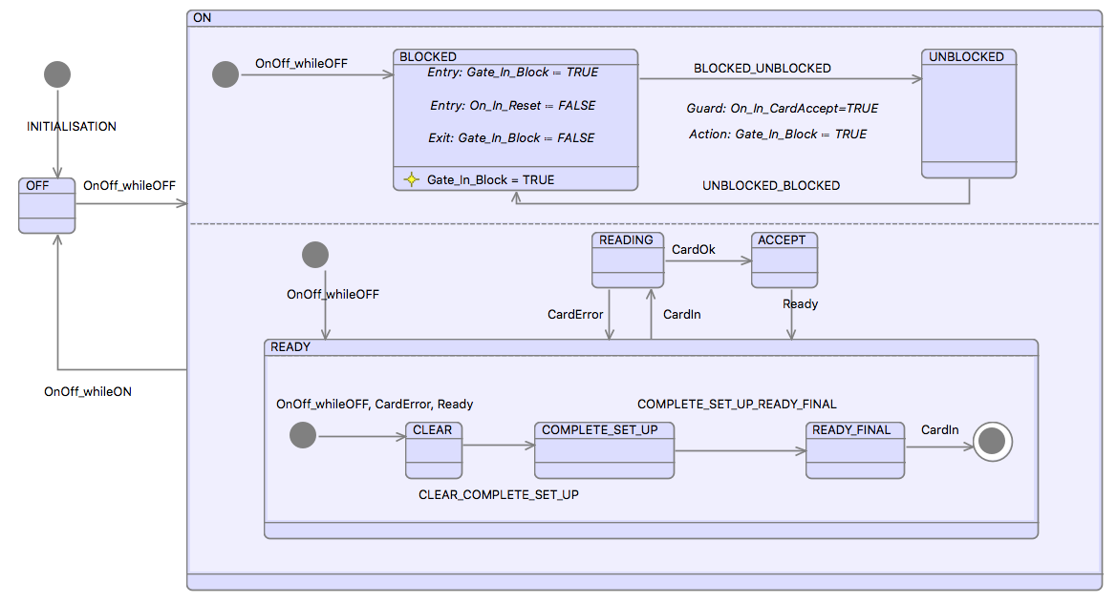
Example – generated iUML-B

Slide 12
The next version – support 4 RTC
Try modelling the run to completion semantics
E.g. trigger events create a token,
A new token can only be consumed when no transitions are enabled
Try enforcing transition sequences
???

Slide 13
Conclusions

Slide 14
Questions?

