Slide 1
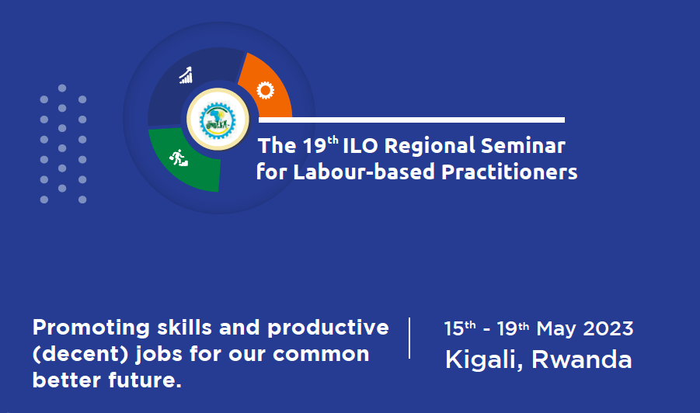
Showcases

Slide 2
Show case Visit Registration
www.ilo.smartevent.rw
Registration Link:
Registration Process
Visit on the link (www.ilo.smartevent.rw)
Select among the locations your area of interest for visiting
If the slots for that location are full, select another favorite location for visiting
List of locations ( if you click on the site name, details of the sites visit are available)
Pink Mango - Kigali
Muhanga ICPC - Muhanga
Center of excellency Rwanda coding academy - Nyabihu
IPRC Tumba - Musanze
Ampersand - Kigali
Kinigi IDG Model Village - Musanze
Green Gicumbi - Gicumbi
Kigali Tourist Venues - Kigali
Registration Deadline
14:30

Slide 3
Showcase sites information
Pink Mango
Summary:
Pink Mango is a textile industry located in Kigali Special Economic Zone that employs 4,681 staff.
Pink Mango works with the aim of protecting the environment through the following methods:
Handling plastics bags;
Handling Sewage system
Waste management system;
PINK – MANGO is ISO 14001 certified (EMS-Environment Management System)
MUHANGA Integrated Craft Production Center (ICPC)
Summary:
Muhanga ICPCs is established to improve employment of local artisans, and it aims to facilitate technology transfer and technical skills. This Center hosts two crafts with 555 working on irregular basis: (1) woodworking (carpentry) and (2) metal working (welding) as well as other support services like hardware shops, restaurant, etc.

Slide 4
Showcase sites information
Center of Excellency - Rwanda Coding Academy
Summary:
This is a TVET that combines Digitalization solutions also providing needed skills on the Labour market in terms of Technology and IT innovation.
The school has 240 students with a uniqueness of enhancing digital literacy, entrepreneurship development for creating sustainable jobs.
Integrated Polytechnic Regional College of Tumba (IPRC TUMBA)
Summary:
IPRC Tumba is know for its incubation program whereby it organizes competitions among its students.
Its purpose is to produce higher skilled technicians to benefit Rwanda and the region's economy

Slide 5
Showcase sites information
Ampersand
Summary:
Ampersand is East Africa’s first and leading integrated electric motorcycle and transport energy solution.
Ampersand is an energy and mobility startup based in Kigali. Which specializes in building electric taxi motorcycles that perform better and easier to drive, cost less to buy and operate, and take less time to refuel
KINIGI Intergrated Development Program - IDP Model Village
Summary:
IDP Model village settlements are a government initiative to provide proper housing to disadvantaged and persons in high risk areas.
The KINIGI IDP Model Village consists of 6 Apartments that accommodate 144 families, Groupe Scolaire Kampanga, an Early Childhood Development ()ECD, Kinigi Health Centre and other welfare support facilities such as cowsheds for 102 cows, poultry cages for 8000 chicken, livestock hall and Agakiriro among others.

Slide 6
Showcase sites information
Green Gicumbi
Summary:
Green Gicumbi aims at strengthening climate resilience of rural communities in Northern Rwanda (locally know as Green Gicumbi Project) is an integrated adaptation project focusing on reducing vulnerability
to climate change by enhancing the adaptive capacity of the targeted groups as well as
reducing their exposure to climate risks.
Green Gicumbi employs over 25.000 casual jobs. The visit will provide with the participants a unique experience in the following:
Presentation on Green Gicumbi Project: to be hosted at Green Gicumbi Head office
Visiting Green Gicumbi Project: the itinerary will be shared by Felix from Head quarter
Planting a tree: During the visit, it is expected that participants can have a chance to plant a tree in the designated zone if time and climate allows
KIGALI TOUR
Summary:
Kigali tour will comprise of Gisozi Genocide Museum, Nyandungu urban Wetland - Eco Tourism park and other touristic venues across numerous hills, ridges and valleys in Kigali

