Slide 1
SendSecure Emily Venuto

Slide 2
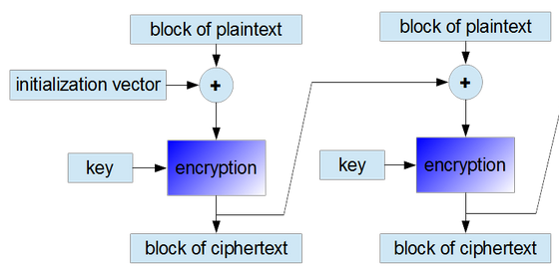
Background
+ Concept
Problem to solve: adding a layer of security to passing text back and forth
128-bit AES encrypt and decrypt of email text
Cipher block chaining

Slide 3
Requirements
- Strings of any length
- String of varying structure (i.e. spaces, tabs, newlines)
Design:
- Treat every message as one string
- Process strings in 128-bit blocks
- Padding added to every string
Methodology

Slide 4
Improvements
Designing this as an email plugin
– encrypt/decrypt directly in email window
Better method for key transfer
– RSA, PGP, Diffie-Hellman

Slide 5
Conclusion
SendSecure can successfully and quickly encrypt or decrypt messages of any length or structure

