Slide 1
D-Sync Presents Dragon Attack
Technical Lead - Javon Lee
Producer – Jacob Lim
Game Designer – Andrew Chong
Product Manager – William Yoong
Notes:
william

Slide 2
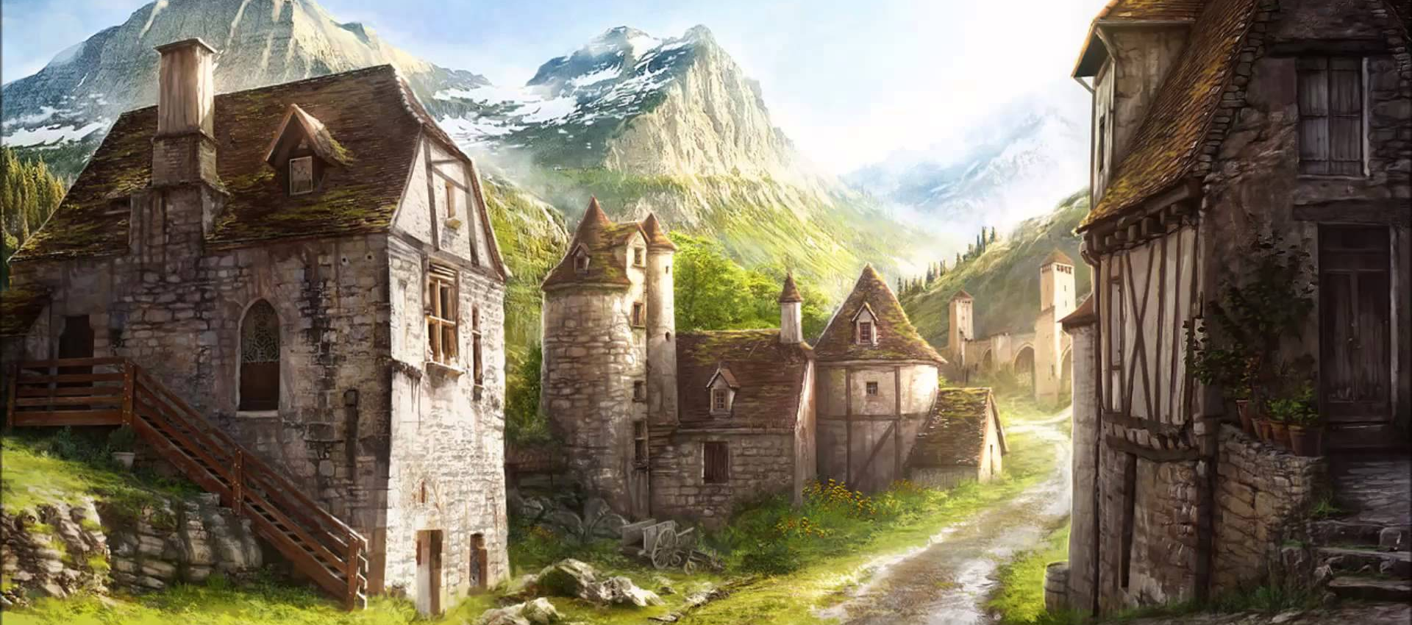
Concept
Dragon Character
Medieval Fantasy
2D Action Platformer
Notes:
william

Slide 3
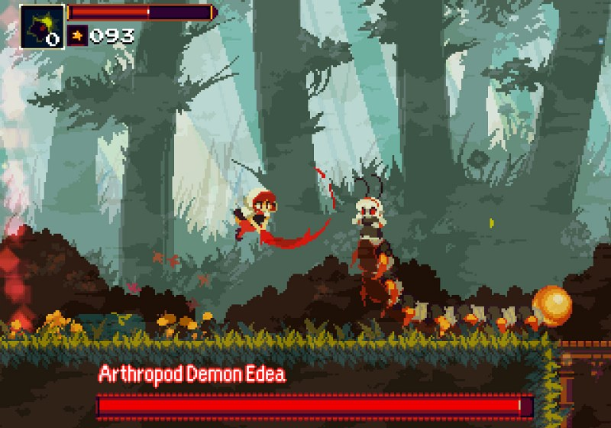
Core Features
Combat
Platformer
Notes:
william

Slide 4
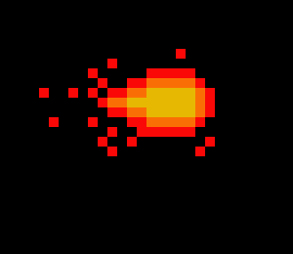
Player Mechanics
Movement
Left or Right
Jump
Attack
Fireball
Mega Fireball
Notes:
andrew

Slide 5
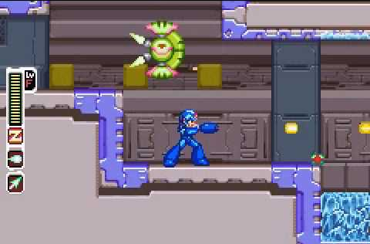
Game Design
3 main stages split into sub-stages
Normal mobs and boss fights
Clear stages and defeat bosses to move on
Notes:
andrew

Slide 6
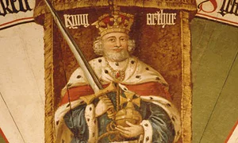
Game Resources
Enemies
Power ups
Bosses
Cerberus
Merlin
King Arthur
Notes:
andrew

Slide 7
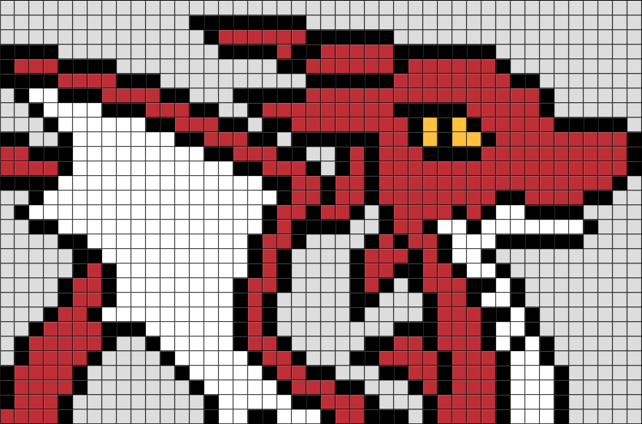
Visual Design
Pixel art
Notes:
javon

Slide 8

Physics Design
Gravity
Collision
Motion Dynamics
Notes:
javon

Slide 9
Priorities
High
King Arthur AI
Basic AI
Character Mechanics
Low
Scoring System
Power Ups
Platforming
Notes:
jacob

Slide 10
Risk and Mitigation
AI (Technical)
Cut down number of bosses
Over Scoping
Cut down low priority features
Schedule Clash
Meet up more after school and weekends
Notes:
jacob

Slide 11
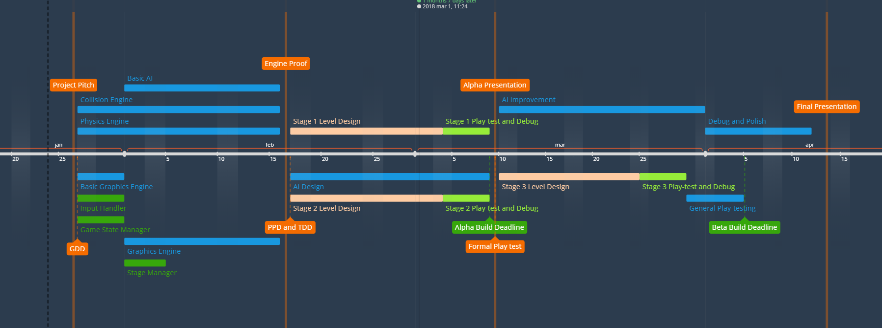
Timeline
Notes:
jacob

Slide 12
Q&A

