Slide 1
D-Sync Presents Dragon Attack
Technical Lead - Javon Lee
Producer – Jacob Lim
Game Designer – Andrew Chong
Product Manager – William Yoong

Slide 2
Concept
Dragon Character
Medieval Fantasy
2D action platformer

Slide 3
Core Features
Combat
Land mode
Flight mode
Platformer
Score system

Slide 4
Player Character
Switch between flight and melee
Different forms have different skills

Slide 5
Mechanics
Clearing stages
Fighting bosses to clear current stage
Win condition
Hazards/puzzles
Side scrolling

Slide 6
Game Resources
Enemies
Power ups
Bosses
Cereberus
Merlin
King Arthur

Slide 7
Visual Design
Pixel art
Camera will focus on player’s character

Slide 8
Physics Design
Gravity
Collision

Slide 9
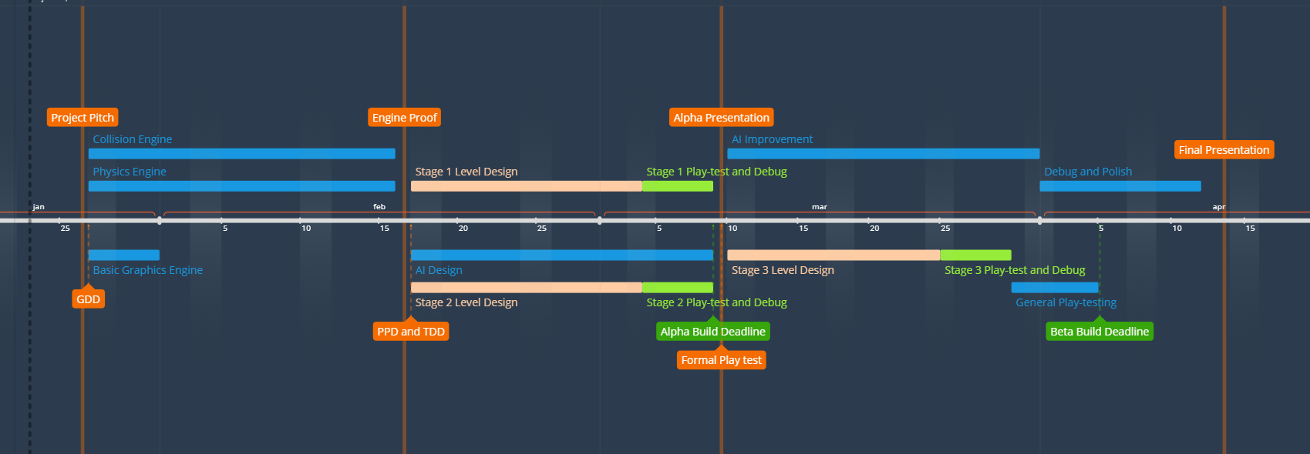
Timeline

Slide 10
Q&A

