Slide 1
D-Sync Presents Dragon Attack
Technical Lead - Javon Lee
Producer – Jacob Lim
Game Designer – Andrew Chong
Product Manager – William Yoong
Notes:
william

Slide 2
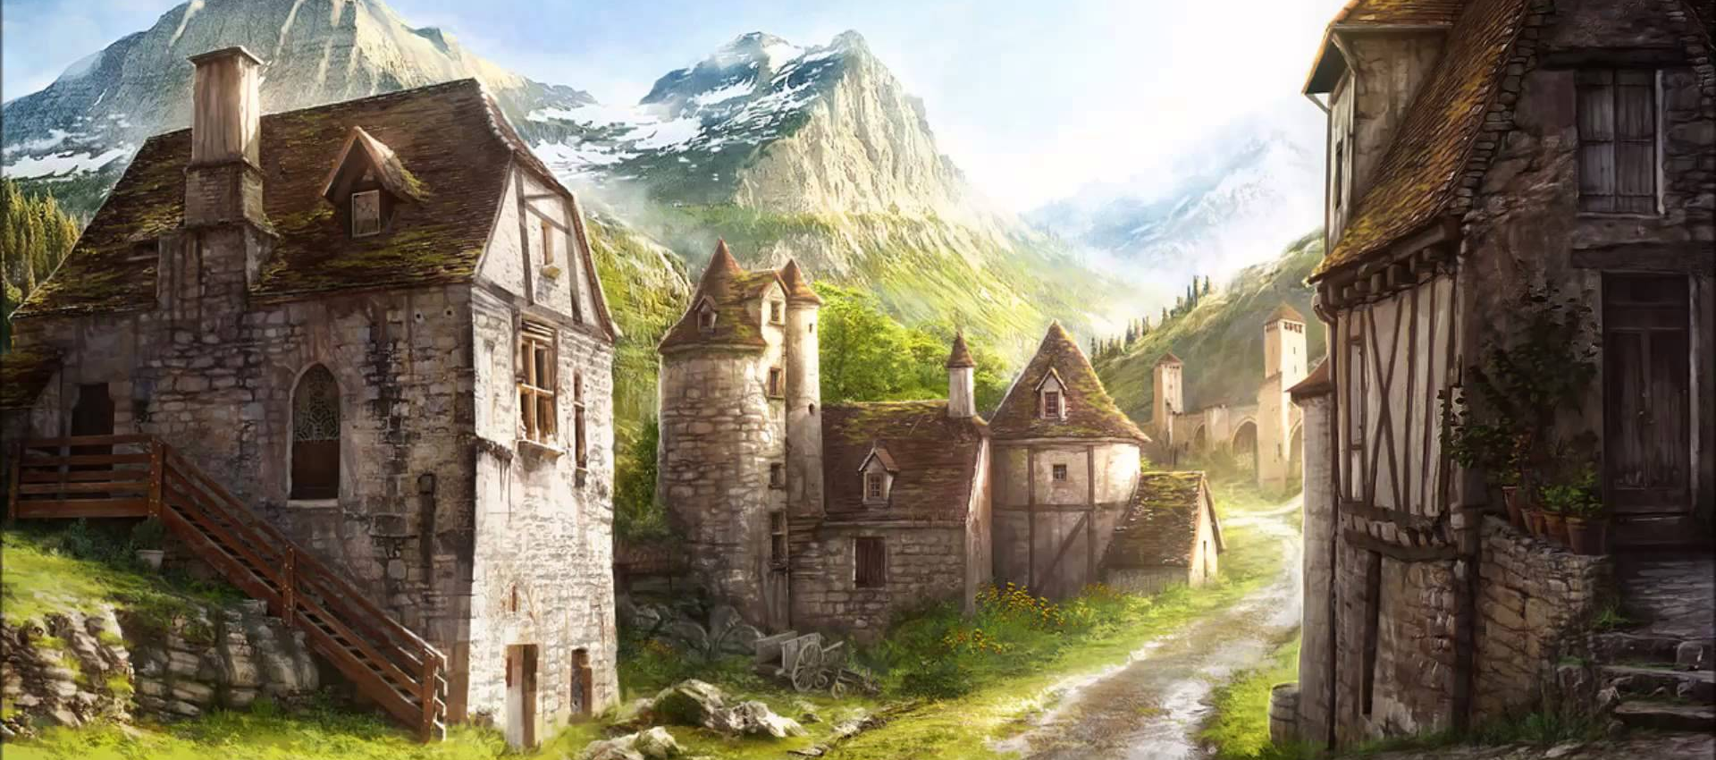
Concept
2D Action Platformer
Medieval Fantasy
Dragon Main Character
Notes:
william

Slide 3
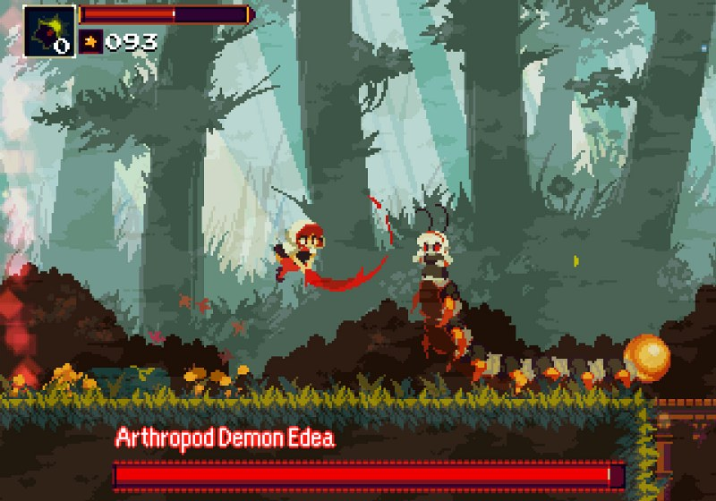
Core Features
Combat
Platformer
Notes:
william

Slide 4
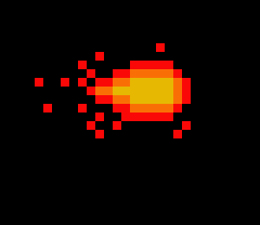
Player Mechanics
Movement
Left or Right
Jump
Attack
Fireball
Mega Fireball (Charged)
Notes:
andrew

Slide 5
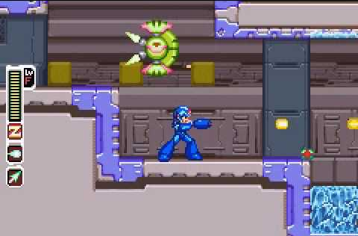
Game Progression
3 main stages split into sub-stages
Boss fights
Different Enemy Behavior
Notes:
andrew

Slide 6
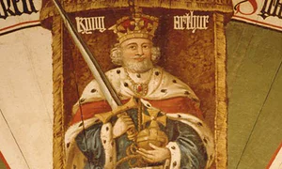
Combat
Enemies
Basic and Elite
Power ups
Bosses
Cerberus
Merlin
King Arthur
Notes:
andrew

Slide 7

Physics Engine
Gravity
Projectiles (Arrows)
Jumping
Notes:
javon

Slide 8
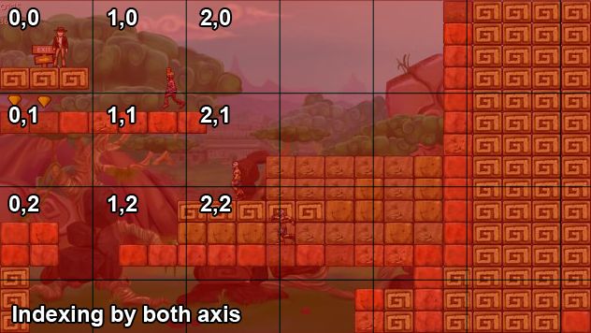
Grid Collision

Slide 9
Priorities
High
King Arthur AI
Basic AI
Character Mechanics
Low
Scoring System
Varied Power Ups
Horde Mode
Notes:
Our higher priorities are AI and mechanics. The King Arthur Final Boss fight is one of our game’s selling points, hence we are prioritizing on completing its AI.
Our lower priority features are the Scoring System, Power Ups and Horde Mode. Horde Mode is an extra feature we plan to implement when our core game is completed.
It is a mode where the player defeats waves of enemies until he dies.

Slide 10
Risk and Mitigation
AI (Technical)
Cut down number of bosses
Over Scoping
Cut down low priority features
Schedule Clash
Meet up more after school and weekends
Notes:
For risks and mitigation, we have AI. The AI for the bosses may be more complicated than we thought and may need more time. If that happens, we plan to cut down on the number of bosses to prioritize the King Arthur AI.
Over scoping may be a problem as we may not have time to include all the features we want to include into our game. If that happens, we will spend more time on the higher priority features.
All our schedules are different so we may not have as many common timeslots for us to work together. Hence, we will be meeting up more after school and during the weekends.

Slide 11
Q&A

