Slide 1
Estimating Observation Errors from Tag Data
Everett J. Rzeszowski

Slide 2
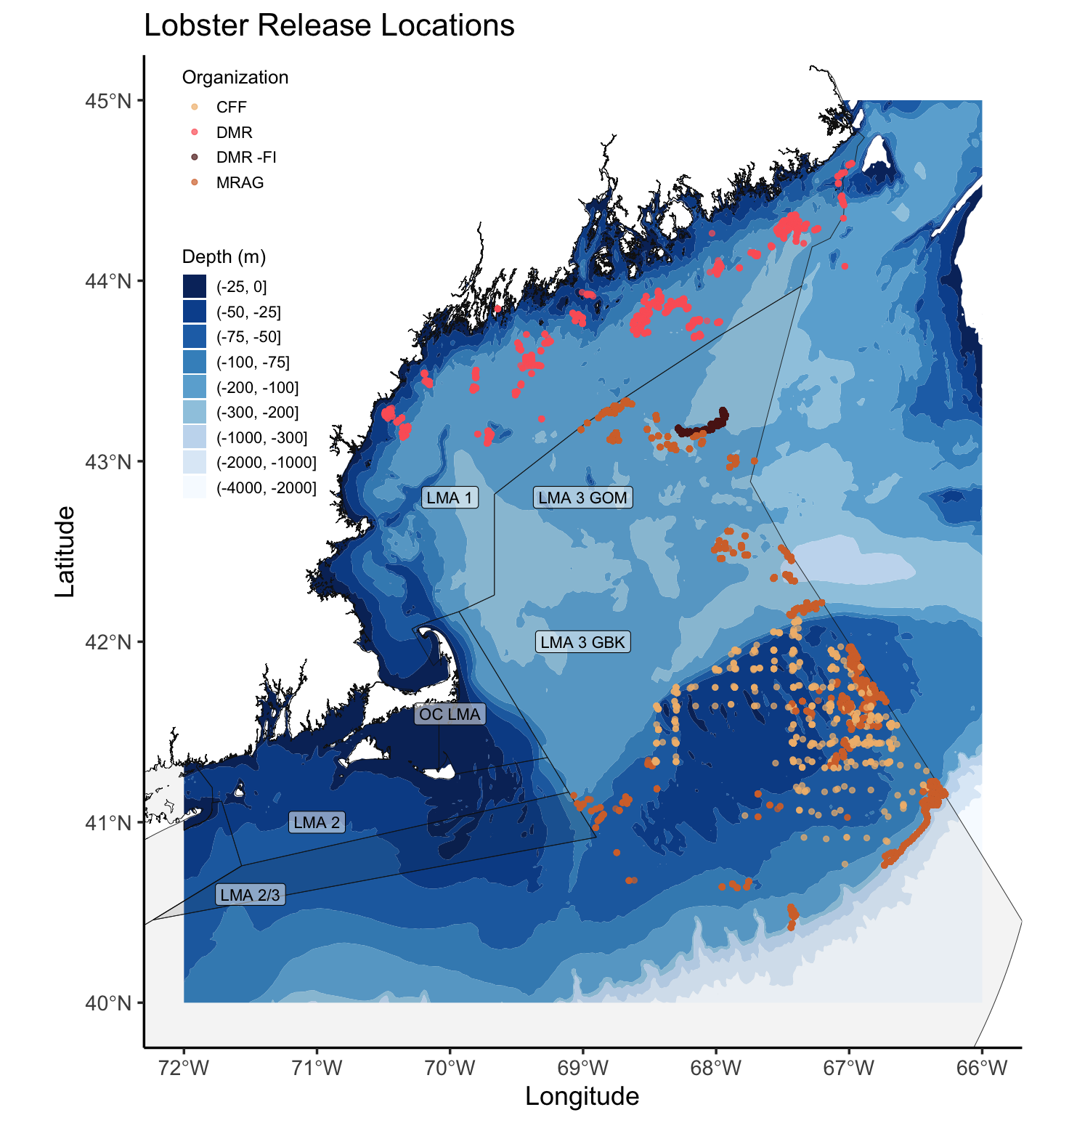
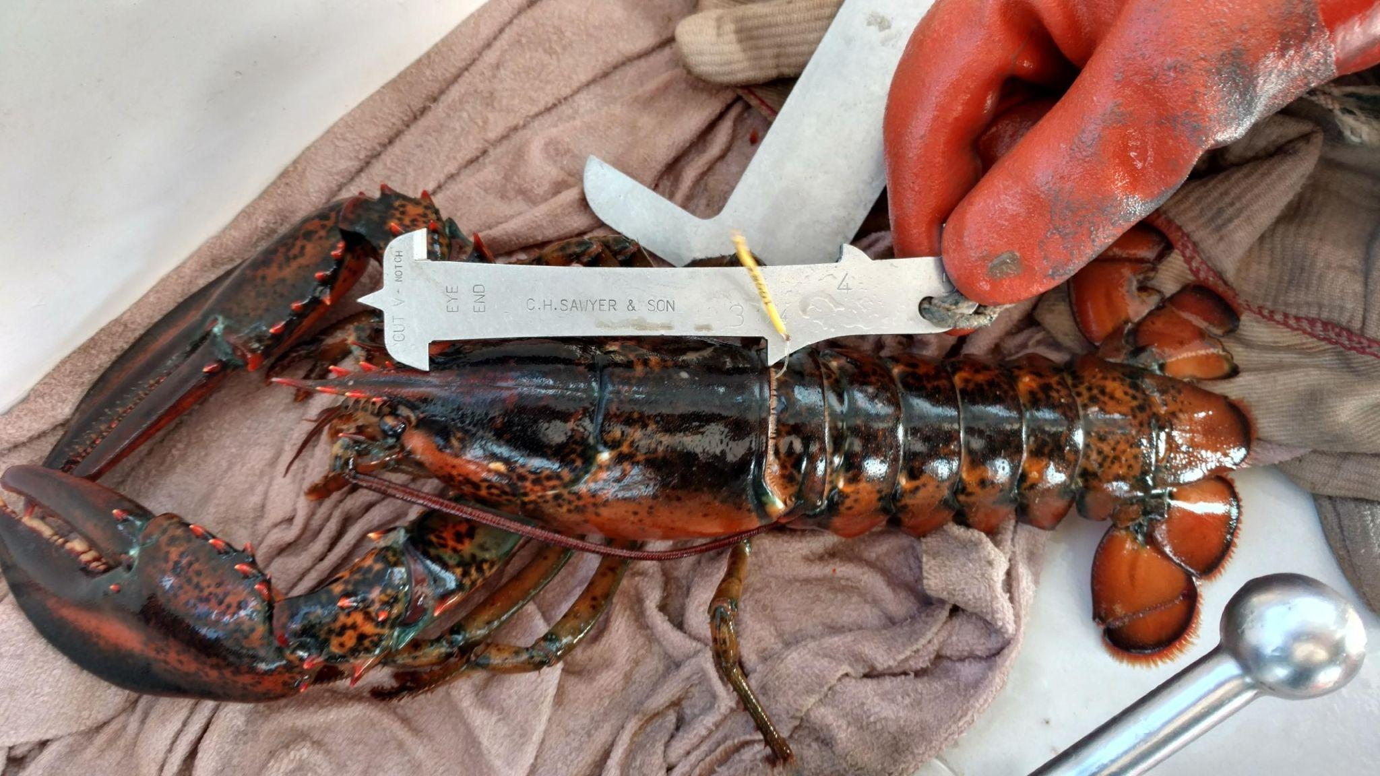
AOLA data collection
Project addressed 2015 ASMFC Stock Assessment research priorities.
“Examine stock connectivity between GOM and GBK”
“Update information on growth and maturity”
Above: Lobster release locations by different organizations; Right: Example image used in industry outreach to fishermen.
Notes:
So I just gave you about 3 minutes of stock assessment background and hopefully nobody is asleep yet. The Atlantic Offshore Lobstermens Association tagging project arose out of the need to validate these new stock assessment assumptions. The project was conceived on a pilot scale on GBK in 2015-2016 before expansion to the larger GOM region and was designed to address multiple research priorities from the previous stock assessment, today I will be focusing on stock connectivity.
Tag release locations across the entire project are shown on the right. During the project, almost 18000 lobsters were released with over 1800 recaptures (slightly more than 10 %). Most of this tagging was done using discard lobsters from active commercial vessels (so undersize, oversize and reproductively marked lobsters) however almost 2000 were tagged and released via fishery independent surveying which targeted lobsters that were not being actively fished or had distance from commercial traps, you can hear more about at poster sessions from Kathleen Reardon. Upon recapture fishermen were asked to report photos of lobsters with gauges for subsequent length estimation in ImageJ, a subset of these data points include both a photo and a caliper measurement which can be used to validate length estimation from this method. Another topic being presented by Kathleen later this week.

Slide 3
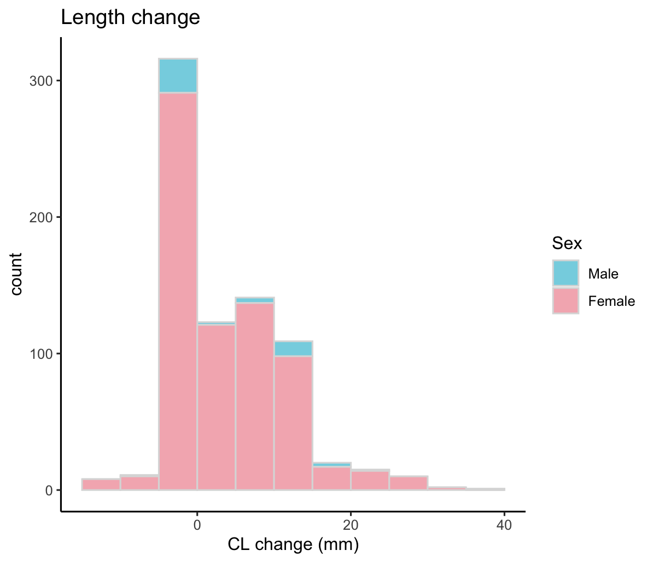
Recapture data
1800+ recaptures
488 caliper only measurement
270 caliper + ImageJ measurement
251 ImageJ measurement
Note: a large proportion of measurements are negative
Calculated length change from caliper measurements (758 total)

Slide 4
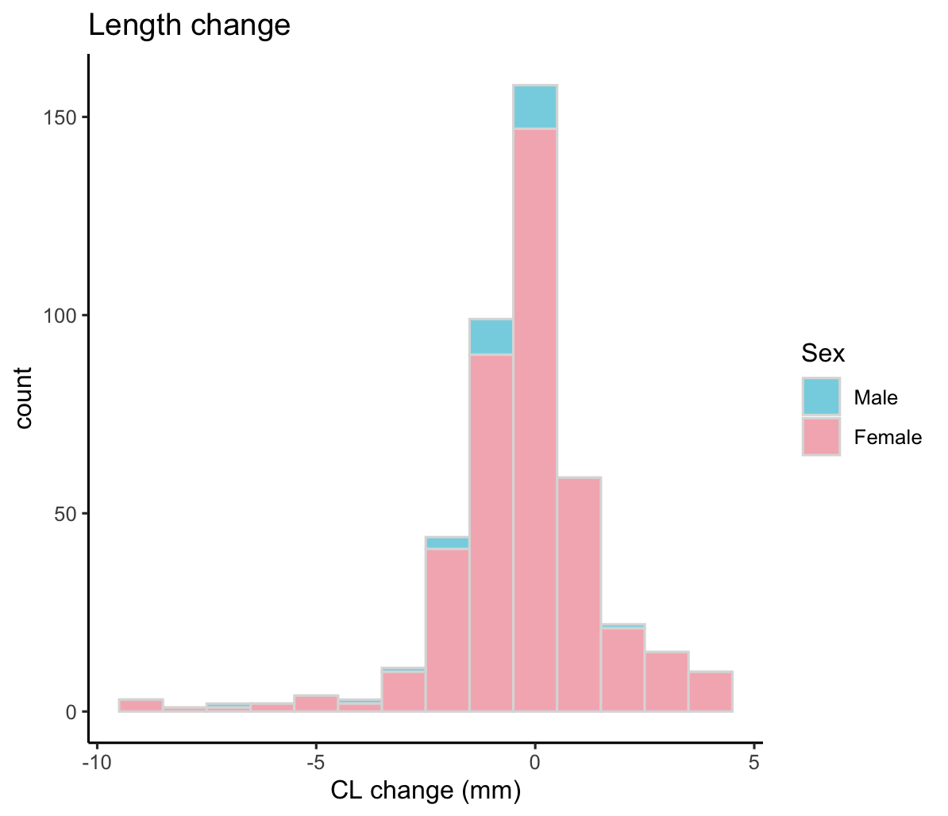
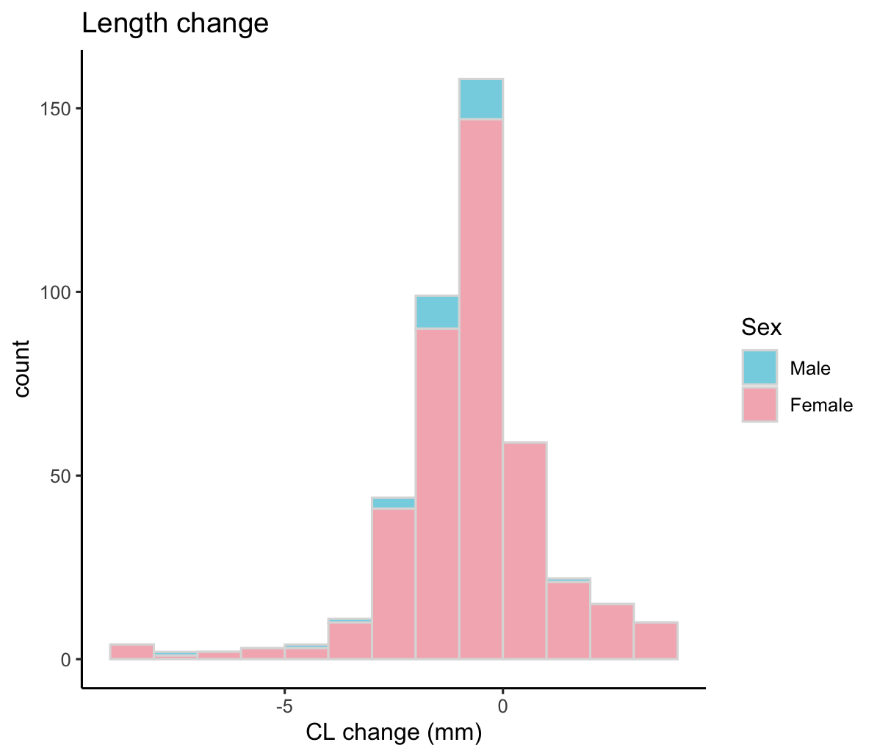
Low growth observations
How can we use poor datapoints i.e. low, negative, zero length change?
Distribution of low length changes.

Slide 5
Estimating error from obs. with E[Growth = 0]
Collect Recapture Length Obs.
Caculate Length Change, and Filter Growth to Minimum Molt Increment, E[G] = 0
Minimize the D-statistic in KS by optimizing standard dev. p
Generate a Normal Vector with Mean = 0, Standard Deviation p
ITERATE
Round Randomized Error Vector to Match Obs. Error Structure
Compare error vectors with KS test, bootstrap to prevent staircase effect.
General Procedure:
Filter growth observations to < 5 mm close to minimum stock assessment growth increment, truncate negative end of distribution as large errors are likely associated with a second error type.
Generate normal vector with mean = 0 and standard deviation = p.
Discretize the vector to match structure of growth measurement errors.
Compare the observed “low growth” distribution to the discretized normal vector using KS non-parametric test.
Optimize the standard deviation parameter to minimize the D-statistic of iterative KS tests. (Brent method of minimization).
The D-statistic describes the maximum distance between 2 ECDFs and thus describes the maximal separation between two distributions.
Iterate the process and select most common parameter value

Slide 6
Why estimate error in this way?
Each length measurement has the potential to introduce error
Combining length estimates may cancel or compound this error → error distribution
If we can estimate a stable stochastic term for this error, we can add noise to GTM growth increment parameter
Running the assessment model with and without this additional noise can inform as to the level of compound measurement bias and its impact on results

Slide 7
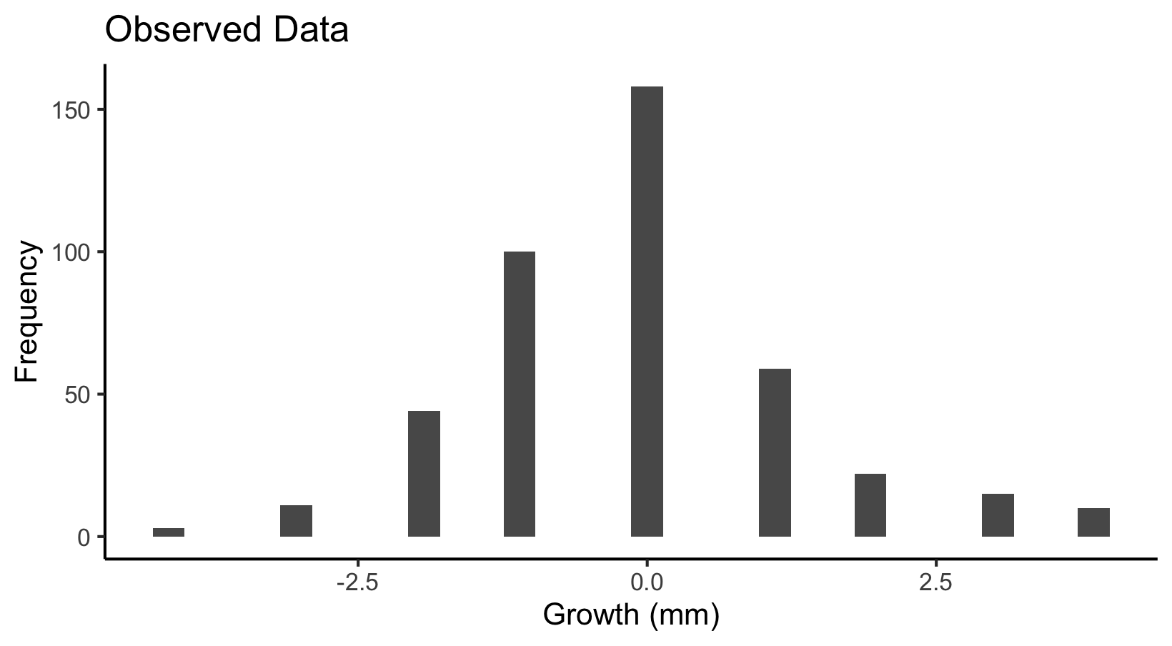
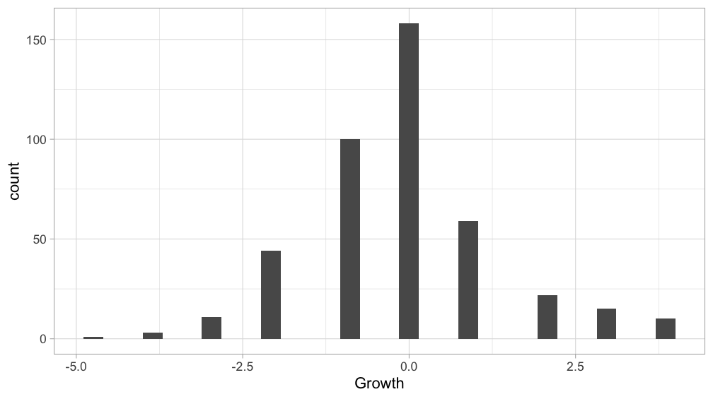
Distribution of low growth measurements
Low growth measurements are not normally distributed due to the discrete structure of observer measurements.
Confirmed with Shapiro-Wilk.

Slide 8
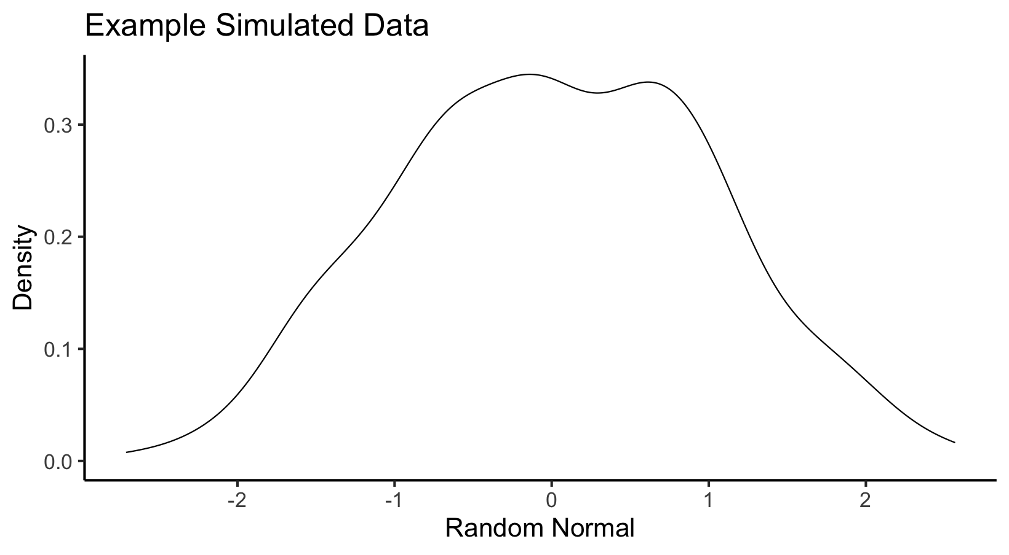
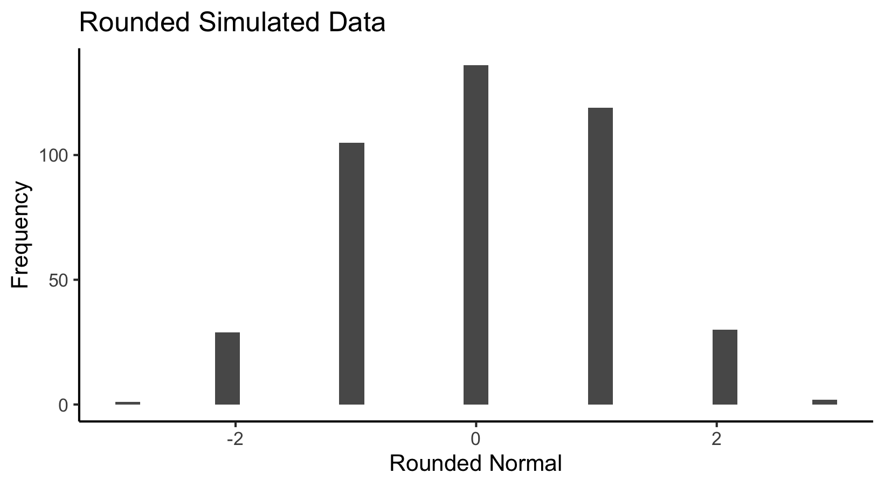
The normal vector, discretization and the D-statistic
Generate random normal, discretize to match growth data, compare distributions via KS D-statistic

Slide 9
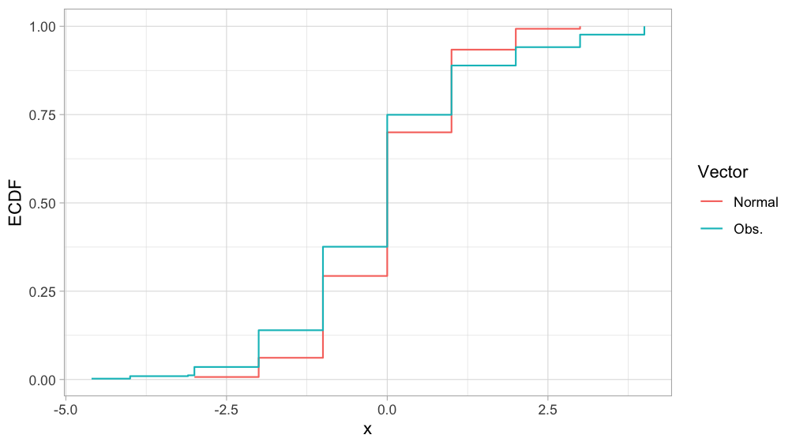
The normal vector, discretization and the D-statistic
D-Statistic

Slide 10
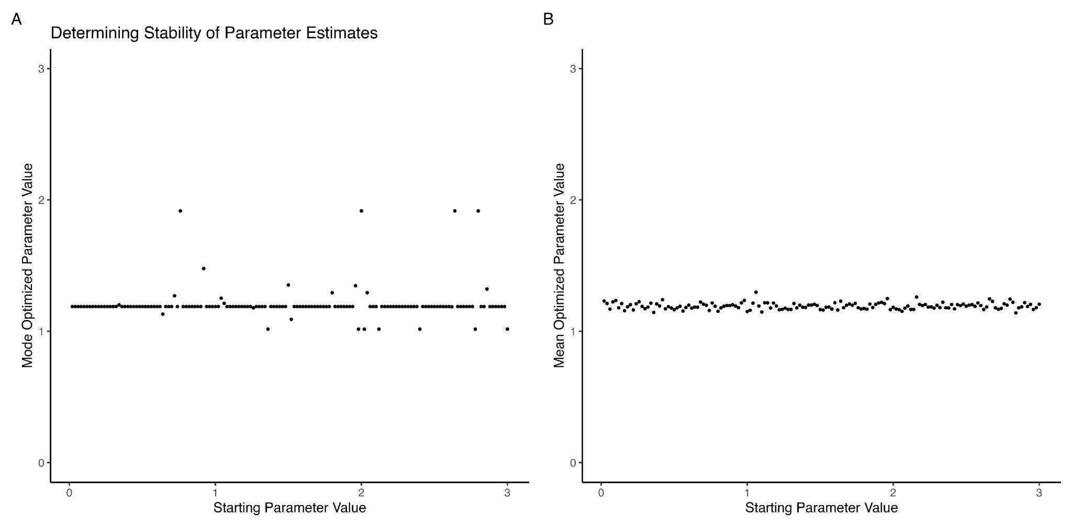
Testing Across Starting Parameters
150 starting standard deviation values from 0.02 to 3.00
Standard deviation is optimized over 100 iterations, mode and mean are reported to determine stability
N(0, 1.19) is identified as the stochastic term.

Slide 11
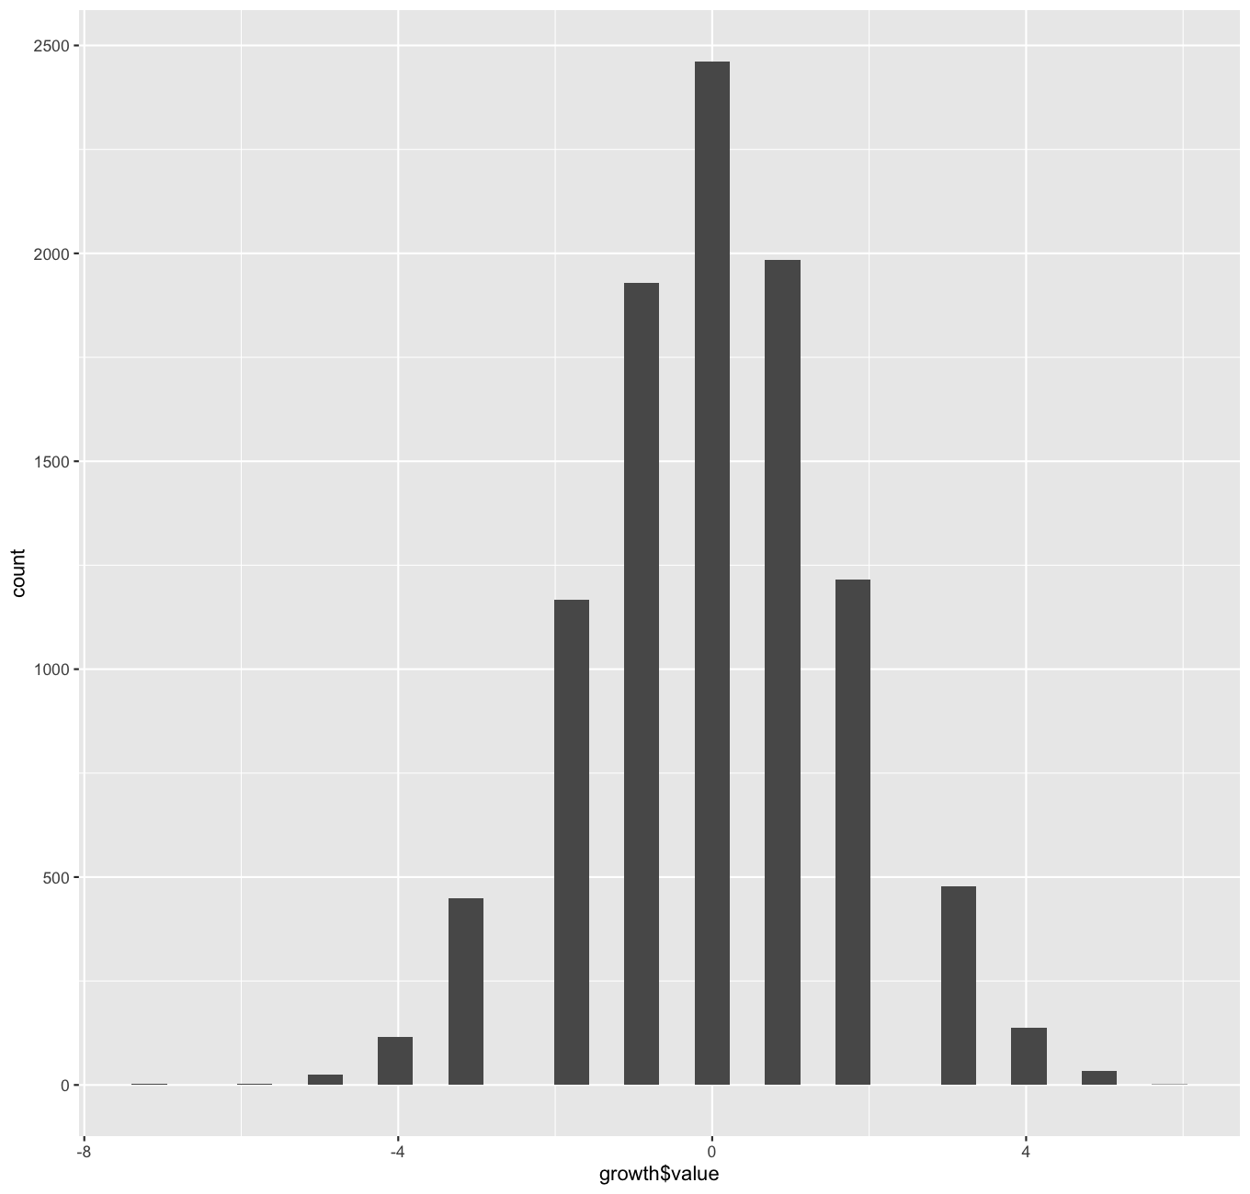
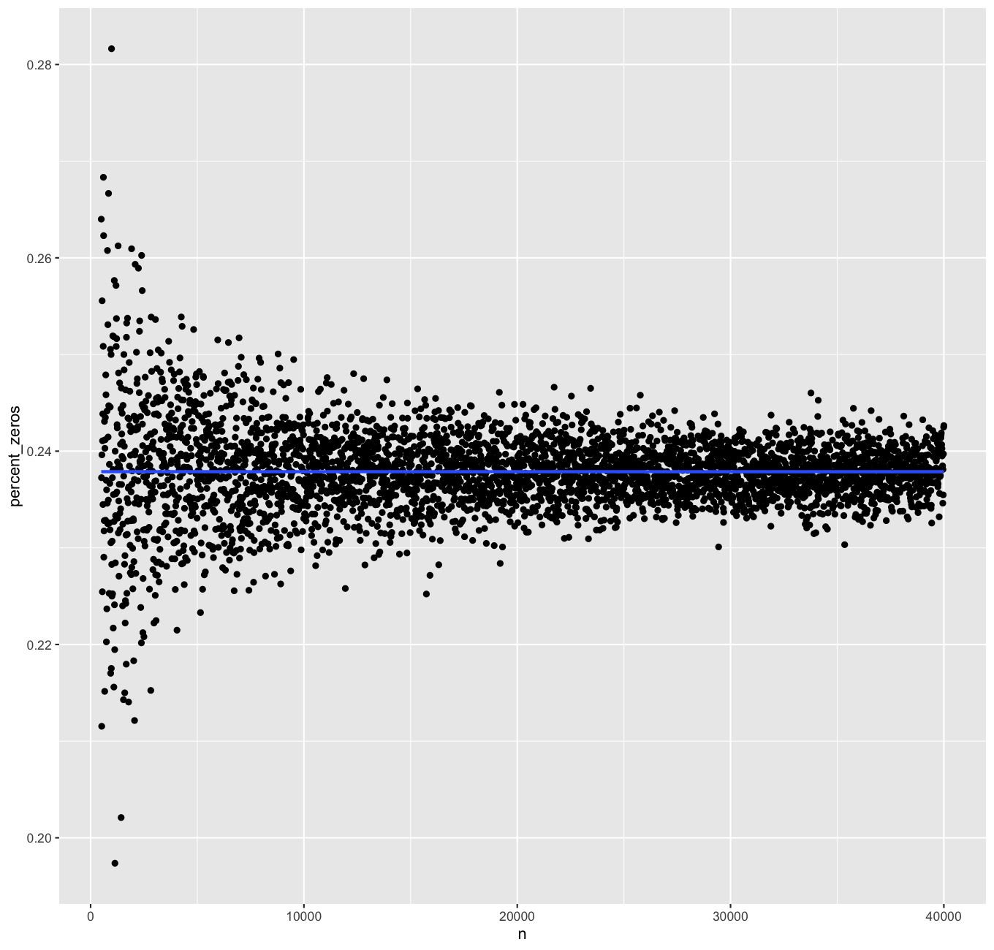
Adding error components
If we assume both observer obs. have the same error structure,
Error cancels itself 23.8 % of the time.

Slide 12
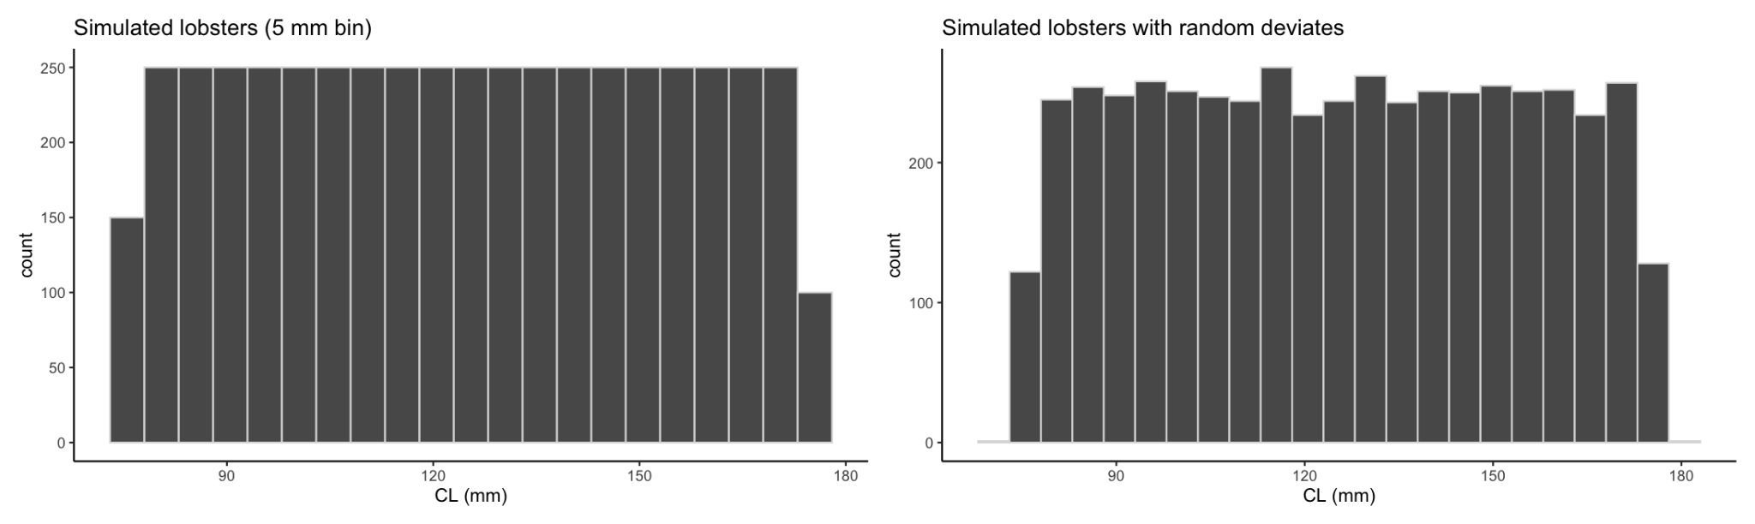
Simulation bin change, n = 5000 “lobsters”
In simulation where lobsters are equally distributed across 5 mm bins, adding the stochastic term changes lobster size 19% of the time.

Slide 13
Take Home Points
When we expect Growth = 0 we can use observations to calibrate an error term for growth.
Optimization of this term across parameter values finds N(0, 1.19) to be an appropriate stochastic term to model introduced observation error.
This stochastic term changes a lobsters size bin 19 % of the time in simulation.
This could be used to add noise to GTM growth increments and determine if observer error impacts our understanding of stocks by changing growth.
Next step: Fit as max likelihood through TMB

Slide 14
Questions!

