Slide 1


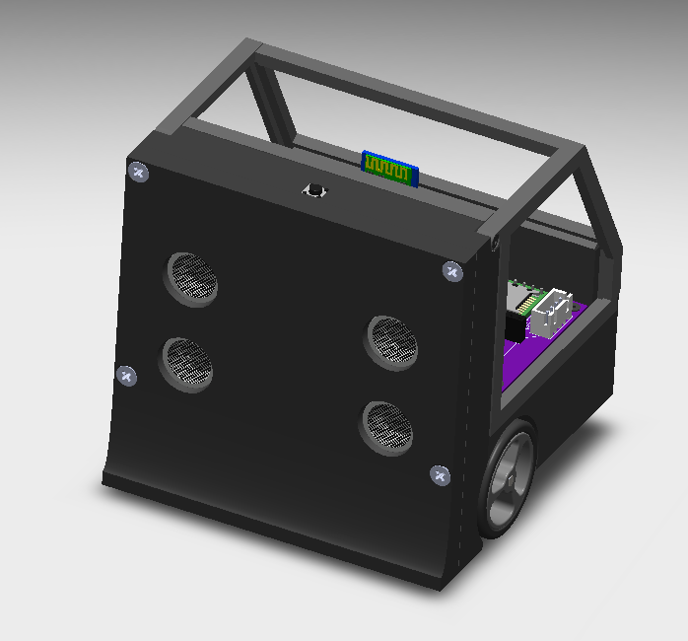
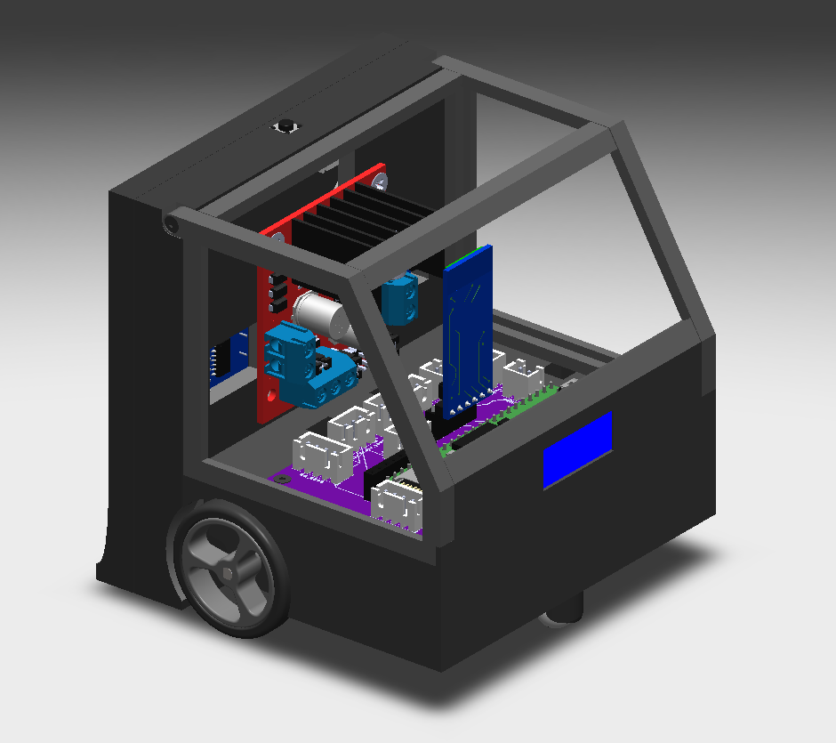
Objectives for Sumo robot
Designing An Autonomous, Remotely Operated Sumo Robot
group Members
Must be able to push an object out of the ring 9 out of 10 times without human intervention.
User must be able to read values for each sensor, such as the infrared and ultrasonic sensors.
Must be between 475 and 500 grams.
Must be able to move 15 minutes on a continuous charge.
Wires must be grouped with split loom or other wiring organization. All wires will be secured to the frame and no cardboard or tape will be visible.
Must push the object out of the ring in under 45 seconds.
Must have an option to be remotely operated by a user.
Everett Brandt, Karsen Burson, Matthew Shuman, Rachael Cate PhD
Start Button
Figure 1
Hinged Sides
Motor Driver
Figure 2
Bluetooth Module
Everett Brandt
Karsen Bursen
Engineering Timeline
Design Research
Fall Term
Preliminary Design Review
Test Preliminary Design
Build
Electronic Modules Purchased
Redesign
HC-SR04 Ultrasonic Sensors – 2
HC-05 Bluetooth Module – 1
Daoki Infrared Sensor – 1
Teensy 3.6 – 1
L2989 Motor Drivers
Tactile SPST Switch - 1
9V Battery Holder with Switch
Review Design
Test
Winter Term
Final Testing
Finalize Documentation
Ultrasonic Sensors
Removable Front Panel
Teensy PCB Shield
OLED Display
Engineering Expo
Block Diagram
Future Work
Enclosure
Design Elements
While testing our robot, we realized that our design choices caused some limitations, such as the size, speed, usability, and battery life of the robot. Therefore, future changes should be made to optimize our design. To increase the speed, a camera with a computer vision package to locate the object would be much faster and more accurate than the ultrasonic sensors. To decrease the size, custom servo driver boards will be designed that are smaller than our purchased boards. Instead of one infrared sensor, two infrared sensors placed on the furthest sides of the front panel would increase the accuracy of detecting the line.
Power Supply
Infrared Sensor
enclosure
Printed Circuit Board and Microcontroller
The enclosure was designed in SOLIDWORKS and 3D printed. It was designed so that all electronics can be easily accessed but are also protected. The front panel can be easily taken off to access the ultrasonic sensors and the underside includes a 9V battery holder so that replacing batteries is trivial. The hinged walls can be moved for modifying the inside of the robot but also keeps the inside protected. Lastly, spots for the on/off switch and start button were included so that it’s user friendly
A teensy 3.6 microcontroller was chosen as the microcontroller because of its small footprint, low cost, and programmability. A PCB shield was designed so that connections to each sensor/module can easily be completed and modified via JST connectors.
OLED Display
Microcontroller and PCB
Ultrasonic Sensors
Sensors
An Infrared sensor is used to detect the edge of the ring. To give the robot vision, two ultrasonic sensor were mounted on the frame. These sensors send out an ultrasonic wave and the microcontroller times how long it takes for the wave to return. This is then converted into the distance of the nearest object.
Acknowledgements
Python Program
Servo Driver Board
OLED Display
This project could not have been completed without the help of others that advised and helped us complete the project. We would like to give special thanks to our instructors Matthew Shuman and Rachael Cate PhD for their continuous guidance in the creation of the project. We would like to also thank Westley Wurscher for his feedback and advising on the documentation and usability of the robot. Lastly, we are grateful for Chris Sullivan for helping us design the frame and printing it out on his 3D printer.
The OLED helps satisfies the second engineering requirement and makes live debugging simple. It displays whether the program is in autonomous, user controlled, or idle mode. The values that the teensy reads from the sensors are also displayed so that we can verify whether they are working properly. Lastly, the logic is checked by displaying the current direction that the robot is travelling in.
User controlled
The robot is able to switch between autonomous and user controlled mode. The user can provide input into a computer keyboard which interfaces with the teensy via the Bluetooth Module.

