Slide 1
SLPS Attendance Trends
2023 - 2025 | DESE Proportional Attendance Data
School Board Presentation • February 2026

Slide 2
Executive Summary
2025 district proportional attendance rate: 46.3% - unchanged from 2022
Pre-pandemic peak was 88.3% in 2016; current rate is 42 points below
K-8 rate (50.0%) outpaces high school (36.5%) by ~13.5 points
School-level range: 9.4% (Vashon High) to 94.9% (Mallinckrodt ABI)
SLPS trails the STL metro suburban average by ~40 points
Racial/socioeconomic disparities are severe: White 77.4% vs Black 41.4%

Slide 3
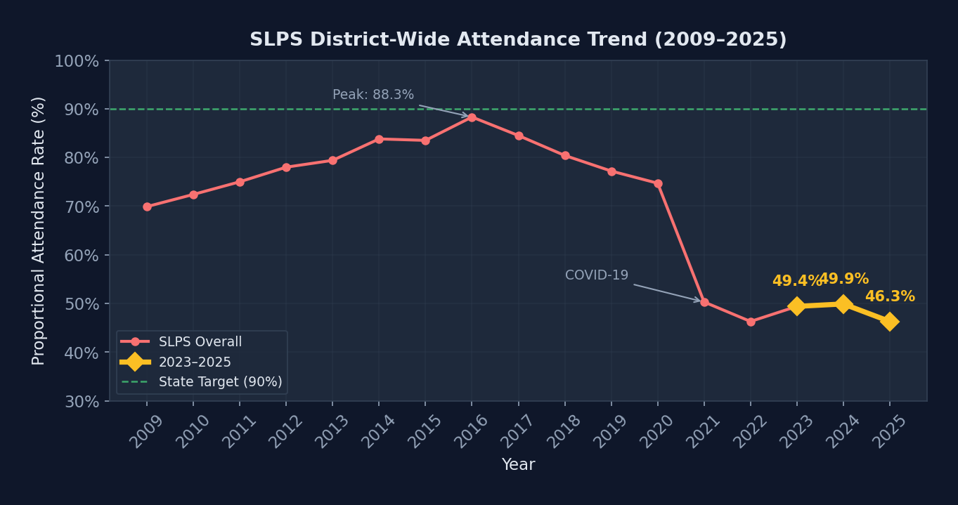
District-Wide Attendance Trend

Slide 4
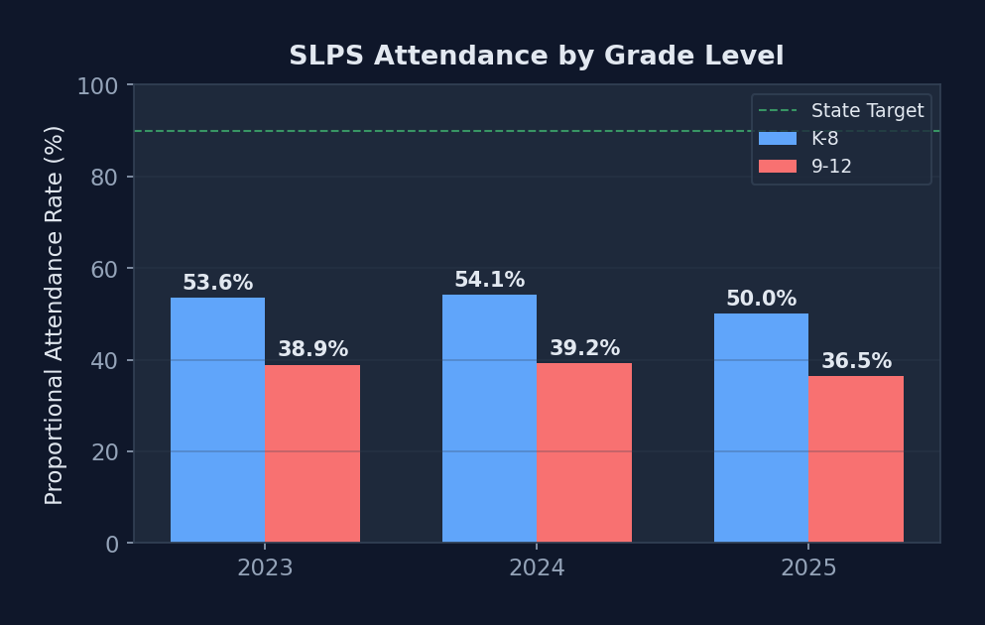
Attendance by Grade Level
K-8 consistently outperforms 9-12 by 13-15 points
Both levels declined in 2025
At 36.5%, barely 1 in 3 HS students attend regularly
Middle school is the critical transition point
Younger students depend more on parent routines
Older students face work, childcare, disengagement

Slide 5
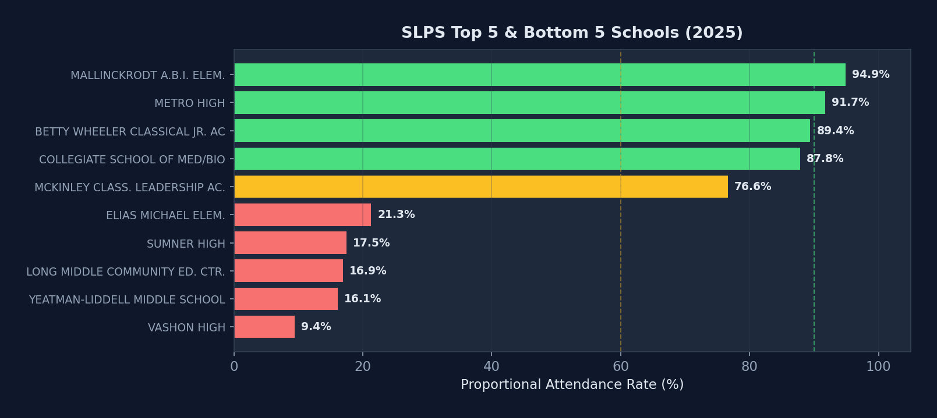
School-Level Performance (2025)

Slide 6
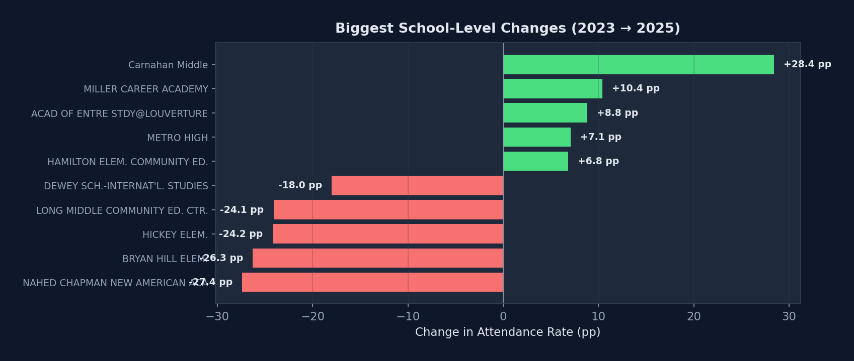
Schools with Largest Changes (2023 → 2025)

Slide 7
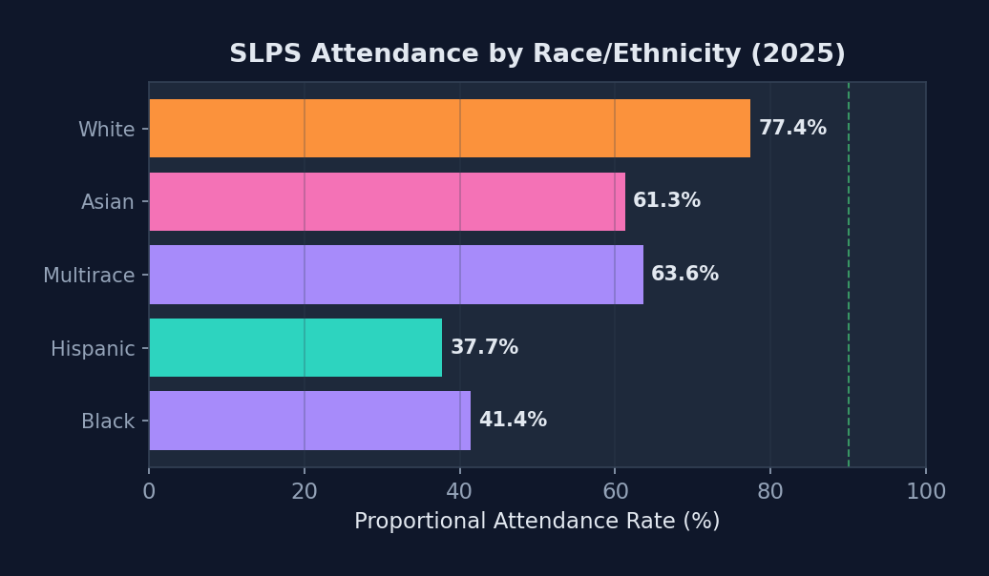
Demographic & Equity Lens (2025)
White students: 77.4% - nearly 2× Black (41.4%)
Hispanic: 37.7% | Asian: 61.3%
FRL rate (46.3%) mirrors overall - most students qualify
IEP: 40.3% | LEP: 44.8%
Gaps have widened since the pandemic
Equity must anchor any intervention strategy

Slide 8
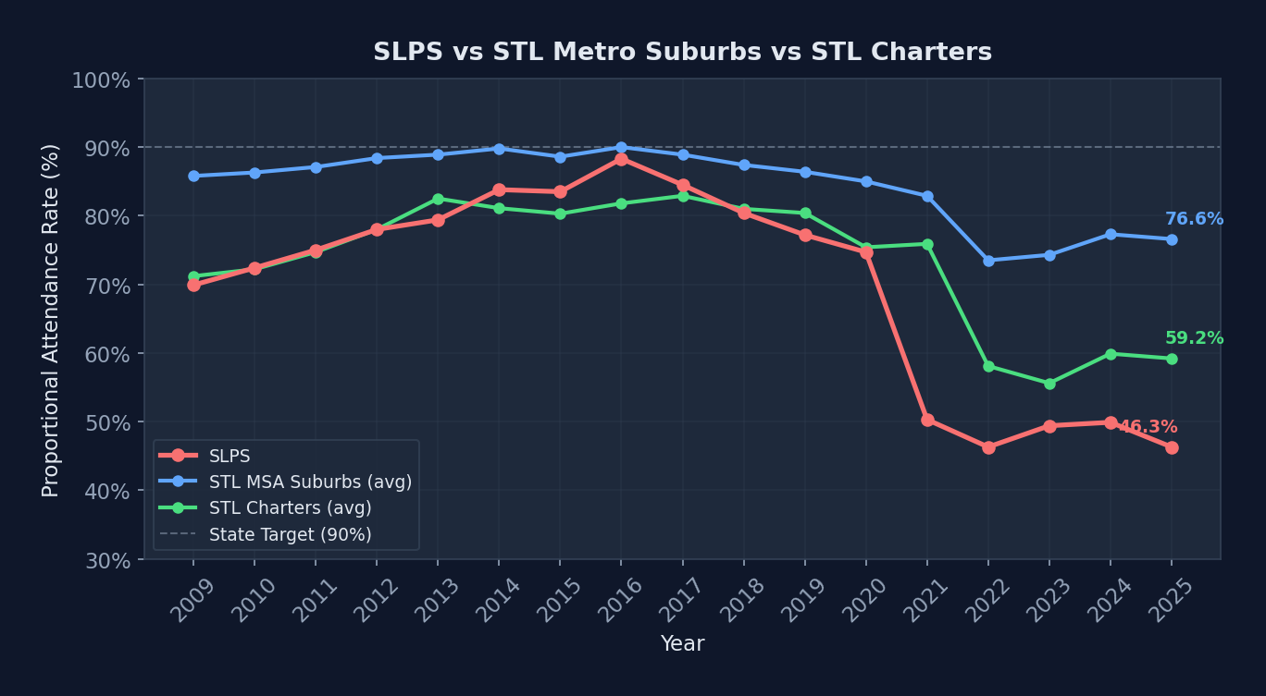
SLPS vs STL Metro Suburbs & Charters
STL suburban avg: 76.6% - ~30.3 pp above SLPS
STL charters avg: 59.2%
Gap has widened significantly since COVID
Suburban districts recovered faster - SLPS has not
Charters show a similar decline pattern to SLPS
Structural barriers (poverty, transport) drive the gap

Slide 9
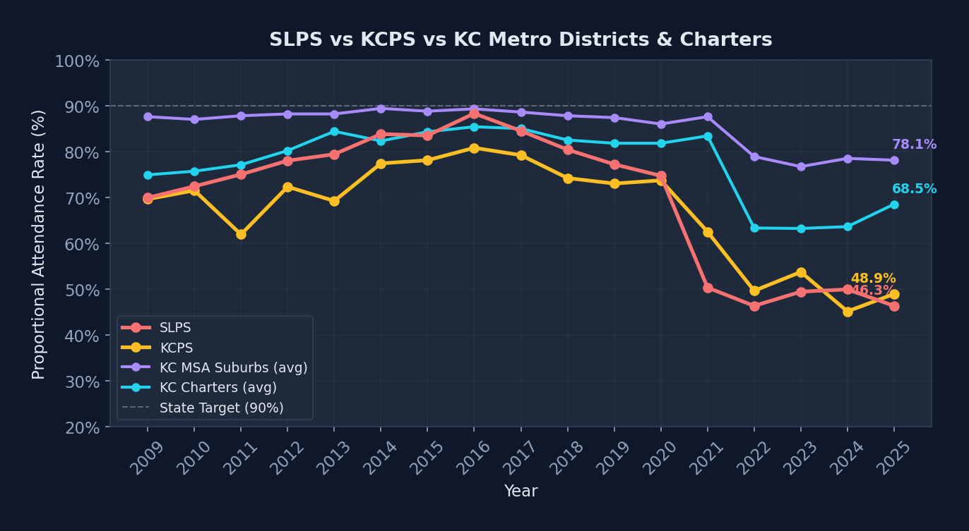
SLPS vs Kansas City Comparison
KCPS 2025: 48.9% - similar urban challenges
KC suburban avg: 78.1%
KC charters avg: 68.5%
Both urban cores lag their suburban rings by 30-40 pp
KCPS and SLPS track closely - systemic urban issue
KC charters also struggle vs suburban districts

Slide 10
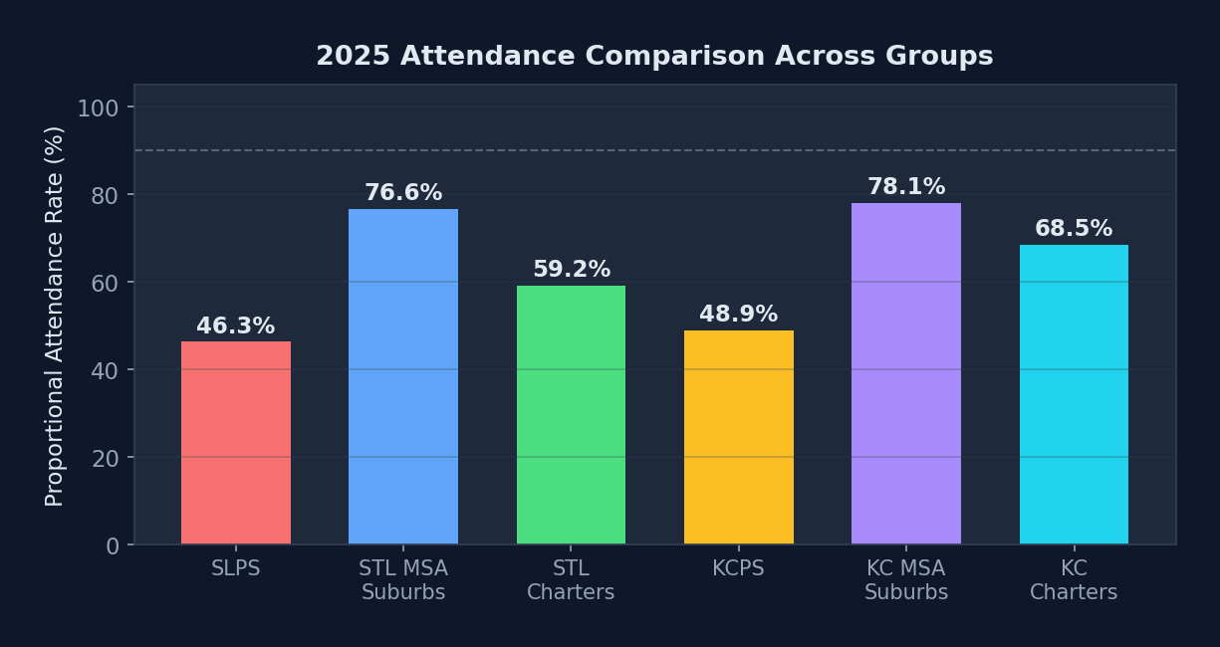
2025 Attendance: All Groups Side-by-Side
Urban cores (SLPS & KCPS) are far below suburban averages
Suburban STL & KC districts cluster around 80-85%
Charter schools fall between urban & suburban rates
The urban-suburban gap is the defining feature
Charters have not closed the gap - face similar challenges
Recovery strategies must address urban-specific barriers

Slide 11
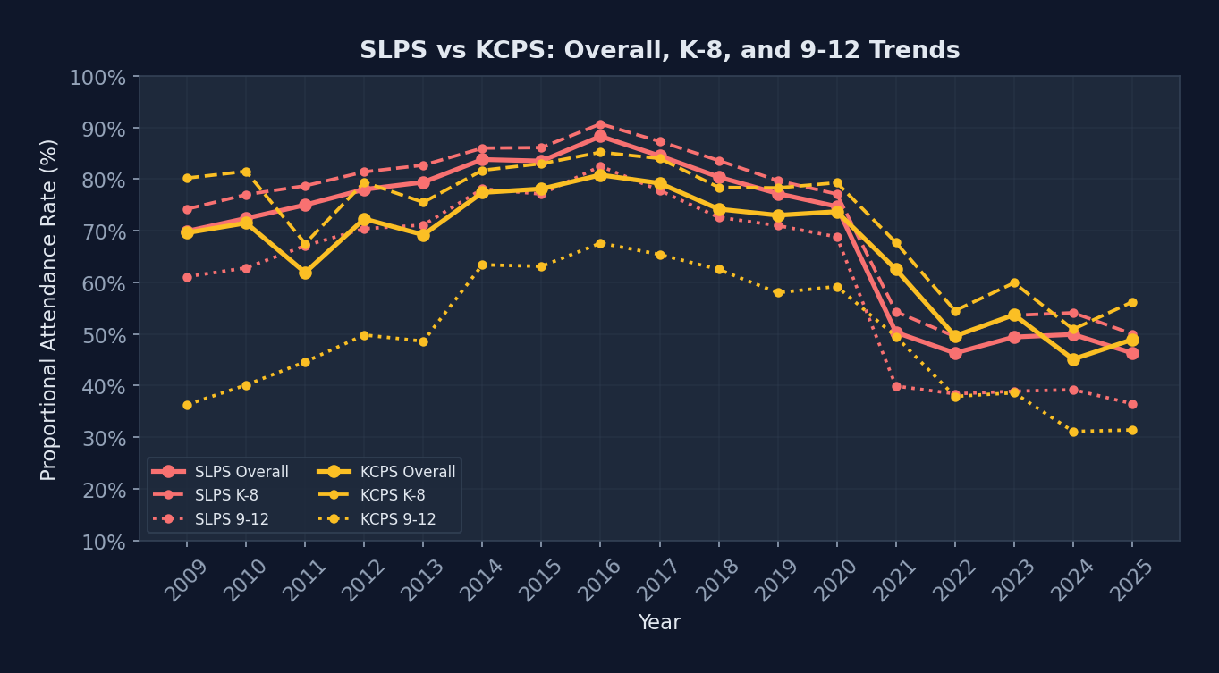
SLPS vs KCPS: Grade-Level Comparison
Both SLPS and KCPS show large K-8 vs 9-12 gaps
KCPS high school rate tracks closely with SLPS
K-8 recovery has stalled at both urban districts
Suburban MSA districts do not show this steep gap
High school disengagement is a shared urban crisis
Interventions at the middle-school transition are key

Slide 12
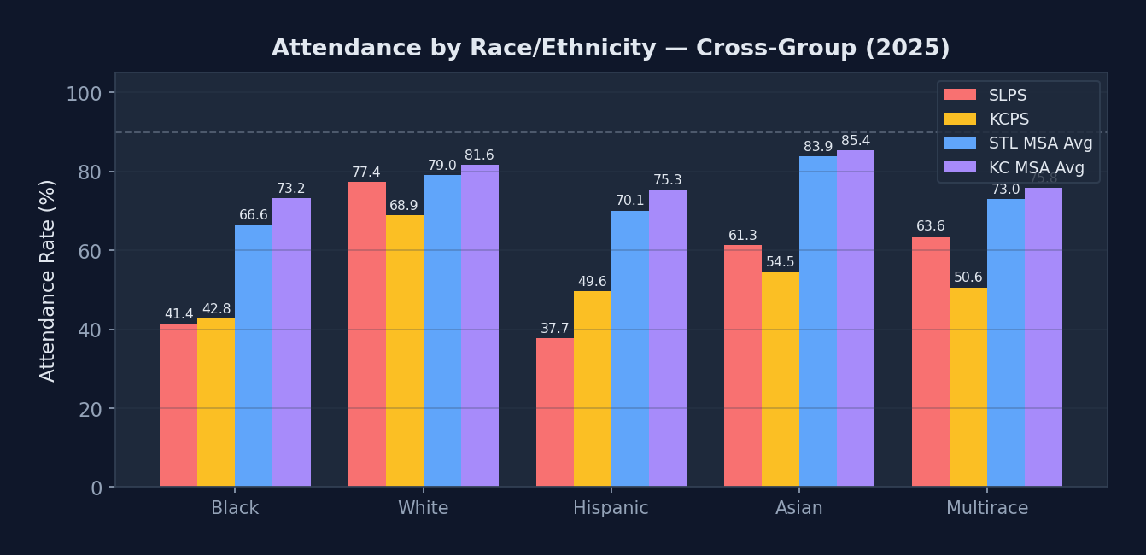
Demographic Attendance: SLPS vs Peers (2025)
Black student rates lowest across all groups
STL & KC suburban districts outperform urban across every race
White-Black gap exists everywhere but is widest in urban cores
SLPS and KCPS show nearly identical demographic patterns
Hispanic rates diverge more between metro areas
Disparities are structural, not unique to one district

Slide 13
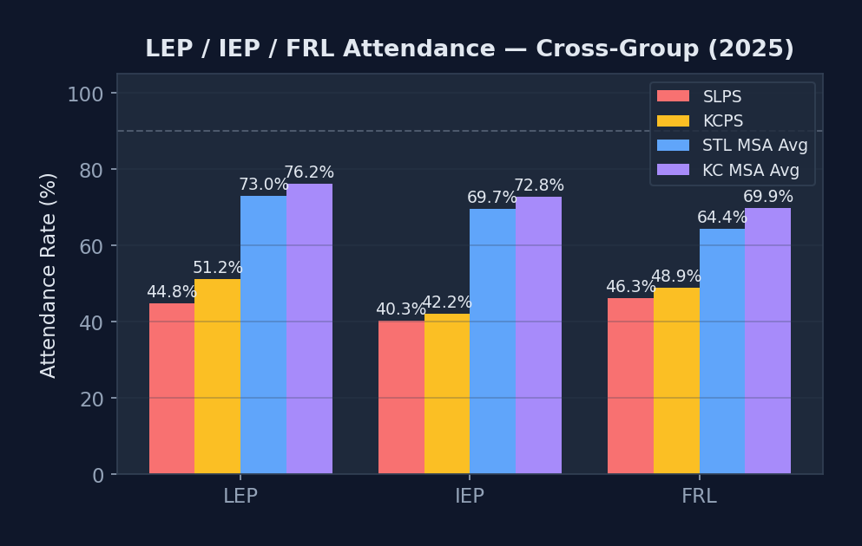
Equity Lens: LEP / IEP / FRL Across Groups (2025)
SLPS LEP, IEP, and FRL rates all lag suburban averages
KCPS shows a similar pattern - urban poverty effect
FRL rate closely mirrors overall rate at both urban districts
Suburban districts serve fewer FRL students at higher rates
IEP attendance gap is smaller - wraparound services help
Targeted investment in high-poverty schools is essential

Slide 14
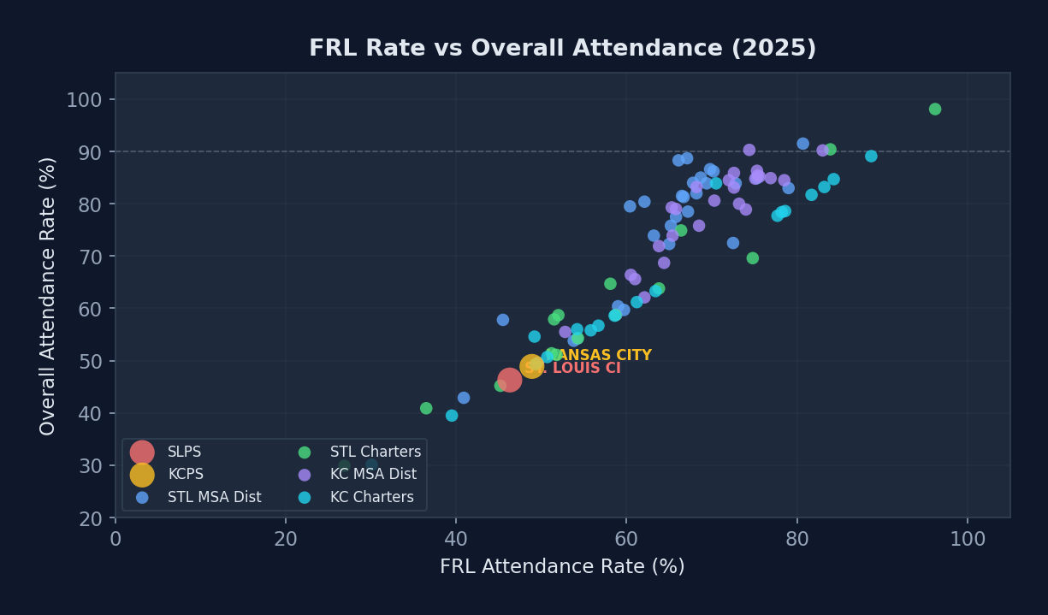
FRL Rate vs Overall Attendance (2025)
Strong correlation: higher FRL → lower attendance
SLPS and KCPS sit at the low-attendance, high-poverty corner
Suburban districts cluster at high-attendance, low-poverty
Charters are scattered - some outperform, some do not
Poverty is the strongest predictor of chronic absence
Any intervention must address socioeconomic barriers

Slide 15
Key Findings & Next Steps
CHRONIC ABSENTEEISM CRISIS - 46.3% rate means >50% of students are chronically absent
NO SUSTAINED RECOVERY - 2025 erased all post-COVID gains; causes are now structural
GRADE LEVEL GAP - 13-15 pp K-8 vs HS gap; middle school is the inflection point
BRIGHT SPOTS EXIST - Mallinckrodt, Metro, Classical Academy prove it's achievable
URGENT INTERVENTION - Several schools below 20%; need immediate, school-specific plans
EQUITY GAPS - Racial and socioeconomic disparities are severe and worsening
Recommendations
Form an Attendance Task Force with cross-functional membership
Conduct site visits to top-performing schools
Deploy early-warning system to flag at-risk students by Day 10
Invest in attendance specialists and social workers at every building
Pilot targeted interventions at 3-5 lowest-performing schools
Set measurable quarterly improvement targets

