Slide 1
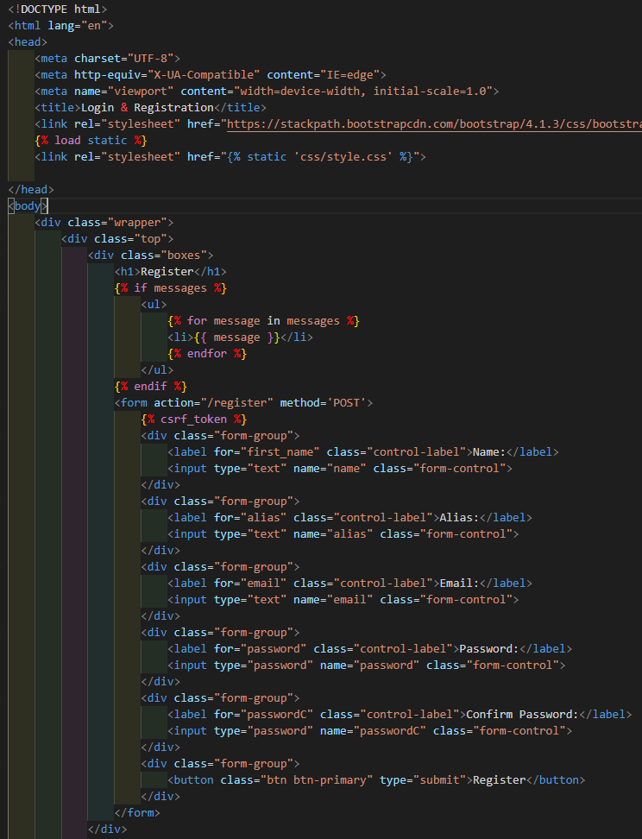
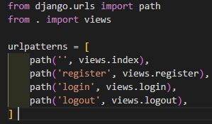

INDEX
beltApp/urls.py
beltApp/views.py
Index function
beltApp/templates/index.html
Erases any current session data and renders the index template

Slide 2
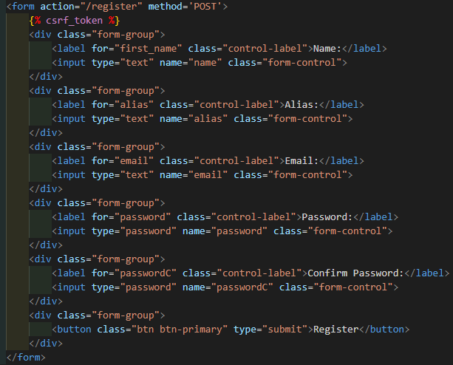
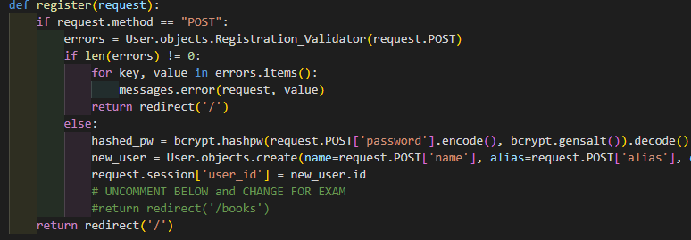
Register Form
Registration information from index.html form sent to /register path which looks for the register function.
beltApp/templates/index.html
beltApp/urls.py
beltApp/views.py
Register function

Slide 3
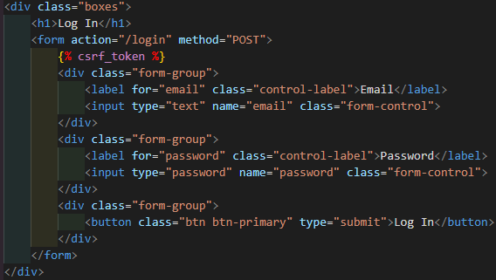
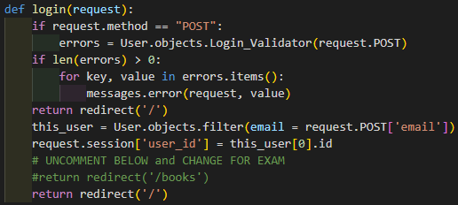
Login Form
Login information from index.html form sent to /login path which looks for the login function. If successful login, redirects to specified page.
beltApp/templates/index.html
beltApp/urls.py
beltApp/views.py
Login function

