Slide 1
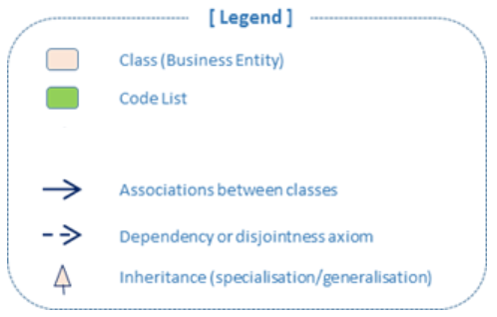
[Legend]
Class (Business Entity)
Code List (enumeration)
Reused entity (from an generic ontology)
Associations between classes
Dependency or disjointness axiom
Inheritance (specialisation/generalisation)

