Slide 1


PREFACE STATEMENT
Introduction to Website Development
https://evermight.com

Slide 2
CODING IS EASY
Coding/Programming/Software Development is one of the simplest things you can learn.
It is as easy as learning Chess.

Slide 3

EASY!!!
CHESS
Memorize movements for 6 different pieces.
Capture your opponent’s king.
CODING (procedural)
Memorize 5 different concepts.
Instruct the computer to do something.
Constants Variables Operations
Conditionals Loops

Slide 4


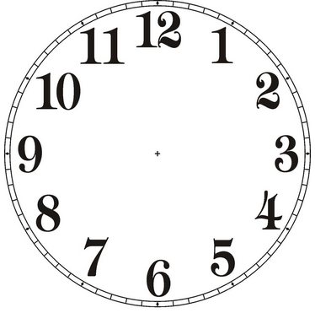


EASY!!!
+
+
Can you beat a toddler who’s playing chess for the first time? EASY!
Given $50B USD and unlimited time, can you build a software that shows “Under Construction”? EASY!

Slide 5
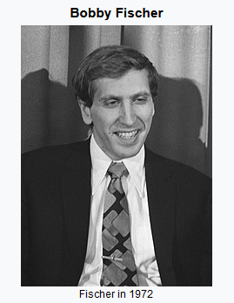
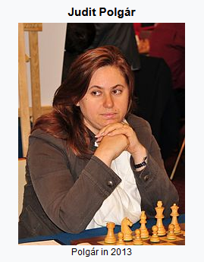
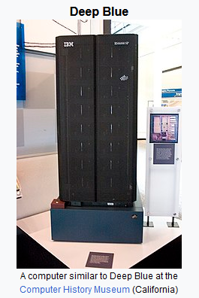
NOT SO EASY
With only 1 days worth of chess experience, can you beat any of the above?

Slide 6





NOT SO EASY
+
+
You are given a software that does forex trading. You have 1 hour to customize it for use as DNA analysis platform. You also need to prepare for a possible pivot for system to be used as a missile guidance system. Your company is on verge of bankruptcy so you can not afford to go over the budget of $100 USD.

Slide 7

TO BE GOOD
Based on what you know about current circumstances, what stance can you afford to achieve such that it will leave you an effective position to capitalize on the future. Good chess players predict what their opponents will do. Good developers predict what the business leaders will do.

