Slide 1


OPENING STATEMENT
Introduction to Full Stack Development
https://evermight.com

Slide 2
CODING IS EASY
Coding/Programming/Software Development is one of the simplest things you can learn.
It is as easy as learning Chess.

Slide 3
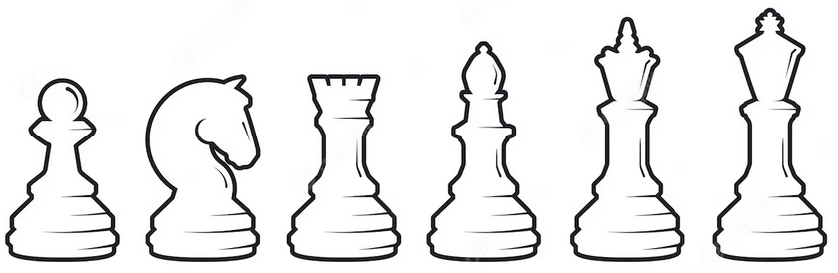
EASY!!!
CHESS
Memorize movements for 6 different pieces.
Capture your opponent’s king.
CODING (procedural)
Memorize 5 different concepts.
Instruct the computer to do something.
Constants Variables Operations
Conditionals Loops

Slide 4
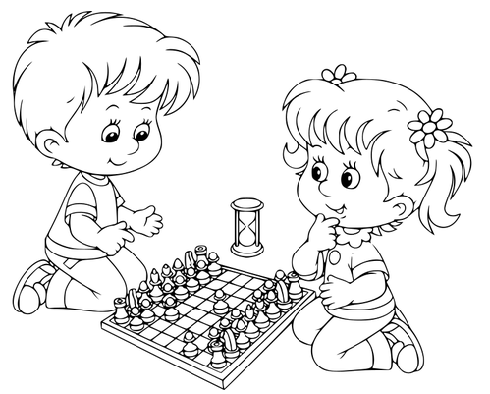

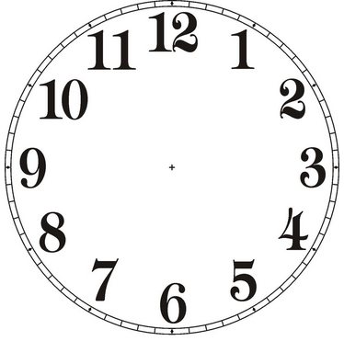


EASY!!!
+
+
Can you beat a toddler who’s playing chess for the first time? EASY!
Given $50B USD and unlimited time, can you build a software that shows “Under Construction”? EASY!

Slide 5
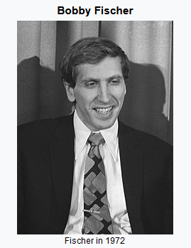
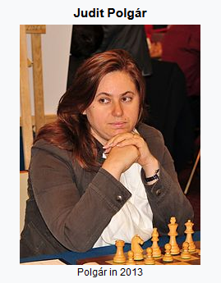
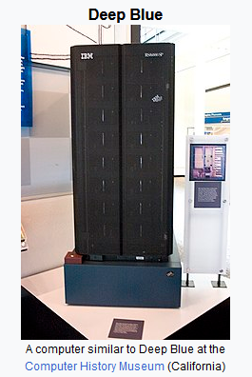
NOT SO EASY
With only 1 day’s worth of chess experience, can you beat any of the above?

Slide 6





NOT SO EASY
+
+
You are given a software that does forex trading. You have 1 month to customize it for use as DNA analysis platform. You also need to prepare for a possible pivot for system to be used as a missile guidance system. Your company is on verge of bankruptcy so you can not afford to go over the budget of $20k USD.

Slide 7
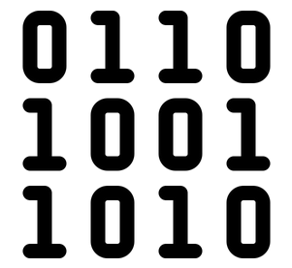
TO BE GOOD
Using your experience, you gauge your circumstances and decide what position to take that to leave you in a better position to capitalize on the future. Good chess players predict what their opponents will do. Good developers predict what the business will do.

