Slide 1

Introduction to Web Programming JavaScript, PHP & Python
https://academy.evermight.com

Slide 2

The Internet
C:\www.toyota.com C:\www.ford.com C:\www.cadillac.com etc…
C:\www.facebook.com C:\www.twitter.com C:\www.nhl.com etc…
Rogers
Verizon
EXAMPLE http://toyota.com/corolla.html
Louise
John
You are looking for the file corolla.html in the C:\www.toyata.com folder on the Rogers computer
C:\www.espn.com C:\www.bbc.com C:\www.mcdonalds.com etc…
C:\www.pizzapizza.com C:\www.starwars.com C:\www.youtube.com etc…
GoDaddy
Google

Slide 3
What is Frontend vs. Backend?
Frontend Development Any work that runs on an end-user’s computer. When you lose internet connection, you still have some access to the software. Front end typically includes: JavaScript, HTML, CSS, JPG, PNG, PDF, MP4, MP3, FLV etc…
Backend Development Any work that runs on a remote computer (ie. Someone else’s computer). IWhen you lose internet connection, you also lose access to backend services. Backend typically involves: Databases, Python, PHP, C++, Java, C#, Ruby etc…

Slide 4
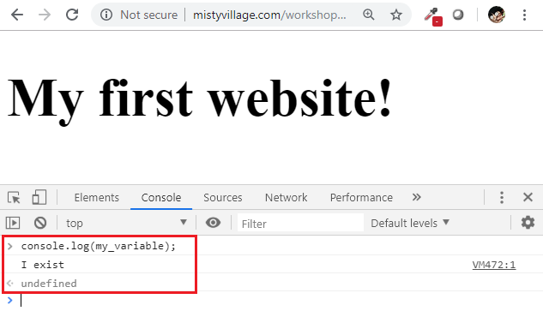
Example of JavaScript as Front End
Given this home.html
<!DOCTYPE html>
<html>
<head>
<script type="text/javascript">
alert("hello world");
var my_variable="I exist!";
</script> <style type="text/css">
h1 {font-size:50px;}
</style>
</head>
<body>
<h1>My first website!</h1>
</body>
</html>
Debug JavaScript code in Console of "Developer Tools"
This file runs completely in your web browser even without an internet connection.

Slide 5
How is PHP/Python backend?
MS Word makes *.docx
Adobe Photoshop makes *.psd (and .jpg, .png etc…)
iOS Camera App makes *.mp4
PHP/Python makes text documents (simplified)

Slide 6
How do you use PHP?
Have PHP software installed on a computer.
Create a PHP file.
Open or Run the PHP file. E.g. $bash : php file1.php
OPTIONAL – save the output of the PHP file. E.g. $bash : php file2.php > file2.html

Slide 7
Use PHP to make static files
The file make-html.php has the following content:
Now run this command:
$bash : php make-html.php > home.html
Notice you now have a home.html in your directory!
A web server can now serve the home.html file to client browsers!
<?php
echo ‘<!DOCTYPE html>
<html>
<head>
<script type="text/javascript">
alert("hello world");
var my_variable="I exist!";
</script> <style type="text/css">
h1 {font-size:50px;}
</style>
</head>
<body>
<h1>My first website!</h1>
</body>
</html>’;

Slide 8
Webserver + Backend
Combine a Web Server with a Backend language to immediately serve content to a client side software like a Web Browser (FireFox, Chrome, Edge etc…). Client-side runs front end code.
Popular Stacks:
ASP.NET (e.g. IIS + C#)
LAMP (E.g. Apache + PHP)
NodeJS (e.g. HTTP + JavaScript)

Slide 9
Technical Layers of a Cloud Software (Simplified)
Frontend
Other Android App / iOS App etc…
Web Browser HTML / CSS / JavaScript
Frontend layers reside completely on a user’s device
Backend layers reside completely on a remote server.
Frontend developers work on front end. Backend developers work on backend. Full stack developers work on both frontend and backend.
Although developers do their best to insulate one layer from the other, but generally speaking, the further down the technical stack you are, the more rigid the architecture will be. E.g. Changing a button in a web page on the front end may not affect your database structure. But changing your database structure will likely affect your middleware code and your web browser code.
Backend
Web Server Apache / Nginx / IIS / TomCat / HTTP Client etc…
Middleware PHP / C# / C++ / Java / Ruby / Python etc…
Database MySQL / SQL Server / DB2 / PostgreSQL etc…
Operating System Linux / Windows / Mac

Slide 10
Variables
These are the six primitive data types variables often store:
var variable1 = 134; // integer var variable2 = 32.342; // float, decimal
var variable3 = "Hello World"; // string
var variable4 = true; // boolean – true or false
var variable5 = null; // null – means not set
And a variable can be undefined, which happens when it was never declared

Slide 11
Arithmatic
You can perform basic arithmetic with the following operators:
+ →adding numbers or joining strings
- →subtracting numbers
* → multiply numbers
/ →dividing numbers
% → modulus of two numbers (get the remainder)
Exercise – What is the remainder of (20 x 5 - 18) ÷ 3?

Slide 12
Arrays
Arrays are a collection of values. Here are 2 ways to declare them:
var arr1 = Array(34,32.433,"Hello World",true); var arr2 = [34,32.433,"Hello World",true];
console.log(arr1[0]); // prints 34 to the console
console.log(arr2[2]); // prints Hello World to the console

Slide 13
If Statements
If statements will execute different sets of code based on specific conditions. Here are 4 ways to use them:
if(some_integer >= 9)
{
alert("Hello!");
}
// … run other code
if(some_integer >= 9)
{
alert("Hello!");
}
else if(some_integer >= 5)
{
alert("World!");
}
// … run other code
if(some_integer >= 9)
{
alert("Hello!");
}
else if(some_integer >= 5)
{
alert("World!");
}
else
{
alert("Default condition");
}
// … run other code
if(some_integer >= 9)
{
alert("Hello!");
}
else
{
alert("World!");
}
// … run other code

Slide 14
Relational Operators
You can perform Boolean evaluations with the following relational operators:
== → equal
!= or <> → not equal
> → greater than
>= →greater than or equal to
< → less than
<= → less than or equal to

Slide 15
Loops
Loops give developers a way to repeat a sets of code. The two popular loops are while loops and for loops.
While Loop
For Loop
var arr1 = [34,43.23,"Hello World",false];
var cnt = 0;
while(cnt<arr1.length)
{
console.log(arr1[cnt]);
cnt=cnt+1;
}
// … run other code
var arr1 = [34,43.23,"Hello World",false];
for(var cnt=0; cnt<arr1.length; cnt++)
{
console.log(arr1[cnt]);
}
// … run other code

Slide 16
Array, If and Loops
Exercise – Create an array of 10 numbers. Then use a loop and an if statement to print Big if a number is greater than 10, print Medium if the number greater than or equal to 5 and less than or equal to 10, and print Small if the number is less than 5.

Slide 17
Functions
Functions give developers a way to re-use a set of code. Here are two examples:
function print_some_messages()
{
console.log("Hello world!");
alert("it feels good to be alive");
console.log("Last words!");
}
print_some_messages();
function calc_house_value(principal,interest,years)
{
var total = principal*Math.pow(1+interest,years);
return total;
}
// prints 110.25
console.log(calc_house_value(100,0.05,2));
// prints 729.60
console.log(calc_house_value(230,0.08,15));

