Slide 1


CODING FUNDAMENTALS
Javascript, PHP, Python
https://evermight.com

Slide 2
CODING/PROGRAMMING
Coding - Write instructions for a microchip. With high level coding languages like Javascript, PHP, Python, C++, Ruby etc… the instructions are human readable.
Microchips operate with a binary code (zeroes and ones).
Interpreters/compilers convert your human readable code to binary code.
Try downloading interpreter/compilers for Javascript, PHP, Python.
Alternatively, you can find “online playgrounds” to test basic coding concepts

Slide 3
PRINT CONTENT
See fundamentals/file1.js – This is the most basic program all coders learn in any language.
See fundamentals/file2.js – This is basically what most backend coding does. Backend code works with a web server to print web content.

Slide 4
VARIABLES
These are the six primitive data types variables often store:
let variable1 = 134; // integer let variable2 = 32.342; // float, decimal
let variable3 = "Hello World"; // string
let variable4 = true; // boolean – true or false
let variable5 = null; // null – means not set
And a variable can be undefined, which happens when it was never declared. See fundamentals/file3.js

Slide 5
ARITHMATIC
You can perform basic arithmetic with the following operators:
+ →adding numbers or joining strings
- →subtracting numbers
* → multiply numbers
/ →dividing numbers
% → modulus of two numbers (get the remainder) See fundamentals/file4.js

Slide 6
BOOLEAN / IF STATEMENT
If statements will execute different sets of code based Boolean conditions.
if(false)
{
alert(“Nothing will happen");
}
if(true)
{
console.log(“This will execute!");
}

Slide 7
BOOLEAN / IF STATEMENT
Here are more interesting ways to use them:
if(some_integer >= 9)
{
alert("Hello!");
}
// … run other code
if(some_integer >= 9)
{
alert("Hello!");
}
else if(some_integer >= 5)
{
alert("World!");
}
// … run other code
if(some_integer >= 9)
{
alert("Hello!");
}
else if(some_integer >= 5)
{
alert("World!");
}
else
{
alert("Default condition");
}
// … run other code
if(some_integer >= 9)
{
alert("Hello!");
}
else
{
alert("World!");
}
// … run other code
See next slide for relational operators

Slide 8
RELATIONAL OPERATORS
You can get Boolean outcomes with the following relational operators:
== → equal
!= or <> → not equal
> → greater than
>= →greater than or equal to
< → less than
<= → less than or equal to
See fundamentals/file5.js

Slide 9
ARRAYS
Arrays are a collection of values. Here are 2 ways to declare them:
let arr1 = Array(34,32.433,"Hello World",true); let arr2 = [34,32.433,"Hello World",true];
console.log(arr1[0]); // prints 34 to the console
console.log(arr2[2]); // prints Hello World to the console See fundamentals/file6.js

Slide 10

WHAT IS THE INTERNET?
Rogers
Verizon
www.toronto.ca www.cntower.com etc…
www.warcraft.com www.ebay.com etc…
Internet is just a collection of computers connected to each other. But how does this make a web page? Why is Chrome, Fire Fox, Edge, Safari called a web browser?
Telus
Alice
www.mountsinai.com www.pizzapizza.com etc…
Bell
Bob
www.canada.ca www.mrsub.com etc…
www.starwars.com www.harrypotter.com etc…
www.google.com www.youtube.com etc…
GoDaddy
Google

Slide 11
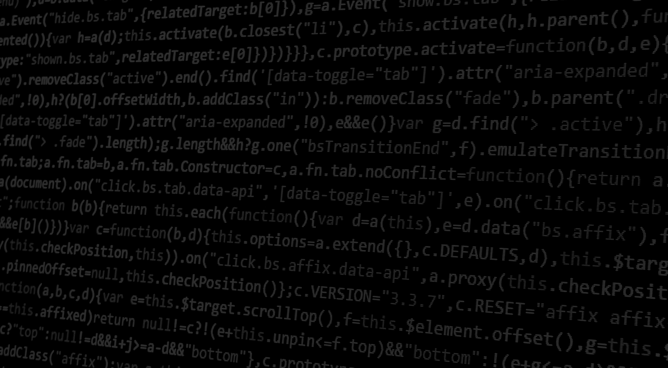

SHARING FILES
Alice’s Computer
Bob’s Computer
C:\Users\Alice\Documents
C:\Users\Bob\Documents
Share folder with Bob
Share folder with Alice

Slide 12
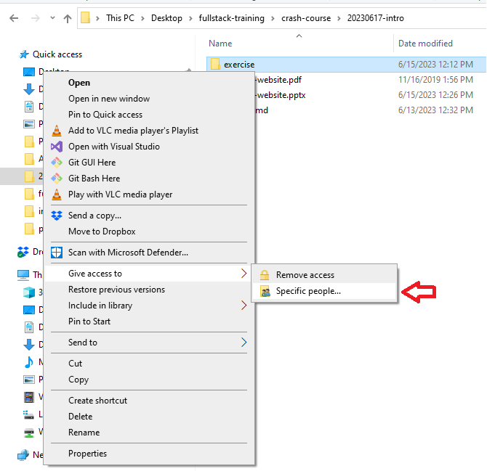
SHARING FILES
Option 1: Share Files on Local Area Network (LAN) Give Access To
C:\Users\Alice\Documents
C:\Users\Bob\Documents
Share folder with Bob
Share folder with Alice

Slide 13
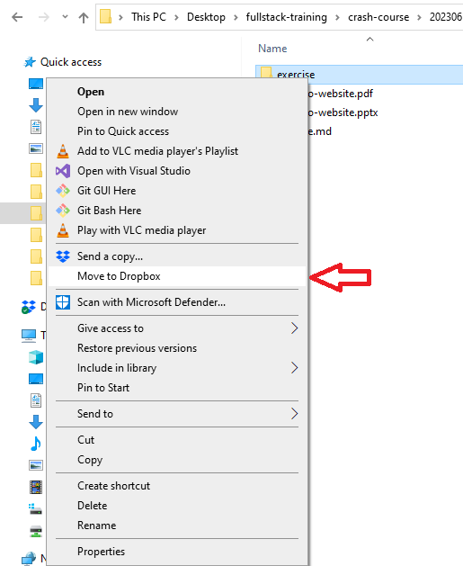
SHARING FILES
Option 2: File Sharing Software Dropbox, Torrent, Napster
In older versions of Dropbox, this option was “Share folder with other Dropbox users”. Then you type in the username of the Dropbox user you want to share with.
C:\Users\Alice\Documents
C:\Users\Bob\Documents
Share folder with Bob
Share folder with Alice

Slide 14
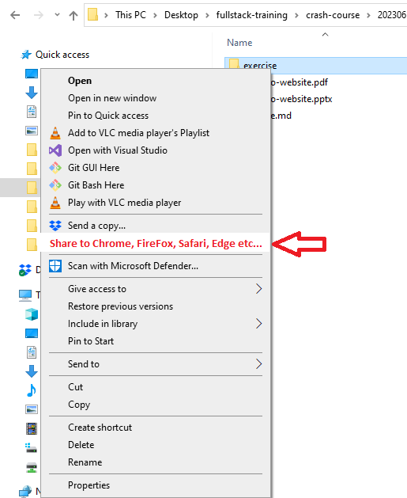
SHARING FILES
Option 3: Web Sharing Software?
Let anyone with a web browser can see this folder. Type IP Address of the computer you want to look at into your web browser. See next slide for definition of IP Address.
C:\Users\Alice\Documents
C:\Users\Bob\Documents
Share folder with Bob
Share folder with Alice

Slide 15
INTERNET PROTOCOL ADDRESS
Internet Protocol Address: When you connect computers together, each computer will identify itself with a unique identifier. Ipv4 example: 50.12.40.12 45.29.124.30 Ipv6 example: 2607:f798:14:32::d194:cd5b: 2607:f8b0:400b:803::200e: IP Address serves the same function as License Plates for automobiles. Or Latitude + Longitude for geography.
Rogers
Verizon
61.52.61.111
194.29.112.53
Telus
Alice
45.74.111.53
11.232.12.109
Bell
Bob
214.53.67.151
13.22.121.29
123.53.23.5
241.124.5.72
GoDaddy
Google

Slide 16
SHARING FILES WITH WEB SERVER
Alice’s Computer
Bob’s Computer
C:\Users\Alice\My Website
C:\Users\Bob\My Website
INTERNET INFORMATION SERVICES (Web Server Software)
cat.jpg, dog.mp4, home.html
Fire Fox / Chrome / Edge / Safari
Fire Fox / Chrome / Edge / Safari
car.jpg, skiing.mp4, home.html
Show Example Screenshots of IIS

Slide 17
SHARING FILES WITH WEB SERVER
Alice’s Computer
Bob’s Computer
/var/www/html
/var/www/html
APACHE (Web Server Software)
cat.jpg, dog.mp4, home.html
Fire Fox / Chrome / Edge / Safari
Fire Fox / Chrome / Edge / Safari
car.jpg, skiing.mp4, home.html
Demonstrate with Linux

Slide 18
DOMAIN NAMES
Star Wars
Verizon
starwars.com 61.52.61.111
verizon.com 194.29.112.53
IP addresses are hard to remember. Buy a domain name and point it to IP address. Similar to vanity license plates for vehicles or replacing latitude and longitude with addresses like 24 King Street. Buy from places like Google, Cloudflare, GoDaddy, etc… Point your domain to the IP address of any computer.
Wait up to 48 hours for all computers in Internet to recognize the change.
Nike
Alice
nike.com 45.74.111.53
11.232.12.109
Bell
Bob
bell.ca 214.53.67.151
13.22.121.29
godaddy.com 123.53.23.5
google.com 241.124.5.72
GoDaddy
Google

Slide 19
DOMAIN NAMES
Star Wars
Verizon
starwars.com 61.52.61.111
verizon.com 194.29.112.53
EXAMPLE https://starwars.com/luke-skywalker.html
Nike
Alice
nike.com 45.74.111.53
11.232.12.109
You are looking at the file luke-skywalker.html in the /var/www/html directory on a computer with the IP address 61.52.61.111.
Bell
Bob
bell.ca 214.53.67.151
13.22.121.29
godaddy.com 123.53.23.5
google.com 241.124.5.72
GoDaddy
Google

Slide 20
ORIGIN OF INTERNET
1960s - academic and government researcher share documents between computers
Need standards, conventions and universally agreed upon protocols/procedures
Demonstrate with a “Book List” exercise
Jan 1, 1983 – Birth of Internet - most protocols standardized

Slide 21
DATA-TYPE DOCUMENT
1969 – Generalized Markup Language – GML
1986 – Standard Generalized Markup Language – SGML
1993 – Hyper Text Markup Language – HTML
1996 – Extensible Markup Language - XML

Slide 22
SOURCE FILE VS. SOFTWARE
Before we continue, we should differentiate between source file and software.
CSV File – View with text editor vs. MS Excel
JPG File – View with text editor vs. Image Viewer
HTML File – View with text editor vs. Web Browser
A source file is just data. A software decides how to present the data for human readability.

Slide 23
ANATOMY OF WEB PAGE
A web page is primarily data-type document that people enjoy reading with a web browser software. It is often created with 3 different coding languages:
HTML – Hyper Text Markup Language → Content note: HTML descended from the IBM’s ancient Generalized Markup Language (GML)
CSS – Cascading Style Sheet → Aesthetics
JavaScript – Programming Language → Interactivity

Slide 24
HTML
Commonly used HTML tags:
<html> | Begin HTML document | <p> | Paragraph
<head> | Description of page | <ol> | Ordered list
<title> | Title of web page | <ul> | Unordered list
<body> | Body content | <li> | List item
<h1> | Main header (<h2> to <h6>) | <a> | Anchor link
<nav> | Navigation | <img> | Image
 |  | <table> | Tabular data (<tr><td>)
Search google for full HTML reference

Slide 25
WEB SEMANTIC
Search Engine Optimization – Search engines better understand your content.
Accessibility – Individuals using assistive devices
Standardization – For interoperability and system integration

Slide 26
WHAT IS CSS?
Cascading Style Sheets (CSS) is a language that consist of declarations / rules that describe the visual representation of HTML documents in a web browser. Here are 3 different ways to incorporate CSS into HTML:
Inline
Style Block
Separate File
<!DOCTYPE html>
<html>
<head>
</head>
<body>
<p style="color:red;“>hello world</p>
</body>
</html>
<!DOCTYPE html>
<html>
<head>
<style>
p {color:red;}
</style>
</head>
<body>
<p>hello world</p>
</body>
</html>
/* my-style.css */
p {color:red;}
<!DOCTYPE html>
<html>
<head>
<link href="my-style.css" rel="stylesheet" />
</head>
<body>
<p>hello world</p>
</body>
</html>
In all 3 examples above, the page will show hello world in red.

Slide 27
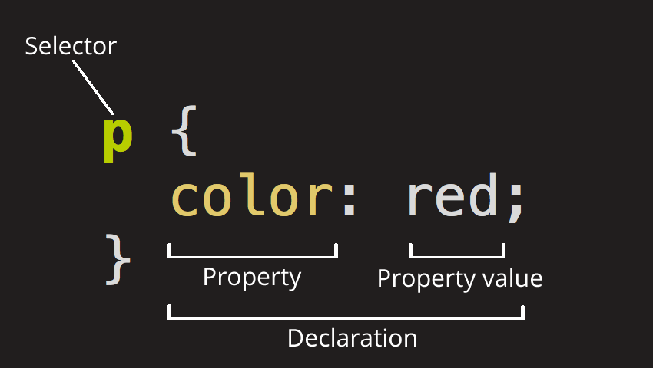
ANATOMY OF CSS DECLARATION
Selector – The HTML tags to style. We will learn shortly that there are many ways to express the specific HTML tag you wish to style. In this example, we are selecting ALL <p> tags.
Declaration – The style rule to apply. In this example, we have only one declaration. However, we can have multiple style declarations separated by the semi-colon. Each declaration is made up of a property and and a property value.
Property – The style property to change. There are many types of properties to choose from, most of which are obvious like font, background, padding, margin, etc…
Property Value – The specific style you wish to apply to a property. The acceptable properties will depend on the property you are trying to change.

Slide 28
CSS – SEPARATE CONCERNS
Maintainability – Easier to update themes separate from HTML
Accessibility – Individuals using assistive devices
Performance/Speed – Decrease page load time

Slide 29
Technical Layers of a Cloud Software (Simplified)
Frontend
Other Android App / iOS App etc…
Web Browser HTML / CSS / JavaScript
Frontend layers reside completely on a user’s device
Backend layers reside completely on a remote server.
Frontend developers work on front end. Backend developers work on backend. Full stack developers work on both frontend and backend.
Developers do their best to insulate one layer from the other. Generally, the further down the technical stack you are, the more rigid the architecture will be. E.g. Changing a button in a web page on the front end may not affect your database structure. But changing your database structure will likely affect your middleware code and your web browser code.
Backend
Web Server Apache / Nginx / IIS / TomCat / HTTP Client etc…
Middleware / Application Logic PHP / C# / C++ / Java / Ruby / Python etc…
Database MySQL / SQL Server / DB2 / PostgreSQL etc…
Operating System Linux / Windows / Mac

