Slide 1
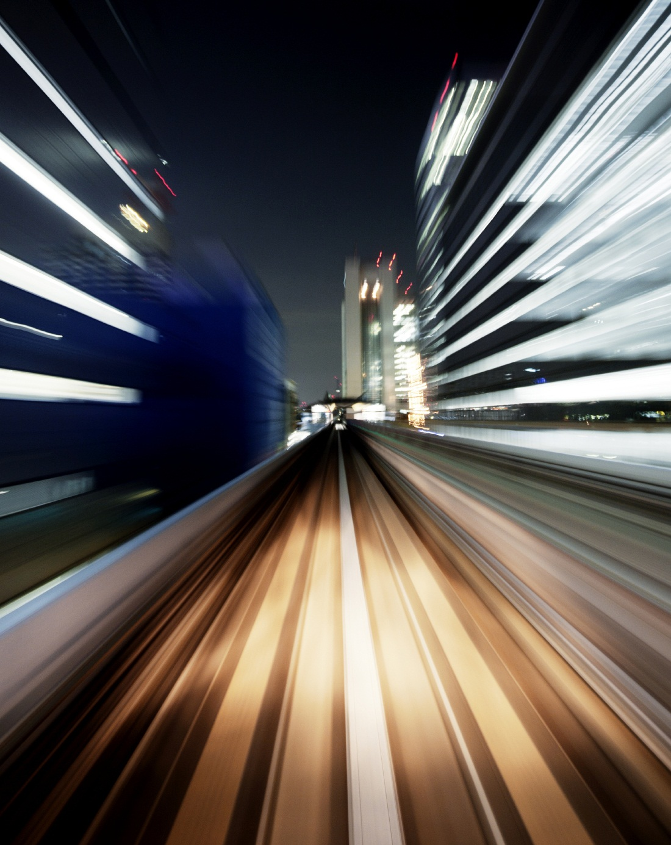

Workshop in Machine Learning for Object Recognition using FlowTensor in Mobile Application Android
Dictated by
Notes:
Para cambiar la imagen de esta diapositiva, seleccione la imagen y elimínela. Después, haga clic en el icono Imágenes del marcador de posición para insertar su propia imagen.

Slide 2

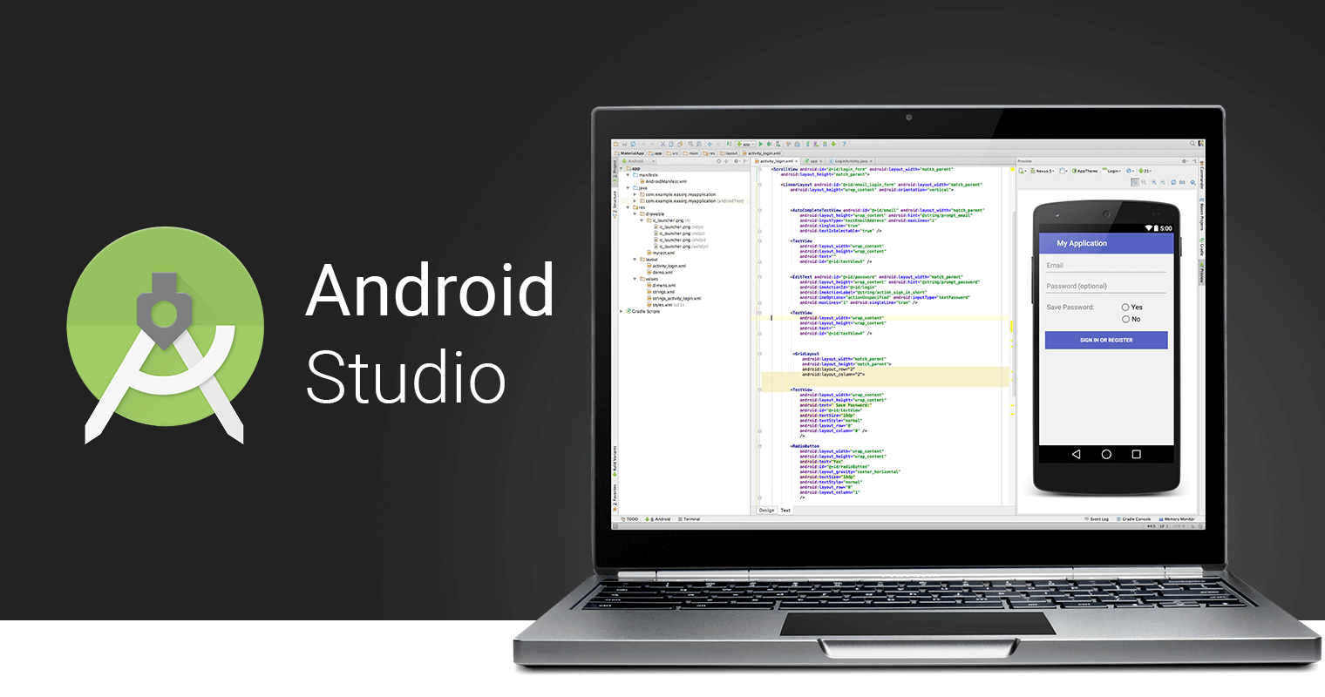
What is Android and Android Studio?

Slide 3


What is TensorFlow and TensorFlow Lite?

Slide 4
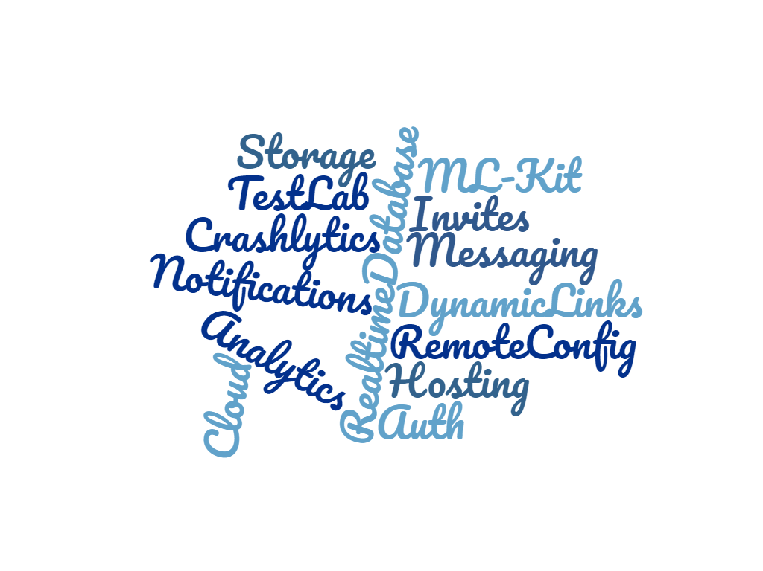

What is Firebase?

Slide 5
Introduction to the Experiment
Download and/or update Android Studio
Install TensorFlow and TensorFlow Lite
Download image dataset
Download code to retrain the algorithms
Download code to retrain the algorithms
Convert trained model to TensorFlow Lite
Get trained model
Test the model in Android application or in the console
Upload predictions to Firebase
Step by step

Slide 6
Install Android Studio

Slide 7
Step 1
Download Java Developer Kit (JDK): https://www.oracle.com/technetwork/java/javase/downloads/jdk8-downloads-2133151.html (jdk-8u162-linux-x64.rpm) for Linux x64
Go to the download path and run this command: sudo dnf install jdk-8u162-linux-x64.rpm
Install Packs : sudo dnf install zlib.i686 ncurses-libs.i686 bzip2-libs.i686 compat-libstdc++-296 compat-libstdc++-33 glibc libgcc nss-softokn-freebl libstdc++ ncurses-libs zlib-devel.i686 ncurses-devel.i686 ant

Slide 8

Step 2
Already downloaded the file. zip Android Studio We will unzip it in the folder "/opt/" with the following command: sudo unzip ~/Descargas/android-studio-id-version-linux.zip -d /opt/
Once the. zip file is unzipped we go to the decompression route in terminal: cd /opt/android-studio/bin
Once located in the route we write in the terminal : ./studio.sh to start with the installation.
We edit our environment variable configuration submittal with the following command: gedit ~/.bash_profile
Add below EXPORT the following line: export PATH=$PATH:$HOME/Android/Sdk/tolos
android update sdk --no-ui --filter build-tools-28.0.2,android-28,extra-android-m2repository

Slide 9
Install TensorFlow and TensorFlow Lite

Slide 10
Step 1
We install Flow Tensor with the following command: pip install –upgrade “tensorflow==1.7.*”
Then execute the following command: pip install PILLOW

Slide 11
Dataset: http://vision.stanford.edu/aditya86/ImageNetDogs/ http://web.mit.edu/torralba/www/indoor.html

Slide 12
We started our experiment
First step:
We proceed to train our model with our dataset:
python -m scripts_py.retrain \
--bottleneck_dir=results/bottlenecks \
--how_many_training_steps=500 \
--model_dir=results/models/ \
--summaries_dir=results/training_summaries/"mobilenet_0.50_224" \
--output_graph=results/model_result.pb \
--output_labels=results/labels_results.txt \
--architecture="mobilenet_0.50_224" \
--image_dir=datasets/dogs

Slide 13
We started our experiment
Second step:
We proceed to test our model with an image::
python -m scripts_py.label_image \
--graph=results/model_result.pb \
--image=results/test/image_name.jpg

Slide 14
We started our experiment
Third step:
Then proceed to convert our model to Tensor Flow Lite with TOCO::
toco \
--graph_def_file=results/model_result.pb \
--output_file=results/model_android.lite \
--output_format=TFLITE \
--input_shape=1,224,224,3 \
--input_array=input \
--output_array=final_result \
--inference_type=FLOAT \
--inference_input_type=FLOAT

Slide 15
Agregar un título de diapositiva (4)

Slide 16


