Slide 1
VoWiFi Handover and QoS
Evers Chen

Slide 2
Agenda
Handover
1. MIP
2. Application Layer Handover
QoS

Slide 3
Application-Based Switching
1. Does not provide IP preservation
2. Rely on the application to survive the IP address change or re-establish the connection

Slide 4
WiFi Mobility
DSMIP
HA is the anchor that binds the identifier (HoA) with the locator (CoA)
Preserves the IP address whenever the network is changed.

Slide 5
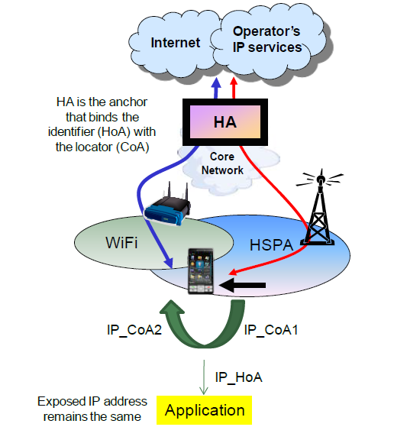
DSMIP-based Wi-Fi mobility

Slide 6
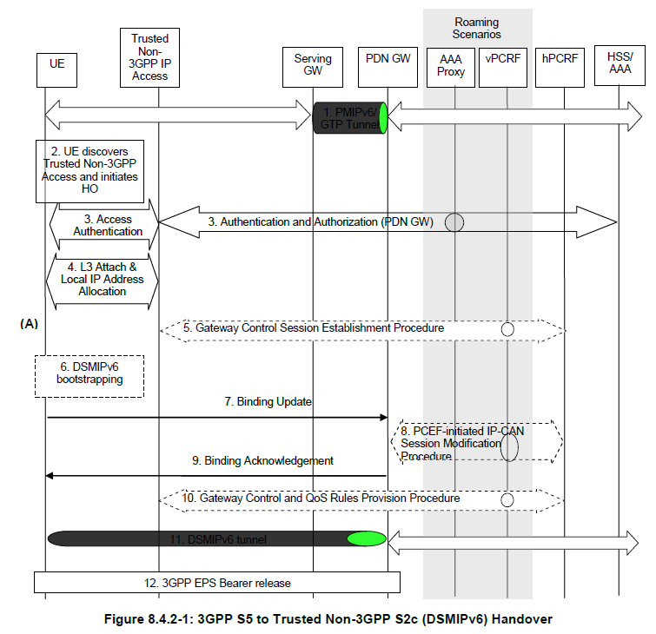
3GPP S5 to Trusted Non-3GPP S2c (DSMIPv6) Handover
Notes:
The UE uses a 3GPP access system. It has an IP address that is supported over S5 interface, this IP address will be used as a HoA over the S2c reference point.
The L3 connection is established between the UE and the Trusted Non-3GPP Access system. As a result of this procedure, an IPv4 address or an IPv6 address/prefix is also assigned to the UE by the access system (i.e. a Local IP address that will be used as a Care-of Address for DSMIPv6 over the S2c reference point).
The UE sends a DSMIPv6 BU message to the PDN GW to register its CoA, the CoA is the local IP address allocated in step 4. The UE shall inform the PDN GW that the whole home prefix shall be moved.
The UE continues with IP service using the same IP address in step 1.
10) The PCRF initiates the Gateway Control and QoS Rules Provision Procedure specified in TS 23.203 [19] by sending a message with the information of mobility protocol tunnelling encapsulation header to the Trusted non-3GPP IP Access. In case the QoS rules have changed, the updated QoS rules shall also be included in this message.

Slide 7
Gateway Control Session Establishment during Attach

Slide 8
Gateway Control and QoS Rules Request

Slide 9
Gateway Control and QoS Rules Provision
Notes:
3. The QoS Rules and Event Triggers received by the GW (BBERF) are deployed. This may result in bearer binding being performed, according to the rules. Subsequent events corresponding to the Event Triggers will cause an Event Report to be delivered to the PCRF by means of a Gateway Control and QoS Rules Request procedure.
4. The GW (BBERF) initiates the IP‑CAN Bearer signalling if required for the QoS Rules and Event Triggers deployed in step 3.
5. The GW (BBERF) receives the response for the IP‑CAN Bearer signalling.

Slide 10
IP‑CAN Session Modification; GW (PCEF) initiated

Slide 11
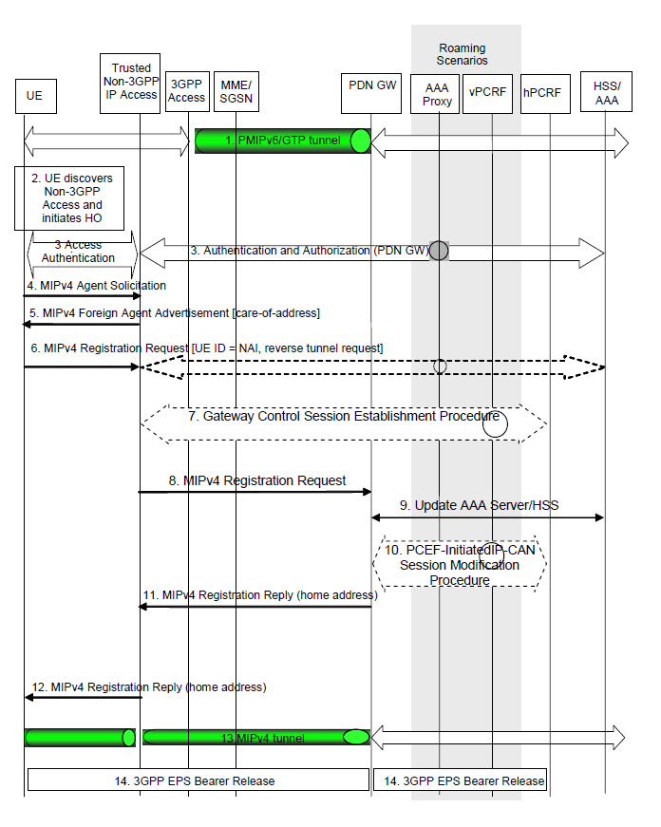
3GPP IP Access to Non-3GPP IP access Handover over MIPv4-based S2a
Notes:
Network Access Identifier (NAI)
The MN-NAI mobility option is used to identify the mobile node. The MN-NAI mobility option uses an identifier of the form user@realm [RFC4282].
10) The PDN GW allocates an IP address for the UE. The PDN GW initiates the IP CAN Session Modification Procedure with the PCRF, as specified in TS 23.203 [19]. The PDN GW provides information to the PCRF that the IP-CAN type has changed and the PCRF responds to the PDN GW with PCC rules and event triggers.
NOTE: When the PDN GW receives the RRQ and the the PS bearers corresponding to the PDN connection being handed over are suspended, then the PDN GW considers the bearers of the PDN connection being handed over as resumed and performs the handover.

Slide 12
IPMS
1) HBM + DSMIPv6 + S2c + CoA (Care-of-Address) + new ip address, local to the access network
2) HBM + MIPv4 + FACoA + S2a
3) NBM + PMIPv6 + UE's capability (depended) S2a/S2b
4) NBM + GTP + UE's capability (depended) S2b

Slide 13
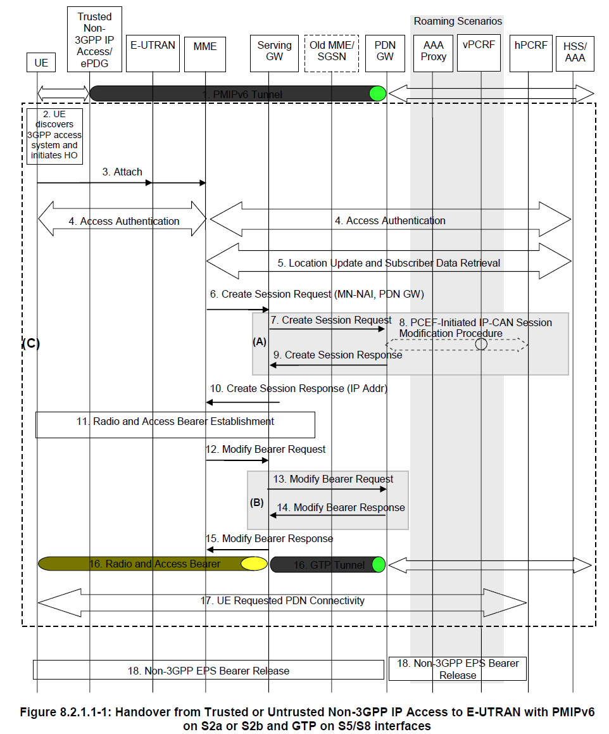
Non-3GPP to E-UTRAN with PMIPv6 on S2a or S2b and GTP on S5/S8 interfaces
Notes:
1) The UE uses a trusted or untrusted non-3GPP access system and is being served by PDN GW (as PMIPv6 LMA).
2) The UE discovers the E-UTRAN access and determines to transfer its current sessions (i.e. handover) from the currently used non-3GPP access system to E-UTRAN. The mechanisms that aid the UE to discover the 3GPP Access system, are specified in clause 4.8 (Network Discovery and Selection).
3) The UE sends an Attach Request to the MME with Request Type indicating "Handover" Attach. The message from the UE is routed by E-UTRAN to the MME as specified in TS 23.401 [4] (E-UTRAN). The UE should include any one of the APNs, corresponding to the PDN connections in the source non-3GPP access. The APN is provided as specified in TS 23.401 [4].
4) The MME may contact the HSS and authenticate the UE as described in TS 23.401 [4].
5) After successful authentication, the MME may perform location update procedure and subscriber data retrieval from the HSS as specified in TS 23.401 [4]. Since theRequest Type is "Handover", the PDN GW identity conveyed to the MME will be stored in PDN subscription context. The MME receives information on the PDNs the UE is connected to over the non-3GPP access in the Subscriber Data obtained from the HSS.
6) The MME selects an APN, a serving GW and PDN GW as described in TS 23.401 [4]. The MME sends a Create Session Request (including IMSI, MME Context ID (SGSN equivalent is TBD), PDN-GW address, Handover Indication, APN) message to the selected Serving GW. Since the Request Type is "Handover", a Handover Indication information is included.
7) The Serving GW sends a Create Session Request (Handover Indication) message to the PDN-GW in the VPLMN or HPLMN as described in TS 23.401 [4]. Since the MME includes Handover Indication information in Create Session Request message, the Serving GW includes this information in Create Session Request message.
Since Handover Indication is included, the PDN GW should not switch the tunnel from non-3GPP IP access to 3GPP access system at this point.
8) Since Handover Indication is included, the PDN GW may execute a PCEF-Initiated IP CAN Session Modification Procedure with the PCRF as specified in TS 23.203 [19] to report e.g. change in IP-CAN type. If the UE had disconnected from the default PDN before handover then the PDN GW executes a PCEF initiated IP CAN Session Establishment procedures as described in TS 23.203 [19].
Since Handover Indication is included in step 7, the PDN GW defers any modification to the PCC Rules (due to changes received from the PCRF, if there is PCRF interaction) and still applies the existing PCC Rules for charging and policy until step 13.
9) The PDN GW responds with a Create Session Response message to the Serving GW as described in TS 23.401 [4].The Create Session Response contains the IP address or the prefix that was assigned to the UE while it was connected to the non-3GPP IP access. It also contains the Charging Id previously assigned to the PDN connection in the non-3GPP access although the Charging Id still applies to the non-3GPP access.
10) The Serving GW returns a Create Session Response message to the MME as specified in TS 23.401 [4]. This message also includes the IP address of the UE. This message also serves as an indication to the MME that the S5 bearer setup and update has been successful. At this step the PMIPv6 or GTP tunnel(s) over S5 are established.
11) Radio and Access bearers are established at this step in the 3GPP access as specified in TS 23.401 [4].
12) The MME sends a Modify Bearer Request (eNodeB address, eNodeB TEID, Handover Indication) message to the Serving GW.
13) Since the Handover Indication is included in step 12), the Serving GW sends a Modify Bearer Request message to the PDN GW to prompt the PDN GW to tunnel packets from non 3GPP IP access to 3GPP access system and immediately start routing packets to the Serving GW for the default and any dedicated EPS bearers established.
In this step, the PDN GW applies any modification to the PCC Rules received from the PCRF, if there is PCRF interaction in step 8. The Charging Id previously in use for the PDN connection in the non-3GPP access now only applies to the default bearer in use in E-UTRAN access. If dedicated bearers are created, a new Charging Id is assigned by the PGW for each of them according to TS 23.401 [4].
NOTE 5: Steps 13 and 14 are not performed if the PDNs are reconnected after handoff by the UE in step 17.
14) The PDN GW acknowledges by sending Modify Bearer Response to the Serving GW.
15)The Serving GW acknowledges by sending Modify Bearer Response (EPS Bearer Identity) message to the MME.
16) The UE sends and receives data at this point via the E-UTRAN system.
17) For connectivity to multiple PDNs, the UE establishes connectivity to each PDN that is being transferred from non-3GPP access, besides the PDN connection established in steps 3-15, by executing the UE requested PDN connectivity procedure specified in TS 23.401 [4].
18) The PDN GW shall initiate resource allocation deactivation procedure in the trusted/untrusted non-3GPP IP access as defined in clause 6.12 or clause 7.9.

Slide 14
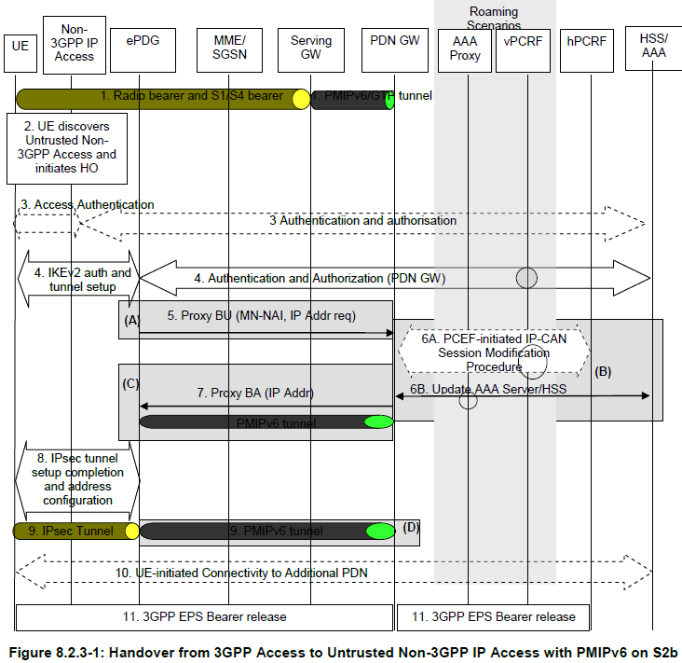
3GPP Access to Untrusted Non-3GPP IP Access with PMIPv6 on S2b
Notes:
1) The UE is initially attached to the 3GPP Access network.
2) The UE moves and attaches to an untrusted non-3GPP IP access network.
3) Access authentication procedure between UE and the 3GPP EPC may be performed as defined by TS 33.402 [45].
4) The IKEv2 tunnel establishment procedure is started by the UE. The ePDG IP address to which the UE needs to form IPsec tunnel with is discovered as specified in clause 4.5.4. After the UE is authenticated, UE is also authorized for access to the APN. The procedure is as described in TS 33.402 [45]. As part of access authentication the PDN GW identity is sent to the ePDG by the 3GPP AAA server. If the UE supports IP address preservation during handover from 3GPP Access to the untrusted non-3GPP IP access, the UE shall include its address (IPv4 address or IPv6 prefix /address or both) allocated when it's attached to 3GPP Access into the CFG_Request sent to the ePDG during IKEv2 message exchange.
5) The ePDG sends the Proxy Binding Update (MN-NAI, Lifetime, Access Technology Type, Handover Indicator, GRE key for downlink traffic, UE Address Info, Additional Parameter) message to the PDN GW. Access Technology Type is set to a value matching the characteristics of the non-3GPP access. The UE Address Info shall be set according to the CFG_Request in step 3. The ePDG shall not change the requested address(es) in the CFG_Request sent by the UE, and encode such address(es) in PBU and send to the PDN GW. If the UE included the address in step 3, the ePDG sets the handover indicator to indicate Handoff between two different interfaces of the UE. The APN is used by the PDN GW to determine which PDN to establish connectivity for, in the case that the PDN GW supports multiple PDN connectivity. The ePDG creates and includes a PDN connection identity if the ePDG supports multiple PDN connections to a single APN.
6A) If PCC is supported, the PDN GW requires configuration for enforcing policy, the PDN GW executes a PCEF-Initiated IP CAN Session Modification Procedure with the PCRF as specified in TS 23.203 [19].
6B) The PDN GW informs the 3GPP AAA Server of its PDN GW identity and the APN corresponding to the UE's PDN Connection and obtains authorization information from the 3GPP AAA Server. The message includes information that identifies the PLMN in which the PDN GW is located. The 3GPP AAA Server may update the information registered in the HSS as described in clause 12.
7) The PDN GW processes the Proxy Binding Update message from the ePDG, updates the binding cache entry for the UE and responds with a Proxy Binding Acknowledgement (MN_NAI, Lifetime, GRE key for uplink traffic, UE Address Info, Charging ID, Additional Parameters) message. In the Proxy Binding Ack, the PDN GW replies with the same IP address and/or prefix that was assigned to the UE earlier. If the corresponding Proxy Binding Update contains a PDN connection identity, the PDN GW shall acknowledge if the PDN GW supports multiple PDN connections to a single APN. At this point a PMIPv6 tunnel exists between PDN GW and ePDG. Since this step is triggered by the Proxy Binding Update message from the ePDG in step 4, it can occur after step 4 and does not need to wait for step 5. The Charging Id provided is the Charging Id previously assigned to the PDN connection if the source access is a PMIP-based access or to the Default Bearer if the source access is GTP-based.
When the PDN GW receives the Proxy Binding Update and the the PS bearers corresponding to the PDN connection being handed over are suspended, then the PDN GW considers the bearers of the PDN connection being handed over as resumed and performs the handover.
8) The ePDG and the UE continue the IKEv2 exchange and IP address configuration.
9) At the end of the handover procedure there is a default bearer for the UE that consists of an IPsec tunnel between the UE and the ePDG and a PMIPv6 tunnel between the ePDG and the PDN GW.
10) For connectivity to multiple PDNs, the UE establishes connectivity to each PDN that is being transferred from 3GPP access, besides the PDN connection that was established in the steps 3-8, by executing the UE-initiated Connectivity to Additional PDN procedure specified in clause 7.6.1.
11) The PDN GW shall initiate the PDN GW Initiated PDN Disconnection procedure in 3GPP access as defined in clause 5.6.2.2 or the PDN GW Initiated Bearer Deactivation procedure as defined in TS 23.401 [4], clause 5.4.4.1.

Slide 15
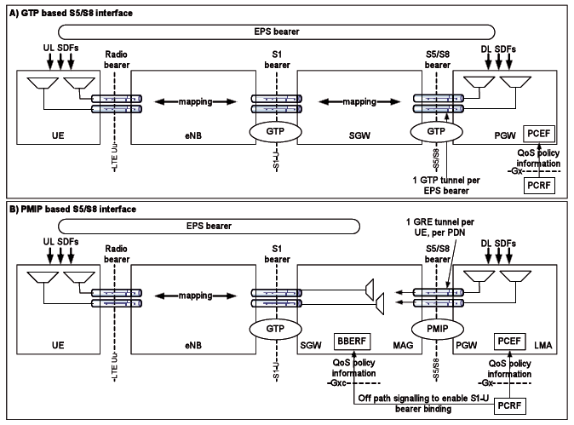
GTP and PMIP based S5/S8 interface

Slide 16
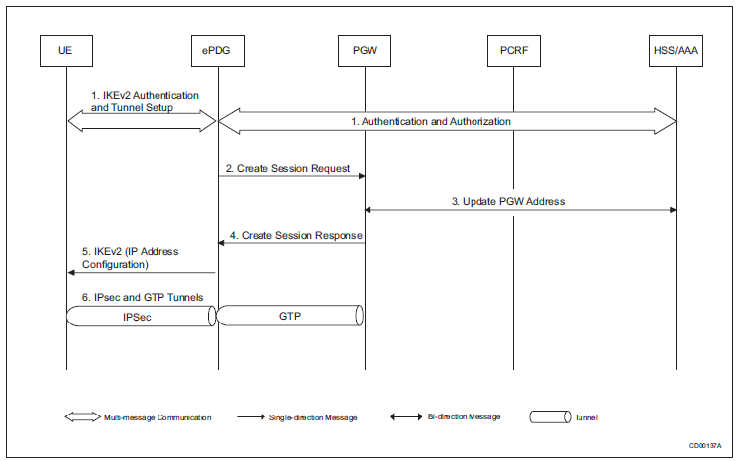
Default Bearer Activation
Notes:
1. The IKEv2 authentication and tunnel are set between the UE and ePDG.
The Home Subscriber Server/Authentication Authorization and Accounting
(HSS/AAA) server informs the ePDG that the UE has authentication and
authorization to connect with the PGW.
2. The ePDG sends the Create Session Request message to PGW.
3. The PGW handles the message then update the PGW address mutually
with the HSS/AAA server.
4. The PGW sends the Create Session Response message to ePDG.
5. The ePDG receives the IP address then forwards it to UE.
6. The IPsec tunnel and GTP tunnel are created. When the GTP tunnel is
established, the default bearer is created for the GTP session. This is only
one default bearer for the GTP session.

Slide 17
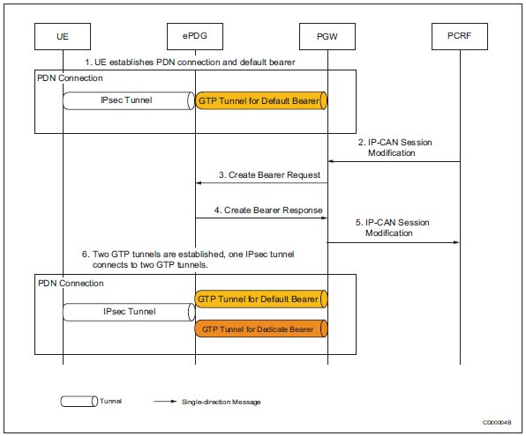
Dedicated Bearer Activation
Notes:
The dedicated bearer is activated with GTP over S2b interface:
1. The UE establishes the PDN connection with the ePDG and PGW. The
IPsec tunnel and GTP tunnel are established, as well as the relationship
between the IPsec and GTP tunnel is also established.
2. If a dynamic Policy and Charging Control (PCC) is deployed, the Policy and
Charging Rules Function (PCRF) sends a PCC decision provision (QoS
policy) message to the PGW. If a dynamic PCC is not deployed, the PGW
may apply a local QoS policy.
3. The PGW uses the QoS policy to assign the Evolved Packet System (EPS)
bearer QoS. The PGW generates a TFT for the dedicated bearer, and
sends a Create Bearer Request message to the ePDG. The Linked EPS
Bearer Identity (LBI) is the EPS bearer identity of the default bearer.
4. The ePDG selects an EPS bearer identity, which is not assigned to the UE.
The ePDG stores the EPS bearer identity and links the dedicated bearer to
the default bearer indicated by the LBI. The ePDG uses the uplink packet
filter (UL TFT) to determine the mapping of uplink traffic flows to the S2b
bearer. The ePDG acknowledges the S2b bearer activation to the PGW by
sending a Create Bearer Response message.
5. If the dedicated bearer activation procedure is triggered by a PCC decision
provision message from the PCRF, the PGW indicates to the PCRF
whether the requested PCC decision (QoS policy) can be enforced.
6. When the dedicated bearer is established between the ePDG and PGW,
one IPsec tunnel connects with two GTP tunnels.

Slide 18
QoS

Slide 19
QoS and Network Performance
QoS features start to be applied to application performance as the load on the network increases. QoS works to keep latency, jitter, and loss for selected traffic types within acceptable boundaries.

Slide 20
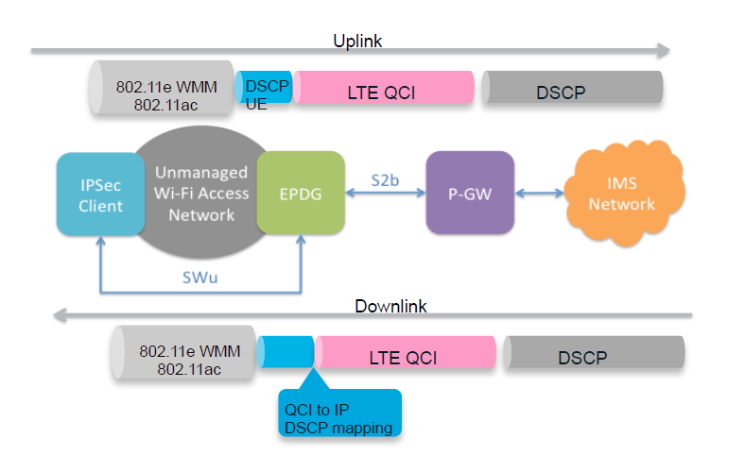
QOS Overview for s2b

Slide 21
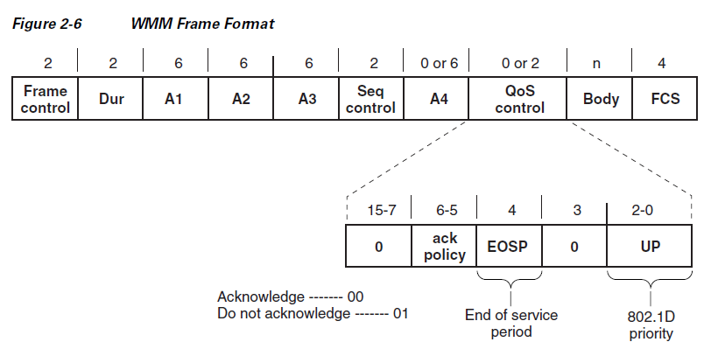
WMM Frame Format

Slide 22
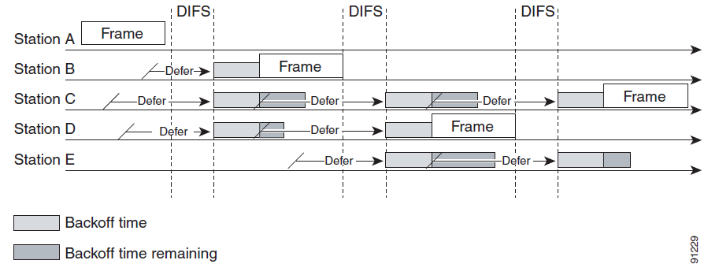
Distributed Coordination Function Example

Slide 23
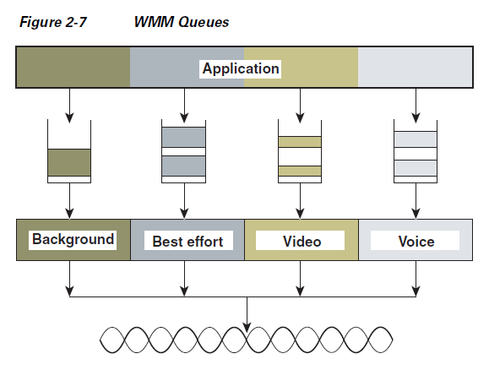
WMM Queues
Notes:
Each of these queues contends for the wireless channel in a similar
manner to the DCF mechanism described previously, with each of the queues using different interframe
space, CWmin, and CWmax values. If more than one frame from different access categories collide
internally, the frame with the higher priority is sent, and the lower priority frame adjusts its backoff
parameters as though it had collided with a frame external to the queuing mechanism. This system is
called enhanced distributed coordination function (EDCF).

Slide 24
802.11 DCF
aCWmin
aCWmax
Retries
Notes:
The random number used in the random backoff is initially a number between 0 and aCWmin. If the
initial random backoff expires without successfully sending the frame, the station or AP increments the
retry counter, and doubles the value random backoff window size. This doubling in size continues until the size equals aCWmax.
There are four separate queues, one
for each of the access categories. Each of these queues contends for the wireless channel in a similar
manner to the DCF mechanism described previously, with each of the queues using different interframe
space, CWmin, and CWmax values.

Slide 25
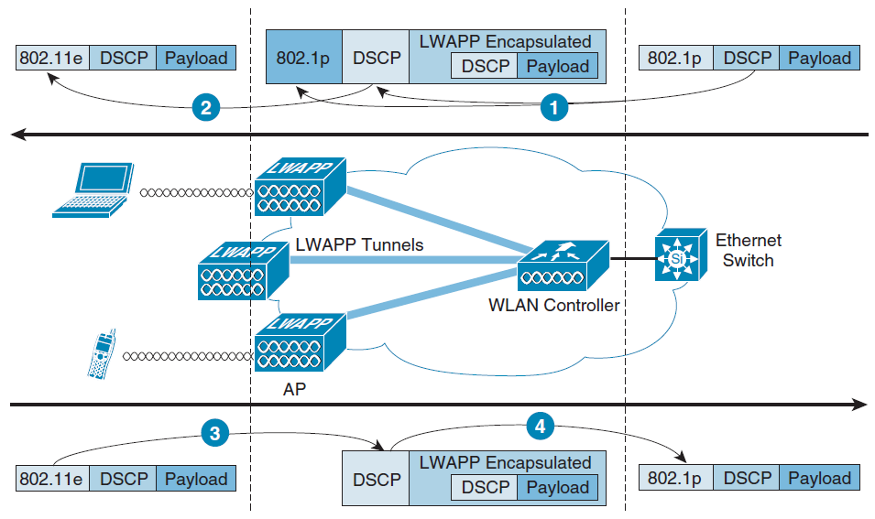
WMM and IEEE 802.1P Relationship

Slide 26
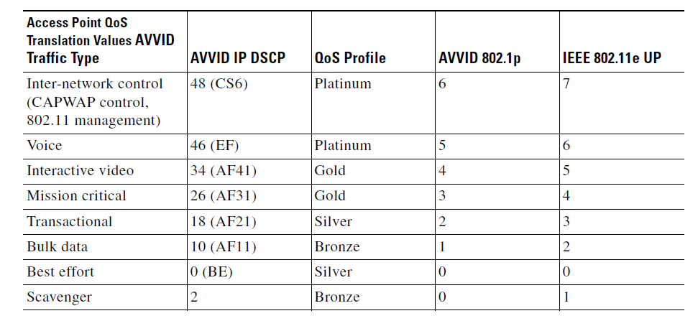
Access Point QoS Translation Values

Slide 27
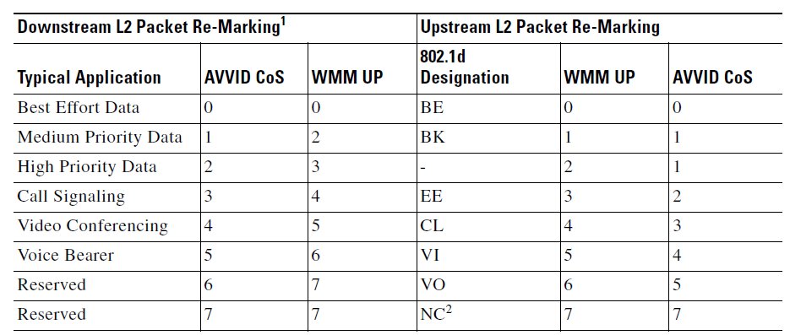
AP is translating CoS values
WMM to AVVID Packet Re-Marking for APs when AVVID Priority Type Configured

Slide 28
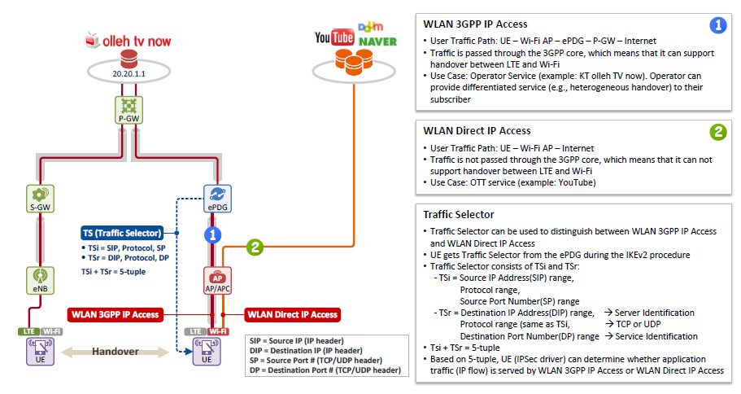
QOS Traffic Selector

Slide 29
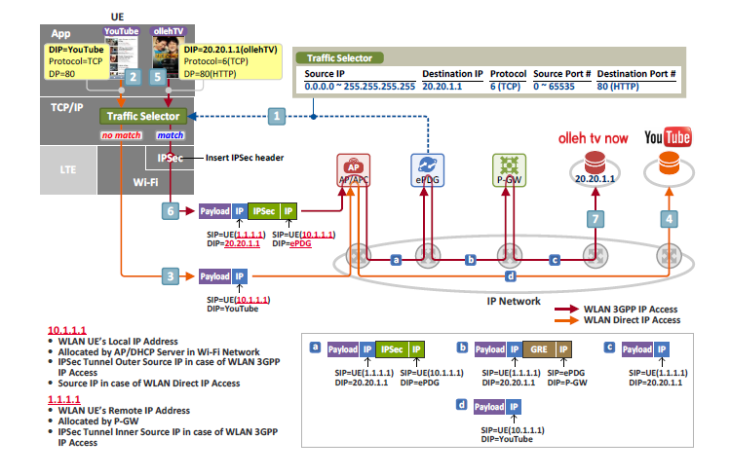
QoS Traffic Selector cont.

Slide 30
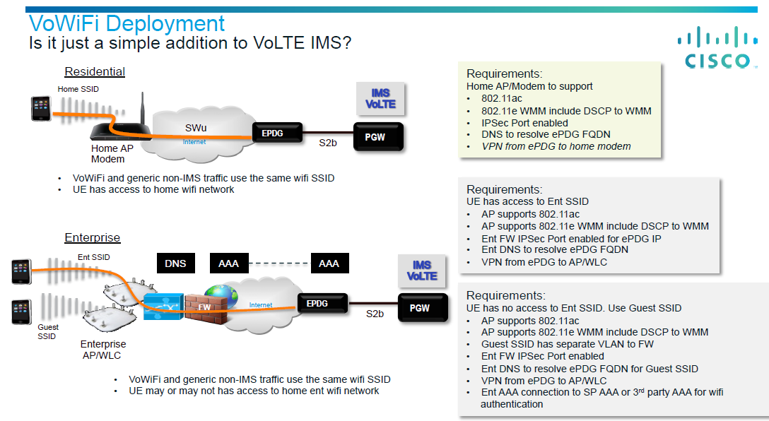
Qos Requirements

Slide 31
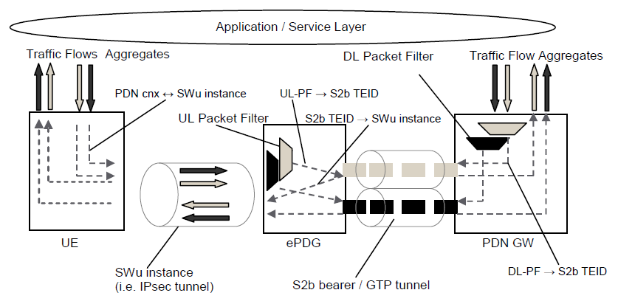
VoWiFi S2b QoS

Slide 32
The EPS bearer with GTP-based S5/S8 for 3GPP access

Slide 33
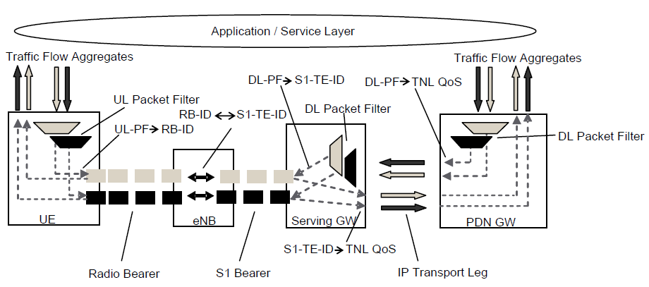
The EPS Bearer with PMIP-based S5/S8 and E-UTRAN access

Slide 34
An EPS bearer is realized by the following elements
In the UE, the UL TFT maps a traffic flow aggregate to an EPS bearer in the uplink direction;
In the PDN GW, the DL TFT maps a traffic flow aggregate to an EPS bearer in the downlink direction;
A radio bearer transports the packets of an EPS bearer between a UE and an eNodeB. If a radio bearer exists, there is a one-to-one mapping between an EPS bearer and this radio bearer;
An S1 bearer transports the packets of an EPS bearer between an eNodeB and a Serving GW;

Slide 35
An EPS bearer is realized by the following elements cont. 1
An E-RAB (E-UTRAN Radio Access Bearer) refers to the concatenation of an S1 bearer and the corresponding radio bearer.
An S5/S8 bearer transports the packets of an EPS bearer between a Serving GW and a PDN GW;
A UE stores a mapping between an uplink packet filter and a radio bearer to create the mapping between a traffic flow aggregate and a radio bearer in the uplink;

Slide 36
An EPS bearer is realized by the following elements cont. 2
A PDN GW stores a mapping between a downlink packet filter and an S5/S8 bearer to create the mapping between a traffic flow aggregate and an S5/S8 bearer in the downlink;
An eNodeB stores a one-to-one mapping between a radio bearer and an S1 Bearer to create the mapping between a radio bearer and an S1 bearer in both the uplink and downlink;

Slide 37
An EPS bearer is realized by the following elements cont. 3
A Serving GW stores a one-to-one mapping between an S1 Bearer and an S5/S8 bearer to create the mapping between an S1 bearer and an S5/S8 bearer in both the uplink and downlink.

Slide 38
Bearer level QoS parameters
QoS Class Identifier (QCI); 5 for default, 1 for dedicated.
Allocation and Retention Priority (ARP). The primary purpose of ARP is to decide whether a bearer establishment / modification request can be accepted or needs to be rejected due to resource limitations.
Guaranteed Bit Rate (GBR);
Maximum Bit Rate (MBR).
per APN Aggregate Maximum Bit Rate (APN-AMBR).
per UE Aggregate Maximum Bit Rate (UE-AMBR).

Slide 39
UL TFT
The Uplink TFT is established by the PCRF and sent to the UE in the context setup messages. DL filtering is done in the P-GW and it's TFT is also established in the PCRF.
The UE uses the TFT to map uplink packets to the appropriate bearers. However, the TFT itself is defined by the PCRF and sent to the P-GW, which passes it down through the S-GW, the MME, and the eNB to get to the UE.

Slide 40
Reference
WLAN Quality of Service Cisco
23.401
23.402
Network Architecture for LTE and Wi-Fi Interworking
Calling-vowifi-the-next-mobile-operator-service-is-here
Signalling Effort Evaluation of Mobility Protocols within
Evolved Packet Core Network

