Slide 1

Making CSS fun again with Sass!
Or how I stopped worrying and learned to love transpilers

Slide 2

I'm Evert Pot
Long-time PHP tinkerer
Live in Toronto
Actually Dutch
Main dev for sabre/dav
Likes thinking about developer experience.
http://evertpot.com/
@evertp

Slide 3
In this talk
A quick history of CSS
The SASS language
Integrating SASS in your development workflow

Slide 4
First draft - 1994
@BODY fo(fa=he,si=18)
@P co(nu=3,wi=80)
Notes:
Called RRP
Font Family Helvetica
3 columns. Didn't come back until 2011

Slide 5
CSS1
Released in 1996
The format as we know it
IE 5.5 launched in 2000 with almost full support.
IE was the only browser that mattered.
Notes:
IE had 80% of the market

Slide 6
body {
margin: 0;
font-family: Arial, sans-serif;
font-size: 10px;
background-image: url('bitterbal.gif');
}
h1 {
font-size: 30px;
font-weight: bold;
padding: 20px;
}
p {
padding: 5px 0;
}
a img {
border: 0;
}

Slide 7
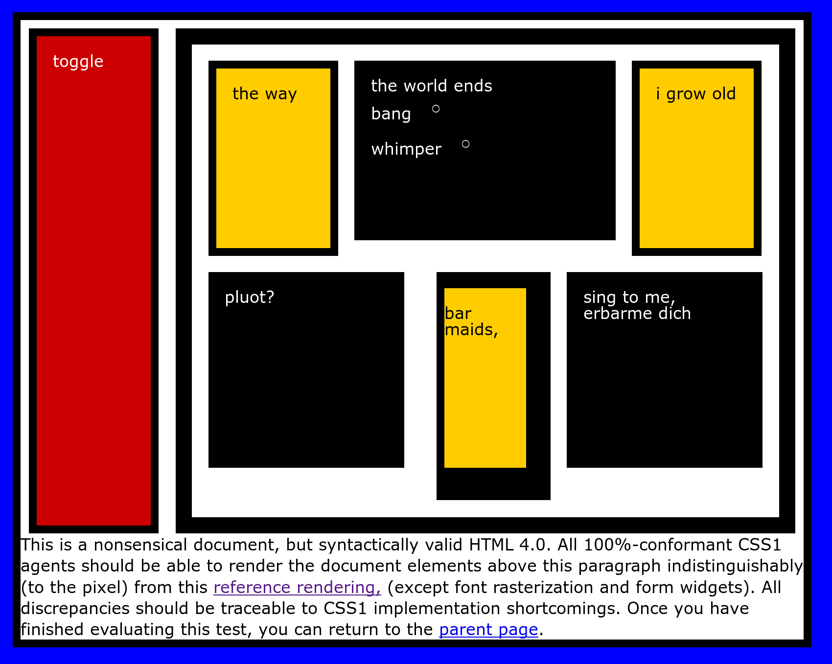

Slide 8
CSS2
1998
Adds absolute/relative positioning
mediatypes
shadows
Notes:
Pixel precise designs

Slide 9

Acid 2

Slide 10
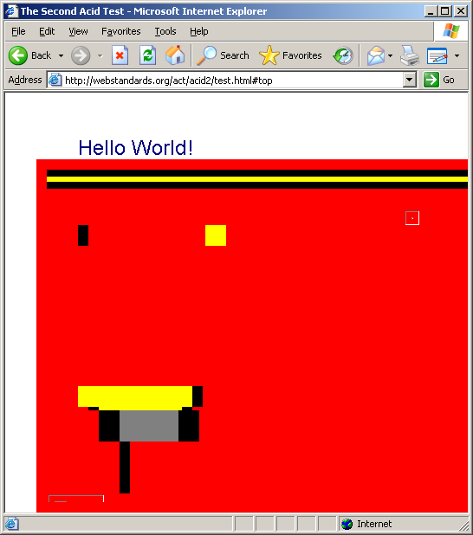

Slide 11
CSS3
Split in several documents
First one from 2007
And ongoing
Columns, Flexible boxes, New selectors, New box model, etc.

Slide 12
The issue
CSS doesn't seem like it was meant to be written by humans.
It's hard to keep CSS files organized.
Usually start with a good structure but becomes a mess over time.

Slide 13
Some causes
CSS doesn't get the scrutiny and love the rest of the code gets.
CSS often touches many features.
Tightly coupled to HTML structure.
Hard to refactor a single area, as it might affect a lot of things.
CSS itself could be better

Slide 14
Some solutions
CSS frameworks.
Semantically style elements and classes.
Be as specific as you can / isolate styles.
External documentation. Treat it like an open source project.
Object oriented CSS.
Notes:
Object oriented CSS from Nicole Sullivan aka Stubbornella

Slide 15


Slide 16
Semantic CSS
HTML is about content, CSS is about style.
This should extend to your css selectors.

Slide 17
Good
<header></header>
<div class="commentBox">
On <time></time>
<div class="author">Evert</div> said:
<div class="comment">
</div>
</div>

Slide 18
Ok
<div class="container"></div>
<div class="main"></div>
<div class="box"></div>

Slide 19
Bad
<!-- bootstrap -->
<div class="col-md-1"></div>
<div class="col-xs-12 col-md-8"></div>
<!-- foundation -->
<div class="row">
<div class="small-2 large-4 columns"><!-- ... --></div>
<div class="small-4 large-4 columns"><!-- ... --></div>
<div class="small-6 large-4 columns"><!-- ... --></div>
</div>

Slide 20
Back to...

Slide 21
What is Sass?
A CSS extension.
A CSS preprocessor.
Adds features such as:
  variables
  mixins
  nesting
  inheritance

Slide 22
How it works
1. Create “style.scss”
2. Run “sass style.scss style.css”
3. Serve “style.css”

Slide 23
Variables
$text-color: #CCC;
$background-color: #3CC;
$main-font: Helvetica, Arial, sans-serif;
body {
color: $text-color;
background-color: $background-color;
font-family: $main-font;
}
body {
color: #CCC;
background-color: #3CC;
font-family: Helvetica, Arial, sans-serif; }

Slide 24
Variables
$modal-height: 500px;
.modal {
position: absolute;
height: $modal-height;
top: 50%;
margin-top: $modal-height / 2;
}
.modal {
position: absolute;
height: 500px;
top: 50%;
margin-top: 250px; }

Slide 25
Variables
$brand-primary: #0275d8;
h1 {
color: $brand-primary;
}
h2 {
color: lighten($brand-primary, 10%)
}
h1 {
color: #0275d8; }
h2 {
color: #108ffd; }

Slide 26
Nested selectors
article {
border-left: 3px solid #448;
}
article h1 {
font-size: 20px;
}
article a {
text-decoration: none;
color: red;
}
article a:hover {
text-decoration: underline;
}

Slide 27
article {
border-left: 3px solid #448;
h1 {
font-size: 20px;
}
a {
text-decoration: none;
color: red;
&:hover {
text-decoration: underline;
}
}
}

Slide 28
Mixins
body {
display:-ms-flexbox; // IE
display:-webkit-flex; // Webkit
display:flex; // Standard
}

Slide 29
Mixins
@mixin display-flex {
display:-ms-flexbox; // IE
display:-webkit-flex; // Webkit
display:flex; // Standard
}

Slide 30
body {
@include display-flex;
header {
@include display-flex;
}
main {
@include display-flex;
aside {
@include display-flex;
}
}
footer {
@include display-flex;
}
}

Slide 31
body {
display: -ms-flexbox;
display: -webkit-flex;
display: flex; }
body header {
display: -ms-flexbox;
display: -webkit-flex;
display: flex; }
body main {
display: -ms-flexbox;
display: -webkit-flex;
display: flex; }
body main aside {
display: -ms-flexbox;
display: -webkit-flex;
display: flex; }
body footer {
display: -ms-flexbox;
display: -webkit-flex;
display: flex; }

Slide 32
Mixin arguments
@mixin modal($height) {
position: absolute;
height: $modal-height;
top: 50%;
margin-top: $modal-height / 2;
}
.save-modal {
@include modal(500px);
}

Slide 33
Conveying intent with mixin
@mixin sidebar-layout {
display:-ms-flexbox;
display:-webkit-flex;
display:flex;
-ms-flex-direction:column;
-webkit-flex-direction:column;
flex-direction: column;
aside {
flex-shrink:0;
width: 200px;
}
}

Slide 34
Convey intent with mixins
article {
@include sidebar-layout;
aside {
background: #ccf;
}
}

Slide 35
Inheritance
.btn {
border-radius: 5px;
border: 0;
background: #ccc;
color: white;
}
.btn-save {
border-radius: 5px;
border: 0;
background: #44c;
color: white;
}
.btn-cancel {
border-radius: 5px;
border: 0;
background: #c44;
color: white;
}

Slide 36
Inheritance
.btn {
border-radius: 5px;
border: 0;
background: #ccc;
color: white;
}
.btn-save {
@extend .btn;
background: #44c;
}
.btn-cancel {
@extend .btn;
background: #c44;
}
.btn, .btn-save, .btn-cancel {
border-radius: 5px;
border: 0;
background: #ccc;
color: white;
}
.btn-save {
background: #44c;
}
.btn-cancel {
background: #c44;
}

Slide 37
Bootstrap grid system
<section class="row">
<aside class="col-md-4"></aside>
<article class="col-md-8"></aside>
</section>

Slide 38
Bootstrap grid system
section {
@extend ".row";
aside {
@extend ".col-md4";
}
article {
@extend ".col-md8";
}
}

Slide 39
Bootstrap grid system
<section>
<aside></aside>
<article></aside>
</section>

Slide 40
Sass in your development workflow

Slide 41
Installing
sudo gem install sass

Slide 42
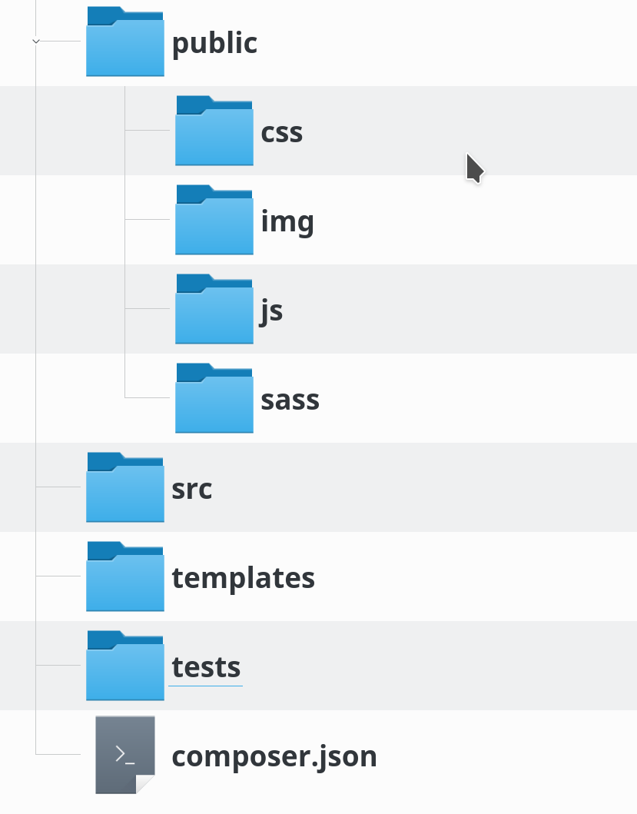
Development workflow

Slide 43
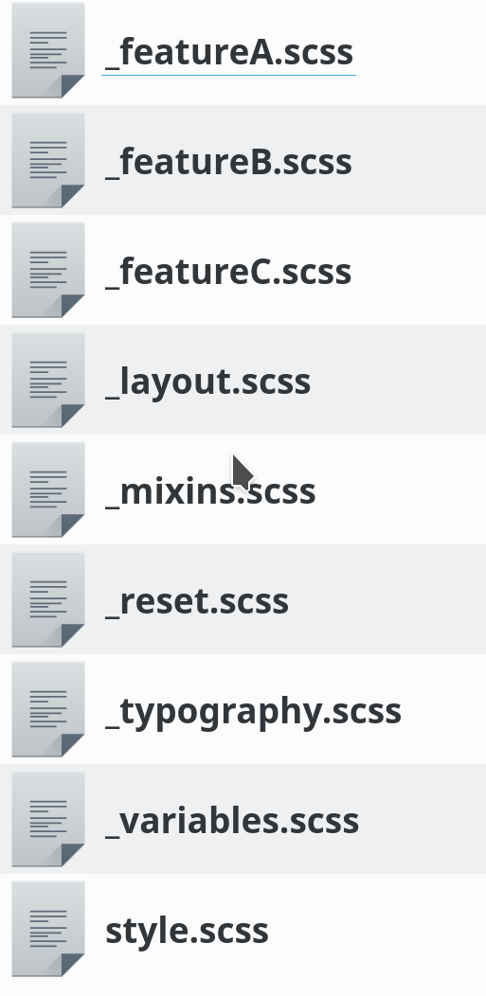
Development workflow
@import "reset";
@import "variables";
@import "mixins";
@import "typography";
@import "layout";
@import "featureA";
@import "featureB";
@import "featureC";

Slide 44
Transpiling
$ sass sass/style.scss css/style.css
$ sass watch sass:css

Slide 45
Thank you!
https://evertpot.com/
twitter: @evertp
https://joind.in/talk/14aee

