Slide 1





Inteligência Artificial
Decision Trees
  You may even try to fit different lines but the prediction error tends to be high.
  It may be a good idea to treat the degree for the polynomial features transform as a hyperparameter and evaluate different values for your dataset → fine-tuning.
Prof. Dr. Samuel Martins (Samuka)
samuel.martins@ifsp.edu.br

Slide 3
This is a Tree...

Slide 4
This is a Decision Tree...
True
False
True
False
True
False
True
False
True
False

Slide 5
Each internal (blue) node makes a statement (rule) about a feature and then makes a decision on such a statement (two or more options).
This is a Decision Tree...
True
False
True
False
True
False
True
False
True
False

Slide 6
Each internal (blue) node makes a statement (rule) about a feature and then makes a decision on such a statement (two or more options).
This is a Decision Tree...
True
False
True
False
True
False
Like classical Star Wars Trilogy
True
False
True
False
True
False
Wise Person
Unhappy Person

Slide 7
Each internal (blue) node makes a statement (rule) about a feature and then makes a decision on such a statement (two or more options).
This is a Decision Tree...
True
False
  The decision may not be necessarily binary.
  Some algorithms provide more than 2 options.
True
False
True
False
Like classical Star Wars Trilogy
True
False
True
False
True
False
Wise Person
Unhappy Person

Slide 8
1. Root Node
It represents the entire population or sample.
True
False
True
False
True
False
True
False
True
False

Slide 9
1. Root Node
It represents the entire population or sample.
2. Splitting
It is the process of dividing a node into two or more sub-nodes.
True
False
True
False
True
False
True
False
True
False

Slide 10
1. Root Node
It represents the entire population or sample.
2. Splitting
It is the process of dividing a node into two or more sub-nodes.
True
False
3. Internal/Decision Nodes
When a sub-node splits into further sub-nodes, it is called a decision node.
True
False
True
False
True
False
True
False

Slide 11
1. Root Node
It represents the entire population or sample.
2. Splitting
It is the process of dividing a node into two or more sub-nodes.
True
False
3. Internal/Decision Nodes
When a sub-node splits into further sub-nodes, it is called a decision node.
True
False
True
False
They have arrows pointing to them...
True
False
True
False

Slide 12
1. Root Node
It represents the entire population or sample.
2. Splitting
It is the process of dividing a node into two or more sub-nodes.
True
False
3. Internal/Decision Nodes
When a sub-node splits into further sub-nodes, it is called a decision node.
True
False
True
False
...and they have arrows pointing away from them.
True
False
True
False

Slide 13
1. Root Node
It represents the entire population or sample.
2. Splitting
It is the process of dividing a node into two or more sub-nodes.
True
False
3. Internal/Decision Nodes
When a sub-node splits into further sub-nodes, it is called a decision node.
True
False
True
False
True
False
True
False
4. Leaf/Terminal Nodes
Nodes that do not split.

Slide 14
1. Root Node
It represents the entire population or sample.
2. Splitting
It is the process of dividing a node into two or more sub-nodes.
True
False
3. Internal/Decision Nodes
When a sub-node splits into further sub-nodes, it is called a decision node.
True
False
True
False
True
False
True
False
4. Leaf/Terminal Nodes
Nodes that do not split.
They have arrows pointing to them but no arrows poiting away from them.

Slide 15
1. Root Node
It represents the entire population or sample.
2. Splitting
It is the process of dividing a node into two or more sub-nodes.
True
False
3. Internal/Decision Nodes
When a sub-node splits into further sub-nodes, it is called a decision node.
True
False
True
False
True
False
True
False
4. Leaf/Terminal Nodes
Nodes that do not split.

Slide 16
1. Root Node
It represents the entire population or sample.
2. Splitting
It is the process of dividing a node into two or more sub-nodes.
True
False
3. Internal/Decision Nodes
When a sub-node splits into further sub-nodes, it is called a decision node.
True
False
True
False
5. Pruning
Process of removing sub-nodes of a decision node.
Some algorithms rely on pruning to delete unnecessary nodes.
True
False
True
4. Leaf/Terminal Nodes
Nodes that do not split.

Slide 17
Like classical Star Wars Trilogy
True
False
Wise Person
Unhappy Person
When a Decision Tree estimates categories, it is called a Classification Tree.

Slide 18
Like classical Star Wars Trilogy
Experience ≤ 10 years
True
False
True
False
Wise Person
Unhappy Person
Salary =
$ 60,000.0
Salary =
$ 100,000.0
When a Decision Tree estimates categories, it is called a Classification Tree.
When a Decision Tree predicts numeric values, it is called a Regression Tree.

Slide 19
Another example of a Decision Tree that…
Does a person have a heart disorder?
Smoke
True
False
weight ≤ 91.5 kg
Workout
True
False
True
False
Workout
Attention
weight ≤ 84.5 kg
Normal
True
False
True
False
Normal
Sick
Normal
Attention

Slide 20
Another example of a Decision Tree that combines numeric data…
Does a person have a heart disorder?
Smoke
True
False
weight ≤ 91.5 kg
Workout
True
False
True
False
Workout
Attention
weight ≤ 84.5 kg
Normal
True
False
True
False
Normal
Sick
Normal
Attention

Slide 21
Another example of a Decision Tree that combines numeric data with categorical (binary) data…
Does a person have a heart disorder?
Smoke
True
False
weight ≤ 91.5 kg
Workout
True
False
True
False
Workout
Attention
weight ≤ 84.5 kg
Normal
True
False
True
False
Normal
Sick
Normal
Attention

Slide 22
Another example of a Decision Tree that combines numeric data with categorical (binary) data, and three classes.
Does a person have a heart disorder?
Smoke
True
False
weight ≤ 91.5 kg
Workout
True
False
True
False
Workout
Attention
weight ≤ 84.5 kg
Normal
True
False
True
False
Normal
Sick
Normal
Attention

Slide 23
Each internal node contains a statement/rule about a single feature/variable.
Does a person have a heart disorder?
Smoke
True
False
weight ≤ 91.5 kg
Workout
True
False
True
False
Workout
Attention
weight ≤ 84.5 kg
Normal
True
False
True
False
Normal
Sick
Normal
Attention

Slide 24
Does a person have a heart disorder?
The same feature can appear in different nodes…
Smoke
True
False
weight ≤ 91.5 kg
Workout
True
False
True
False
Workout
Attention
weight ≤ 84.5 kg
Normal
True
False
True
False
Normal
Sick
Normal
Attention

Slide 25
Does a person have a heart disorder?
The same feature can appear in different nodes and have different rules (thresholds).
Smoke
True
False
weight ≤ 91.5 kg
Workout
True
False
True
False
Workout
Attention
weight ≤ 84.5 kg
Normal
True
False
True
False
Normal
Sick
Normal
Attention

Slide 26
Does a person have a heart disorder?
The classes can be repeated (in multiple leaves).
Smoke
True
False
weight ≤ 91.5 kg
Workout
True
False
True
False
Workout
Attention
weight ≤ 84.5 kg
Normal
True
False
True
False
Normal
Sick
Normal
Attention

Slide 27
Does a person have a heart disorder?
  Decision Trees do not require Feature Scaling.
Smoke
True
False
weight ≤ 91.5 kg
Workout
True
False
True
False
Workout
Attention
weight ≤ 84.5 kg
Normal
True
False
True
False
Normal
Sick
Normal
Attention

Slide 28
Does a person have a heart disorder?
Smoke
depth=3
True
False
weight ≤ 91.5 kg
Workout
True
False
True
False
Workout
Attention
weight ≤ 84.5 kg
Normal
True
False
True
False
Normal
Sick
Normal
Attention

Slide 29
Predicting a sample is simple:
- Start at the root node.
- Traverse the tree until reaching a leaf.
Does this person have a heart disorder?
Weight: 88 kg
Smoke: Yes
Work out: No
Smoke
True
False
weight ≤ 91.5 kg
Workout
True
False
True
False
Workout
Attention
weight ≤ 84.5 kg
Normal
True
False
True
False
Normal
Sick
Normal
Attention

Slide 30
Predicting a sample is simple:
- Start at the root node.
- Traverse the tree until reaching a leaf.
Does this person have a heart disorder?
Weight: 88 kg
Smoke: Yes
Work out: No
Smoke
Sick
True
False
weight ≤ 91.5 kg
Workout
True
False
True
False
Workout
Attention
weight ≤ 84.5 kg
Normal
True
False
True
False
Normal
Sick
Normal
Attention

Slide 31
  We will consider the CART Algorithm – Classification And Regression Trees – which is used by Scikit-Learn.
  These trees only splits the nodes into two sub-nodes.
Training a Decision Tree

Slide 32
smoke | workout | weight | heart condition
No | Yes | 85.0 | Sick
No | Yes | 78.0 | Normal
Yes | No | 75.0 | Sick
No | Yes | 84.0 | Normal
No | Yes | 72.0 | Normal
No | No | 78.0 | Sick
Yes | No | 120.0 | Attention
… | … | … | …
Yes | Yes | 84.0 | Sick
No | No | 98.0 | Attention
Consider this simple (and fake) dataset about heart condition of a set of 100 people.
$m=100$ samples

Slide 33
Does the person smoke?
smoke | workout | weight | heart condition
No | Yes | 85.0 | Sick
No | Yes | 78.0 | Normal
Yes | No | 75.0 | Sick
No | Yes | 84.0 | Normal
No | Yes | 72.0 | Normal
No | No | 78.0 | Sick
Yes | No | 120.0 | Attention
… | … | … | …
Yes | Yes | 84.0 | Sick
No | No | 98.0 | Attention
Consider this simple (and fake) dataset about heart condition of a set of 100 people.
$m=100$ samples

Slide 34
Does the person work out?
smoke | workout | weight | heart condition
No | Yes | 85.0 | Sick
No | Yes | 78.0 | Normal
Yes | No | 75.0 | Sick
No | Yes | 84.0 | Normal
No | Yes | 72.0 | Normal
No | No | 78.0 | Sick
Yes | No | 120.0 | Attention
… | … | … | …
Yes | Yes | 84.0 | Sick
No | No | 98.0 | Attention
Consider this simple (and fake) dataset about heart condition of a set of 100 people.
$m=100$ samples

Slide 35
What is the person’s weight (kg)?
smoke | workout | weight | heart condition
No | Yes | 85.0 | Sick
No | Yes | 78.0 | Normal
Yes | No | 75.0 | Sick
No | Yes | 84.0 | Normal
No | Yes | 72.0 | Normal
No | No | 78.0 | Sick
Yes | No | 120.0 | Attention
… | … | … | …
Yes | Yes | 84.0 | Sick
No | No | 98.0 | Attention
Consider this simple (and fake) dataset about heart condition of a set of 100 people.
$m=100$ samples

Slide 36
What is the person’s heart condition (class)?
smoke | workout | weight | heart condition
No | Yes | 85.0 | Sick
No | Yes | 78.0 | Normal
Yes | No | 75.0 | Sick
No | Yes | 84.0 | Normal
No | Yes | 72.0 | Normal
No | No | 78.0 | Sick
Yes | No | 120.0 | Attention
… | … | … | …
Yes | Yes | 84.0 | Sick
No | No | 98.0 | Attention
Consider this simple (and fake) dataset about heart condition of a set of 100 people.
$m=100$ samples

Slide 37
smoke | workout | weight | heart condition
No | Yes | 85.0 | Sick
No | Yes | 78.0 | Normal
Yes | No | 75.0 | Sick
No | Yes | 84.0 | Normal
No | Yes | 72.0 | Normal
No | No | 78.0 | Sick
Yes | No | 120.0 | Attention
… | … | … | …
Yes | Yes | 84.0 | Sick
No | No | 98.0 | Attention
Let’s see how to train/build a Decision Tree from a dataset.
True
False
True
False
True
False
True
False
True
False
$m=100$ samples

Slide 38
Which feature should be at the root?
smoke | workout | weight | heart condition
No | Yes | 85.0 | Sick
No | Yes | 78.0 | Normal
Yes | No | 75.0 | Sick
No | Yes | 84.0 | Normal
No | Yes | 72.0 | Normal
No | No | 78.0 | Sick
Yes | No | 120.0 | Attention
… | … | … | …
Yes | Yes | 84.0 | Sick
No | No | 98.0 | Attention
?
True
False
True
False
True
False
True
False
True
False
$m=100$ samples

Slide 39
smoke
100 samples
smoke | workout | weight | heart condition
No | Yes | 85.0 | Sick
No | Yes | 78.0 | Normal
Yes | No | 75.0 | Sick
No | Yes | 84.0 | Normal
No | Yes | 72.0 | Normal
No | No | 78.0 | Sick
Yes | No | 120.0 | Attention
… | … | … | …
Yes | Yes | 84.0 | Sick
No | No | 98.0 | Attention
True
False
Heart Condition
Heart Condition
Normal Attention Sick
0 0 0
Normal Attention Sick
0 0 0
$m=100$ samples

Slide 40
smoke
100 samples
smoke | workout | weight | heart condition
No | Yes | 85.0 | Sick
No | Yes | 78.0 | Normal
Yes | No | 75.0 | Sick
No | Yes | 84.0 | Normal
No | Yes | 72.0 | Normal
No | No | 78.0 | Sick
Yes | No | 120.0 | Attention
… | … | … | …
Yes | Yes | 84.0 | Sick
No | No | 98.0 | Attention
True
False
Heart Condition
Heart Condition
Normal Attention Sick
0 0 0
Normal Attention Sick
0 0 1
$m=100$ samples

Slide 41
smoke
100 samples
smoke | workout | weight | heart condition
No | Yes | 85.0 | Sick
No | Yes | 78.0 | Normal
Yes | No | 75.0 | Sick
No | Yes | 84.0 | Normal
No | Yes | 72.0 | Normal
No | No | 78.0 | Sick
Yes | No | 120.0 | Attention
… | … | … | …
Yes | Yes | 84.0 | Sick
No | No | 98.0 | Attention
True
False
Heart Condition
Heart Condition
Normal Attention Sick
0 0 0
Normal Attention Sick
1 0 1
$m=100$ samples

Slide 42
smoke
100 samples
smoke | workout | weight | heart condition
No | Yes | 85.0 | Sick
No | Yes | 78.0 | Normal
Yes | No | 75.0 | Sick
No | Yes | 84.0 | Normal
No | Yes | 72.0 | Normal
No | No | 78.0 | Sick
Yes | No | 120.0 | Attention
… | … | … | …
Yes | Yes | 84.0 | Sick
No | No | 98.0 | Attention
True
False
Heart Condition
Heart Condition
Normal Attention Sick
0 0 1
Normal Attention Sick
1 0 1
$m=100$ samples

Slide 43
smoke
100 samples
smoke | workout | weight | heart condition
No | Yes | 85.0 | Sick
No | Yes | 78.0 | Normal
Yes | No | 75.0 | Sick
No | Yes | 84.0 | Normal
No | Yes | 72.0 | Normal
No | No | 78.0 | Sick
Yes | No | 120.0 | Attention
… | … | … | …
Yes | Yes | 84.0 | Sick
No | No | 98.0 | Attention
True
False
Heart Condition
Heart Condition
45 samples
55 samples
Normal Attention Sick
6 15 24
Normal Attention Sick
28 18 9
and so on...
$m=100$ samples

Slide 44
smoke
100 samples
smoke | workout | weight | heart condition
No | Yes | 85.0 | Sick
No | Yes | 78.0 | Normal
Yes | No | 75.0 | Sick
No | Yes | 84.0 | Normal
No | Yes | 72.0 | Normal
No | No | 78.0 | Sick
Yes | No | 120.0 | Attention
… | … | … | …
Yes | Yes | 84.0 | Sick
No | No | 98.0 | Attention
True
False
Heart Condition
Heart Condition
45 samples
55 samples
Normal Attention Sick
6 15 24
Normal Attention Sick
28 18 9
  Since these nodes have samples from different classes, they are impure.
$m=100$ samples

Slide 45
smoke
100 samples
smoke | workout | weight | heart condition
No | Yes | 85.0 | Sick
No | Yes | 78.0 | Normal
Yes | No | 75.0 | Sick
No | Yes | 84.0 | Normal
No | Yes | 72.0 | Normal
No | No | 78.0 | Sick
Yes | No | 120.0 | Attention
… | … | … | …
Yes | Yes | 84.0 | Sick
No | No | 98.0 | Attention
True
False
Heart Condition
Heart Condition
45 samples
55 samples
Normal Attention Sick
6 15 24
Normal Attention Sick
28 18 9
  Since these nodes have samples from different classes, they are impure.
  A node is pure when all its samples belong to the same class.
$m=100$ samples
Heart Condition
Normal Attention Sick
45 0 0

Slide 46
smoke
100 samples
smoke | workout | weight | heart condition
No | Yes | 85.0 | Sick
No | Yes | 78.0 | Normal
Yes | No | 75.0 | Sick
No | Yes | 84.0 | Normal
No | Yes | 72.0 | Normal
No | No | 78.0 | Sick
Yes | No | 120.0 | Attention
… | … | … | …
Yes | Yes | 84.0 | Sick
No | No | 98.0 | Attention
True
False
Heart Condition
Heart Condition
45 samples
55 samples
Normal Attention Sick
6 15 24
Normal Attention Sick
28 18 9
workout
100 samples
$m=100$ samples
True
False
Heart Condition
Heart Condition
Normal Attention Sick
0 0 0
Normal Attention Sick
0 0 0

Slide 47
smoke
100 samples
smoke | workout | weight | heart condition
No | Yes | 85.0 | Sick
No | Yes | 78.0 | Normal
Yes | No | 75.0 | Sick
No | Yes | 84.0 | Normal
No | Yes | 72.0 | Normal
No | No | 78.0 | Sick
Yes | No | 120.0 | Attention
… | … | … | …
Yes | Yes | 84.0 | Sick
No | No | 98.0 | Attention
True
False
Heart Condition
Heart Condition
45 samples
55 samples
Normal Attention Sick
6 15 24
Normal Attention Sick
28 18 9
workout
100 samples
$m=100$ samples
True
False
Heart Condition
Heart Condition
35 samples
Normal Attention Sick
19 8 8
Normal Attention Sick
25 25 15
65 samples

Slide 48
smoke
Analyzing just these two features, which should we choose?
100 samples
True
False
Heart Condition
Heart Condition
45 samples
55 samples
Normal Attention Sick
6 15 24
Normal Attention Sick
28 18 9
workout
100 samples
True
False
Heart Condition
Heart Condition
35 samples
Normal Attention Sick
19 8 8
Normal Attention Sick
25 25 15
65 samples

Slide 49
smoke
Analyzing just these two features, which should we choose?
100 samples
True
False
Heart Condition
Heart Condition
The least impure / the purest...
45 samples
55 samples
Normal Attention Sick
6 15 24
Normal Attention Sick
28 18 9
workout
100 samples
True
False
Heart Condition
Heart Condition
35 samples
Normal Attention Sick
19 8 8
Normal Attention Sick
25 25 15
65 samples

Slide 50
smoke
Analyzing just these two features, which should we choose?
100 samples
True
False
Heart Condition
Heart Condition
The least impure / the purest...
45 samples
55 samples
Normal Attention Sick
6 15 24
Normal Attention Sick
28 18 9
How to compute impurity?
- Gini impurity
- Entropy
- Information Gain
workout
100 samples
True
False
Heart Condition
Heart Condition
35 samples
Normal Attention Sick
19 8 8
Normal Attention Sick
25 25 15
65 samples

Slide 51
smoke
Analyzing just these two features, which should we choose?
100 samples
True
False
Heart Condition
Heart Condition
The least impure / the purest...
45 samples
55 samples
Normal Attention Sick
6 15 24
Normal Attention Sick
28 18 9
How to compute impurity?
- Gini impurity
- Entropy
- Information Gain
workout
100 samples
True
False
Heart Condition
Heart Condition
35 samples
Normal Attention Sick
19 8 8
Normal Attention Sick
25 25 15
65 samples

Slide 52

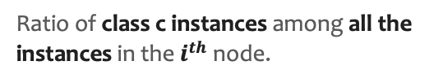
Gini impurity for a node i
smoke
100 samples
$$G_{i}=1−\sum_{c=1}^{n_classes}{p_{i,c}^{2}}$$
True
False
Heart Condition
Heart Condition
$p_{i,c}$ is the probability of class c of $i^{th}$ node.
45 samples
55 samples
Normal Attention Sick
6 15 24
Normal Attention Sick
28 18 9
Ratio of class c instances among all the instances in the $i^{th}$ node.

Slide 53
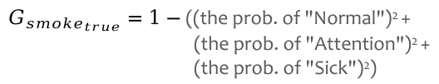
Gini impurity for a node i
smoke
100 samples
$$G_{i}=1−\sum_{c=1}^{n_classes}{p_{i,c}^{2}}$$
True
False
Heart Condition
Heart Condition
$p_{i,c}$ is the probability of class c of $i^{th}$ node.
45 samples
55 samples
Normal Attention Sick
6 15 24
Normal Attention Sick
28 18 9
Ratio of class c instances among all the instances in the $i^{th}$ node.
$G_{{smoke}_{true}}=1−$ ((the prob. of "Normal")² +
(the prob. of "Attention")² +
(the prob. of "Sick")²)

Slide 54
Gini impurity for a node i
smoke
100 samples
$$G_{i}=1−\sum_{c=1}^{n_classes}{p_{i,c}^{2}}$$
True
False
Heart Condition
Heart Condition
$p_{i,c}$ is the probability of class c of $i^{th}$ node.
45 samples
55 samples
Normal Attention Sick
6 15 24
Normal Attention Sick
28 18 9
Ratio of class c instances among all the instances in the $i^{th}$ node.
$G_{{smoke}_{true}}=1−$ ((the prob. of "Normal")² +
(the prob. of "Attention")² +
(the prob. of "Sick")²)

Slide 55
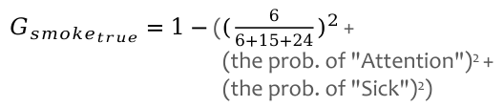
Gini impurity for a node i
smoke
100 samples
$$G_{i}=1−\sum_{c=1}^{n_classes}{p_{i,c}^{2}}$$
True
False
Heart Condition
Heart Condition
$p_{i,c}$ is the probability of class c of $i^{th}$ node.
45 samples
55 samples
Normal Attention Sick
6 15 24
Normal Attention Sick
28 18 9
Ratio of class c instances among all the instances in the $i^{th}$ node.
$G_{{smoke}_{true}}=1−$ (${(\frac{6}{6+15+24})}^{2}$ +
(the prob. of "Attention")² +
(the prob. of "Sick")²)

Slide 56
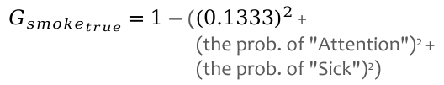
Gini impurity for a node i
smoke
100 samples
$$G_{i}=1−\sum_{c=1}^{n_classes}{p_{i,c}^{2}}$$
True
False
Heart Condition
Heart Condition
$p_{i,c}$ is the probability of class c of $i^{th}$ node.
45 samples
55 samples
Normal Attention Sick
6 15 24
Normal Attention Sick
28 18 9
Ratio of class c instances among all the instances in the $i^{th}$ node.
$G_{{smoke}_{true}}=1−$ (${(0.1333)}^{2}$ +
(the prob. of "Attention")² +
(the prob. of "Sick")²)

Slide 57
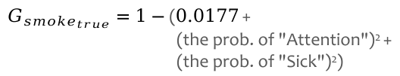
Gini impurity for a node i
smoke
100 samples
$$G_{i}=1−\sum_{c=1}^{n_classes}{p_{i,c}^{2}}$$
True
False
Heart Condition
Heart Condition
$p_{i,c}$ is the probability of class c of $i^{th}$ node.
45 samples
55 samples
Normal Attention Sick
6 15 24
Normal Attention Sick
28 18 9
Ratio of class c instances among all the instances in the $i^{th}$ node.
$G_{{smoke}_{true}}=1−$ ($0.0177$ +
(the prob. of "Attention")² +
(the prob. of "Sick")²)

Slide 58
Gini impurity for a node i
smoke
100 samples
$$G_{i}=1−\sum_{c=1}^{n_classes}{p_{i,c}^{2}}$$
True
False
Heart Condition
Heart Condition
$p_{i,c}$ is the probability of class c of $i^{th}$ node.
45 samples
55 samples
Normal Attention Sick
6 15 24
Normal Attention Sick
28 18 9
Ratio of class c instances among all the instances in the $i^{th}$ node.
$G_{{smoke}_{true}}=1−$ ($0.0177$ +
(the prob. of "Attention")² +
(the prob. of "Sick")²)
Notes:
- O Gini é como medir “o quão provável é pegar duas bolinhas de cores diferentes da urna”.
- Se quase todas são da mesma cor, a chance é pequena → nó puro.
- Se há várias cores equilibradas, a chance é alta → nó impuro.

Slide 59
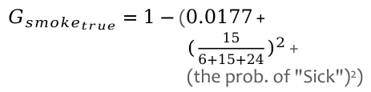
Gini impurity for a node i
smoke
100 samples
$$G_{i}=1−\sum_{c=1}^{n_classes}{p_{i,c}^{2}}$$
True
False
Heart Condition
Heart Condition
$p_{i,c}$ is the probability of class c of $i^{th}$ node.
45 samples
55 samples
Normal Attention Sick
6 15 24
Normal Attention Sick
28 18 9
Ratio of class c instances among all the instances in the $i^{th}$ node.
$G_{{smoke}_{true}}=1−$ ($0.0177$ +
${(\frac{15}{6+15+24})}^{2}$ +
(the prob. of "Sick")²)

Slide 60
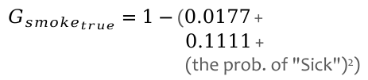
Gini impurity for a node i
smoke
100 samples
$$G_{i}=1−\sum_{c=1}^{n_classes}{p_{i,c}^{2}}$$
True
False
Heart Condition
Heart Condition
$p_{i,c}$ is the probability of class c of $i^{th}$ node.
45 samples
55 samples
Normal Attention Sick
6 15 24
Normal Attention Sick
28 18 9
Ratio of class c instances among all the instances in the $i^{th}$ node.
$G_{{smoke}_{true}}=1−$ ($0.0177$ +
$0.1111$ +
(the prob. of "Sick")²)

Slide 61
Gini impurity for a node i
smoke
100 samples
$$G_{i}=1−\sum_{c=1}^{n_classes}{p_{i,c}^{2}}$$
True
False
Heart Condition
Heart Condition
$p_{i,c}$ is the probability of class c of $i^{th}$ node.
45 samples
55 samples
Normal Attention Sick
6 15 24
Normal Attention Sick
28 18 9
Ratio of class c instances among all the instances in the $i^{th}$ node.
$G_{{smoke}_{true}}=1−$ ($0.0177$ +
$0.1111$ +
(the prob. of "Sick")²)

Slide 62
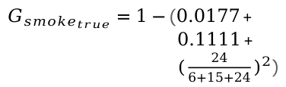
Gini impurity for a node i
smoke
100 samples
$$G_{i}=1−\sum_{c=1}^{n_classes}{p_{i,c}^{2}}$$
True
False
Heart Condition
Heart Condition
$p_{i,c}$ is the probability of class c of $i^{th}$ node.
45 samples
55 samples
Normal Attention Sick
6 15 24
Normal Attention Sick
28 18 9
Ratio of class c instances among all the instances in the $i^{th}$ node.
$G_{{smoke}_{true}}=1−$ ($0.0177$ +
$0.1111$ +
${(\frac{24}{6+15+24})}^{2}$)

Slide 63
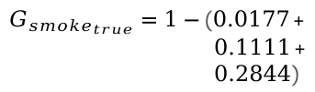
Gini impurity for a node i
smoke
100 samples
$$G_{i}=1−\sum_{c=1}^{n_classes}{p_{i,c}^{2}}$$
True
False
Heart Condition
Heart Condition
$p_{i,c}$ is the probability of class c of $i^{th}$ node.
45 samples
55 samples
Normal Attention Sick
6 15 24
Normal Attention Sick
28 18 9
Ratio of class c instances among all the instances in the $i^{th}$ node.
$G_{{smoke}_{true}}=1−$ ($0.0177$ +
$0.1111$ +
$0.2844$)

Slide 64

Gini impurity for a node i
smoke
100 samples
$$G_{i}=1−\sum_{c=1}^{n_classes}{p_{i,c}^{2}}$$
True
False
Heart Condition
Heart Condition
$p_{i,c}$ is the probability of class c of $i^{th}$ node.
45 samples
55 samples
Normal Attention Sick
6 15 24
Normal Attention Sick
28 18 9
Ratio of class c instances among all the instances in the $i^{th}$ node.
$G_{{smoke}_{true}}=1−$ $0.4132$

Slide 65

Gini impurity for a node i
smoke
100 samples
$$G_{i}=1−\sum_{c=1}^{n_classes}{p_{i,c}^{2}}$$
True
False
Heart Condition
Heart Condition
$p_{i,c}$ is the probability of class c of $i^{th}$ node.
45 samples
55 samples
Normal Attention Sick
6 15 24
Normal Attention Sick
28 18 9
Ratio of class c instances among all the instances in the $i^{th}$ node.
$G_{{smoke}_{true}}=1−$ $0.4132=0.587$

Slide 66
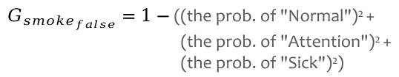

Gini impurity for a node i
smoke
100 samples
$$G_{i}=1−\sum_{c=1}^{n_classes}{p_{i,c}^{2}}$$
True
False
Heart Condition
Heart Condition
$p_{i,c}$ is the probability of class c of $i^{th}$ node.
45 samples
55 samples
Normal Attention Sick
6 15 24
Normal Attention Sick
28 18 9
Ratio of class c instances among all the instances in the $i^{th}$ node.
$$G_{{smoke}_{true}}=0.587$$
$G_{{smoke}_{false}}=1−$ ((the prob. of "Normal")² +
(the prob. of "Attention")² +
(the prob. of "Sick")²)

Slide 67
Gini impurity for a node i
smoke
100 samples
$$G_{i}=1−\sum_{c=1}^{n_classes}{p_{i,c}^{2}}$$
True
False
Heart Condition
Heart Condition
$p_{i,c}$ is the probability of class c of $i^{th}$ node.
45 samples
55 samples
Normal Attention Sick
6 15 24
Normal Attention Sick
28 18 9
Ratio of class c instances among all the instances in the $i^{th}$ node.
$$G_{{smoke}_{true}}=0.587$$
$G_{{smoke}_{false}}=1−$ (${(\frac{28}{28+18+9})}^{2}$ +${(\frac{18}{28+18+9})}^{2}$ +${(\frac{9}{28+18+9})}^{2}$)

Slide 68

Gini impurity for a node i
smoke
100 samples
$$G_{i}=1−\sum_{c=1}^{n_classes}{p_{i,c}^{2}}$$
True
False
Heart Condition
Heart Condition
$p_{i,c}$ is the probability of class c of $i^{th}$ node.
45 samples
55 samples
Normal Attention Sick
6 15 24
Normal Attention Sick
28 18 9
Ratio of class c instances among all the instances in the $i^{th}$ node.
$$G_{{smoke}_{true}}=0.587$$
$$G_{{smoke}_{false}}=1−0.393=0.607$$

Slide 69

Gini impurity for a node i
smoke
100 samples
$$G_{i}=1−\sum_{c=1}^{n_classes}{p_{i,c}^{2}}$$
True
False
Heart Condition
Heart Condition
$p_{i,c}$ is the probability of class c of $i^{th}$ node.
45 samples
55 samples
Normal Attention Sick
6 15 24
Normal Attention Sick
28 18 9
Ratio of class c instances among all the instances in the $i^{th}$ node.
$$G_{{smoke}_{true}}=0.587$$
$$G_{{smoke}_{false}}=0.607$$

Slide 70
Gini impurity for a node i
smoke
100 samples
$$G_{i}=1−\sum_{c=1}^{n_classes}{p_{i,c}^{2}}$$
True
False
Heart Condition
Heart Condition
$p_{i,c}$ is the probability of class c of $i^{th}$ node.
45 samples
55 samples
Normal Attention Sick
6 15 24
Normal Attention Sick
28 18 9
Ratio of class c instances among all the instances in the $i^{th}$ node.
$$G_{{smoke}_{true}}=0.587$$
$$G_{{smoke}_{false}}=0.607$$
  A pure node has Gini = 0.

Slide 71
Gini impurity for a node i
smoke
100 samples
$$G_{i}=1−\sum_{c=1}^{n_classes}{p_{i,c}^{2}}$$
True
False
Heart Condition
Heart Condition
$p_{i,c}$ is the probability of class c of $i^{th}$ node.
45 samples
55 samples
Normal Attention Sick
6 15 24
Normal Attention Sick
28 18 9
Ratio of class c instances among all the instances in the $i^{th}$ node.
$$G_{{smoke}_{true}}=0.587$$
$$G_{{smoke}_{false}}=0.607$$
Because the leaf on the left has a different number of samples from the leaf on the right, so the Total Gini Impurity for the feature Smoke is the weighted average Gini Impurity of its sub-nodes.
  This is exactly the cost function used for CART during training.

Slide 72


Gini impurity for a node i
smoke
100 samples
$$G_{i}=1−\sum_{c=1}^{n_classes}{p_{i,c}^{2}}$$
True
False
Heart Condition
Heart Condition
$p_{i,c}$ is the probability of class c of $i^{th}$ node.
45 samples
55 samples
Normal Attention Sick
6 15 24
Normal Attention Sick
28 18 9
Ratio of class c instances among all the instances in the $i^{th}$ node.
$$G_{{smoke}_{true}}=0.587$$
$$G_{{smoke}_{false}}=0.607$$
Because the leaf on the left has a different number of samples from the leaf on the right, so the Total Gini Impurity for the feature Smoke is the weighted average Gini Impurity of its sub-nodes.
CART cost function for feature k for classification
$$J(k)=\frac{m_{left}}{m}G_{left}+\frac{m_{right}}{m}G_{right}$$
  This is exactly the cost function used for CART during training.
$$\left\{\begin{matrix}G_{left/right} \\ m_{left/right}\end{matrix}\right.$$
measures the impurity of the left/right subset,
where
is the number of instances in the left/right subset.

Slide 73

$$J(smoke)=0.598$$
smoke
100 samples
True
False
Heart Condition
Heart Condition
45 samples
55 samples
Normal Attention Sick
6 15 24
Normal Attention Sick
28 18 9

Slide 74
$$J(smoke)=0.598$$
smoke
100 samples
True
False
Heart Condition
Heart Condition
45 samples
55 samples
Normal Attention Sick
6 15 24
Normal Attention Sick
28 18 9
Now, let's compute the Total Gini Impurity for the feature Workout.
workout
100 samples
True
False
Heart Condition
Heart Condition
35 samples
Normal Attention Sick
19 8 8
Normal Attention Sick
25 25 15
65 samples

Slide 75

$$J(smoke)=0.598$$
smoke
100 samples
True
False
Heart Condition
Heart Condition
45 samples
55 samples
Normal Attention Sick
6 15 24
Normal Attention Sick
28 18 9
Now, let's compute the Total Gini Impurity for the feature Workout.
$$J(workout)=0.633$$
workout
100 samples
True
False
Heart Condition
Heart Condition
35 samples
Normal Attention Sick
19 8 8
Normal Attention Sick
25 25 15
65 samples

Slide 76
smoke | workout | weight | heart condition
No | Yes | 85.0 | Sick
No | Yes | 78.0 | Normal
Yes | No | 75.0 | Sick
No | Yes | 84.0 | Normal
No | Yes | 72.0 | Normal
No | No | 78.0 | Sick
Yes | No | 120.0 | Attention
… | … | … | …
Yes | Yes | 84.0 | Sick
No | No | 98.0 | Attention
Now, let's compute the Total Gini Impurity for the feature weight.
$m=100$ samples

Slide 77
smoke | workout | weight | heart condition
No | Yes | 85.0 | Sick
No | Yes | 78.0 | Normal
Yes | No | 75.0 | Sick
No | Yes | 84.0 | Normal
No | Yes | 72.0 | Normal
No | No | 78.0 | Sick
Yes | No | 120.0 | Attention
… | … | … | …
Yes | Yes | 84.0 | Sick
No | No | 98.0 | Attention
Now, let's compute the Total Gini Impurity for the feature weight.
Because weight is a numerical feature, we will need to define a threshold to make the rule/statement.
$m=100$ samples

Slide 78
smoke | workout | weight | heart condition
No | Yes | 85.0 | Sick
No | Yes | 78.0 | Normal
Yes | No | 75.0 | Sick
No | Yes | 84.0 | Normal
No | Yes | 72.0 | Normal
No | No | 78.0 | Sick
Yes | No | 120.0 | Attention
… | … | … | …
Yes | Yes | 84.0 | Sick
No | No | 98.0 | Attention
Now, let's compute the Total Gini Impurity for the feature weight.
Because weight is a numerical feature, we will need to define a threshold to make the rule/statement.
Let's see a strategy fot that!
$m=100$ samples

Slide 79
A possible strategy...
weight | heart condition
85.0 | Sick
78.0 | Normal
75.0 | Sick
84.0 | Normal
72.0 | Normal
78.0 | Sick
120.0 | Attention
… | …
84.0 | Sick
98.0 | Attention
$m=100$ samples

Slide 80
A possible strategy...
weight | heart condition
56 | Normal
56 | Attention
57 | Attention
57 | Normal
57 | Attention
60 | Attention
63 | Normal
... | ...
140 | Sick
140 | Attention
First of all, we sort the rows by weight in ascending order.
$m=100$ samples

Slide 81
A possible strategy...
weight | heart condition
56 | Normal
56 | Attention
57 | Attention
57 | Normal
57 | Attention
60 | Attention
63 | Normal
... | ...
140 | Sick
140 | Attention
First of all, we sort the rows by weight in ascending order.
56
Then, we calculate the average weight for all adjacent instances to become possible thresholds.
$m=100$ samples

Slide 82
A possible strategy...
weight | heart condition
56 | Normal
56 | Attention
57 | Attention
57 | Normal
57 | Attention
60 | Attention
63 | Normal
... | ...
140 | Sick
140 | Attention
First of all, we sort the rows by weight in ascending order.
56
56.5
Then, we calculate the average weight for all adjacent instances to become possible thresholds.
$m=100$ samples

Slide 83
A possible strategy...
weight | heart condition
56 | Normal
56 | Attention
57 | Attention
57 | Normal
57 | Attention
60 | Attention
63 | Normal
... | ...
140 | Sick
140 | Attention
First of all, we sort the rows by weight in ascending order.
56
56.5
57
Then, we calculate the average weight for all adjacent instances to become possible thresholds.
57
58.5
61.5
140
$m=100$ samples

Slide 84
A possible strategy...
weight | heart condition
56 | Normal
56 | Attention
57 | Attention
57 | Normal
57 | Attention
60 | Attention
63 | Normal
... | ...
140 | Sick
140 | Attention
56
56.5
57
57
58.5
61.5
140
$m=100$ samples

Slide 85
A possible strategy...
weight ≤ ???
100 samples
weight | heart condition
56 | Normal
56 | Attention
57 | Attention
57 | Normal
57 | Attention
60 | Attention
63 | Normal
... | ...
140 | Sick
140 | Attention
For each threshold, we build a statement/rule...
True
False
56
Heart Condition
Heart Condition
56.5
Normal Attention Sick
0 0 0
Normal Attention Sick
0 0 0
57
57
58.5
61.5
140
$m=100$ samples

Slide 86



A possible strategy...
weight ≤ 56.0
100 samples
weight | heart condition
56 | Normal
56 | Attention
57 | Attention
57 | Normal
57 | Attention
60 | Attention
63 | Normal
... | ...
140 | Sick
140 | Attention
For each threshold, we build a statement/rule...
True
False
56
Heart Condition
Heart Condition
56.5
Normal Attention Sick
1 1 0
Normal Attention Sick
33 32 33
57
57
58.5
$$G_{left}=0.5$$
$$G_{right}=0.666$$
61.5
140
CART cost function for
feature k and threshold t_{k} for classification
$m=100$ samples
$$J(k,t_{k})=\frac{m_{left}}{m}G_{left}+\frac{m_{right}}{m}G_{right}$$
$$\left\{\begin{matrix}G_{left/right} \\ m_{left/right}\end{matrix}\right.$$
measures the impurity of the left/right subset,
where
is the number of instances in the left/right subset.

Slide 87

A possible strategy...
weight ≤ 56.0
100 samples
weight | heart condition
56 | Normal
56 | Attention
57 | Attention
57 | Normal
57 | Attention
60 | Attention
63 | Normal
... | ...
140 | Sick
140 | Attention
For each threshold, we build a statement/rule...
True
False
56
Heart Condition
Heart Condition
56.5
Normal Attention Sick
1 1 0
Normal Attention Sick
33 32 33
57
57
58.5
$$G_{left}=0.5$$
$$G_{right}=0.666$$
61.5
$$J(weight,56)=\frac{2}{100}0.5+\frac{98}{100}0.666=0.663$$
140
$m=100$ samples

Slide 88

A possible strategy...
weight | heart condition
56 | Normal
56 | Attention
57 | Attention
57 | Normal
57 | Attention
60 | Attention
63 | Normal
... | ...
140 | Sick
140 | Attention
For each threshold, we build a statement/rule...
56
$$J(weight,56)=0.663$$
56.5
57
57
58.5
61.5
140
$m=100$ samples

Slide 89





A possible strategy...
weight | heart condition
56 | Normal
56 | Attention
57 | Attention
57 | Normal
57 | Attention
60 | Attention
63 | Normal
... | ...
140 | Sick
140 | Attention
For each threshold, we build a statement/rule...
56
$$J(weight,56)=0.663$$
56.5
$$J(weight,56.5)=0.663$$
57
$$J(weight,57)=0.656$$
57
$$J(weight,57)=0.656$$
58.5
$$J(weight,58.5)=0.656$$
61.5
$$J(weight,61.5)=0.652$$
...
140
$$J(weight,140)=0.666$$
$m=100$ samples

Slide 90

A possible strategy...
weight | heart condition
56 | Normal
56 | Attention
57 | Attention
57 | Normal
57 | Attention
60 | Attention
63 | Normal
... | ...
140 | Sick
140 | Attention
For each threshold, we build a statement/rule...
56
$$J(weight,56)=0.663$$
56.5
$$J(weight,56.5)=0.663$$
$$J(weight,57)=0.656$$
We select the threshold with the lowest gini impurity...
57
57
$$J(weight,57)=0.656$$
58.5
$$J(weight,58.5)=0.656$$
61.5
$$J(weight,61.5)=0.652$$
...
140
$$J(weight,140)=0.666$$
$m=100$ samples
$$J(weight,94.5)=0.636$$

Slide 91
A possible strategy...
weight | heart condition
56 | Normal
56 | Attention
57 | Attention
57 | Normal
57 | Attention
60 | Attention
63 | Normal
... | ...
140 | Sick
140 | Attention
For each threshold, we build a statement/rule...
  Some algorithms use different strategies to define the candidate thresholds.
56
$$J(weight,56)=0.663$$
56.5
$$J(weight,56.5)=0.663$$
$$J(weight,57)=0.656$$
We select the threshold with the lowest gini impurity...
57
57
$$J(weight,57)=0.656$$
58.5
$$J(weight,58.5)=0.656$$
61.5
$$J(weight,61.5)=0.652$$
...
140
$$J(weight,140)=0.666$$
$m=100$ samples
$$J(weight,94.5)=0.636$$

Slide 92



smoke
weight ≤ 94.5
100 samples
100 samples
True
False
True
False
Heart Condition
Heart Condition
Heart Condition
Heart Condition
Normal Attention Sick
6 15 24
Normal Attention Sick
28 18 9
Normal Attention Sick
15 24 25
Normal Attention Sick
19 9 8
$$J(smoke)=0.598$$
$$J(weight,94.5)=0.636$$
Now, let's compute the Total Gini Impurity for the feature Workout.
workout
100 samples
Finally, we compare all Gini Impurities and choose rule (feature + threshold) the lowest one.
True
False
Heart Condition
Heart Condition
Normal Attention Sick
19 8 8
Normal Attention Sick
25 25 15
$$J(workout)=0.633$$

Slide 93

smoke
weight ≤ 94.5
100 samples
100 samples
True
False
True
False
Heart Condition
Heart Condition
Heart Condition
Heart Condition
Normal Attention Sick
6 15 24
Normal Attention Sick
28 18 9
Normal Attention Sick
15 24 25
Normal Attention Sick
19 9 8
$$J(smoke)=0.598$$
$$J(weight,94.5)=0.636$$
Now, let's compute the Total Gini Impurity for the feature Workout.
workout
100 samples
Finally, we compare all Gini Impurities and choose rule (feature + threshold) the lowest one.
True
False
Heart Condition
Heart Condition
Normal Attention Sick
19 8 8
Normal Attention Sick
25 25 15
$$J(workout)=0.633$$

Slide 94
Which feature should be at the root?
smoke | workout | weight | heart condition
No | Yes | 85.0 | Sick
No | Yes | 78.0 | Normal
Yes | No | 75.0 | Sick
No | Yes | 84.0 | Normal
No | Yes | 72.0 | Normal
No | No | 78.0 | Sick
Yes | No | 120.0 | Attention
… | … | … | …
Yes | Yes | 84.0 | Sick
No | No | 98.0 | Attention
?
True
False
True
False
True
False
True
False
True
False
$m=100$ samples

Slide 95
smoke
100 samples
smoke | workout | weight | heart condition
No | Yes | 85.0 | Sick
No | Yes | 78.0 | Normal
Yes | No | 75.0 | Sick
No | Yes | 84.0 | Normal
No | Yes | 72.0 | Normal
No | No | 78.0 | Sick
Yes | No | 120.0 | Attention
… | … | … | …
Yes | Yes | 84.0 | Sick
No | No | 98.0 | Attention
True
False
Heart Condition
Heart Condition
45 samples
55 samples
Normal Attention Sick
6 15 24
Normal Attention Sick
28 18 9
$m=100$ samples

Slide 96
smoke
100 samples
smoke | workout | weight | heart condition
No | Yes | 85.0 | Sick
No | Yes | 78.0 | Normal
Yes | No | 75.0 | Sick
No | Yes | 84.0 | Normal
No | Yes | 72.0 | Normal
No | No | 78.0 | Sick
Yes | No | 120.0 | Attention
… | … | … | …
Yes | Yes | 84.0 | Sick
No | No | 98.0 | Attention
True
False
Heart Condition
Heart Condition
45 samples
55 samples
Normal Attention Sick
6 15 24
Normal Attention Sick
28 18 9
Since the nodes are impure, we can keep spitting them in order to reduce their impurities.
$m=100$ samples

Slide 97
smoke
100 samples
smoke | workout | weight | heart condition
No | Yes | 85.0 | Sick
No | Yes | 78.0 | Normal
Yes | No | 75.0 | Sick
No | Yes | 84.0 | Normal
No | Yes | 72.0 | Normal
No | No | 78.0 | Sick
Yes | No | 120.0 | Attention
… | … | … | …
Yes | Yes | 84.0 | Sick
No | No | 98.0 | Attention
True
False
Heart Condition
Heart Condition
45 samples
55 samples
Normal Attention Sick
6 15 24
Normal Attention Sick
28 18 9
workout
weight ≤ ???
Should we split these smokers (45 people) by the workout or weight feature?
$m=100$ samples

Slide 98
smoke
100 samples
smoke | workout | weight | heart condition
No | Yes | 85.0 | Sick
No | Yes | 78.0 | Normal
Yes | No | 75.0 | Sick
No | Yes | 84.0 | Normal
No | Yes | 72.0 | Normal
No | No | 78.0 | Sick
Yes | No | 120.0 | Attention
… | … | … | …
Yes | Yes | 84.0 | Sick
No | No | 98.0 | Attention
True
False
Heart Condition
Heart Condition
45 samples
55 samples
Normal Attention Sick
6 15 24
Normal Attention Sick
28 18 9
workout
weight ≤ ???
Should we split these smokers (45 people) by the workout or weight feature?
$m=100$ samples
Let's repeat the same steps we did before.

Slide 99
smoke | workout | weight | heart condition
Yes | No | 74 | Sick
Yes | No | 64 | Sick
Yes | No | 140 | Attention
Yes | No | 80 | Attention
Yes | No | 75 | Sick
Yes | No | 98 | Sick
Yes | No | 73 | Normal
… | … | … | …
Yes | Yes | 105 | Sick
Yes | Yes | 105 | Attention
$m=45$ samples
Only smokers

Slide 100




$$J(workout)=???$$
workout
45 samples
smoke | workout | weight | heart condition
Yes | No | 74 | Sick
Yes | No | 64 | Sick
Yes | No | 140 | Attention
Yes | No | 80 | Attention
Yes | No | 75 | Sick
Yes | No | 98 | Sick
Yes | No | 73 | Normal
… | … | … | …
Yes | Yes | 105 | Sick
Yes | Yes | 105 | Attention
True
False
Heart Condition
Heart Condition
Normal Attention Sick
0 0 0
Normal Attention Sick
0 0 0
$$G_{left}=???$$
$$G_{right}=???$$
$$J(weight, t)=???$$
weight ≤ t
45 samples
$m=45$ samples
True
False
Heart Condition
Heart Condition
Normal Attention Sick
0 0 0
Normal Attention Sick
0 0 0
$$G_{left}=???$$
$$G_{right}=???$$

Slide 101



$$J(workout)=0.584$$
workout
45 samples
smoke | workout | weight | heart condition
Yes | No | 74 | Sick
Yes | No | 64 | Sick
Yes | No | 140 | Attention
Yes | No | 80 | Attention
Yes | No | 75 | Sick
Yes | No | 98 | Sick
Yes | No | 73 | Normal
… | … | … | …
Yes | Yes | 105 | Sick
Yes | Yes | 105 | Attention
True
False
Heart Condition
Heart Condition
10 samples
Normal Attention Sick
2 3 5
Normal Attention Sick
4 12 19
35 samples
$$G_{left}=0.62$$
$$G_{right}=0.574$$
$$J(weight, t)=???$$
weight ≤ t
45 samples
$m=45$ samples
True
False
Heart Condition
Heart Condition
Normal Attention Sick
0 0 0
Normal Attention Sick
0 0 0
$$G_{left}=???$$
$$G_{right}=???$$

Slide 102


$$J(workout)=0.584$$
workout
45 samples
smoke | workout | weight | heart condition
Yes | No | 74 | Sick
Yes | No | 64 | Sick
Yes | No | 140 | Attention
Yes | No | 80 | Attention
Yes | No | 75 | Sick
Yes | No | 98 | Sick
Yes | No | 73 | Normal
… | … | … | …
Yes | Yes | 105 | Sick
Yes | Yes | 105 | Attention
True
False
Heart Condition
Heart Condition
10 samples
Normal Attention Sick
2 3 5
Normal Attention Sick
4 12 19
35 samples
$$G_{left}=0.62$$
$$G_{right}=0.574$$
$$J(weight, 91.5)=0.533$$
weight ≤ 91.5
45 samples
$m=45$ samples
True
False
Heart Condition
Heart Condition
24 samples
Normal Attention Sick
4 4 16
Normal Attention Sick
2 11 8
21 samples
$$G_{left}=0.5$$
$$G_{right}=0.571$$

Slide 103
$$J(workout)=0.584$$
workout
45 samples
smoke | workout | weight | heart condition
Yes | No | 74 | Sick
Yes | No | 64 | Sick
Yes | No | 140 | Attention
Yes | No | 80 | Attention
Yes | No | 75 | Sick
Yes | No | 98 | Sick
Yes | No | 73 | Normal
… | … | … | …
Yes | Yes | 105 | Sick
Yes | Yes | 105 | Attention
True
False
Heart Condition
Heart Condition
10 samples
Normal Attention Sick
2 3 5
Normal Attention Sick
4 12 19
35 samples
$$G_{left}=0.62$$
$$G_{right}=0.574$$
$$J(weight, 91.5)=0.533$$
weight ≤ 91.5
45 samples
$m=45$ samples
True
False
Heart Condition
Heart Condition
24 samples
Normal Attention Sick
4 4 16
Normal Attention Sick
2 11 8
21 samples
$$G_{left}=0.5$$
$$G_{right}=0.571$$

Slide 104
smoke
100 samples
smoke | workout | weight | heart condition
No | Yes | 85.0 | Sick
No | Yes | 78.0 | Normal
Yes | No | 75.0 | Sick
No | Yes | 84.0 | Normal
No | Yes | 72.0 | Normal
No | No | 78.0 | Sick
Yes | No | 120.0 | Attention
… | … | … | …
Yes | Yes | 84.0 | Sick
No | No | 98.0 | Attention
True
False
Heart Condition
Heart Condition
45 samples
55 samples
Normal Attention Sick
6 15 24
Normal Attention Sick
28 18 9
workout
weight ≤ ???
$m=100$ samples

Slide 105
smoke
100 samples
smoke | workout | weight | heart condition
No | Yes | 85.0 | Sick
No | Yes | 78.0 | Normal
Yes | No | 75.0 | Sick
No | Yes | 84.0 | Normal
No | Yes | 72.0 | Normal
No | No | 78.0 | Sick
Yes | No | 120.0 | Attention
… | … | … | …
Yes | Yes | 84.0 | Sick
No | No | 98.0 | Attention
True
False
weight ≤ 91.5
Heart Condition
45 samples
55 samples
Normal Attention Sick
28 18 9
True
False
Heart Condition
Heart Condition
Normal Attention Sick
4 4 16
Normal Attention Sick
2 11 8
$m=100$ samples

Slide 106
smoke
100 samples
smoke | workout | weight | heart condition
No | Yes | 85.0 | Sick
No | Yes | 78.0 | Normal
Yes | No | 75.0 | Sick
No | Yes | 84.0 | Normal
No | Yes | 72.0 | Normal
No | No | 78.0 | Sick
Yes | No | 120.0 | Attention
… | … | … | …
Yes | Yes | 84.0 | Sick
No | No | 98.0 | Attention
True
False
weight ≤ 91.5
Heart Condition
45 samples
55 samples
Normal Attention Sick
28 18 9
True
False
Heart Condition
Heart Condition
Normal Attention Sick
4 4 16
Normal Attention Sick
2 11 8
The splitting process continues until the algorithm reaches a stop condition.
$m=100$ samples

Slide 107
smoke
100 samples
smoke | workout | weight | heart condition
No | Yes | 85.0 | Sick
No | Yes | 78.0 | Normal
Yes | No | 75.0 | Sick
No | Yes | 84.0 | Normal
No | Yes | 72.0 | Normal
No | No | 78.0 | Sick
Yes | No | 120.0 | Attention
… | … | … | …
Yes | Yes | 84.0 | Sick
No | No | 98.0 | Attention
True
False
weight ≤ 91.5
Heart Condition
45 samples
55 samples
Normal Attention Sick
28 18 9
True
False
Heart Condition
Heart Condition
Normal Attention Sick
4 4 16
Normal Attention Sick
2 11 8
The splitting process continues until the algorithm reaches a stop condition.
$m=100$ samples
Examples:
All leaves are pure;
  high chances of overfitting;
Maximum tree depth (hyperparameter);
  Regularization

Slide 108
smoke
100 samples
smoke | workout | weight | heart condition
No | Yes | 85.0 | Sick
No | Yes | 78.0 | Normal
Yes | No | 75.0 | Sick
No | Yes | 84.0 | Normal
No | Yes | 72.0 | Normal
No | No | 78.0 | Sick
Yes | No | 120.0 | Attention
… | … | … | …
Yes | Yes | 84.0 | Sick
No | No | 98.0 | Attention
True
False
weight ≤ 91.5
Heart Condition
45 samples
55 samples
Normal Attention Sick
28 18 9
True
False
Heart Condition
Heart Condition
Normal Attention Sick
4 4 16
Normal Attention Sick
2 11 8
The splitting process continues until the algorithm reaches a stop condition.
$m=100$ samples
Examples:
All leaves are pure;
  high chances of overfitting;
Maximum tree depth (hyperparameter);
  Regularization

Slide 109
max depth = 3
smoke
Does a person have a heart disorder?
depth=3
True
False
weight ≤ 91.5 kg
workout
True
False
True
False
workout
Attention
weight ≤ 117.5 kg
weight ≤ 79.0 kg
weight ≤ 84.5 kg
Attention
True
False
True
False
True
False
True
False

Slide 110
In Classification Trees, the label/class of each leaf is its most frequent class.
max depth = 3
smoke
Does a person have a heart disorder?
depth=3
True
False
weight ≤ 91.5 kg
workout
True
False
True
False
workout
Attention
weight ≤ 117.5 kg
weight ≤ 79.0 kg
weight ≤ 84.5 kg
Attention
True
False
True
False
True
False
True
False

Slide 111
In Classification Trees, the label/class of each leaf is its most frequent class.
max depth = 3
smoke
Does a person have a heart disorder?
depth=3
True
False
weight ≤ 91.5 kg
workout
True
False
True
False
workout
Attention
weight ≤ 117.5 kg
weight ≤ 79.0 kg
weight ≤ 84.5 kg
Attention
True
False
True
False
True
False
True
False
Heart Condition
Normal Attention Sick
7 5 1

Slide 112
In Classification Trees, the label/class of each leaf is its most frequent class.
max depth = 3
smoke
Does a person have a heart disorder?
depth=3
True
False
weight ≤ 91.5 kg
workout
True
False
True
False
workout
Attention
weight ≤ 117.5 kg
weight ≤ 79.0 kg
weight ≤ 84.5 kg
Attention
True
False
True
False
True
False
True
False
Normal
Sick
Attention
Attention
Normal
Normal
Normal
Attention

Slide 113
To classify a given instance, we just traverse the Decision Tree from the root to a leaf according to the instance's features.
max depth = 3
smoke
Does a person have a heart disorder?
depth=3
True
False
weight ≤ 91.5 kg
workout
True
False
True
False
workout
Attention
weight ≤ 117.5 kg
weight ≤ 79.0 kg
weight ≤ 84.5 kg
Attention
True
False
True
False
True
False
True
False
Normal
Sick
Attention
Attention
Normal
Normal
Normal
Attention

Slide 114
To classify a given instance, we just traverse the Decision Tree from the root to a leaf according to the instance's features.
Weight: 80 kg
Smoke: No
Work out: No
max depth = 3
smoke
Does a person have a heart disorder?
depth=3
True
False
weight ≤ 91.5 kg
workout
True
False
True
False
workout
Attention
weight ≤ 117.5 kg
weight ≤ 79.0 kg
weight ≤ 84.5 kg
Attention
True
False
True
False
True
False
True
False
Normal
Sick
Attention
Attention
Normal
Normal
Normal
Attention

Slide 115
To classify a given instance, we just traverse the Decision Tree from the root to a leaf according to the instance's features.
Weight: 80 kg
Smoke: No
Work out: No
Normal
max depth = 3
smoke
Does a person have a heart disorder?
depth=3
True
False
weight ≤ 91.5 kg
workout
True
False
True
False
workout
Attention
weight ≤ 117.5 kg
weight ≤ 79.0 kg
weight ≤ 84.5 kg
Attention
True
False
True
False
True
False
True
False
Normal
Sick
Attention
Attention
Normal
Normal
Normal
Attention

Slide 116
To classify a given instance, we just traverse the Decision Tree from the root to a leaf according to the instance's features.
Decision Tree can also estimate the probability of an instance belongs to a particular class c.
This probability is the ratio of training samples of class c in the leaf node found for the instance.
Weight: 80 kg
Smoke: No
Work out: No
Normal
max depth = 3
smoke
Does a person have a heart disorder?
depth=3
True
False
weight ≤ 91.5 kg
workout
True
False
True
False
workout
Attention
weight ≤ 117.5 kg
weight ≤ 79.0 kg
weight ≤ 84.5 kg
Attention
True
False
True
False
True
False
True
False
Normal
Sick
Attention
Attention
Normal
Normal
Normal
Attention

Slide 117
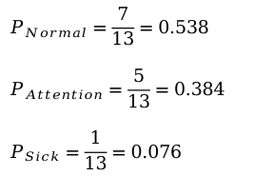
To classify a given instance, we just traverse the Decision Tree from the root to a leaf according to the instance's features.
Decision Tree can also estimate the probability of an instance belongs to a particular class c.
This probability is the ratio of training samples of class c in the leaf node found for the instance.
Weight: 80 kg
Smoke: No
Work out: No
Normal
$$P_{Normal}=\frac{7}{13}=0.538$$
$$P_{Attention}=\frac{5}{13}=0.384$$
$$P_{Sick}=\frac{1}{13}=0.076$$
Does a person have a heart disorder?
max depth = 3
smoke
depth=3
True
False
weight ≤ 91.5 kg
workout
True
False
True
False
workout
Attention
weight ≤ 117.5 kg
weight ≤ 79.0 kg
weight ≤ 84.5 kg
Attention
True
True
False
True
True
False
False
False
False
Normal
Sick
Attention
Attention
Normal
Normal
Attention
Heart Condition
Normal Attention Sick
7 5 1

Slide 118
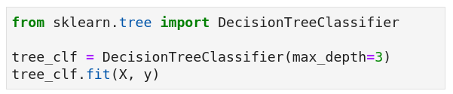
Codes
  Scikit-learn implements the CART algorithm for Decision Tree.

Slide 119
Codes
  Scikit-learn implements the CART algorithm for Decision Tree.
default=None
it expands the nodes until all leaves are pure or until
all leaves contain less than a min_samples_split samples.

Slide 120
Codes
  Scikit-learn implements the CART algorithm for Decision Tree.
  The default cost function (criterion) is based on Gini Impurity, but Entropy is also supported.

Slide 121
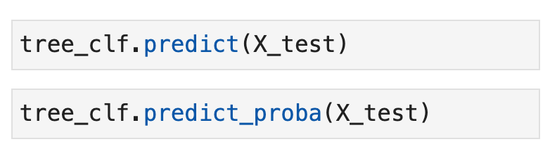
Codes
  Scikit-learn implements the CART algorithm for Decision Tree.
Classification/prediction
Predicting class probabilities

Slide 122
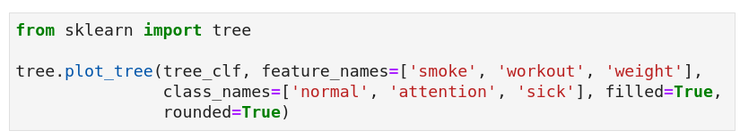
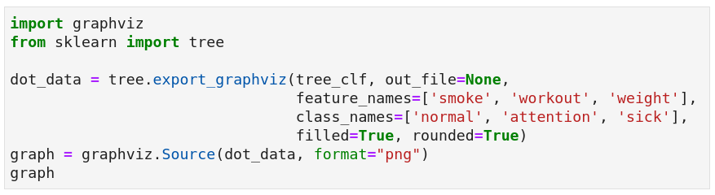
Codes
  Scikit-learn implements the CART algorithm for Decision Tree.
To visualize a trained Decision Tree:
  We need to install grapviz first.

Slide 123
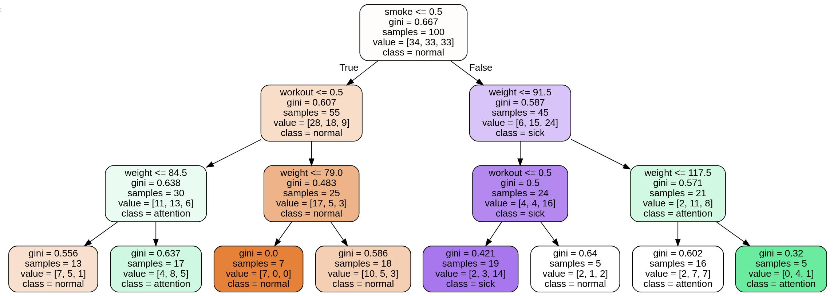
  Scikit-learn Decision Tree treat all variables as numeric!

Slide 124
  Scikit-learn Decision Tree treat all variables as numeric!
non-smokers
smokers

Slide 125
pure leaf

Slide 126
Decision Tree is nonparametric!
Decision Trees (DT) make very few assumptions about the training data:
True
False
True
False
True
False
True
False
True
False

Slide 127
Decision Tree is nonparametric!
Decision Trees (DT) make very few assumptions about the training data:
  as opposed to linear models, which assume that the data is linear, for example.
True
False
True
False
True
False
True
False
True
False

Slide 128
Decision Tree is nonparametric!
Decision Trees (DT) make very few assumptions about the training data:
  as opposed to linear models, which assume that the data is linear, for example.
Such a model is often called a nonparametric model:
True
False
True
False
True
False
True
False
True
False

Slide 129
Decision Tree is nonparametric!
Decision Trees (DT) make very few assumptions about the training data:
  as opposed to linear models, which assume that the data is linear, for example.
Such a model is often called a nonparametric model:
  not because it does not have any parameters (it often has a lot),
  but because the number of parameters is not determined prior to training.
True
False
True
False
True
False
True
False
True
False

Slide 130
Decision Tree is nonparametric!
Decision Trees (DT) make very few assumptions about the training data:
  as opposed to linear models, which assume that the data is linear, for example.
Such a model is often called a nonparametric model:
  not because it does not have any parameters (it often has a lot),
  but because the number of parameters is not determined prior to training.
Thus, the model structure is free to stick closely to the data, which tends to overfit the data.
True
False
True
False
True
False
True
False
True
False

Slide 131
Decision Tree is nonparametric!
Decision Trees (DT) make very few assumptions about the training data:
  as opposed to linear models, which assume that the data is linear, for example.
Such a model is often called a nonparametric model:
  not because it does not have any parameters (it often has a lot),
  but because the number of parameters is not determined prior to training.
Thus, the model structure is free to stick closely to the data, which tends to overfit the data.
  E.g., a DT without a maximum depth allowed can make the tree grow deep until
  it has only pure leafs, which consequently overfits the data.
True
False
True
False
True
False
True
False
True
False

Slide 132
Decision Tree is nonparametric!
Decision Trees (DT) make very few assumptions about the training data:
  as opposed to linear models, which assume that the data is linear, for example.
Such a model is often called a nonparametric model:
  not because it does not have any parameters (it often has a lot),
  but because the number of parameters is not determined prior to training.
Thus, the model structure is free to stick closely to the data, which tends to overfit the data.
  E.g., a DT without a maximum depth allowed can make the tree grow deep until
  it has only pure leafs, which consequently overfits the data.
In contrast, a parametric model (e.g., a linear model):
  has a pre‐determined number of parameters,
  so its degree of freedom is limited, reducing the risk of overfitting
  but increasing the risk of underfitting.
True
False
True
False
True
False
True
False
True
False

Slide 133
Regularization Parameters
To avoid overfitting the training data, you need to restrict the Decision Tree’s freedom during training (Regularization).
True
False
True
False
True
False
True
False
True
False

Slide 134
Regularization Parameters
To avoid overfitting the training data, you need to restrict the Decision Tree’s freedom during training (Regularization).
The common strategy is to restrict the maximum depth of the Decision Tree.
  max_depth in sklearn
Reducing max_depth will regularize the model and thus reduce the risk of overfitting.
max depth = 3
True
False
True
False
True
False
True
False
True
False

Slide 135
Regularization Parameters
To avoid overfitting the training data, you need to restrict the Decision Tree’s freedom during training (Regularization).
The common strategy is to restrict the maximum depth of the Decision Tree.
  max_depth in sklearn
Reducing max_depth will regularize the model and thus reduce the risk of overfitting.
  max_depth is a hyperparameter that can be optimized by a fune-tunning technique.
max depth = 3
True
False
True
False
True
False
True
False
True
False

Slide 136
Regularization Parameters
To avoid overfitting the training data, you need to restrict the Decision Tree’s freedom during training (Regularization).
The common strategy is to restrict the maximum depth of the Decision Tree.
  max_depth in sklearn
Reducing max_depth will regularize the model and thus reduce the risk of overfitting.
The Scikit-learn DT has a few other hyparameters that similarly restrict the DT's shape:
  min_samples_split, min_samples_leaf , min_weight_fraction_leaf;
  max_leaf_nodes, max_features;
True
False
True
False
True
False
True
False
True
False

Slide 137
Regularization Parameters
To avoid overfitting the training data, you need to restrict the Decision Tree’s freedom during training (Regularization).
The common strategy is to restrict the maximum depth of the Decision Tree.
  max_depth in sklearn
Reducing max_depth will regularize the model and thus reduce the risk of overfitting.
The Scikit-learn DT has a few other hyparameters that similarly restrict the DT's shape:
  min_samples_split, min_samples_leaf , min_weight_fraction_leaf;
  max_leaf_nodes, max_features;
↑Increasing min_* hyperparameters or ↓reducing max_* hyperparameters will regularize the model.
True
False
True
False
True
False
True
False
True
False

Slide 138
Regularization Parameters
To avoid overfitting the training data, you need to restrict the Decision Tree’s freedom during training (Regularization).
The common strategy is to restrict the maximum depth of the Decision Tree.
  max_depth in sklearn
Reducing max_depth will regularize the model and thus reduce the risk of overfitting.
The Scikit-learn DT has a few other hyparameters that similarly restrict the DT's shape:
  min_samples_split, min_samples_leaf , min_weight_fraction_leaf;
  max_leaf_nodes, max_features;
↑Increasing min_* hyperparameters or ↓reducing max_* hyperparameters will regularize the model.
True
False
  Other algorithms work by first training the Decision Tree without restrictions, then pruning (deleting) unnecessary nodes.
True
False
True
False
True
False
True
False

Slide 139
Instability
Decision Trees output orthogonal decision boundaries (all splits are perpendicular to an axis)
  because of its nature of statements/rules based on thresholds

Slide 140
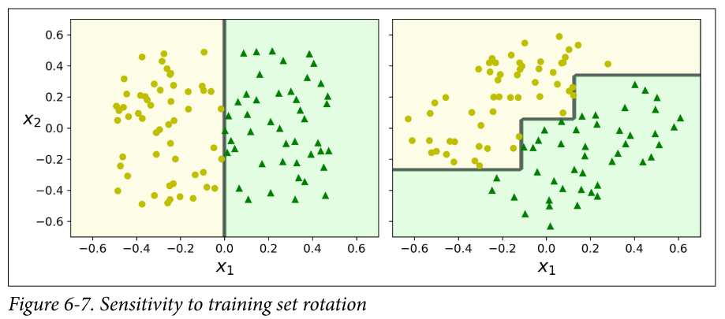
Instability
Decision Trees output orthogonal decision boundaries (all splits are perpendicular to an axis)
  because of its nature of statements/rules based on thresholds
Consequently, they are sensitive to training set rotation.
Géron, Aurélien. Hands-on machine learning with Scikit-Learn, Keras, and TensorFlow: Concepts, tools, and techniques to build intelligent systems. O'Reilly Media, 2019.

Slide 141
Instability
Decision Trees output orthogonal decision boundaries (all splits are perpendicular to an axis)
  because of its nature of statements/rules based on thresholds
Consequently, they are sensitive to training set rotation.
  One possible solution is to reduce the data dimensionaly by Principal Component Analysis (PCA), which tends to result in a better orientation of the training data.
Géron, Aurélien. Hands-on machine learning with Scikit-Learn, Keras, and TensorFlow: Concepts, tools, and techniques to build intelligent systems. O'Reilly Media, 2019.

Slide 142
Instability
Decision Trees output orthogonal decision boundaries (all splits are perpendicular to an axis)
  because of its nature of statements/rules based on thresholds
Consequently, they are sensitive to training set rotation.
Similarly, a small change in the training data can cause a large change in the DT's structure.
Géron, Aurélien. Hands-on machine learning with Scikit-Learn, Keras, and TensorFlow: Concepts, tools, and techniques to build intelligent systems. O'Reilly Media, 2019.

Slide 143
Instability
Decision Trees output orthogonal decision boundaries (all splits are perpendicular to an axis)
  because of its nature of statements/rules based on thresholds
Consequently, they are sensitive to training set rotation.
Similarly, a small change in the training data can cause a large change in the DT's structure.
  Random Forests can limit this instability by averaging predictions over many trees (we'll see soon).
Géron, Aurélien. Hands-on machine learning with Scikit-Learn, Keras, and TensorFlow: Concepts, tools, and techniques to build intelligent systems. O'Reilly Media, 2019.

Slide 144
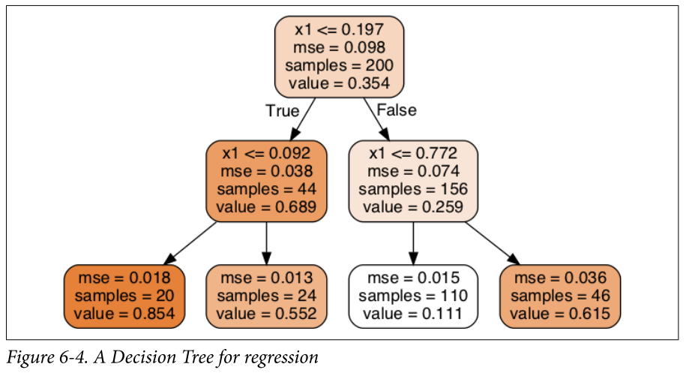
Regression Trees
Géron, Aurélien. Hands-on machine learning with Scikit-Learn, Keras, and TensorFlow: Concepts, tools, and techniques to build intelligent systems. O'Reilly Media, 2019.

Slide 145
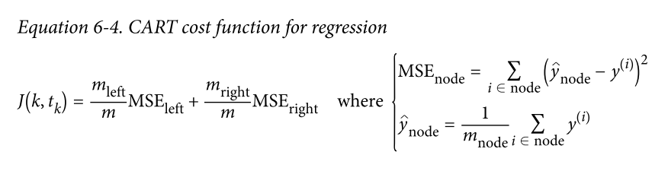
Regression Trees
The CART algorithm works mostly the same way as earlier, except that:
instead of trying to split the training set in a way that minimizes impurity,
it now tries to split the training set in a way that minimizes the MSE.
Géron, Aurélien. Hands-on machine learning with Scikit-Learn, Keras, and TensorFlow: Concepts, tools, and techniques to build intelligent systems. O'Reilly Media, 2019.

Slide 146
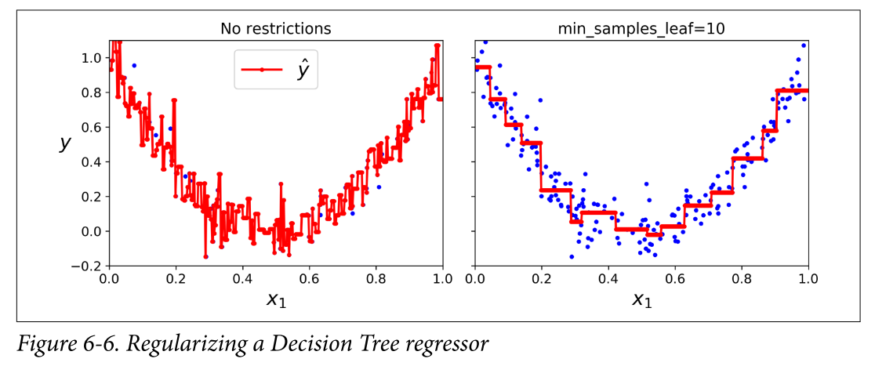
Regression Trees
  Decision Trees are also prone to overfitting when dealing with regression tasks.
Géron, Aurélien. Hands-on machine learning with Scikit-Learn, Keras, and TensorFlow: Concepts, tools, and techniques to build intelligent systems. O'Reilly Media, 2019.

Slide 147
https://ethen8181.github.io/machine-learning/text_classification/naive_bayes/naive_bayes.html
https://www.oreilly.com/library/view/machine-learning-with/9781787121515/697c4c5f-1109-4058-8938-d01482389ce3.xhtml
https://dhirajkumarblog.medium.com/top-5-advantages-and-disadvantages-of-decision-tree-algorithm-428ebd199d9a
Decision Trees
Pros
Easy to understand and interpret, perfect for visual representation (white box model).
Requires little data preprocessing:
  no need for one-hot encoding, dummy variables, and so on.
Non-parametric model: no assumptions about the shape of data.
Feature selection happens automatically:
  unimportant features will not influence the result;
  the presence of features that depend on each other (multicollinearity) also does not affect the quality.

Slide 148
https://ethen8181.github.io/machine-learning/text_classification/naive_bayes/naive_bayes.html
https://www.oreilly.com/library/view/machine-learning-with/9781787121515/697c4c5f-1109-4058-8938-d01482389ce3.xhtml
https://dhirajkumarblog.medium.com/top-5-advantages-and-disadvantages-of-decision-tree-algorithm-428ebd199d9a
Decision Trees
Cons
A small change in the data can cause a large change in the structure of the decision tree causing instability;
Sometimes calculation can go far more complex compared to other algorithms;
It often involves higher time to train the model;
Decision Tree is often inadequate for applying regression and predicting continuous values.

Slide 149
Inteligência Artificial
Decision Trees
  You may even try to fit different lines but the prediction error tends to be high.
  It may be a good idea to treat the degree for the polynomial features transform as a hyperparameter and evaluate different values for your dataset → fine-tuning.
Prof. Dr. Samuel Martins (Samuka)
samuel.martins@ifsp.edu.br

